Slide 1
Calculations of wakefields for the LHCb VeLo.
Olga Zagorodnova
Desy
Hamburg
April 29, 2015

Slide 2
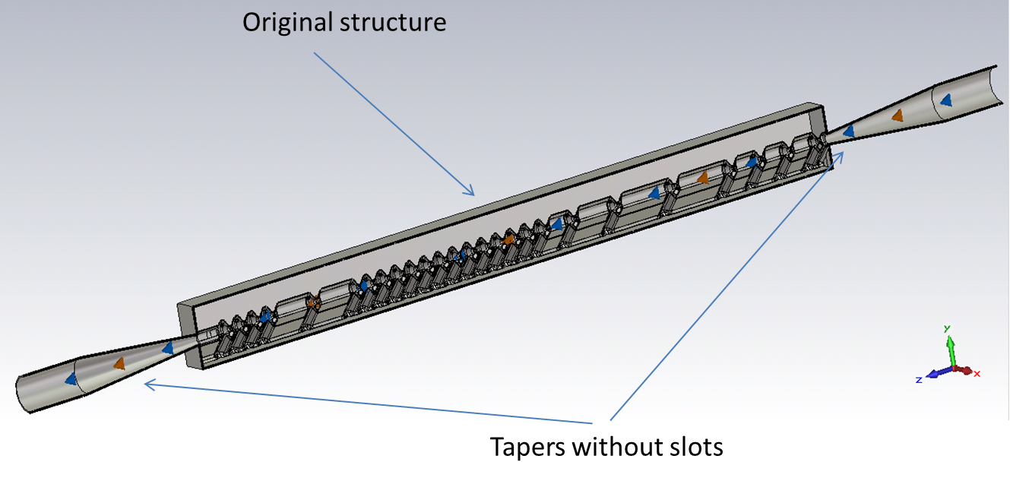
3D-calculations of wake fields for the LHCb VeLo were done using of
the Wakefield Solver of CST 2015.
The first step of the calculations – calculations for the original CATIA structure.
The accuracy of the calculations was insufficient.
The second step – calculations for the simplified model.

Slide 3
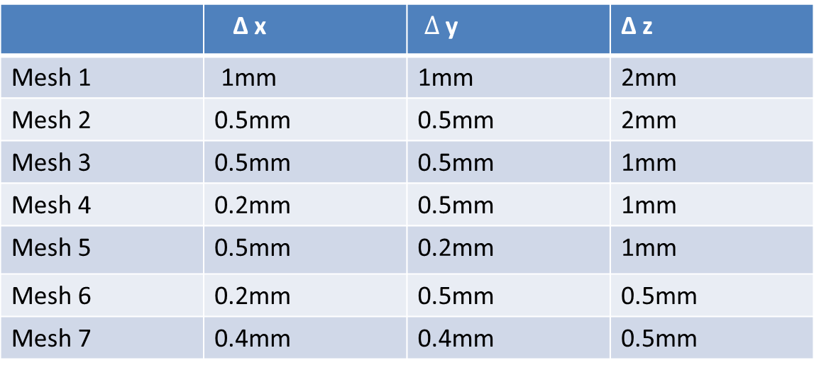
Different sets of the meshes.
 | Δ x | $Δ$ y | Δ z
Mesh 1 | 1mm | 1mm | 2mm
Mesh 2 | 0.5mm | 0.5mm | 2mm
Mesh 3 | 0.5mm | 0.5mm | 1mm
Mesh 4 | 0.2mm | 0.5mm | 1mm
Mesh 5 | 0.5mm | 0.2mm | 1mm
Mesh 6 | 0.2mm | 0.5mm | 0.5mm
Mesh 7 | 0.4mm | 0.4mm | 0.5mm
impossibly
The calculations were performed for different beam positions:
1. x=0, y=0; 2. x=1.5mm, y=0; 3. x=0, y=1.5mm

Slide 4
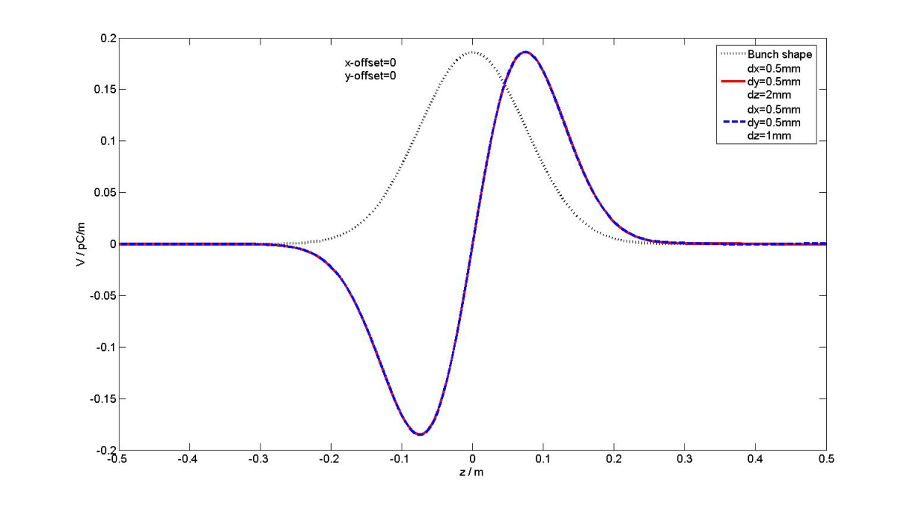
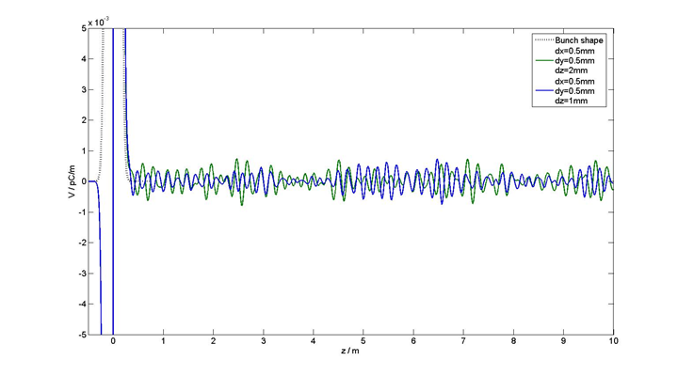

Longitudinal wake potential was calculated for 10m and for different mesh properties – Mesh2, Mesh3.
Calculations have been done for the Gaussian bunch shape (σ = 7.5cm).
$k_{∥}$=0.00012 V/pC

Slide 5
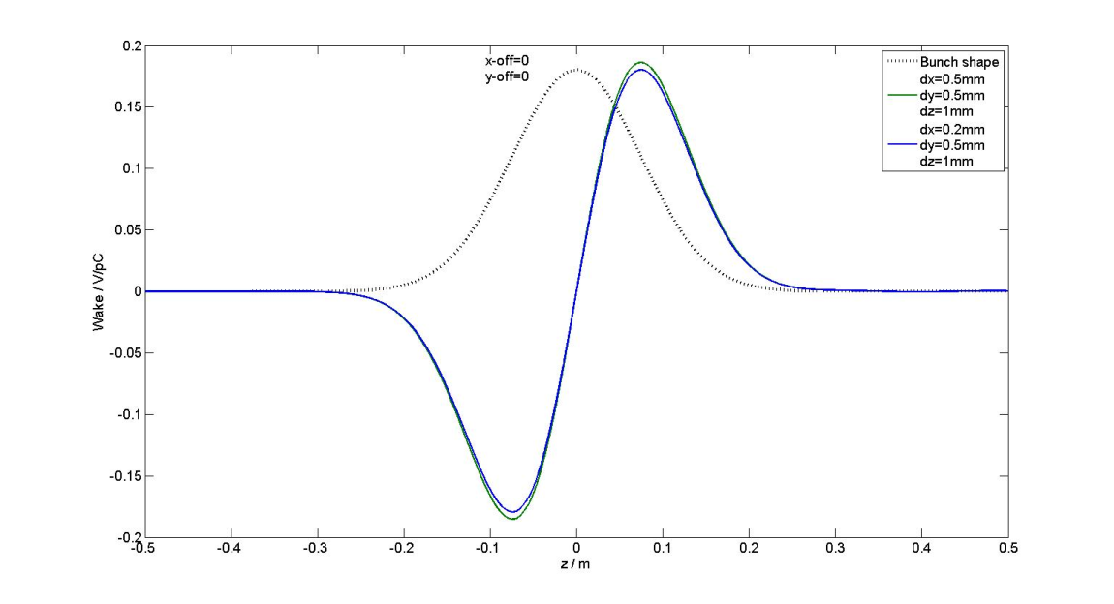
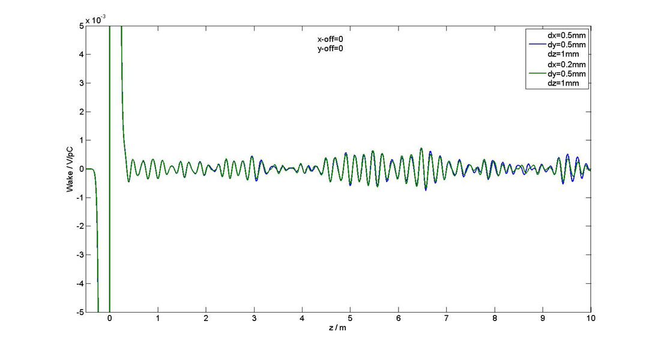
Longitudinal wake potential for Mesh3, Mesh4.
Calculations have been done for the Gaussian bunch shape (σ = 7.5cm).

Slide 6
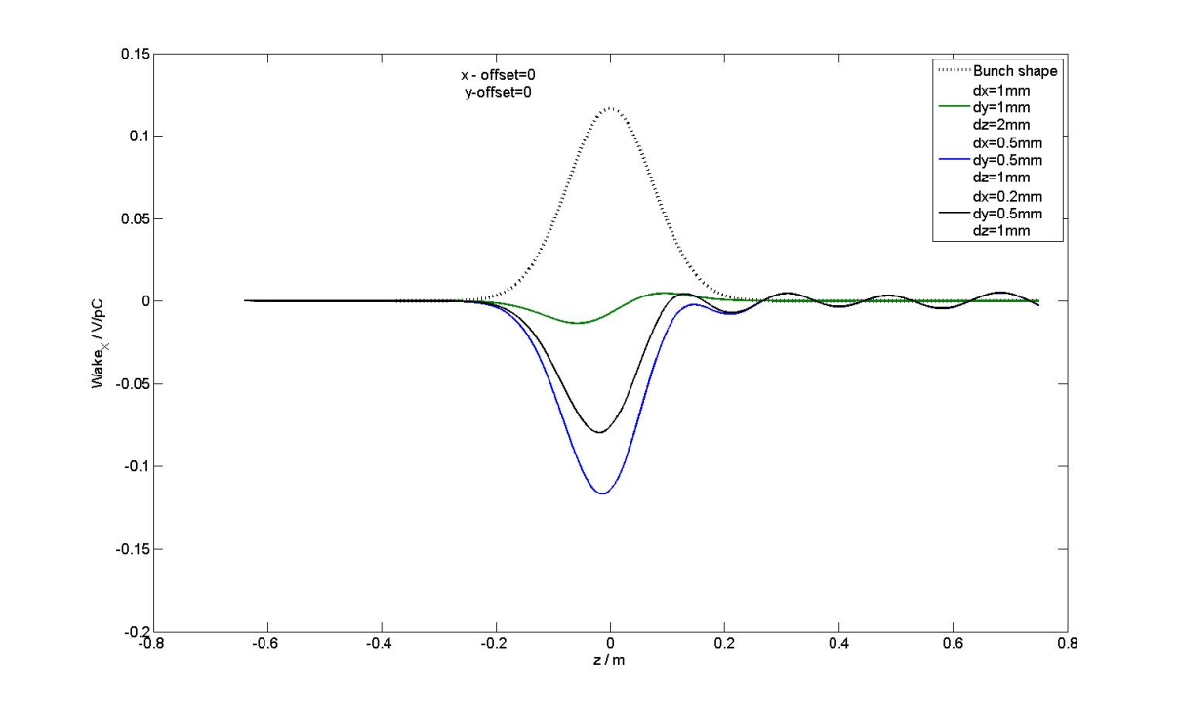
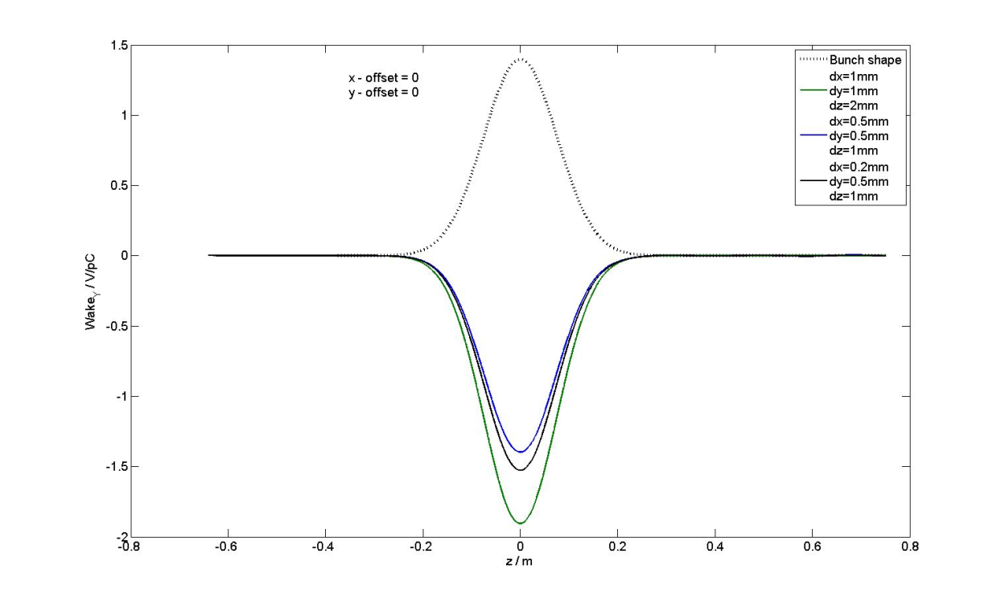
X-component and Y-component of the transverse wake potential for different mesh properties.
Beam position – on axis. Calculations have been done for the Gaussian bunch shape (σ = 7.5cm).
Mesh1, Mesh3, Mesh4

Slide 7
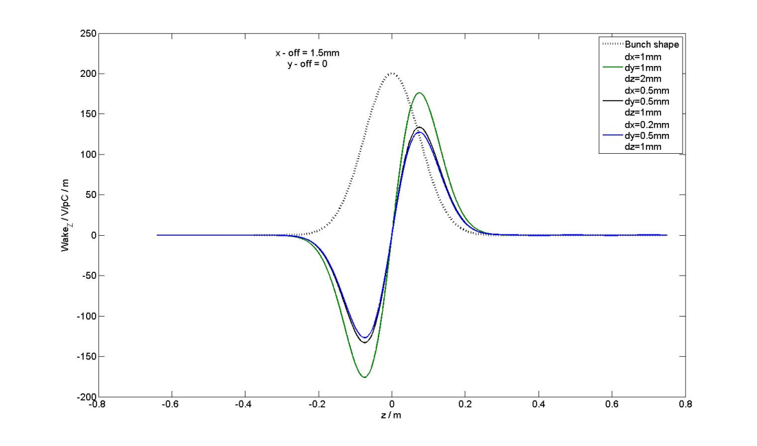
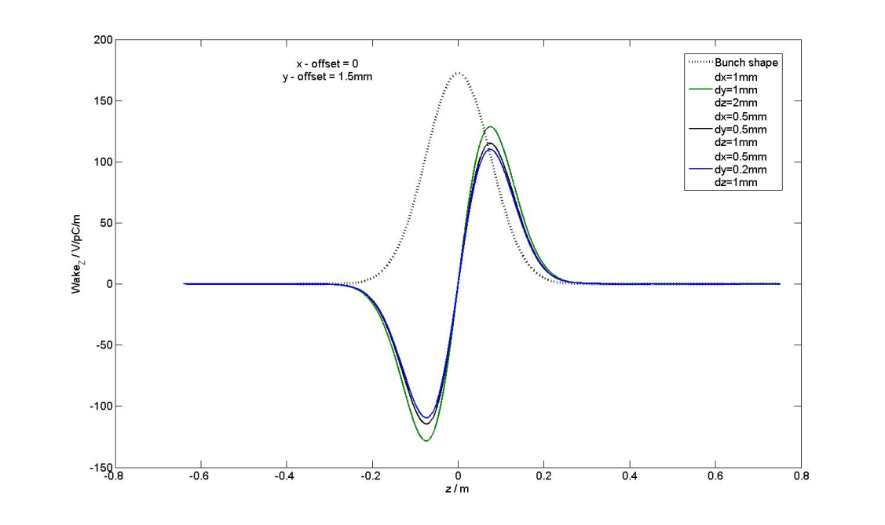
Longitudinal wake potentials for different mesh properties and for different beam positions:
1. x = 1.5mm, y=0 and 2. x=0, y=1,5mm. Gaussian bunch shape (σ = 7.5cm).
Mesh1, Mesh3, Mesh4
1
2
Mesh1, Mesh3, Mesh5

Slide 8
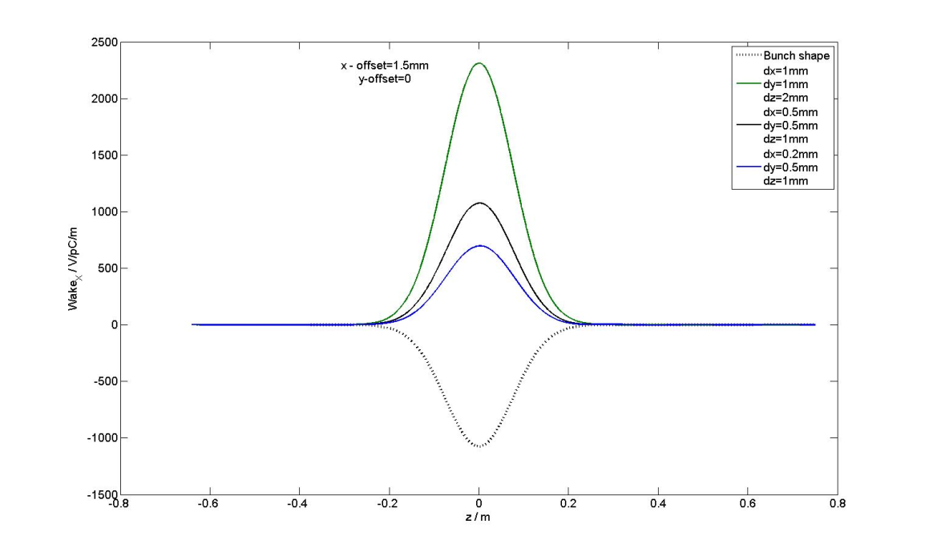
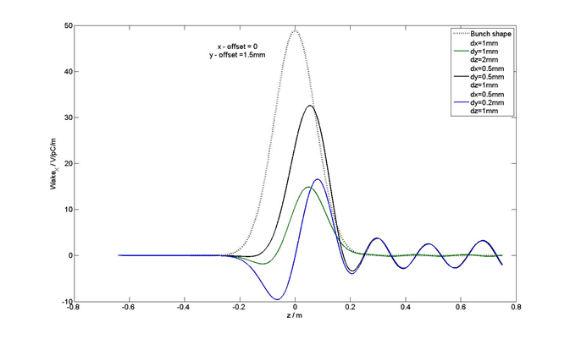
X – components of the transverse wake potentials for different mesh properties
and for different beam positions: 1. x = 1.5mm, y=0 and 2. x=0, y=1,5mm.
Gaussian bunch shape (σ = 7.5cm).
Mesh1, Mesh3, Mesh4
Mesh1, Mesh3, Mesh5

Slide 9
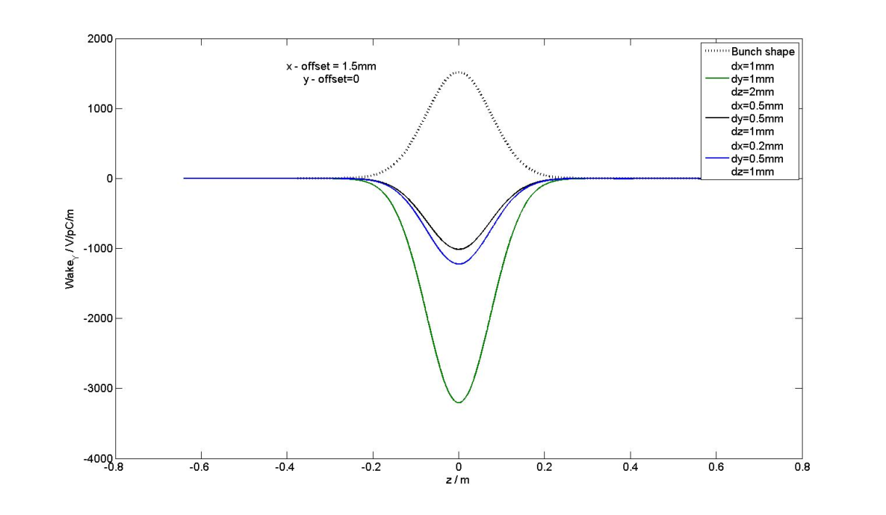
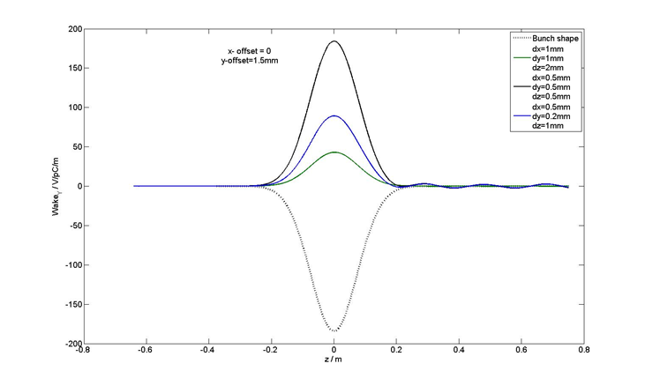
Y – components of the transverse wake potentials for different mesh properties
and for different beam positions: 1. x = 1.5mm, y=0 and 2. x=0, y=1,5mm.
Gaussian bunch shape (σ = 7.5cm).
Mesh1, Mesh3, Mesh4
Mesh1, Mesh3, Mesh5

Slide 10
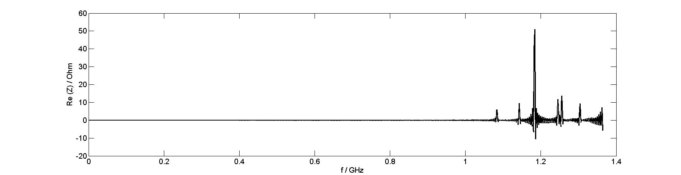
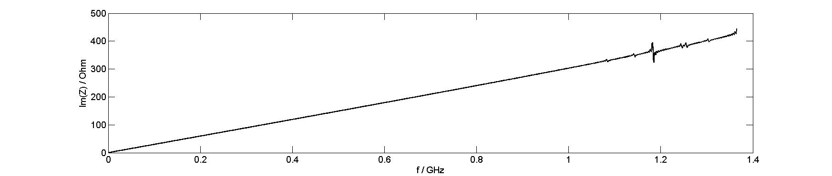
Real and imaginary parts of the longitudinal wake impedance.
The impedance was calculated with help of CST Studio for the wake potential (75m).
Wake potential was calculated for the Gaussian bunch shape (σ = 7.5cm). with following mesh set: dx=0.5mm, dy=0.5mm, dz=1mm.

Slide 11
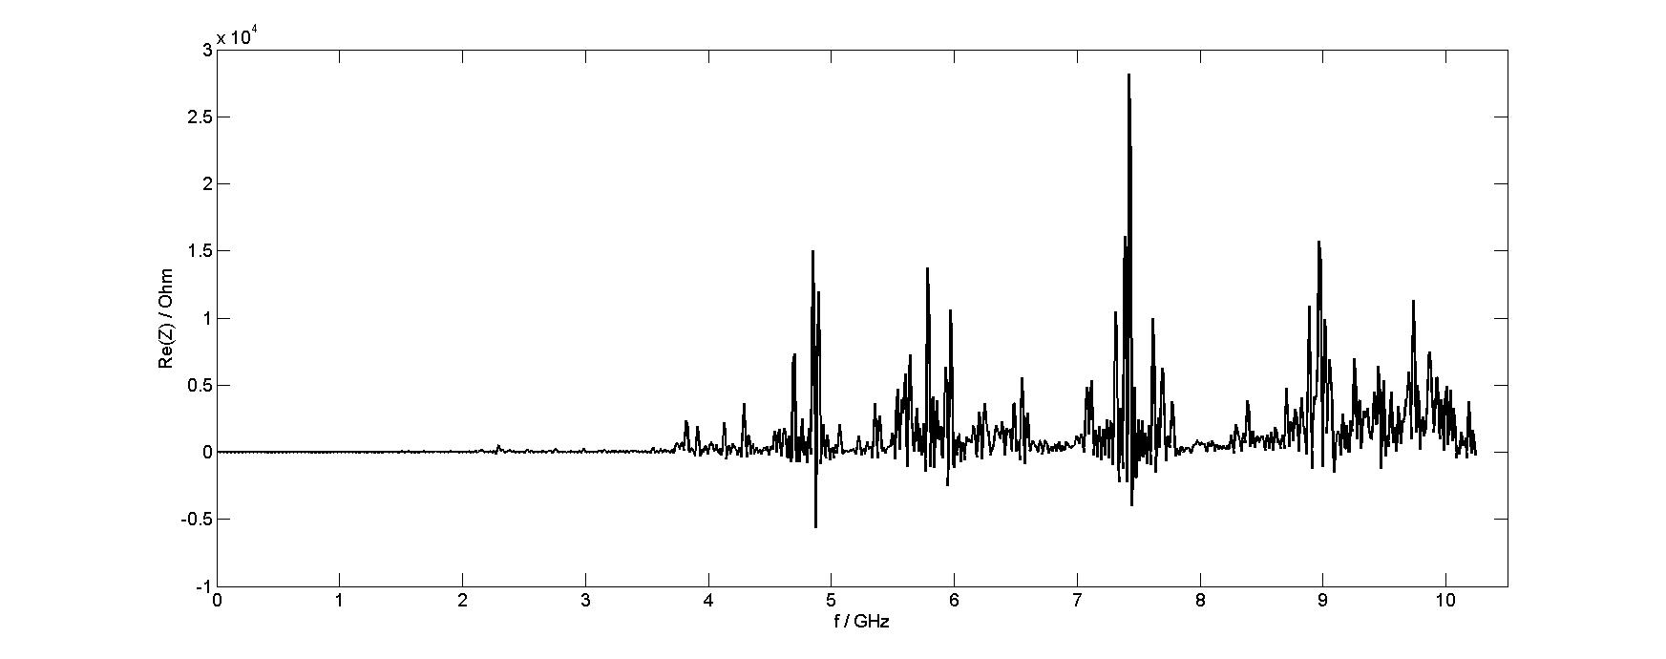
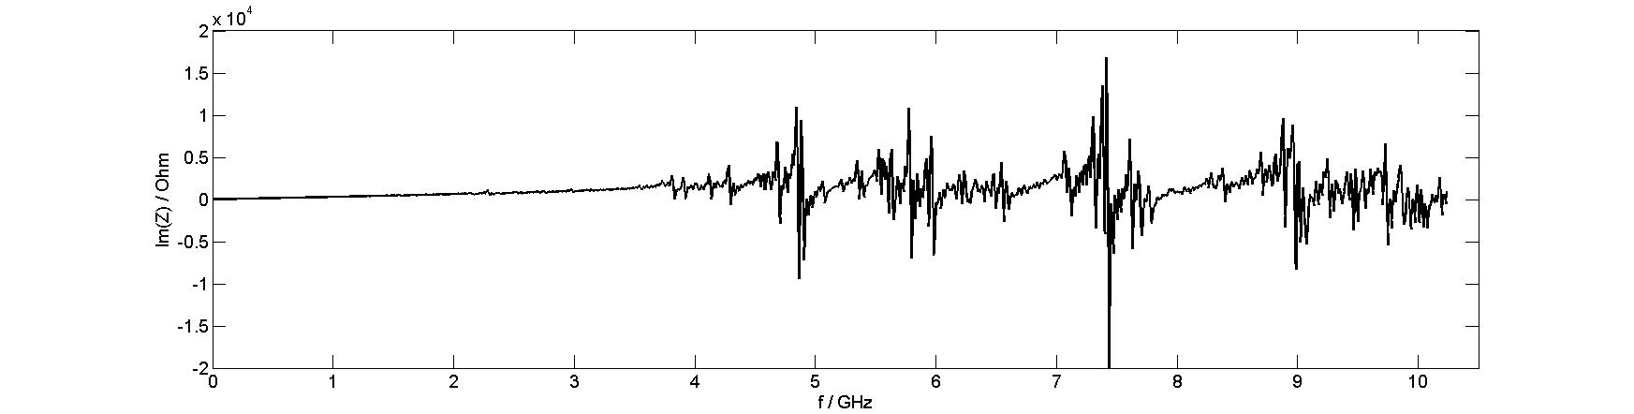
Real and imaginary parts of the longitudinal wake impedance.
The impedance was calculated with help of CST Studio for the wake potential(10m).
Wake potential was calculated for the Gaussian bunch shape (σ = 1cm) with
following mesh set: dx=0.2mm, dy=0.5mm, dz=1mm.

Slide 12
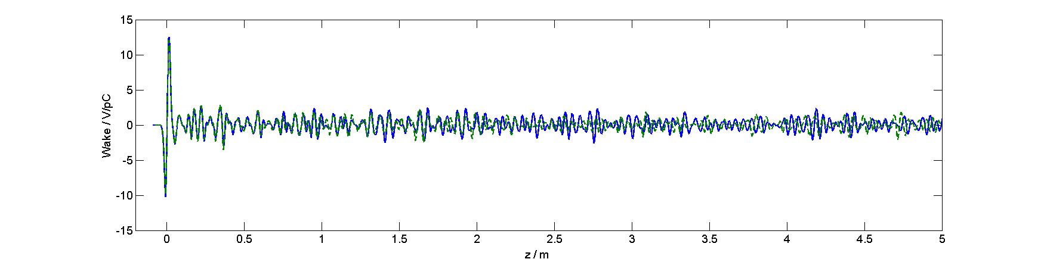
Comparison of 10-m longitudinal wake potentials,
presented for the region until 5m.
Wake potentials were calculated for Gaussian bunch shape (σ = 1cm)
with following mesh sets:
dx=0.5mm, dy=0.5mm, dz=1mm;
dx=0.2mm, dy=0.5mm, dz=1mm;

Slide 13
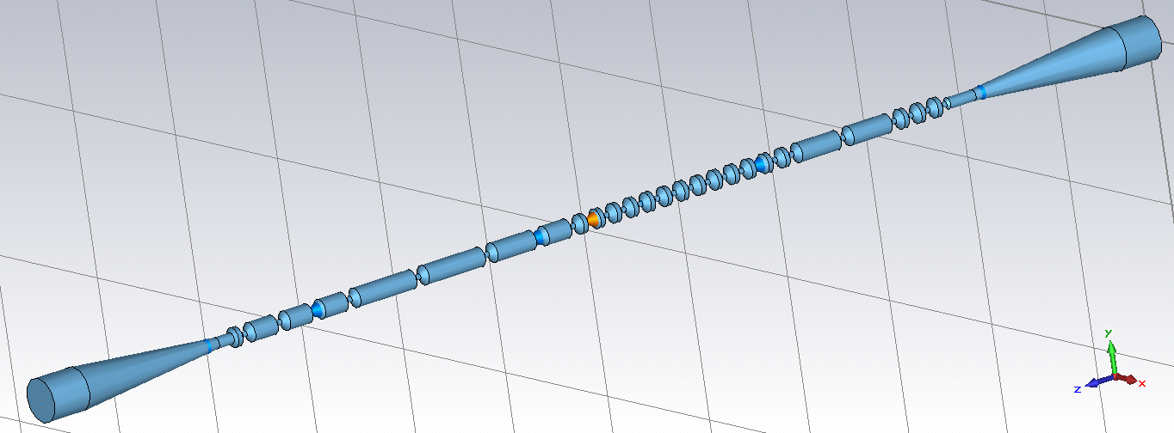
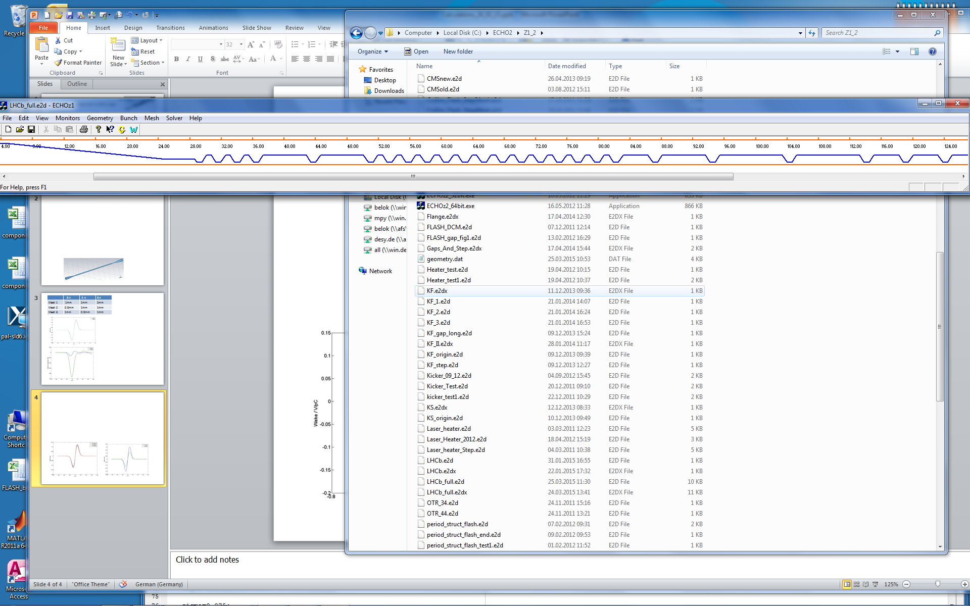
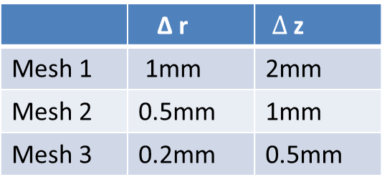
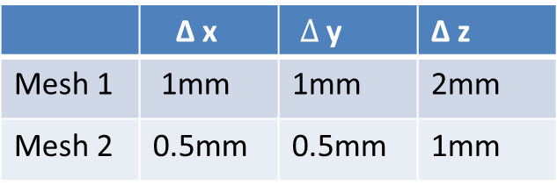
The third step of calculations – calculations for the simplified model.
Symmetric 3D model for CST
 | Δ x | $Δ$ y | Δ z
Mesh 1 | 1mm | 1mm | 2mm
Mesh 2 | 0.5mm | 0.5mm | 1mm
Symmetric 2D model for ECHO2D.
 | Δ r | $Δ$ z
Mesh 1 | 1mm | 2mm
Mesh 2 | 0.5mm | 1mm
Mesh 3 | 0.2mm | 0.5mm

Slide 14
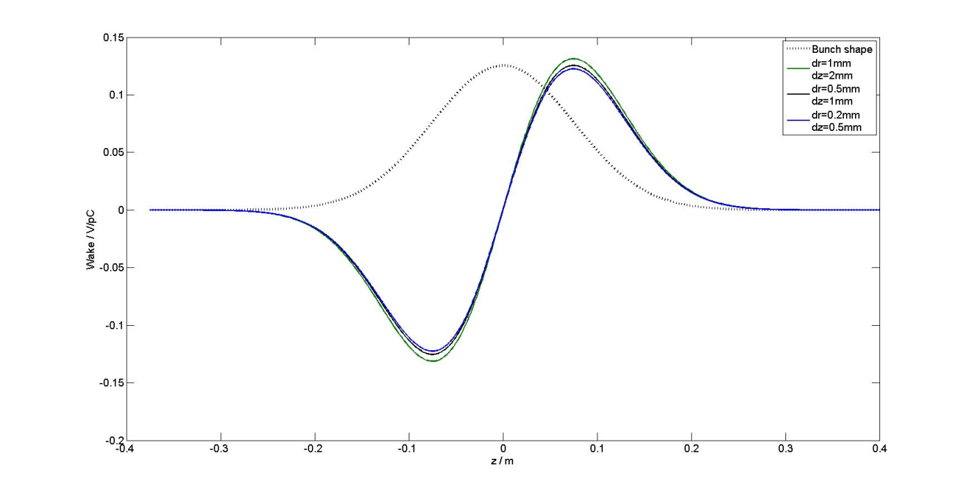
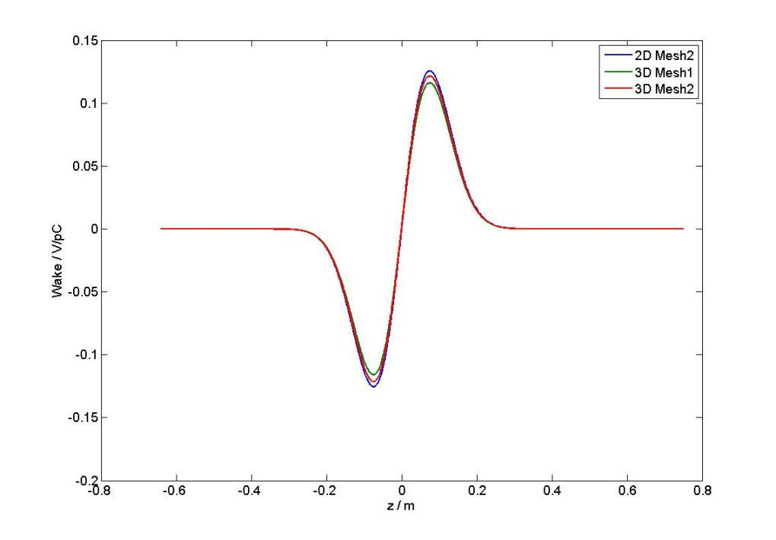



Longitudinal monopole wake potential – 2D and 3D calculations.
For Gaussian bunch shape σ = 7.5cm
$W_{ǁ}$(2D)
$W_{ǁ}$(2D, 3D)
$k_{∥}$ ~̴ 0.0 V/pC

Slide 15
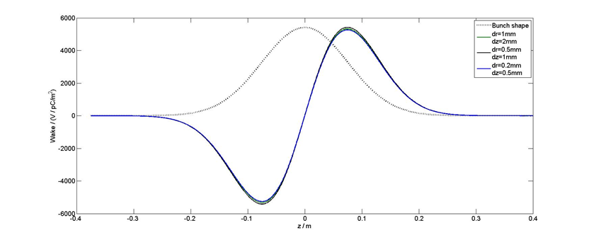
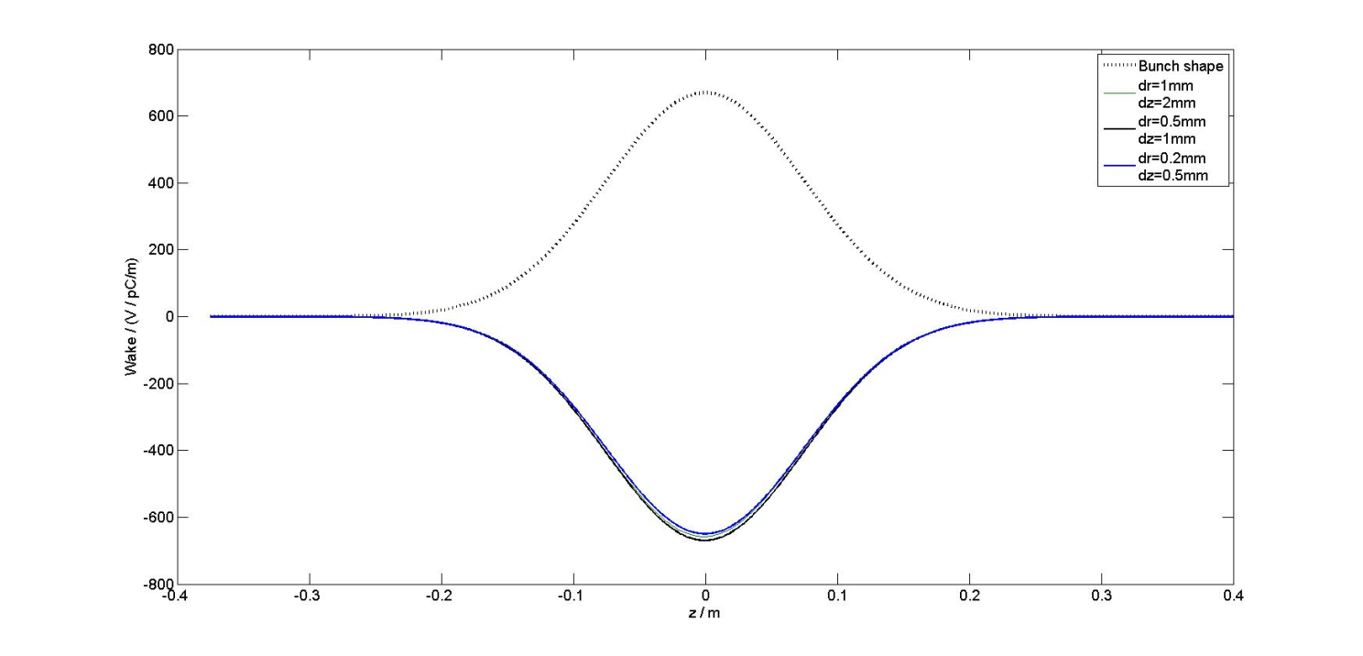

Longitudinal dipole and transverse dipole wake potential – 2D calculations.
For Gaussian bunch shape σ = 7.5cm
Longitudinal dipole wake potential
Transverse dipole wake potential
$k_{⊥}$ ~̴ 459.12 V/pC/m

Slide 16
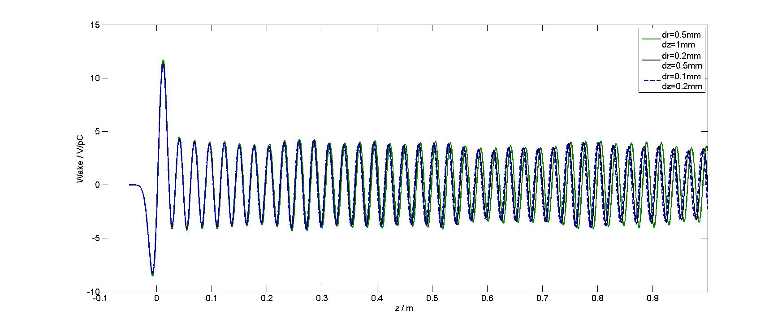
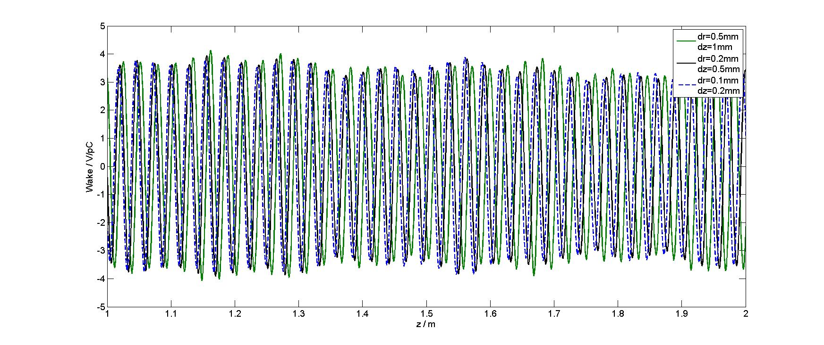
Comparison of 10-m longitudinal wake potentials, presented for the region until 2m.
Wake potentials were calculated for Gaussian bunch shape (σ = 1cm) with different mesh sets.

Slide 17
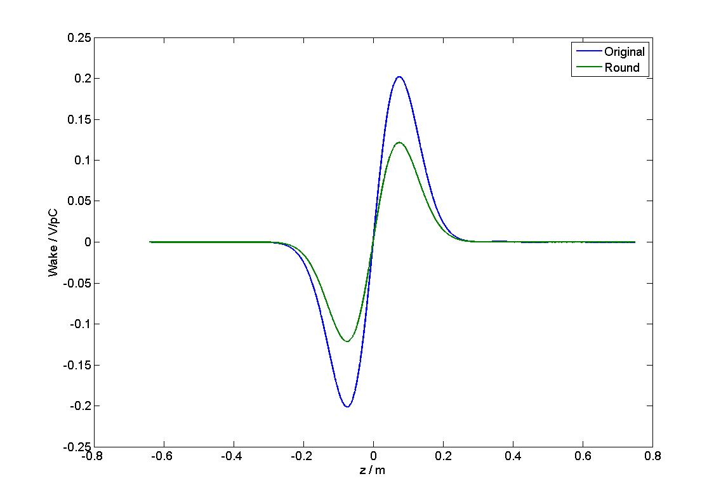
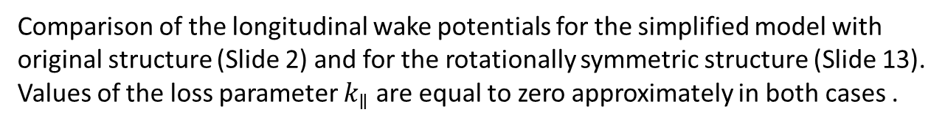
Comparison of the longitudinal wake potentials for the simplified model with
original structure (Slide 2) and for the rotationally symmetric structure (Slide 13).
Values of the loss parameter $k_{∥}$ are equal to zero approximately in both cases .

Slide 18
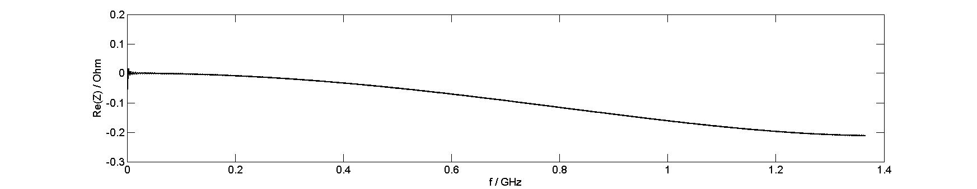
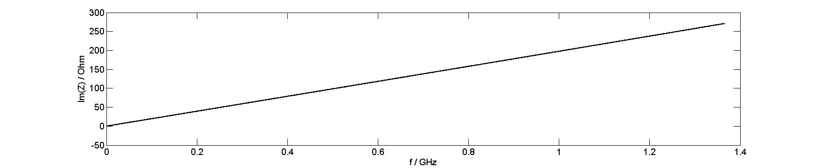
Real and imaginary parts of the longitudinal wake impedance for the rotationally symmetric structure.
The impedance was calculated with help of CST Studio for the wake potential
obtained for the Gaussian bunch shape (σ = 7.5cm).

Slide 19
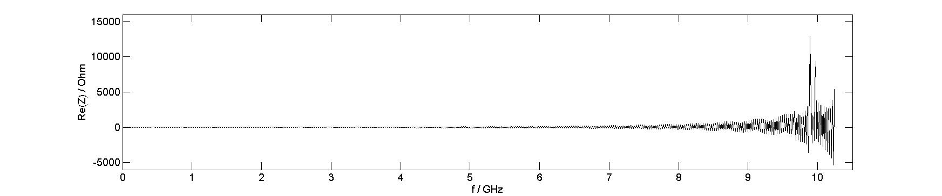
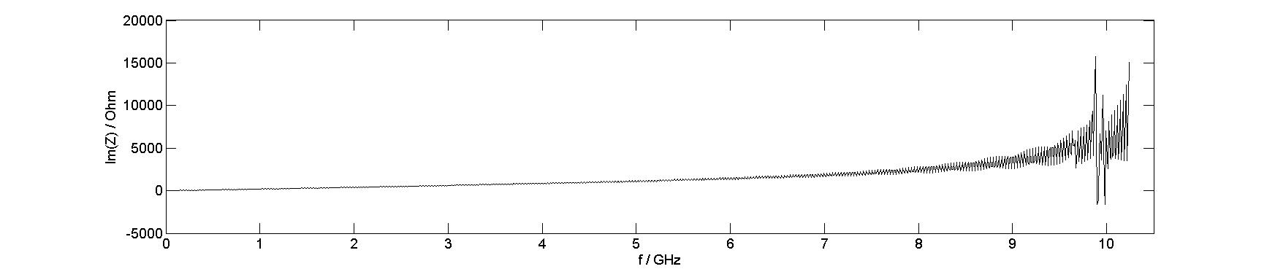
Real and imaginary parts of the longitudinal wake impedance for the rotationally symmetric structure.
The impedance was calculated with help of CST Studio for the wake potential
obtained for the Gaussian bunch shape (σ = 1cm).

