Slide 1

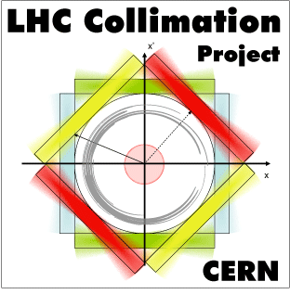
Investigations of Unidentified Lying Objects in the LHC
D. Mirarchi, R. Bruce, P. Hermes,
S. Redaelli, B. Salvachua, G. Valentino
On behalf of
the LHC Collimation Team
Special thanks to BE-OP for the support during measurements

Slide 2
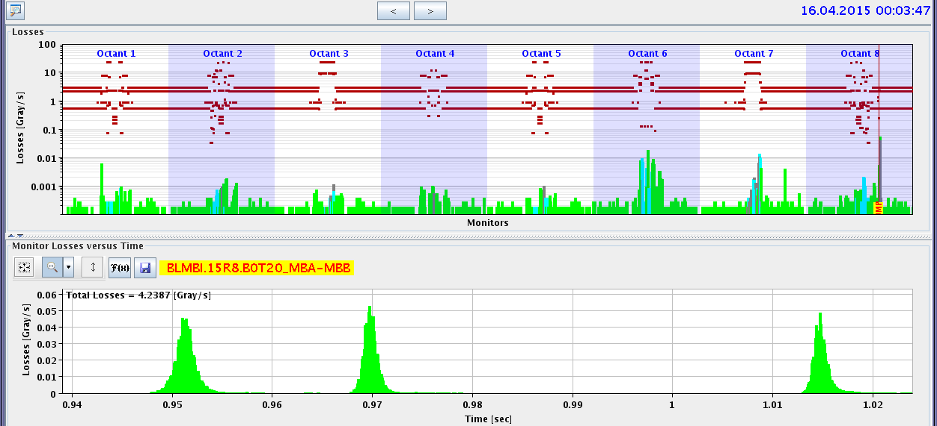
Introduction
Various dump of beam 2 triggered after ~10-15 min at flat top by BLMBI.15R8.B0T20_MBA-MBB
Main suspect: Multi-UFOs event
40 μs int. time
hadronic showers causing such losses should take place in the middle of MB.15R8.B2(FLUKA)
Initial local aperture measurements: aperture restriction were not found
Beam screen of C15R8 warmed up of >70K for 2h the 18th of April
First ramp after (night of 19th of April) last for 4h without M-UFOs events
New local aperture measurements show the presence of Unidentified Lying Objects (ULOs)
May be something frozen was creating “falling objects” and then fallen down for the warm up?

Slide 3
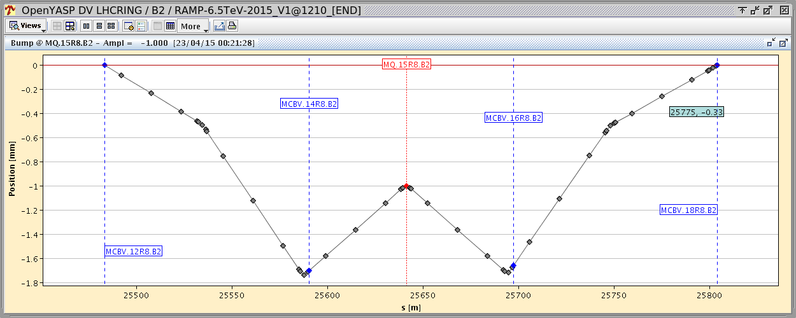
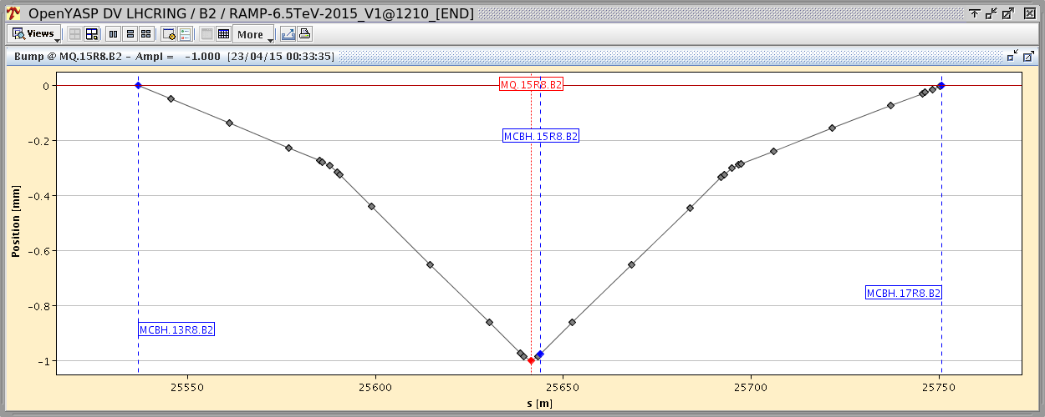
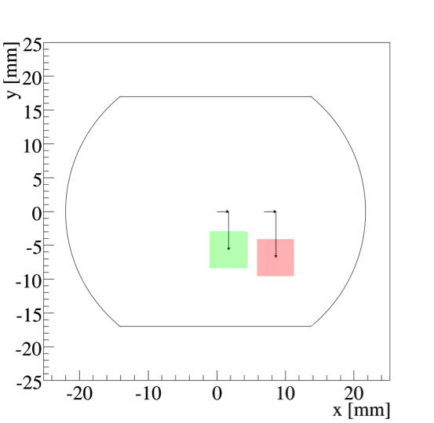
Measurements procedure
Local orbit bump: given that MQ.15R8.B2 is a focusing quadrupole
4 correctors bump in V plane
3 correctors bump in H plane
B15=1.14*Q15
Q15
B15=0.86*Q15
Q15
Q14
Q16
Beam screen
First fast scans performed the night of 18th April
First detailed scan performed the night of 20th April:
No losses at B15
Beam shaped with IR7-TCPs (H & V)
Systematic probing of local aperture
1st losses at B15
Max excursion in H~±14mm,
in V~±8mm (due to losses rising at Q14 and Q16)

Slide 4
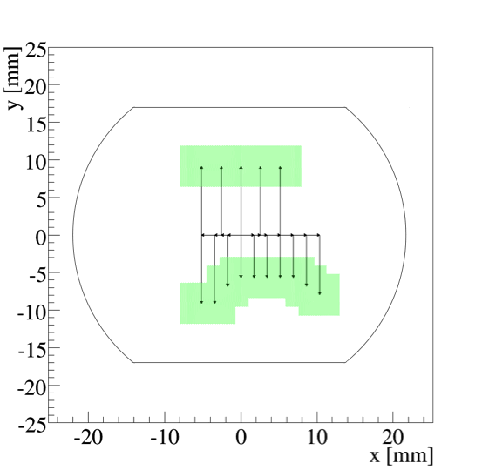
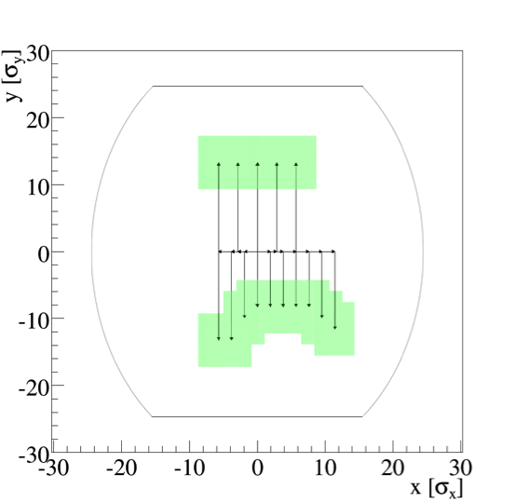
First scan 20-21/4/15
Measurements performed at injection
Cut applied with IR7-TCPs: 4σ_{y} and 3σ_{x}
Step of 2-3mm for H bumps, 1mm for V bumps (~1.4σ_{y} at MB15R8)
Safe aperture (last step before losses on MB15R8)
Physics aperture at MB.15R8
Aperture in units of σ
~-8.4mm
~12σ_{y}

Slide 5
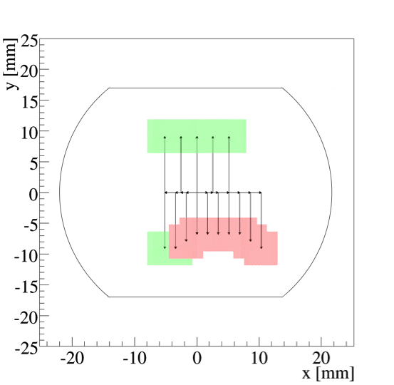
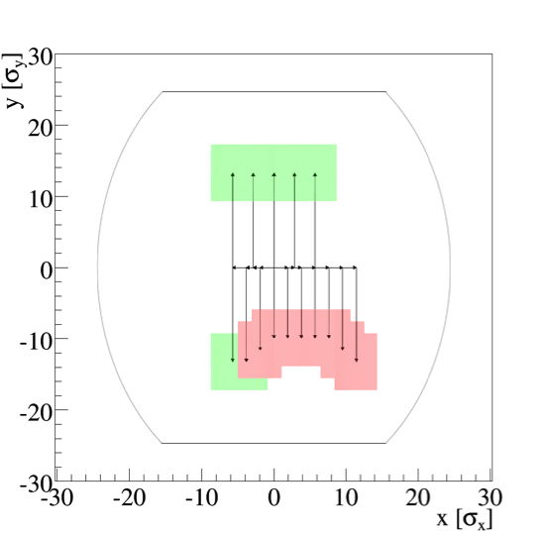
First scan 20-21/4/15
V bumps stopped when losses observed on BLMBI.15R8.B0T20_MBA-MBB
Each beam loss provoked about the same BLM signal and drop in intensity
Touched aperture
Physics aperture at MB.15R8
Aperture in units of σ
~-9.4mm
~14σ_{y}
Edge of aperture restriction found between ~ -8.4mm and ~ -9.4mm, i.e. ~12σ_{y} and ~14σ_{y}

Slide 6
OP scans 22/4/15
Similar scan performed during the night shift of 22nd April by OP (B. Salvachua) at flat top
Cut applied with IR7-TCPs: 9.5σ_{x} and 5.4σ_{y}
Steps of ~200μm (~1σ_{y} at MB15R8) for V bump
Less positions probed, however:
First losses in C15R8 observed with: bump H=0mm, V= -1.7mm
Taking into account the beam dimensions of 5.4σ_{y} , and translating this at MB.15R8:
Edge of aperture restriction found between ~ -3.1mm and ~ -3.3mm, i.e. ~4.5σ_{y} and ~4.8σ_{y}

Slide 7
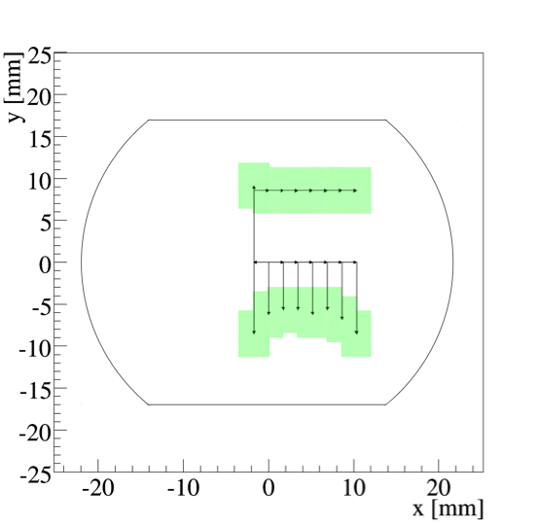
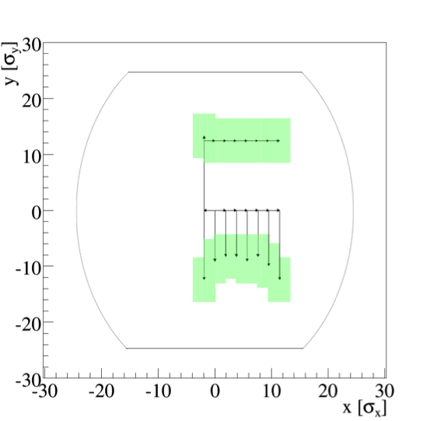
Second scan 23/4/15
Measurements performed at injection
Cut applied with IR7-TCPs: 4σ_{y} and 2σ_{x}
Step of 2mm for H bumps, 0.5mm for V bumps (~0.7σ_{y} at MB15R8)
Safe aperture (last step before losses on MB15R8)
Physics aperture at MB.15R8
Aperture in units of σ
~8.4mm
~12σ_{y}

Slide 8
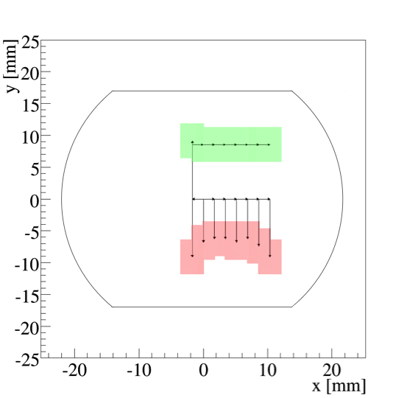
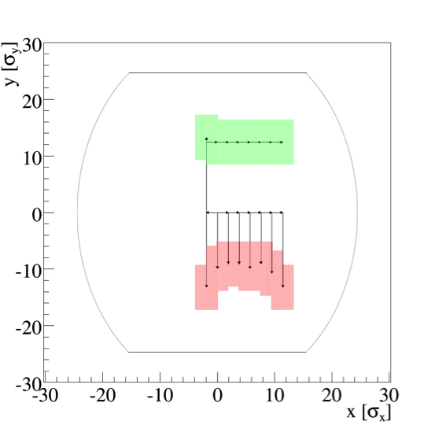
Second scan 23/4/15
V bumps stopped when losses observed on BLMBI.15R8.B0T20_MBA-MBB
Tentatively each beam loss provoked same BLM signal and drop in intensity
The ADT was now operational, small blow up made after each beam loss
Touched aperture
Physics aperture at MB.15R8
Aperture in units of σ
~-9.0mm
~13σ_{y}
Edge of aperture restriction found between ~ -8.4mm and ~ -9.0mm, i.e. ~12σ_{y} and ~13σ_{y}

Slide 9
Second scan 23/4/15
Probed also same location for B1 (at injection): aperture restrictions were not found
After measurements at injection for B2, performed also at flat top:
Unfortunately only one measurements (with bump H=0mm) was possible due to
dump triggered by a UFO at our location
Cut applied with IR7-TCPs: 5σ_{y} and 5σ_{x}
Steps of 0.1mm for V bumps (~0.5σ_{y} at MB15R8)
Edge of local aperture restriction found with V bump of -7.9mm
Taking into account the beam dimensions of 5σ_{y} , and translating this at MB.15R8:
Edge of aperture restriction (at H=0mm) found at V ~ -9.91mm at flat top
Consistent with what found at injection for bump H=0mm: edge found with bump V=-6.0mm
Taking into account the beam dimensions of 4σ_{y} , and translating this at MB.15R8:
Edge of aperture restriction (at H=0mm) found at V ~ -9.60mm at injection

Slide 10
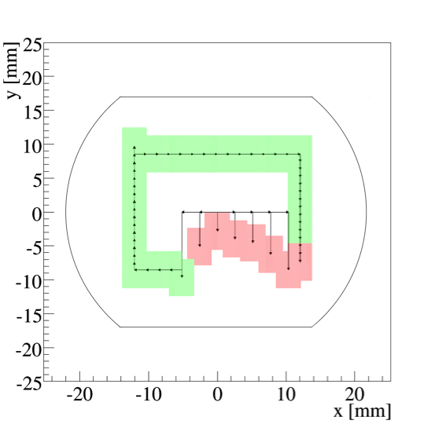
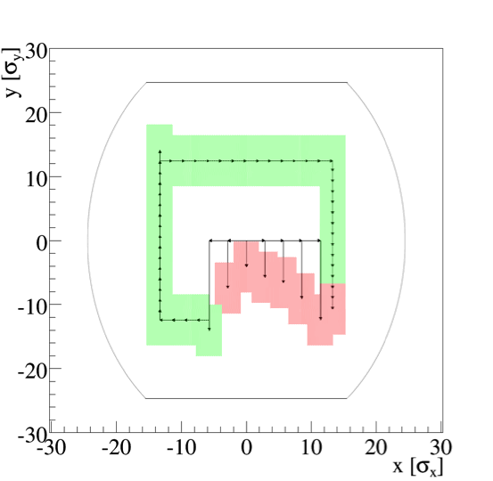
Third scan 26/4/15
Measurements performed at injection
Beam screen of C15R8 warmed up again the 25th of April
Same measurements performed (bump steps and IR7-TCPs cuts) as in the second scan
Physics aperture at MB.15R8
Aperture in units of σ
~-5.6mm
~8σ_{y}
Edge of aperture restriction found between ~ -5.0mm and ~ -5.6mm, i.e. ~7σ_{y} and ~8σ_{y}

Slide 11
More scans 26/4/15
After the previous measurement performed another two scans at injection with fresh beam
Only bump H=0mm was probed: edge aperture restriction found again with bump V=-6.5mm
(i.e. at V=~-9.6mm at MB.15R8, plus the beam dimensions of 4σ_{y} )
WHY??
Correlation with circulating intensity?
(scans of 20th and 23th pilot bunch, 22nd with nominal, and 26th after about 20min with nominal)
Injected nominal bunch and left in the machine for about 30min
Measurement repeated right after using pilot bunch
edge aperture restriction found again with bump H=0mm at V=-6.5mm
(i.e. at V=~-9.6mm at MB.15R8, plus the beam dimensions of 4σ_{y} )

Slide 12
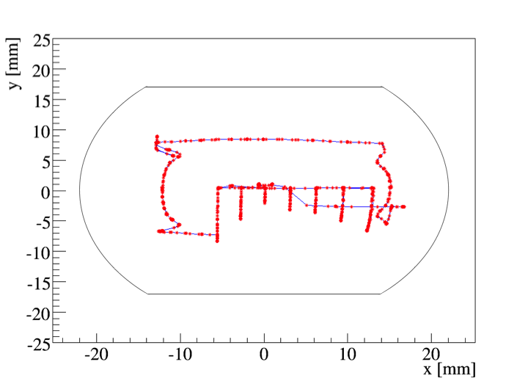
Were we where we though?
Measured beam position by BPM.15R8.B2 during third scan (26/4)
Distortions due to non-linearities at large displacements

Slide 13
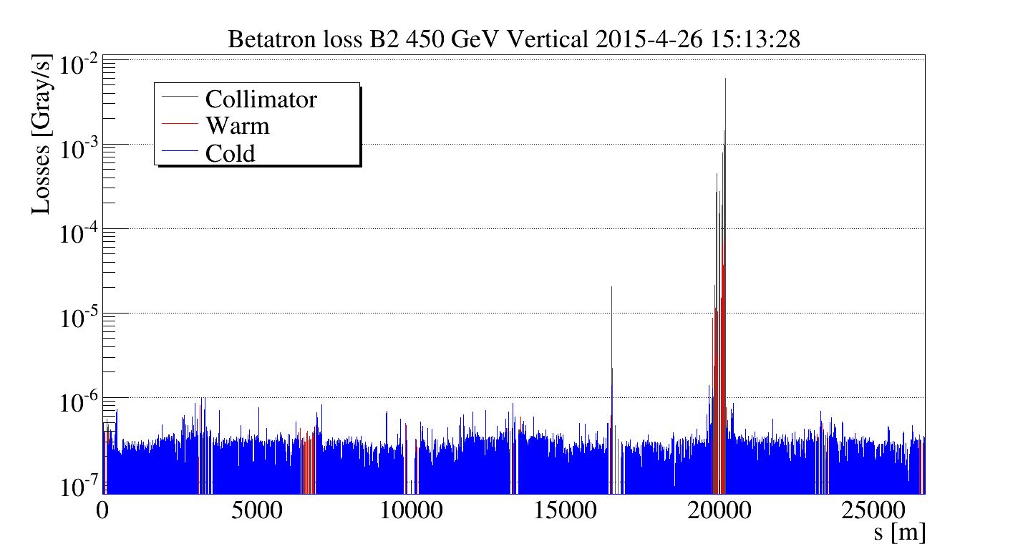
Beam 2 loss maps
No obvious activity seen in C15R8

Slide 14
Conclusions
Various dump of beam 2 triggered after ~10-15 min at flat top by M-UFOs in MB.15R8.B2
Local aperture restriction were not found before beam screen warm up, while ULOs after
First (20/4 at injection) and second scan (23/4 at injection and flat top) made with pilot bunch:
consistent results were found (restriction at H=0, -9mm < V < -10mm at B15R8)
OP scan (22/4 at flat top) made with nominal bunch:
restriction at H=0, -3.1mm < V < -3.3mm
Third scan (26/4 at injection) made with pilot bunch, but after about 20min with nominal
bunch circulating in the machine:
restriction at H=0, -5.0mm < V < -5.6mm
“More scans” (26/4 at injection) made with pilot bunch after about 2 hours of measurements (third scan):
restriction at H=0, -9.0mm < V < -9.5mm
Correlation with circulating intensity seems also excluded
More scans are yet to come,
any idea is welcome!
(Latest meas. tonight: >6mm)
More news at LMC by Stefano
No obvious activity seen in C15R8 during Beam 2 loss maps

Slide 15
BACKUP

Slide 16
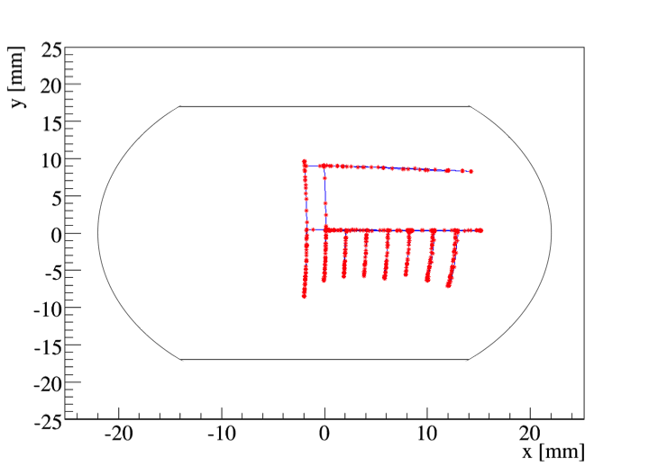
Were we where we though?
Measured beam position by BPM.15R8.B2 during second scan (23/4)
Distortions due to non-linearities at large displacements

Slide 17
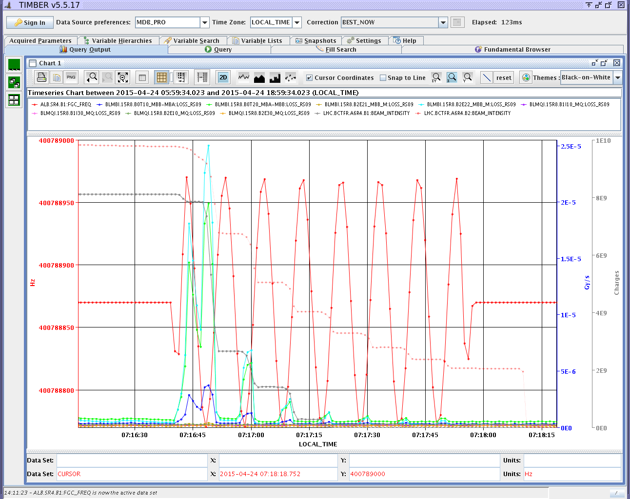
Q' measurements
S. Redaelli

Slide 18
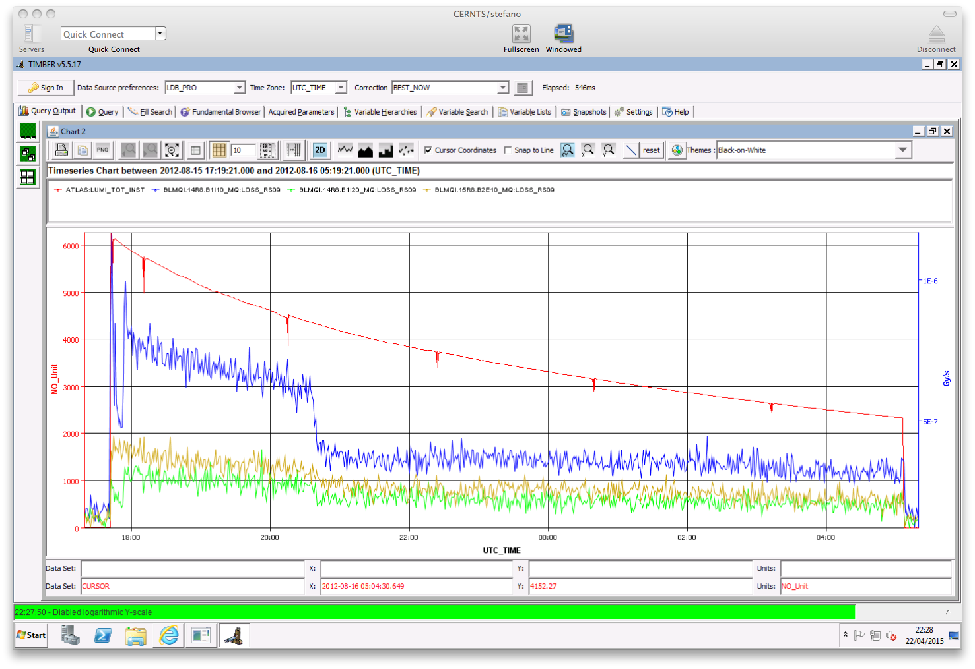
Losses in physics in 2012
S. Redaelli

Slide 19
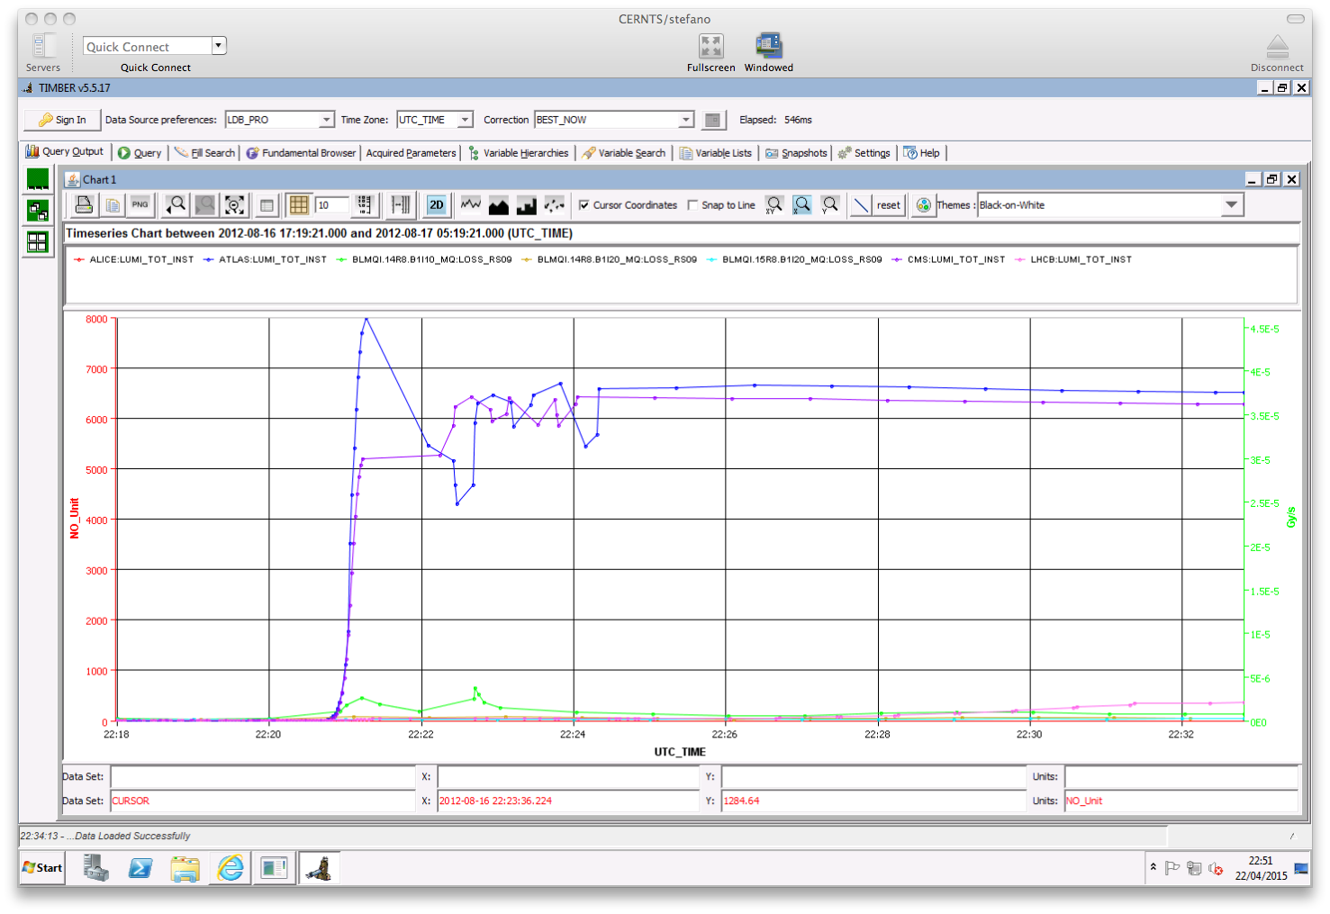
Losses in physics in 2012
S. Redaelli

