Slide 1
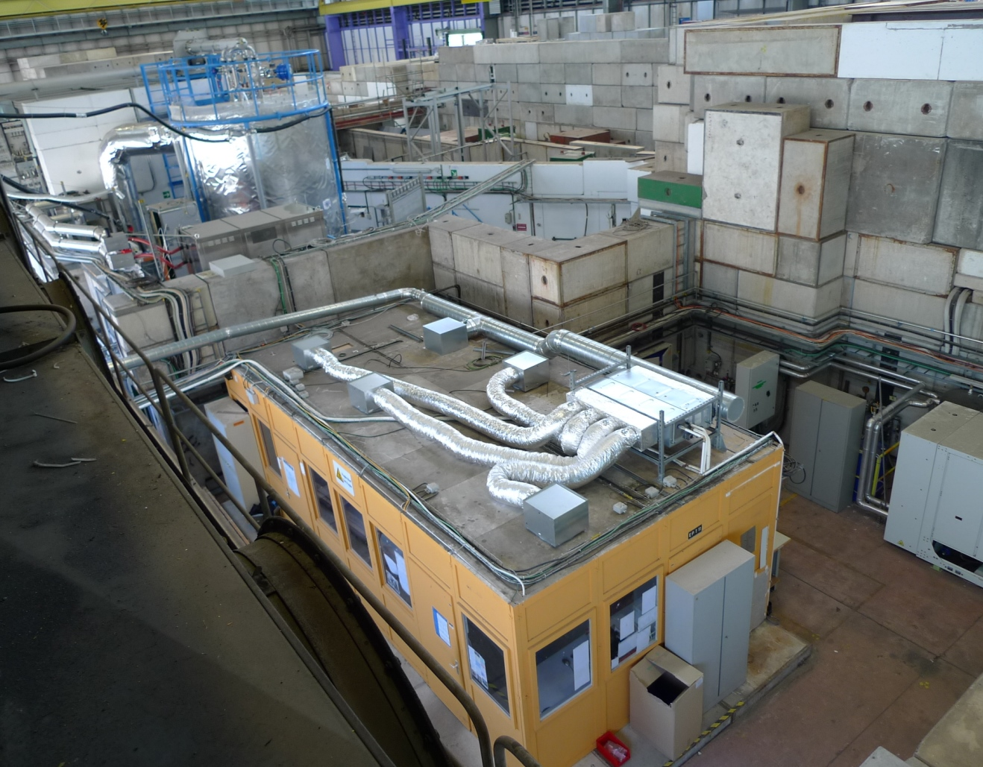
1st meeting on LS2 East Area upgrade, 1 April 2015
Inputs from CLOUD
Antti Onnela, PH-DT, CLOUD Technical and Resource coordinator, GLIMOS
http://indico.cern.ch/event/382763/

Slide 2
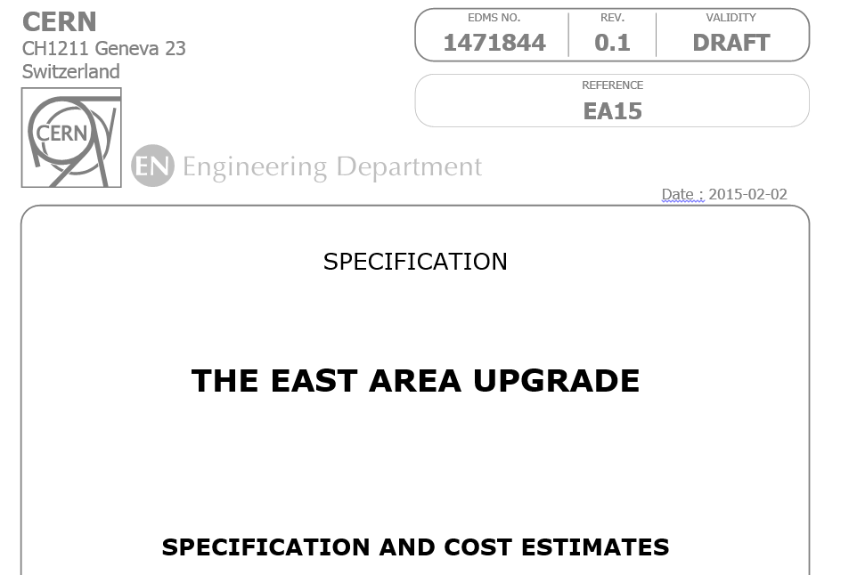
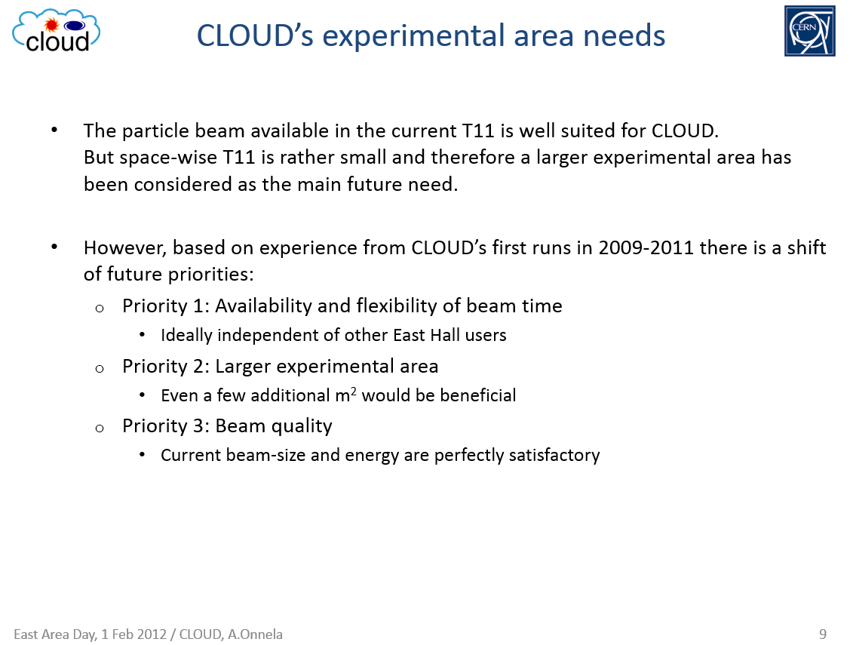
Feed-back on the East Area Upgrade Spec
A layout of the future East Area with T11 has been designed by Lau Gatignon et al. Thank you!
However, in the current draft spec the moving of CLOUD to T9 end is still shown as the base-line, while preserving T11 is mentioned as an option. This is opposite to CLOUD’s view point and requests.
Before the CLOUD start in 2009 a larger beam-area was considered important. However, the past 6 years of running CLOUD have proven that the current T11 area is sufficient and that the decoupling of T11 from the other beams is very important for CLOUD and useful for the neighbouring beams, too.
  This change of CLOUD priority has been mentioned in several discussions and the reasons for it presented in the East Area Day on 1 Feb 2012 (slide above).
In the spec the preserving of T11 is shown with additional costs and complications, while the resource needs and complications in moving CLOUD (if T11 suppressed) are not accounted.

Slide 3
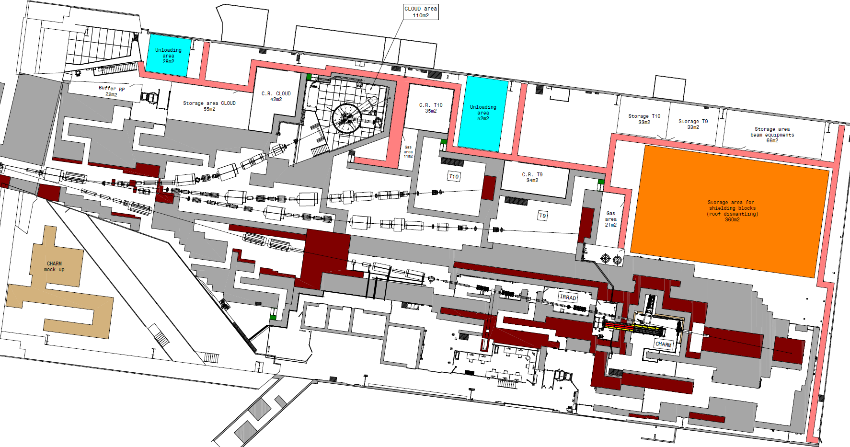
CLOUD’s request: Future East Area with T11

Slide 4
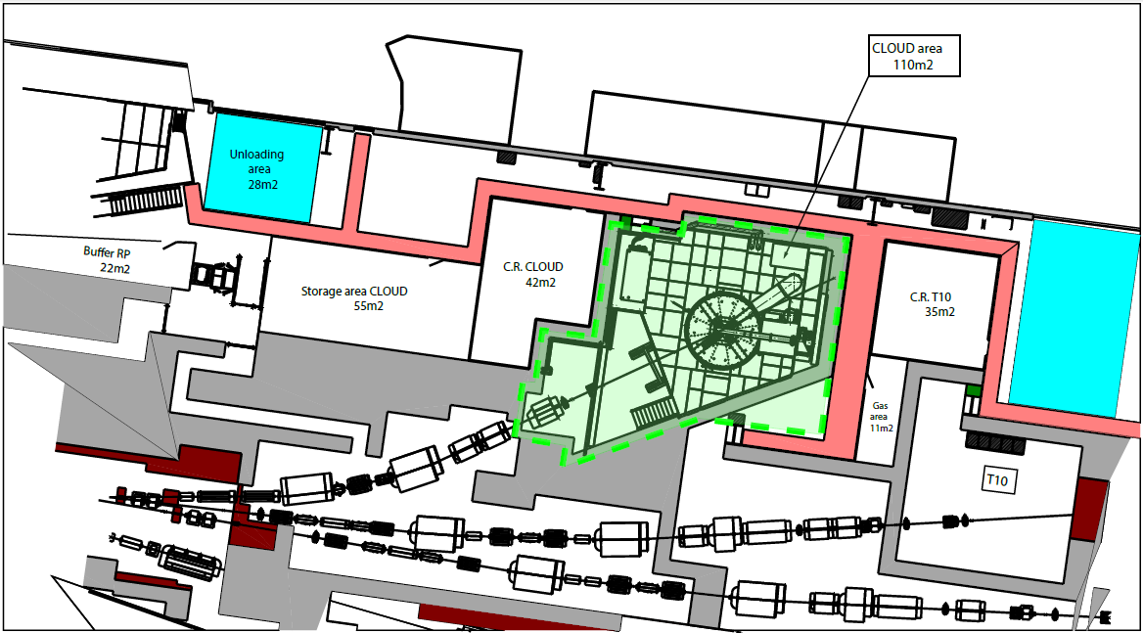
Even better, with small modification
10-15 m2 extension, with corridor modified

Slide 5
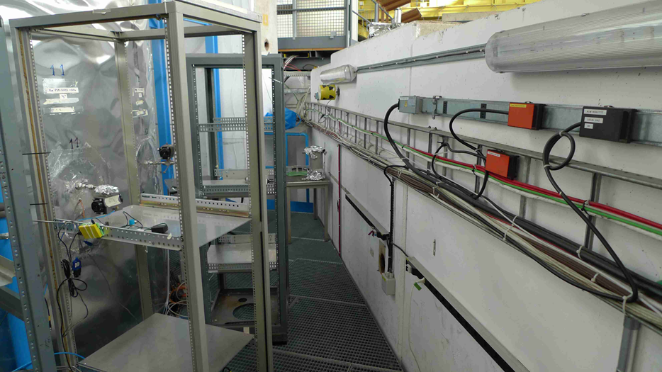
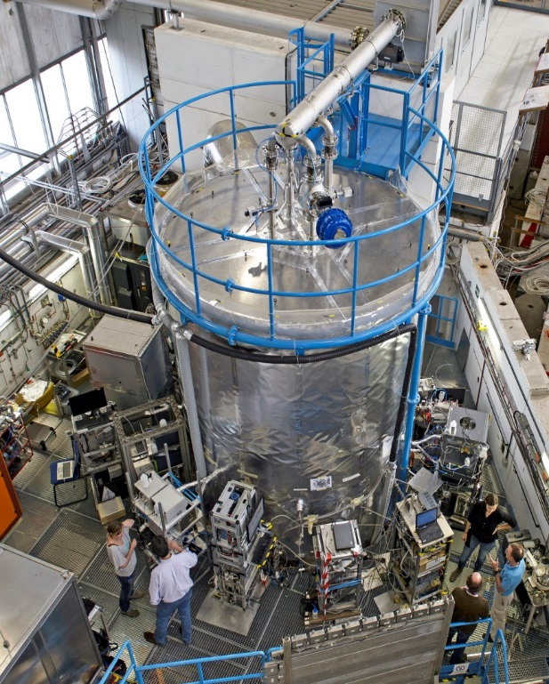
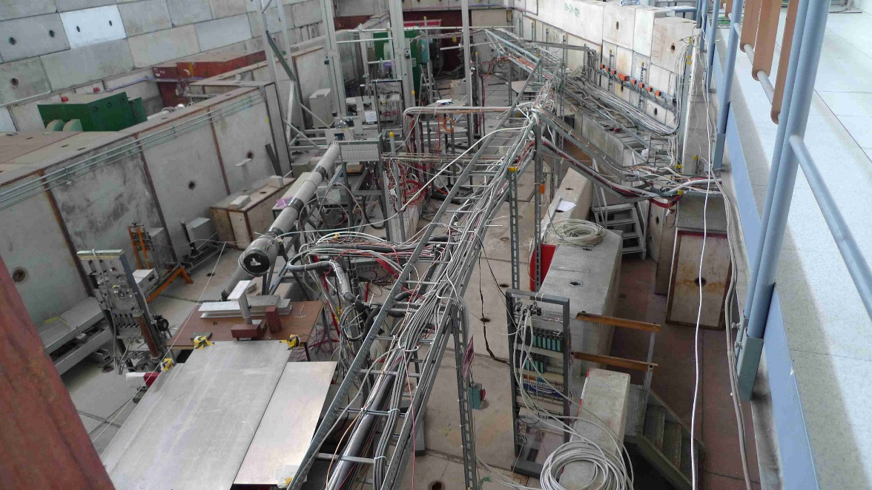
That extension helps precisely where needed
Narrowest space around the CLOUD chamber
T11 extension
Current T10 area

Slide 6
CLOUD, towards future
CLOUD is operational since autumn 2009.
Physics runs every year, also during LS1 (with cosmics).
Recognised as world’s top lab experiment in its field (so far, performance is unmatched).
CLOUD status & long-term plans, CERN-SPSC-2014-018 SPSC-P-317-ADD-4, 4 June 2014:
”… we (CLOUD collaboration) estimate that CLOUD will need a further ten years’ operation at the CERN PS to carry out the important experimental and modelling programme described…”
SPSC 114 minutes, June 2014:
"...The SPSC congratulates the consortium on the internationally leading results, which were achieved since 2009... The Committee recommends CERN to provide adequate support to the collaboration."

Slide 7
Summary
CLOUD re-confirms its request to preserve the T11,
and asks this to become the choice for the planned East Area Upgrade.
A small extension to T10, modifying the geometry of a planned access corridor, would increase T11 by 10-15 m², exactly where it is most useful.

Slide 8
Spare slides

Slide 9
CLOUD until now
2006: Approved as CERN experiment
Technical pre-run with a 8 m³ chamber in the East Hall T11 area.
2008-2009: Design and construction of 27 m³ aerosol chamber
Modification of East Hall T11 area to accommodate the chamber, its supplies and instruments
Beam-runs:
Run | Month | Year | Aim
CLOUD1 | Nov–Dec | 2009 | Commissioning
CLOUD2 | Jun–Jul | 2010 | Binary H₂SO₄ and NH₃ ternary nucleation
CLOUD3 | Oct–Nov | 2010 | Binary H₂SO₄ and NH₃ ternary nucleation
CLOUD4 | Jun–Jul | 2011 | Dimethylamine & pinanediol ternary nucleation
CLOUD5 | Oct–Nov | 2011 | Free tropospheric binary H₂SO₄ & NH₃ ternary nucleation
CLOUD6 | Jun | 2012 | Initial cloud formation (cloudy) experiments
CLOUD7 | Oct–Dec | 2012 | NH₃, dimethylamine & alpha-pinene ternary nucleation & growth
CLOUD8 | Oct-Dec | 2013 | Low H₂SO₄ nucleation & cloudy expts. (aqueous phase & ice, with GCRs – no PS)
CLOUD9 | Sep-Nov | 2014 | Cloudy experiments (aqueous phase & ice) & small ion studies
Continuous modifications, improvements between beam-runs:
  Gas system and its controls, Thermal system (-70C operation, temperature measurements), UV-systems
  Additional / improved measurement instruments
  Modifications foreseen to continue in future, to match with the experimental programme.
Results:
  5 high-impact publications (2 Nature, 1 Science, 2 PNAS), 8 other publications (physics + technical & method developments). More in preparation.
  CLOUD is recognised as world’s top lab experiment in its field (so far, performance is unmatched)

Slide 10
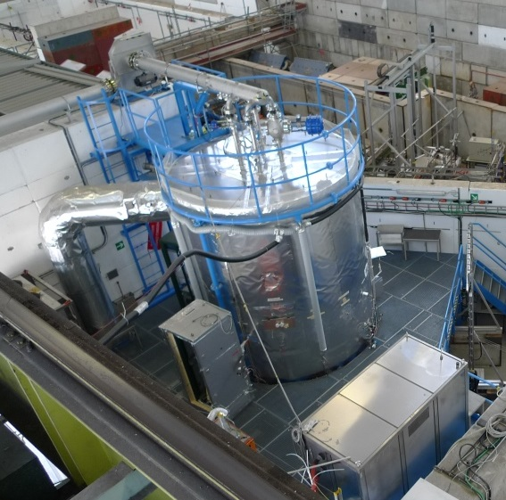
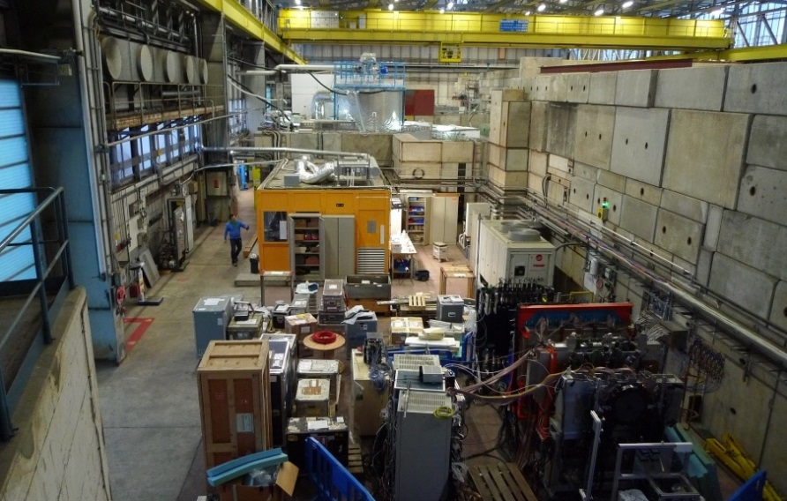
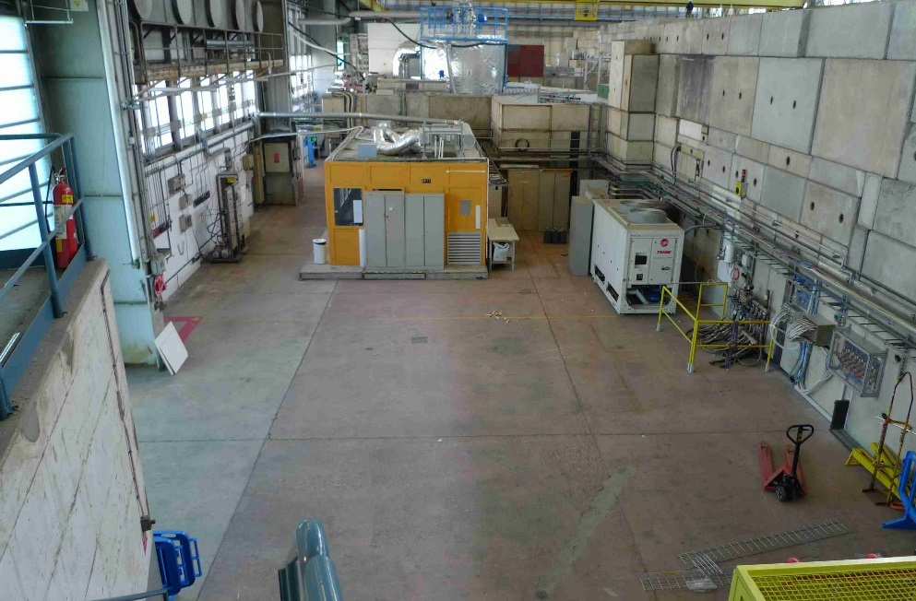
Instrument reception/preparation
CLOUD
equipments
P349 equipments
No run
Oct 2014
Run
March 2015

Slide 11
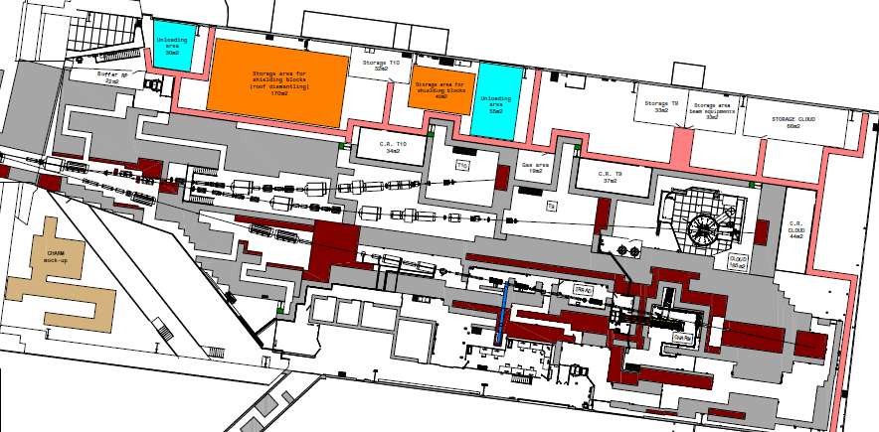
East Area layout option without T11

