Slide 1
East Area consolidation phase 2
Lau Gatignon, 1 April 2015

Slide 2
Introduction
Up to early 2012 we had defined an upgrade and consolidation program for the East Area, following a large number of serious hardware failures. The program aimed at consolidating beams and infrastructures, but also to optimize the beam lines in terms of performance (top momentum, choice of particle type, etc) and maintainability and better management of radiation dose.
The T7 and T11 lines would disappear, T9 and T10 be improved and the front-end of the primary line modified. All beam lines would only contain magnets approved by TE/MSC. At that time it was thought that DIRAC might continue to run after LS1 and only after some time the radiation facilities might move to the DIRAC location.
The proposed program was validated during the East Area day in 2012, but with the request to maintain the T11 beam in the reorganization of the beam lines.

Slide 3
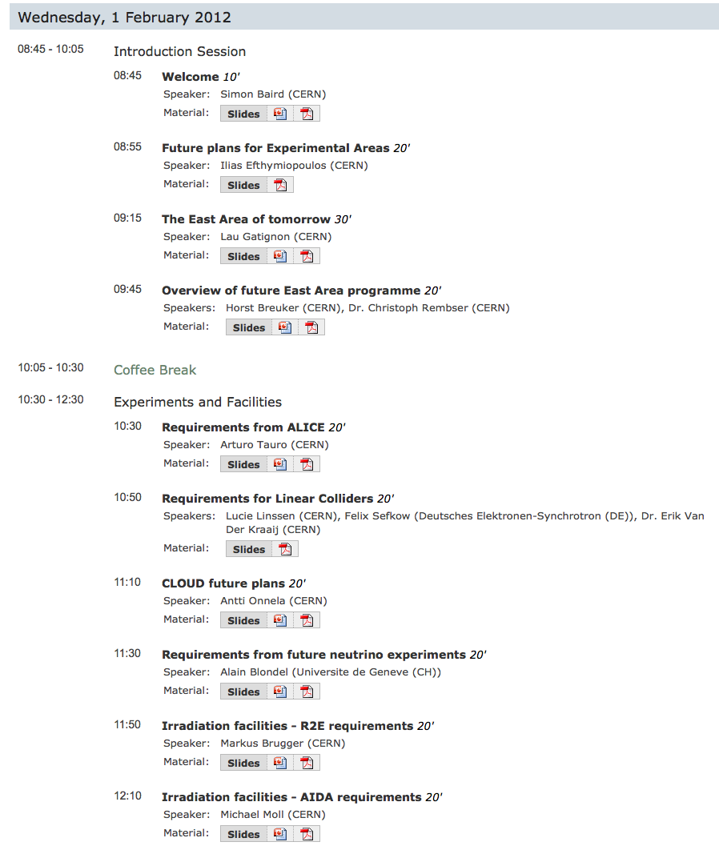
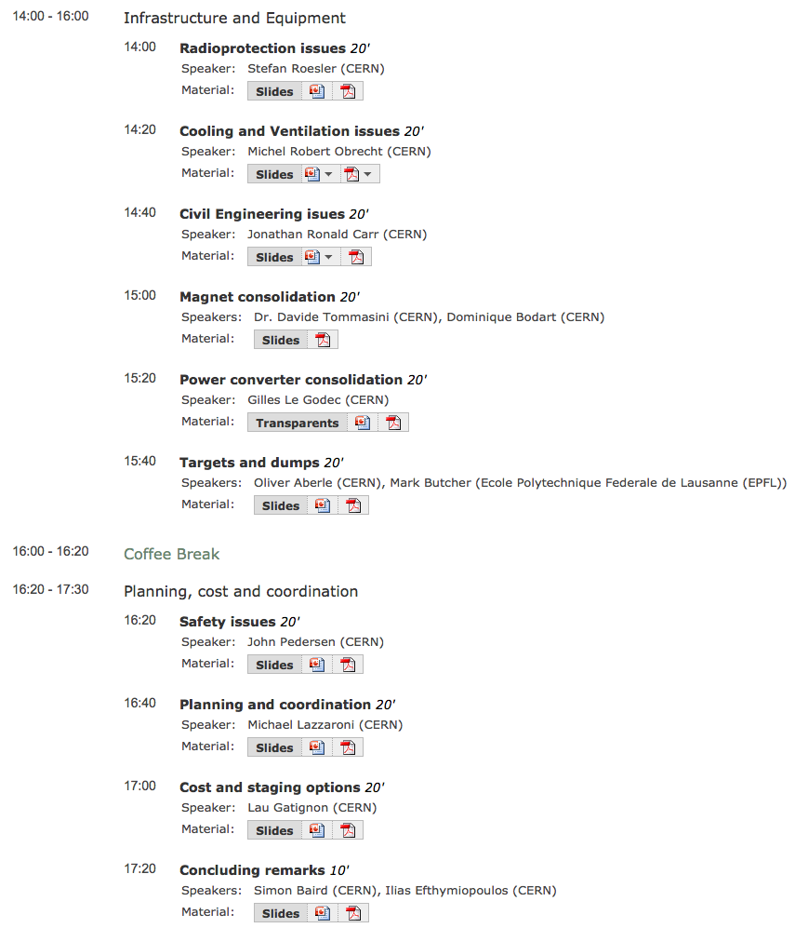
https://indico.cern.ch/event/167761/

Slide 4
What has changed?
However, towards the end of 2012 it was decided to stop and dismantle DIRAC immediately and to give priority to the radiation facilities, which in the meantime have been constructed (CHARM and IRRAD).
Also at the same time it was suggested to replace a number of massive magnets in the beam lines by laminated equivalents that can be pulsed. The power savings would amortize the investment cost for new magnets in a few years. Also the new electrical and cooling infrastructure can be re-dimensioned (i.e. smaller), leading to potentially even larger savings.
In this light it is now time to come back to this remaining part of the project and finalise the design, documentation and costing. We have compiled the existing documentation into a single (large) document which is available at https://indico.cern.ch/event/167761/

Slide 5
Aim of these meetings
The aim of this meeting (and probably a few more) is to correct, complete and finalise this document. The chapter on T11 and pulsed magnets still need some work.
The particular issues are:
Correct the description of the CHARM and IRRAD part,
COSTING of pulsed magnets incl. power supplies and impact on electrical and cooling system cost,
Review all other COSTS, in view of what we have done and learned in the first project phase,
Any other corrections to the text.
Since 2012 a lot of information concerning the East Area complex has been carefully documented in the Safety File, e.g. EDMS document number 1273737 (descriptive part)

Slide 6
Additional input needed
Time profiles
Risk scores
If there would be any items for 2015, we need a
Consolidation Work Unit Description document

Slide 7
Add T11 beam
The initial project proposal did not include a T11 replacement, as CLOUD wanted a larger area and ideally an even larger beam spot (now ~1.6x1.6 m²)
Just before the East Area Day (early 2012) CLOUD changed priority and likes the present location better, as it provides more freedom for their running plans. It also provides one more beam line, even if only used for a fraction of the beam time.
A study has been done (by E.Montbarbon and LG) to study the feasibility of adding again a T11.like beam and it is possible, but at the cost of more difficult access to some magnets, reduced functionality of T10 (no pure electron beams) and extra cost (tbd).
The extra cost has to be defined. The required input is available in the report. Your reaction on the implications is welcome.

Slide 8
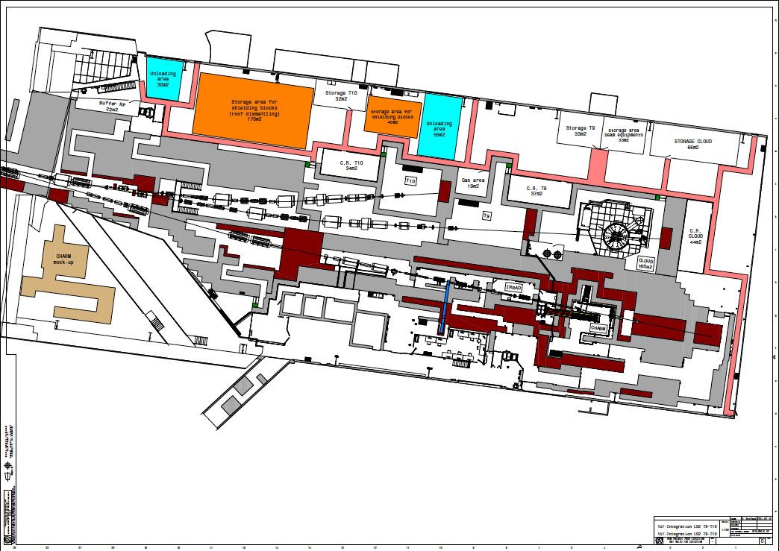
Without T11

Slide 9
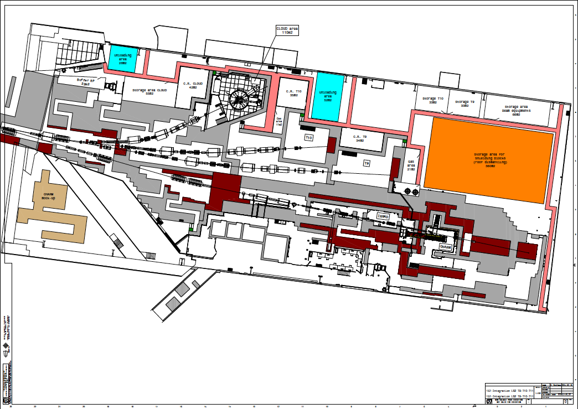
With T11

Slide 10
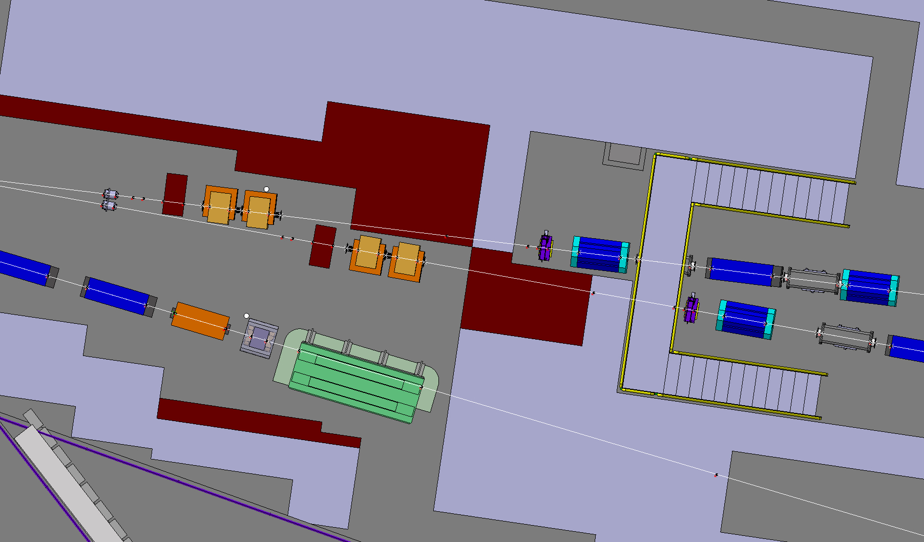
Without T11

Slide 11
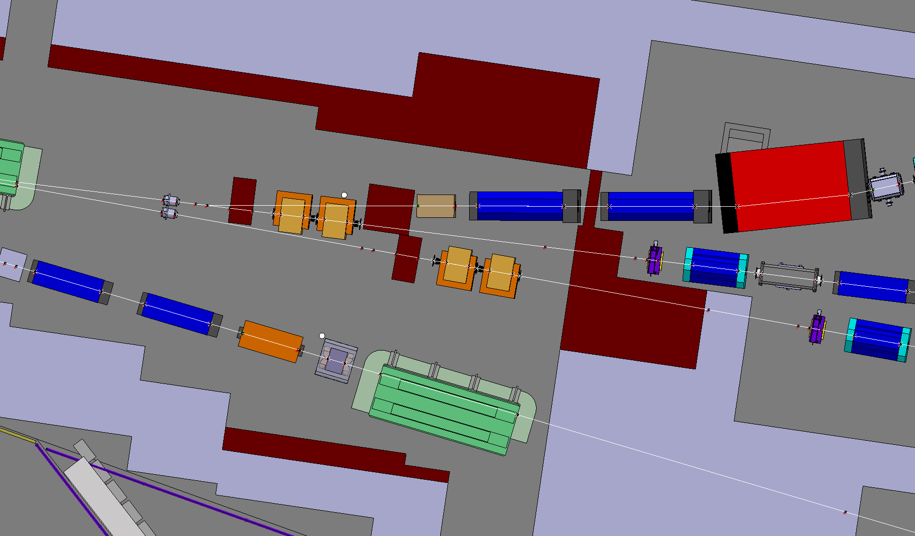
With T11

Slide 12
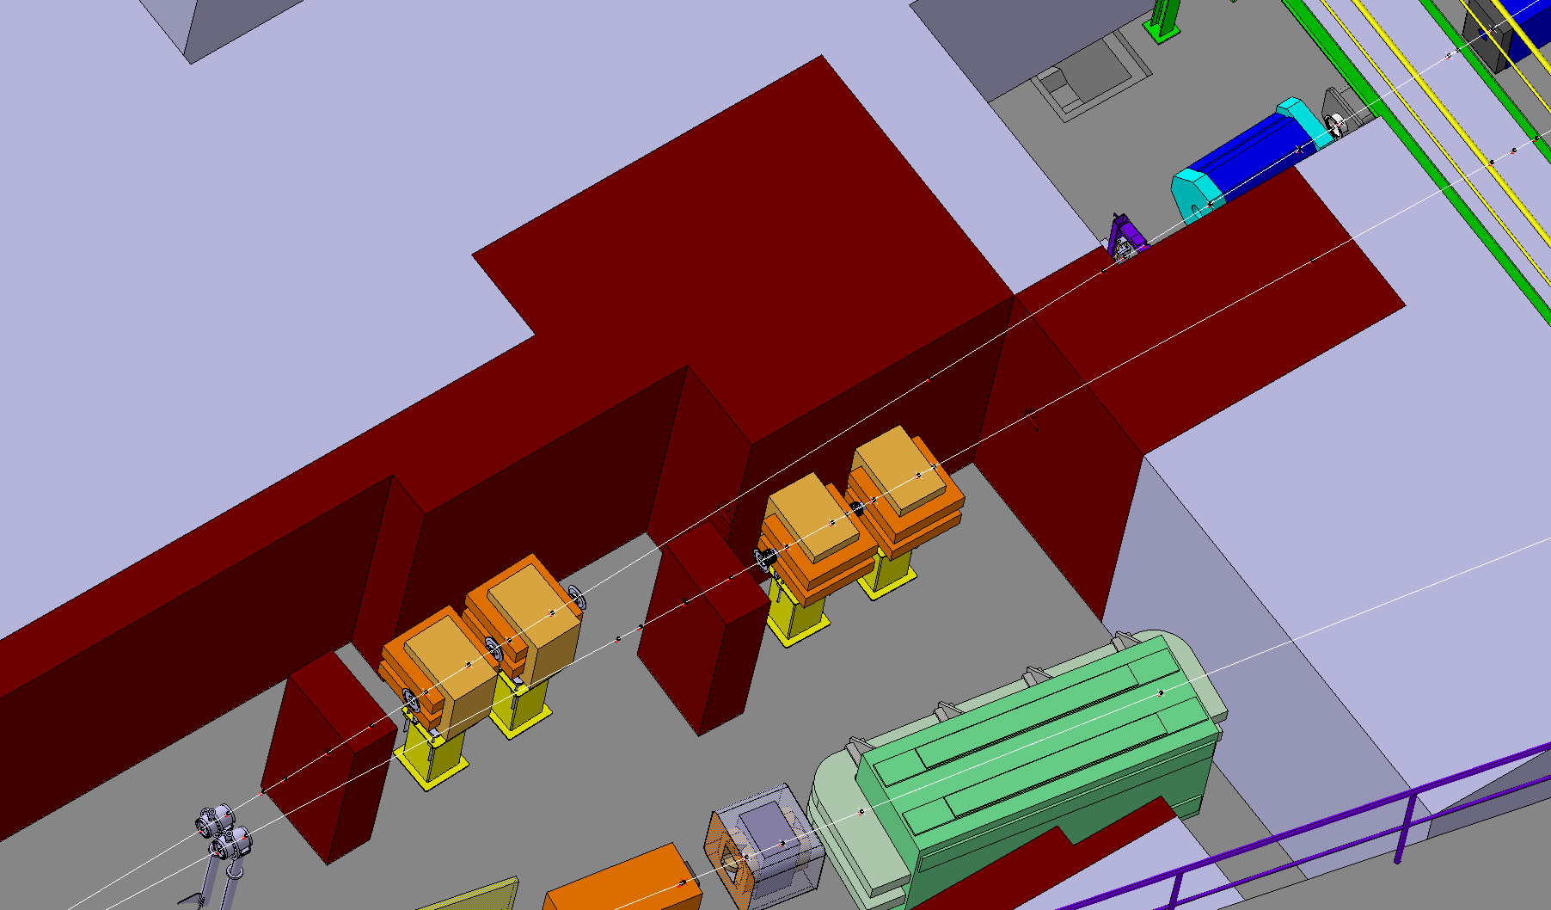
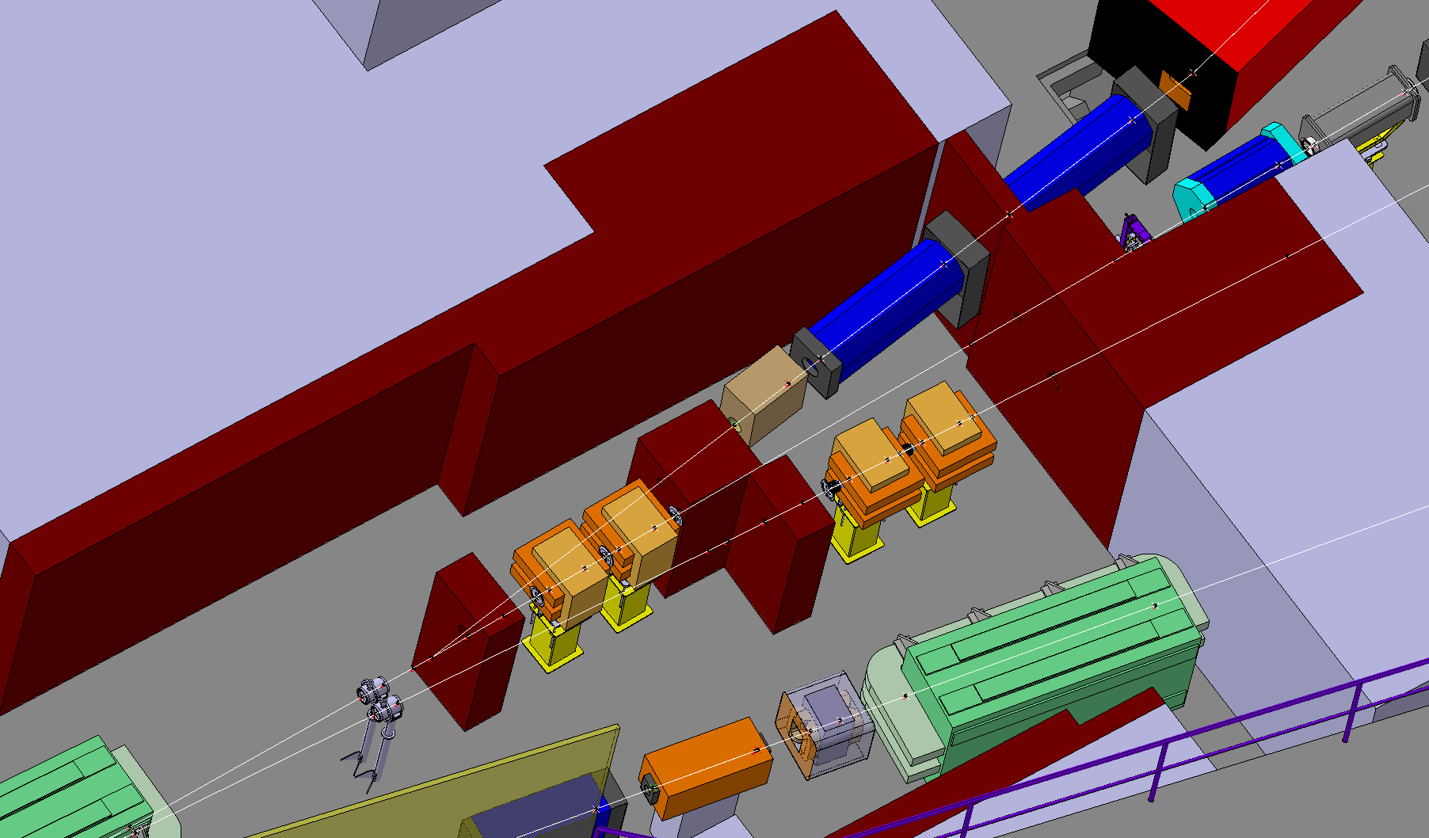

Slide 13
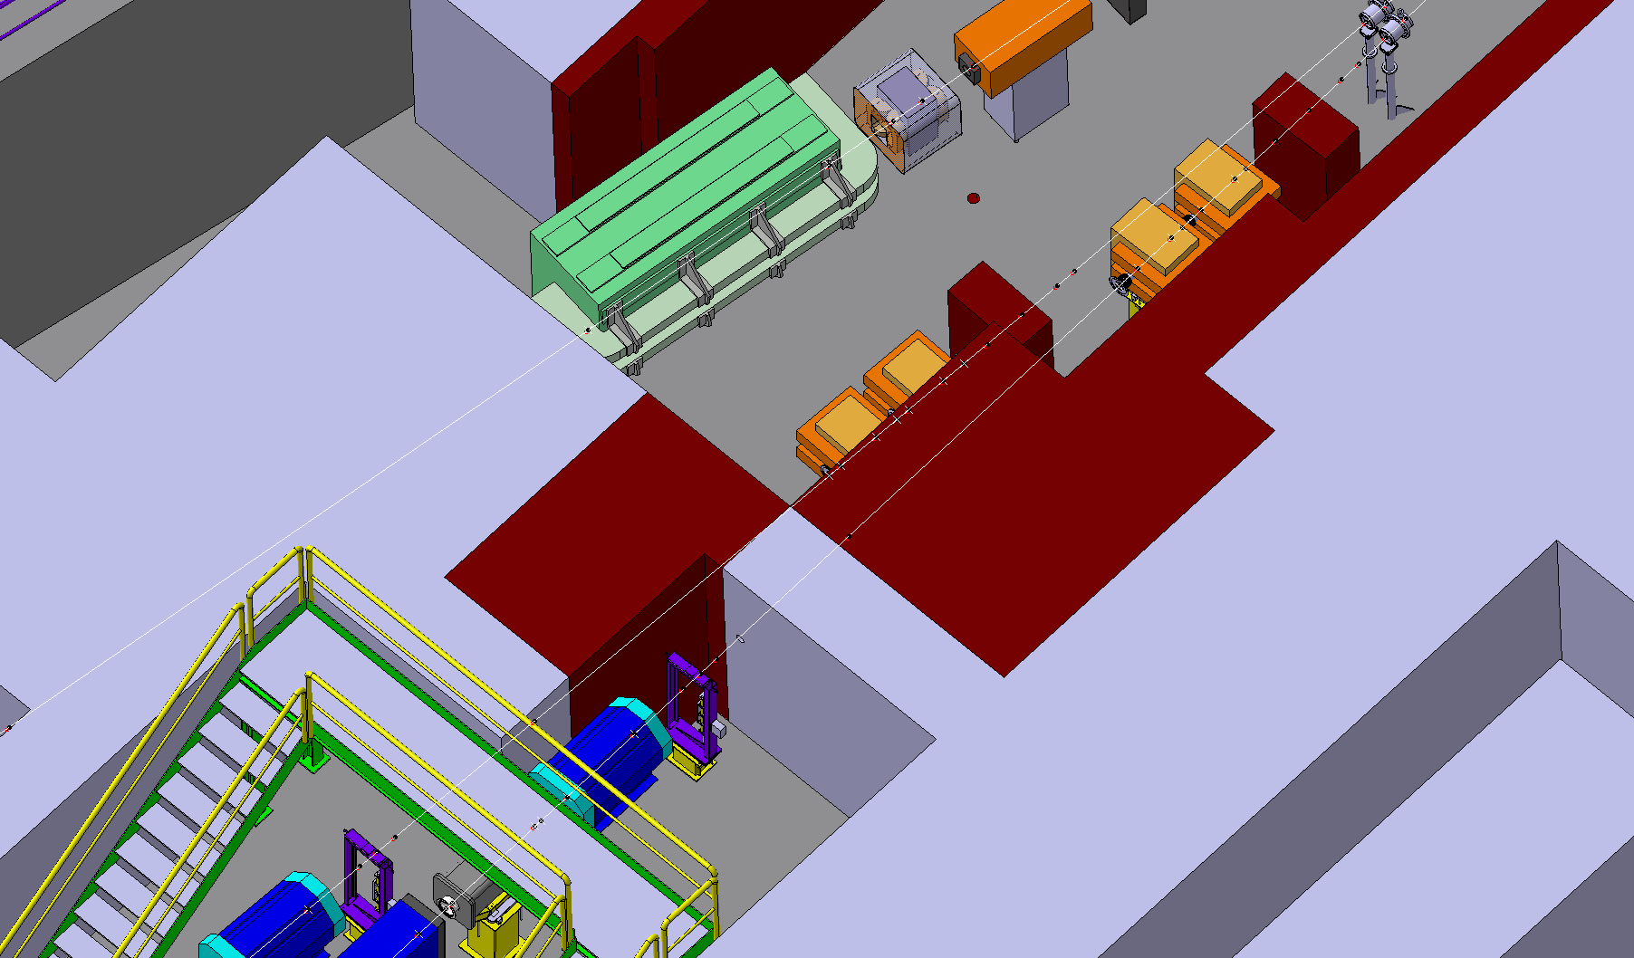
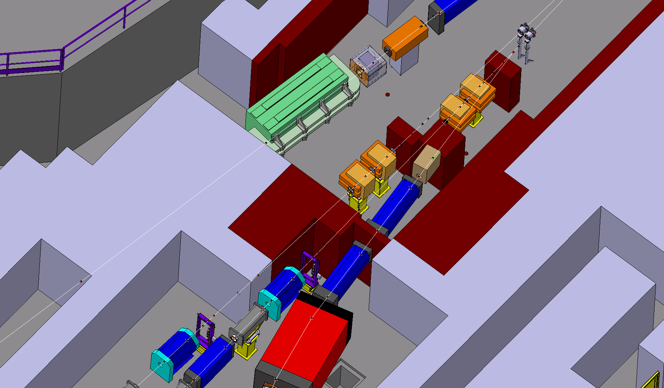

Slide 14
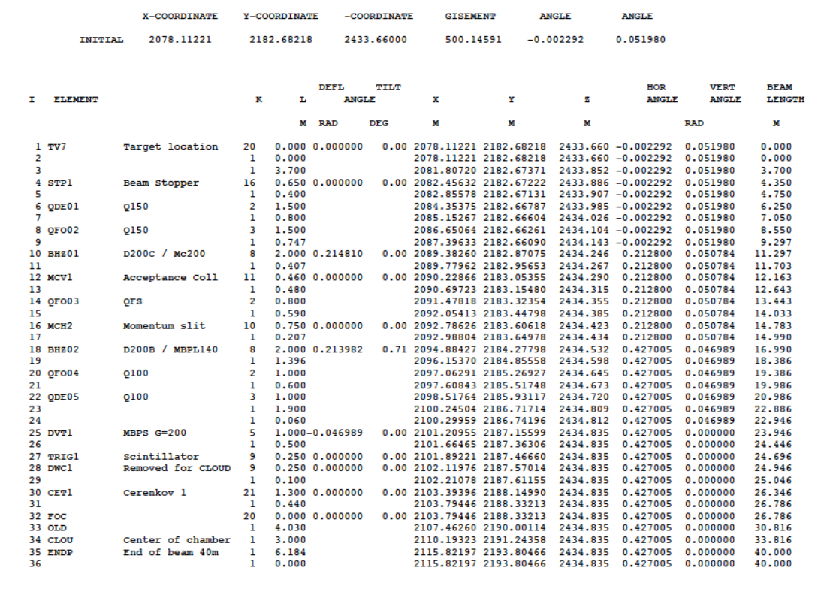
Beatch for new T11 beam line

Slide 15
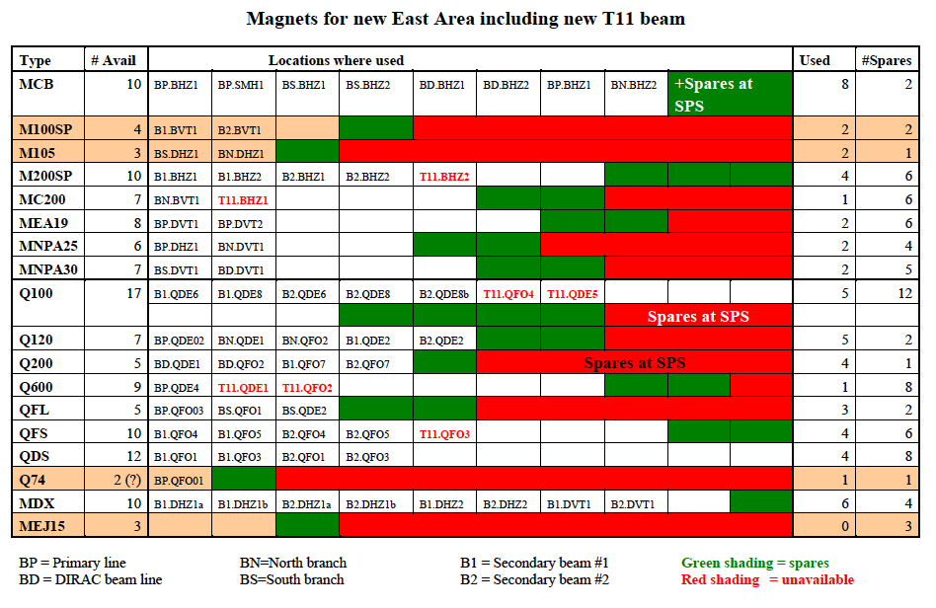

Slide 16
Currents new T11
Magnet | Type | Type for BL/GL | GL/BL max (T or Tm) | I max (Amps)
QDE1 | Q600 | Q150 | 5.85 | 400
QFO2 | Q600 | Q150 | 6.10 | 400
BHZ01 | Mc200 | D200c | 2.51 | 700
QFO3 | QFS | QFS | 9.3 | 300
BHZ2 | MBPL | MBPL140 | 2.50 | 500
QFO4 | Q100 | QPS | 9.4 | 600
QDE5 | Q100 | QPS | 10.5 | 600
BVT1 | M100 | MBPS200 | 1.0 | 500
The I max includes a reasonable margin for tuning

Slide 17
Pulsing magnets
It was pointed out by J.Cottet and J.P.Burnet that a lot of electrical power could be saved by pulsing the magnets in the East Area.
However, as many magnets are massive, they have to be replaced (at least their yokes) by laminated ones. This concerns all M100, M200, Q100, Q200 and possibly MDX magnets. The investment cost and lead time must be defined.
E.Montbarbon has shown that all M100m M200 can have 140 mm gap, except the last M100 in T11 (which could remain as it is).
The reduced power consumption is known but must be completed for the case with T11.
As the power consumption decreases, the requirements on electrical and cooling infrastructure decrease. As it has to be consolidated anyway, the cost savings must be evaluated for these items.

Slide 18
Timeline
Next meeting in about 3 weeks from now (around 21/04)
Come with your findings and confront with those of other groups
Final meeting: first week of May (around 6 May)
Agree on final document for circulation and approval
Any preferred time in the week?

Slide 19
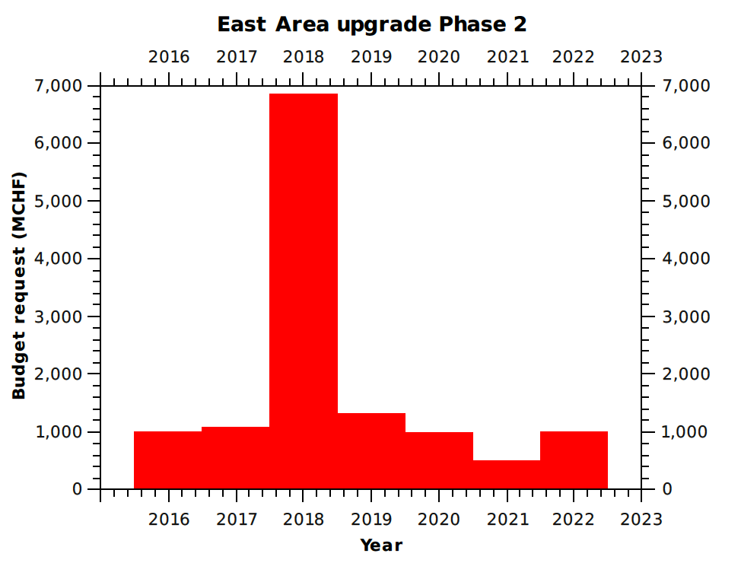
Where do we go from there
As a result of our studies we have to provide solutions and to get cost and manpower estimates as well as a spending profile
The preliminary spending profile has
a peak in LS2, not presently foreseen
(2012 estimates are shown)
Based on these numbers the
management can decide on
prioritisation of the consolidation
work between NA and EA
Preliminary

