Slide 1

East Area Consolidation
01 April 2015
Konstantinos Papastergiou
CERN Technology Department | Electrical Power Converters
With information by J-L. Blanc, G. Le Godec, J. Cottet and J-P Burnet

Slide 2
Previously discussed
The East Area Energy Consumption is high at 15GWh/yr
  Third highest consumer after PS (55GWh) and PS Booster (25GWh)
  Continuously energised BUT used < 4% of time for physics operations
  DC powering of magnets  unnecessary cooling requirements
Cycling the magnet current can save electricity
  Energy requirement from 11GWh to 0.6GWh per year
  Saving estimated at 600kCHF per year* for new EA configuration
Example of a self-funded project
  Extra cost originally estimated 3MCHF (Magnets+P. Conversion)
  Short investment depreciation time - approximately 5 years
New technology is being developed for transfer lines
* Source: J.Cottet, Energy Balance of the East Area and possible Improvements, 2012

Slide 3
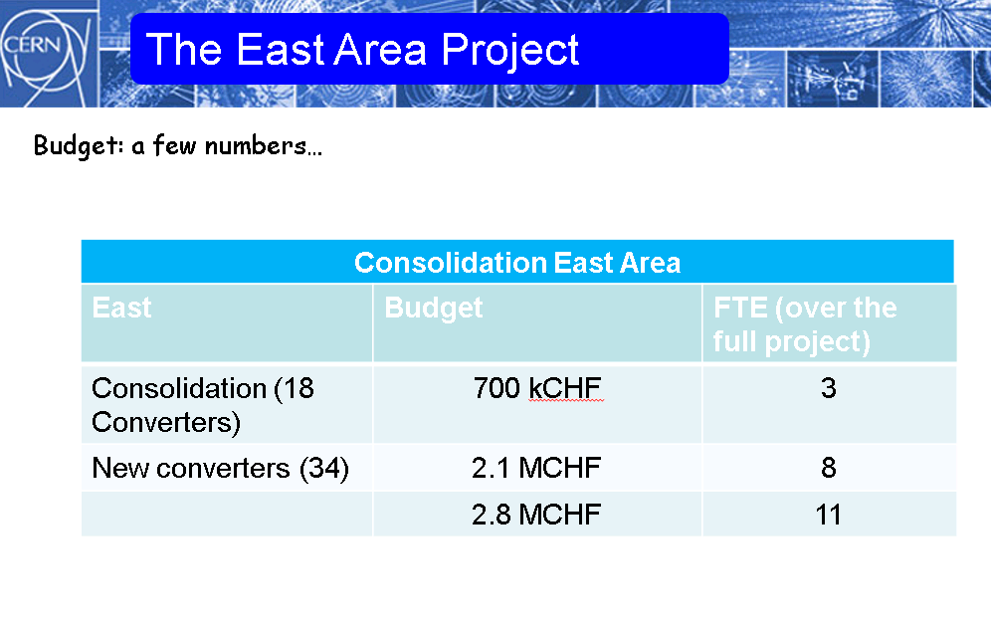
2012 proposal

Slide 4
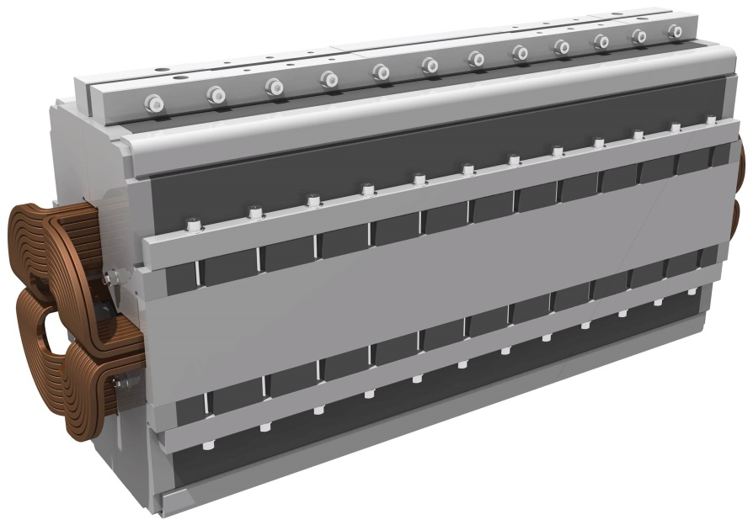
Cycling magnet operation
Cycling operation requires a di/dt through the magnet
  23/55 magnets do not support cycling due to a solid steel yoke
  Eddy currents would heat up the yoke material

Slide 5
Energy Consumption: detail
84%
12%
4%
Equipment | Energy in MWh
T8 Spectrometer | 6 360
T7 Spectrometer | NA
Building 251 | 5 386
SMH 57 AND 61 | 22
Building 263 | 1 303
5

Slide 6
Magnet refurbishment cost
Solution Elaborated by the Magnet Groups at CERN
replacement all the solid steel yokes by new laminated yokes while keeping the present coils
Type | Estimated Price magnet (kCHF) | Number of magnets | Total cost per family (kCHF)
MDX | 20 | 6 | 120
M100 | 70 | 2 | 140
M200 | 100 | 5 | 500
Q100 | 50 | 5 | 250
Q200 | 70 | 4 | 280
Q74 | 40 | 1 | 40
Total |  | 23 | 1.3 MCHF
Total magnet refurbishment cost is 1.3MCHF
Considerable cost – could it be financed by energy saving?

Slide 7
Pulsed Operation: consumption
FUTURE OPERATION (HYPOTHESIS)
Zone | number of cycle per Supercycle | duration in 2011 (in hr) | duty cycle
Total - East | 6 | 4301 | 15%
EASTA | 2 | 4301 | 5%
EASTA on T9 | 1 | 4301 | 2.5%
EASTA on T10 | 1 | 4301 | 2.5%
EASTB | 4 | 4044 | 10%
CALCULATION RESULTS: ENERGY-WATER CONSUMPTION
 | Pulsed Mode |  | Continuous Mode
 | Energy in MWh | Price in kCHF | Energy in MWh | Price in kCHF
Total magnet electrical consumption | 557 | 28.3 | 9 128 | 464
Water cooling electrical consumption | 79 | 4.0 | 1 294 | 66
Air cooling electrical consumption | 26 | 1.3 | 431 | 22
Total electricity consumption | 662 | 33.7 | 10 853 | 551.8
Total cooling fluid cost |  | 6.2 |  | 101.5
TOTAL energy cost |  | 40 kCHF  |  | 653 kCHF 

Slide 8

Direct versus Cycling operation
Magnet type | Total (1.2sec) | Recoverable | Thermal loss (1.2sec)
Quadrupole (26Gev) | 11kJ | 6kJ | 5kJ
Small Dipole (26Gev) | 31.5kJ | 25kJ | 6.5kJ
Large Dipole (26Gev) | 101kJ | 82kJ | 19kJ
Annual cost of electricity for 1kJ:
(Non-recoverable/consumed every 1.2seconds)
270-350 CHF*
* Assuming cost of electricity between 0.05 and 0.065CHF/kWh. 1kJ of energy over a 1.2sec cycle corresponds to 1kJ/1.2sec=0.83kW of average power. Assuming this 1.2sec (PS) cycle repeats for 24hours over 270 working days the total energy required from the power network (for each 1kJ) is 5378kWh/annum. If this energy is not recovered in capacitor banks after every magnet cycle it is returned to the power network and is not remunerated by the provider.

Slide 9
The System View
From DC to Cycling magnet current:
Reduction of power converter RMS rating by 40-45%
Reduction of power losses in magnets
Reduction of cooling requirements

Slide 10
Magnet Energy Recovery
Magnet Energy Recovery is a specific variant of power cycling in which energy is stored locally in the power converter instead of returning it to the grid

Slide 11
System Level Gains
(Cost: ~225CHF/kJ)
Benefits of energy recovery in the converter:
Significantly lower costs of grid interconnection equipment
Grid infrastructure standardisation/standard equipment
Lower capacity of reactive power compensation
Fault ride-through capability of power converters

Slide 12
Examples of converter standard bricks

Slide 13
Cycling Operation Impact
preliminary
figures
Cycling operation will raise the project costs:
  Magnet consolidation of solid steel yokes: 1.3MCHF
  Power Converter replacement costs will increase > 1.5MCHF (to 3M+)
    Power converter consolidation was already scheduled
  Electrical distribution costs will be lower
    2x2MVA transformers are sufficient to power the EAST Area (currently 8 transformers)
And will result recurring savings:
  Up to 10GWh/year
  Up to 600kCHF/year
…and a much smaller carbon footprint from the East Experimental Area
Depending on the level of consolidation desired the project additional costs be recovered in 5-10 years of operation (~4500h/yr)

Slide 14
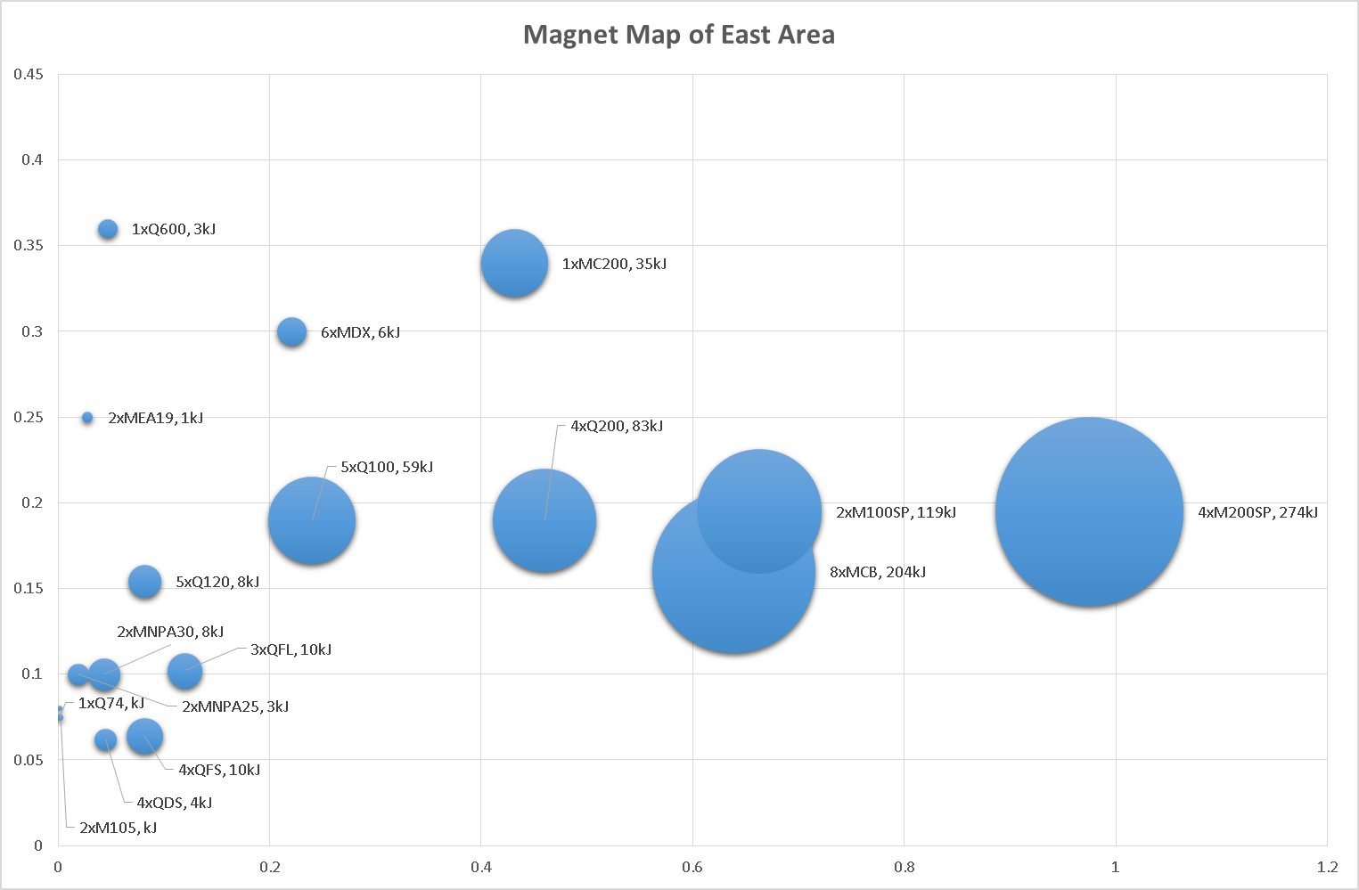
Magnet Map
preliminary
figures
110kCHF
12kCHF/yr*
* Accounting for magnet losses only

Slide 15
Introduce to key figures
Key cost drivers of the project (in the following order)
  8xMCB (800A_{pk}) (204kJ per circuit)
  4xM200SP (750A_{pk}) (274kJ per circuit)
  2xM100SP (600A_{pk}) (119kJ per circuit)
Converters with local energy recovery or mix of technologies?
Multiple or single scenario for P.Conversion budget?

Slide 16
Related documents
G.Le Godec, Energy Recovery and Modular Approach: introduction to a collaboration, TETM, CERN (EDMS 1295364)
J.Cottet, J-P.Burnet, Energy balance of the East Area and possible improvements, TETM, CERN
S.Rossini, K.Papastergiou, Magnet Energy Recovery: a review of topologies and energy management strategies, 2014, EDMS1450551
D.Tommasini, Practical definitions and formulae for magnets, CERN, Geneva (EDMS1162401)
K.Papastergiou, Functional Specification: Economy Mode Operation in Accelerator Transfer Lines, EDMS1493325
➲
➲
➲
➲

