Slide 1

Post-Processing of
Wall-Current-Monitor
Signals
By Kevin Luxem
BE-BI-PI

Slide 2
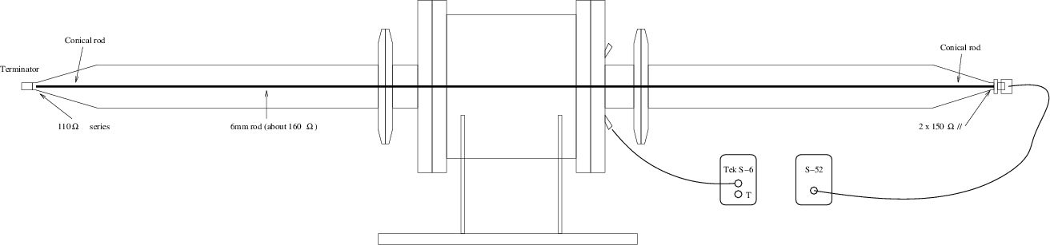
WCM-Setup
A rod inside the Wall-Current-Monitor is used to simulate the beam with the Tektronix S-52 - S-6 setup.

Slide 3
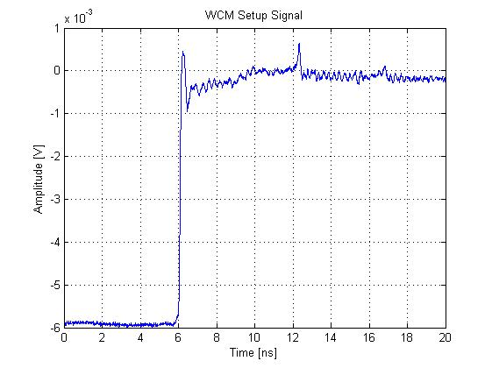
WCM-Setup
20%-80% Risetime: 70 ps

Slide 4

WCM-Setup
S - 52
WCM
S - 6
Yfull
$$Y_{full}=X_{test}∙H_{test}∙H_{wcm}∙H_{coax}$$
Yfull = Measured Signal from WCM-Setup
Xtest = Desired Signal Model for Test-Setup
Htest = Transfer-Function from Test Setup
Hwcm = Transfer-Function WCM
Hcoax = Transfer-Function Coaxial-Setup

Slide 5
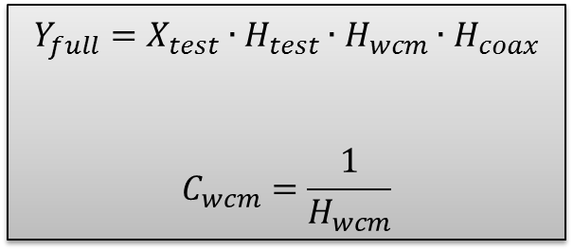
WCM-Setup
S - 52
WCM
S - 6
Yfull
$$Y_{full}=X_{test}∙H_{test}∙H_{wcm}∙H_{coax}$$
$$C_{wcm}=\frac{1}{H_{wcm}}$$
Yfull = Measured Signal from WCM-Setup
Xtest = Desired Signal Model for Test-Setup
Htest = Transfer-Function from Test Setup
Hwcm = Transfer-Function WCM
Hcoax = Transfer-Function Coaxial-Setup
Cwcm = WCM Correction-Function

Slide 6
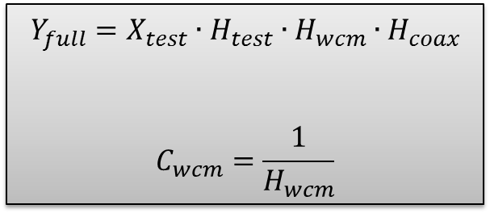
WCM-Setup
S - 52
WCM
S - 6
Yfull
$$Y_{full}=X_{test}∙H_{test}∙H_{wcm}∙H_{coax}$$
$$C_{wcm}=\frac{1}{H_{wcm}}$$
Yfull = Measured Signal from WCM-Setup
Xtest = Desired Signal Model for Test-Setup
Htest = Transfer-Function from Test Setup
Hwcm = Transfer-Function WCM
Hcoax = Transfer-Function Coaxial-Setup
Cwcm = WCM Correction-Function

Slide 7
WCM-Setup
S - 52
WCM
S - 6
Yfull
$$Y_{full}=X_{test}∙H_{test}∙H_{wcm}∙H_{coax}$$
$$C_{wcm}=\frac{1}{H_{wcm}}$$
Yfull = Measured Signal from WCM-Setup
Xtest = Desired Signal Model for Test-Setup
Htest = Transfer-Function from Test Setup
Hwcm = Transfer-Function WCM
Hcoax = Transfer-Function Coaxial-Setup
Cwcm = WCM Correction-Function

Slide 8
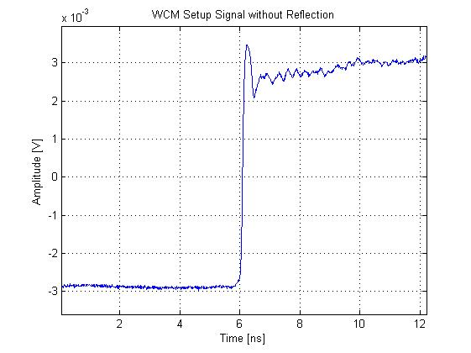
WCM-Setup
S - 52
WCM
S - 6
Yfull
$$Y_{full}=X_{test}∙H_{test}∙H_{wcm}∙H_{coax}$$
Hardware Problem
Yfull = Measured Signal from WCM-Setup
Xtest = Desired Signal Model for Test-Setup
Htest = Transfer-Function from Test Setup
Hwcm = Transfer-Function WCM
Hcoax = Transfer-Function Coaxial-Setup

Slide 9

Test-Setup
S - 52
S - 6
Ytest
$$Y_{test}=X_{test}∙H_{test}$$
$$H_{test}=\frac{Y_{test}}{X_{test}}$$
$$C_{test}=\frac{1}{H_{test}}$$
Ytest = Actual measured Signal
Xtest = Desired Signal Model for Test-Setup
Ctest = Correction-Function for Test-Setup
Htest = Transfer-Function from Test Setup

Slide 10
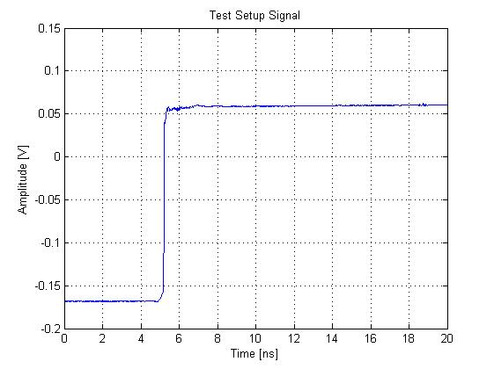
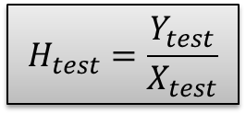
Test-Setup
S - 52
S - 6
Ytest
20%-80% Risetime: 28 ps
$$H_{test}=\frac{Y_{test}}{X_{test}}$$

Slide 11
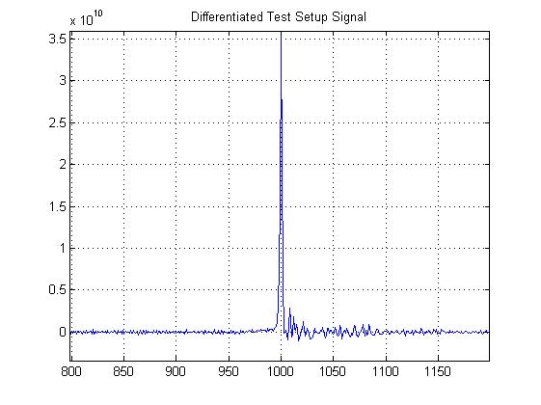
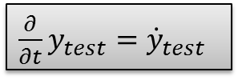
Test-Setup
$\frac{∂}{∂t}y_{test}={\dot{y}}_{test}$
2000 Sample points

Slide 12
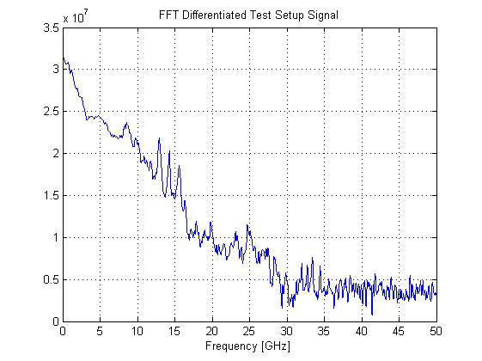

Test-Setup
$ℱ\left\{{\dot{y}}_{test}\right\}=Y_{test}$

Slide 13
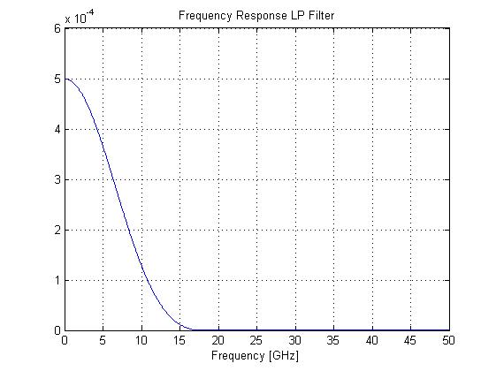
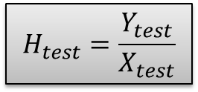
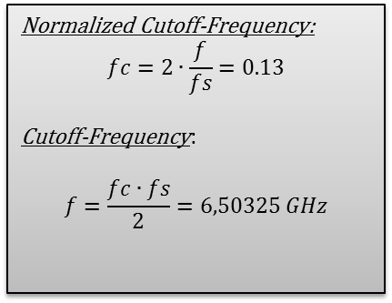
Test-Setup
Desired Signal Model Function Xtest
$$H_{test}=\frac{Y_{test}}{X_{test}}$$
Normalized Cutoff-Frequency:
$$fc=2∙\frac{f}{fs}=0.13$$
Cutoff-Frequency:
$$f=\frac{fc∙fs}{2}=6,50325 GHz$$

Slide 14
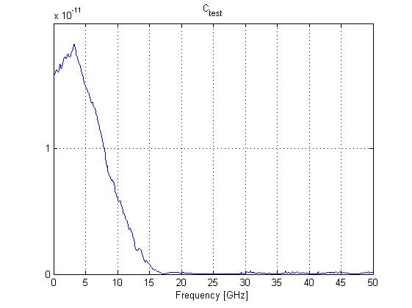

Test-Setup
Calculating Ctest
$$Y_{test}=X_{test}∙H_{test}$$
$H_{test}=\frac{Y_{test}}{X_{test}}$
$C_{test}=\frac{1}{H_{test}}=\frac{X_{test}}{Y_{test}}$
Ytest = Actual measured Signal
Xtest = Desired Signal Model for Test-Setup
Ctest = Correction-Function for Test-Setup
Htest = Transfer-Function from Test Setup

Slide 15
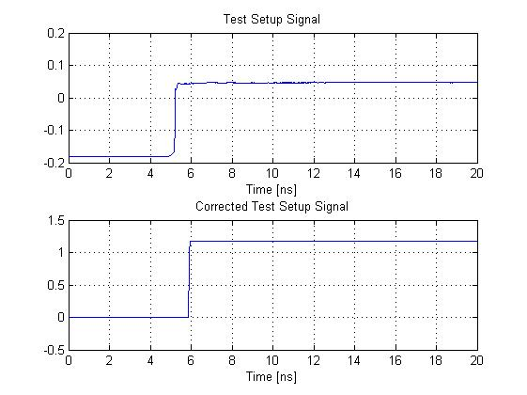
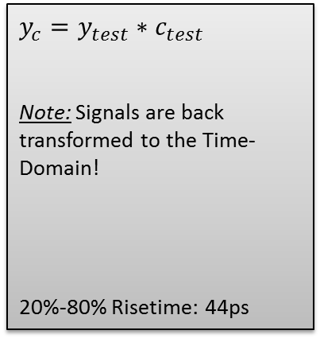
Test-Setup
Applying the Ctest Correction Function to the Signal Ytest by Convolution
$$y_{c}=y_{test}∗c_{test}$$
Note: Signals are back transformed to the Time-Domain!
20%-80% Risetime: 44ps

Slide 16

WCM-Correction-Function
S - 52
WCM
S - 6
Yfull
$$Y_{full}=X_{test}∙H_{test}∙H_{wcm}∙H_{coax}$$
Yfull = Measured Signal from WCM-Setup
Xtest = Desired Signal Model for Test-Setup
Htest = Transfer-Function from Test Setup
Hwcm = Transfer-Function WCM
Hcoax = Transfer-Function Coaxial-Setup

Slide 17
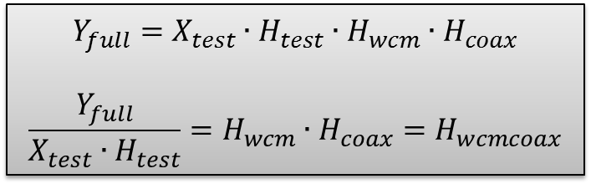
WCM-Correction-Function
S - 52
WCM
S - 6
Yfull
$$Y_{full}=X_{test}∙H_{test}∙H_{wcm}∙H_{coax}$$
$$\frac{Y_{full}}{X_{test}∙H_{test}}=H_{wcm}∙H_{coax}=H_{wcmcoax}$$
Yfull = Measured Signal from WCM-Setup
Xtest = Desired Signal Model for Test-Setup
Htest = Transfer-Function from Test Setup
Hwcm = Transfer-Function WCM
Hcoax = Transfer-Function Coaxial-Setup

Slide 18

WCM-Correction-Function 1
$$\frac{Y_{full}}{X_{test}∙H_{test}}=H_{wcm}∙H_{coax}=H_{wcmcoax}$$
$$C_{wcm}=\frac{1}{H_{wcmcoax}}=\frac{1}{H_{wcm}∙H_{coax}}$$
Yfull = Measured Signal from WCM-Setup
Xtest = Desired Signal Model for Test-Setup
Htest = Transfer-Function from Test Setup
Hwcm = Transfer-Function WCM
Hcoax = Transfer-Function Coaxial-Setup
Cwcm = WCM Correction Function

Slide 19
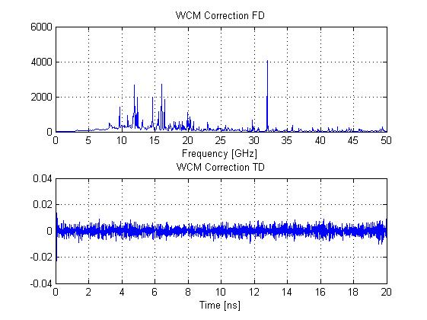
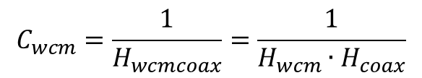
WCM-Correction-Function 1
$$C_{wcm}=\frac{1}{H_{wcmcoax}}=\frac{1}{H_{wcm}∙H_{coax}}$$

Slide 20
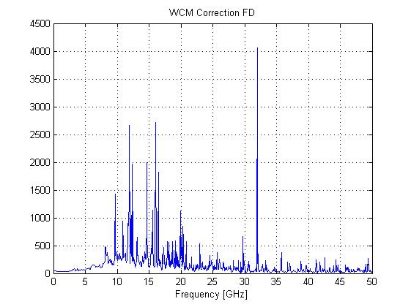
WCM-Correction-Function 1
$$C_{wcm}=\frac{1}{H_{wcmcoax}}=\frac{1}{H_{wcm}∙H_{coax}}$$

Slide 21
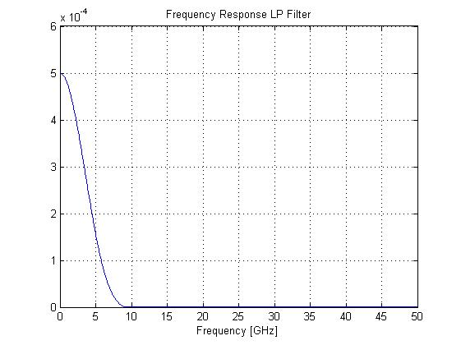
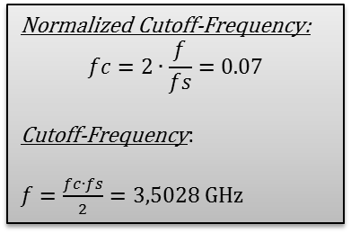
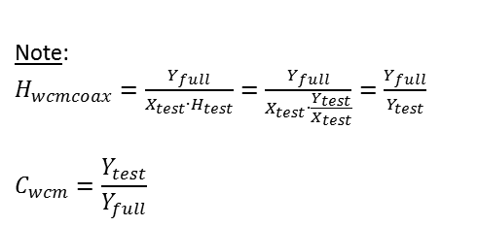
WCM-Correction-Function
If we apply an other lowpass Filter with a lower Cutoff-Frequency like below
Normalized Cutoff-Frequency:
$$fc=2∙\frac{f}{fs}=0.07$$
Cutoff-Frequency:
$f=\frac{fc∙fs}{2}=3,5028$ GHz
Note:
$H_{wcmcoax}=\frac{Y_{full}}{X_{test}∙H_{test}}=\frac{Y_{full}}{X_{test}∙\frac{Y_{test}}{X_{test}}}=\frac{Y_{full}}{Y_{test}}$
$$C_{wcm}=\frac{Y_{test}}{Y_{full}}$$
Lowpass Filter is abbreviated,
so a new Desired Signal Model
is needed!

Slide 22

WCM-Correction-Function
Now we have a WCM-Correction-Function:
$$C_{wcm}=\frac{D_{wcmcoax}}{H_{wcmcoax}}=\frac{D_{wcmcoax}}{H_{wcm}∙H_{coax}}=\frac{D_{wcmcoax}∙Y_{test}}{Y_{full}}$$
Note: Hcoax is supposed to be close to unity!
Cwcm = WCM Correction Function
Dwcmcoax = Desired Signal Model for the WCM Setup
Hwcm = Transfer-Function WCM
Hcoax = Transfer-Function Coaxial-Setup
Ytest = Actual measured Signal Test Setup
Yfull = Actual measured Signal WCM Setup

Slide 23
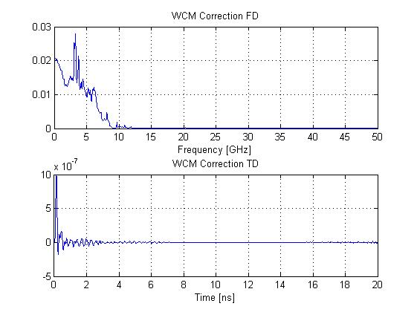
WCM-Correction-Function 2
$$C_{wcm}=\frac{D_{wcmcoax}}{H_{wcmcoax}}=\frac{D_{wcmcoax}}{H_{wcm}∙H_{coax}}$$

Slide 24
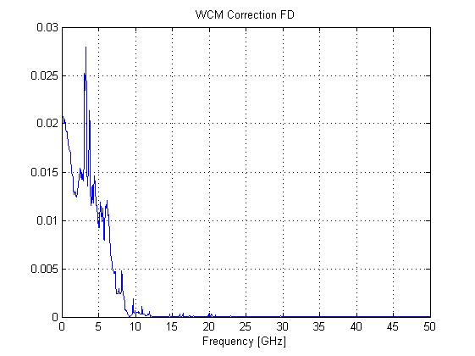
WCM-Correction-Function 2
$$C_{wcm}=\frac{D_{wcmcoax}}{H_{wcmcoax}}=\frac{D_{wcmcoax}}{H_{wcm}∙H_{coax}}$$

Slide 25
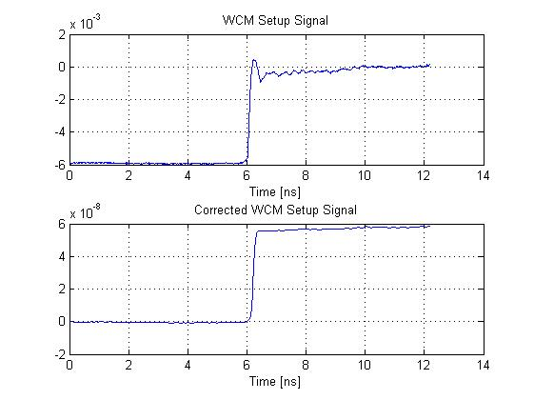
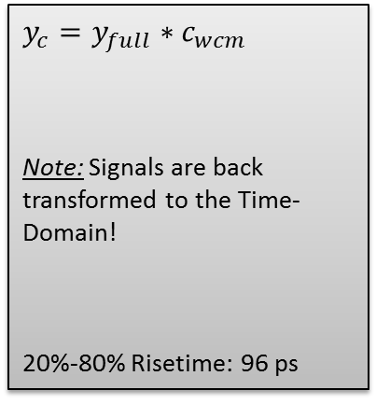
WCM-Correction-Function 2
Applying the Cwcm Correction Function to the Signal Yfull by Convolution:
$$y_{c}=y_{full}∗c_{wcm}$$
Note: Signals are back transformed to the Time-Domain!
20%-80% Risetime: 96 ps

Slide 26
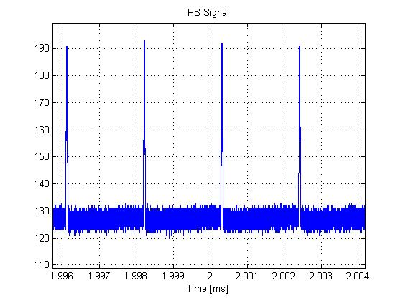
PS-Signal

Slide 27
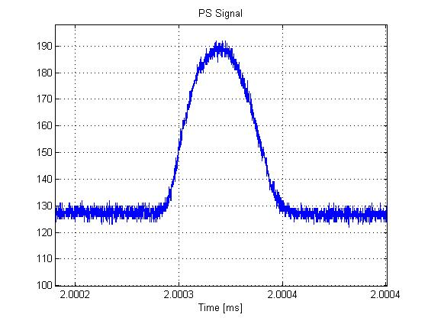
PS-Signal

Slide 28
PS-Signal
Thanks for your Attention!

