Slide 1
Introduction to data management
Alberto Pace

Slide 2
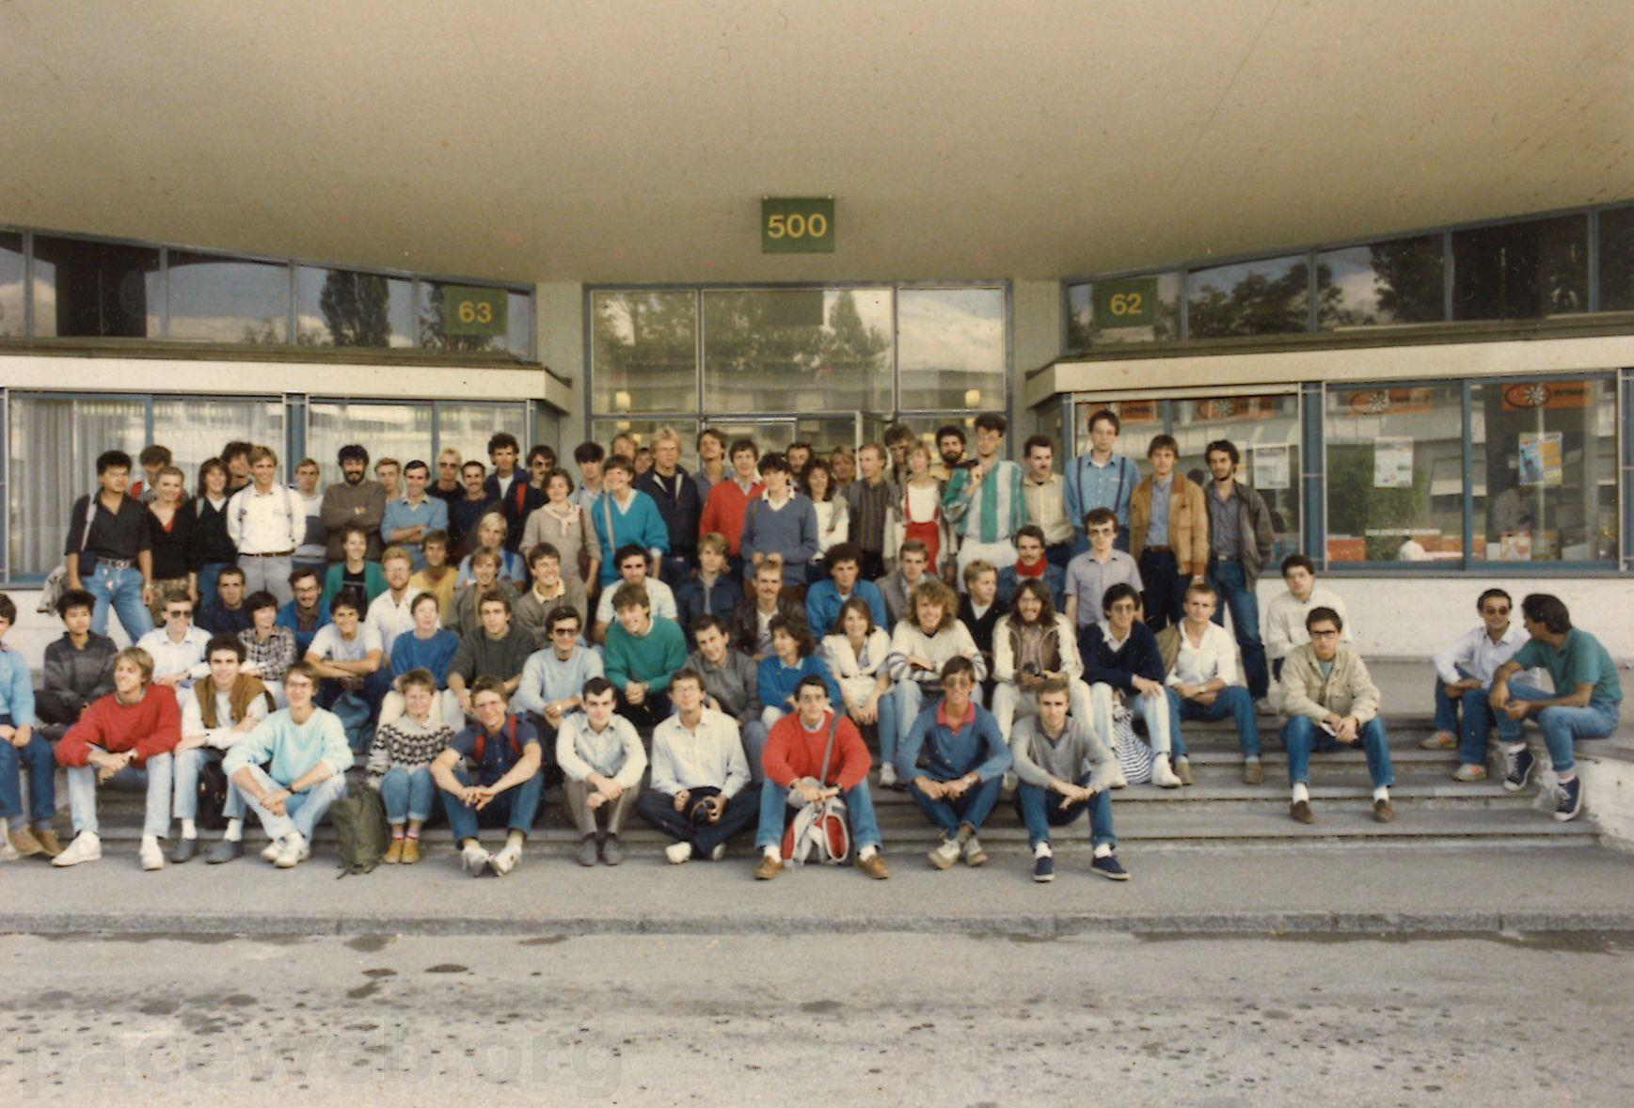

Slide 3


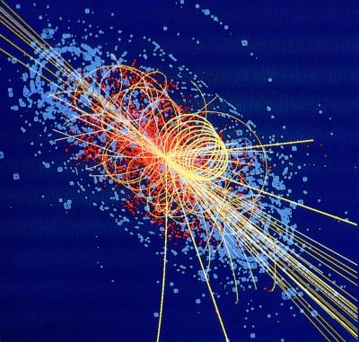

The mission of CERN
We are here
?
Discovery
Accelerating particle beams
Detecting particles
(experiments)
Large-scale computing (Analysis)

Slide 4
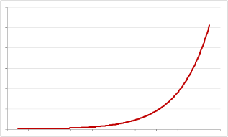
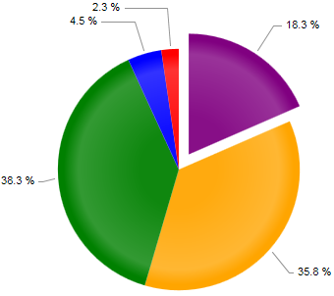
The need for computing in research
Scientific research in recent years has exploded the computing requirements
  Computing has been the strategy to reduce the cost of traditional research
  Computing has opened new horizons of research not only in High Energy Physics
  At constant cost, exponential growth of performances
  Return in computing investment higher than other fields: Budget available for computing increased, growth is more than exponential

Slide 5
The need for storage in computing
Scientific computing for large experiments is typically based on a distributed infrastructure
Storage is one of the main pillars
Storage requires Data Management…
Scientific Computing
DATA
CPU
NET

Slide 6
“Why” data management ?
Data Management solves the following problems
  Data reliability
  Access control
  Data distribution
  Data archives, history, long term preservation
  In general:
    Empower the implementation of a workflow for data processing

Slide 7
Can we make it simple ?
A simple storage model: all data into the same container
  Uniform, simple, easy to manage, no need to move data
  Can provide sufficient level of performance and reliability
“Cloud” Storage
For large repositories,
it is too simplistic !

Slide 8
Why multiple pools and quality ?
Derived data used for analysis and accessed by thousands of nodes
  Need high performance, Low cost, minimal reliability (derived data can be recalculated)
Raw data that need to be analyzed
    Need high performance, High reliability, can be expensive (small sizes)
Raw data that has been analyzed and archived
    Must be low cost (huge volumes), High reliability (must be preserved), performance not necessary

Slide 9
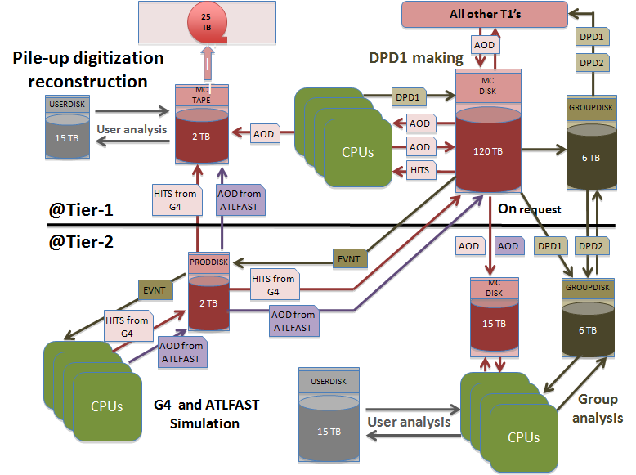
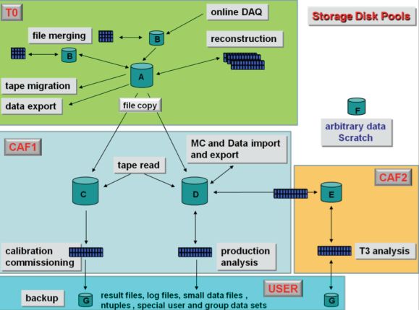
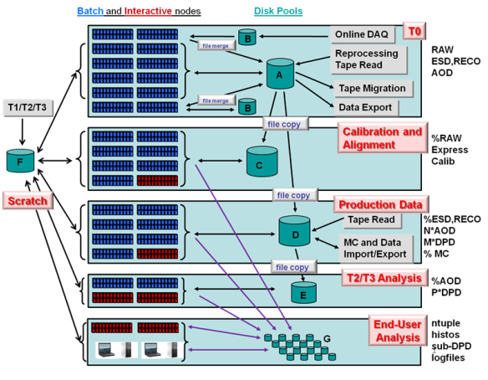
So, … what is data management ?
Examples from LHC experiment data models
Two building blocks to empower data processing
  Data pools with different quality of services
  Tools for data transfer between pools

Slide 10
Data pools
Different quality of services
  Three parameters: (Performance, Reliability, Cost)
  You can have two but not three
Expensive
Flash, Solid State Disks
Mirrored disks
Tapes
Disks
Slow
Unreliable

Slide 11
But the balance is not as simple
Many ways to split (performance, reliability, cost)
Performance has many sub-parameters
Cost has many sub-parameters
Reliability has many sub-parameters
Performance
Cost
Reliability
Scalability
Electrical consumption
Latency /
Throughput
Ops Cost
(manpower)
Consistency
HW cost

Slide 12
And reality is complicated
Key requirements: Simple, Scalable, Consistent, Reliable, Available, Manageable, Flexible, Performing, Cheap, Secure.
Aiming for “à la carte” services (storage pools) with on-demand “quality of service”
And where is scalability ?

Slide 13
Areas of research in
Data Management
Reliability, Scalability, Security, Manageability

Slide 14
Storage Reliability
Reliability is related to the probability to lose data
  Def: “the probability that a storage device will perform an arbitrarily large number of I/O operations without data loss during a specified period of time”
Reliability of the “service” depends on the environment (energy, cooling, people, ...)
  Will not discuss this further
Reliability of the “service” starts from the reliability of the underlying hardware
  Example of disk servers with simple disks: reliability of service = reliability of disks
But data management solutions can increase the reliability of the hardware at the expenses of performance and/or additional hardware / software
  Disk Mirroring
  Redundant Array of Inexpensive Disks (RAID)

Slide 15

Hardware reliability
Do we need tapes ?
Tapes have a bad reputation in some use cases
  Slow in random access mode
    high latency in mounting process and when seeking data (F-FWD, REW)
  Inefficient for small files (in some cases)
  Comparable cost per (peta)byte as hard disks
Tapes have also some advantages
  Fast in sequential access mode
    > 2x faster than disk, with physical read after write verification
  Several orders of magnitude more reliable than disks
    Few hundreds GB loss per year on 80 PB tape repository
    Few hundreds TB loss per year on 50 PB disk repository
  No power required to preserve the data
  Less physical volume required per (peta)byte
  Inefficiency for small files issue resolved by recent developments
  Nobody can delete hundreds of PB in minutes
Bottom line: if not used for random access, tapes have a clear role in the architecture

Slide 16

Reminder: types of RAID
RAID0
  Disk striping
RAID1
  Disk mirroring
RAID5
  Parity information is distributed across all disks
RAID6
  Uses Reed–Solomon error correction, allowing the loss of 2 disks in the array without data loss
http://en.wikipedia.org/wiki/RAID

Slide 17
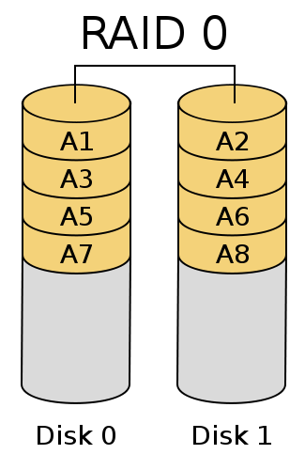
Reminder: types of RAID
RAID0
  Disk striping
RAID1
  Disk mirroring
RAID5
  Parity information is distributed across all disks
RAID6
  Uses Reed–Solomon error correction, allowing the loss of 2 disks in the array without data loss
http://en.wikipedia.org/wiki/RAID

Slide 18
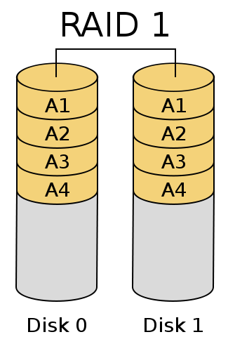
Reminder: types of RAID
RAID0
  Disk striping
RAID1
  Disk mirroring
RAID5
  Parity information is distributed across all disks
RAID6
  Uses Reed–Solomon error correction, allowing the loss of 2 disks in the array without data loss
http://en.wikipedia.org/wiki/RAID

Slide 19
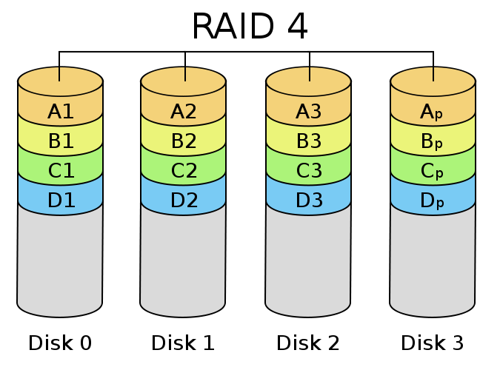
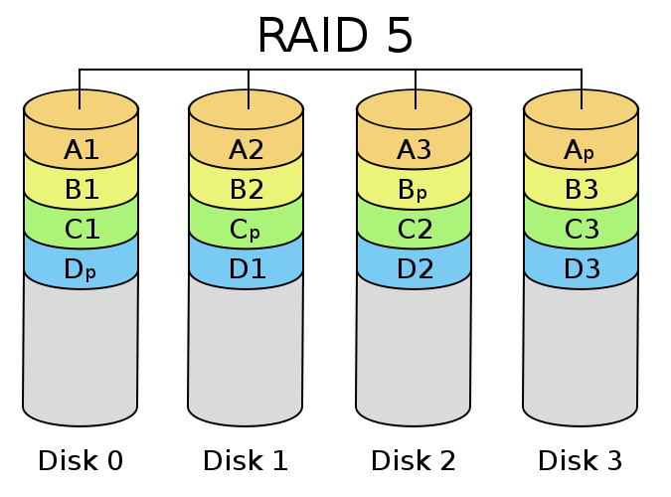
Reminder: types of RAID
RAID0
  Disk striping
RAID1
  Disk mirroring
RAID5
  Parity information is distributed across all disks
RAID6
  Uses Reed–Solomon error correction, allowing the loss of 2 disks in the array without data loss
http://en.wikipedia.org/wiki/RAID

Slide 20
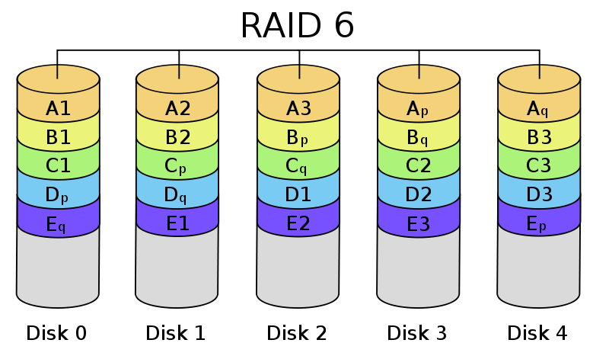
Reminder: types of RAID
RAID0
  Disk striping
RAID1
  Disk mirroring
RAID5
  Parity information is distributed across all disks
RAID6
  Uses Reed–Solomon error correction, allowing the loss of 2 disks in the array without data loss
http://en.wikipedia.org/wiki/RAID

Slide 21
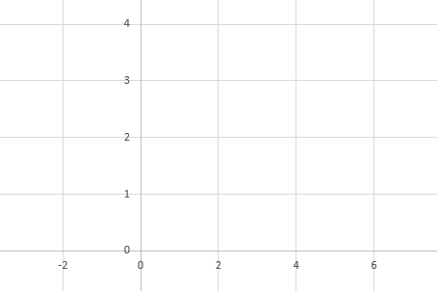
Understanding error correction
A line is defined by 2 numbers: a, b
  (a, b) is the information
  y = ax + b
Instead of transmitting a and b, transmit some points on the line at known abscissa. 2 points define a line. If I transmit more points, these should be aligned.
2 points
3 points
4 points

Slide 22
If we lose some information …
If we transmit more than 2 points, we can lose any point, provided the total number of point left is >= 2
?
1 point instead of 2
information lost
2 points instead of 3
2 or 3 points instead of 4

Slide 23
If we have an error …
If there is an error, I can detect it if I have transmitted more than 2 points, and correct it if have transmitted more than 3 points
?
Information lost
(and you do not notice)
Error detection
Information is lost
(and you notice)
Error correction
Information is recovered

Slide 24
If you have checksumming on data …
You can detect errors by verifying the consistency of the data with the respective checksums. So you can detect errors independently.
… and use all redundancy for error correction
?
Information lost
(and you notice)
Error correction
Information is recovered
2 Error corrections possible
Information is recovered

Slide 25
Reed–Solomon error correction …
.. is an error-correcting code that works by oversampling (by n points) a polynomial constructed from the data
Any m distinct points uniquely determine a polynomial of degree, at most, m − 1
The sender determines the polynomial (of degree m − 1), that represents the m data points. The polynomial is "encoded" by its evaluation at n+m points. If during transmission, the number of corrupted values is < n the receiver can recover the original polynomial.
Implementation examples:
  n = 0 no redundancy
  n = 1 is Raid 5 (parity)
  n = 2 is Raid 6 (Reed Solomon, double / diagonal parity)
  n = 3 is … (Triple parity)
http://en.wikipedia.org/wiki/Reed-Solomon

Slide 26
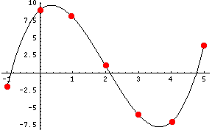
Reed–Solomon (simplified) Example
4 Numbers to encode: { 1, -6, 4, 9 } (m=4)
polynomial of degree 3 (m − 1):
We encode the polynomial with n + m = 7 points
{ -2, 9, 8, 1, -6, -7, 4 }
y = x³ - 6x² + 4x + 9

Slide 27
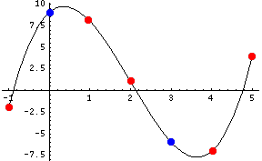
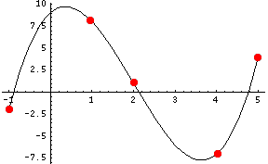
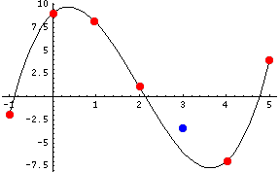
Reed–Solomon (simplified) Example
To reconstruct the polynomial, any 4 points are enough: we can lose any 3 points.
We can have an error on any 2 points that can be corrected: We need to identify the 5 points “aligned” on the only one polynomial of degree 3 possible
http://kernel.org/pub/linux/kernel/people/hpa/raid6.pdf

Slide 28
Error detection vs Error correction
With Reed-Solomon:
  If the number of corrupted values is = n we can only detect the error
  If the number of corrupted values is < n we can correct the error
However, by adding a checksum or hash on each point, we can individually identify the corrupted values
  If checksum has been added, Reed-Solomon can correct corrupted values ≤ n

Slide 29
Reliability calculations
With RAID, the final reliability depends on several parameters
  The reliability of the hardware
  The type of RAID
  The number of disks in the set
Already this gives lot of flexibility in implementing arbitrary reliability

Slide 30
Raid 5 reliability
  Disk are regrouped in sets of equal size. If c is the capacity of the disk and n is the number of disks, the sets will have a capacity of
  c (n-1)
  example: 6 disks of 1TB can be aggregated to a “reliable” set of 5TB
  The set is immune to the loss of 1 disk in the set. The loss of 2 disks implies the loss of the entire set content.

Slide 31
Some calculations for Raid 5
Disks MTBF is between 3 x 10⁵ and 1.2 x 10⁶ hours
Replacement time of a failed disk is < 4 hours
Probability of 1 disk to fail within the next 4 hours

Slide 32
Some calculations for Raid 5
Disks MTBF is between 3 x 10⁵ and 1.2 x 10⁶ hours
Replacement time of a failed disk is < 4 hours
Probability of 1 disk to fail within the next 4 hours
Probability to have a failing disk in the next 4 hours in a 15 PB computer centre (15’000 disks)

Slide 33
Some calculations for Raid 5
Disks MTBF is between 3 x 10⁵ and 1.2 x 10⁶ hours
Replacement time of a failed disk is < 4 hours
Probability of 1 disk to fail within the next 4 hours
Probability to have a failing disk in the next 4 hours in a 15 PB computer centre (15’000 disks)
Imagine a Raid set of 10 disks. Probability to have one of the remaining disk failing within 4 hours
p( A and B ) = p(A) * p(B/A)
if A,B independent : p(A) * p(B)

Slide 34
Some calculations for Raid 5
Disks MTBF is between 3 x 10⁵ and 1.2 x 10⁶ hours
Replacement time of a failed disk is < 4 hours
Probability of 1 disk to fail within the next 4 hours
Probability to have a failing disk in the next 4 hours in a 15 PB computer centre (15’000 disks)
Imagine a Raid set of 10 disks. Probability to have one of the remaining disk failing within 4 hours
However the second failure may not be independent from the first one. There is no way to calculate this probability ! We can arbitrarily increase it by two orders of magnitude to account the dependencies (over temperature, high noise, EMP, high voltage, faulty common controller, ....)
p( A and B ) = p(A) * p(B/A)
if A,B independent : p(A) * p(B)

Slide 35
Some calculations for Raid 5
Disks MTBF is between 3 x 10⁵ and 1.2 x 10⁶ hours
Replacement time of a failed disk is < 4 hours
Probability of 1 disk to fail within the next 4 hours
Probability to have a failing disk in the next 4 hours in a 15 PB computer centre (15’000 disks)
Imagine a Raid set of 10 disks. Probability to have one of the remaining disk failing within 4 hours
However the second failure may not be independent from the first one. There is no way to calculate this probability ! We can arbitrarily increase it by two orders of magnitude to account the dependencies (over temperature, high noise, EMP, high voltage, faulty common controller, ....)
Probability to lose computer centre data in the next 4 hours
Probability to lose data in the next 10 years
p( A and B ) = p(A) * p(B/A)
if A,B independent : p(A) * p(B)

Slide 36
Raid 6 reliability
  Disk are regrouped in sets of arbitrary size. If c is the capacity of the disk and n is the number of disks, the sets will have a capacity of
  c (n-2)
  example: 12 disks of 1TB can be aggregated to a “reliable” set of 10TB
  The set is immune to the loss of 2 disks in the set. The loss of 3 disks implies the loss of the entire set content.

Slide 37
Same calculations for Raid 6
Probability of 1 disk to fail within the next 4 hours
Imagine a raid set of 10 disks. Probability to have one of the remaining 9 disks failing within 4 hours (increased by two orders of magnitudes)
Probability to have another of the remaining 8 disks failing within 4 hours (also increased by two orders of magnitudes)
Probability to lose data in the next 4 hours
Probability to lose data in the next 10 years

Slide 38
Arbitrary reliability
RAID is “disks” based. This lacks of granularity
For increased flexibility, an alternative would be to use files ... but files do not have constant size
File “chunks” (or “blocks”) is the solution
  Split files in chunks of size “s”
  Group them in sets of “m” chunks
  For each group of “m” chunks, generate “n” additional chunks so that
    For any set of “m” chunks chosen among the “m+n” you can reconstruct the missing “n” chunks
  Scatter the “m+n” chunks on independent storage
s
s
m
n

Slide 39
Arbitrary reliability with the “chunk” based solution
The reliability is independent form the size “s” which is arbitrary.
  Note: both large and small “s” impact performance
Whatever the reliability of the hardware is, the system is immune to the loss of “n” simultaneous failures from pools of “m+n” storage chunks
  Both “m” and “n” are arbitrary. Therefore arbitrary reliability can be achieved
The fraction of raw storage space loss is n / (n + m)
Note that space loss can also be reduced arbitrarily by increasing m
  At the cost of increasing the amount of data loss if this would ever happen

Slide 40
Analogy with the gambling world
  We just demonstrated that you can achieve “arbitrary reliability” at the cost of an “arbitrary low” amount of disk space. This is possible because you increase the amount of data you accept loosing when this rare event happens.
  In the gambling world there are several playing schemes that allows you to win an arbitrary amount of money with an arbitrary probability.
  Example: you can easily win 100 Euros at > 99 % probability ...
    By playing up to 7 times on the “Red” of a French Roulette and doubling the bet until you win.
    The probability of not having a “Red” for 7 times is (19/37)⁷ = 0.0094)
    You just need to take the risk of loosing 12’700 euros with a 0.94 % probability
Amount |  | Win |  | Lost
Bet | Cumulated | Probability | Amount | Probability | Amount
100 | 100 | 48.65% | 100 | 51.35% | 100
200 | 300 | 73.63% | 100 | 26.37% | 300
400 | 700 | 86.46% | 100 | 13.54% | 700
800 | 1500 | 93.05% | 100 | 6.95% | 1500
1600 | 3100 | 96.43% | 100 | 3.57% | 3100
3200 | 6300 | 98.17% | 100 | 1.83% | 6300
6400 | 12700 | 99.06% | 100 | 0.94% | 12700

Slide 41
Practical comments
m=6
n can be …
  1 = Parity
  2 = Parity + Reed-Solomon, double parity
  3 = Reed Solomon, ZFS triple parity
m chunks of any (m + n) sets are enough to obtain the information. Must be saved on independent media
  Performance can depend on m (and thus on s, the size of the chunks): The larger m is, the more the reading can be parallelized
  Until the client bandwidth is reached
For n > 2 Reed Solomon has a computational impact affecting performances
  Alternate encoding algorithms are available requiring z chunks to reconstruct the data, being m < z < m+n (see example later on with LDPC).
  These guarantees high performance at the expenses of additional storage. When m=z we fall back in the “optimal” storage scenario
z=7
n=4
http://blogs.sun.com/ahl/entry/triple_parity_raid_z

Slide 42
Chunk transfers
Among many protocols, Bittorrent is the most popular
An SHA1 hash (160 bit digest) is created for each chunk
All digests are assembled in a “torrent file” with all relevant metadata information
Torrent files are published and registered with a tracker which maintains lists of the clients currently sharing the torrent’s chunks
In particular, torrent files have:
  an "announce" section, which specifies the URL of the tracker
  an "info" section, containing (suggested) names for the files, their lengths, the list of SHA-1 digests
Reminder: it is the client’s duty to reassemble the initial file and therefore it is the client that always verifies the integrity of the data received
http://en.wikipedia.org/wiki/BitTorrent_(protocol)

Slide 43
Cryptographic Hash Functions
A transformation that returns a fixed-size string, which is a short representation of the message from which it was computed
  Any (small) modification in the message generates a modification in the digest
Should be efficiently computable and impossible to:
  find a (previously unseen) message that matches a given digest
  find "collisions", wherein two different messages have the same message digest
Message or File
Message Digest
Message Hash
Digital fingerprint
This is the document created by Alice
Py75c%bn
SHA, MD5
Generate
Hash

Slide 44
Reassembling the chunks
Data reassembled directly on the client
(bittorrent client)
Reassembly done by the data management infrastructure
Middleware

Slide 45
Ensure integrity, identify corruptions
You must be able to identify broken files
  A hash is required for every file.
You must be able to identify broken chunks
  A hash for every chunk (example SHA1 160 bit digest) guarantees chunks integrity.
It tells you the corrupted chunks and allows you to correct n errors (instead of n-1 if you would not know which chunks are corrupted)
s
File hash
m
n
hash or checksum

Slide 46
Chunk size and physical blocks
The storage overhead of the checksum is typically of few hundred bytes and can be easily neglected compared to the chunk size that is of few megabytes.
To guarantee a high efficiency in transferring the chunks is essential that the sum of the chunk size with its checksum is an exact multiple or divisor of the physical block size of the storage
Avoid at all cost is to choose a chunk size equal to the physical disk block size leaving no space to save the checksum in the same physical block.
s
Correct chunk size (fits with checksum in phys.block)
Physical block size
incorrect chunk size (requires 2 phys.block)

Slide 47
Types of arbitrary reliability (summary)
Plain (reliability of the service = reliability of the hardware)

Slide 48
Types of arbitrary reliability (summary)
Plain (reliability of the service = reliability of the hardware)
Replication
  Reliable, maximum performance, but heavy storage overhead
  Example: 3 copies, 200% overhead
{
100%
300%
Any of the 3 copies is enough to reconstruct the data
checksum

Slide 49
Types of arbitrary reliability (summary)
Double parity / Diagonal parity
  Example 4+2, can lose any 2, remaining 4 are enough to reconstruct, only 50 % storage overhead
Storage 150%
Data 100%
Any 4 of the 6 chunks can reconstruct the data
checksum

Slide 50
Types of arbitrary reliability (summary)
Plain (reliability of the service = reliability of the hardware)
Replication
  Reliable, maximum performance, but heavy storage overhead
  Example: 3 copies, 200% overhead
Reed-Solomon, double, triple parity, NetRaid5, NetRaid6
  Maximum reliability, minimum storage overhead
  Example 10+3, can lose any 3, remaining 10 are enough to reconstruct, only 30 % storage overhead
100%
130%
Any 10 of the 13 chunks are enough to reconstruct the data
checksum

Slide 51
Types of arbitrary reliability (summary)
Plain (reliability of the service = reliability of the hardware)
Replication
  Reliable, maximum performance, but heavy storage overhead
  Example: 3 copies, 200% overhead
Reed-Solomon, double, triple parity, NetRaid5, NetRaid6
  Maximum reliability, minimum storage overhead
  Example 10+3, can lose any 3, remaining 10 are enough to reconstruct, only 30 % storage overhead
Low Density Parity Check (LDPC) / Fountain Codes / Raptor Codes
  Excellent performance, more storage overhead
  Example: 8+6, can lose any 3, remaining 11 are enough to reconstruct, 75 % storage overhead (See next slide)

Slide 52
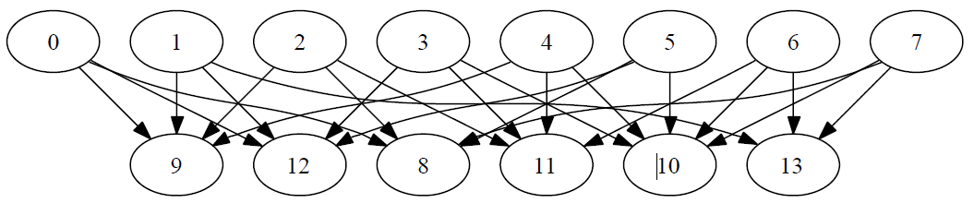
Example: 8+6 LDPC
0 .. 7: original data
8 .. 13: data xor-ed following the arrows in the graph
Any 11 of the 14 chunks are enough to reconstruct the data using only XOR operations (very fast)
100%
(original data size)
175%
(total size
on disk)
138%
(min size required
to reconstruct)
You are allowed to
lose any 3 chunks (21 %)
checksum

Slide 53
Types of arbitrary reliability (summary)
Plain (reliability of the service = reliability of the hardware)
Replication
  Reliable, maximum performance, but heavy storage overhead
  Example: 3 copies, 200% overhead
Reed-Solomon, double, triple parity, NetRaid5, NetRaid6
  Maximum reliability, minimum storage overhead
  Example 4+2, can lose any 2, remaining 4 are enough to reconstruct, 50 % storage overhead
  Example 10+3, can lose any 3, remaining 10 are enough to reconstruct, 30 % storage overhead
Low Density Parity Check (LDPC) / Fountain Codes
  Excellent performance, more storage overhead
  Example: 8+6, can lose any 3, remaining 11 are enough to reconstruct, 75 % storage overhead
In addition to
  File checksums (available today)
  Block-level checksums (available today)

Slide 54
Virtual visit to the computer Centre
Photo credit to Alexey Tselishchev

Slide 55


Slide 56


Slide 57


Slide 58
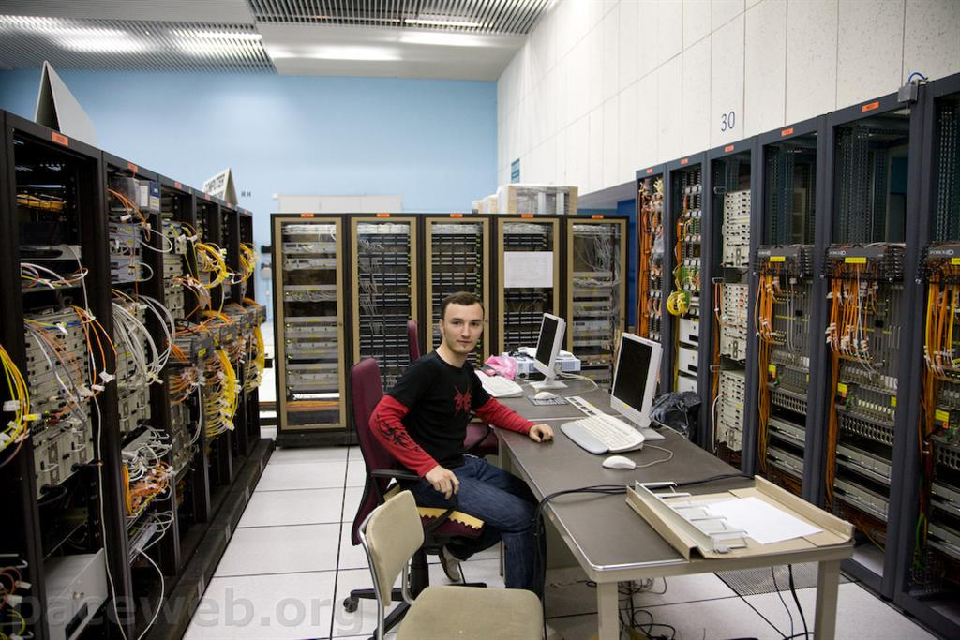

Slide 59
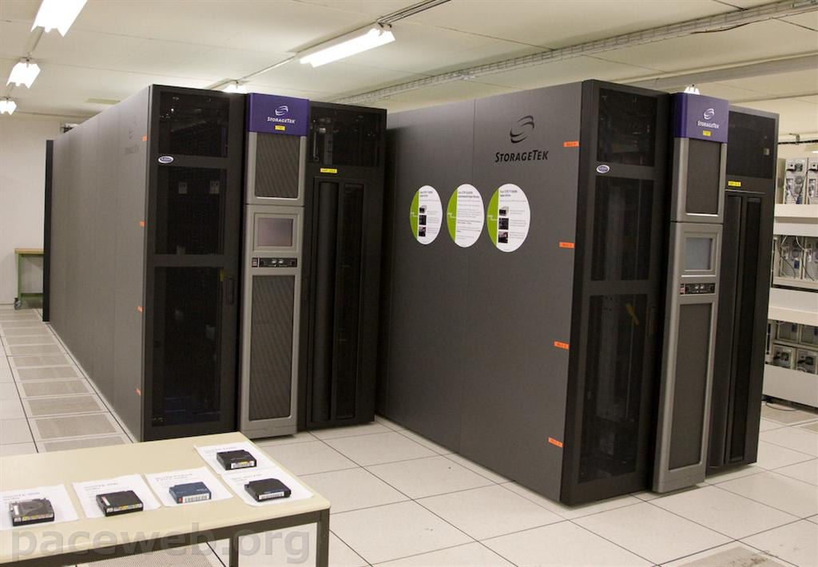

Slide 60
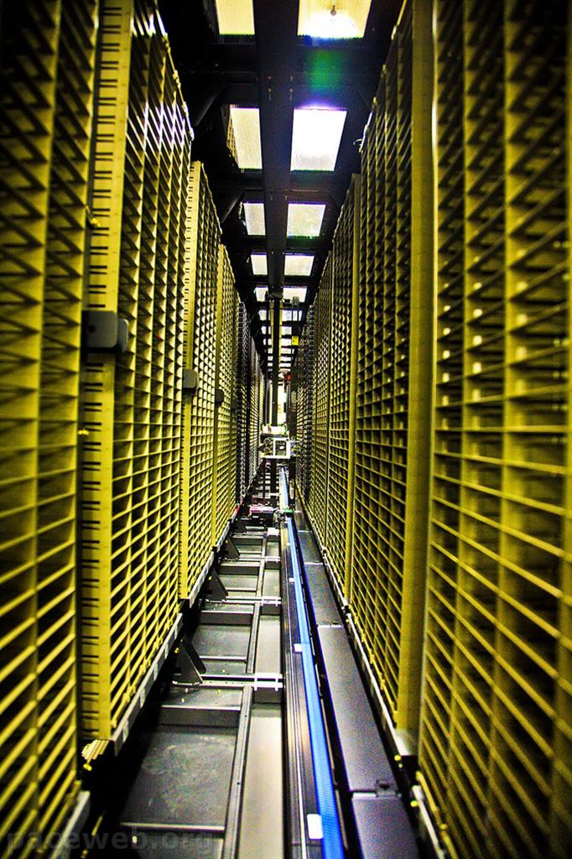

Slide 61
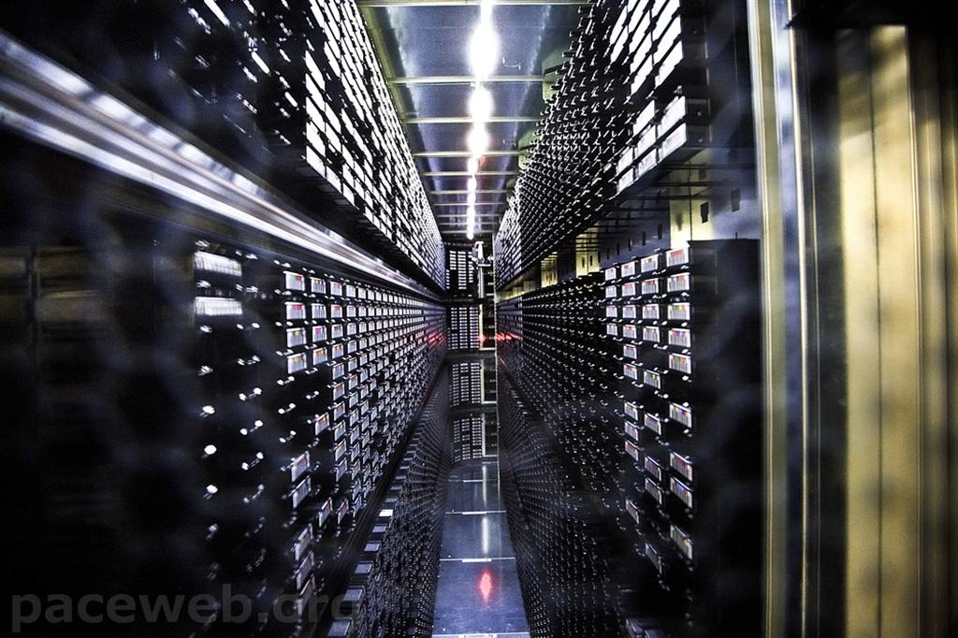

Slide 62
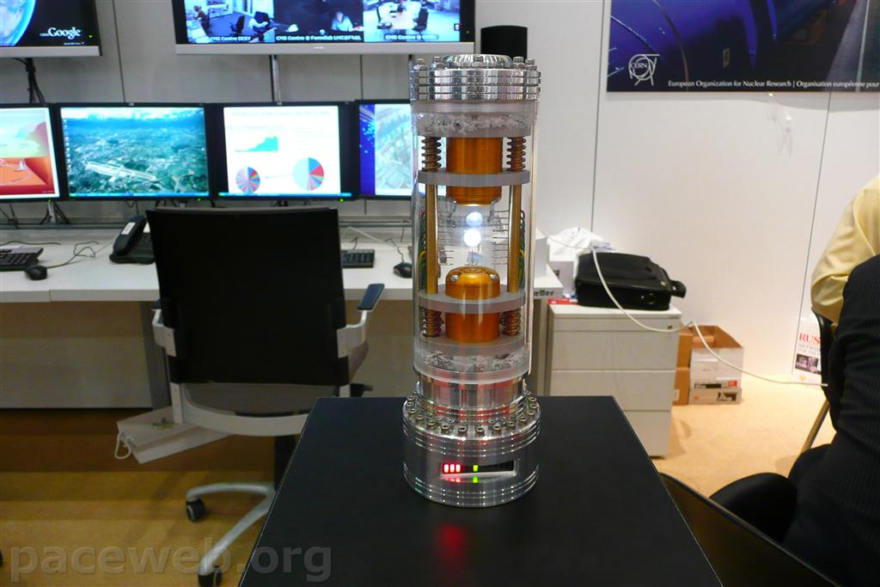
And the antimatter ...

Slide 63
Conclusion
Be Ambitious
Be Brave

