Slide 1
Knowledge Transfer at CERN
N.Ziogas
Knowledge Transfer Group

Slide 2
KT: one of CERN’s missions
Push back the frontiers of knowledge in nuclear research
Develop new technologies for accelerators and detectors
Train scientists and engineers of tomorrow
Unite people from different countries and cultures in pursuing this endavour
Education
Innovation
CERN
Uniting People
Research

Slide 3
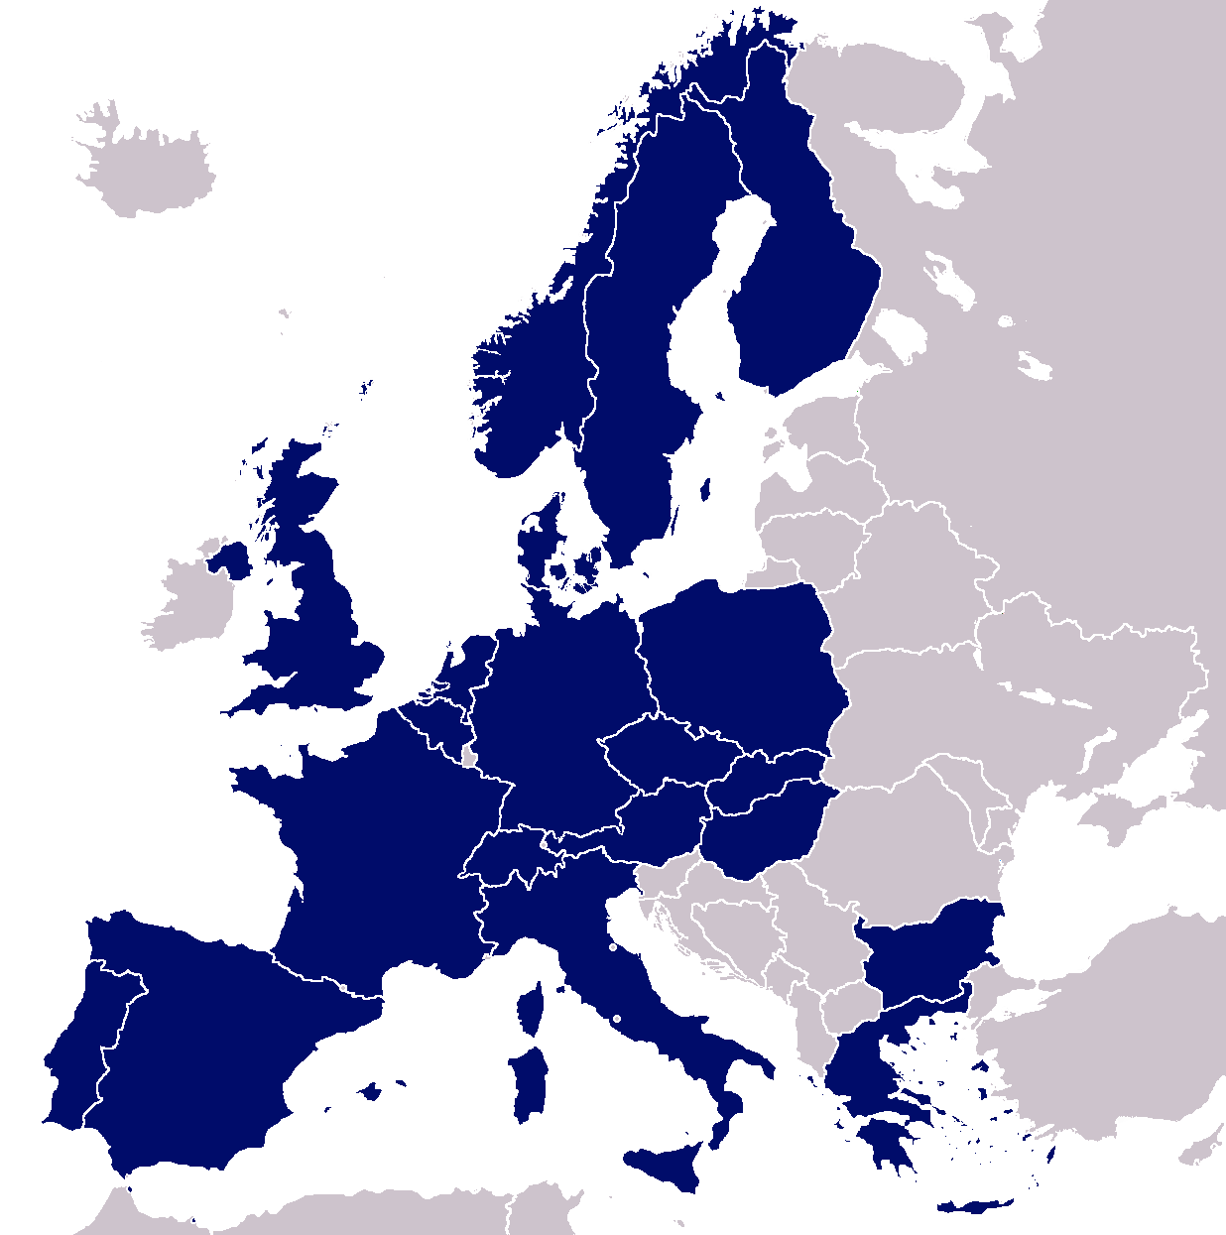
Knowledge Transfer Aims
Maximizing the technological and knowledge return to the Member States industry and society in general
Promoting CERN’s image as a center of excellence for technology

Slide 4
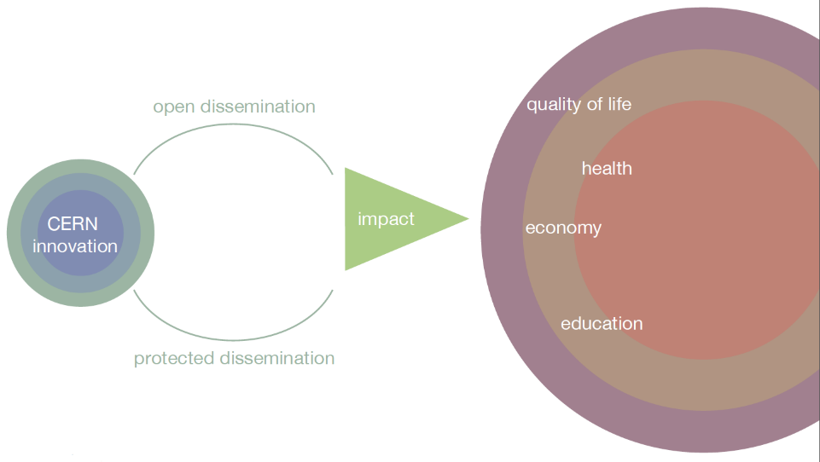
Impact-driven Innovation Approach
Key words: dissemination and impact
Notes:
Have to innovate e.g LHC is a 27 km cryogenic installation at 1.9 K. You can’t go out any buy that stuff.
Our mission is to transfer these innovations (through open or protected dissemination) in order to
Have impact in society (quality, health, economy, education)

Slide 5
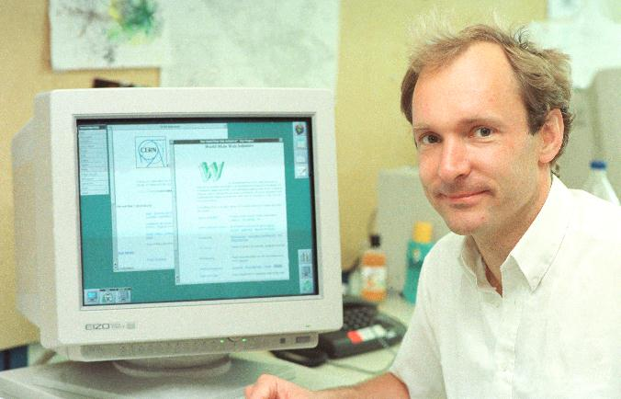
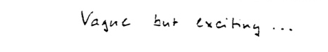

The World Wide Web
Invented at CERN in 1989 by British scientist Tim Berners-Lee and has grown to revolutionize communication worldwide

Slide 6
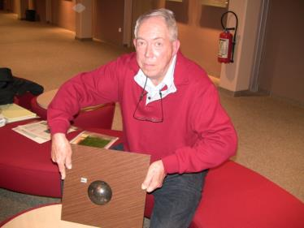

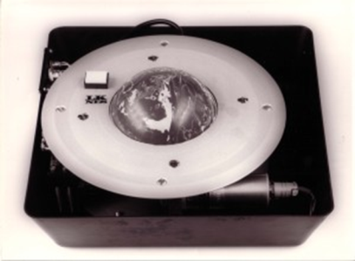
Did you know?
Notes:
Touchscreen: Frank Beck and Bent Stumpe

Slide 7
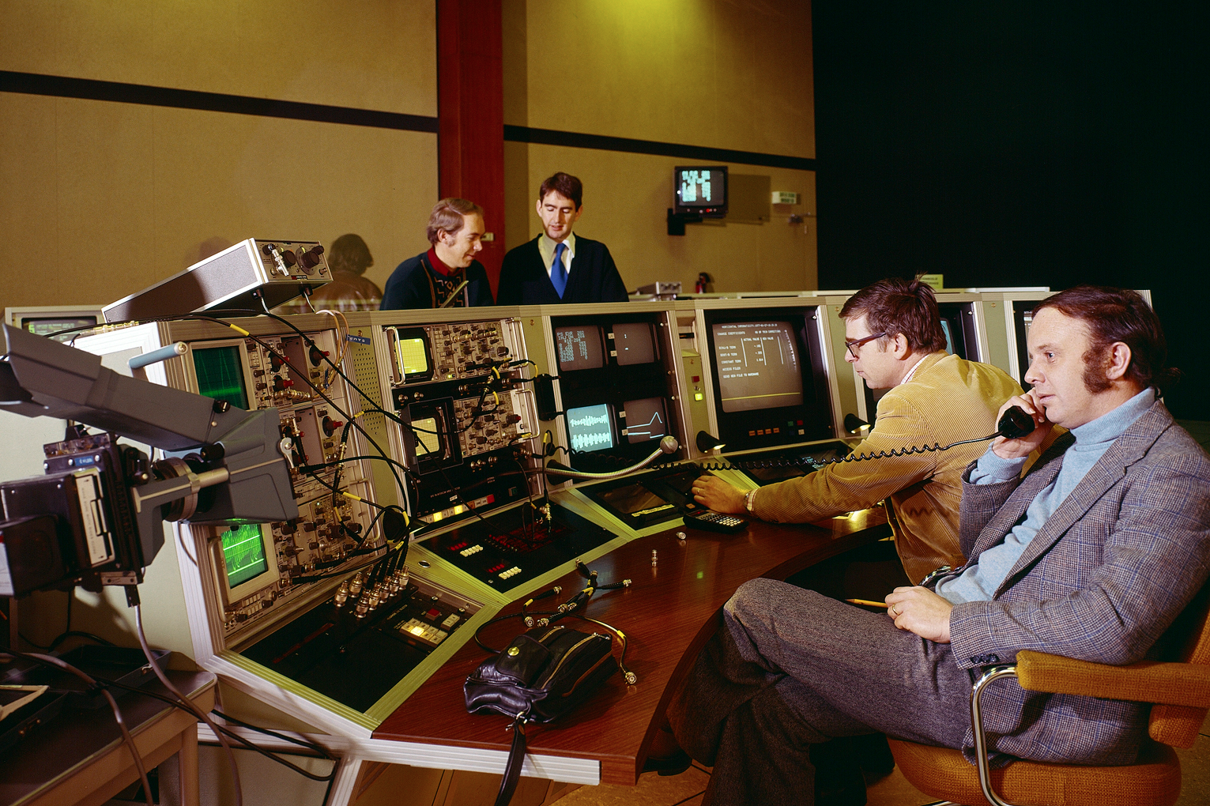
Is it a natural process?
Story of the capacitive touchscreen developed for the SPS control room
Knowledge
Transfer
Notes:
The picture show the super proton synchrotron (SPS) control room which had the worlds first capacitive touchscreen installed to control the accelerator.
The capacitive touchscreen used in the SPS was developed by Danish engineer Bent Stumpe seen back to the left.

Slide 8

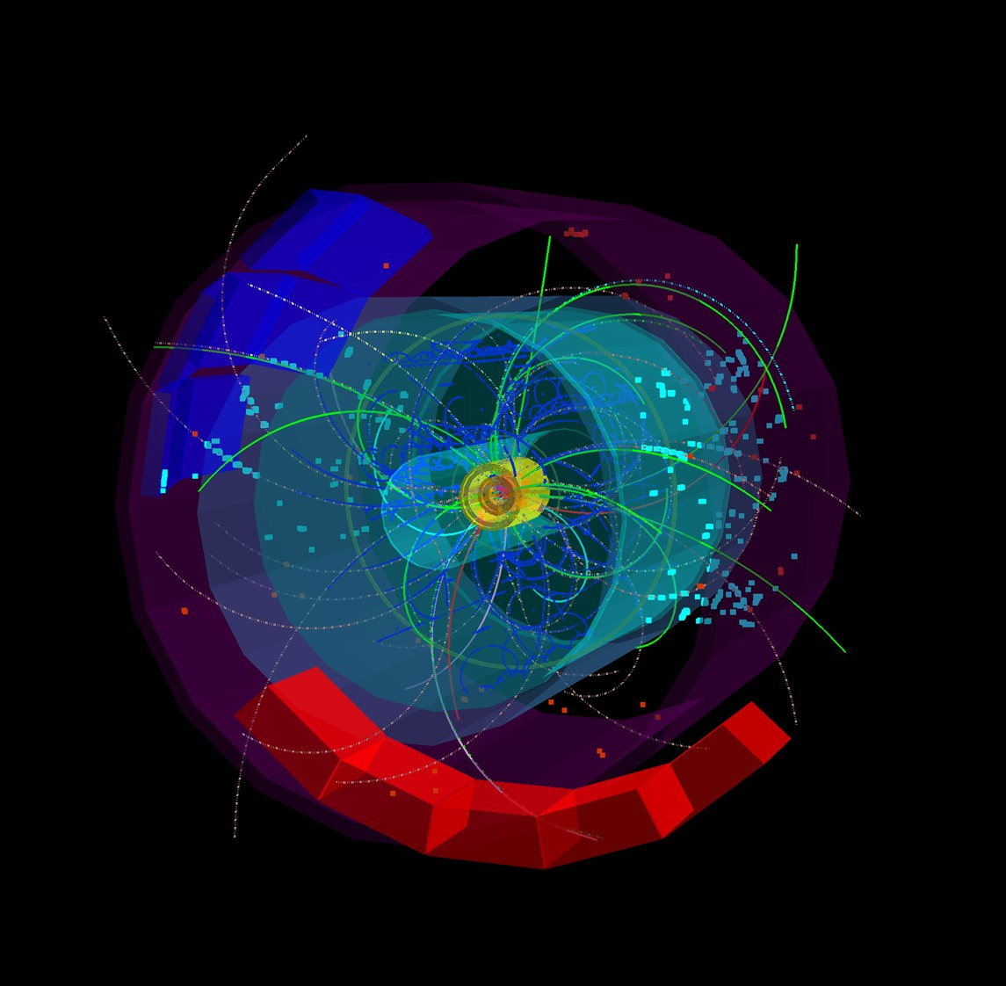
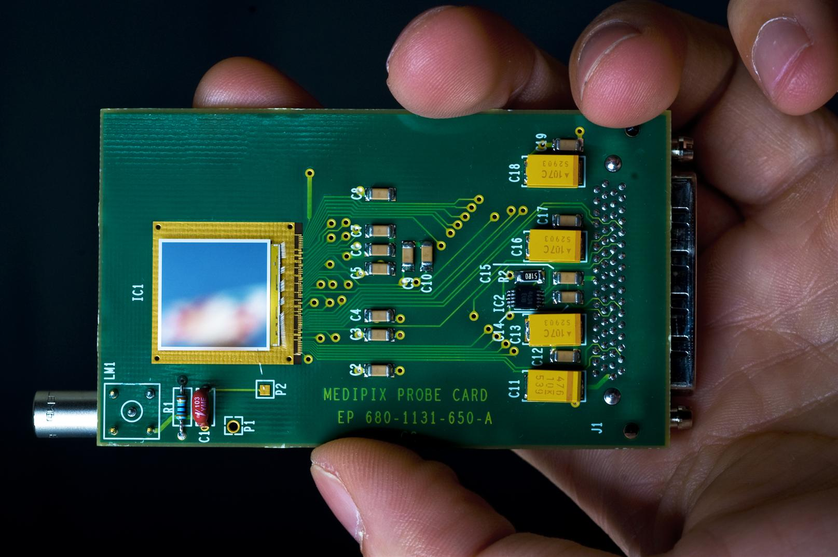
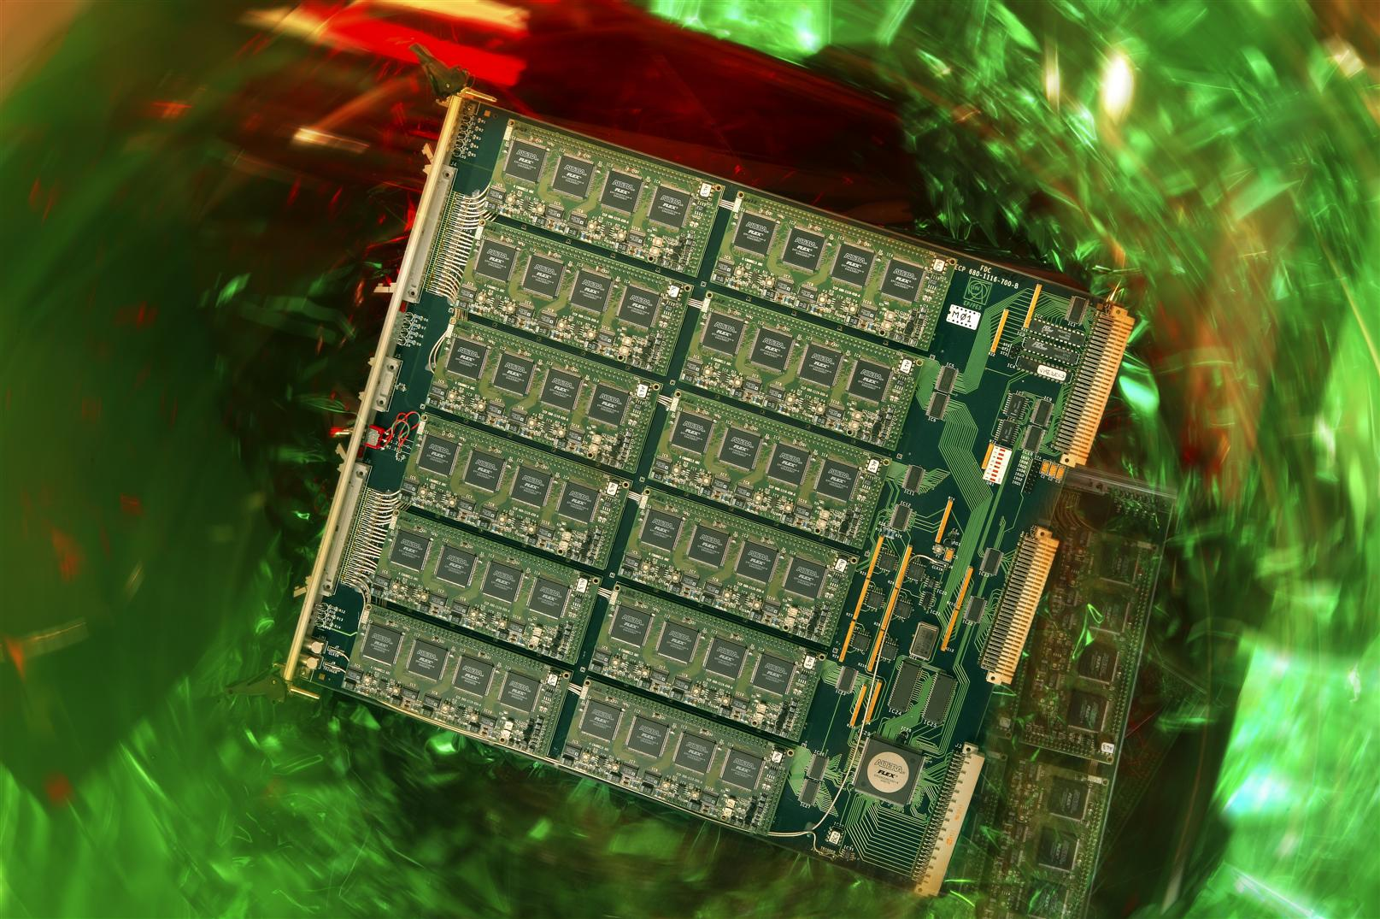
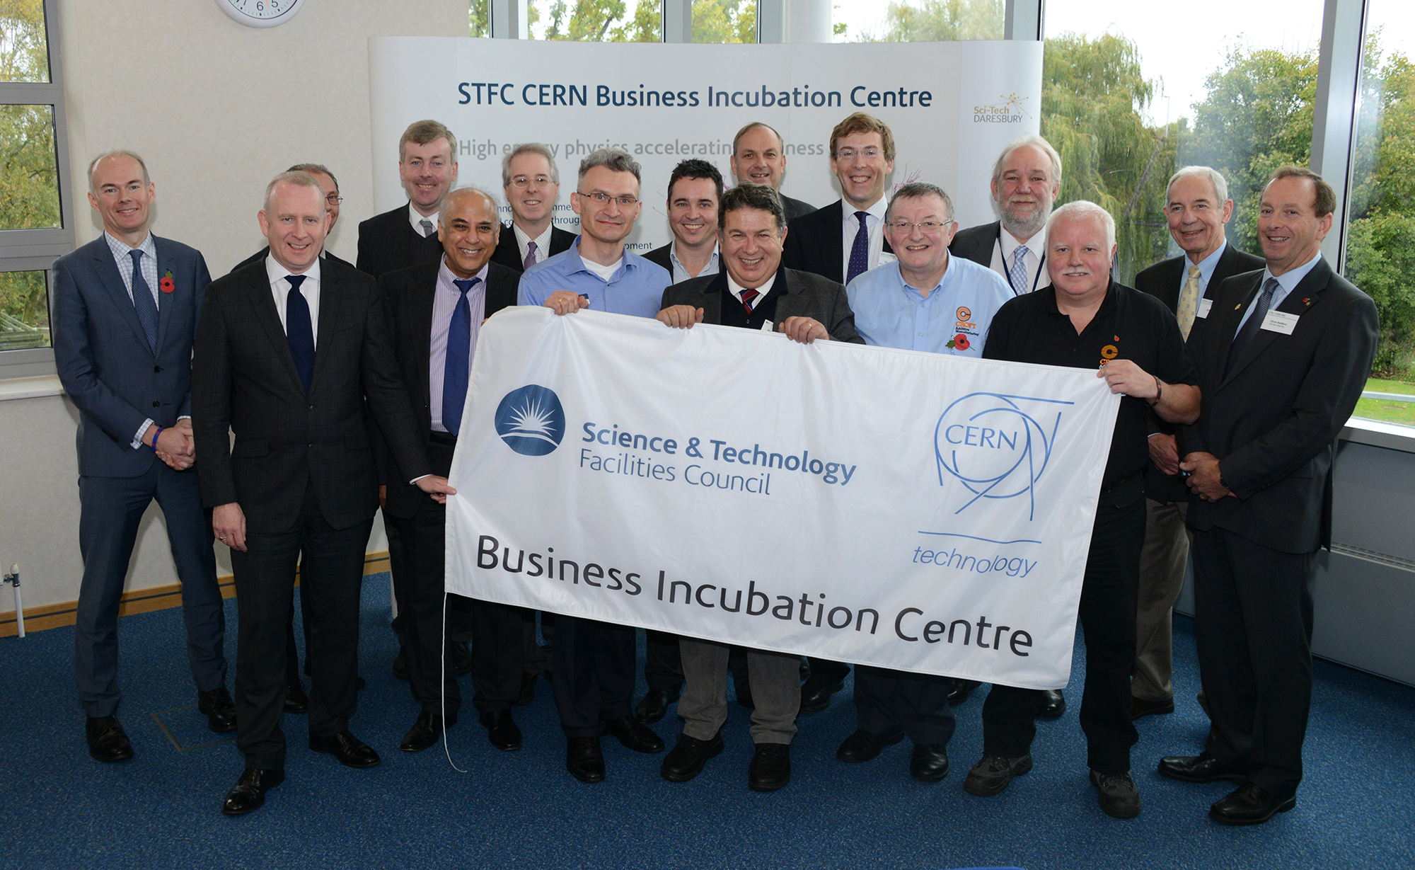

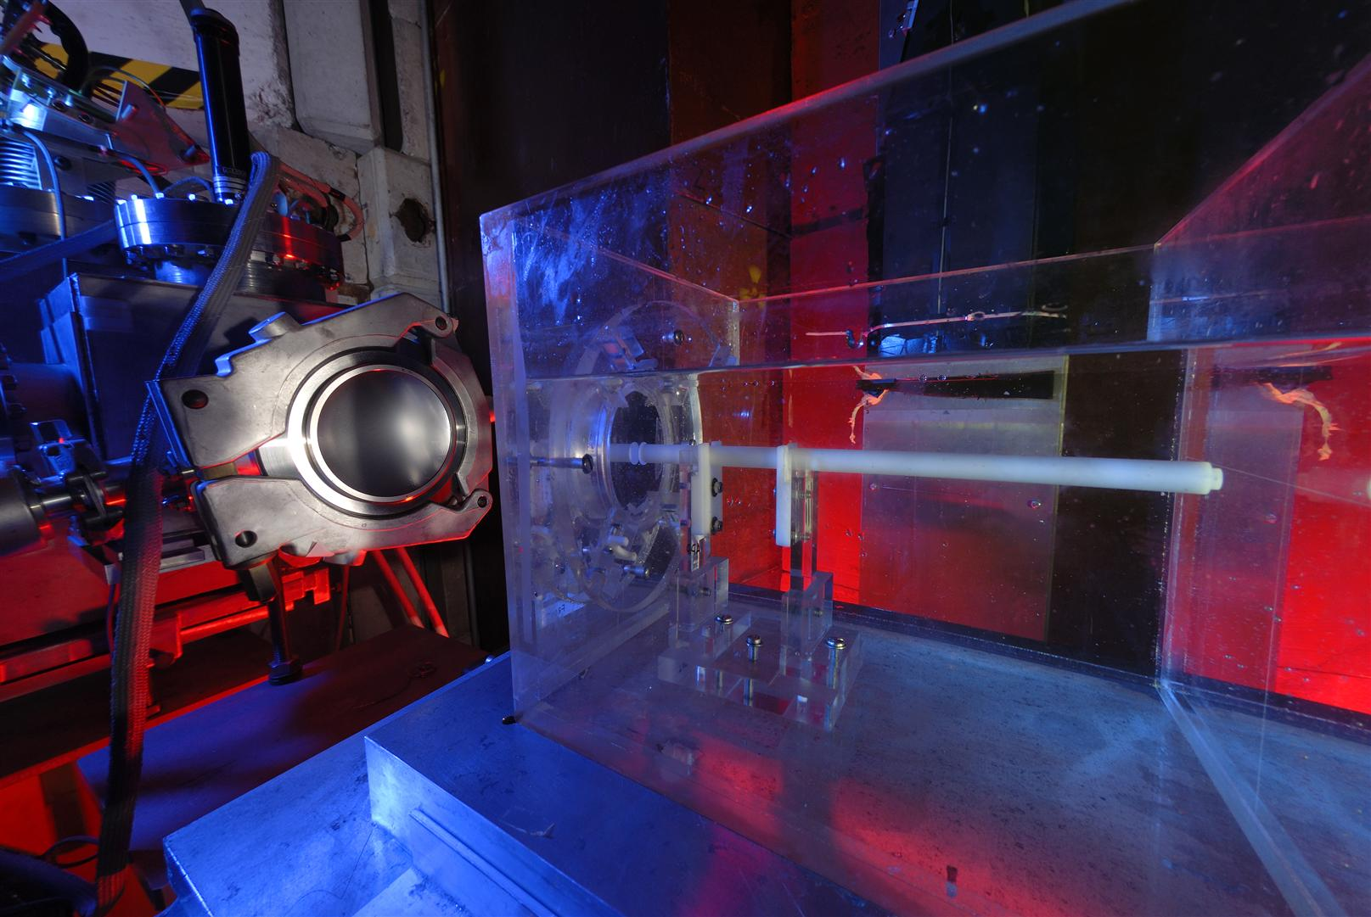
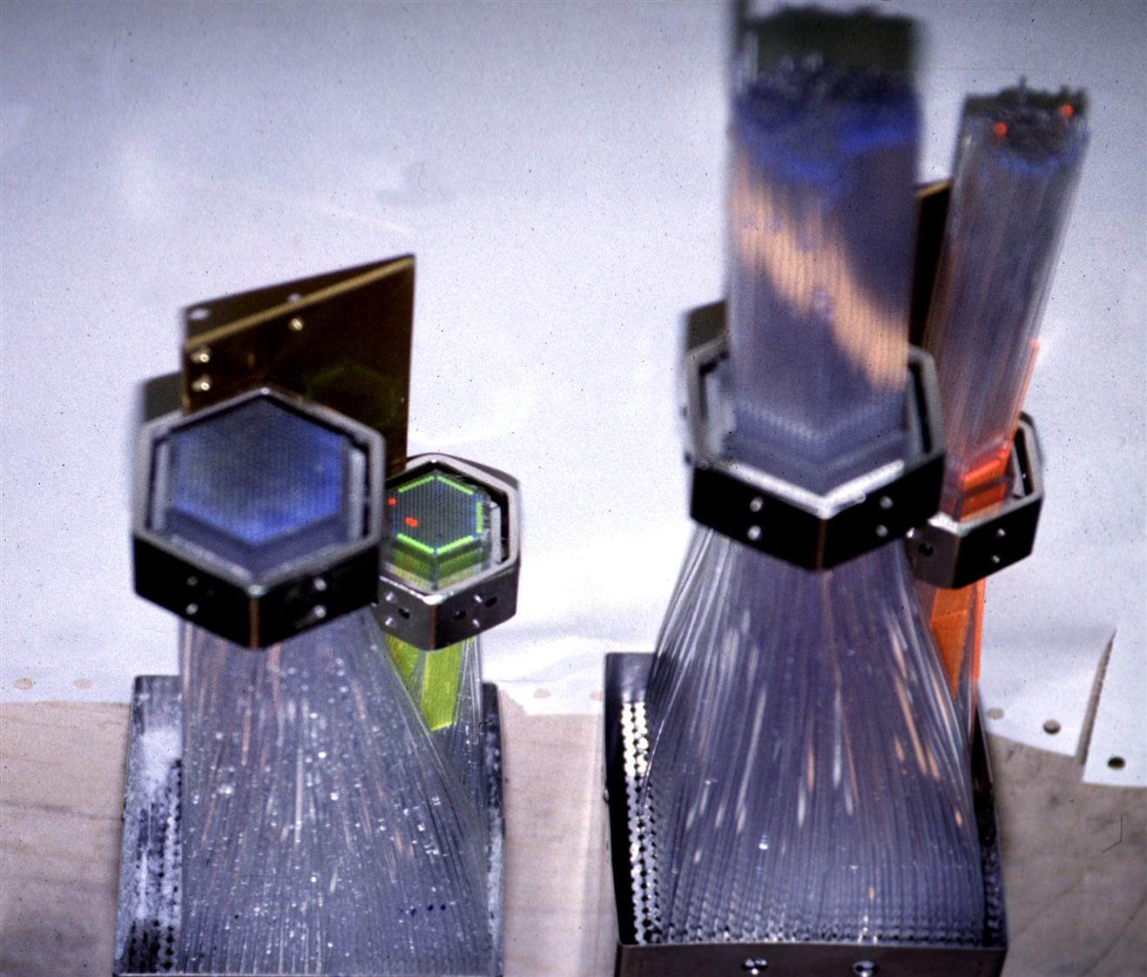
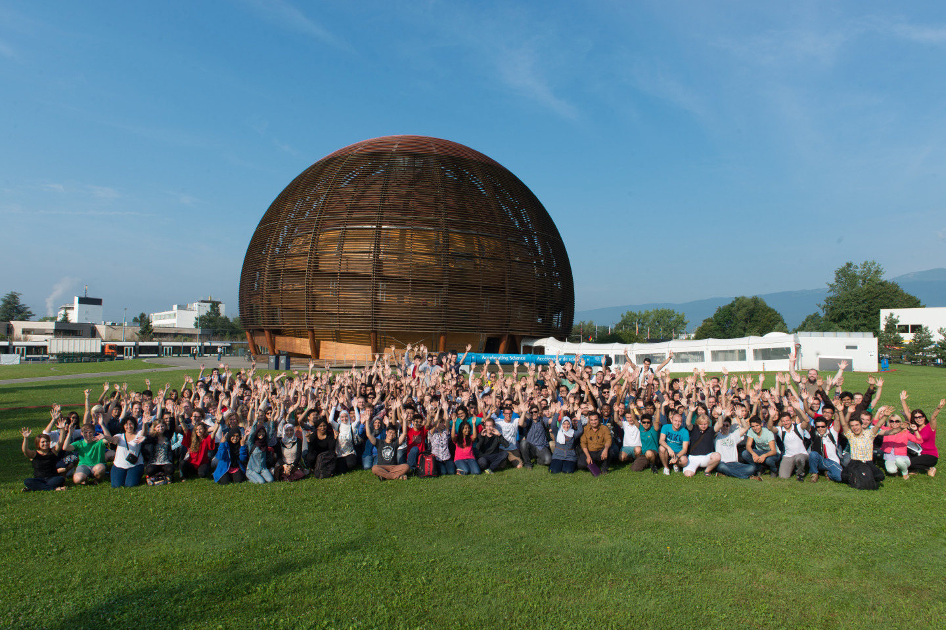

The Knowledge Exchange
Easy Access IP
Licensing
Business Incubation
Open Source Software
Open Hardware
Procurement
Service and Consultancy
EU Projects
Training
R&D Collaborations
Notes:
Collaboration agreements
Joint R&D
Others
Service agreements
Consultancy agreements
Consortia & exploitation agreements
Through Procurement
Licensing
Open
Protected
Patents
Know-how exchange
(Trade secrets)
Spin out companies & Incubators
Training
Research programs
Events & Conferences
Students & Outreach
The Technology Transfer process:
invention disclosure → IP protection → licence to a company
Difficult, especially for the world of particle physics.
Collaborative R&D (with industry and other research institutes) is key for a successful transfer.
Other ways of dissemination are also very important for the Organization

Slide 9
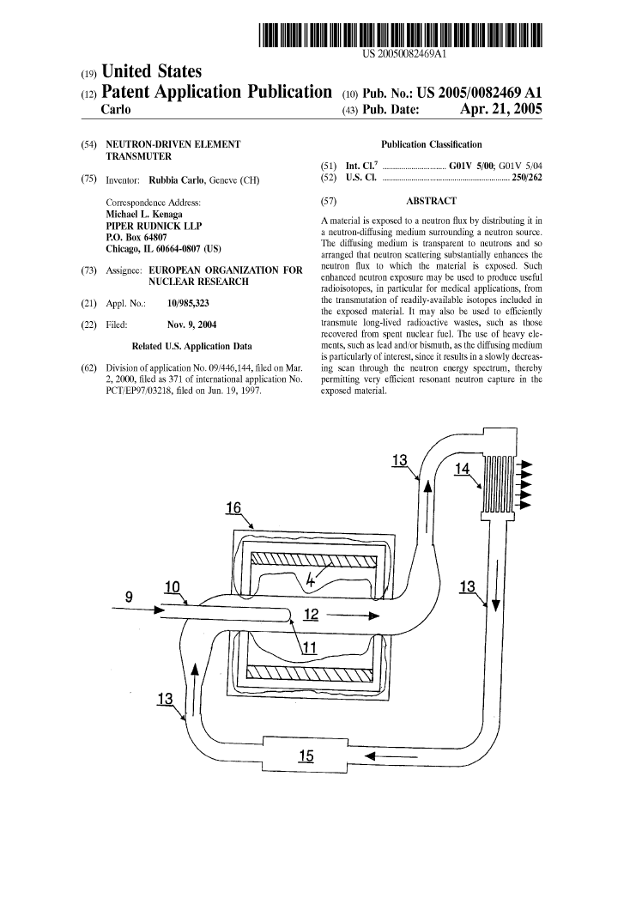
CERN and patents
Strategic motivation:
  “Promote and enhance the image of the organization as a source of innovation and economic activities”
Patents are taken when it:
Increases the probability of having the technology transferred (justify development investments from industry)
Significantly enhances the commercial value
Is needed to ensure CERNs recognition as inventor
Notes:
The patent in the picture is the Energy Amplifier by Nobel Laureate Carlo Rubia and one of the earlier patents taken by CERN!

Slide 10
Patent Portfolio Overview
51 Patent Families
  Radiation Detection
  Materials
  Radioisotope production
  Linear Accelerators
  Cryogenics
  Vacuum technology
Notes:
CERN currently holds about 51 patents families in various domains. Very little in comparison to other research infrastructures and universities.

Slide 11
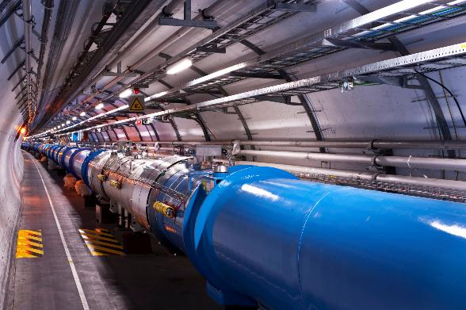
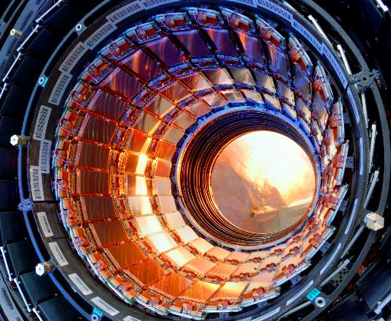
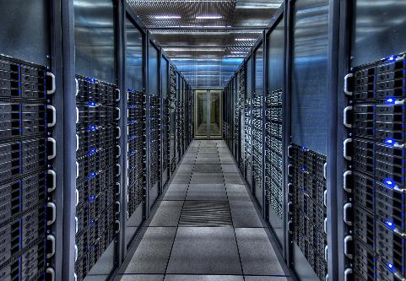
CERN’s areas of excellence
Notes:
Accelerator Technology
Detectors
Information Technology (Grid etc)

Slide 12
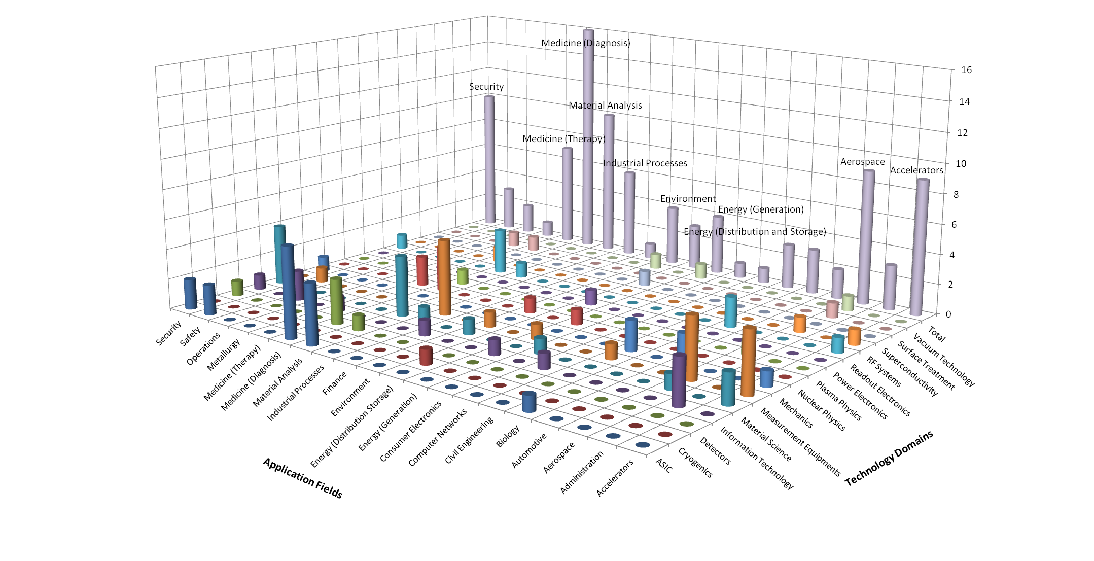
CERN’s Technology Portfolio
Knowledge Transfer | Accelerating Innovation

Slide 13
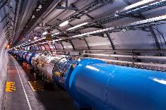
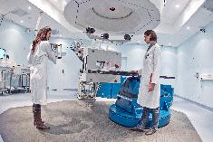

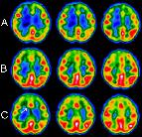
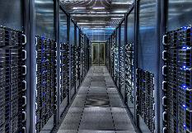
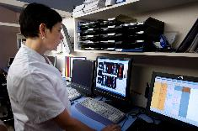
Medical application examples
From particle accelerators to cancer therapy
From particle detectors to medical imaging
From grid computing to medical data management and analysis

Slide 14

Hadron Therapy
New treatment opportunities for deep-seated tumours
Photons
Carbon
Protons
Notes:
Protons and other ions deposit most of their energy at the end of their path, unlike charged particles.
The Bragg peak, for William Henry Bragg who discovered it in 1903.
When a fast charged particle moves through matter, it ionizes atoms of the material and deposits a dose along its path. A peak occurs because the interaction cross section increases as the charged particle's energy decreases

Slide 15
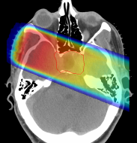
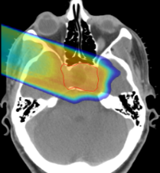
Hadron Therapy
New treatment opportunities for deep-seated tumours
Photons
Carbon
Protons
GSI
Notes:
Cannot treat radioresistant tumour cells with X rays (5%)
Deep seated tumours (head)
Difficult, delicate areas like the eyes.

Slide 16
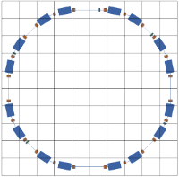



Hadron Therapy
Contributions from CERN
PIMMS Proton-Ion Medical Machine Study
Coordinated by CERN
PIMMS was then modified by the TERA foundation in Italy
CNAO in Italy and MedAustron in Austria are based on the modified PIMMS and also collaborated with CERN on the accelerator development
Notes:
Hadron therapy was originally developed at Berkeley in the US.
CERNs contribution to the European community came first trough the Proton Ion Medical Machine Study ~ 2000
This study was modified by the TERA foundation and later used as the basis for CNAO in Italy and MedAustron in Austria.
CERN has shared its expertise in accelerators with both these projects and hosted many researchers for periods at CERN during the development and construction of the accelerator components and for training of personnel,
CNAO started treating patients in 2012 and MedAustron will be ready in 2015!

Slide 17
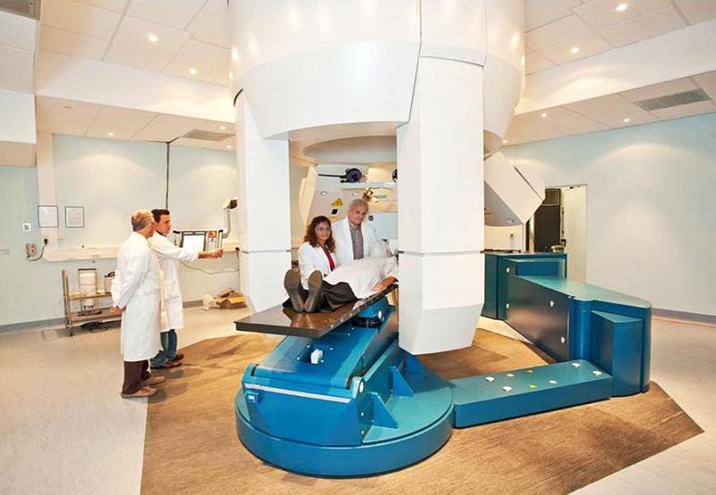
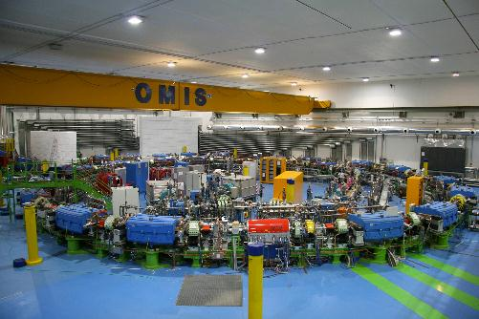
Hadron Therapy
CNAO
Notes:
Treatment room and accelerator at CNAO
The synchrotron at CNAO is a prototype resulting from the research in high energy physics
80 meters long with a diameter of 25 meters
“sources”, which contain plasma formed by the gas atoms that have lost their electrons. Using magnetic fields and radio frequency pulses, these atoms are extracted and the protons and carbon ions are extracted. In this way “packages” composed of beams -each one containing billions of particles- are formed.
they are accelerated to kinetic energies of 250 MeV for protons and 480 MeV for carbon ions
The beam that strikes the cells of the tumor is like a “brush” that moves in a manner similar to that of electrons in a TV and acts with a precision of 200 micrometers (two tenths of a millimeter).
This accuracy is achieved by means of:
• Constant monitoring of the patient to follow any movements of the body (breathing, for example) that can change the location of the tumor, using infrared cameras to measure movement in a three-dimensional way;
• Two scanning magnets that, based on feedback of the beam monitoring system, move the “brush” along the outline of the tumor.

Slide 18
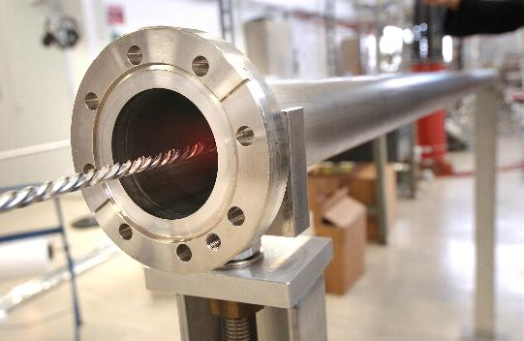
From high vacuum…
NEGs - Non-Evaporable Getter thin film coatings
Technology used to create and maintain ultra-high vacuum in the accelerator vacuum chambers.

Slide 19
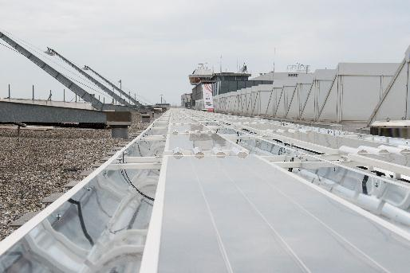
… to solar energy collectors
The innovative technology within the collectors was developed at CERN and commercialized by the CERN spin-off company, SRB Energy.
Here you can see thermal solar collector panels on the roof of Geneva airport

Slide 20
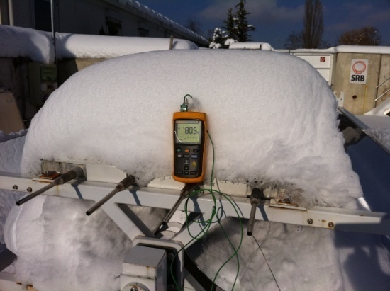
… to solar energy collectors
Vacuum acts as an Excellent insulator!

Slide 21
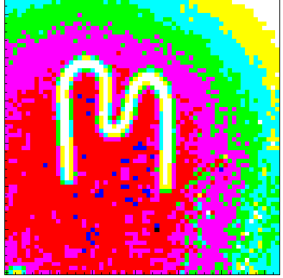
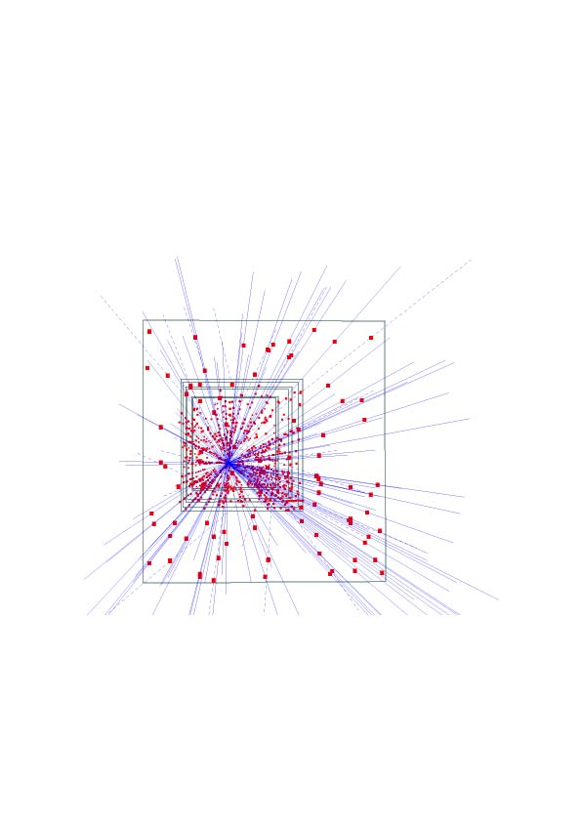
Silicon pixel detectors (SPDs)
Hybrid silicon pixel detectors for tracking applications in High Energy Physics
153 high energy particle tracks flying through a telescope of half a million pixels in the WA97 experiment back in 1995
Notes:
Charged Coupled Device (CCD) but much wider energy spectrum and capability to detect photons in narrow energy bands.

Slide 22
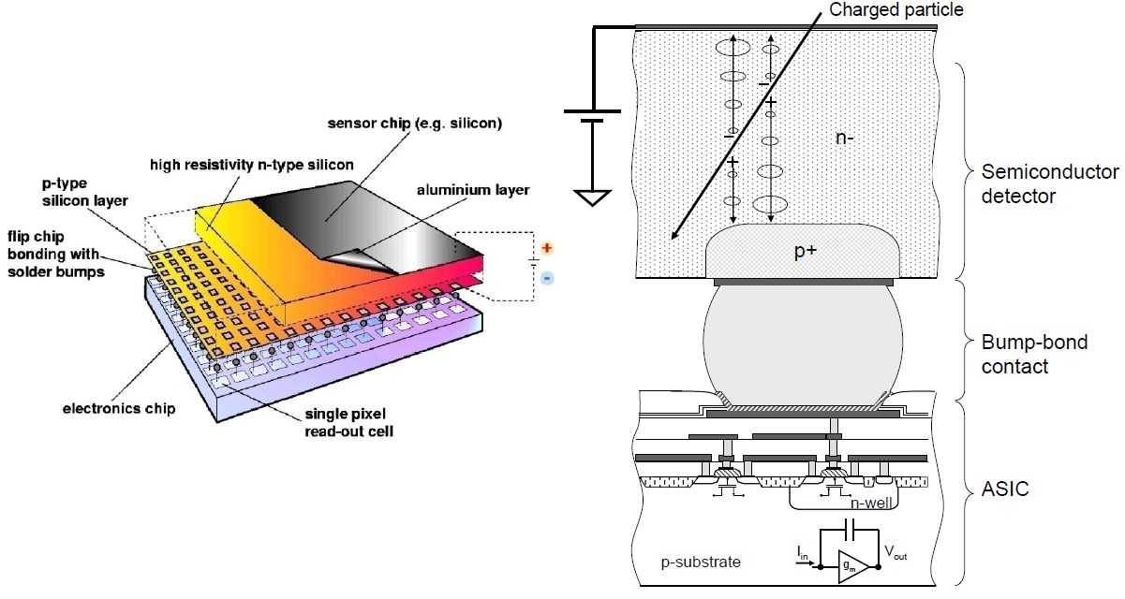
Medipix
Notes:
Medipix is a family of application specific integrated circuits or ASICs combined with a detection medium typically a semiconductor detector.
In Medipix the ASIC is connected to the detection medium by a bump-bond contact, as shown in the figure to the right. This separation allows better optimization of both detection medium and electronics.
The complex electronics, with different forms of embedded intelligence allows for high resolution and low noise in x-ray and gamma-ray detection, and the ability to detect single photons.

Slide 23
Medipix
A family of single photon counting integrated circuits used in Hybrid Silicon Pixel Detectors
The Medipix collaborations (close to 20 institutes) contributed to the development and dissemination of the technology
A good example of how (fundamental) science fosters innovation which can be transferred to society… and back!
Notes:
The Medipix chips was developed a part of the Medipix collaborations, which is hosted by CERN and contains close to 20 different institutes.
These institutes have contributed both to the development of the chip itself, but also the dissemination of the technology, to industry by collaborations and spinning off companies, and to academia
The Medipix case is special as the knowledge and technology transfer has gone full circle, so to speak.
Initially the Medipix project sprung out as researchers saw that the detector technology developed for the experiments for the LHC could be useful in medical applications and the Medipix project was established.
Later, however, developments done in the collaboration, the Timepix chip in particular, can be used in many high-energy physics applications.
Timepix is based on the Medipix 2 developments, and it not only counts the particle arriving in the pixel, but also measures the time of their arrival with very high precisions. This is very useful for high-energy physics applications and the Medipix design team is working on using the Timepix as a prototype for one of the upgrades of LHCb, which is one of the LHC experiments.

Slide 24
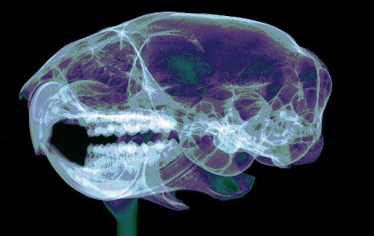
Application: X-Ray
Medical and industrial X Ray imaging
Picture is from X-Ray Imaging Europe GmbH a start-up company selling Medipix2 and Timepix detectors and detector systems
Credit X-Ray Imaging Europe
Notes:
In comparison with a CCD ~ 3 transistors per pixel – Medipix ~ 1000 . Much more processing can be done
Very low noise – 256x256 – 65,536 single photon detectors in 2 cm sq)
accurately differentiate the atomic and density variation within body tissues - counting the number of photons at multiple narrow energy bands
spectral (multi-energy ‘true colour’) imaging technology
energy resolving and photon counting which allows true colour images

Slide 25
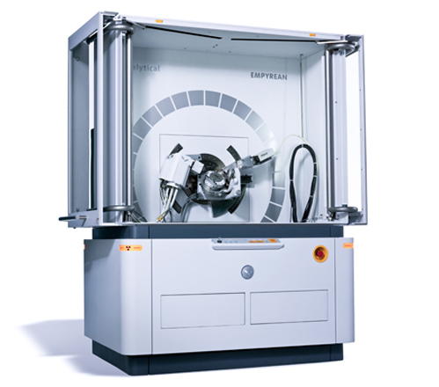
Application: Material analysis
PANalytical is a Dutch company that develops and produces scientific instruments
Medipix is used in their range of for x-ray diffractometers
Notes:
In this picture we can see a system for material analysis using medipix as detector, provided by a company from the Netherlands.
A typical diffractometer consists of a source of radiation, a monochromator to choose the wavelength, slits to adjust the shape of the beam, a sample and a detector.
used to study crystal structure
Used by a well known cement maker for quality control - online

Slide 26

Application: Radiation monitoring
Medipix is used for radiation monitoring in space and other types background radiation monitoring and dosimetry
Notes:
We have also applications in the space, like … ESA and NASA are using the medipix family of chips to characterize the radiation in the space.

Slide 27
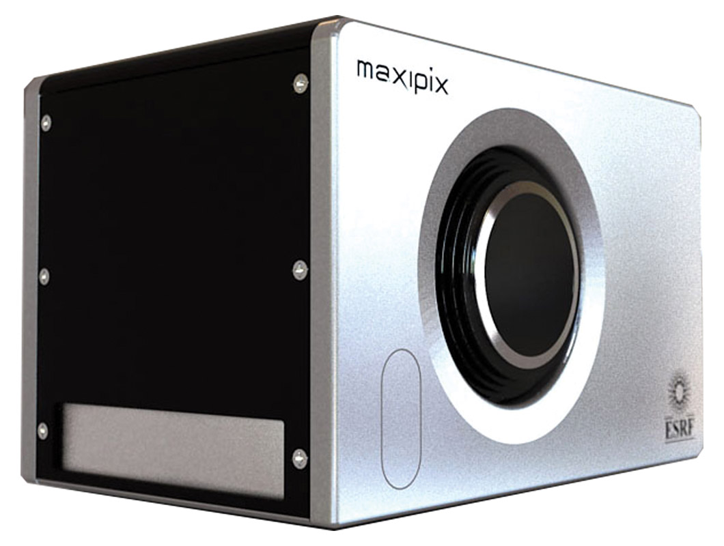
Application: Research
Research applications:
Synchrotron radiation
Electron microscopy
Detection of low energy particles
Adaptive optics
Neutron imaging
and more
Notes:
We have also research applications such as … In this picture we can see an example of system based on the medipix family of chips, developed for synchrotron radiation applications in the ESRF (European Synchrotron Radiation Facility) in Grenoble

Slide 28
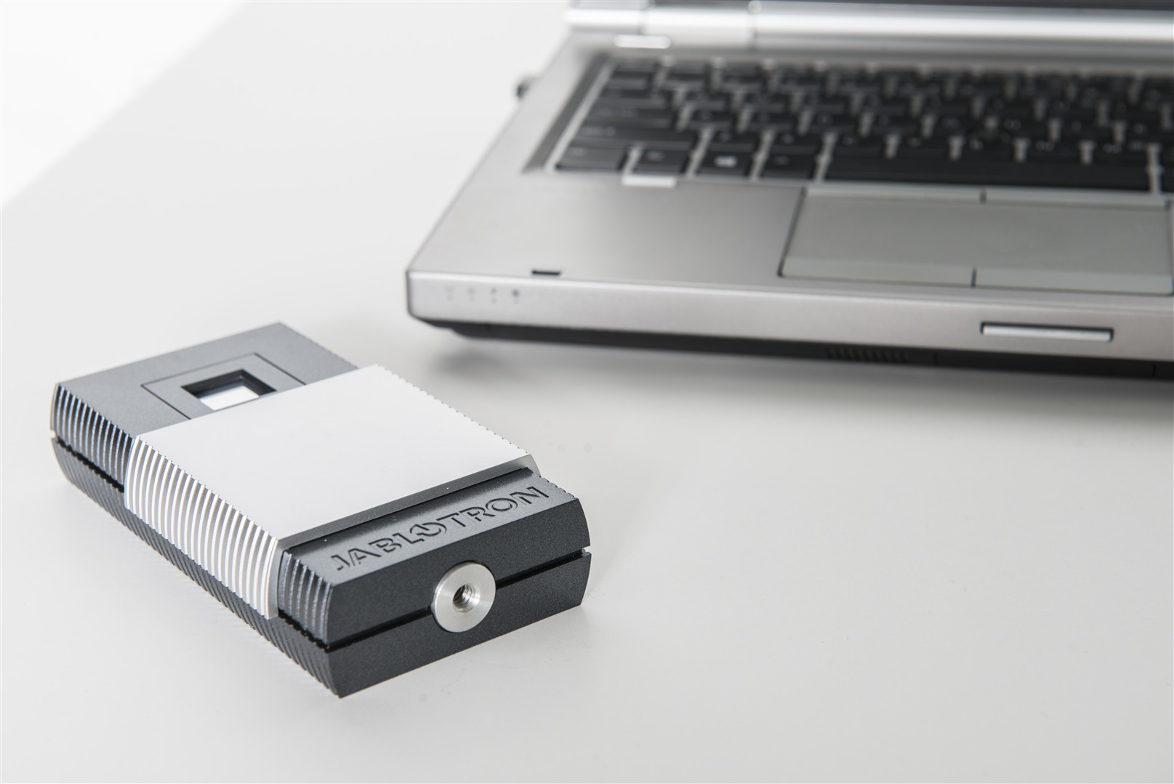
Application: Education
Medipix 2 technology used in an educational toolkit
Allows students to use a Timepix chip in the lab to visualise radiation
CERN has recently adopted this toolkit as part of its new SchoolLab
Notes:
The Czech company JABLOTRON is using medipix 2 technology to produce and sell an educational toolkit, that consists of an easy to use particle detector that can detect ionizing radiation in real time. The students can then observe the particles arriving to the detector on a PC screen. CERN has recently adopted this toolkit as part of its new SchoolLab

Slide 29
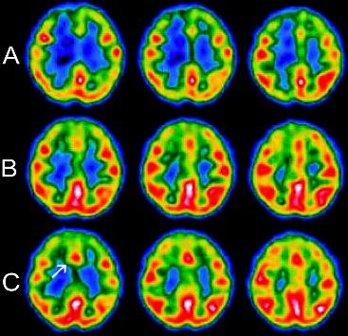
Application: Medical Imaging
Computed Tomography (CT)
Radiography,
Mammography,
SPECT,
Dental radiography,
Angiography,
PET
and more
Notes:
The collaboration was initially founded to design the hybrid pixel detector for medical use

Slide 30

CERN Open Hardware licence
A legal framework to facilitate knowledge exchange across the electronic design community.
Notes:
In the spirit of knowledge and technology dissemination, the CERN OHL was created to govern the use, copying, modification and distribution of hardware design documentation, and the manufacture and distribution of products.

Slide 31
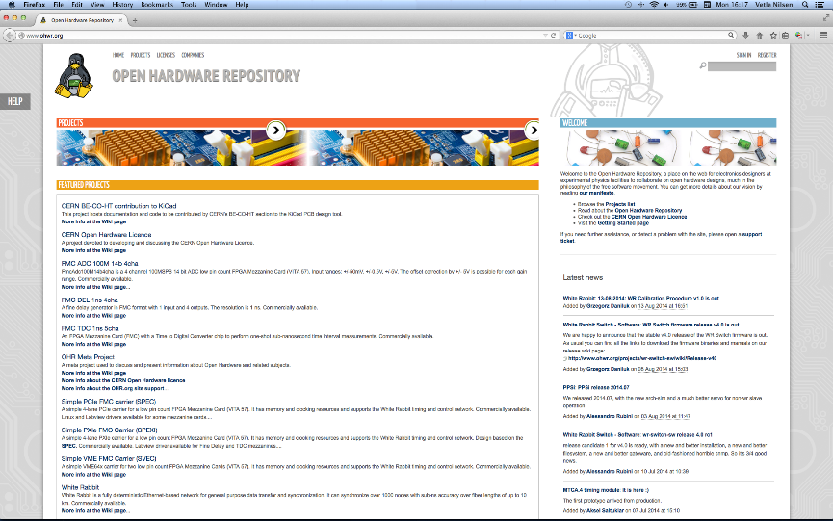
Open Hardware Repository – ohwr.org
Notes:
In addition to creating the CERN open hardware licence and releasing CERN hardware under it, CERN also created the Open Hardware Repository for posting open hardware projects.
The repository is used by CERN but also other public research organizations and companies are posting their projects on there.
Per January 2013, there are 100 projects on ohwr:
52 hardware projects
39 HDL or Software projects
9 other projects
There are eleven institutes leading the different projects and 16 commercial companies involved, who develop, produce and/or test open hardware products.

Slide 32
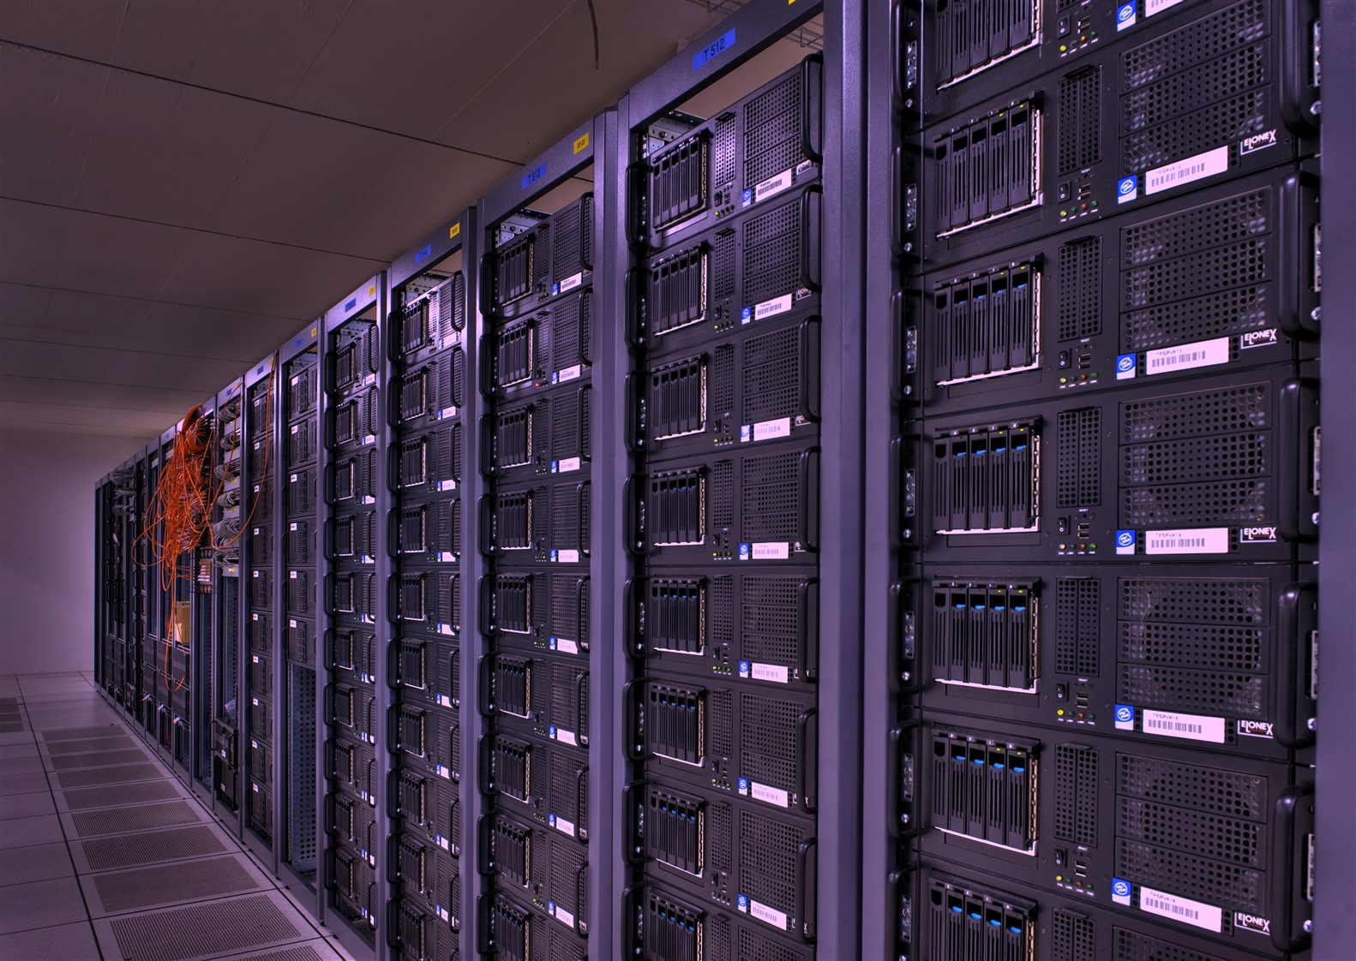
Open Source Software
Software developed at CERN is often released as open source
Some examples of the use of CERN’s open source software are:

Slide 33
OSS example
ROOT
Powerful tool developed for handling big data in the CERN experiments
Widely adopted by the physics community and has found other applications such as:
Finance
Aerospace
Telecom
Automobile and more

Slide 34
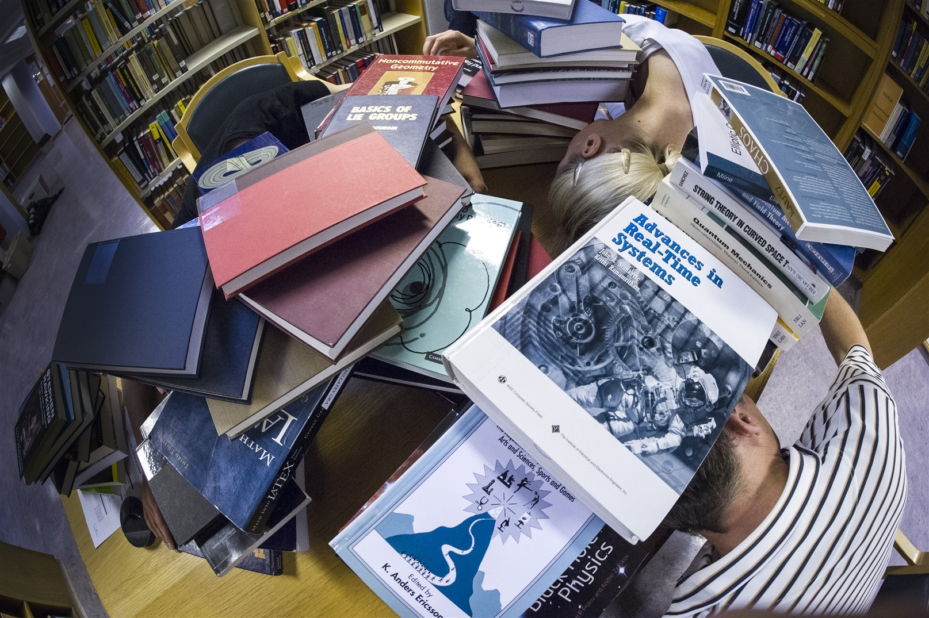
OSS example
Invenio
Software developed for running the digital library at CERN
Invenio is widely adopted outside CERN and a spin-off company has been created for delivering service, support and customisation

Slide 35
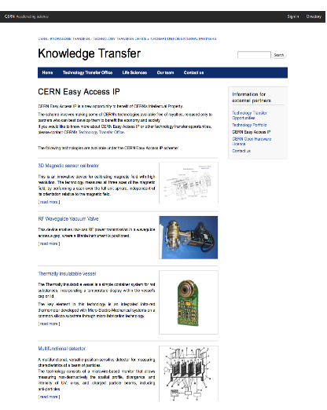
CERN Easy Access IP
Scheme pioneered by the University of Glasgow
For some of our technologies free licences are given to companies who will demonstrate that they can turn it into a product
Notes:
Screenshot from our webpage, showing the different technologies that are released under easy access IP.

Slide 36

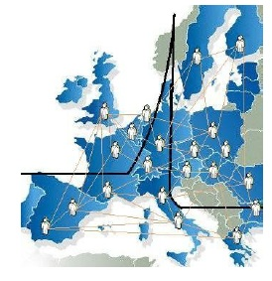
12 years of ENLIGHT Collaboration
CERN philosophy into health field
Common multidisciplinary platform
Identify challenges
Share knowledge
Share best practices
Harmonise data
Provide training, education
Innovate to improve
Lobbying for funding
Coordinated by CERN
> 150 institutes
> 400 people
> 25 countries
(with >80% of MS involved)
Notes:
36
State-of-the-art techniques borrowed from particle accelerators and detectors are a key element in hadrontherapy and several European projects are actively fostering the collaboration amongst the various disciplines and countries.
ENLIGHT was established in 2002 to coordinate these European efforts in hadron therapy.
The ENLIGHT network is formed by the European hadrontherapy Community, with more than 300 participants from twenty European countries. A major achievement of ENLIGHT has been the blending of traditionally separate communities so that clinicians, physicists, biologists and engineers with experience and interest in particle therapy are working together. Annual meetings are held each year in different locations. For more information on the annual meetings.

Slide 37






ENLIGHT platform projects
Marie Curie Initial Training Network
12 institutions
29 trainees
Infrastructures for hadron therapy
20 institutions
2008-2012
2009-2014
R&D on medical imaging for hadron therapy
16 institutions
Marie Curie ITN
12 institutions
16 trainees
2010-2014
2011-2015
13/06/2013
Manjit Dosanjh – Zuppinger-Symposium 2013
37
Notes:
All FP7 projects
Partner – Multi disciplinary, & Entervision – Medical Imaging TRAINING
Med Physicist, Doctors, Engineers, IT specialists, Radiobiologists
ULICE – Infrastructure. Learn from HIT, CNAO, MedAustron
Clinical trials etc
Envision – Quality assurance for Hadron therapy in real time
& asses the effectiveness.

Slide 38

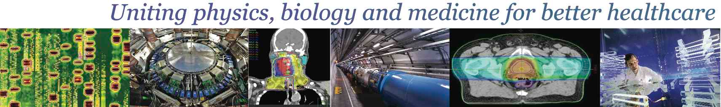
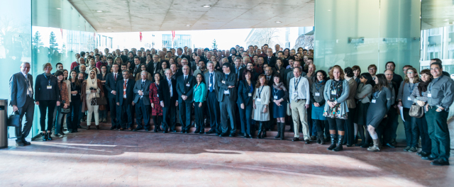
February 10 – 14, 2014 (CICG, Geneva)
2 days devoted to physics, 2 days to medicine, 1 day of overlapping topics
Chairs: Jacques Bernier (Genolier) and Manjit Dosanjh (CERN)
Key Subjects:
Biology
Pre-clinical & clinical strategies
Nuclear medicine
Detectors & Imaging
New Technologies
Radiotherapy
400 participants from 31 countries

Slide 39
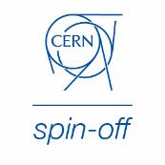
KT implementation ways
Market Pull
Transfer to Existing Companies
Technology Push
Creation of New Companies
Spin-Off Support

Slide 40



CERN Business Ideas Accelerator
CERN
Pre-Incubator
CERN BIC FRANCE
CERN STFC BIC UK
CERN BIC NORWAY
CERN BIC AUSTRIA
CERN BIC THE NETHERLANDS
CERN BIC GREECE

Slide 41
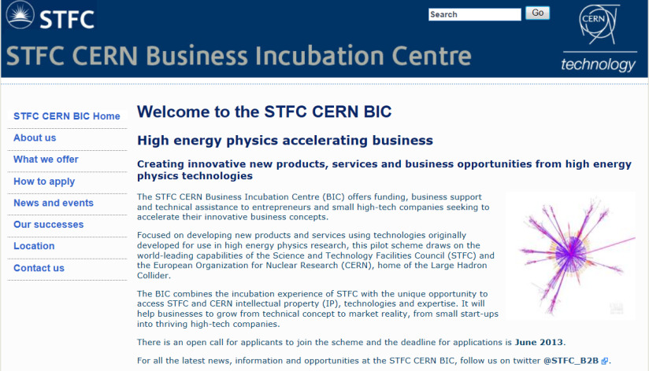
Turning CERN technologies into new business opportunities
Notes:
Sci – Tech STFC Innovation Campus in Daresbury in the UK

Slide 42
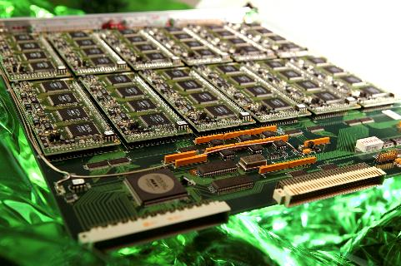
Knowledge Transfer through Procurement
Survey of companies involved in technology-intensive procurement contracts with CERN.
178 questionnaires analyzed
503 MCHF procurement budget
Results:
44% indicated technological learning
42% increased their international exposure
38% developed new products
36% indicated market learning
13% started new R&D teams
52% would have had poorer sales performance without CERN
41% would have had poorer technological performance

Slide 43

Knowledge Transfer through People
Every year hundreds of students come to CERN to ontribute to our research programs
An opportunity for young people to learn in a multicultural environment
Not only for physicists! Also engineers, computer scientists, administrative students…

Slide 44





European Knowledge Transfer Networks
Forum for European Intergovernmental Research Organisations
EEN, Enterprise Europe Network
TTN, Technology Transfer Network
TTO Circle - European Technology Transfer Offices Circle
The European Network for LIGht ion Hadron Therapy

Slide 45
Conclusions
KT is integral part of CERN’s mission
CERN technologies have applications in several domains with high relevance to society.
Significant contribution to innovation in medical sciences over the last 10-15 years
Impact which delivers tangible benefits to mankind

Slide 46

More info / Contacts
www.cern.ch/knowledgetransfer
mail-KT@cern.ch
Nick.Ziogas@cern.ch
Questions ?

