Slide 1
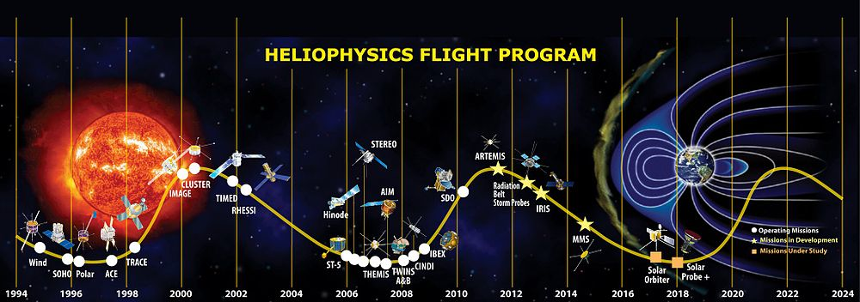
Flares at the Maximum of Cycle 24
Richard Fisher¹, Bryan Yamashiro², Veronica Bindi² , and Kristine Rock³
1 Code 670 GFSC, Greenbelt MD; 2 University of Hawaii, Honolulu, HI ; ^{3 Retired, Silver Spring, MD}
22 October 2015
Solar Energetic Particles, Solar Modulation and Space Radiation:
New Opportunities in the AMS-02 Era
Notes:
SLIDE 1: Title Page
17 instruments on 7 spacecraft were used to examine X–Class solar flares. This data set has unique spatial and temporal coverage of
solar activity occurring from 1 January 2011 to 26 September 2014 .

Slide 2
Unique Conditions 2011-2014
Evolved Heliophysics fleet allowed nearly continuous, simultaneous remote sensing and in situ observations from multiple locations in the solar system.
NASA Data and Modeling Infrastructure revised.
Solar sunspot maximum (Cycle 24) occurred during period of study.

Slide 3
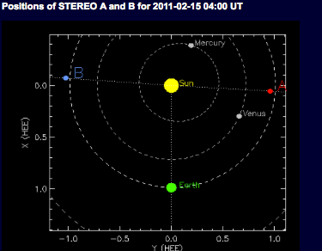
SOHO –C3 RDIF “HALO” CME
STEREO B Cor2
SDO DISK LCPF
STEREO A Cor2
STEREO B
STEREO A
SOHO
WIND
ACE
SDO
FERMI
ISS
GOES
RESSI
SO
Notes:
Black START

Slide 4
NASA Heliophysics Data and Models
Heliophysics Data Environment (HPDE) 2009
Community Coordinated Modeling Center (CCMC)
Heliophysics Data Portal
Virtual Solar Observatory
The VSO provides access to data from a comprehensive set of solar missions through simple interfaces that search by time, data product, product "nicknames" (e.g., "H-alpha"), and other parameters. It then delivers data files, typically in FITS format, that can then be viewed in numerous applications and analyzed using the SolarSoft or other routines.
Space Physics Data Facility
The SPDF provides plot, download, and direct application access to a large collection of space physics datasets. Data from different sets may be plotted together, and output datasets may be created that include only desired variables and for an arbitrary desired time range. Services include orbit graphing and 3-D visualization, access to the popular OMNI dataset of 1 AU solar wind data and related solar and ground-based indices.

Slide 5
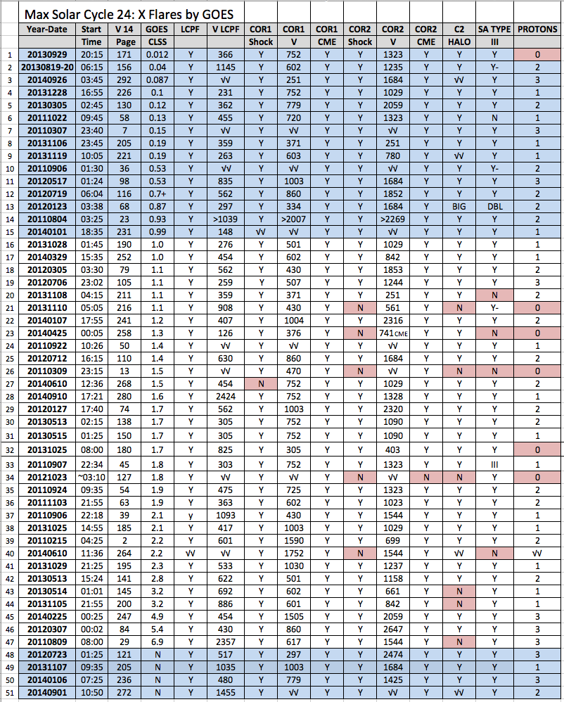
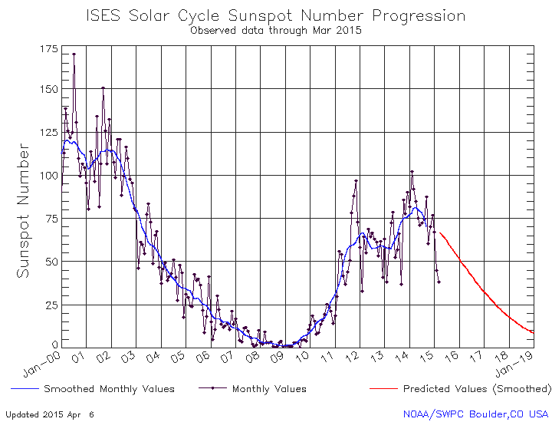
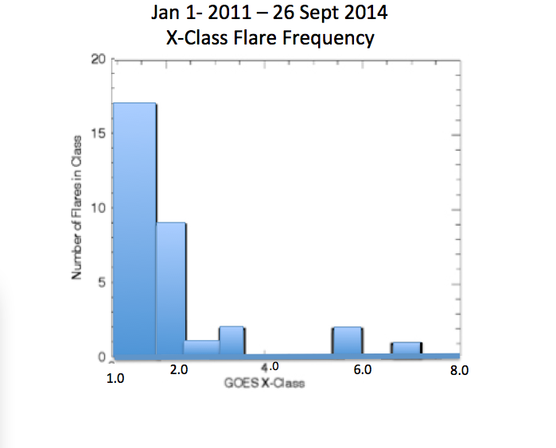
Notes:
SLIDE 3: INFRASTRUCTURE
A database of 52 Entries, of which 33 are X-Class Flares
Blue background -- significant activity, but not X-Class Flares
White Background -- the X-Class Flares of this study
Many events showed a similar evolution, therefore
one event 20120307 X-5.4 will be used to demonstrate this study.

Slide 6
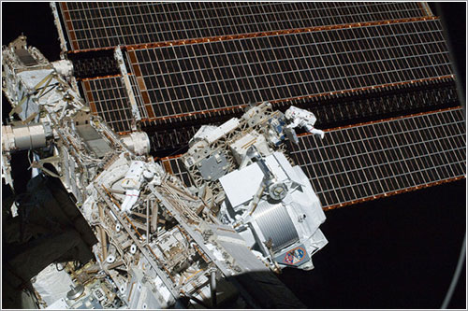
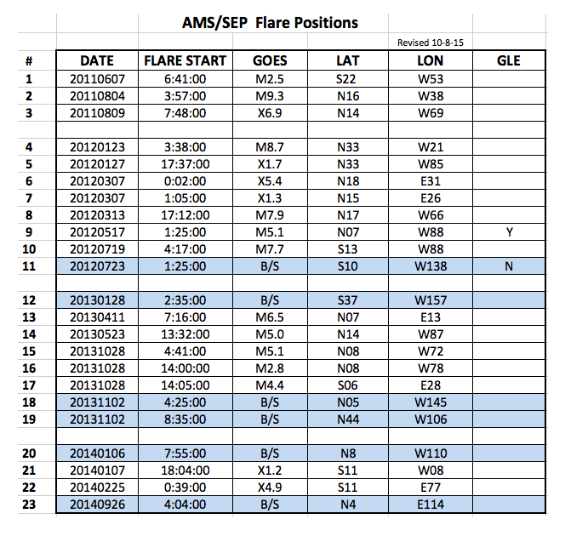
AMS-02 SEP Events
Solar Cycle 24 1011-2014

Slide 7
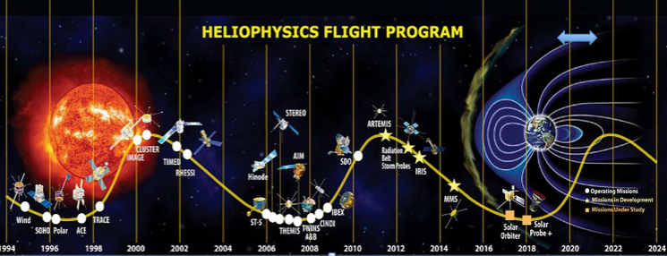
A set of 54 Flare events, 33-X Class
and 23 AMS-02 events were used to
investigate flare activity around the
maximum of Cycle 24, 2011-2014
33 were GOES-X class
23 Were identified by their association with energetic SEP events (300-Mev – 1.0 Ge V)
detected by the AMS-02 instrument on the ISS. (“AMS-02 events”)
The AMS-02 subset is comprised of 6 X-class and 11 M-class flares, with 6 others associated
with flare activity on the back of the sun as seen from Earth – not detected or classified by the GOES integrated x-ray flux detector.
12 Flares were associated with terrestrial geomagnetic storms. Only one of these was included in the AMS-02 list (M9.3 201108040).
Flares associated with terrestrial geomagnetic storm activity had GOES classes of 3 X-class, 3 M-class, 1 C-class and 5 not detected or classified by GOES (back of solar disk)
]
d

Slide 8
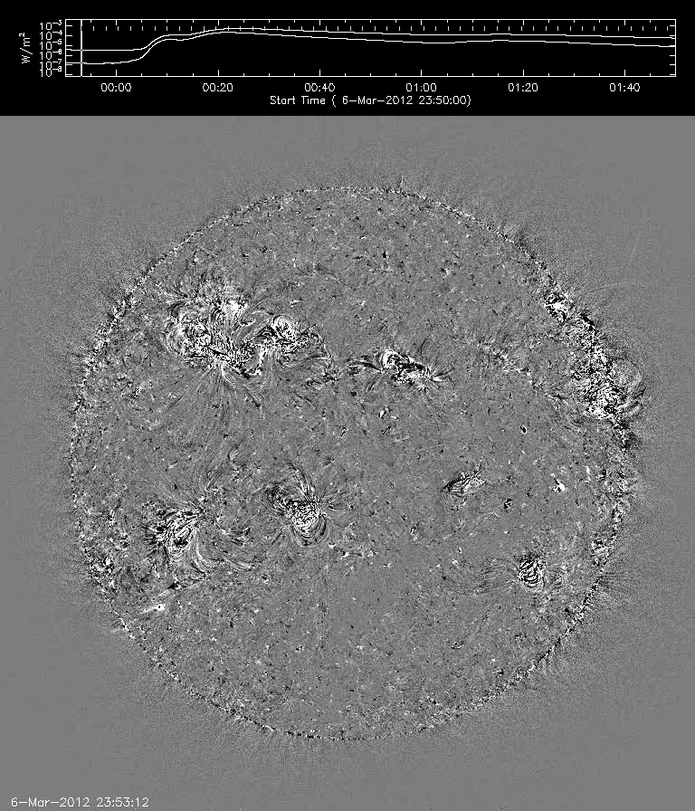
20120307 LCPF FeXII 193 Running Difference
Notes:
Black START

Slide 9
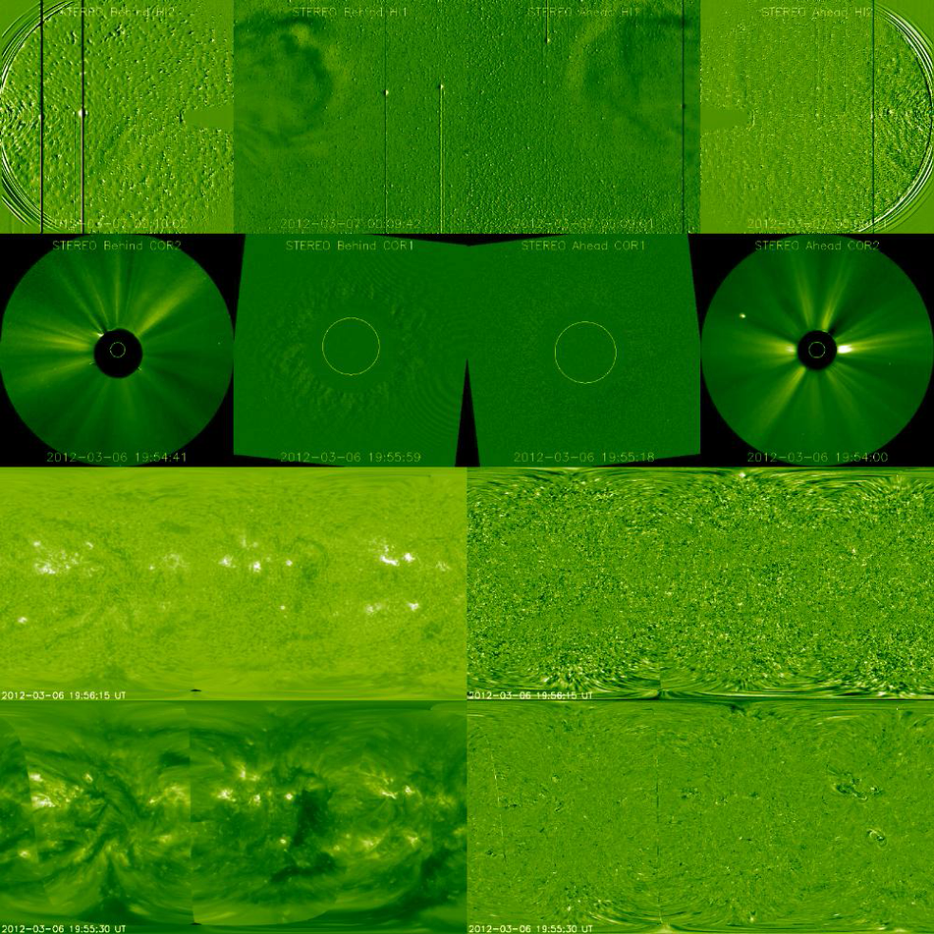
20120307 Solar Diagnostic
Helio Hi 2B
& Hi 1B
Corona
Cor2B-Cor1B
304 Full Sun
Intensity
193 Full Sun
Intensity
Helio Hi 2B
& Hi 1B
Corona
Cor2A-
Cor1A
304 Full Sun RDIF
193 Full Sun
RDIF
FGS
CME
X 5.4 Flare
LCPF
Notes:
SLIDE 4: Demo of SOLAR-HELIO DIAGNOSTIC 25 SEC
45% of disk involved
Acceleration= 1200
V DISC = 837 km/sec (Nitta et. al. 2012)
V Plate Courée = 714 km/sec (Fisher and Rock 2015)
V COR 1 = 647
V COR 2 = 2300
V DONKI = 2200
V HELIO ~ 800

Slide 10
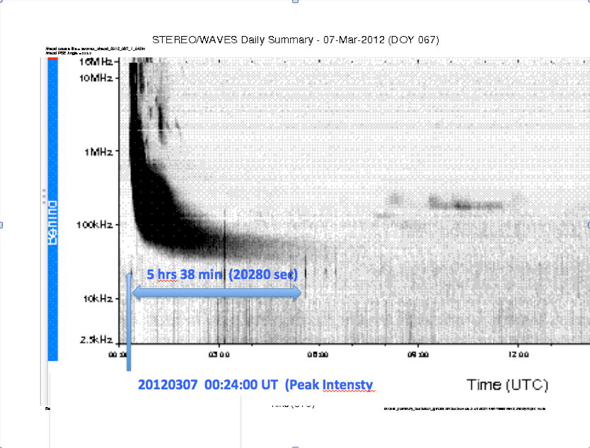
20120305
Intensity)
Notes:
SLIDE 13:
Flare accelerated Type III radio burst from Stereo B
Broad band tail
Burst initiates at time of AIA flare initiation
Second radio burst, if any, blended with the previous larger flare
Broad band decametric radio feature approximately 5.5 hours in duration

Slide 11
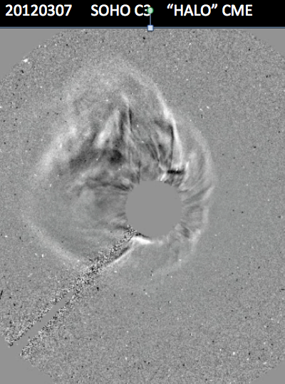
20120307 SOHO C3 “HALO” CME
Notes:
SLIDE 10:
Demonstration of the so called Halo CME as seen in SOHO C3 RDIF image sequence
CME is optically thin
CME is relatively close to disc center as seen by SOHO

Slide 12
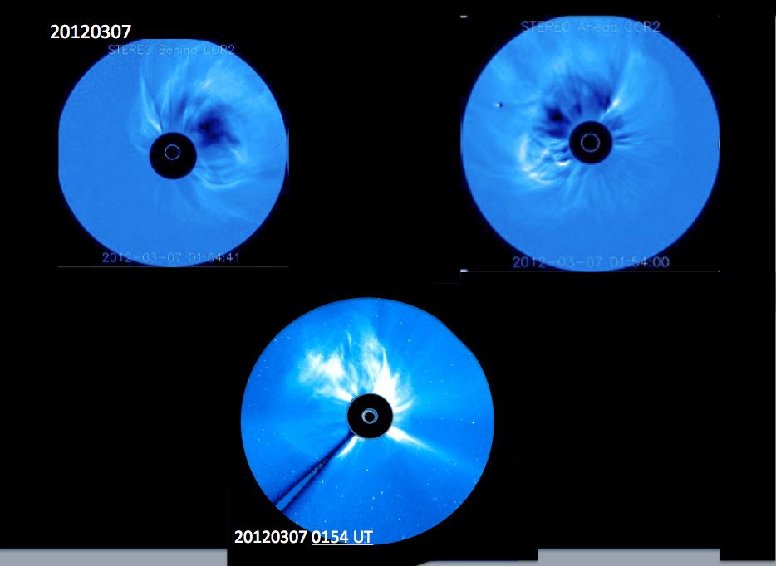
20120307 STEREO A Cor2, SOHO C2, STEREO B Cor2 - FGS CME
Notes:
SLIDE 6: CME from 3 viewpoints
Simultaneous observation from 3 vantage points in Solar System
CME expansion rate approximately equal
CME is optically thin
CME characterized by Cactus and DONKI as a “halo” CME

Slide 13
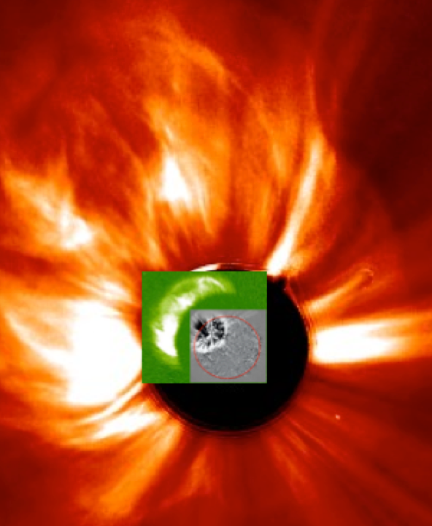
20120307 Stereo A Cor1, Cor2, AIA-193 RDIF
COR 2 ENVELOPING
SHOCK FRONT
COR 2 “HORN”
COR 2 DEFLECTED STREAMER
CME MATERIAL
COR 1 SHOCK
COR 1 CAVITY
COR 1 PROMINENCE
COR 2 “HORN”
AIA LCPF
Notes:
SLIDE 5: Combined FOV check list of disc to 20 Ro
NOTE: White circle is an ellipse and does not fully characterize the oblate spheroid of the shock front

Slide 14
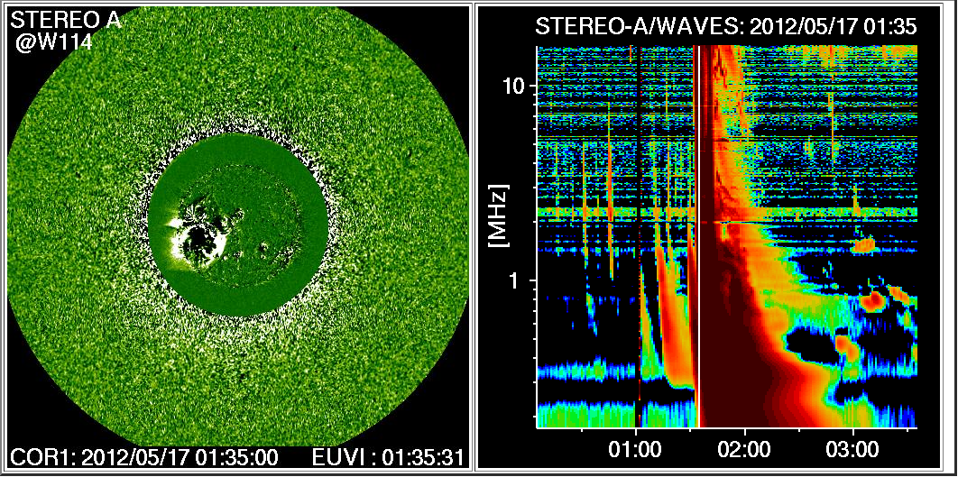
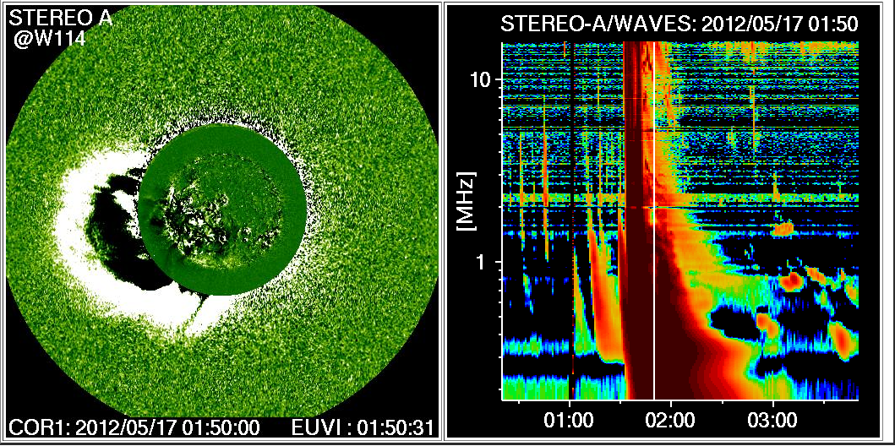
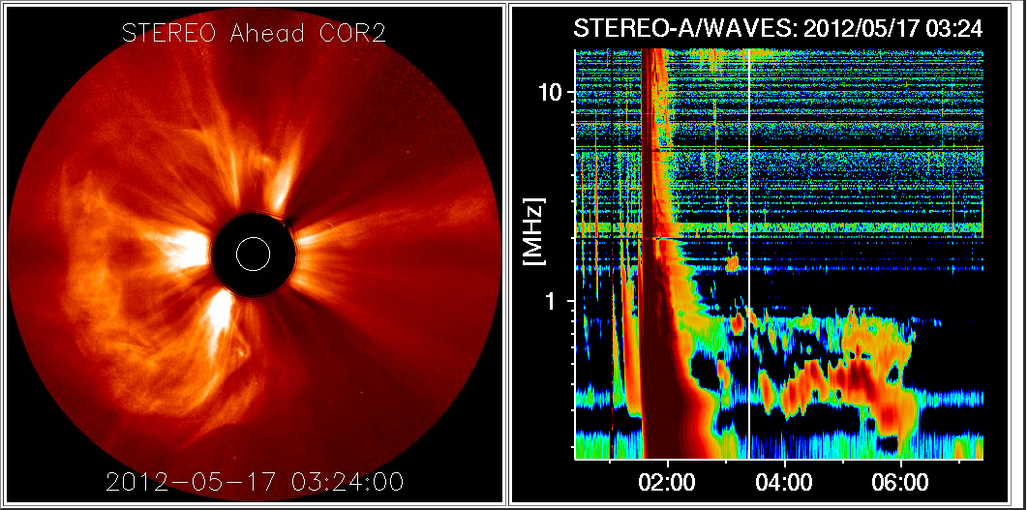
STEREO A20120517
20120517

Slide 15
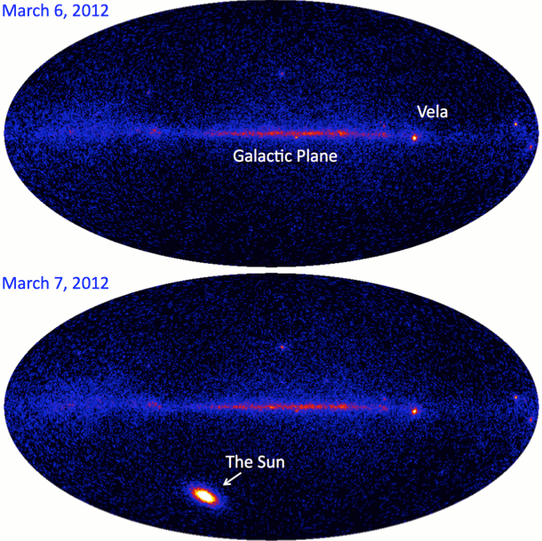
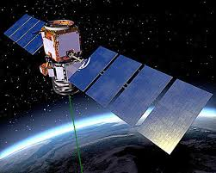
FERMI

Slide 16
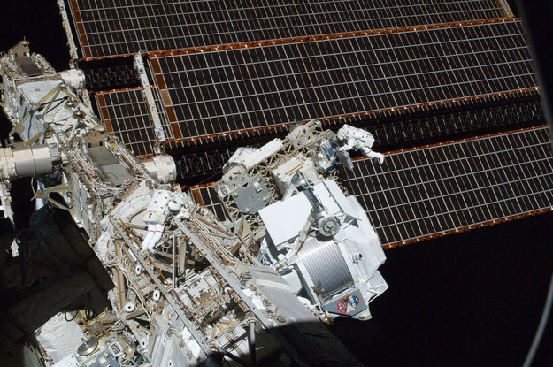
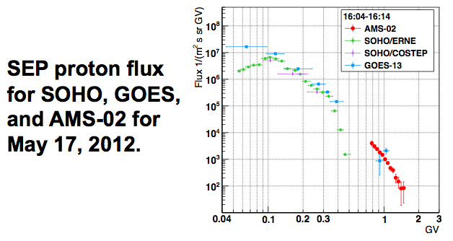
AMS-02 (ISS)

Slide 17
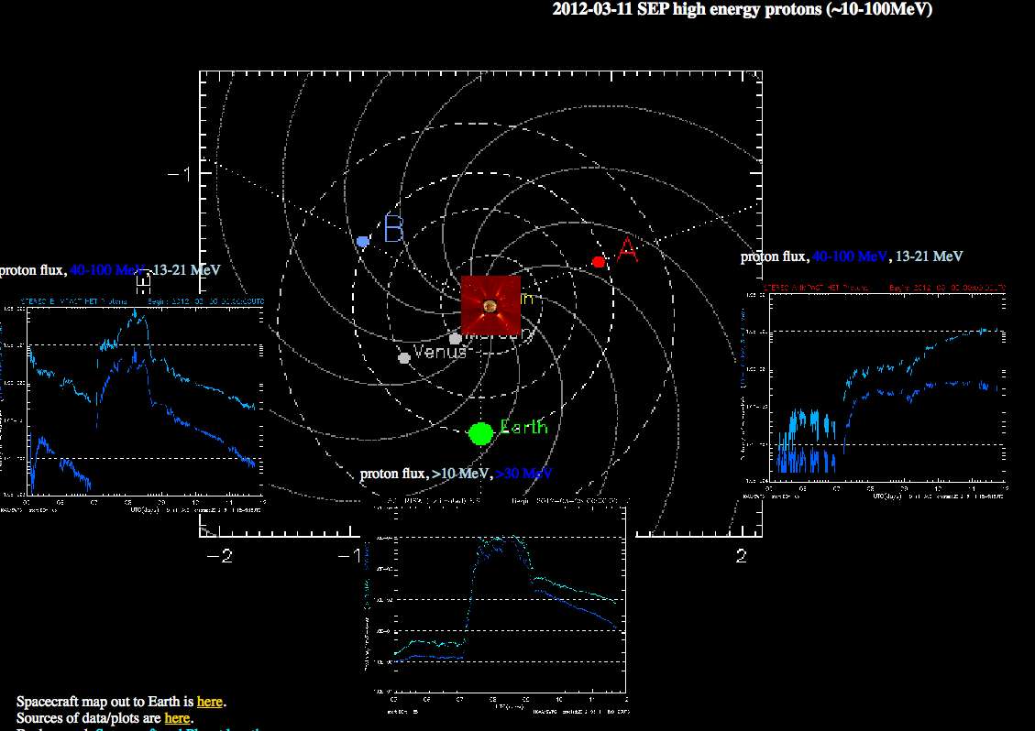

20120307 - 20120311 SEP Duration
2012-03-09 SEP-High Energy Protons (~10-100 MeV)
Notes:
SLIDE 14:
SEP high energy protons
Four order of magnitude increase in proton flux detected over large volume of solar system
Heliospheric diagnostic from STEREO A and B
Two instruments provide a means of visualizing Earth directed plasma
In this specific case 20120307, a geomagnetic storm on the Earth was measured
Timing and velocity identify geomagnetic storm with flare

Slide 18
2011-2014 Findings:
LCPFs
Electron
Dome
CMEs
Coronal
Shock
Wave
SEPs/ L
Bursts
West
Bias
ALL AMS-02 Events and ALL X-flares generated LCPF structures in the lower corona. Physical sizes range from 0.2-1.3 solar hemispheres as seen in the Fe XII 195 running difference image sequences of STEREO and SDO imagers.
MOST AMS-02 and X-flares (97 %) ejected a hemispheric, dome shaped electron CME structure seen in the lowest (Cor-1) coronal images.
ALL AMS-02 flares and MOST (97 %) X-flares produced 3-part CME events, with approximately equal rates of latitudinal, longitudinal and radial expansion rates.
In the cases of the CMEs, MOST AMS-02 (97 %) and MANY X-class flares (81 %) were found to be enveloped by a leading shock wave.
ALL AMS-02 events were associated with Type-III-L radio bursts with duration longer than 150 minutes. Most X-Class flares (60 %) were associated with either (classical) Type III bursts - (36 %) type III-L burst .
Locations of originating AMS-02 flare sites were found to be biased toward the
Western limb of the sun - center of mass ~(W60) suggesting a direct magnetic
connection with Earth for a fraction of the ejected protons.

Slide 19
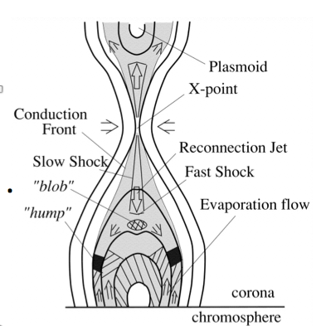
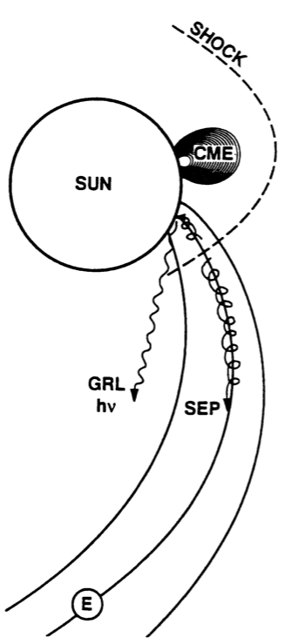
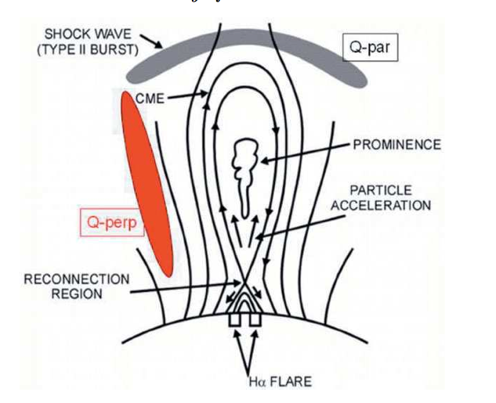
7. The set of 33 X-Flares does not show a marked E-W location bias and are more or less uniformly distributed over solar longitude.
.8. SEP inferred duration estimates may be dependent upon the location of the location in situ measurement systems ( ACE, SOHO, STEREO A&B).
9. Some AMS SEP events have wide longitudinal extent at a distance of 1 A.U.

Slide 20
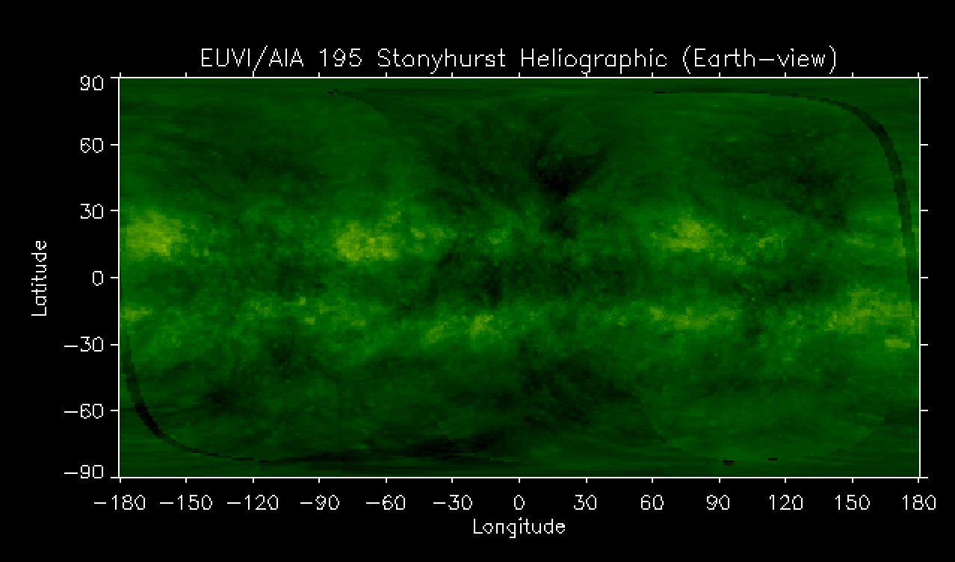
Location of AMS-02 Flares 2011-2014v3.0
20131102
20120307
2012123
20120313
2012127
20130523
20120307
20110804
20131028(2)
20140926
20130411
20110809
20120517
20140106
20131102
20140225
20131028
20140107
20120719
20120723
20110607
20130128

Slide 21
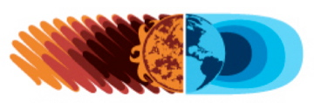
Pau Hana

