Slide 1




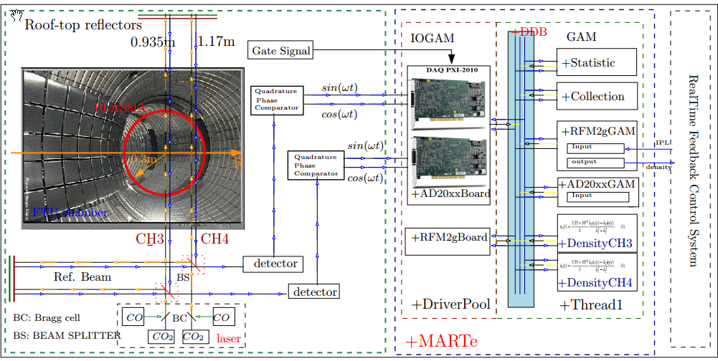

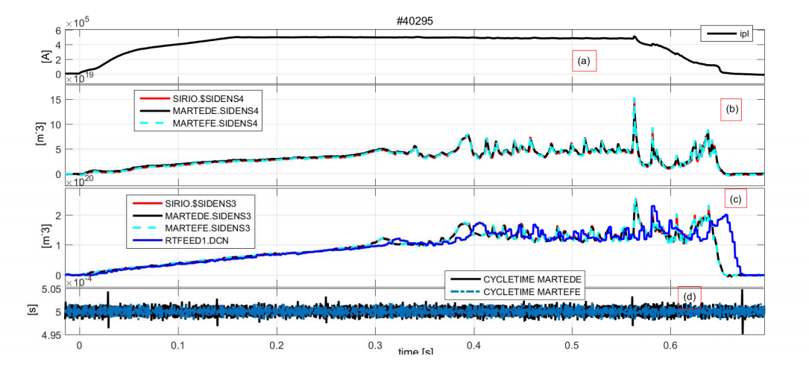
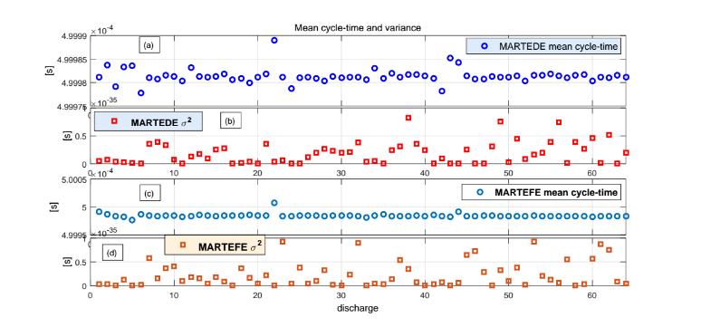
MARTe real-time acquisition system of a Two-Color Interferometer for
electron density measurements on FTU (Frascati tokamak upgrade)
M. Gospodarczyk ², L. Boncagni¹, O. Tudisco¹, D. Carnevale², B. Esposito¹ and the FTU Team
¹ENEA Unità Tecnica Fusione, C.R. Frascati, Via E. Fermi 45, 00044-Frascati, Roma, Italy
²Dipartmento di Ing. Civile e Ing. Informatica, Università di Roma, Tor Vergata, Via del Politecnico 1, 00133-Roma, Italy
OBJECTIVE OF THIS WORK
Development a new real-time acquisition system of a two-color interferometer (Figure 1) installed on FTU (a medium size tokamak device: major radius R = 0.935m, minor radius a = 0.3m, toroidal magnetic filed Btor = 4 ≤ 8T and current plasma IP < 1.8MA) that calculates, in real-time, the density along 2 fixed chords, central chord (CH3) at 0.935 m and external chord (CH4) at 1.17 m. sampled at 200 Khz and processed at 2Khz.
The electron density provided by the CO2 ( = 10.6µm) and CO(=5.4µm) lasers, of the two-color interferometer discussed ref.[1], can by computed on-line by eq.(1) during the pulse by a Generic Application Module (GAM) running on a RT-Thread deployed on the developed MARTe system ref.[1].
PROCEDURE
Interferometric data are acquired with two high speed acquisition boards (DAQ) and one Reflective Memory (RFM) module. The two boards are externally synchronized by the gate signal (synchronizing all FTU devices).
The first DAQ has been devoted to the acquisition of four channels (CO2 and CO lasers) to evaluate the central chord CH3 and similarly other four channel for the CH4 are acquired by the second DAQ. Each one-half millisecond 100 samples for each channel are acquired, and then read the plasma current, calculated by the real-time Feedback control system, using the RFM. As first, the software corrects the sine and cosine signals (Fig. 1) removing the offset from the two probing beam laser, then computes the CO_2 and CO phases and the electron density with an average over 0.5 ms using the Density Elab. GAM that implements eq.(1) and the results are provided to users via RFM module.
Figure 1: A schematic layout of a two-color interferometer. On the left: the poloidal section of the path of the fixed chords (CH3 and CH4).
On the right: schematic of MARTe architecture.
Results
The Acquisition (200 Khz) and the density elaboration (2 Khz) has been successfully tested more than 60 shots with a wide range of plasma parameters during the last experimental campaign.
In Figure 2 the comparison of the line density evolution elaborated by MARTe system, SIRIO system (off-line elaboration) and the actual real-time density elaboration system by Main Feedback system (rtfeed1) (solid blue line) is shown.
The mean value of the executions time of our RT system is 500μs and his variance, show in Figure 3 (b) and (d), is almost negligible ( ≈10−35).
In Figure 2 we also show the density profile (blue line) of the existing real-time system as we can see our density (black line and cyan line) doesn't exhibit the time delay and has the same density profile of SIRIO density elaboration.
Figure 2: Comparison of interferometric measurements on two chords for a 500 kA discharge. (a) Plasma current, (b) CH3 and (c) CH4: MARTe density elaboration (black line) and MARTe feedback system (cyan line), SIRIO density off-line elaboration (red line) and rtfeed1 realtime density elaboration (DCN, blue solid line) and (d) density computation time (solid black) and rtfeed1 computation time (blue dash-dot) .
CONCLUSIONS
The measure of the density using two LOS was successful computed
during the last experimental campaign as show above.
The next step will be the elaboration in real-time of the Two-color
medium-infrared scanning interferometer described in [4].
The use of such scanning interferometer will allow to improve the
estimation of the runaway beam radial position in real-time enabling
robust runaway beam suppression strategies [1][2].
Figure 3: Real-time performance for different discharge. (a) and (b) MARTe density elaboration (c) and (d) MARTe feedback system: mean cycle-time value (blue circle) and the variance σ (red/orange square)
ACKNOWLEDGEMENTS
This work has been carried out within the framework of the EUROfusion Consortium and received funding from the Euratom research and training programme 2014-2018 under grant agreement No 633053. The views and opinions expressed herein do not necessarily reflect those of the European Commission.
REFERENCES
[1] L. Boncagni, Y Sadeghi, D. Carnevale, ..., “First steps in the FTU migration towards a modular and distributed real-time control architecture based on MARTe”, Nuclear Science, IEEE Transactions on 58 (4), 1778-1783
[2] L. Boncagni, D. Carnevale, ..., “A first approach to runaway electron control in FTU”, Fusion Engineering and Design 88 (6), 1109-1112
[3] Luca. Boncagni, et al. “MARTe at FTU: The new feedback control”, Fusion Engineering and Design 87 (12): 1917-1920).
[4] A. Canton, P. Innocente and O. Tudisco ,“Two-color medium-infrared scanning interferometer for the Frascati tokamak upgrade fusion test device”, Appl Opt. 2006 Dec 20;45(36):9105-14.
[5] O. Tudisco, et al. “Chapter 8: The Diagnostic Systems in the FTU”, Fusion Science and Technology Volume 45/Number 3/May 2004/Pages 402-421.

