Slide 1
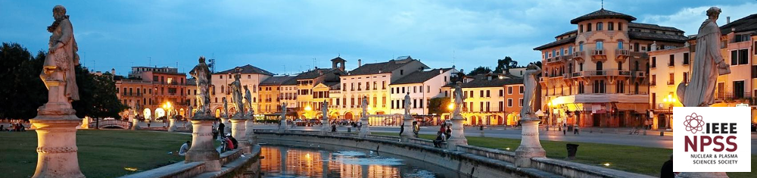


Wavelet trigger
Zbigniew Szadkowski
University of Łódź
IEEE Real Time Conference, Padova, Italy, 09 June 2016

Slide 2

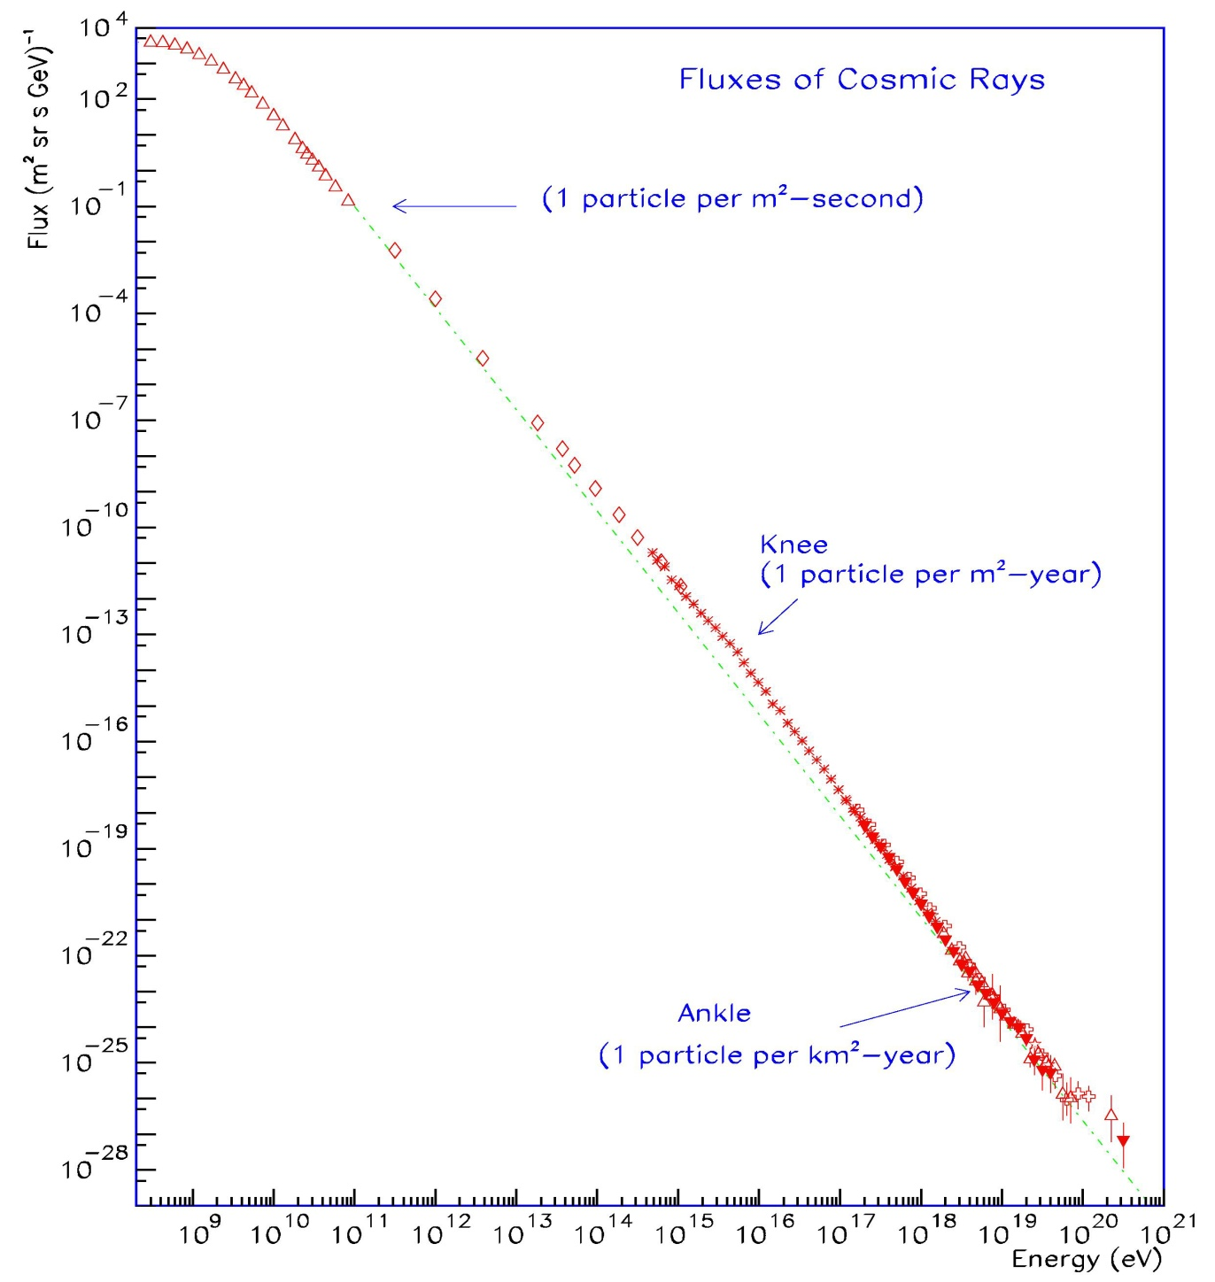
Fluxes of Cosmic Rays
E^{-2.7}
Direct measurements
Indirect measurements
32 orders of magnitude
Ankle
(1 particle /km² yr)
E^{-3.1}
1 particle per km² sr century
Fixed target (p-A)
HERA (γ-p)
Tevatron (p-p)
LHC (C-C)
RHIC (p-p)
LHC (p-p)
12 orders of magnitude

Slide 3
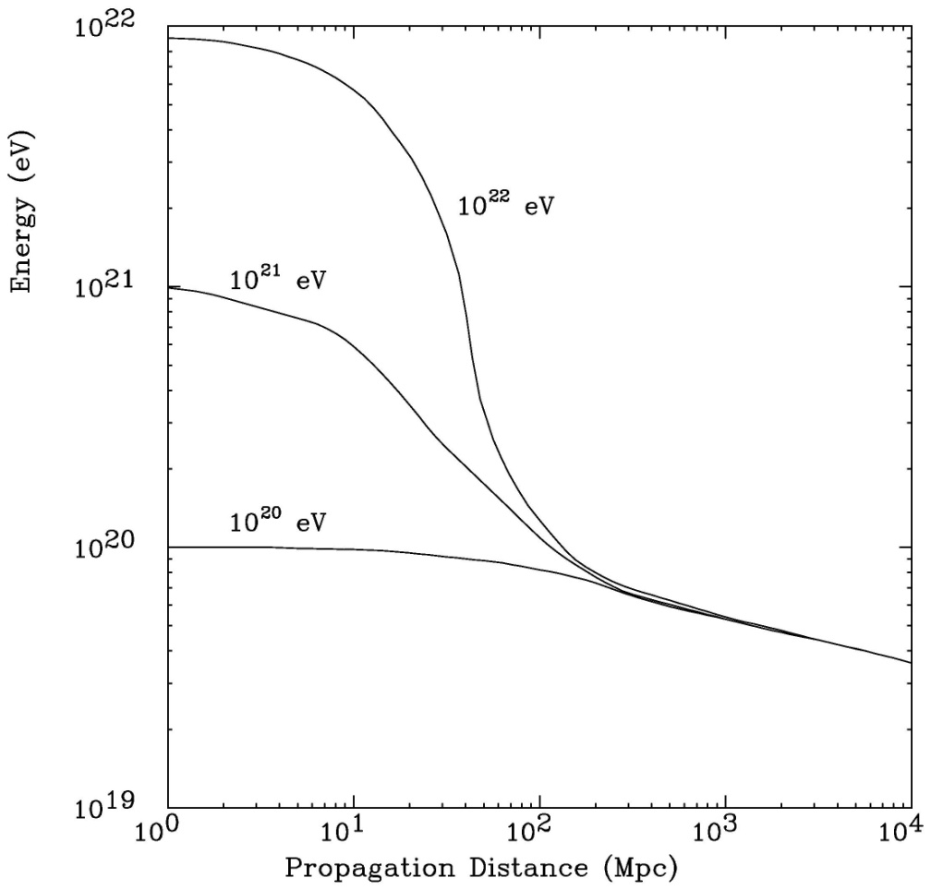
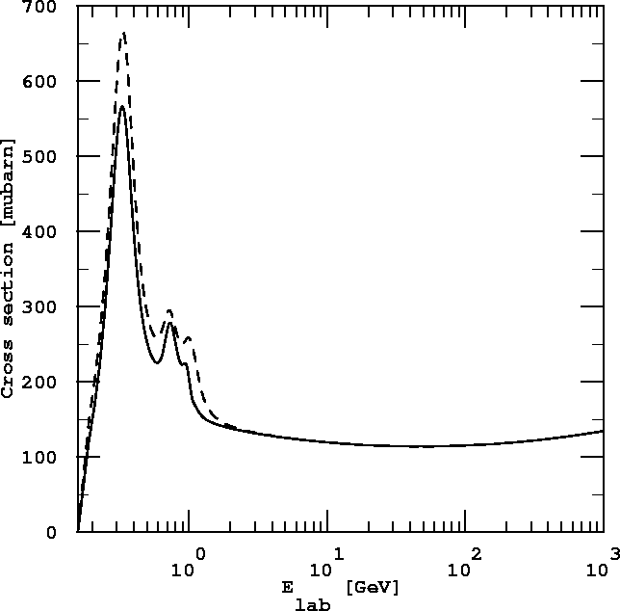
GZK cut-off
J. Cronin, Nucl. Phys. 28B (1992)
Δ-resonance
multi-pions

Slide 4

Bottom-up
A particle penetrating such a cloud from the front can be kicked back, like a tennis ball hit by a racket, with energy larger than its initial value..
A more efficient and faster process is acceleration by crossing shock fronts generated in explosive phenomena (1st order Fermi mechanism - ΔE > 0). The energy of accelerating particles depends on the value and the size of the magnetic field and is limited by the Larmor radius related to their confinement.
Many theories and models propose either sophisticated explanations or require some new physics. One of the models explores ultra relativistic shock acceleration such as in hot spots of powerful radio galaxies and Gamma Ray Bursts. Relativistic jets are produced perpendicular to the accretion disk around a super–massive black hole in the central part of an active galactic nucleus.

Slide 5
Top-down
Many theories propose top–down mechanism, decay of super–heavy, super–symmetric or Grand Unified Theories (GUT) particles. The only problem is a justification of their existence or their surviving after the Big Bang. They could have survived up to now by some yet unknown mechanism (a very weakly violated quantum number, particles trapped inside huge potential walls called topological defects and released via spontaneous symmetry breaking mechanism),
Their decay into some ~10⁴ secondary particles (mainly pions) by hadronization of quark – antiquark pairs would easily produce the ZeV energies we need and their decay products would then be dominated by photons (coming from the decay of neutral pions) and neutrinos (decay of charged pions).
There are a few experimental consequences of this model, which constitute, if observed, a unique and irrefutable signature of the existence of the Grand Unification, a horizon toward which all the modern quantum field theories are supposed to converge, i.e. heavy nuclei would rather exclude the top-down mechanism.

Slide 6
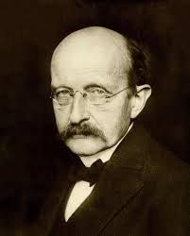
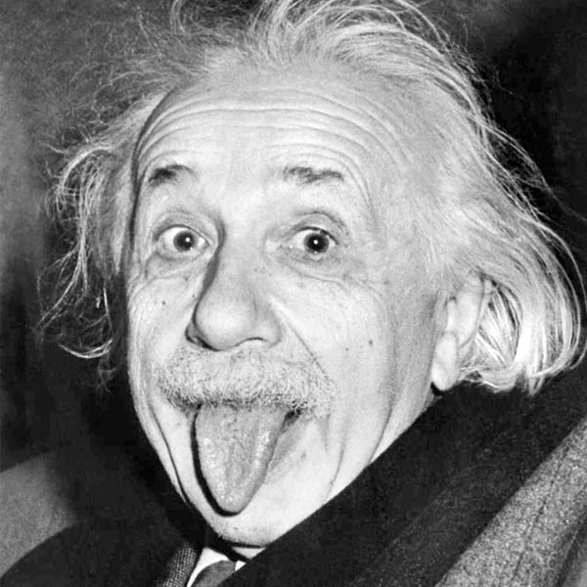
Max Planck & Albert Einstein

Slide 7
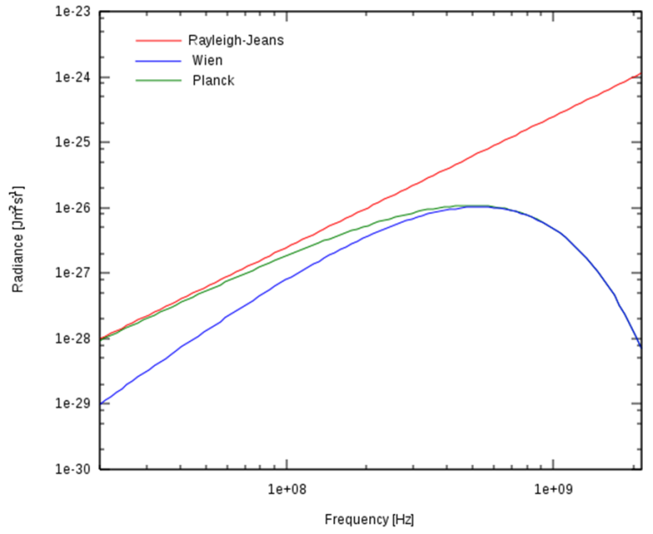

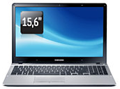


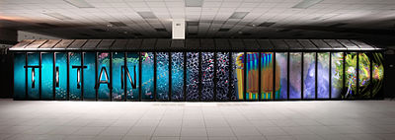
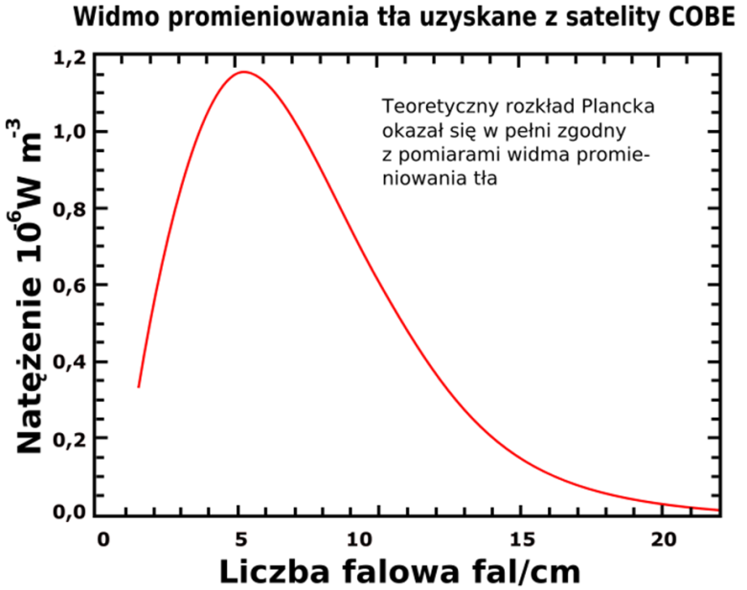
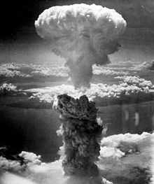
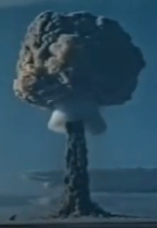
Black body spectrum

Slide 8

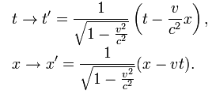



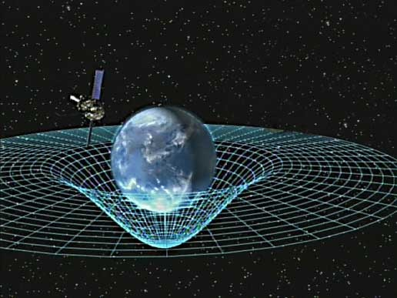
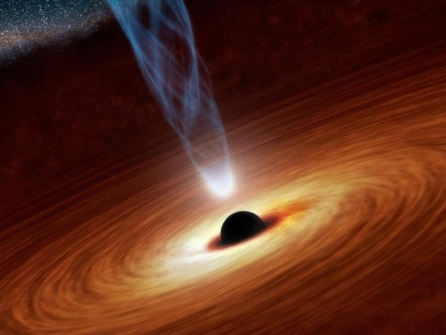
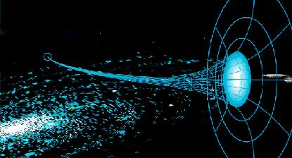
Electromagnetic waves
Special Theory of Relativity
General Theory of Relativity

Slide 9
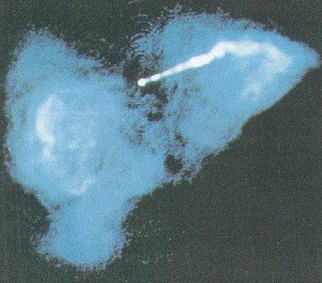
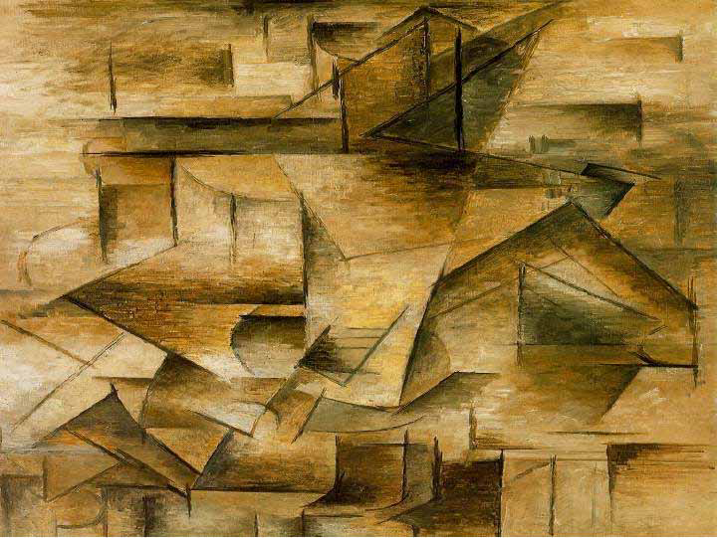
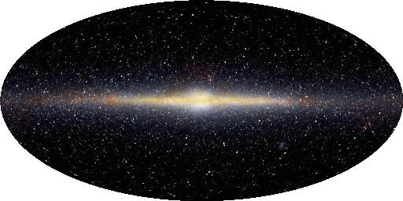
Origin of UHECRs
Galaxy Jets from Black Holes?
Gamma Ray Bursts?
Young Neutron Stars?
Fast Extra-galactic Magnetars?
Topological Defects?
Super Heavy Relics in the Dark Halo of our Galaxy?
Topological Defects?

Slide 10
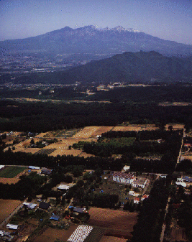
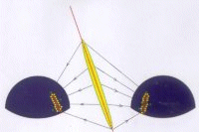
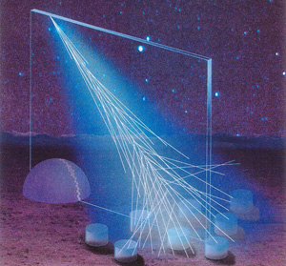
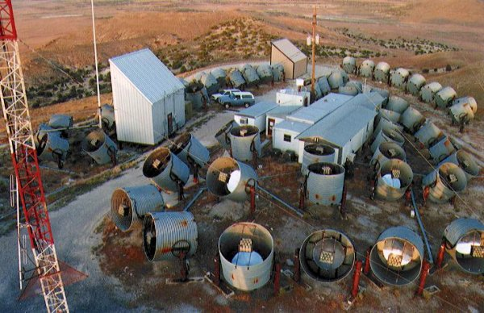
3 independent experiments observe
Ultra High-Energy Cosmic Rays
AGASA
Fly’s Eye
Pierre Auger Observatory

Slide 11
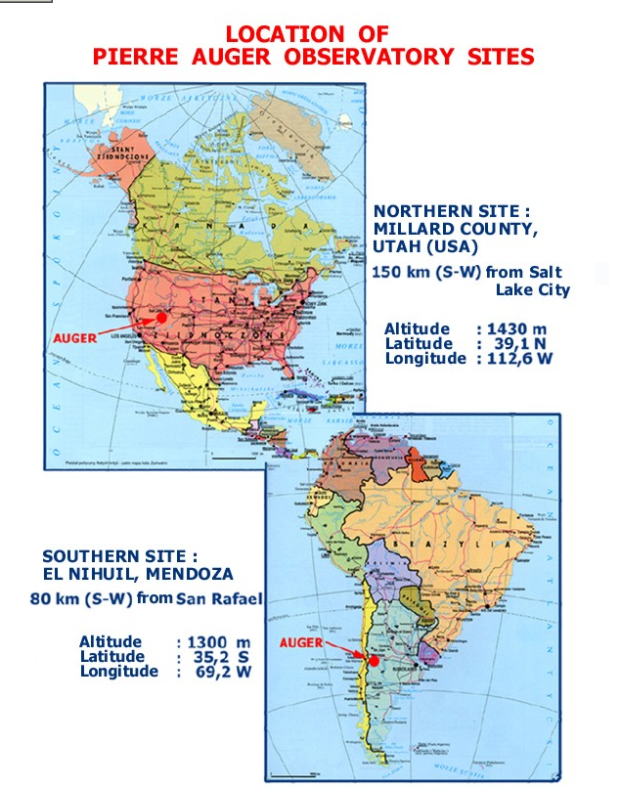
Auger North and Auger South
Northern Site Colorado (USA)
Altitude : 3706 ft ~ 1111m
Latitude : 39° 7' N Longitude : 108° 3' W
Investigation of the origin and propagation of UHECR
GZK cut-off ?
Directions - isotropy ?
  Extragalactic? Galactic? DM halo? Space?
Sources ?
  SM BHs? NSs? Shocks? Jets? DM? TD?
  Acceleration or Decay? Injection Spectrum?
Mass sprectrum ?
  Protons, Mixed Nuclei?
  Any Gammas? Neutrinos?
Beyond the current physics
Southern Site Mendoza province Argentina
Altitude : 1300 m Latitude : 35.2° S Longitude : 69.2 ° W

Slide 12
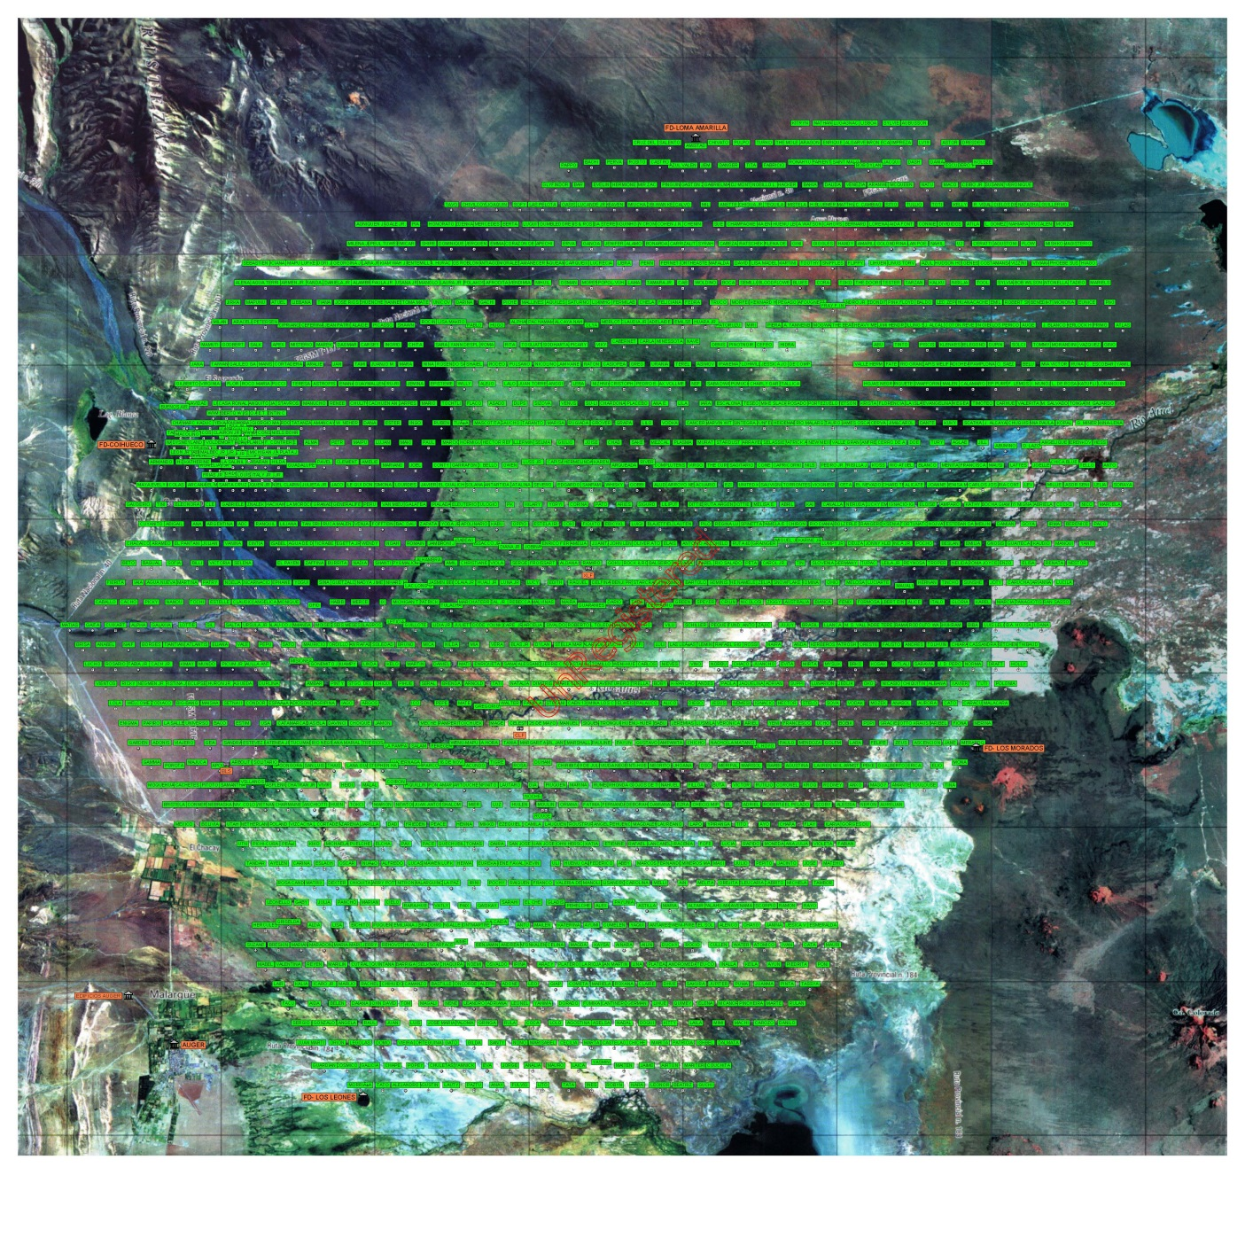
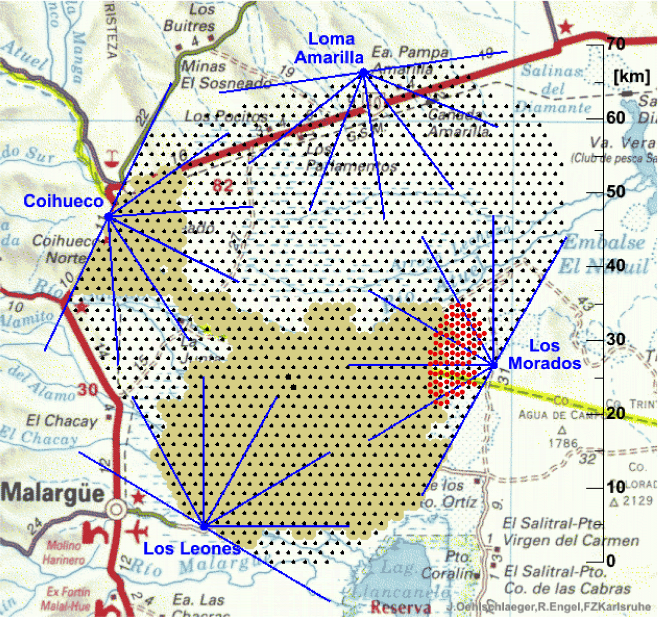
Location of the Auger South detectors
Surface Array
1660 detector stations
1.5 km spacing
3000 km²
Infill Array
Fluorescence Detectors
4 Telescope enclosures
6 Telescopes per
enclosure
24 Telescopes total

Slide 13
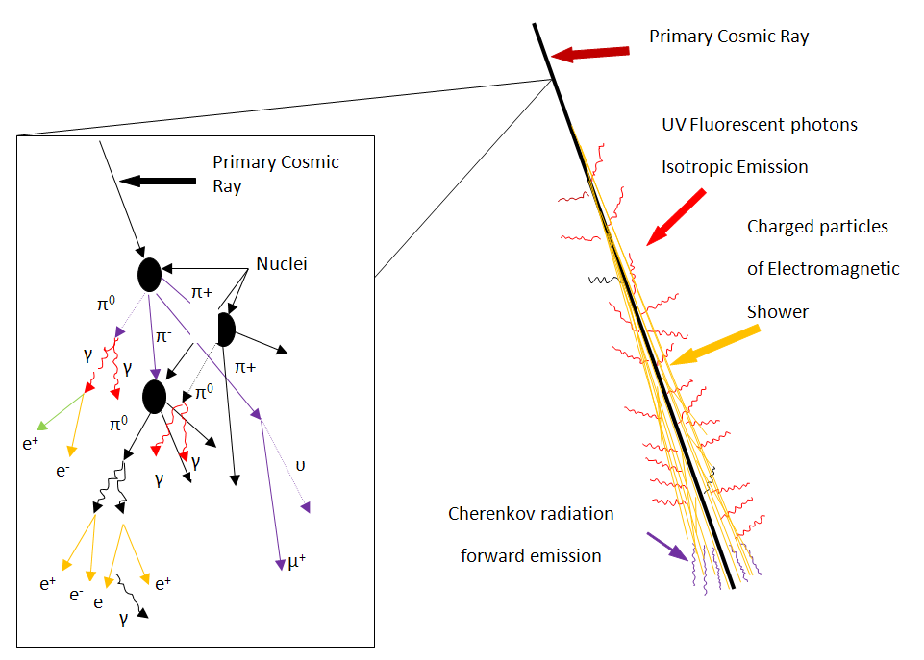
Extensive Air Showers

Slide 14
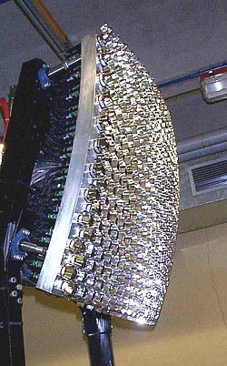
Fluorescence detector

Slide 15
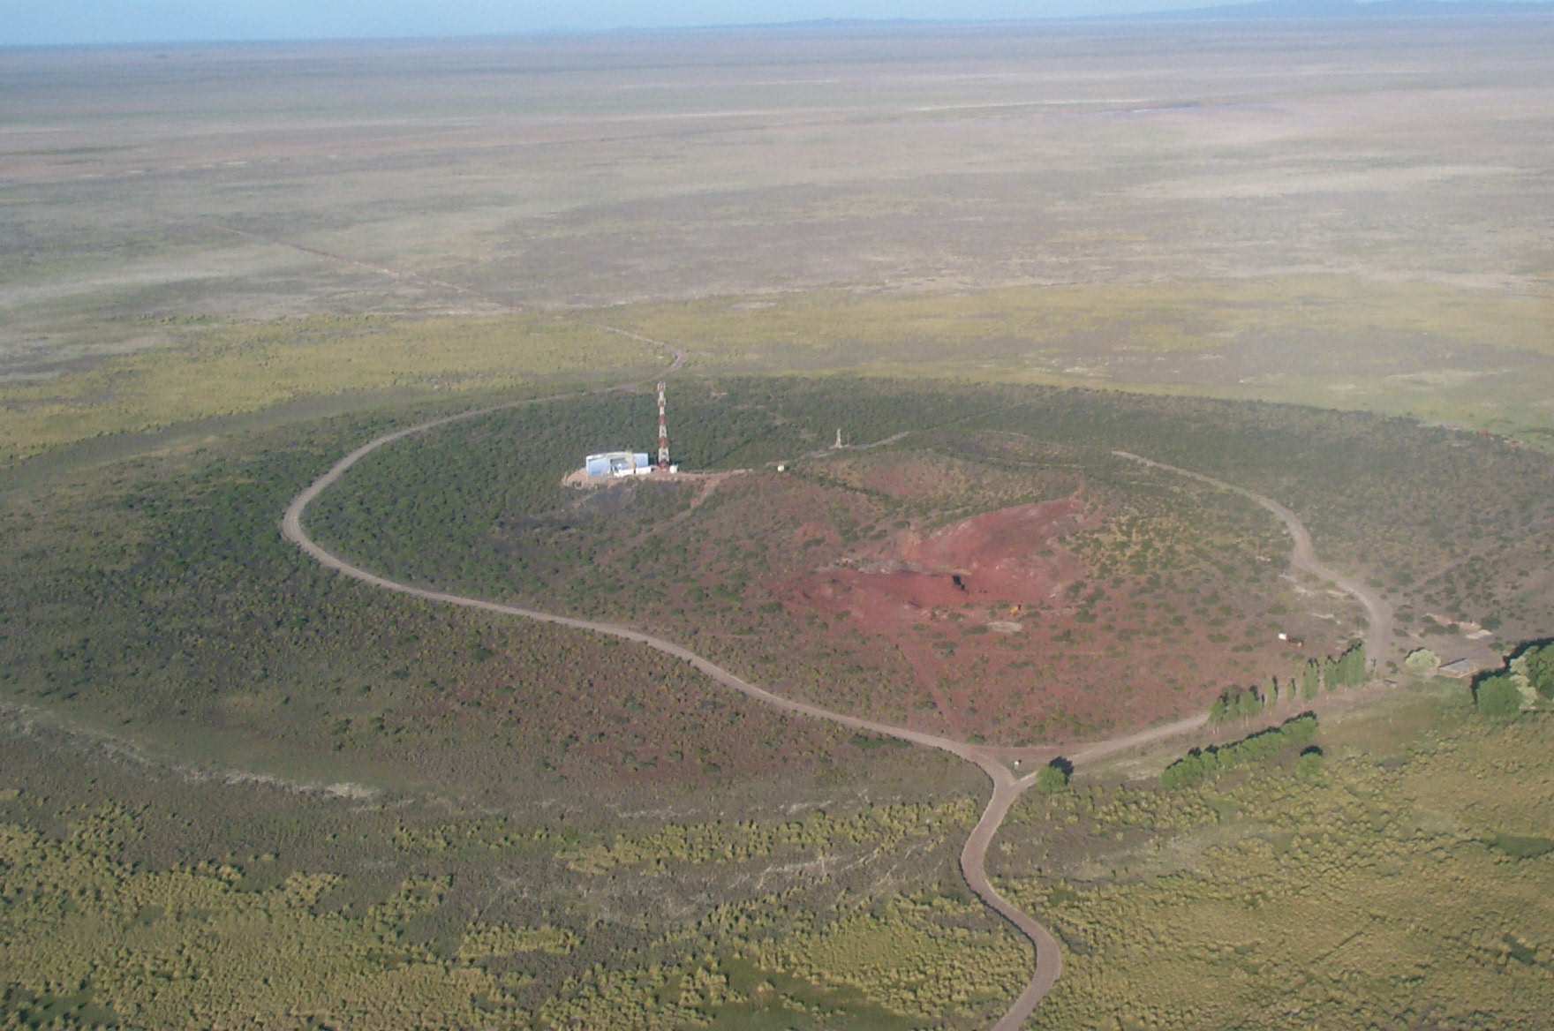
view of Los Leones FD

Slide 16
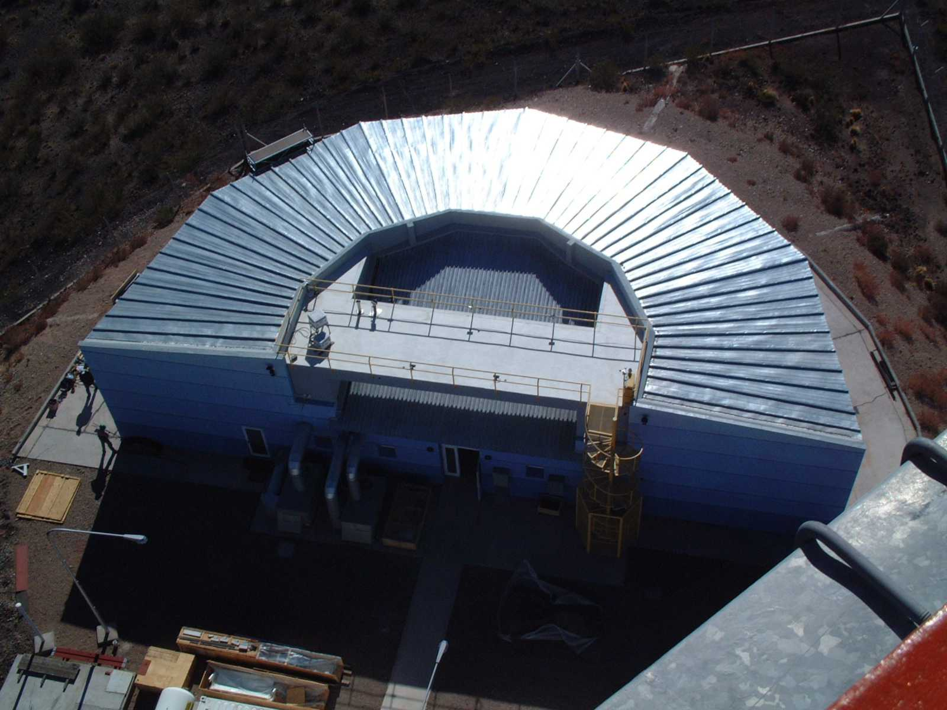
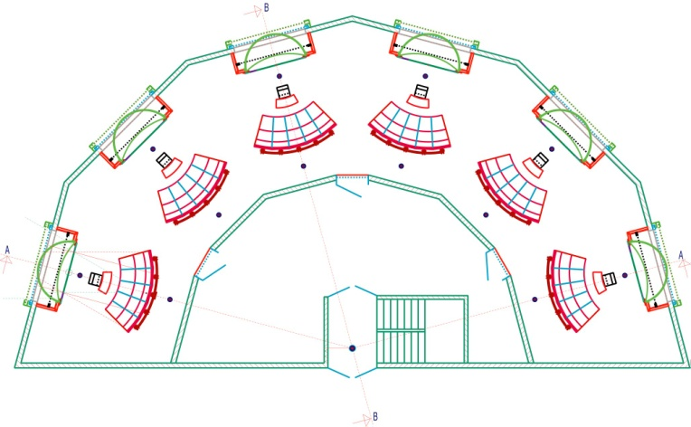

Slide 17
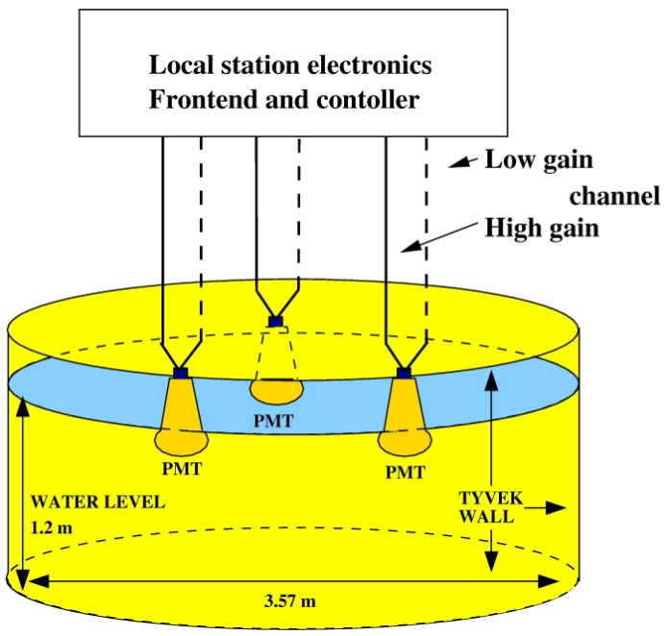
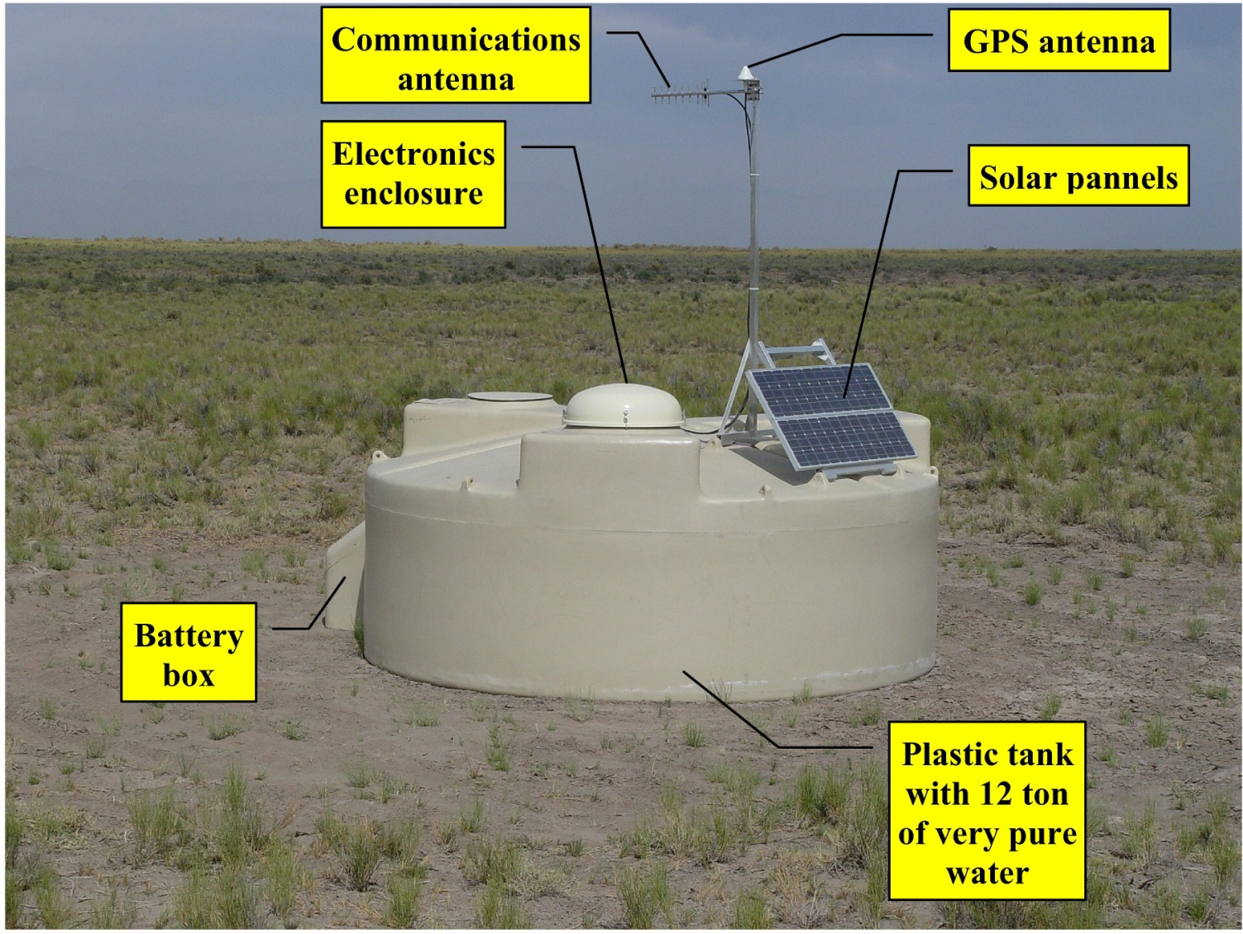
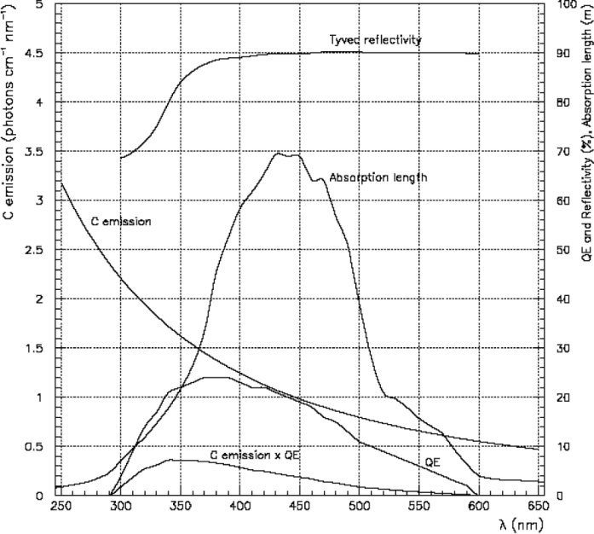
Surface Detector
www.auger.org/admin/DesignReport/index.html

Slide 18
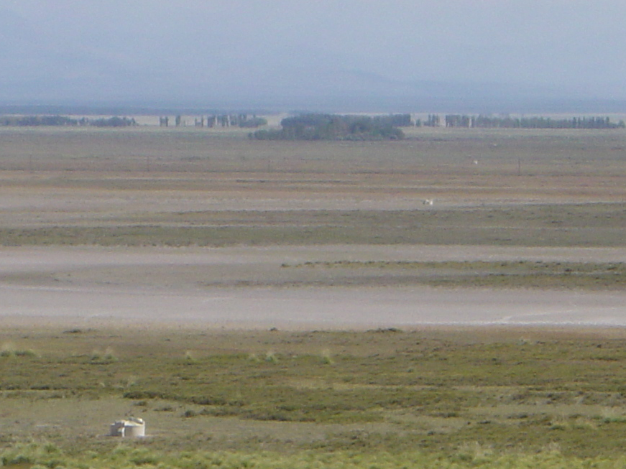
tanks aligned seen from Los Leones

Slide 19
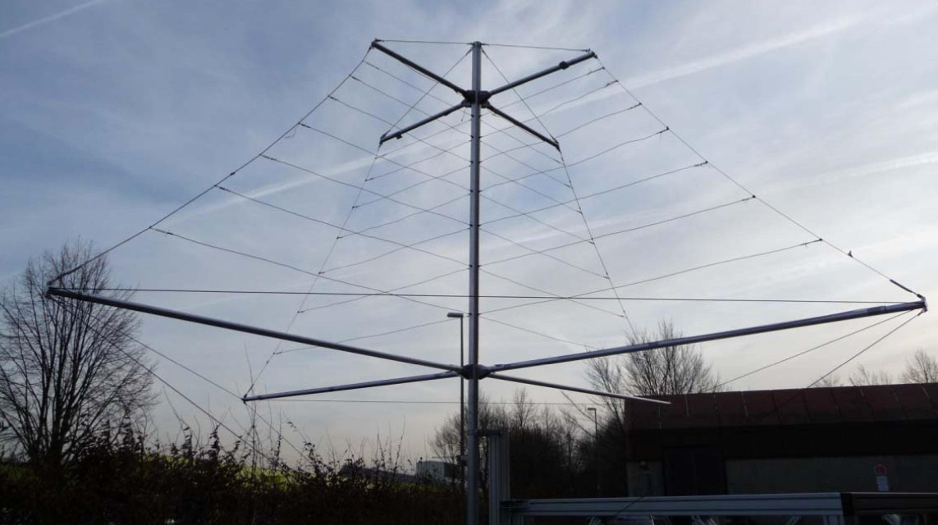
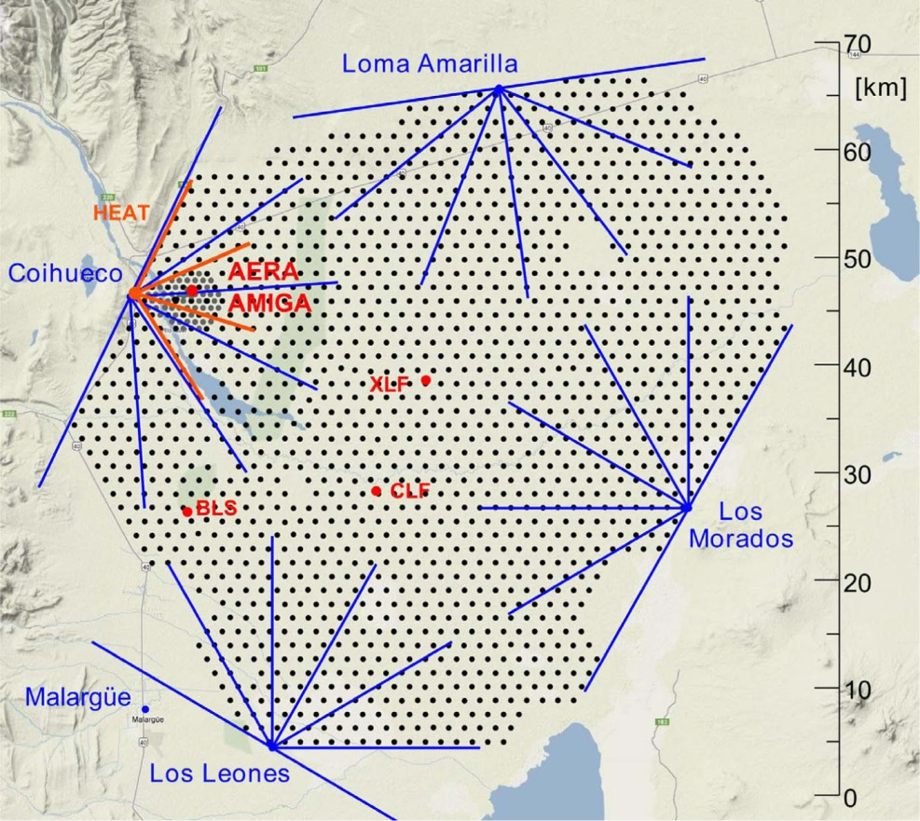
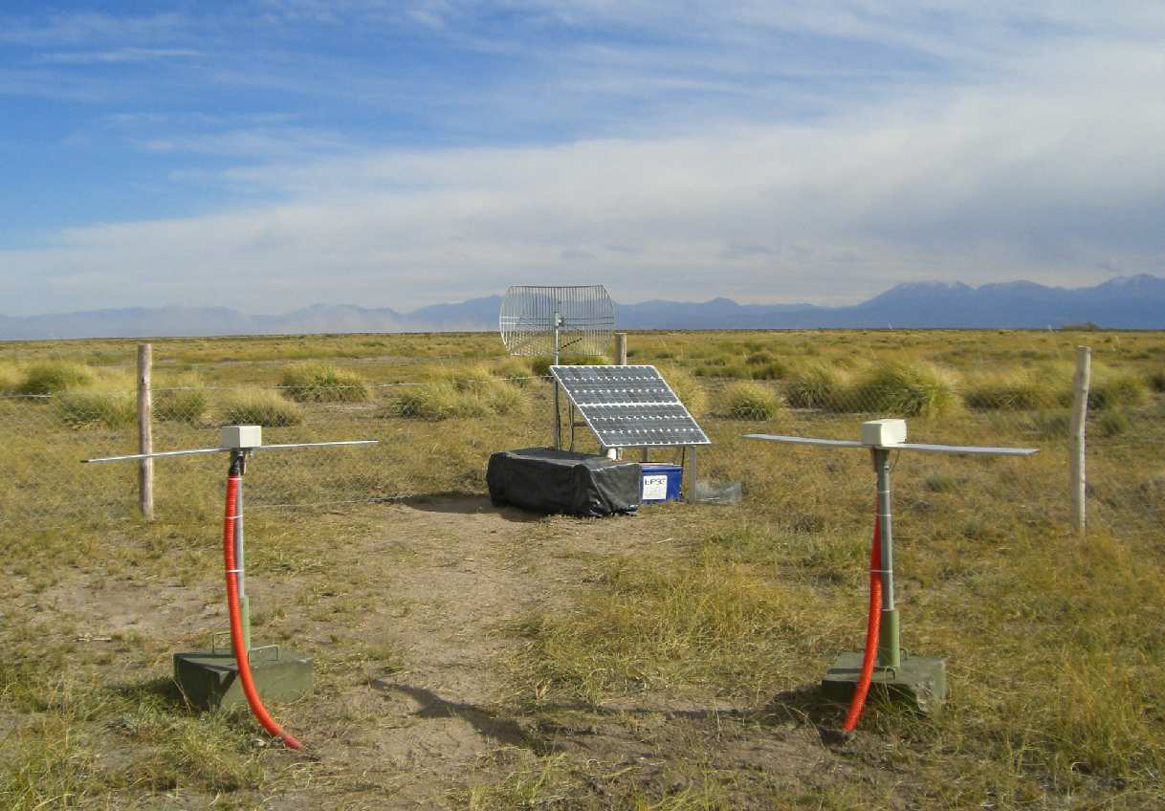
Radio detector

Slide 20
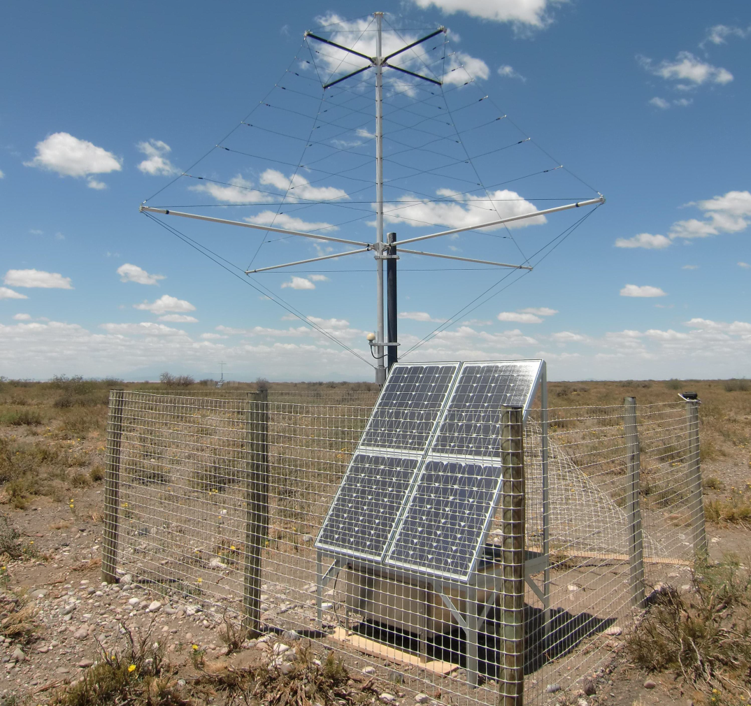
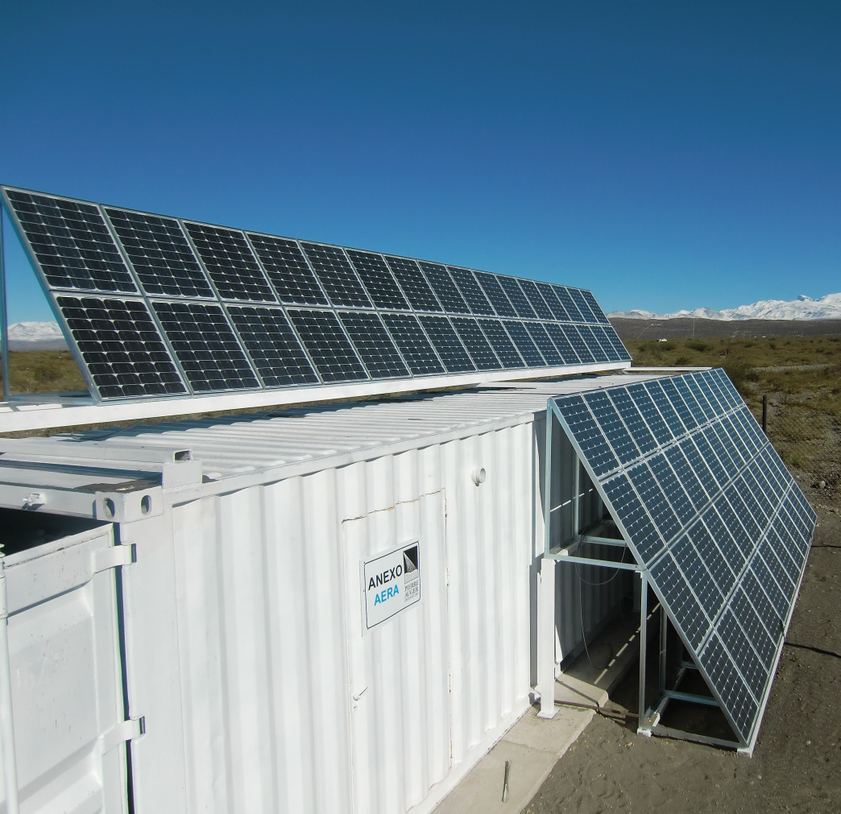
Auger Engineering Radio Array

Slide 21
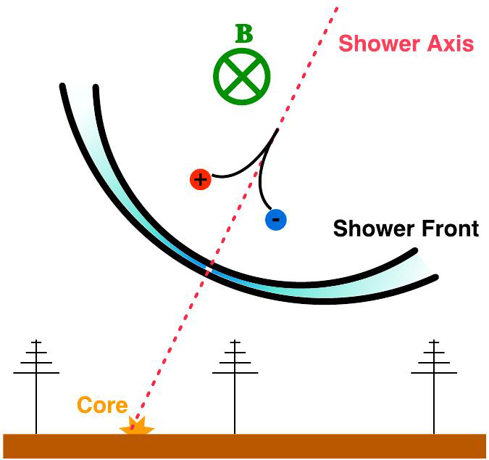
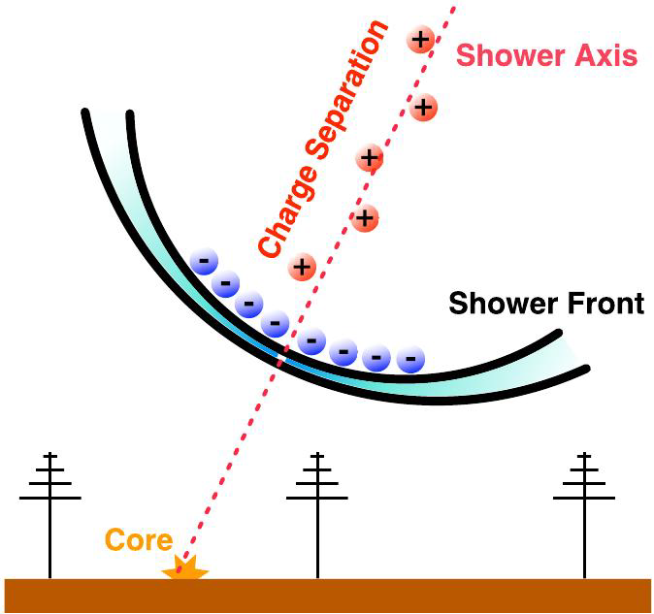
Geo-magnetic radiation and charge excess

Slide 22
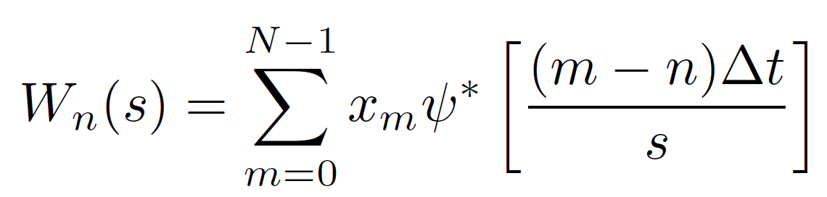
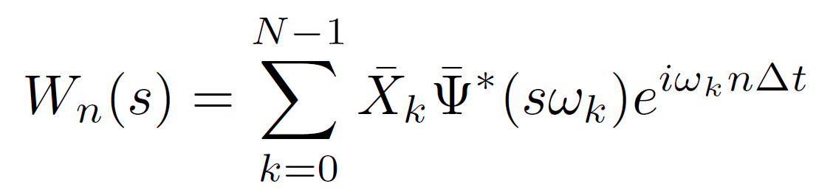
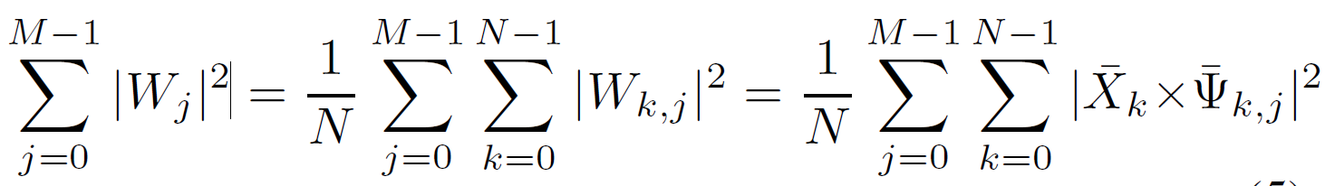
Wavelet formulas

Slide 23
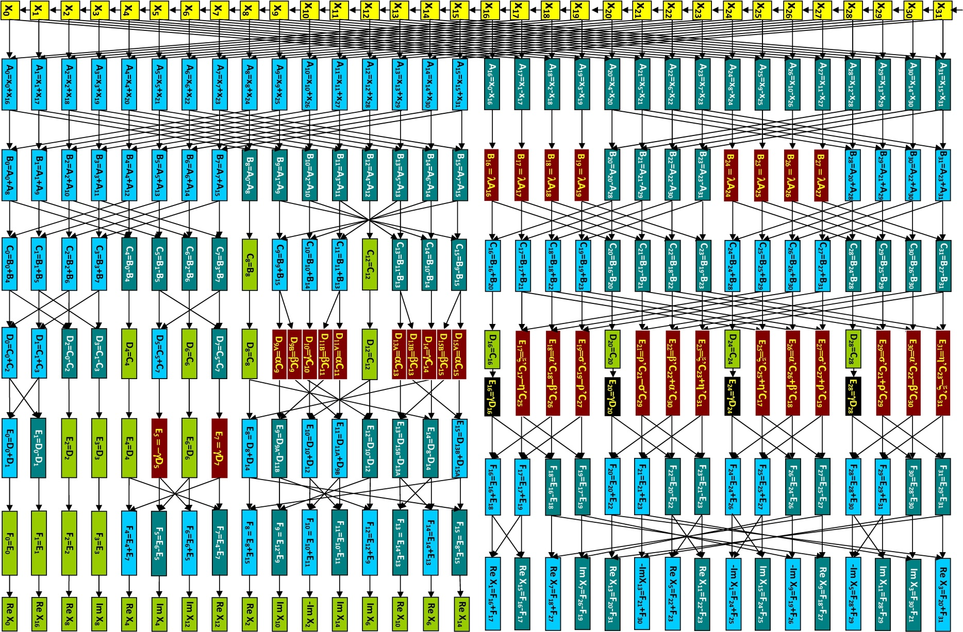
FFT32 in the FPGA

Slide 24
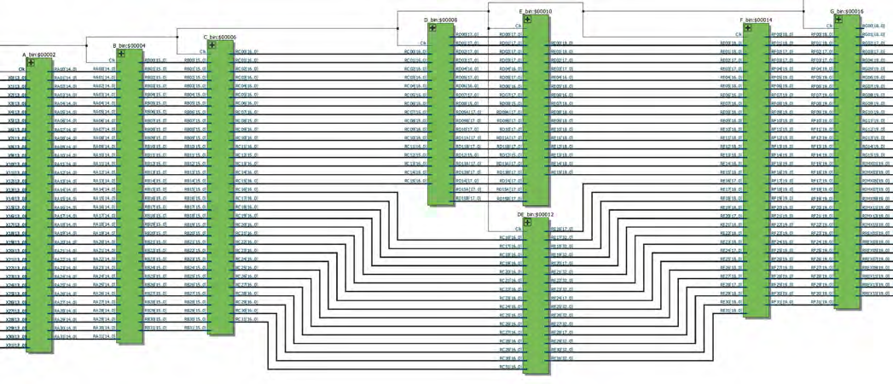
FPGA implementation

Slide 25
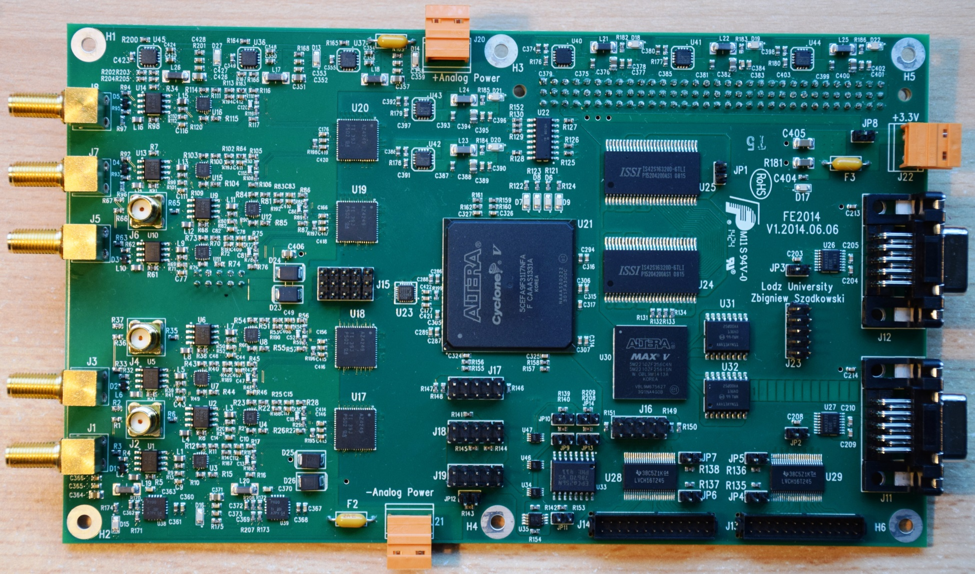
Front-End Board

Slide 26
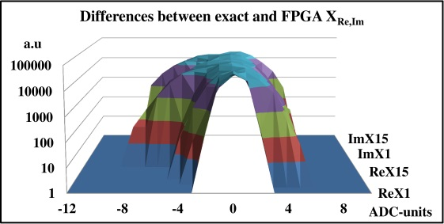
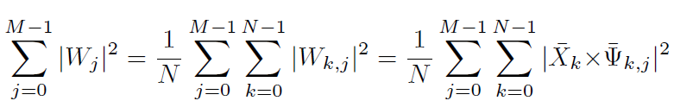


Accuracy

Slide 27




Motivations
Suspicious event with a wide spectral characteristics – although 30-80MHz band-pass filter used for analog inputs

Slide 28




Spurious triggers

Slide 29




Burst pulses

Slide 30




Real radio pulses

Slide 31



Optimization

Slide 32




Thresholds

Slide 33




Power over threshold

Slide 34




Artificially generated pulses

Slide 35




Artificially generated pulses

Slide 36


Brazilian Journal of Physics 2014
Trans. on Nucl. Science 2015

Slide 37
Conclusions
The wavelet trigger has been successfully implemented into prototype Front-End Board for the surface detector with 5CEFA9F31I7 FPGA from the Cyclone V family,
Simultaneous analysis in real time in two-dimensional time-frequency domain allows an improvement of trigger efficiency and rejection of spurious triggers.

