Slide 1
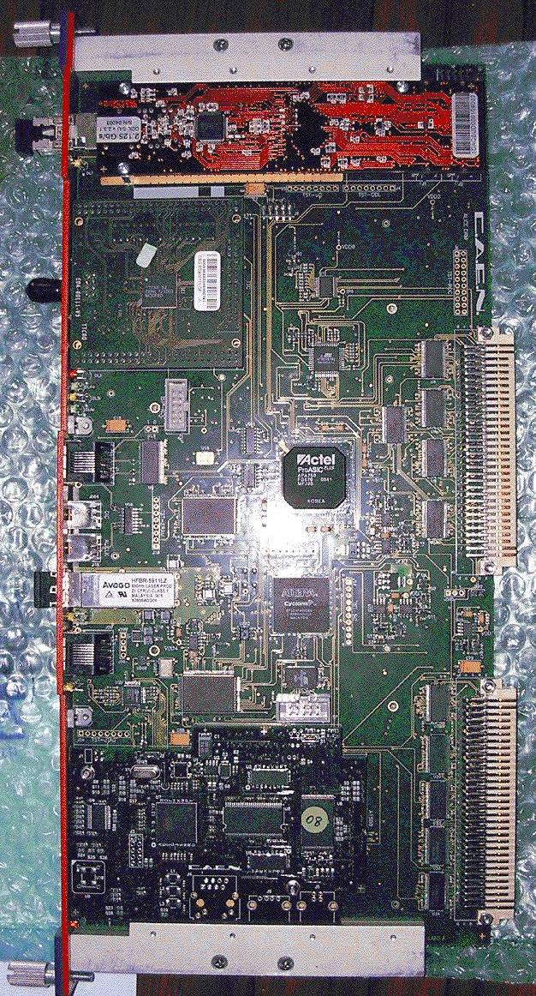
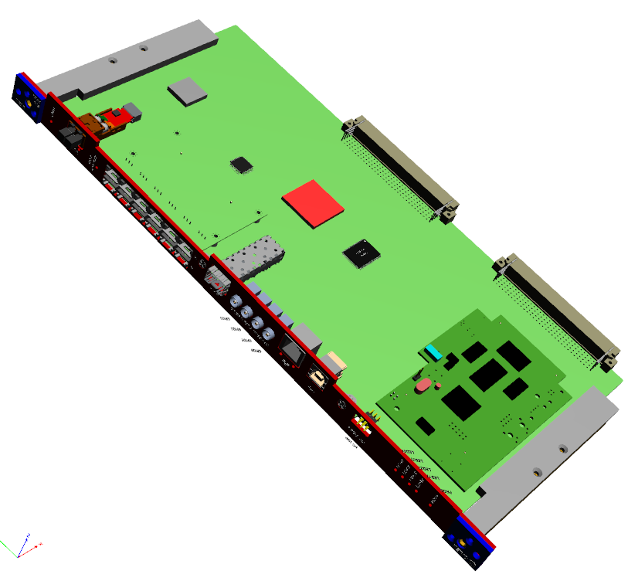
Design and test of a GBTx based board
for the upgrade of the ALICE TOF readout electronics
P. Antonioli, C. Baldanza, D. Falchieri, F.M. Giorgi, A. Mati, C. Tintori
INFN Bologna, INFN & University of Bologna, CAEN S.p.A
DRM1
DRM2
SIU
GBTx
VTRx
TTCrq
Igloo2
Actel APA
CONET2
VME
GBTx test board
SSRAM
VME
CONET
SSRAM
A1500
A1500

Slide 2
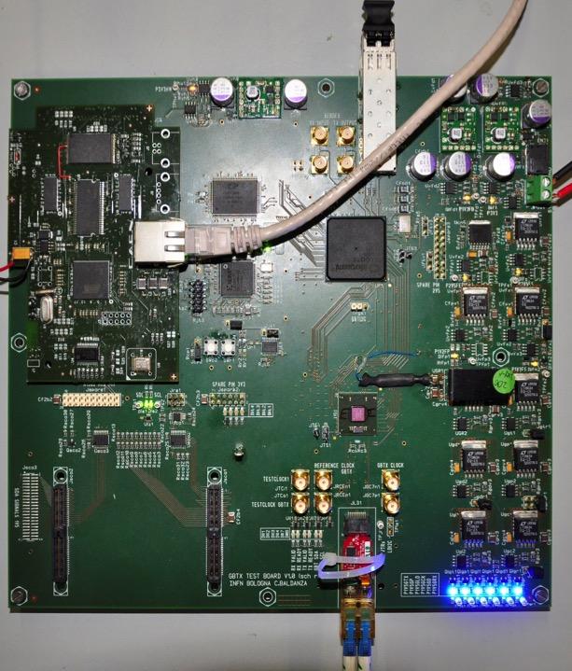
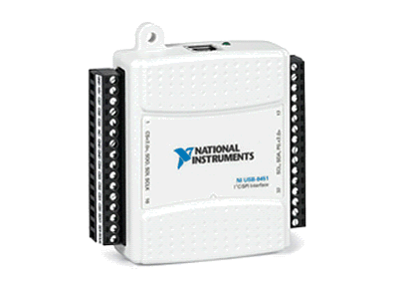

GBTx test board: picture
VTRx
4.8 Gbps
NI USB pod
8451
GBTx
E-Links
USB
IGLOO2
CONET2

Slide 3
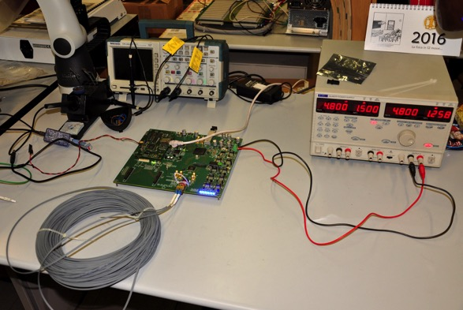

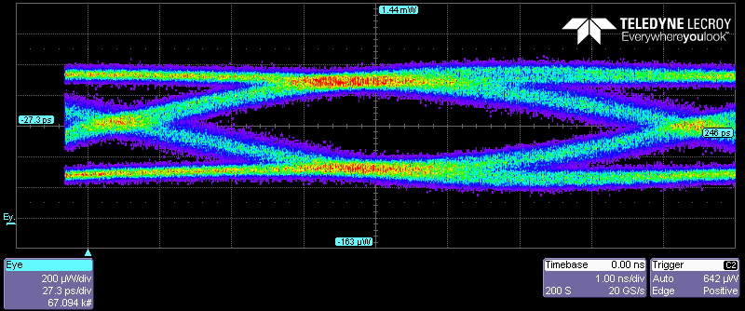
GBTx loopback tests
GBTx tested in loopback while transmitting fixed patterns (0xAAABBB…) at 4.8 Gbps and no errors were found.
multi-mode fiber
GBTx
VTRx
TX
RX
eye diagram of the GBTx TX output
Igloo2
GBTx
40 diff pairs @ 80 Mb/s
LVDS, SLVS
LVDS
40 diff pairs @ 80 Mb/s
SLVS
Measured BER lower than 10⁻¹⁴

Slide 4
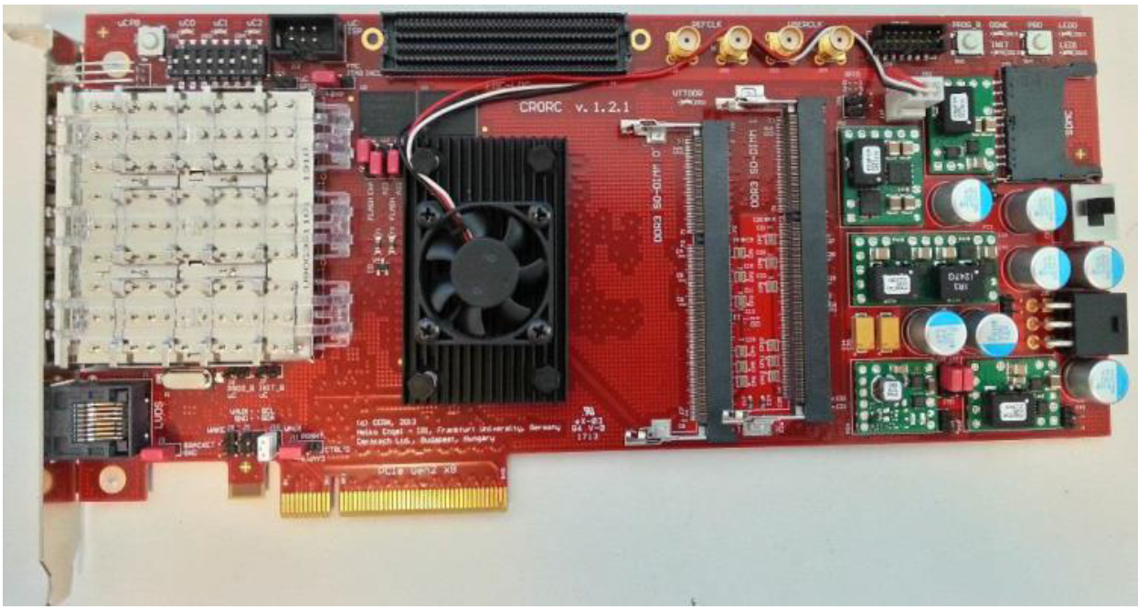
Conclusions
Good testbench for testing the Igloo2 – GBTx – VTRx system
Very good BER (as low as 10⁻¹⁴)
Already used in connection to a PCIe C-RORC board for data acquisition on a PC
200 KHz trigger rate
270 MB/s throughput

Slide 5
Backup

Slide 6
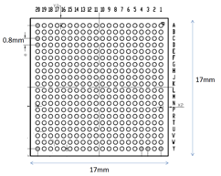
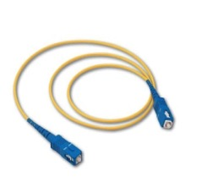
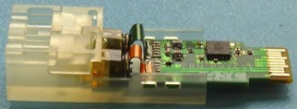

GBTx test board: scheme
debug
SSRAM
CY7C1350G 133AXC
clock
SFP
clock
GBTx
58
VTRx-VTTx
SERDES
80+80
JTAG
FPGA IGLOO2
M2GL90T
I2C+SC
40
PXL_*
clock
A1500
mezzanine
ETH
USB
ALICE C-RORC

