Slide 1
A Reconfigurable Ethernet-Based DAQP System for Particle Physics Experiments
Zhaoqi Wang^{1,2}, Yuan Yao^{1,2}, Lian Chen^{1,2}, Feng Li^{1,2}, Ge Jin^{1,2}
1. Modern Physics Department, University of Science and Technology of China (USTC)
2. State Key Laboratory of Particle Detection and Electronics, USTC
PosterSession2
Abstract ID: 034

Slide 2
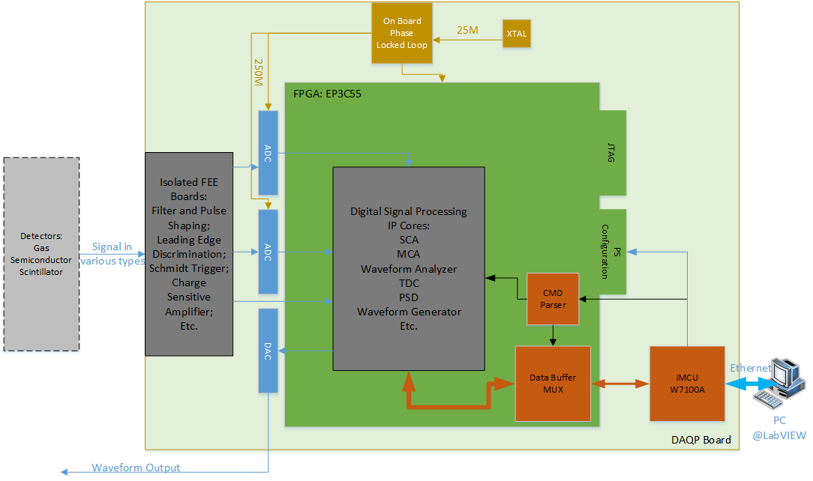
Structure of the DAQP System
The DAQP system mainly consists of four parts: FEE Boards, DAQP module, Reconfiguration module and PC Software.

Slide 3
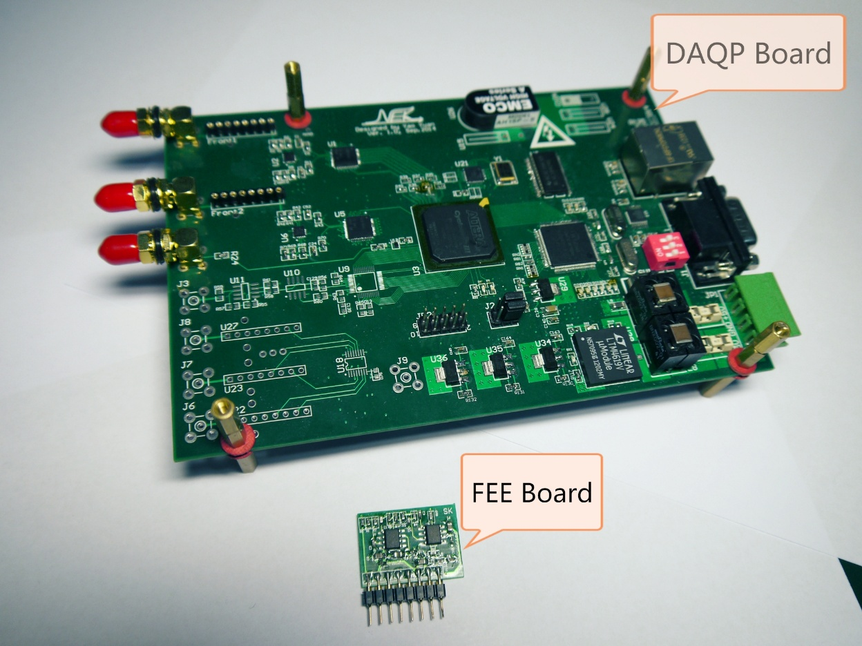
Prototype PCB of the DAQP Board and FEE Board
All the FEE Boards we design have uniform package style, making it convenient to change front-end signal conditioning circuit aiming at different experiments. One FEE Board has 8 pins for signal connection as well as mechanical fixation to match with the socket on DAQP Board.

Slide 4
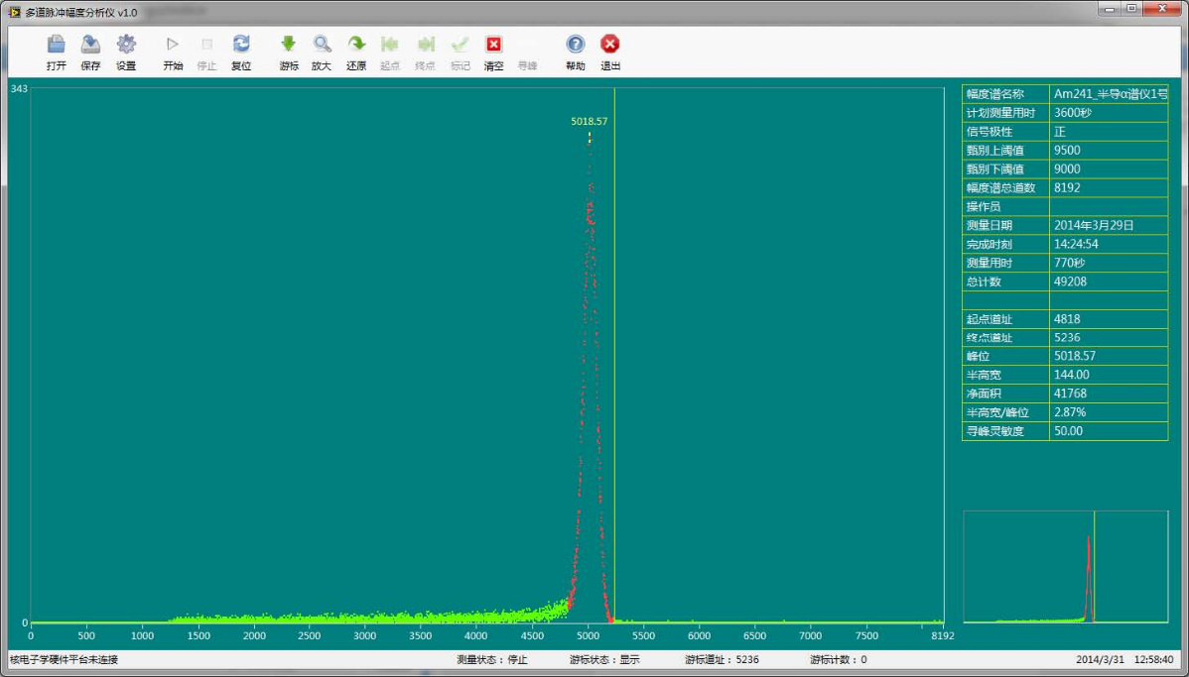
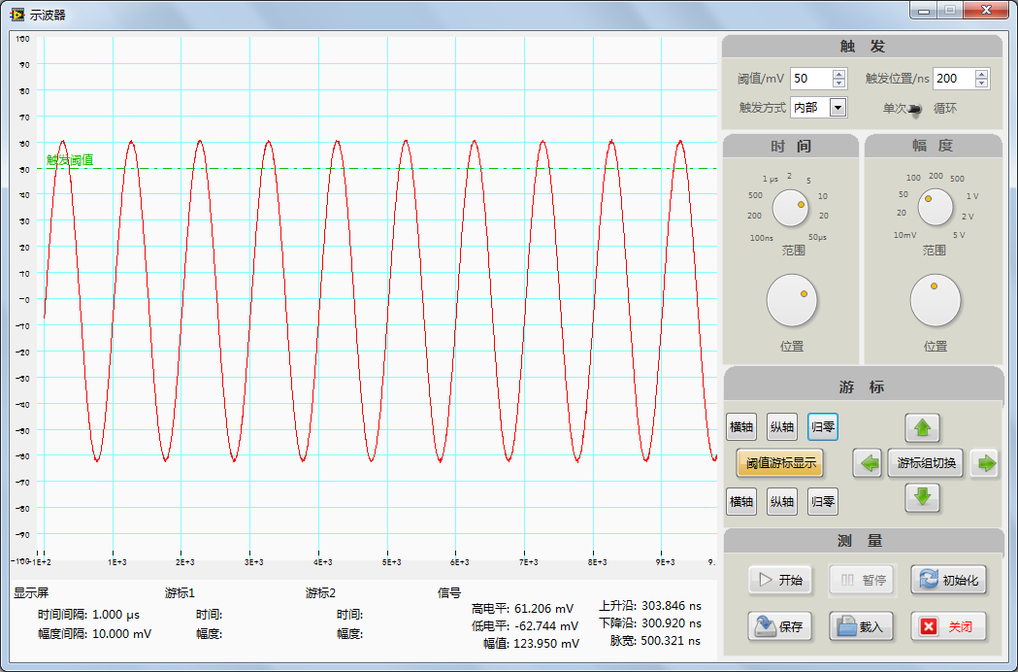
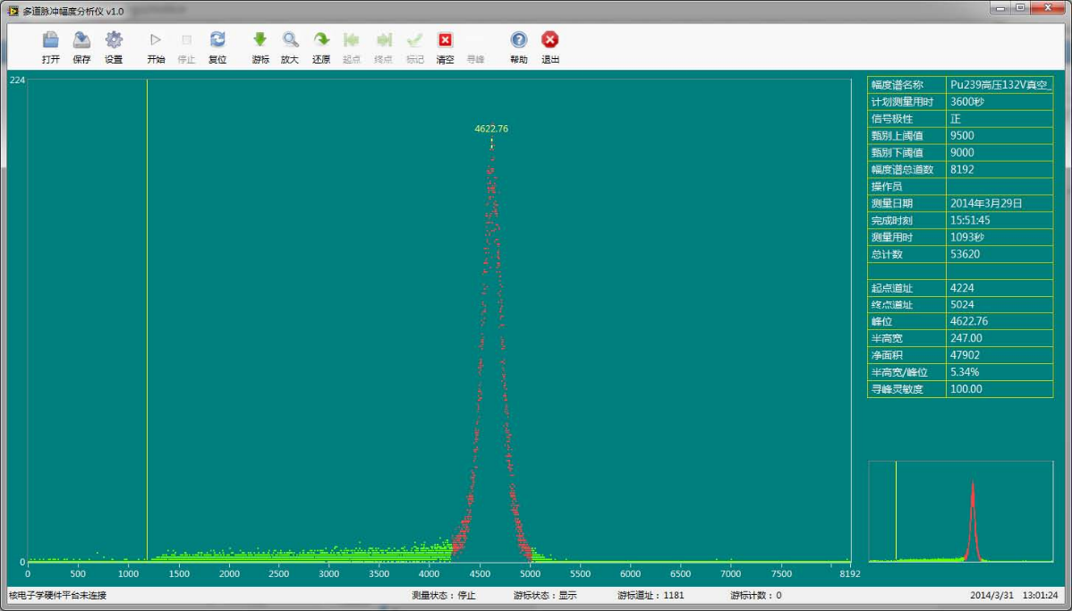
Application Examples:
Oscilloscope and MCA
The DAQP system aims at providing various virtual instruments for the need of particle physics experiments in university. Most experiments can be carried out conveniently with combination of virtual instruments.

Slide 5
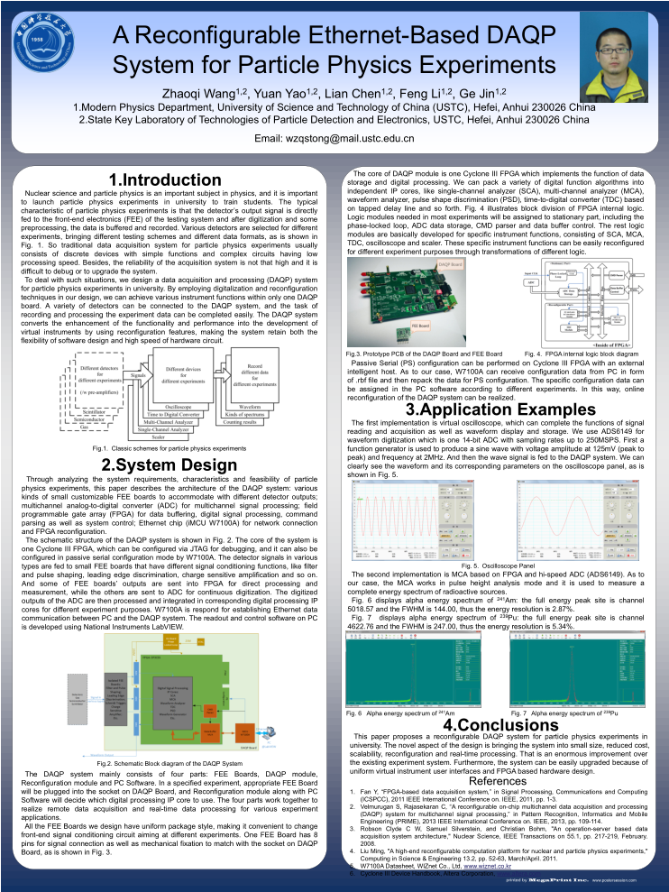
Zhaoqi Wang wzqstong@mail.ustc.edu.cn
PosterSession2
Abstract ID: 034

