Slide 1
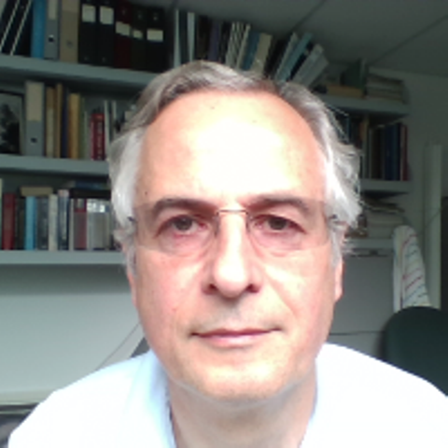
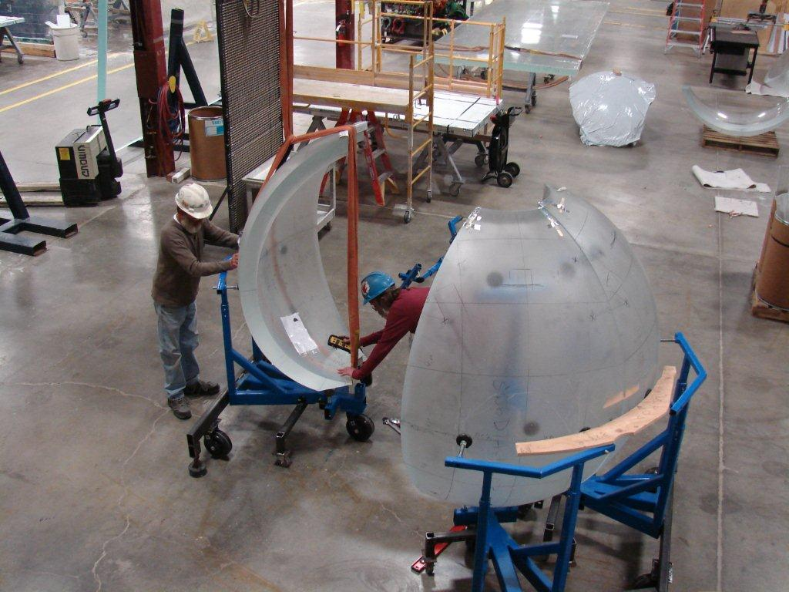
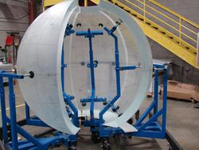
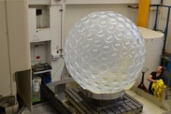
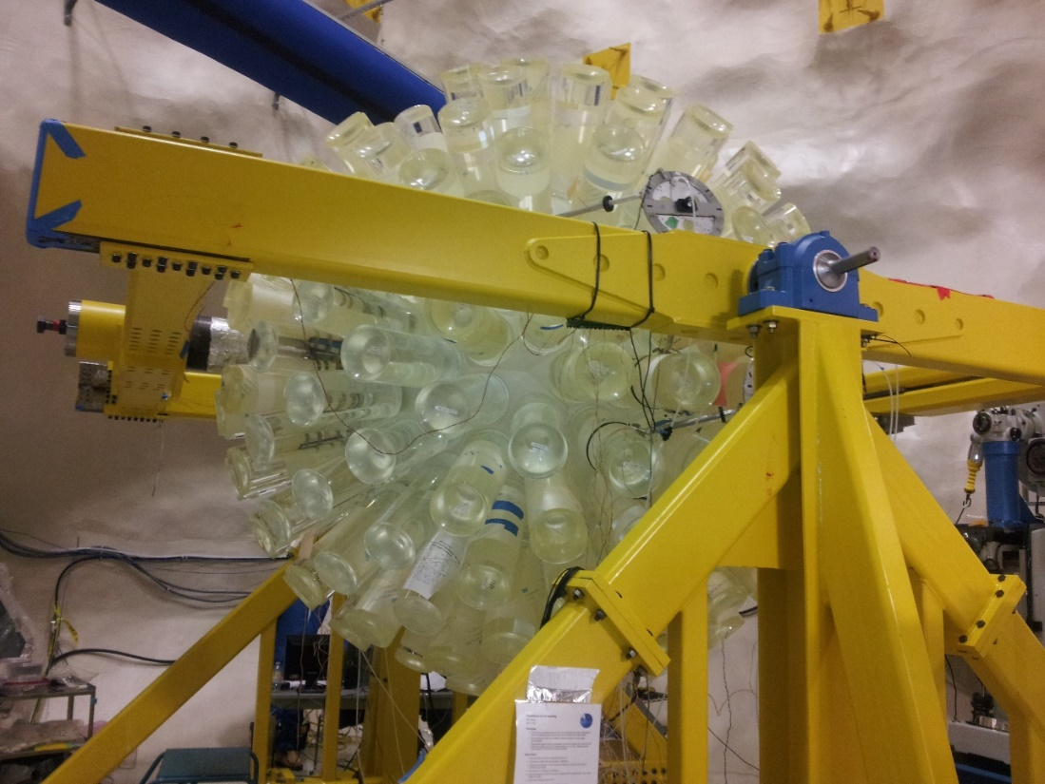
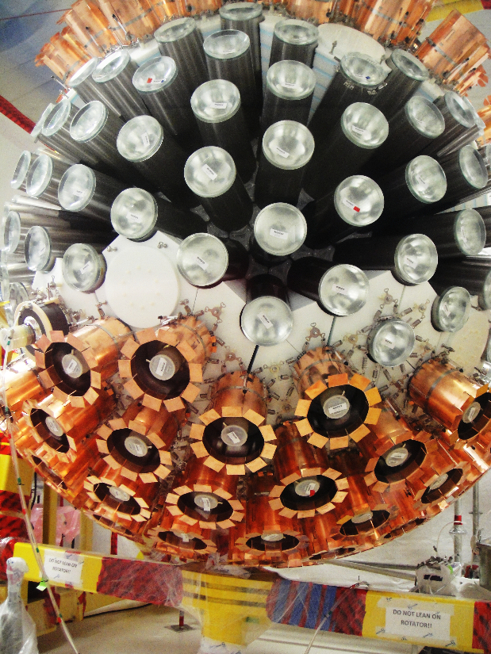
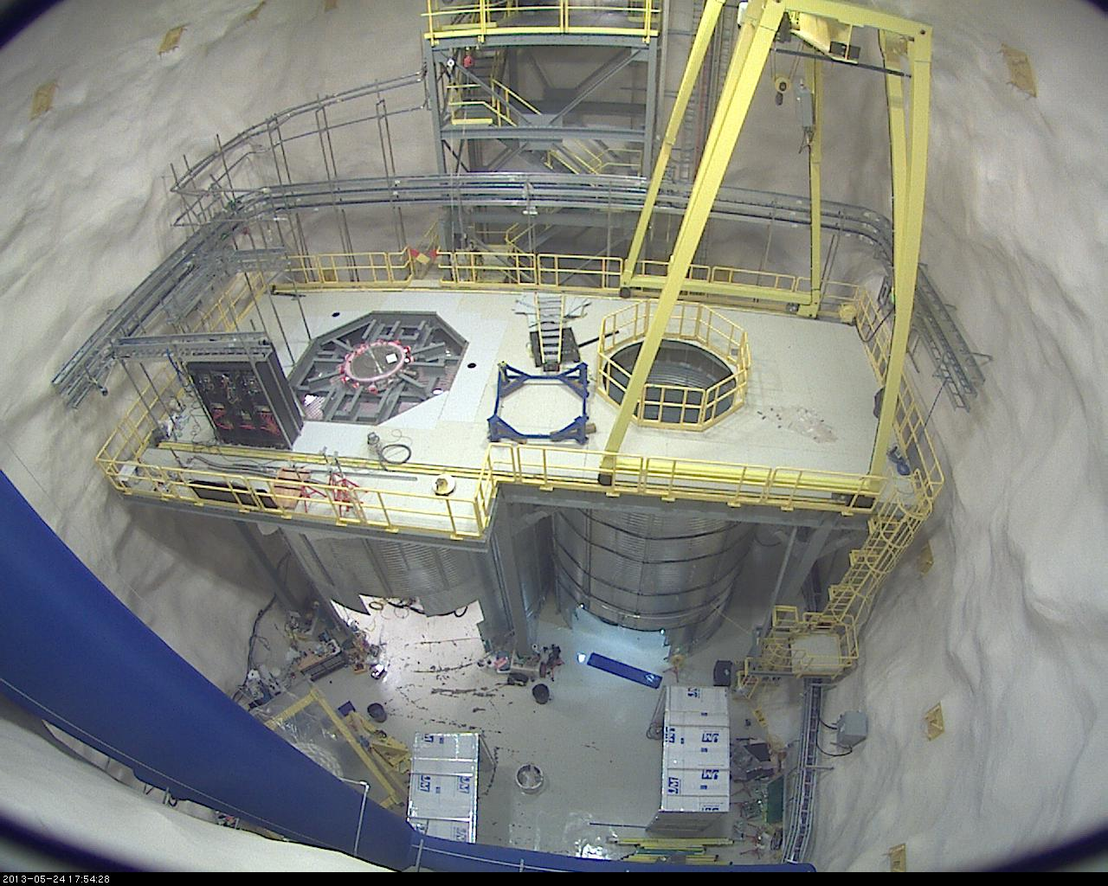
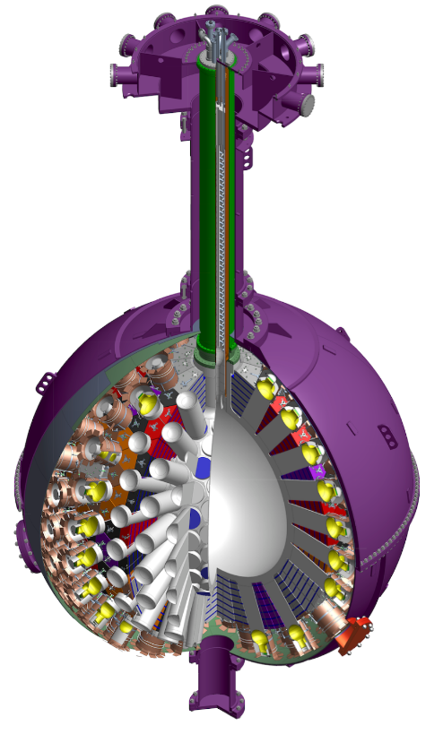
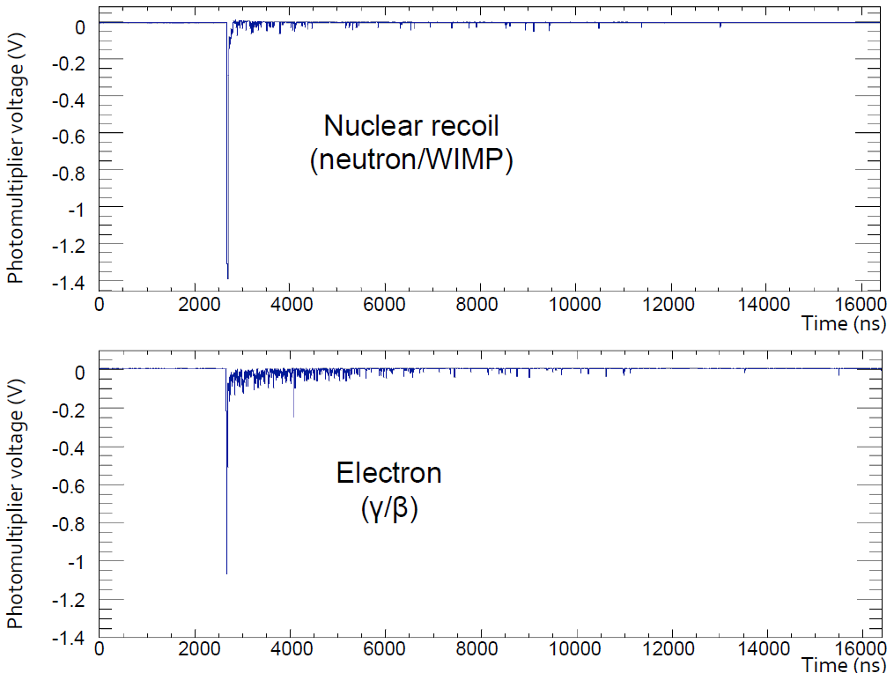
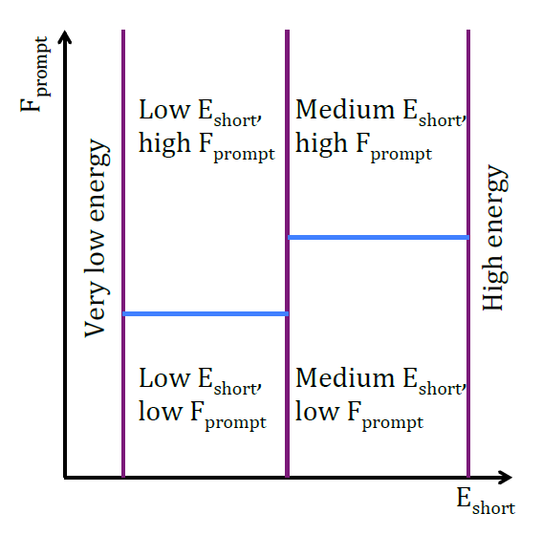
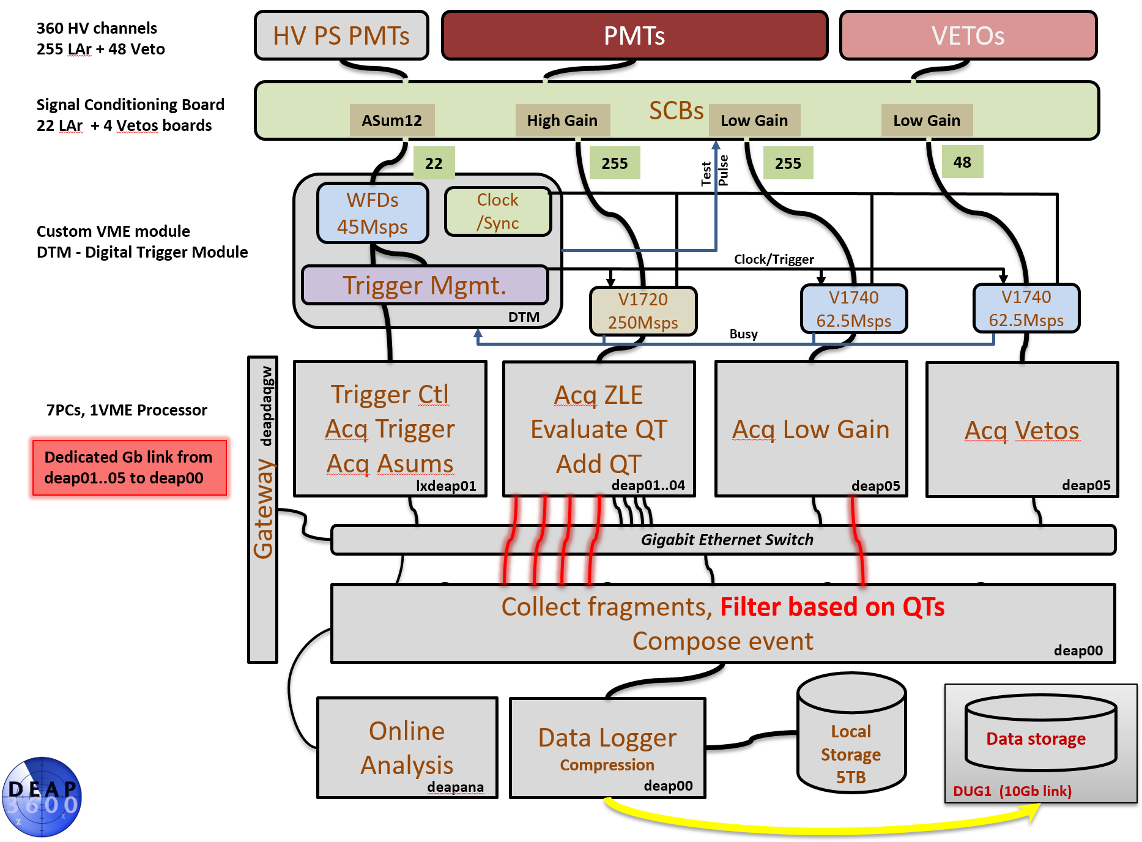
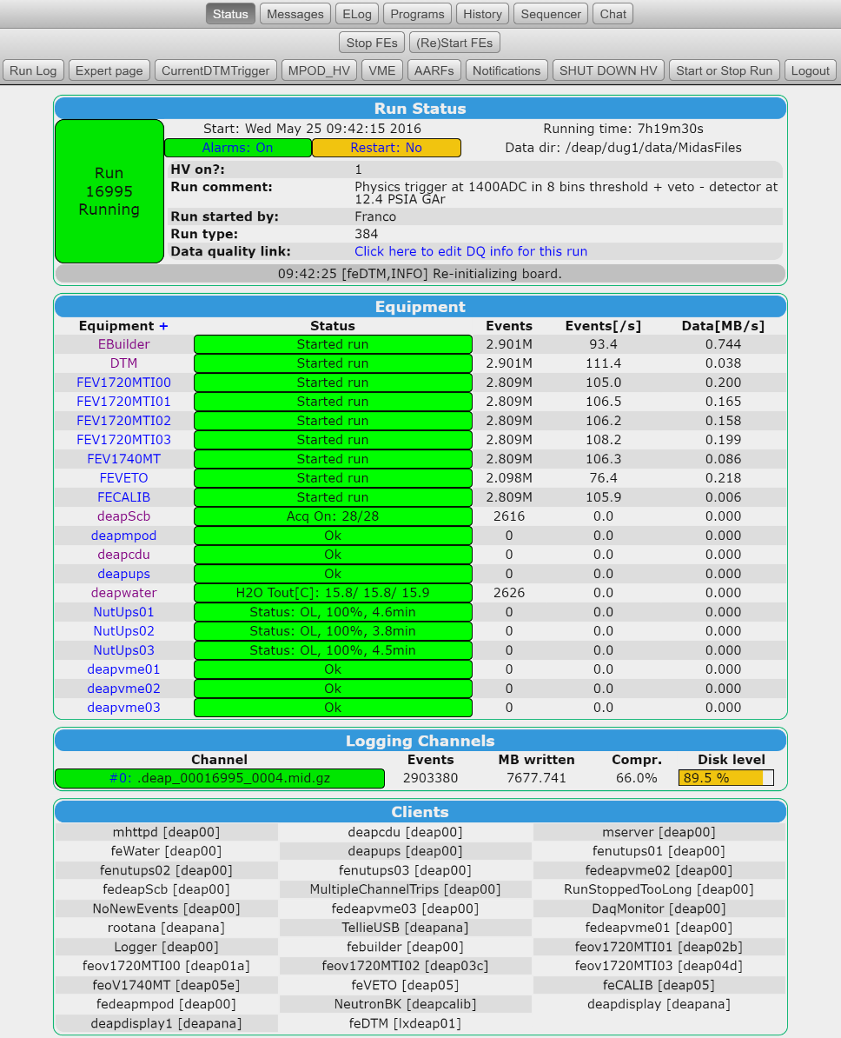
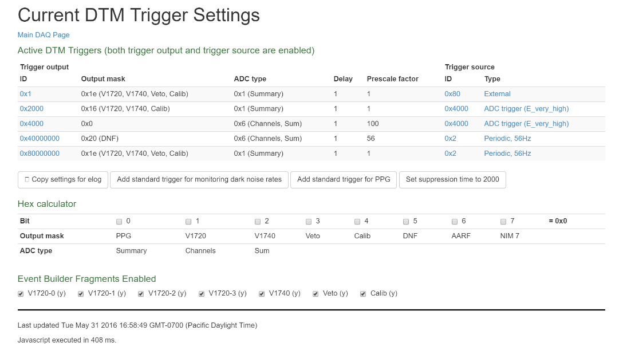
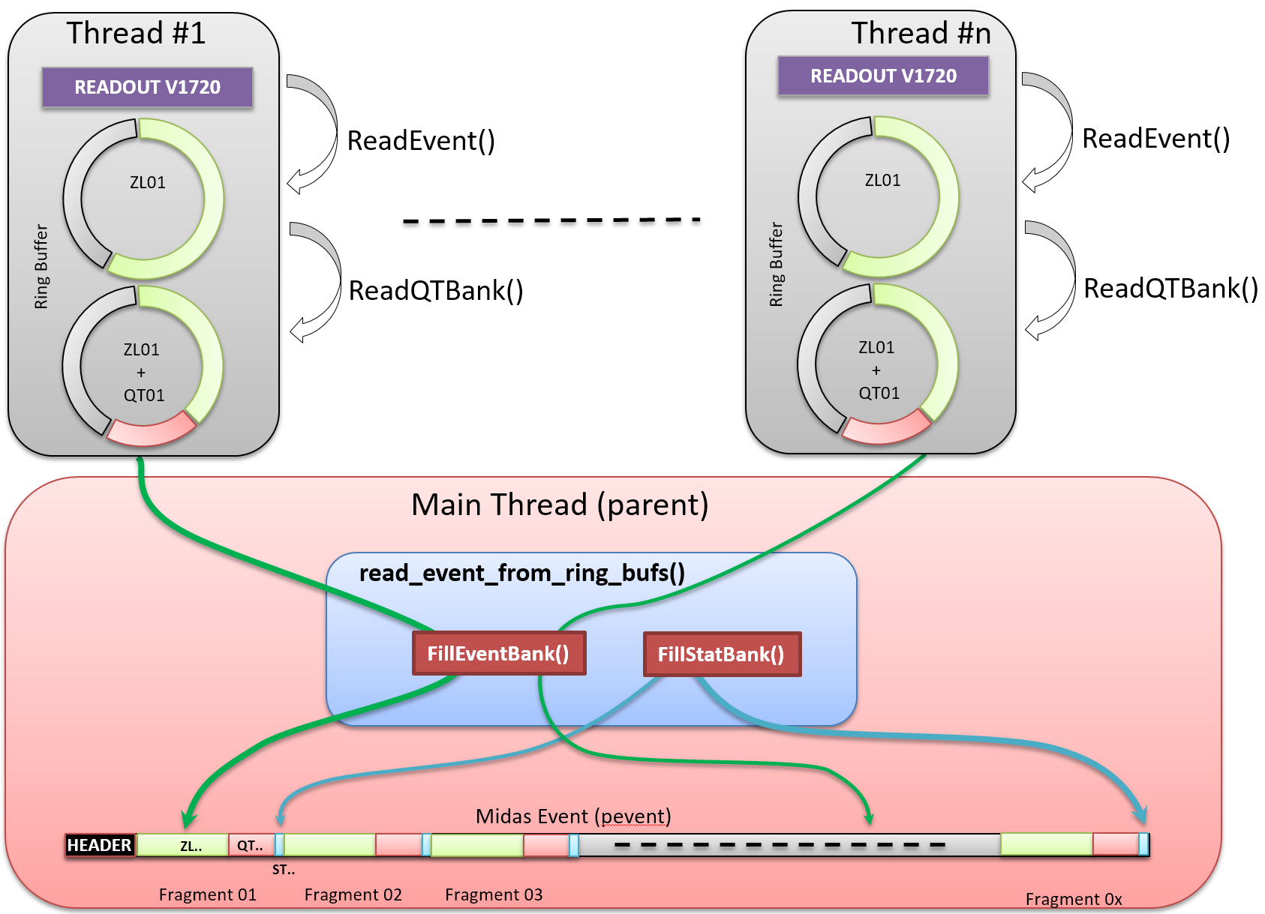
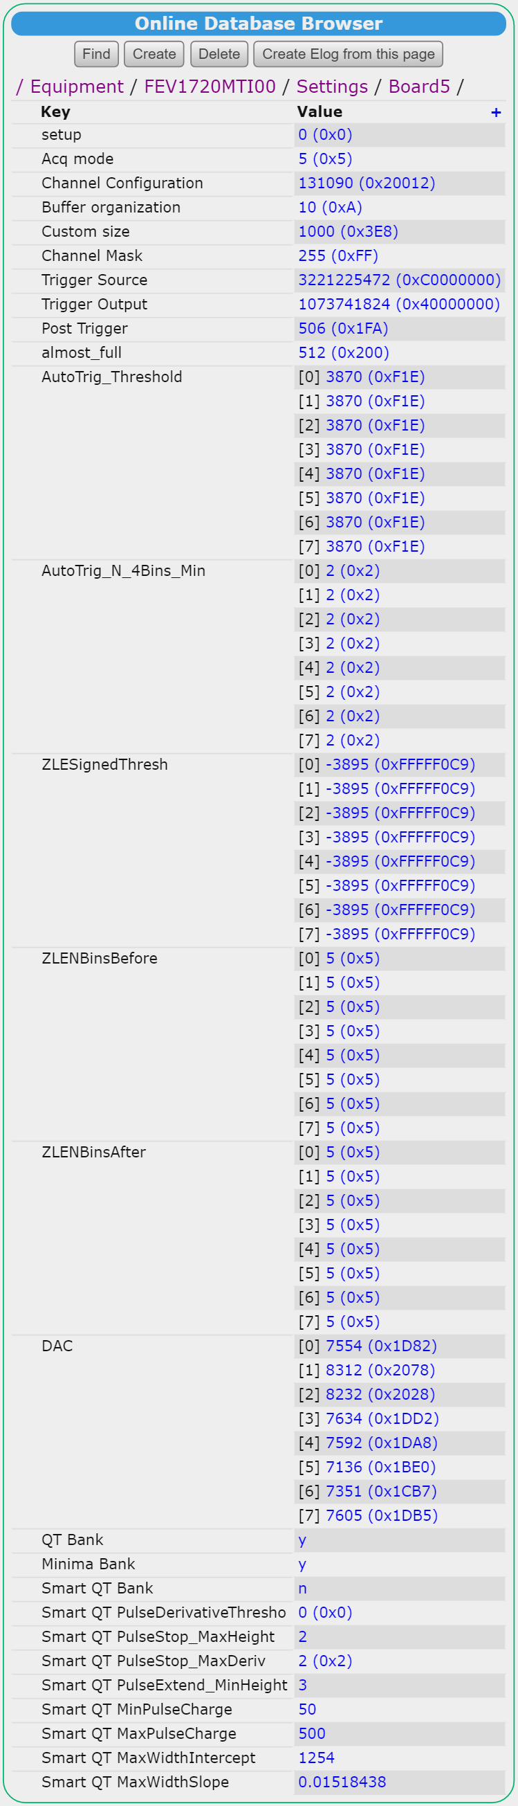
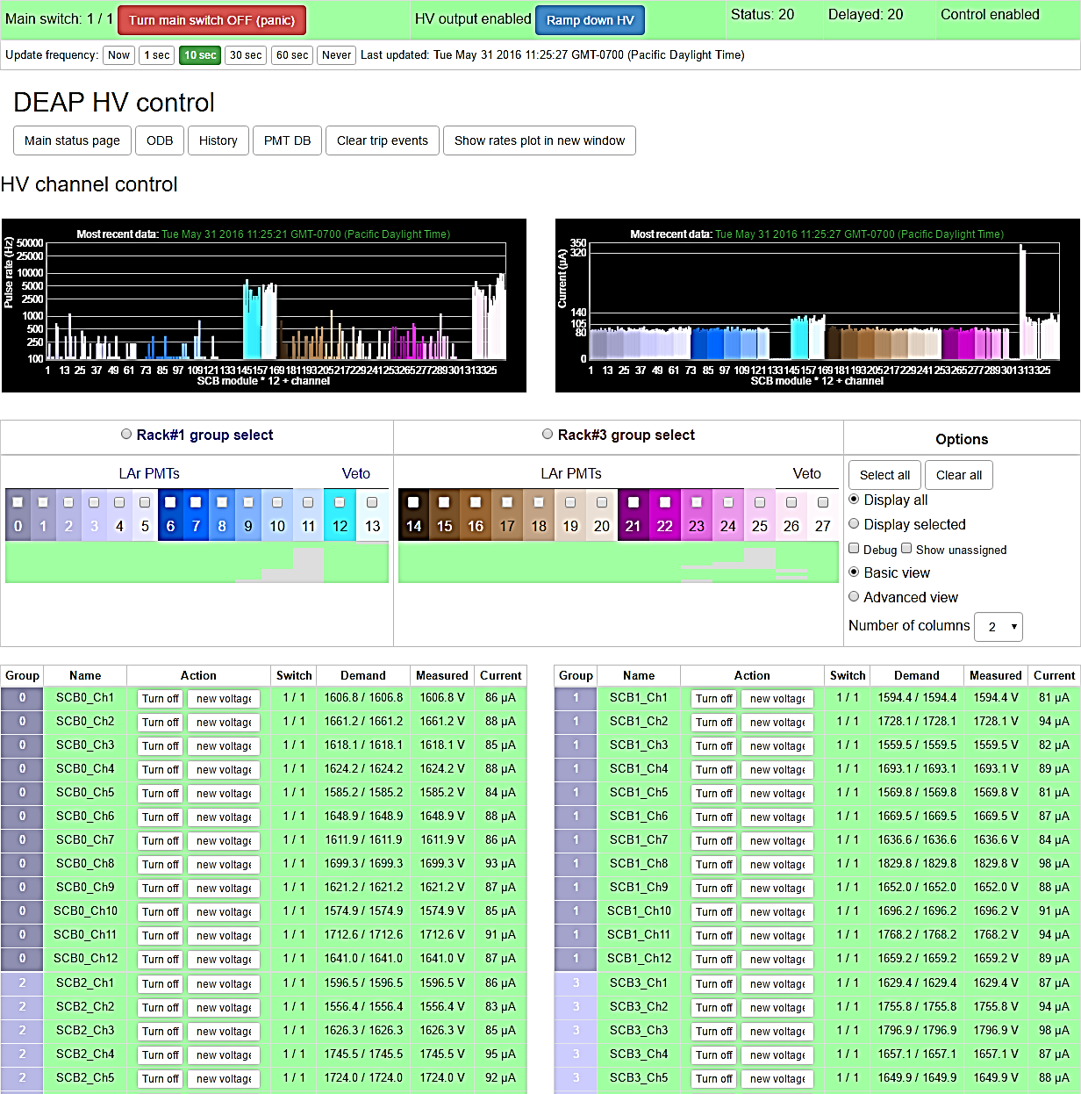
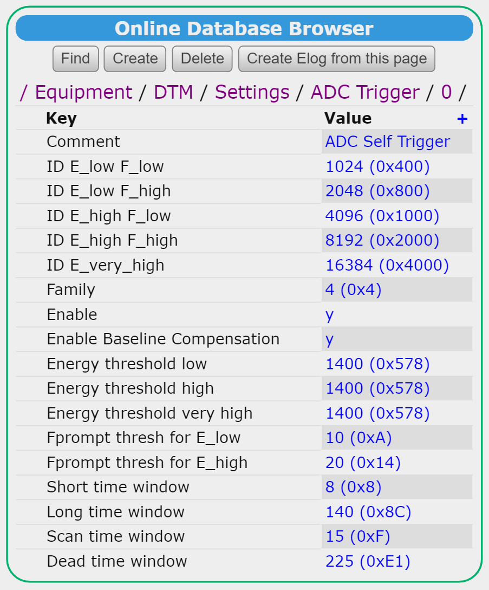
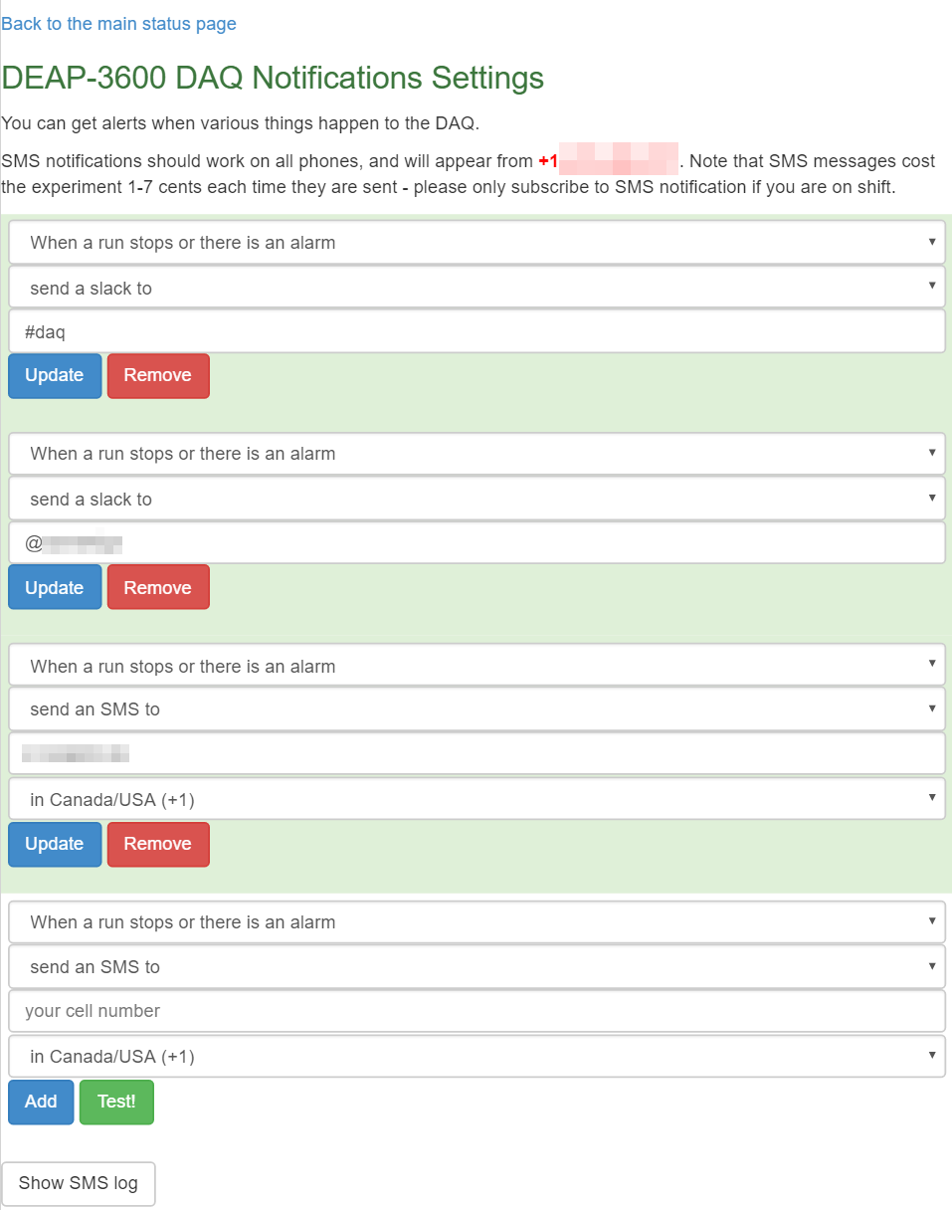
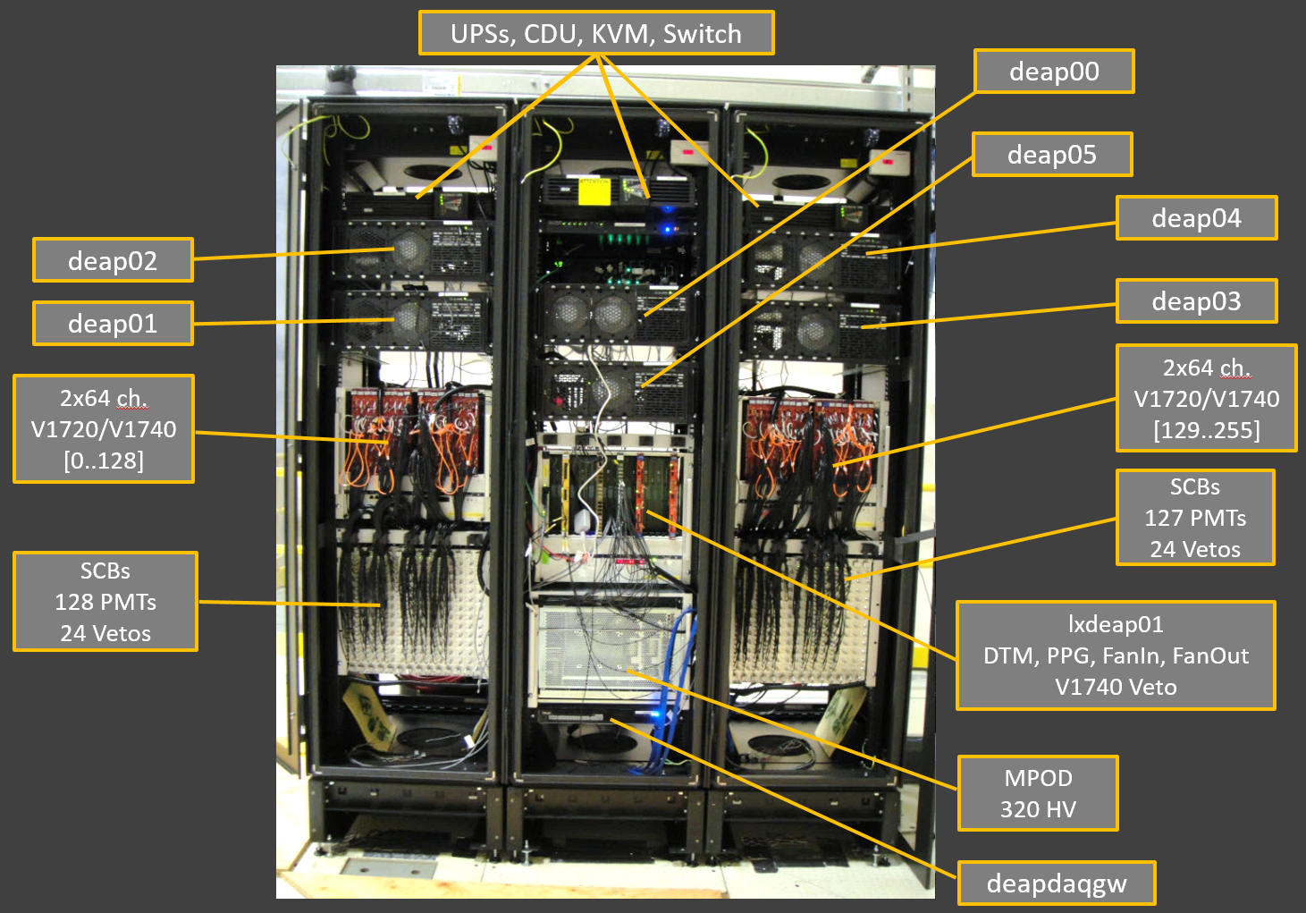
The Data Acquisition Architecture for the "Dark matter Experiment” using Argon Pulse-shaped discrimination” - DEAP-3600 -
Pierre-André Amaudruz, Daryl Bishop, Thomas Lindner, Yair Linn, Konstantin Olchanski, Fabrice Retière, Bryerton Shaw, Ben Smith @ TRIUMF, Vancouver B.C, CANADA
The Detector
Pierre Gorel @ University of Alberta, SNOLAB Ontario, CANADA
THE DEAP experiment is taking place at the SNO underground laboratory (SNOLAB) near Sudbury in Ontario, Canada. A spherical transparent Acrylic Vessel (AV) - 85cm inner radius, 5cm wall thickness - holds 3600kg of Liquid 39Ar and makes up the detection volume. This acrylic sphere is surrounded by 255 8” Hamamatsu R5912 PMTs pointing inwards, mounted on 50 cm long, 8” diameter light guides The Data Acquisition system maintains control and monitoring of the conditioning and digitization of all PMT signals, the on-line trigger functionality and the recording of data to permanent storage.
The Trigger system
The major challenge in this experiment is the suppression of the large background from the ³⁹Ar beta decay. Fortunately the timing signature of the electron recoils from beta decay is different from the nuclear recoils of the WIMPs and neutron background. This characteristics permits a first in-line stage reduction of 5 to 10 by beta decay rejection using pulse shape discrimination. This stage of the trigger is performed by custom a hardware receiving the analog sum signal of the 22 SCBs (ASUM). This Deap Trigger Module (DTM) custom hardware is a VME module hosting 3 separate FMC mezzanines.
22 channels of pipe-lined 12bit ADC running at 45Msps.
Reference clock generator (62.5MHz)
I/O section (Single Ended: 4 Inputs, 8 Outputs)
The DTM serves multiple functions:
Digitizes the 22 SCB’s ASUM channels.
Analyzes “on-the-fly” the 22 digitized SCB’s ASUMs to make a trigger decision based on the physics parametric requirements.
Manages the different implemented trigger types such as external calibration, test pulse, and internal physics triggers. All of them have parameters such as pre-scaling, delay and trigger output mask (fragment selection).
Generates trigger information associated with the issued trigger. This information is composed of the trigger time stamp (used as a time reference), trigger counters, requested trigger mask, issued trigger mask, and operation status registers content.
Distributes the trigger signal to the acquisition modules. The dedicated I/O mezzanine on the DTM propagate physically the issued trigger to the different hardware modules. A total of 8 outputs are available. They corresponds to 4 V1720, 2 V1740, Veto, and Calibration.
Accepts busy signals from the WFDs for trigger throttling. All the digitizers have the capability to produce a hardware signal when their internal buffers reach a specified occupancy level. This signal is combined across all the WFDs with controllable logic to feed back to the DTM as a single busy signal. This signal throttles the DTM generated trigger output.
Provides the reference clock to all the acquisition hardware modules. The clock generator on the DTM provides the reference clock to all the appropriate modules. The overall number of WFDs for DEAP is 38 modules plus test pulse and auxiliary modules. This clock fan-out is provided by three low jitter circuits which guarantee consistent phase and delay to each module.
The DTM implements in its firmware several triggers and provides 32 generic trigger output configurations. This scheme makes the triggering of the hardware very flexible.
The Frontend Acquisition
A running frontend tasks once initialized goes through the following acquisition sequences:
Thread level: Poll the hardware for data. This polling is done by individual threads, therefore the readout implementation is simpler and faster compared to a possible interrupt mechanism.
Thread level: Acquire the data from the hardware module. This uses proprietary DMA channels through the optical links (CAEN).
Thread level: Extract summary information from acquired data (charge and Time of each WF structure). Customized code scans the incoming raw data and computes the pulse timing and charge for every pulse of each WFD channel acquisition time window.
Thread level: Append summary data to the raw data ring buffer thread.
Main thread level: Do sanity check while collecting data from the different ring buffer threads. This assembly is based on polling the atomic thread counter (semaphore equivalent).
Transmit the event fragment to the backend computer (Event builder).
The Backend Acquisition
The event builder sequence, once the threads are created is:
All threads: Poll for fragment and place them in dedicated fragment ring buffers
Main thread: Poll for DTM fragment first, extract time stamp and fragment list (trigger mask).
Main thread: Poll, and check time stamp of involved fragment against DTM time stamp for data validity.
Main thread: Extract summary information (QT) from involved fragment (fragment list).
Analyze overall QT and make decision for final event composition.
Assemble final event using fragment list
Further information from the event builder can be appended to the event itself.
The Experiment
The DEAP experiment operation is subject to multiple operation constrains such as: its location in an active Nickel mine with its restricted accessibility and operation, its cryogenic systems operation, electrical and safety operation rules, etc. All of them have some impact on the Data Acquisition infrastructure. Regular blasting (mine operation) generate micro particles that have been detected on the electronics and potentially causing electrical faults. Therefore the all the DAQ equipment is installed and operated in 3 sealed racks with dedicated internal water/air heat exchangers. Underground electrical services are subject to sudden interruptions. For that purpose, we installed dedicated UPS from TRIPP LITE (SUINT3000 & 1500RTXL2U) with double-conversion function improving dramatically the quality of the AC power line. To improve the power distribution, we operate at 208VAC. Custom UPSs monitoring software is configured such that the system will partially self-shutdown within a few minutes of the power loss in order to maintain and preserve the essential electronics components for several hours and facilitate the restart of the system. This shutdown operation is possible with the addition of a Cabinet Distribution Unit (CDU) from ServerTech (CWG-16H2A454), with 16 network controlled AC ports serving all the main electronics equipment. This shutdown sequence is particularly important for the High Voltage units (WIENER MPOD crate) powering the PMTs, as the access to the PMTs for replacement is unlikely to happen for several years. Additional high voltage protection is in place for detecting abnormal PMT’s current and possible light leaks. Light leaks detection is based on PMT noise rate increase. These rates are computed by a dedicated online analysis task, which triggers a ramp down of the high voltage in case of excessive pulse rate on any PMT. This protection mechanism requires the DAQ to be fully operational. In case of a loss of the data acquisition or event analysis, here again, automatic HV ramp down procedure will kick in (Fig 9). We also installed a KVM from ATEN (KH1508Ai) connected to all the computers for network console access in case of boot problems. Besides power loss management and possible computer issues, additional DEAP DAQ operation safety requires a shift person to be logged into the DAQ system. Lack of network connection to their station will trigger a shutdown of the PMTs high voltage as well.
The Performance
The two mode of acquisition (physics, calibration) have different event and data rate requirements.
A maximum data rate of 5MB/s for the physics runs can easily be achieved with the system when the hardware is switched in compression mode (CAEN “Zero Length Encoding”, ZLE). The event size is reduced to about 8KB, the event rate is then limited by the overall frontend acquisition around 4500Hz. In the case of the calibration, the uncompressed WF are usually saved. In this case the limitation are due to frontend Ethernet link (1Gb), Data compression in the Data logger or write access to the Data storage. We do hit the network limitation first around 80MB/s between the deap01..05 to the deap00 backend machine. The Midas data logger has been extended to support lz4-compression algorithm, which reduces the CPU usage (in our case single thread) at the cost of ~10% loss in compression which is acceptable and permit the recording around 250MB/s for 500Hz of trigger. Further investigation is plan to raise this data rate limit.
Specific Midas terminology figures related to the DAQ configuration:
Average number of Midas banks per assembled event: 65
Number of Midas “equipment”: 20
Concurrent number of Midas client: ~30

