Slide 1
The Trigger-Time-Event-System for Wendelstein 7-X: Overview and First operational Experiences
J. Schacht¹, H. Laqua¹, I. Müller¹, J. Skodzik², H. Puttnies², and the W7-X Team
¹Max-Planck-Insitute for Plasma Physics, EURATOM Association, Greifswald, Germany
²Institute of Applied Microelectronics and Computational Engineering, University of Rostock, Germany
Real Time conference 2016, Padua

Slide 2
Outline
Introduction
Operational phase OP1.1 of Wendelstein 7-X
TTE system

Slide 3
Outline
Business model for the control system of a fusion experiment
W7-X control system overview
Operational phase OP1.1 of Wendelstein 7-X

Slide 4
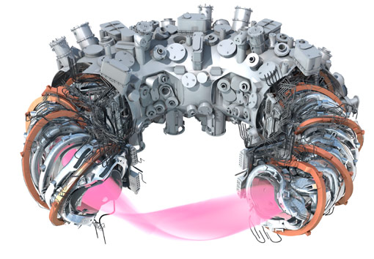
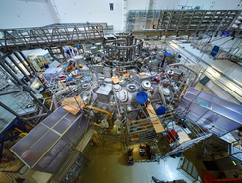
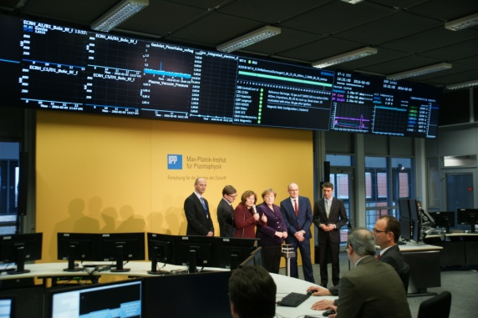
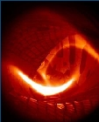
Structure of W7-X control system
Business model for the control system of a fusion experiment
W7-X control system overview
W7-X in operation
The superconducting stellarator W7-X started plasma operation in December 2015:
The main technical and diagnostics systems have been finished successfully.
In operational phase OP1.1 940 plasma discharges were processed for commissioning, for conditioning, and for physics.
The W7-X control system allows a safe and flexible control of preparation and conducting of discharges.
The Trigger-Time-Event System of W7-X as a part of the CoDa-system worked successfully during commissioning and OP1.1.
CAD model of W7-X
View on W7-X in the torus hall
German chancellor Dr. Merkel started the first H2-plasma discharge
Video of the first H2-plasma
(3. February 2016)

Slide 5

Operational phase OP1.1
Business model for the control system of a fusion experiment
W7-X control system overview
W7-X operation: First discharge in Hydrogen on 3th of February 2016
Video (2 min)

Slide 6
TTE system structure
Business model for the control system of a fusion experiment
W7-X control system overview
TTE system architecture
Structure of TTE system:
Hierarchical: ctte System on top, local TTE systems are part of the control components and diagnostics,
Distribution of synchronization signals, time information, and event messages via a fiber optic network,
Good scalability in terms of number of devices.

Slide 7
TTE system functions
Business model for the control system of a fusion experiment
W7-X control system overview
Functions of the TTE system:
Generation of a global time for all CoDa components of W7-X,
Synchronization of all local time counters of the lTTE systems of the technical components and diagnostics,
Providing event messages processing and standard trigger signals,
Providing time and trigger related functions like:
  Time capturing,
  Pulse sequence generation,
  Time delays,
  Impulse counter,
  Event trigger processing.

Slide 8
Business model for the control system of a fusion experiment
W7-X control system overview
Thanks for attention!
Please contact me during the poster session!
Poster session 2, Poster ID #83

