Slide 1

First Measurements of Novati Wafer
Ulrich Heintz, Meenakshi Narain, Sinan Sagir, Eric Spencer, Juan Trenado
Brown University, Providence

Slide 2
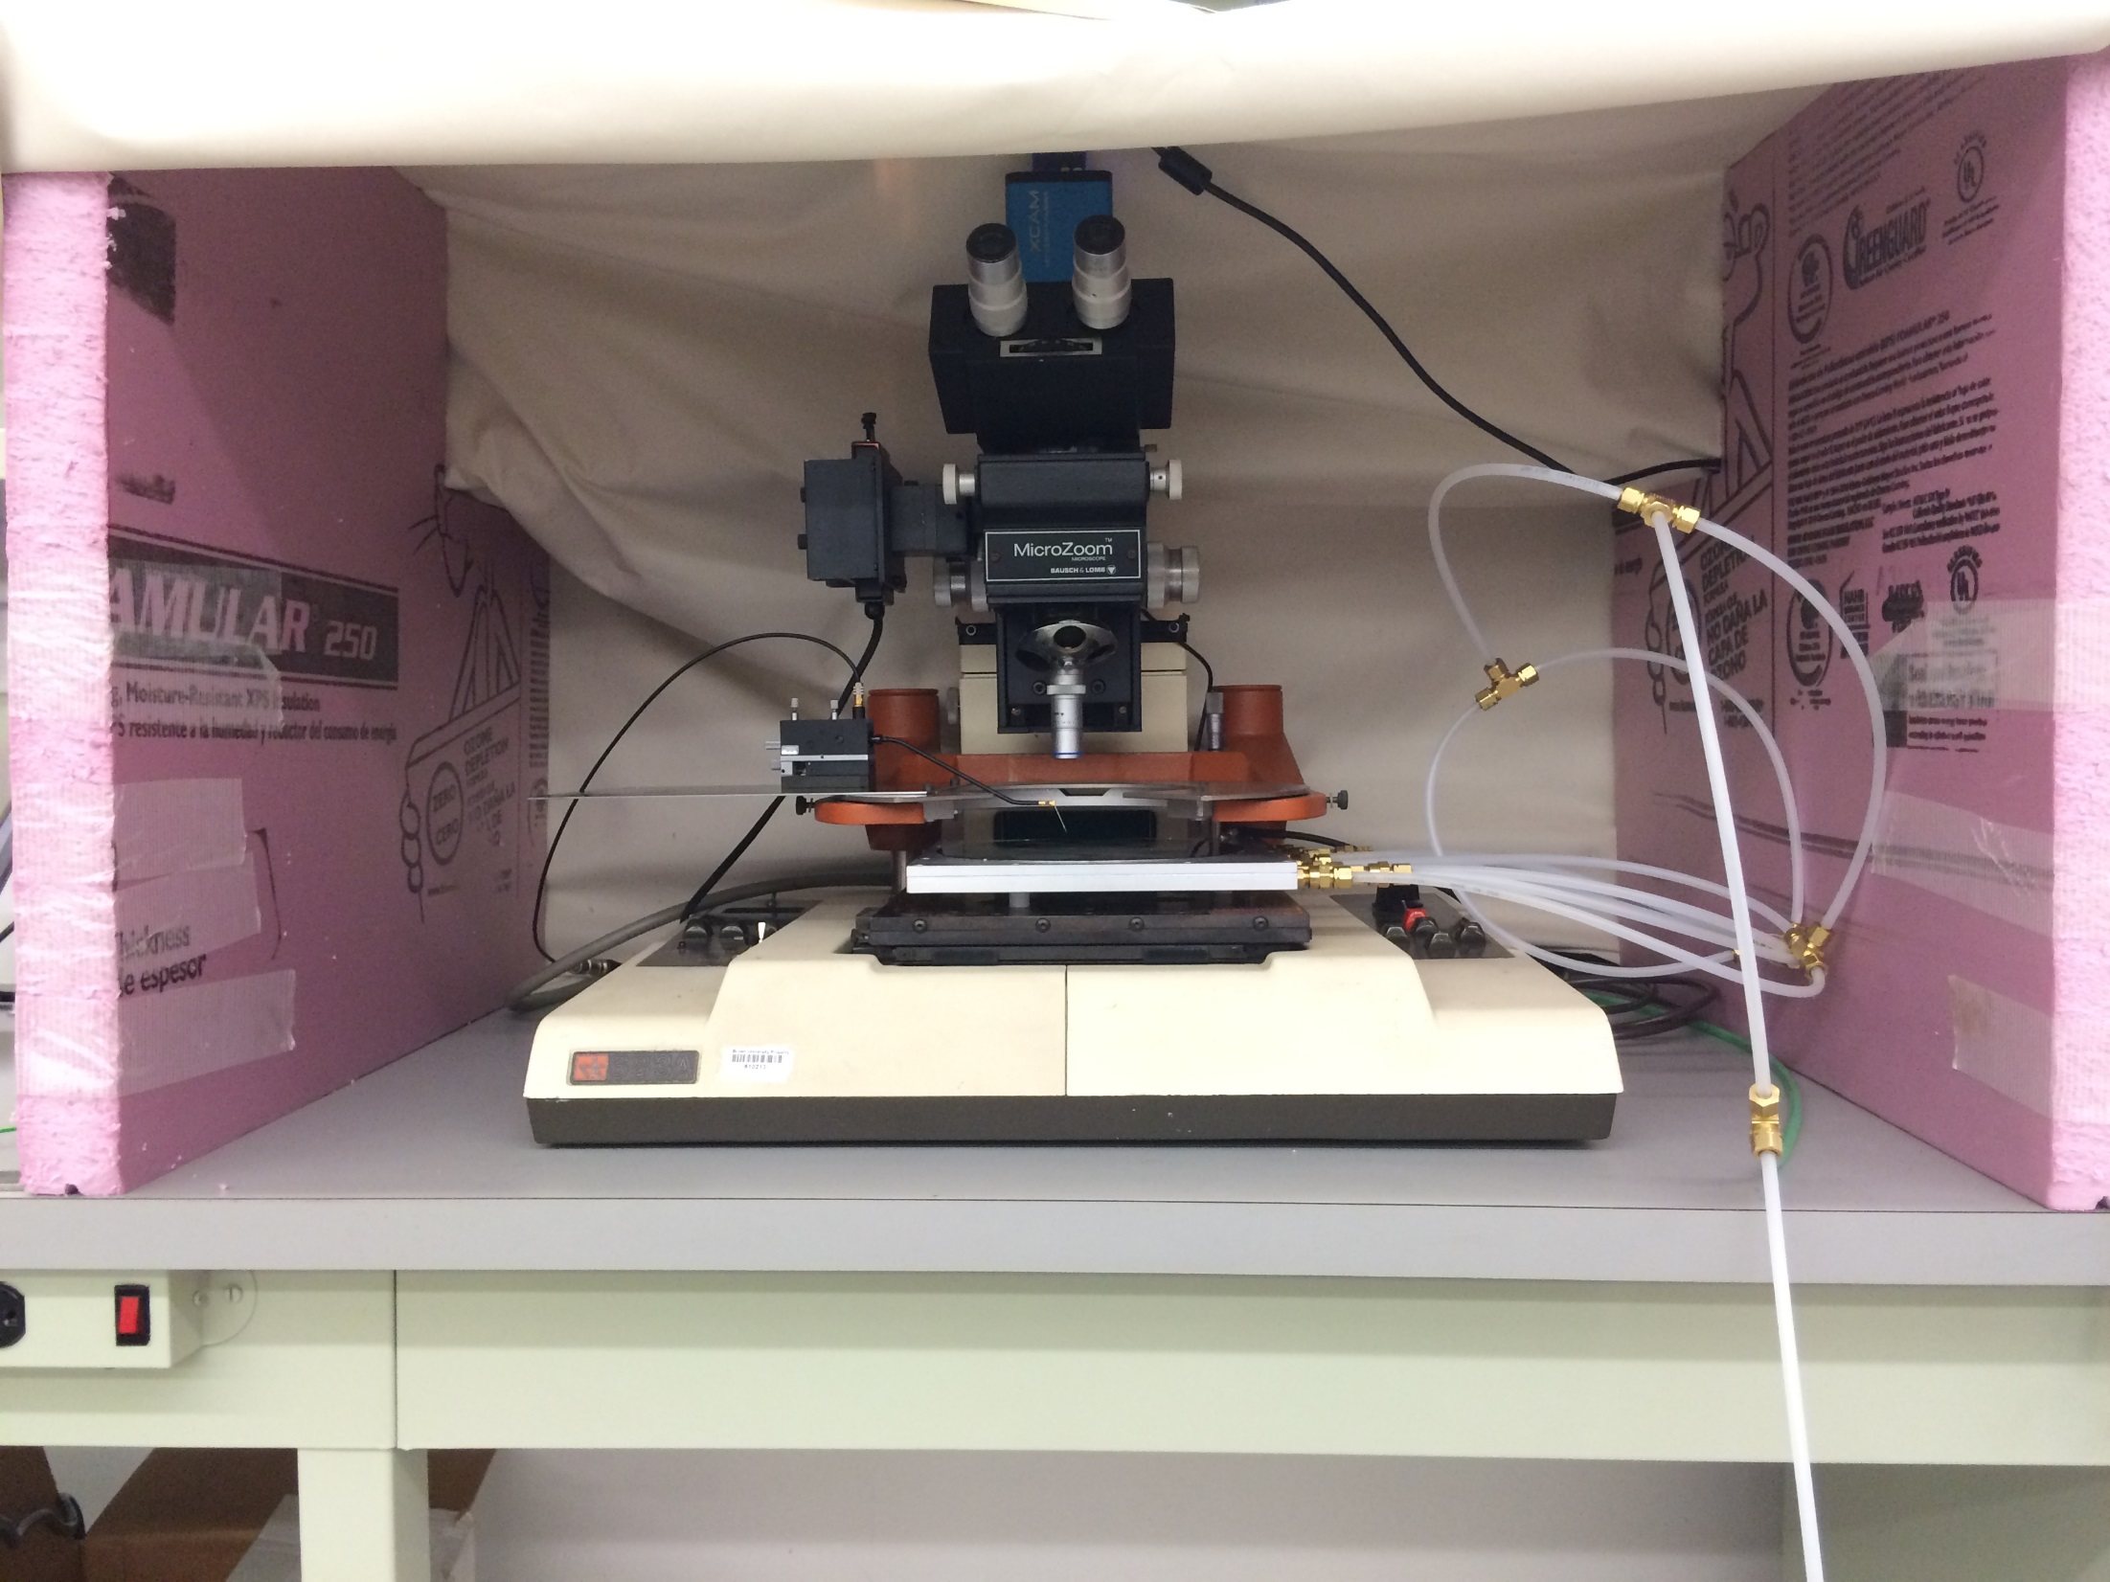
Probe station setup

Slide 3
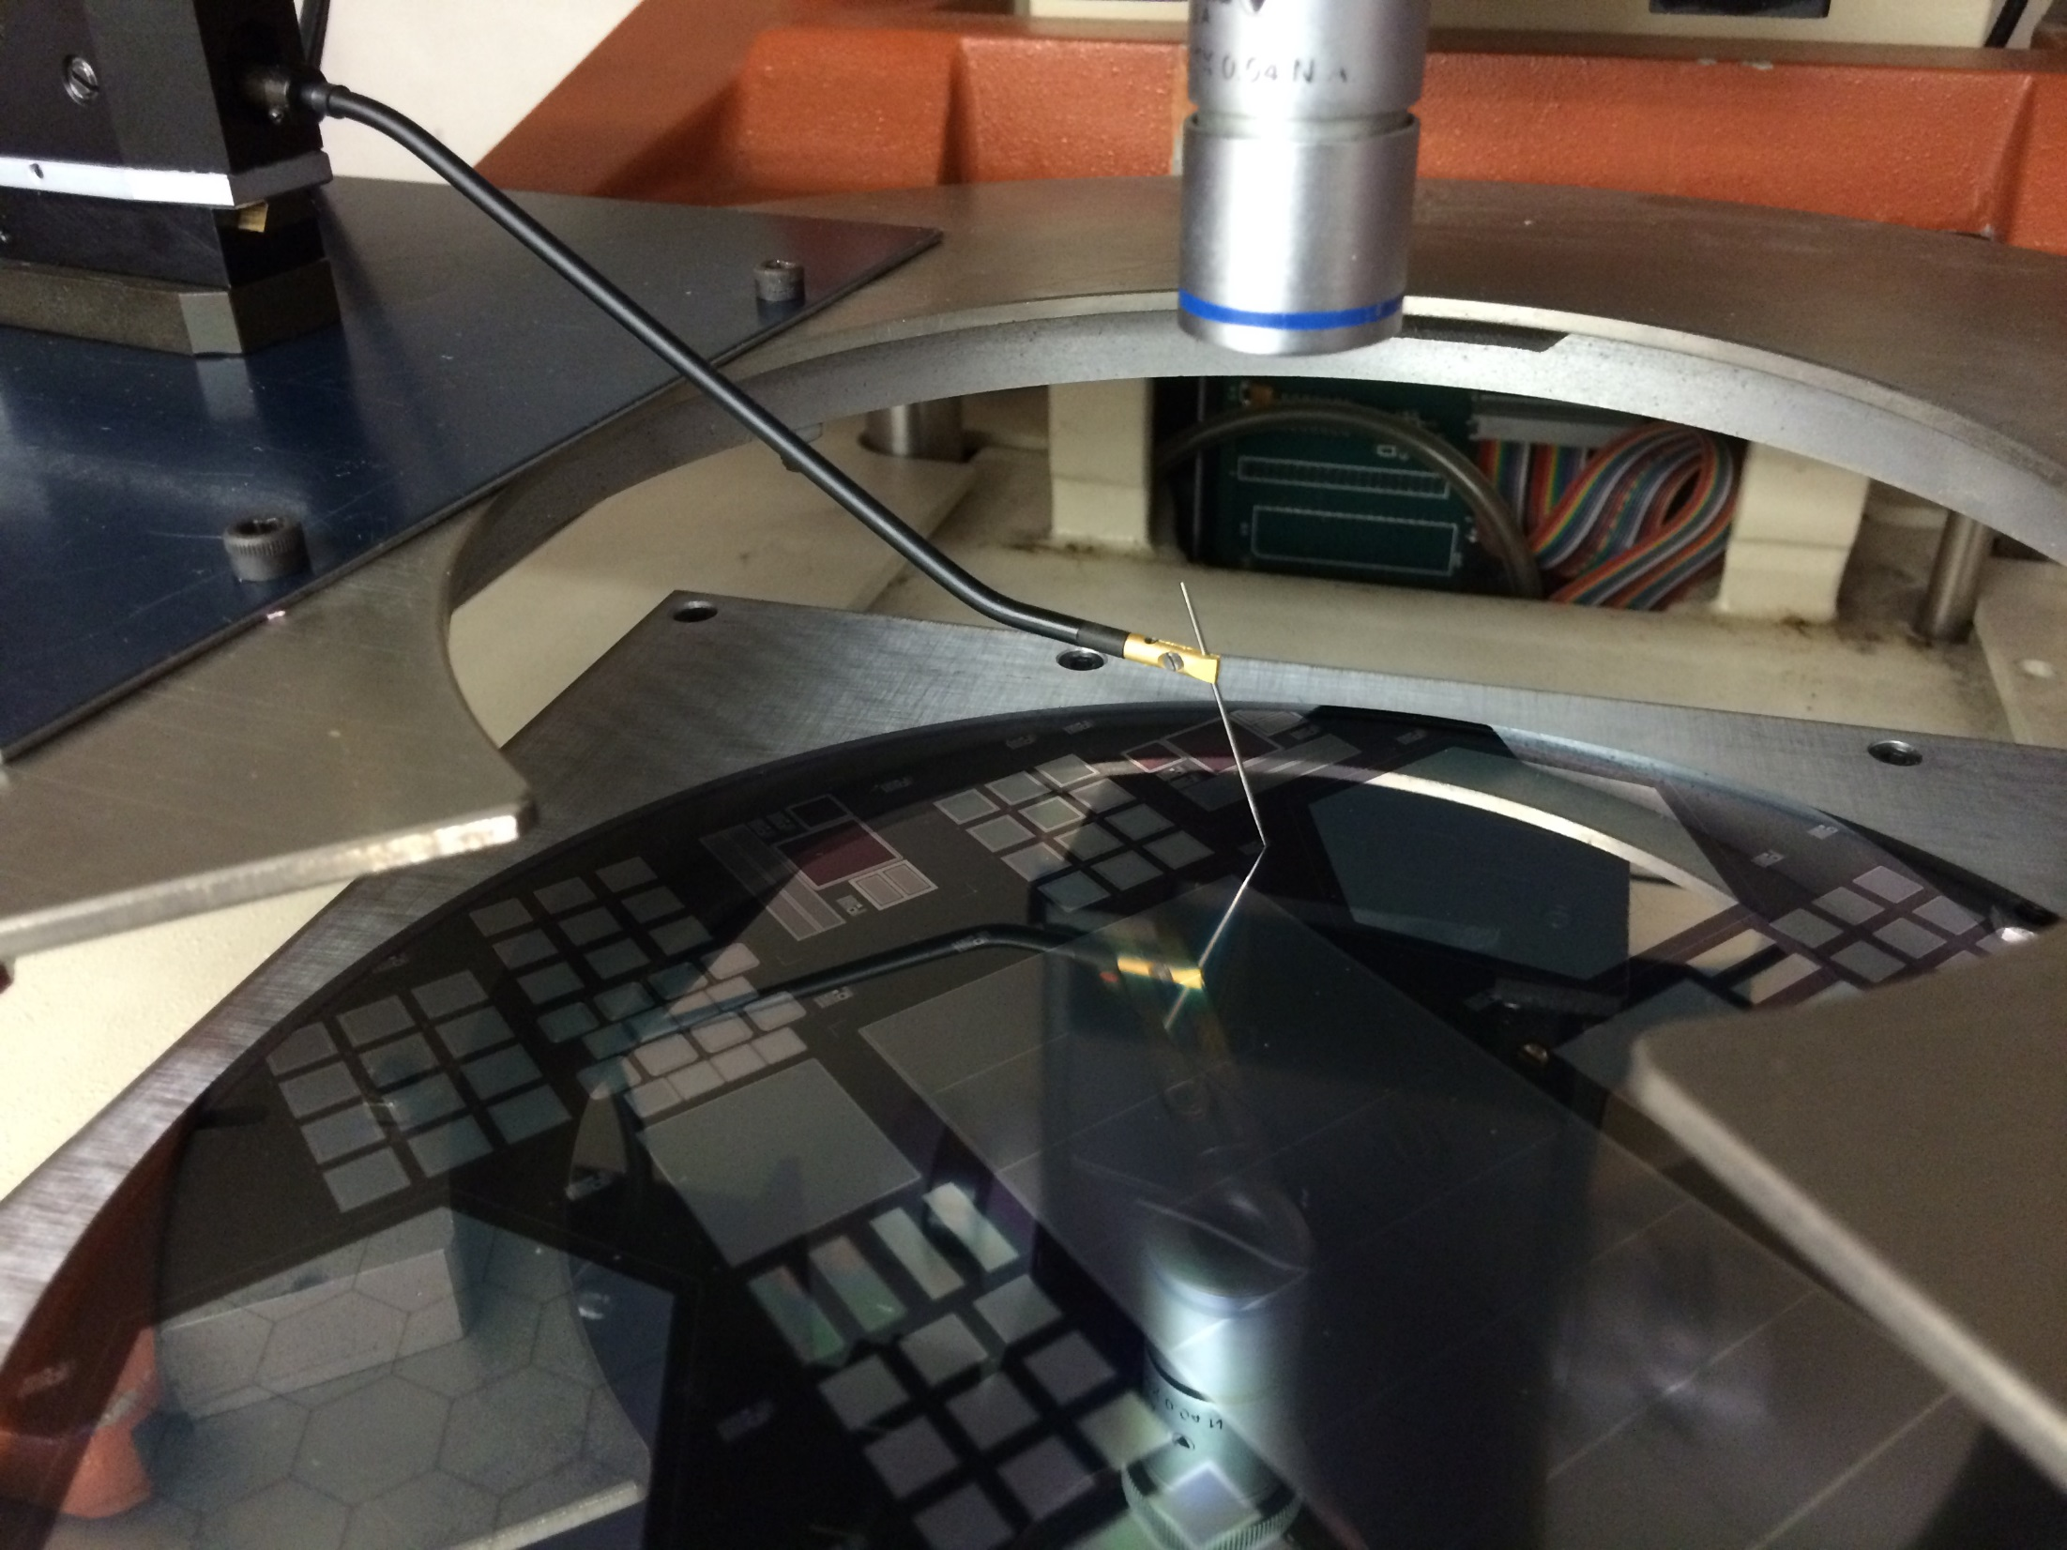
A scratch

Slide 4
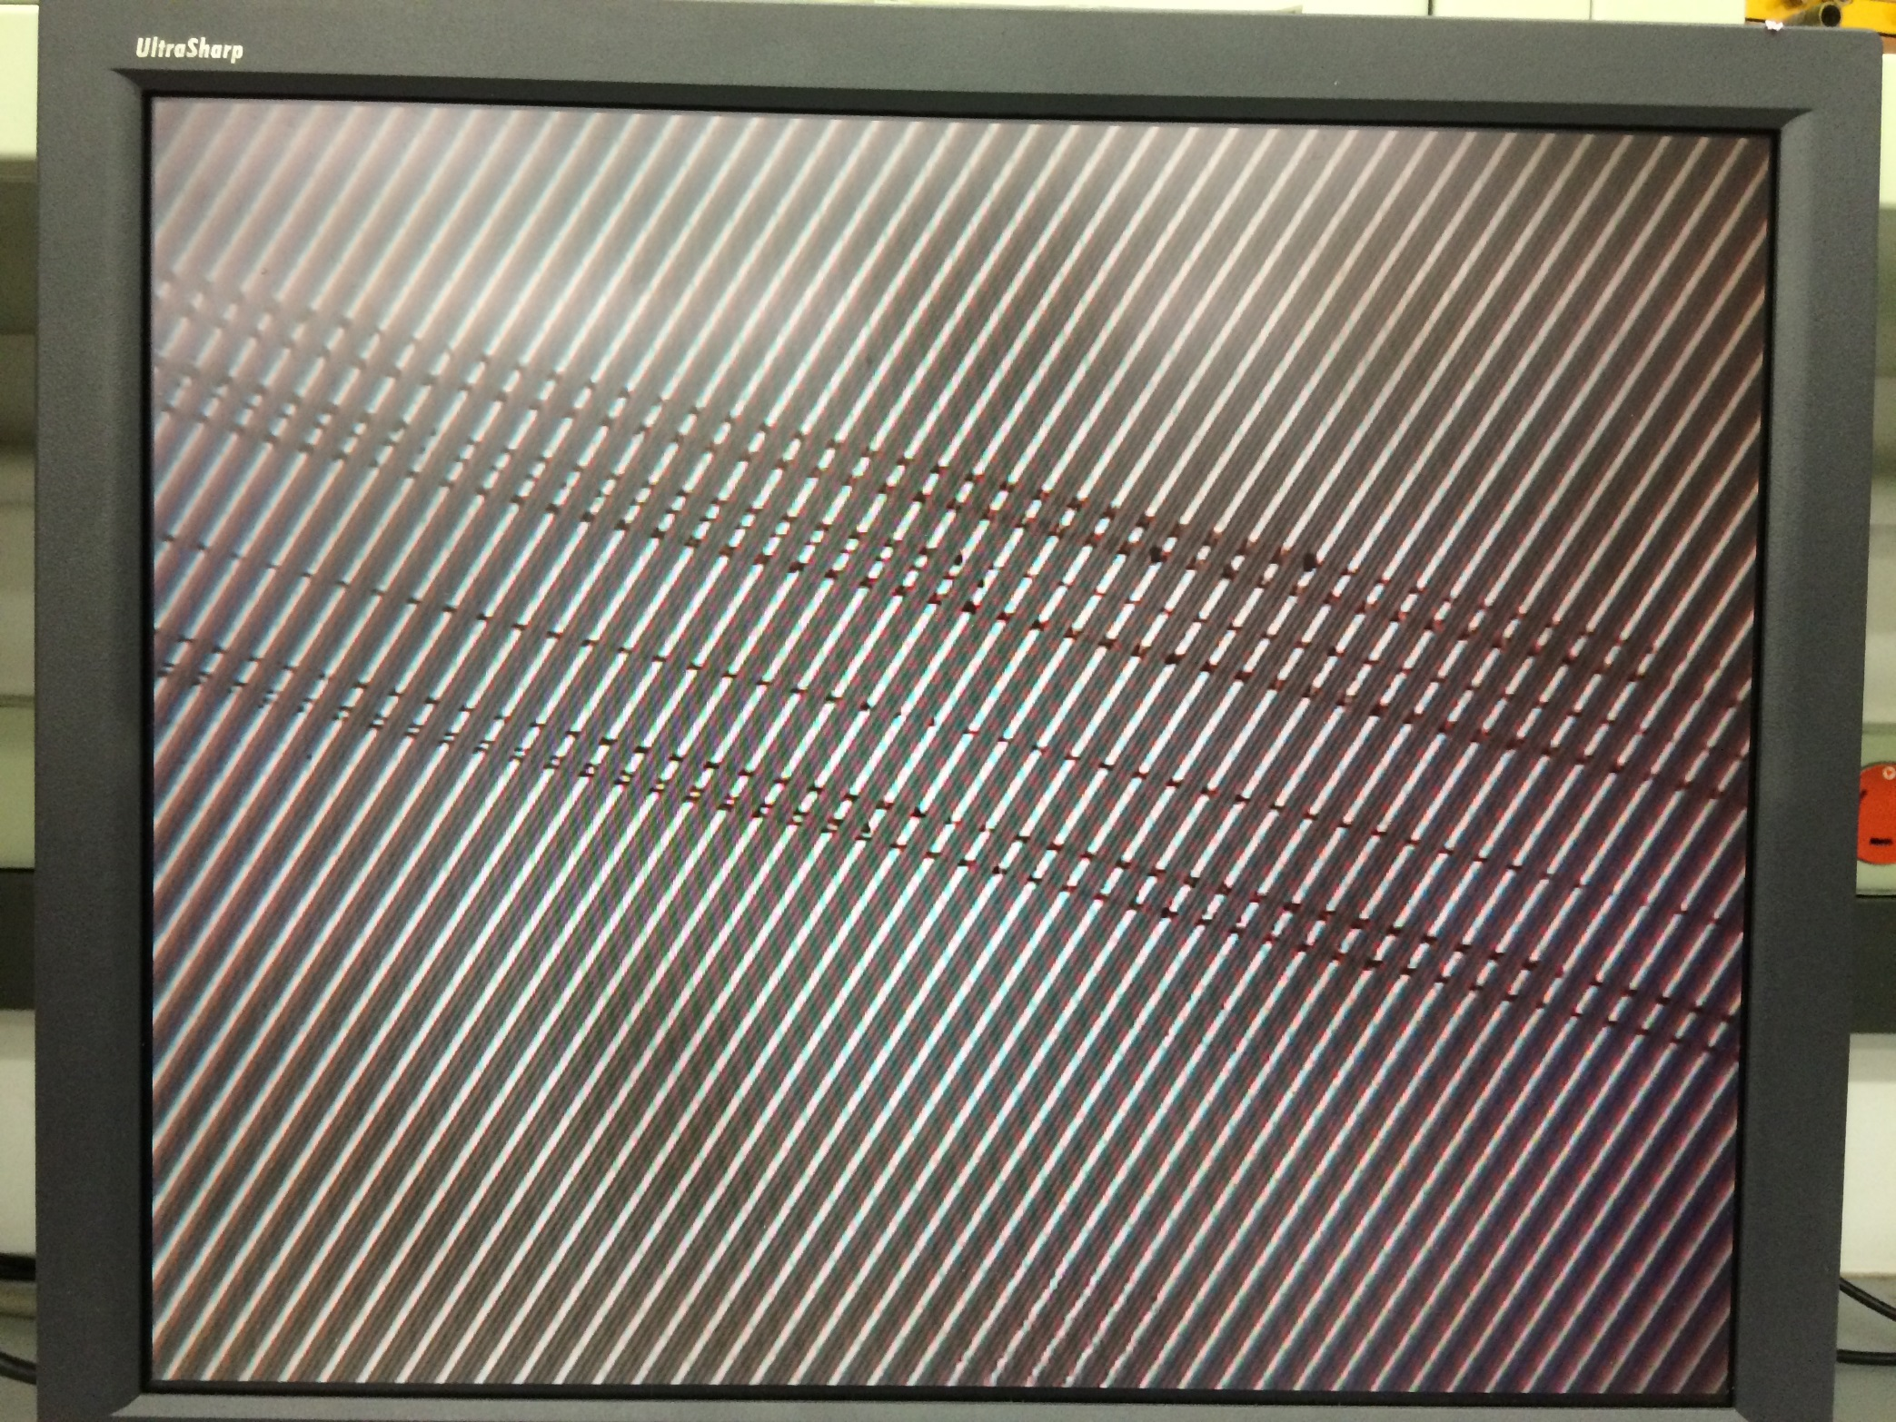
Scratch

Slide 5
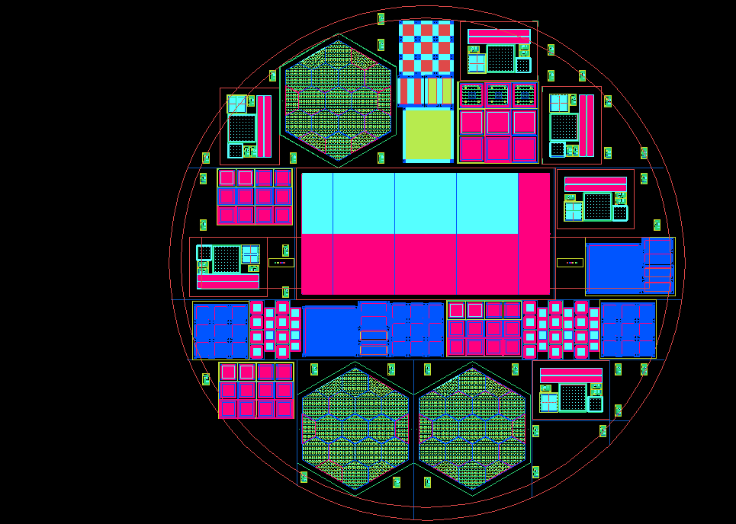
Wafer Map
ss31
ss30
TS-1
ss1
ss28
ST-1
ss2
HGC-2
ss3
TS-6
CL-1
Ts-2
ss26
ss27
ss29
ss4
ss5
ss25
TS-3
ss6
CS-3
ss24
ss7
ss23
PS
TS-5
SL-1
ss22
SR-2
AL-2
ST-2
CS-1
AL-1
SR-1
ss21
ss19
ss18
ss15
ss14
ss8
ss9
CS-2
TS-4
HGC-2
ss10
HGC-1
ss12
ss11
ss17
ss16
ss13
ss20

Slide 6
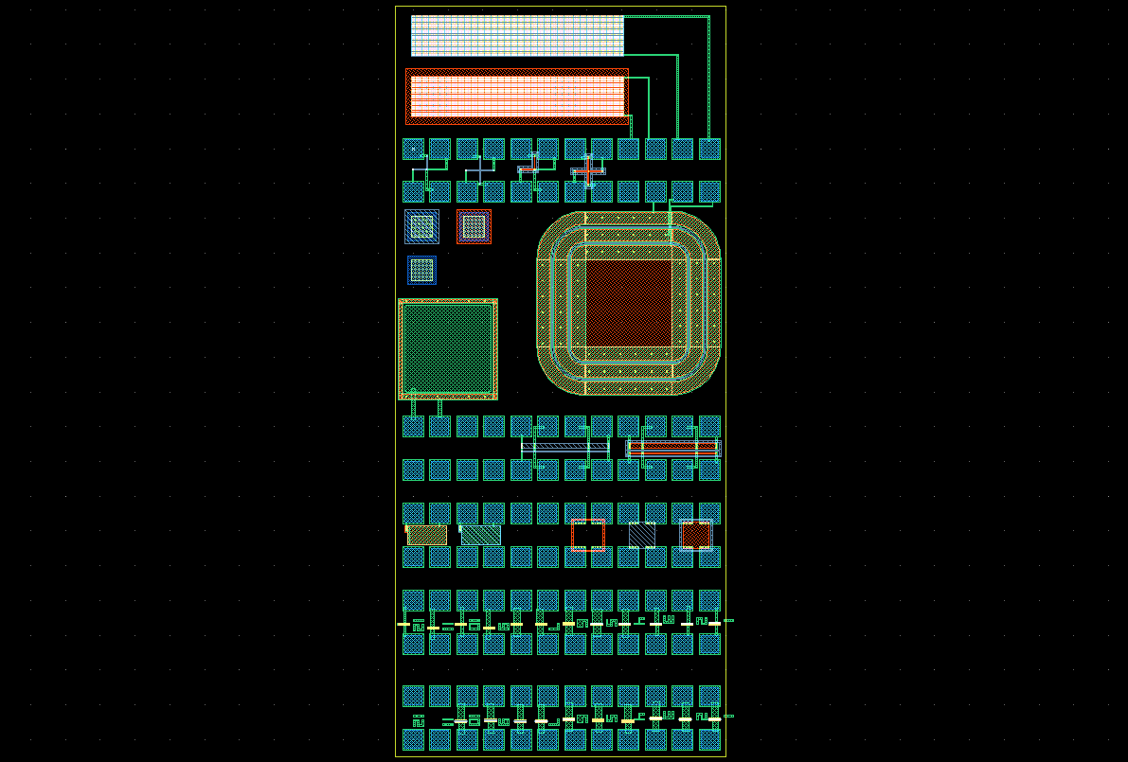
Novati Structure
VC-1
Via chains
VC-2
VDP1-4
Van der Paw
SIMS field
SD
Small diode
Reference for test:
SS-#/VC-# (eg)
MOS
BS-1-2
PT-1-12
Punchthrough
structures
PT-13-24

Slide 7
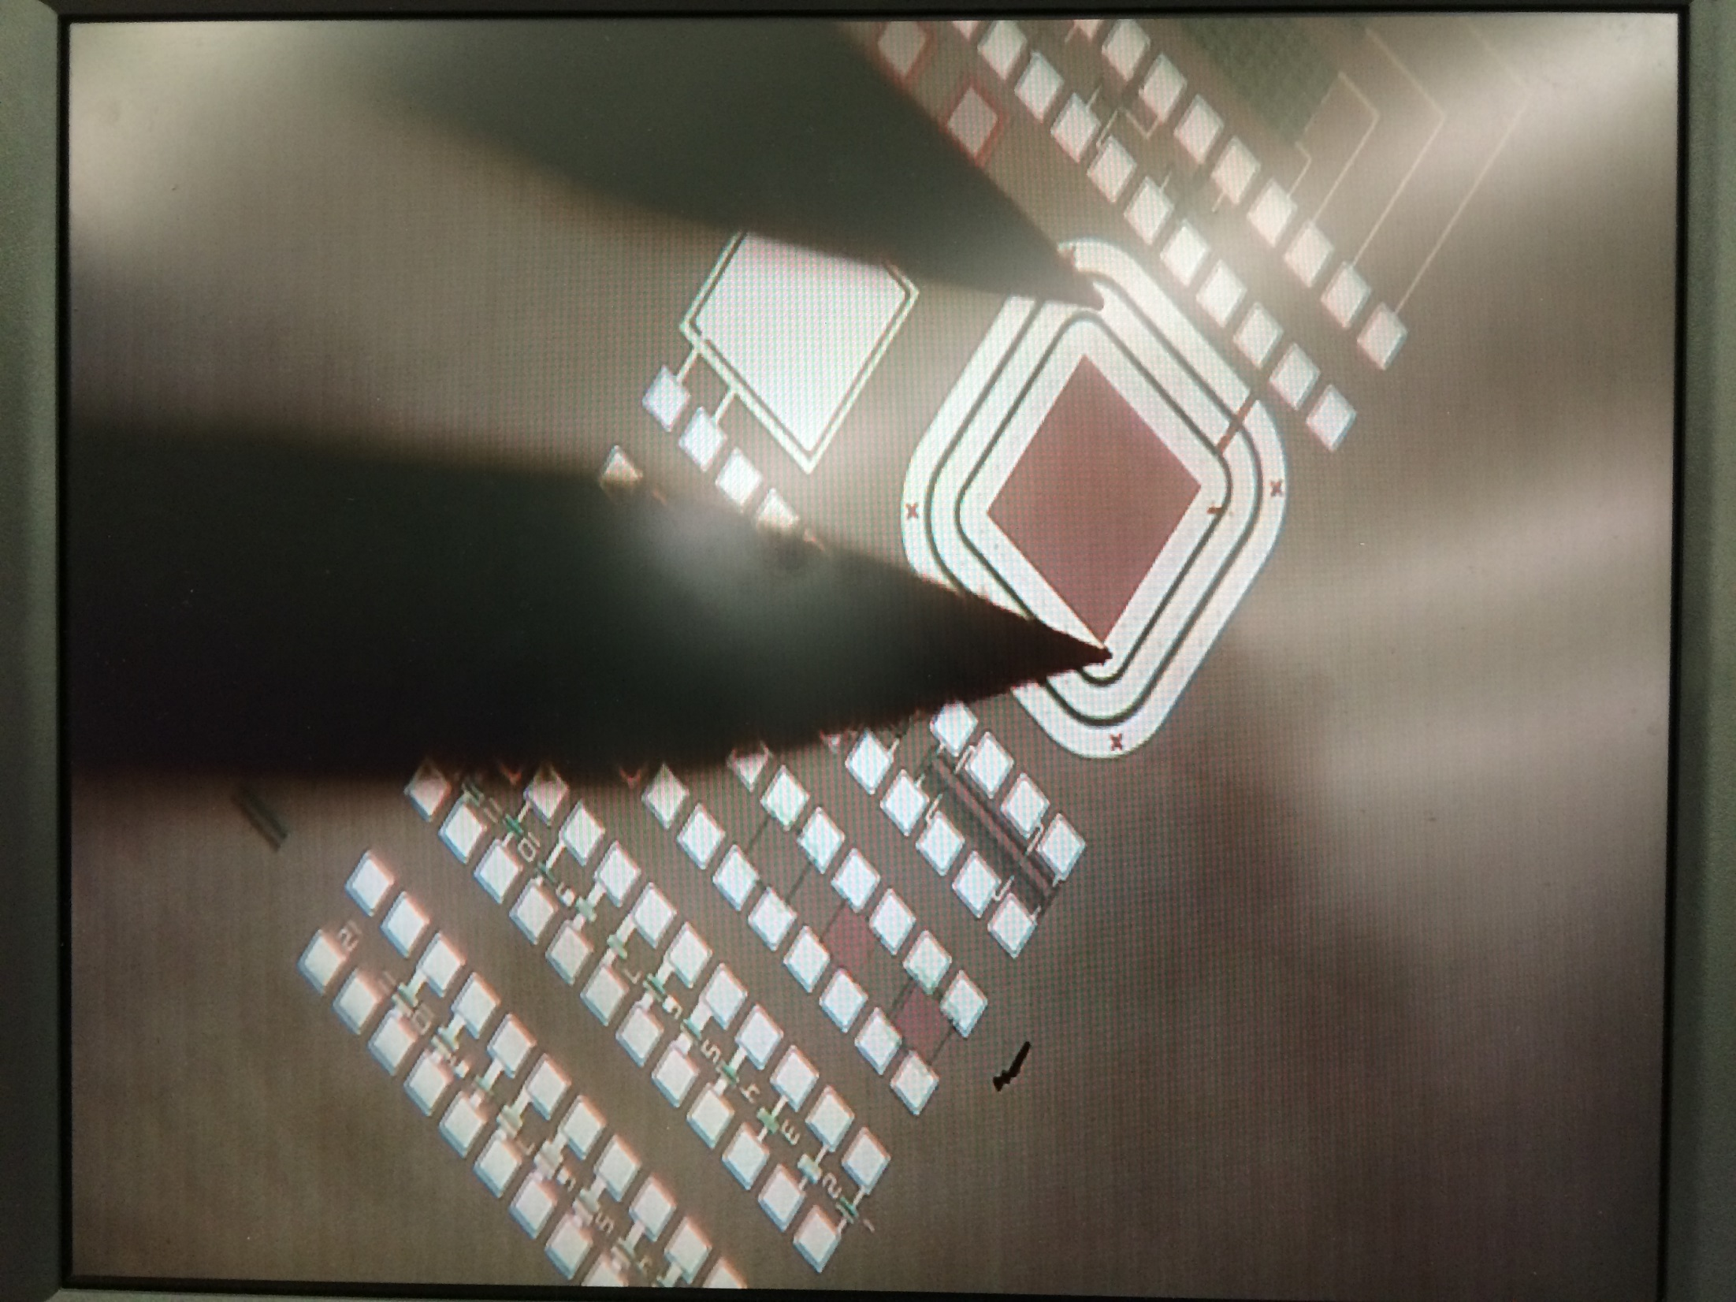
Contact to ss27-SD

Slide 8
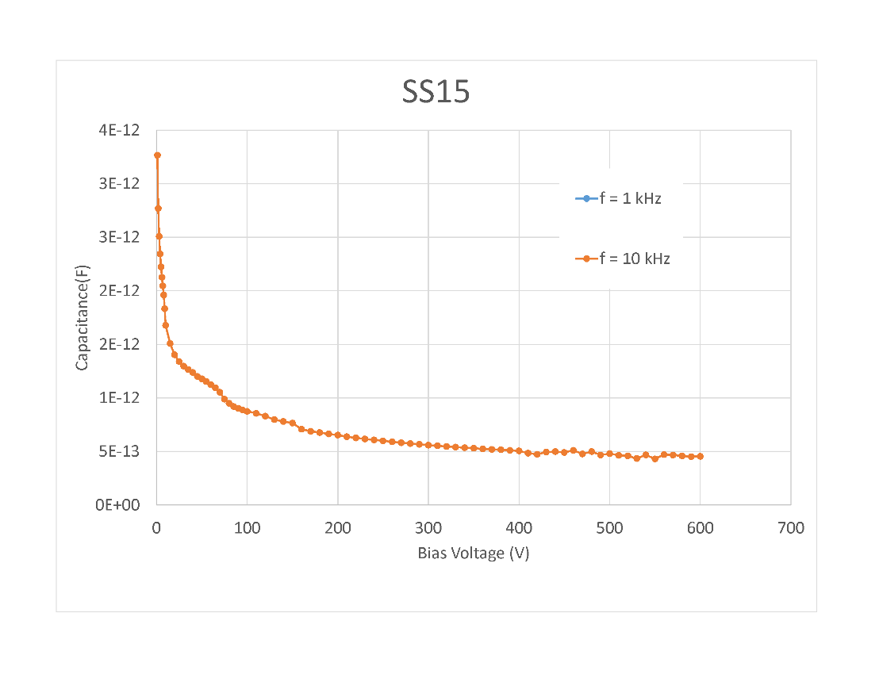
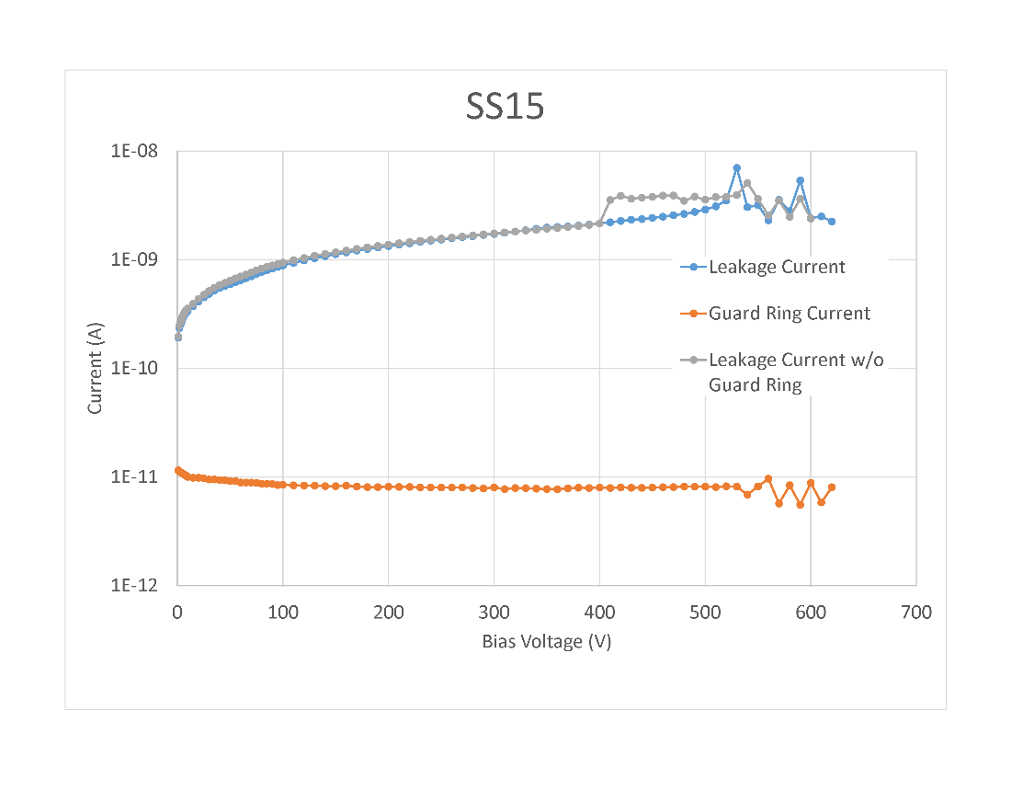
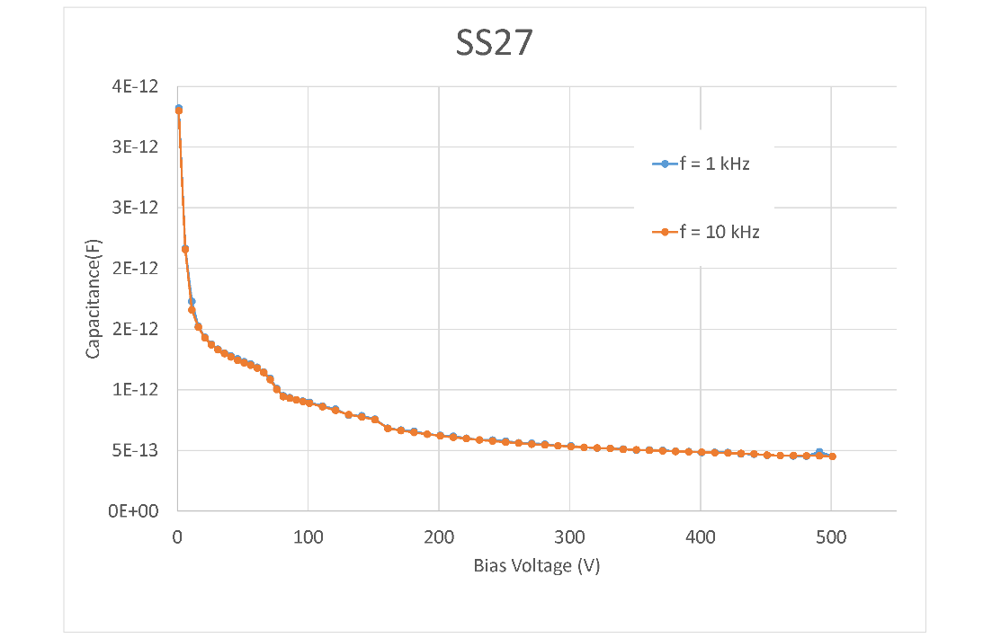
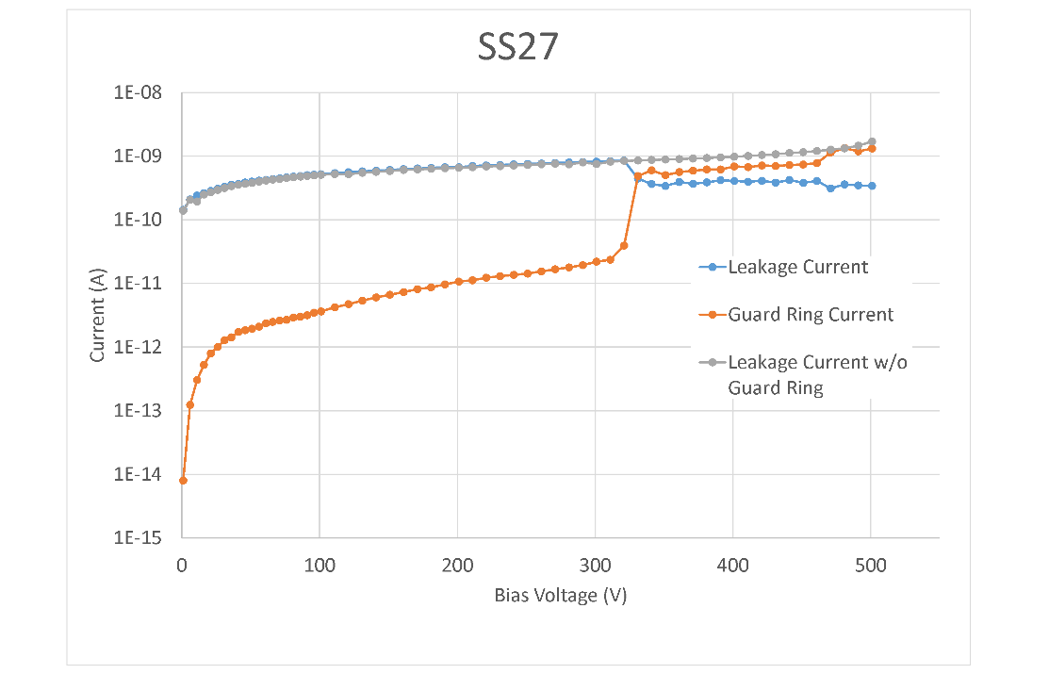
Ss15 and ss27 small diodes

Slide 9
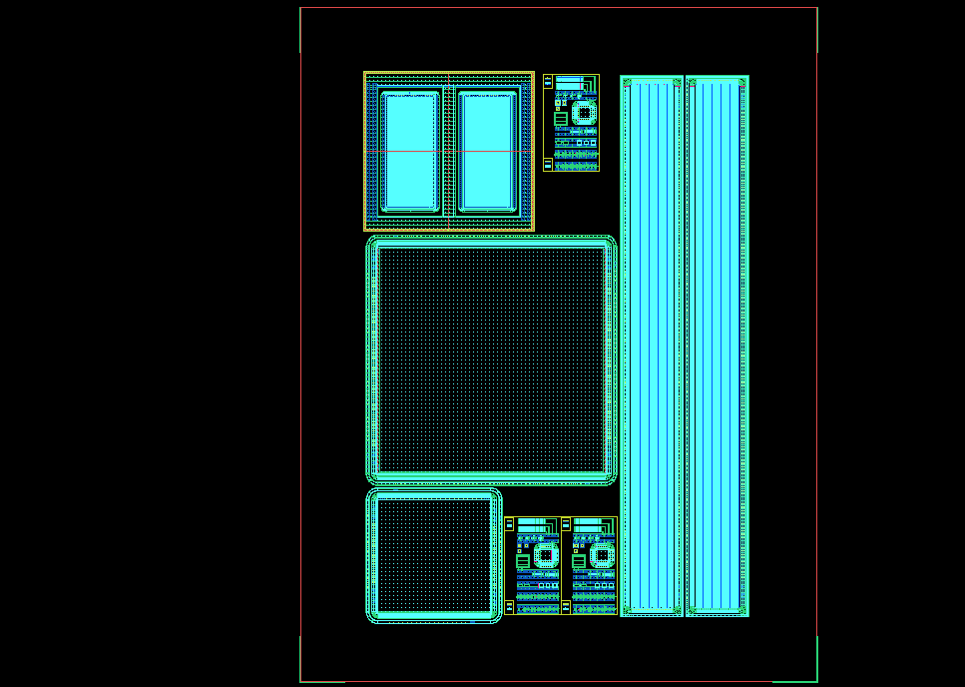
Test Structure Cell
Probe test
structures
GD-1
GD-2
SS-1
DCS
ACS
Reference:
TS-#/GD-#
LD
MD
SS-3
SS-2
DC and punchthough strips

Slide 10
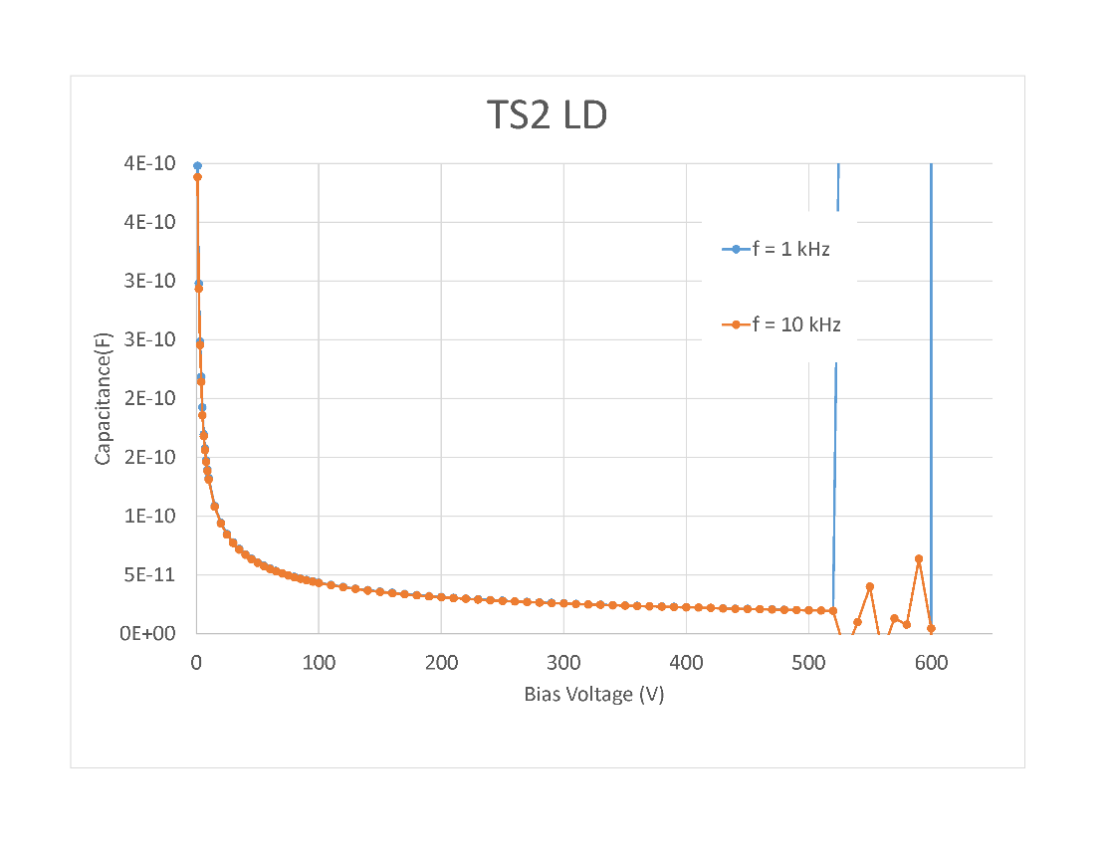
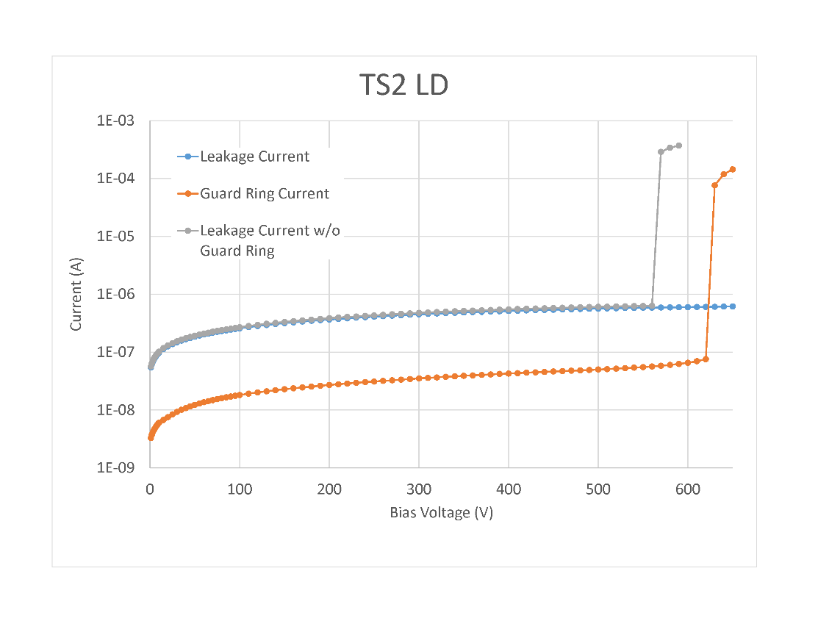
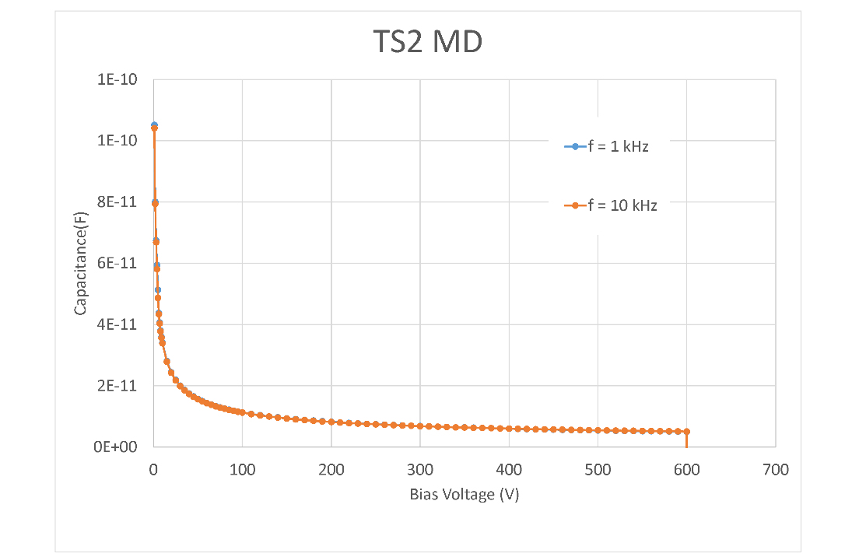
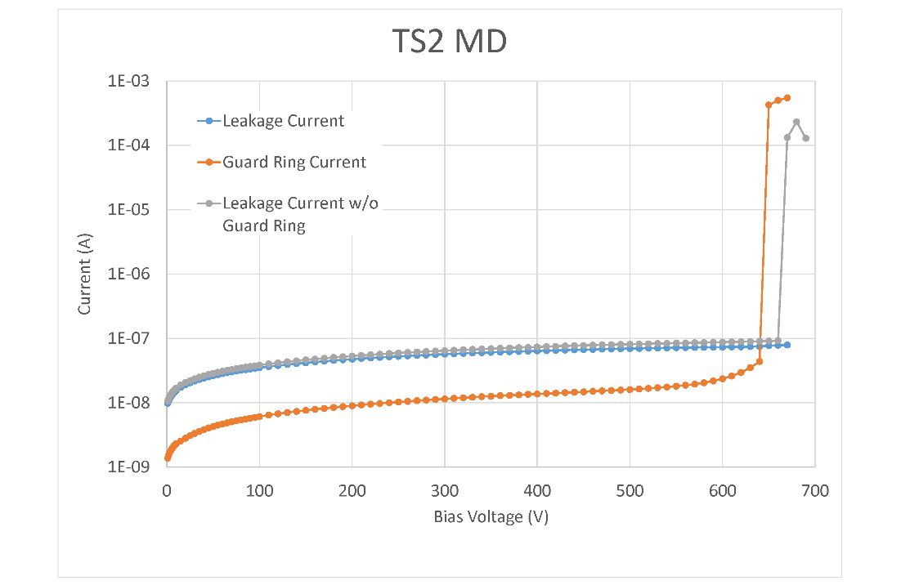
TS-2 large and medium diodes

