Slide 1
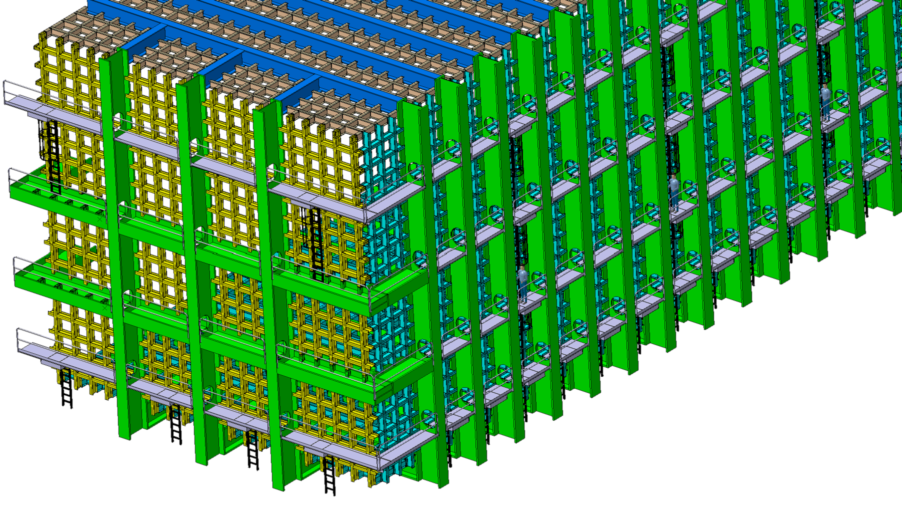
Neutrino
List of Bolted/welded connection

Slide 2
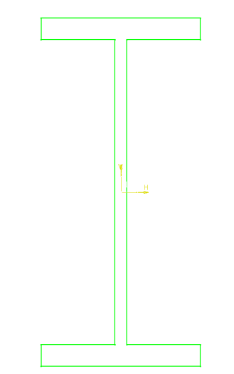

Neutrino
W
3 types of beam:
 | H | W | A | B
Type 1 | 300 | 150 | 10 | 15
Type 2 | 700 | 350 | 20 | 35
Type 3 | 1200 | 550 | 40 | 75
A
H
B

Slide 3
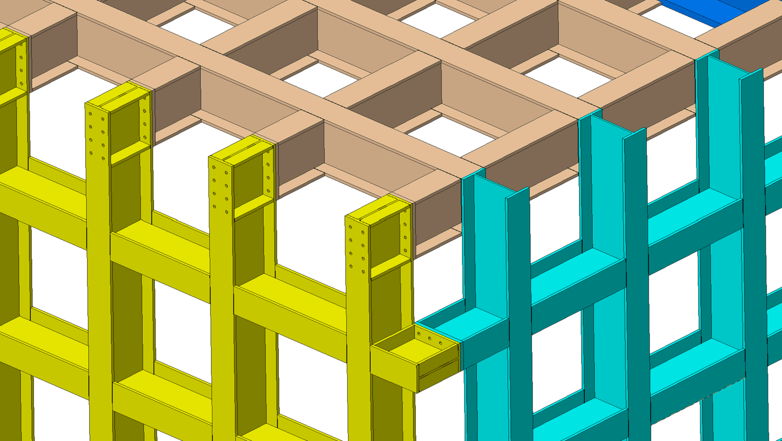

Neutrino
Bolted connections:
Type 1 beam with type 1 beam (draft solution shown)

Slide 4
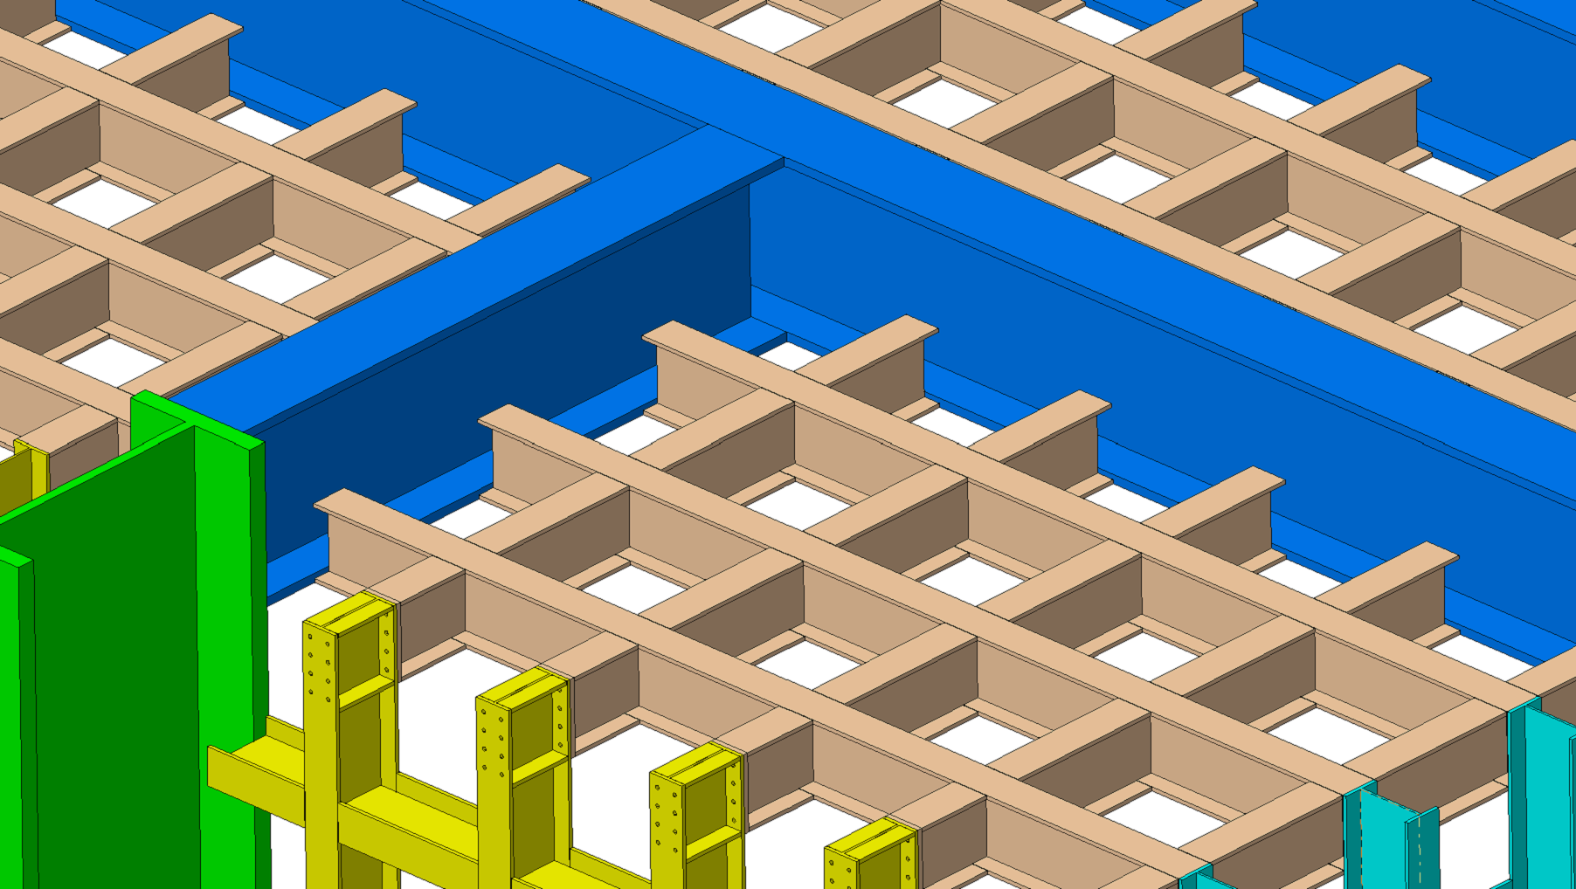
Neutrino
Bolted connections:
Type 1 beam with type 2 beam

Slide 5
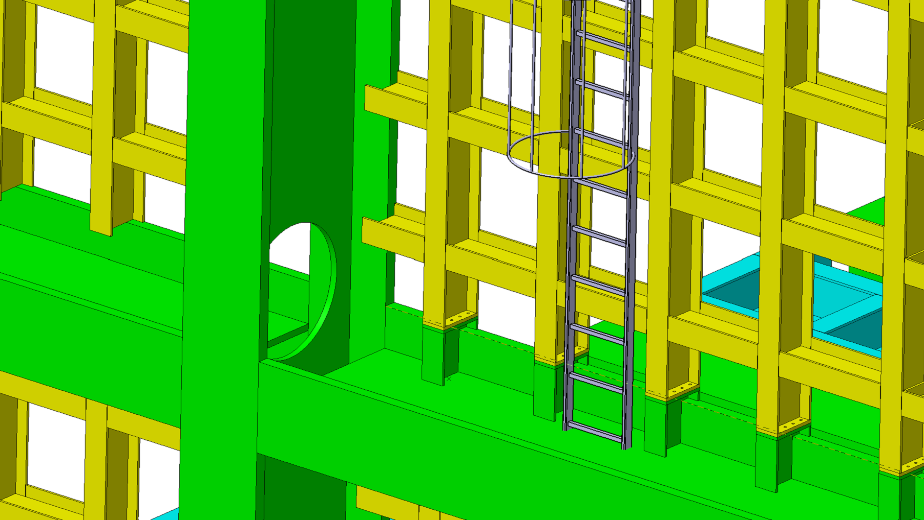
Neutrino
Bolted connections:
Type 1 beam with type 3 beam (draft solution shown)

Slide 6
Neutrino
Bolted connections:
Type 2 beam with type 2 beam

Slide 7
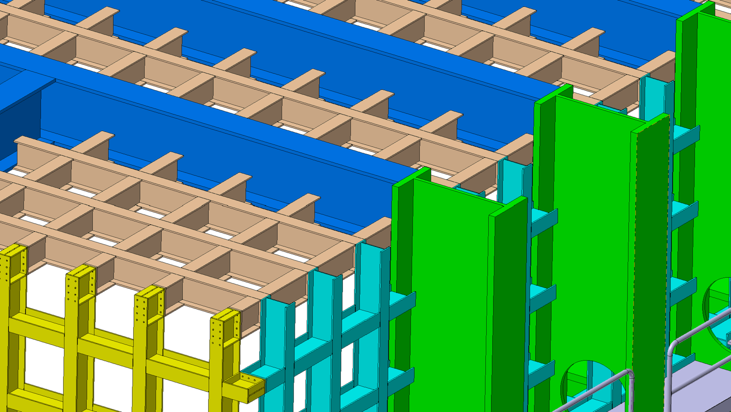
Neutrino
Bolted connections:
Type 2 beam with type 3 beam

Slide 8
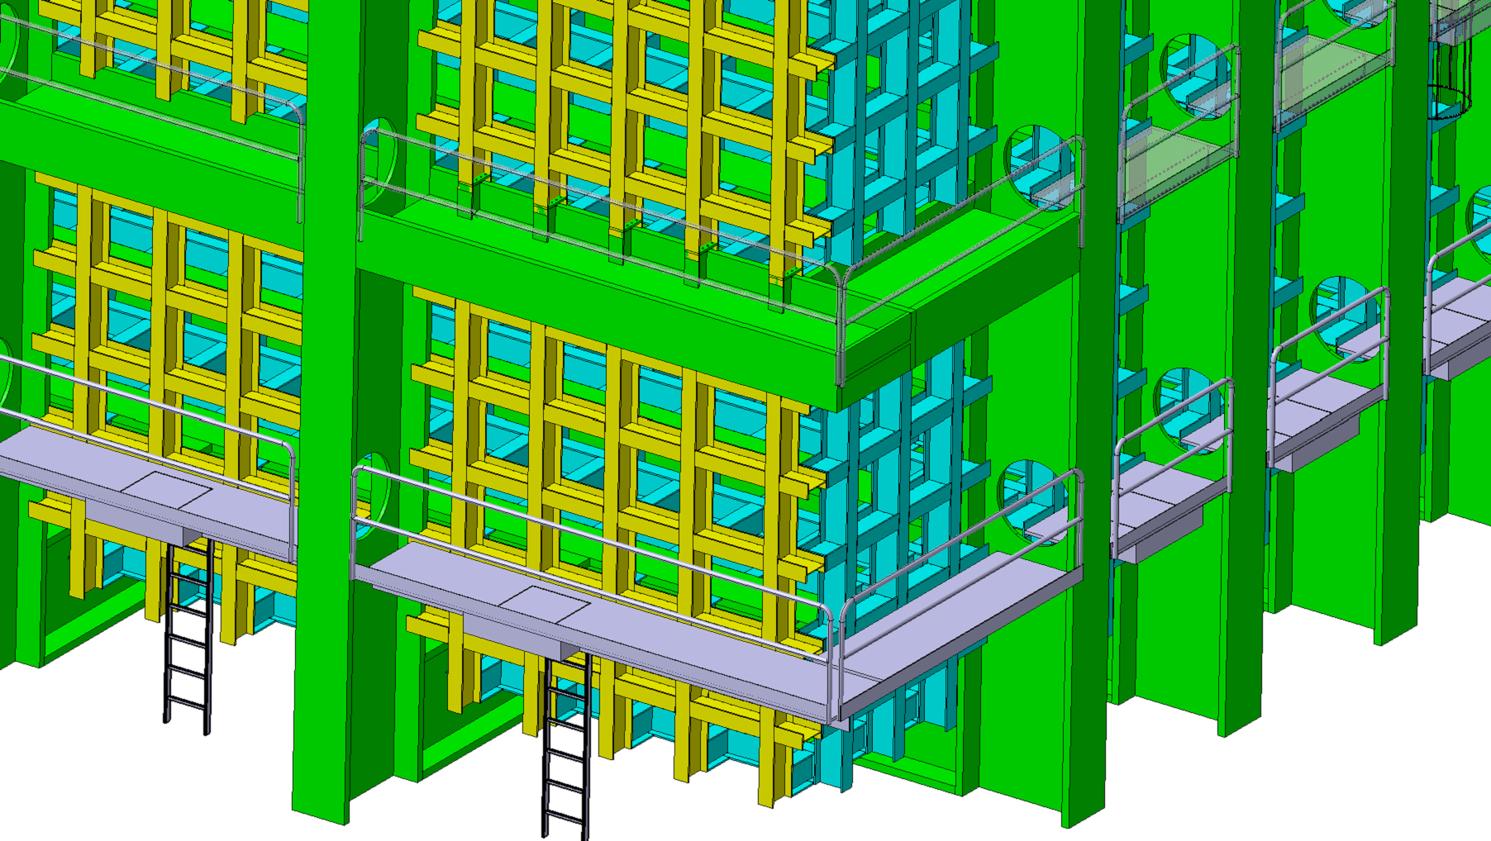
Neutrino
Bolted connections:
Type 3 beam with type 3 beam

