Slide 1
Preliminary FEA Results
PH-DT Engineering Office, CERN
CERN, April 2015

Slide 2
Contents
Maximum Beam Stresses
FEA of Moment Connection

Slide 3
Maximum Beam Stresses

Slide 4
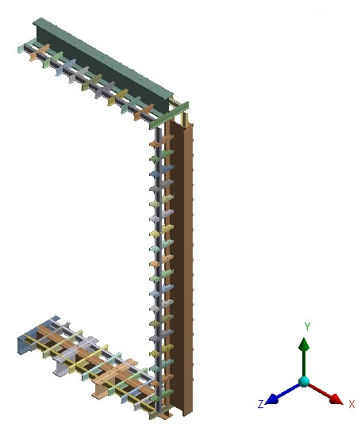
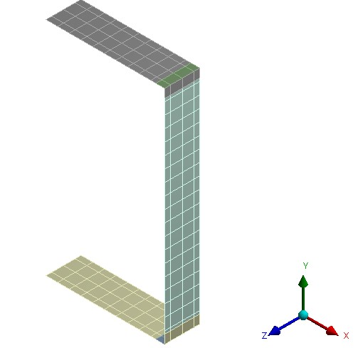
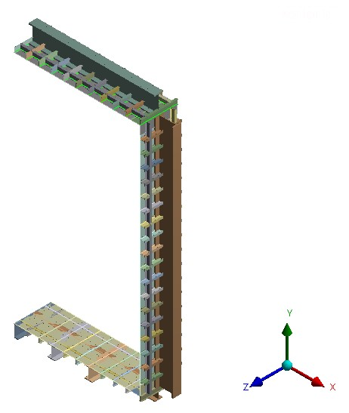
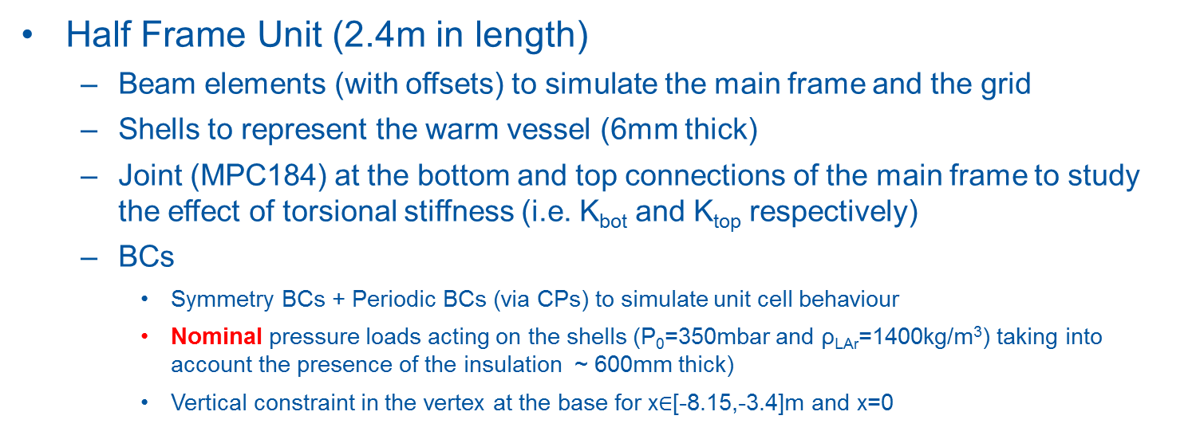
Maximum Beam Stresses: FEA Model Details
Half Frame Unit (2.4m in length)
  Beam elements (with offsets) to simulate the main frame and the grid
  Shells to represent the warm vessel (6mm thick)
  Joint (MPC184) at the bottom and top connections of the main frame to study the effect of torsional stiffness (i.e. K_{bot} and K_{top} respectively)
  BCs
    Symmetry BCs + Periodic BCs (via CPs) to simulate unit cell behaviour
    Nominal pressure loads acting on the shells (P₀=350mbar and ρ_{LAr}=1400kg/m³) taking into account the presence of the insulation ~ 600mm thick)
    Vertical constraint in the vertex at the base for x$∈$[-8.15,-3.4]m and x=0
+
=

Slide 5
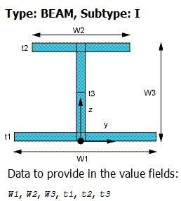
Baseline Configuration
Main frame composed by three large beams with the same cross section
Steel S355 (EC properties for t>40mm)
  σ_{y}=335 MPa → σ_{y}/1.5=223 MPa
  UTS=470 MPa → UTS/3.5=134 MPa
K=1700 MNm/rad →
 | Section Grid | Section Vertical | Section Floor | Section Roof
W1 (m) | 0.15 | 0.55 | 0.55 | 0.55
W2 (m) | 0.15 | 0.55 | 0.55 | 0.55
W3 (m) | 0.3 | 1.2 | 1.2 | 1.2
t1 (m) | 0.015 | 0.075 | 0.075 | 0.075
t2 (m) | 0.015 | 0.075 | 0.075 | 0.075
t3 (m) | 0.01 | 0.04 | 0.04 | 0.04
Mass/m (kg/m) | 56.52 | 977.325 | 977.325 | 977.325
Stiffness estimated via FEA for a bolted joint between two of the large beams used in the main frame

Slide 6
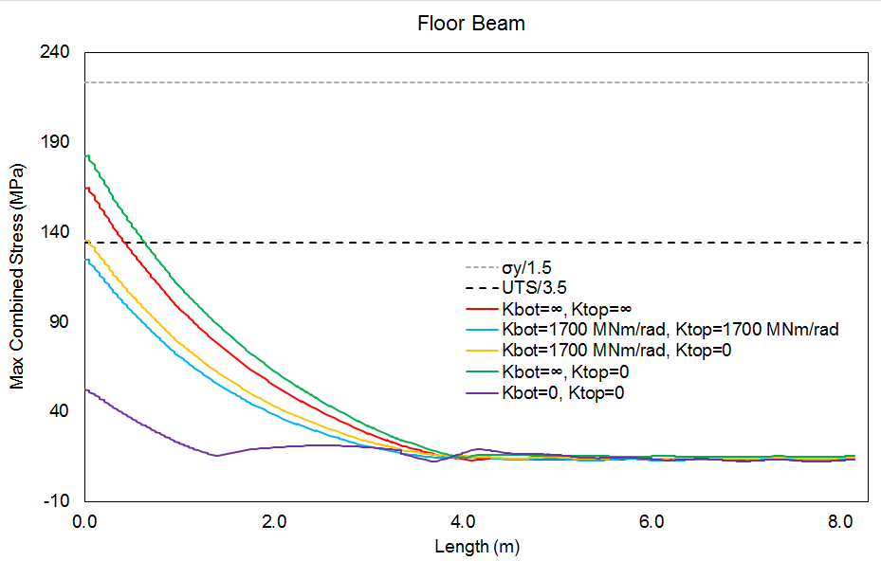
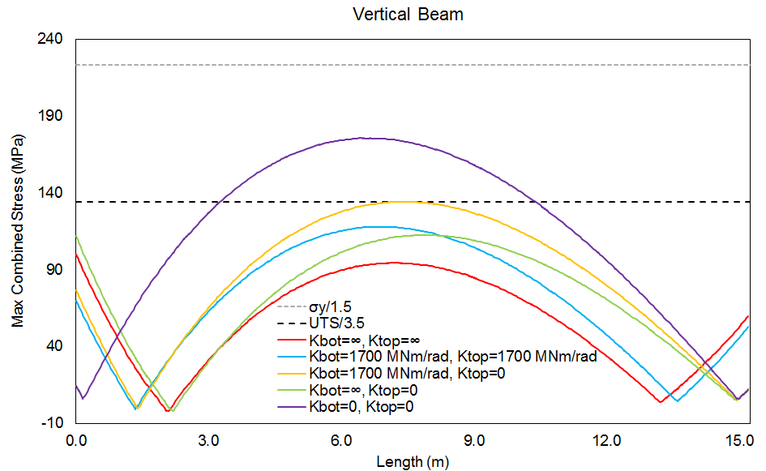
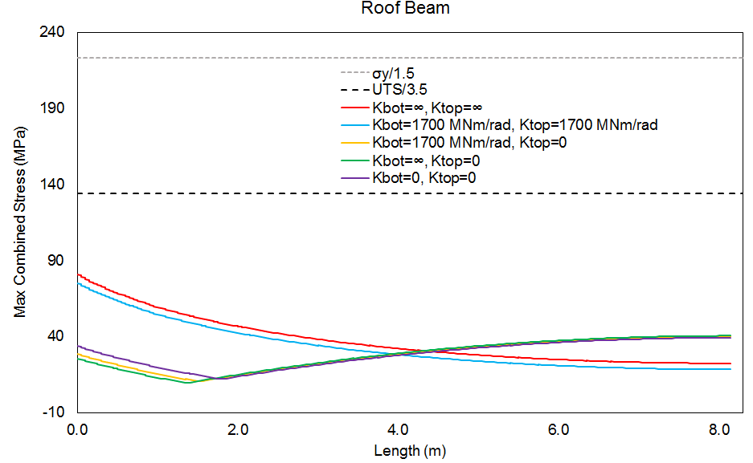
Baseline Configuration: Effect of Joint Stiffness
Effect of the Joint Stiffness on the maximum combined stress for the main vertical, floor and roof beams
Only two configurations seems to be acceptable:
K_{bot}=K_{top}=1700MNm/rad
K_{bot}=1700MNm/rad, K_{top}=0
(Although the second one would be at the very limit in the vertical and floor beams).

Slide 7
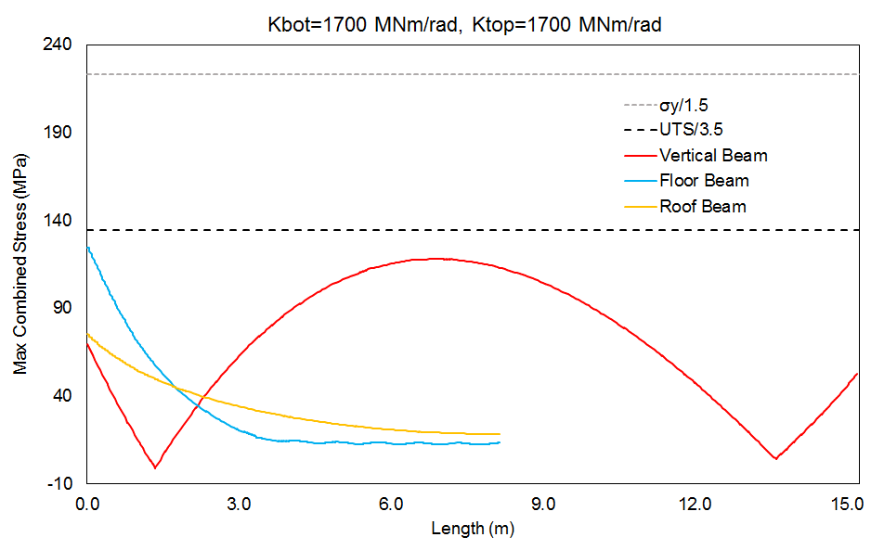
Baseline Configuration: Imperfect Joint

Slide 8
Smaller Roof Beam: Parametric Study
Parametric study varying the cross section of the large beam used at the roof (floor and vertical beams remain unchanged):
  Dimitar’s original roof beam taken as the starting point
  Progressive increase of the web length (i.e. W3)
  Effect of the joint stiffness on the maximum values of the maximum combined stress for the different cross sections
Characteristics of the I-beam sections considered for the large roof beam
 | Case 1 | Case 2 | Case 3 | Case 4 | Baseline
W1 (m) | 0.35 | 0.35 | 0.35 | 0.35 | 0.55
W2 (m) | 0.35 | 0.35 | 0.35 | 0.35 | 0.55
W3 (m) | 0.7 | 0.8 | 0.9 | 1 | 1.2
t1 (m) | 0.035 | 0.035 | 0.035 | 0.035 | 0.075
t2 (m) | 0.035 | 0.035 | 0.035 | 0.035 | 0.075
t3 (m) | 0.02 | 0.02 | 0.02 | 0.02 | 0.04
I (m4) | 0.003128 | 0.004235 | 0.005538 | 0.007047 | 0.030001
Mass/m (kg/m) | 291.235 | 306.935 | 322.635 | 338.335 | 977.325

Slide 9
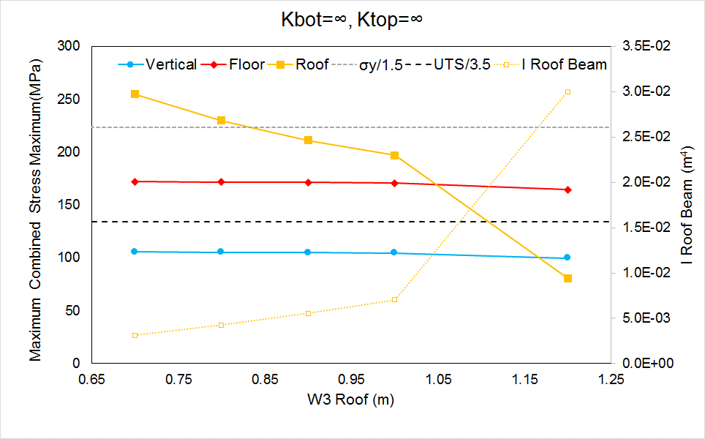
Small Roof Beam: Perfect Moment Connections

Slide 10
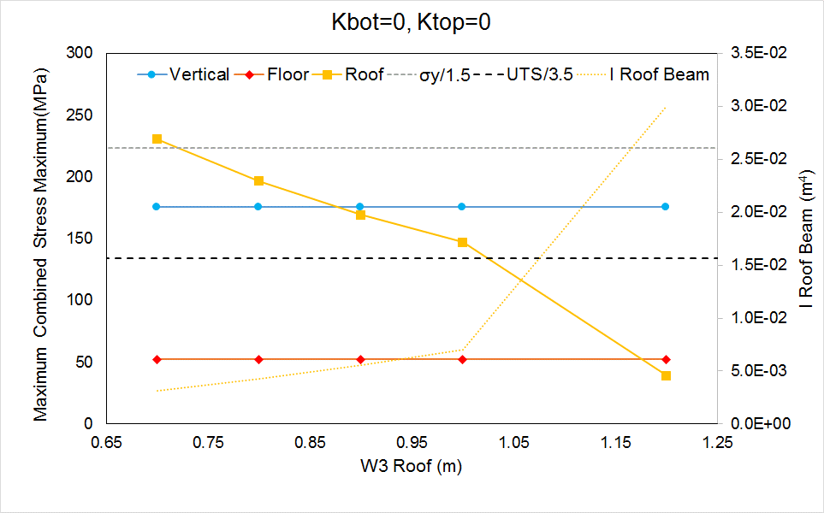
Small Roof Beam: Pinned Connections

Slide 11
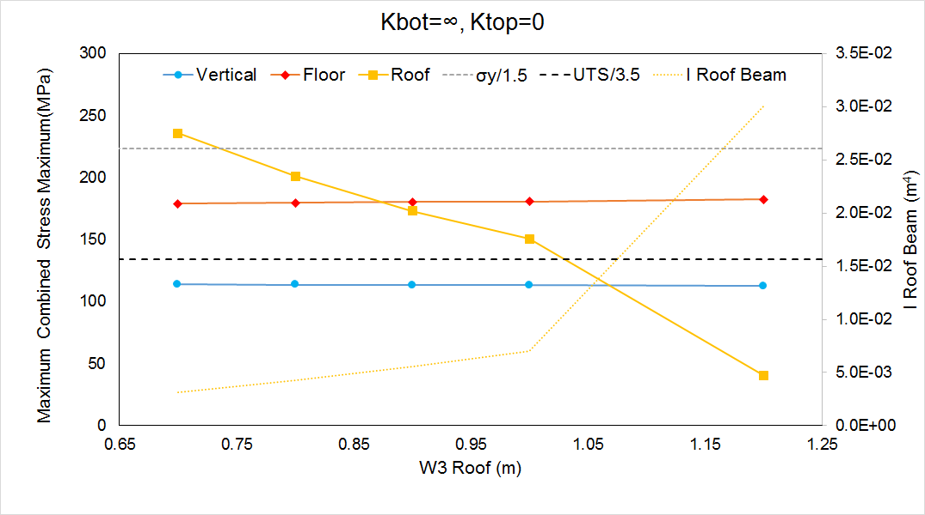
Small Roof Beam: K_{bot}=∞, K_{top}=0

Slide 12
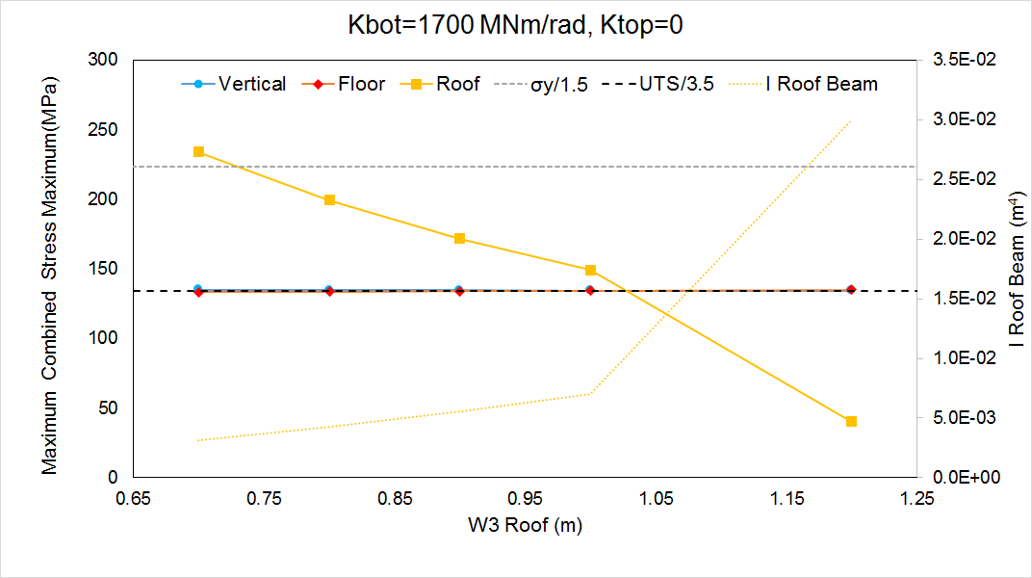
Small Roof Beam: K_{bot}=1700 MNm/rad, K_{top}=0

Slide 13
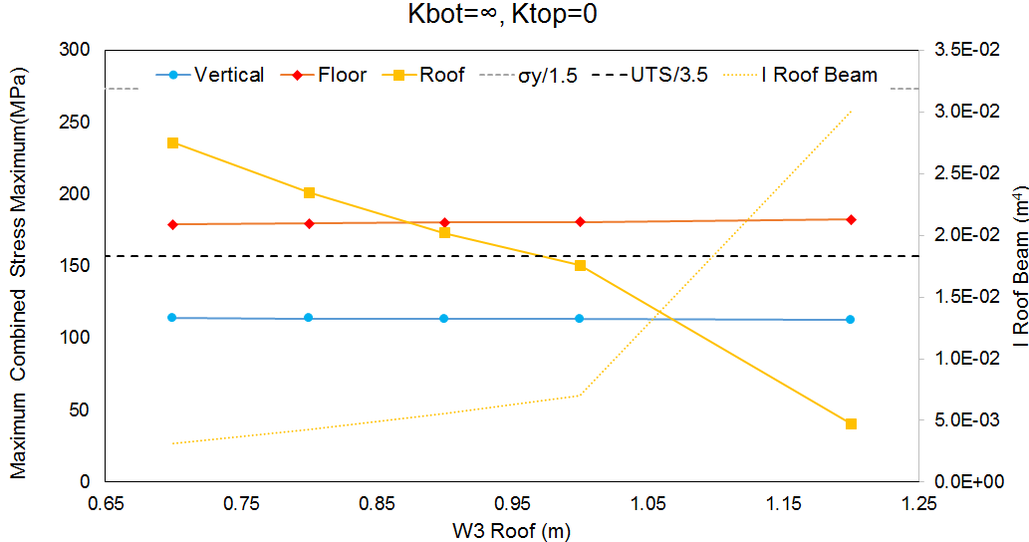
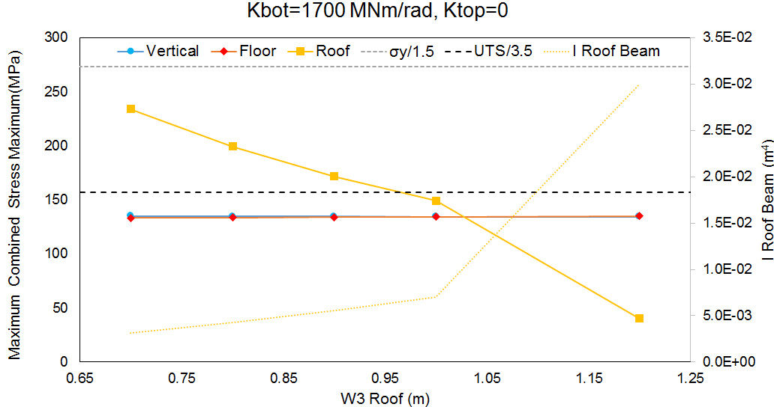
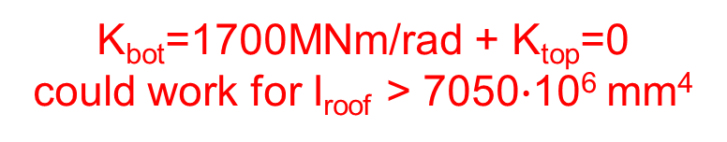
Change is Steel Grade?
Small Improvements by moving to S450 (EC properties for t>40mm):
  σ_{y}=410 MPa → σ_{y}/1.5=273.3 MPa
  UTS=550 MPa → UTS/3.5=157 MPa
K_{bot}=1700MNm/rad + K_{top}=0
could work for I_{roof} > 7050$∙$10⁶ mm⁴

Slide 14
Smaller Floor Beam: Parametric Study
Parametric study varying the cross section of the large beam used at the floor (roof and vertical beams remain unchanged):
  Dimitar’s original roof beam taken as the starting point
  Progressive increase of the web length (i.e. W3)
  Effect of the joint stiffness on the maximum values of the maximum combined stress for the different cross sections
Characteristics of the I-beam sections considered for the large roof beam
 | Case 1 | Case 2 | Case 3 | Case 4 | Baseline
W1 (m) | 0.5 | 0.5 | 0.5 | 0.5 | 0.55
W2 (m) | 0.5 | 0.5 | 0.5 | 0.5 | 0.55
W3 (m) | 0.8 | 0.9 | 1 | 1.1 | 1.2
t1 (m) | 0.05 | 0.05 | 0.05 | 0.05 | 0.075
t2 (m) | 0.05 | 0.05 | 0.05 | 0.05 | 0.075
t3 (m) | 0.025 | 0.025 | 0.025 | 0.025 | 0.04
I (m4) | 0.007756 | 0.010108 | 0.01281 | 0.015875 | 0.030001
Mass/m (kg/m) | 529.875 | 549.5 | 569.125 | 588.75 | 977.325
Initially S355 is considered

Slide 15
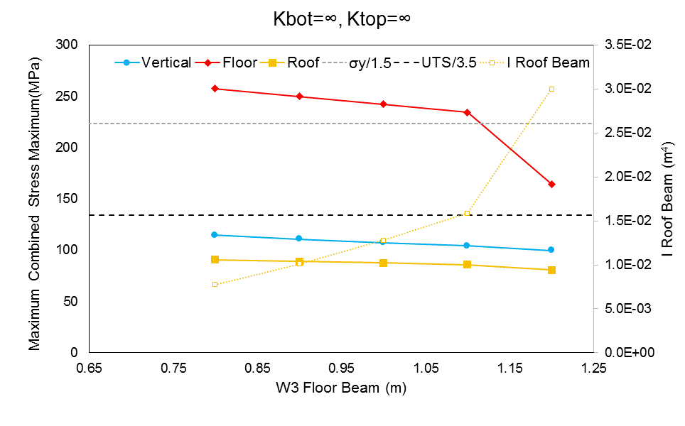
Small Floor Beam: Perfect Moment Connections

Slide 16
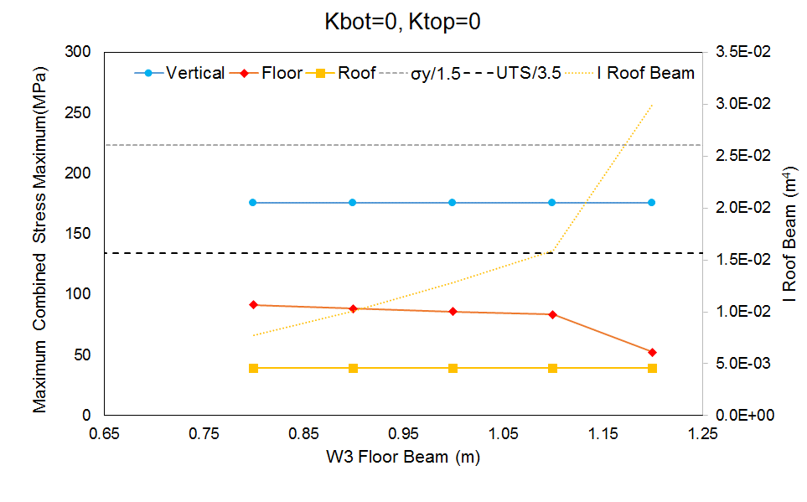
Small Floor Beam: Pinned Connections

Slide 17
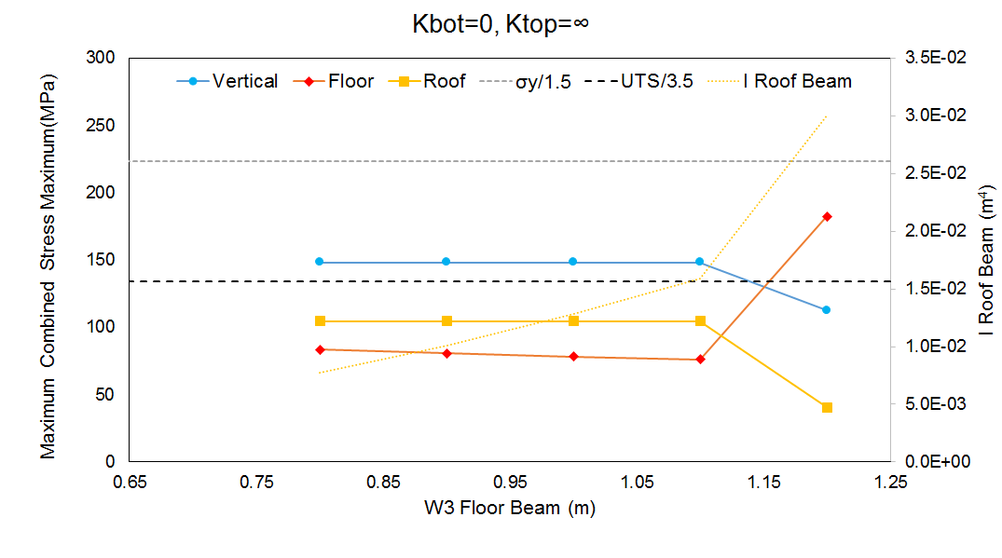
Small Floor Beam: K_{bot}=0, K_{top}=∞

Slide 18
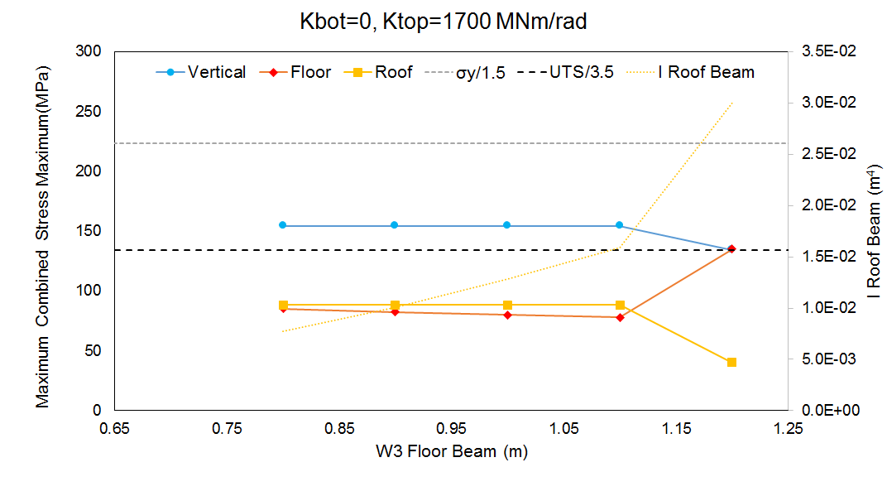
Small Roof Beam: K_{bot}=0, K_{top}=1700 MNm/rad

Slide 19
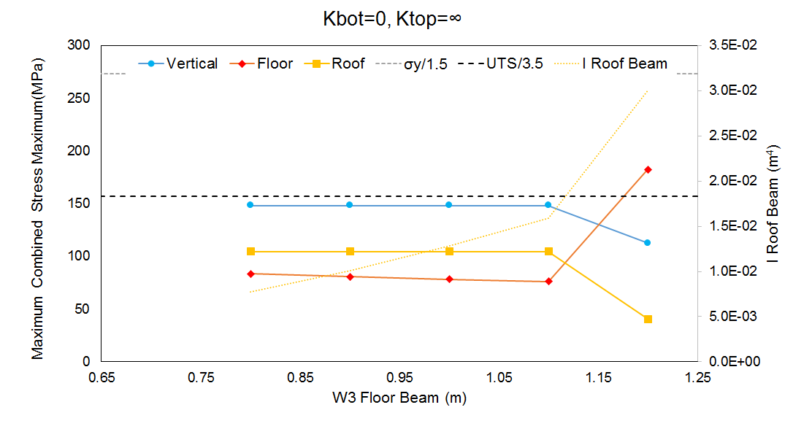
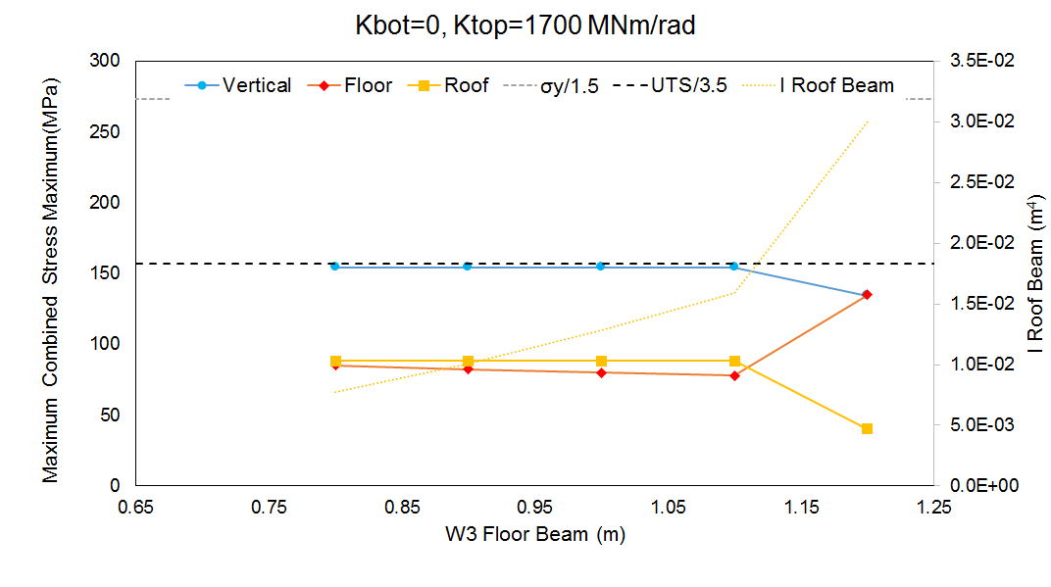
Change is Steel Grade?
Small Improvements by moving to S450 (EC properties for t>40mm):
  σ_{y}=410 MPa → σ_{y}/1.5=273.3 MPa
  UTS=550 MPa → UTS/3.5=157 MPa
Moment connection at the top and a pinned joint at the bottom could work, but just marginally.

Slide 20
Summary
Initial FEA results suggest that the stresses in the main frame would make it difficult to reduce the size of the roof beam substantially.
  This is even worse taking into account that the nominal loads were considered for the previous analysis
  Moving to higher grade steels (e.g. S450 instead S355) should make things a bit easier
Moving to a hinged connection at the top also seems difficult (even for the baseline configuration).
Reducing the dimensions of the floor beam also seems very problematic (with the vertical beam becoming the critical element).
From a mass standpoint, a truss structure would appear a much more suitable solution for the main frame.

Slide 21
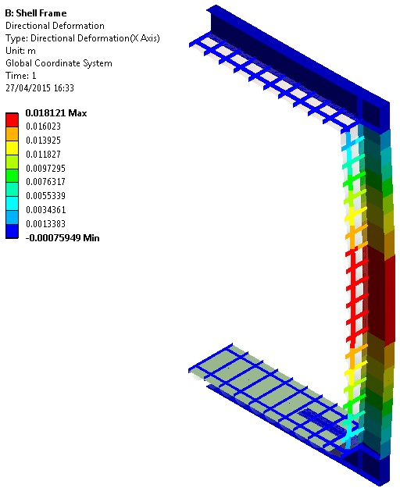
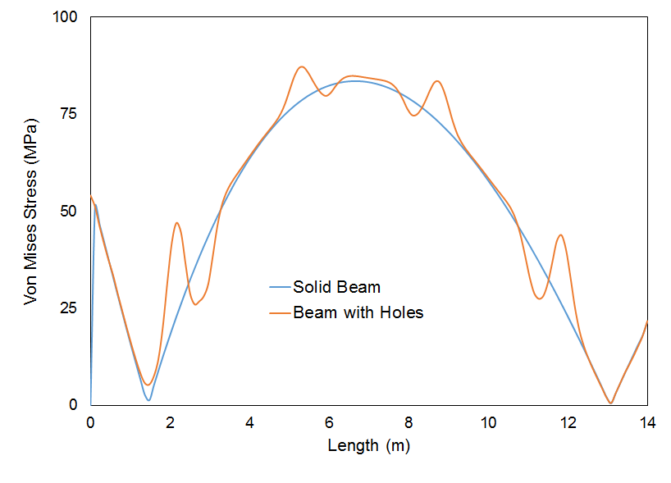
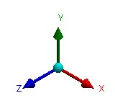
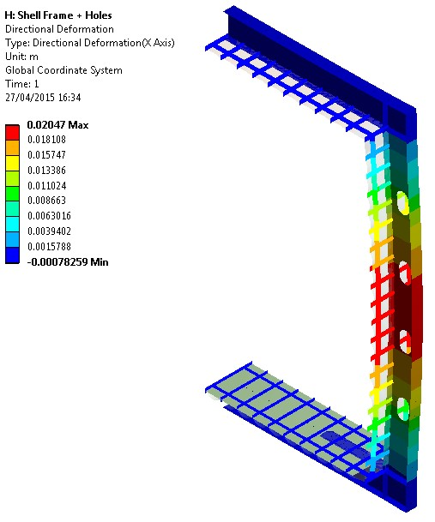
Note: Access Holes in the Vertical Beams
The holes to be included in the web of the vertical beams for access purposes were neglected in the previous analysis.

Slide 22
FEA of Moment Connection

Slide 23
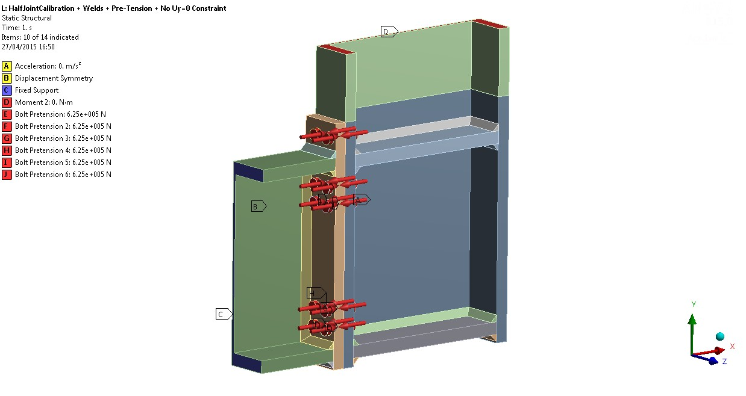
Moment Connection: FEA Model Details
Half Joint (each beam extending 0.6m from intersection)
  M48 x 10 bolts with pre-tension (625kN)
  Frictional contacts (µ=0.25)
  Welds (40mm)
  Non-linear materials (S355 for beams, 10.9 for bolts)
Stiffness as a function of the applied moment?

Slide 24
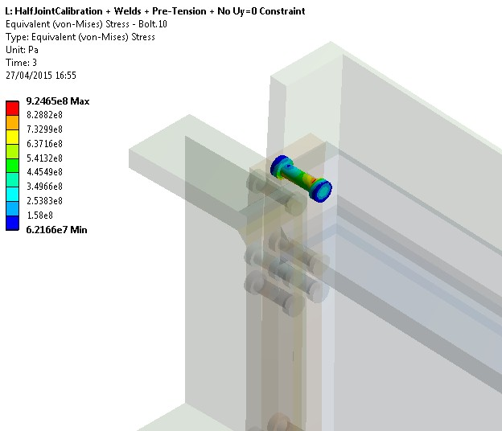
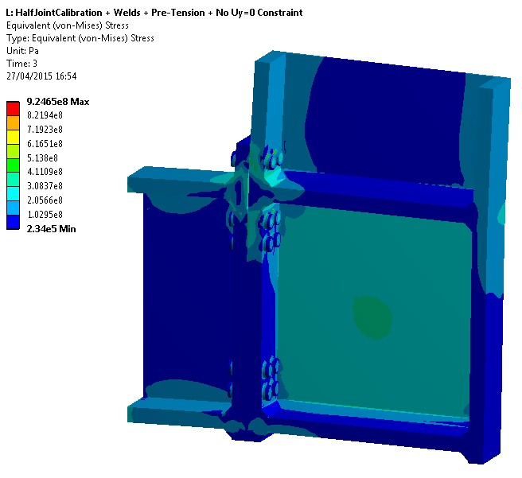
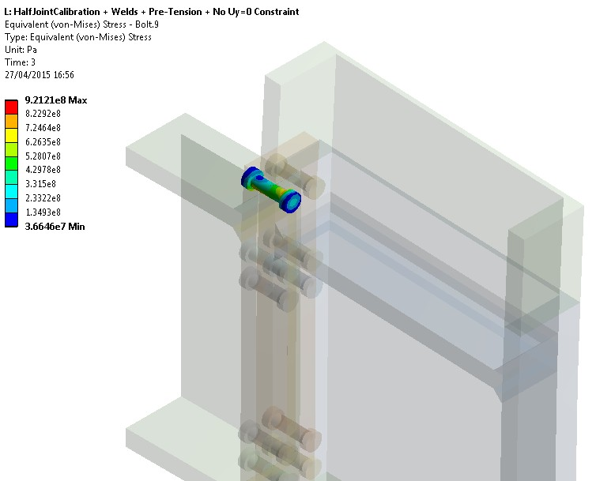
Moment Connection: FEA Model Results
For applied moment M=8MNm
K=1600-2100 MNm/rad (depending on corner support

