Slide 1
LHC CRAB CAVITY
Helium Tanks Overview
R.Leuxe
CERN (EN-MME)

Slide 2
Outline
Main views of DQW & RFD designs
Details of RFD design
Details of DQW design

Slide 3
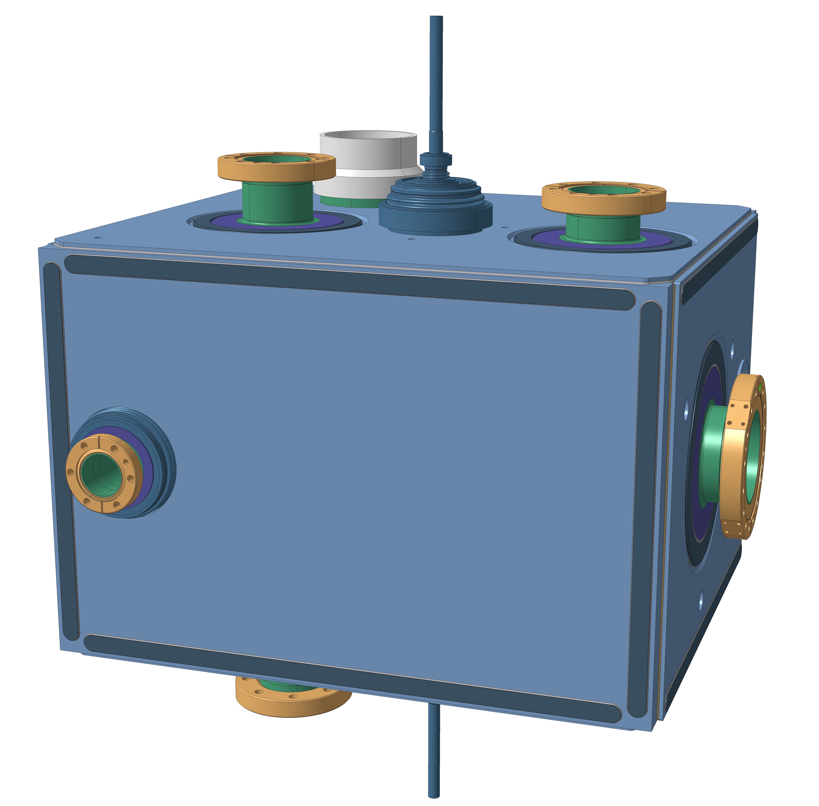
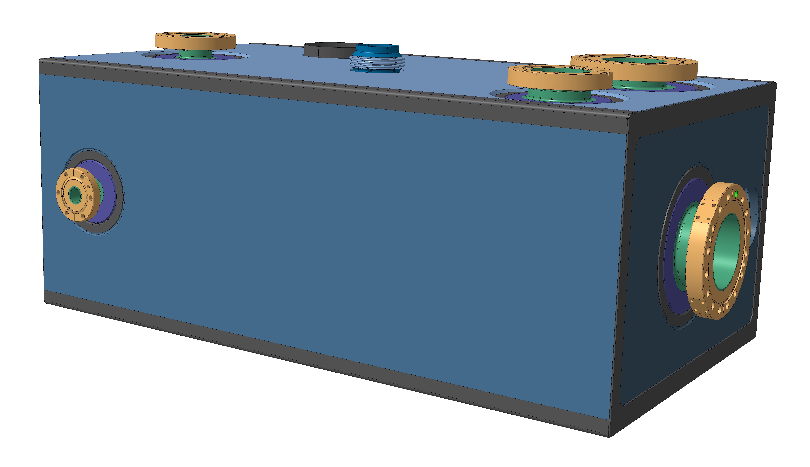
Main Views of DQW & RFD Designs
DQW
RFD

Slide 4
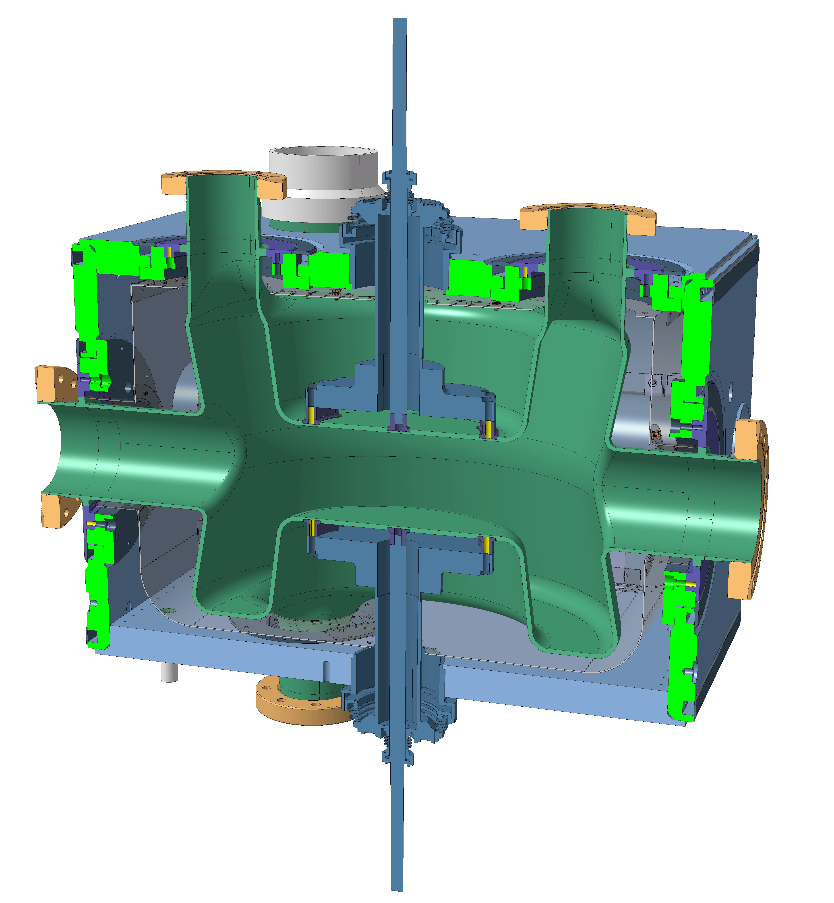
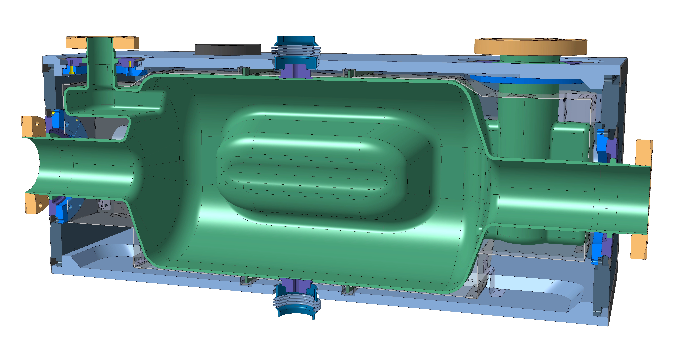
Main Views of DQW & RFD Designs
DQW
RFD

Slide 5
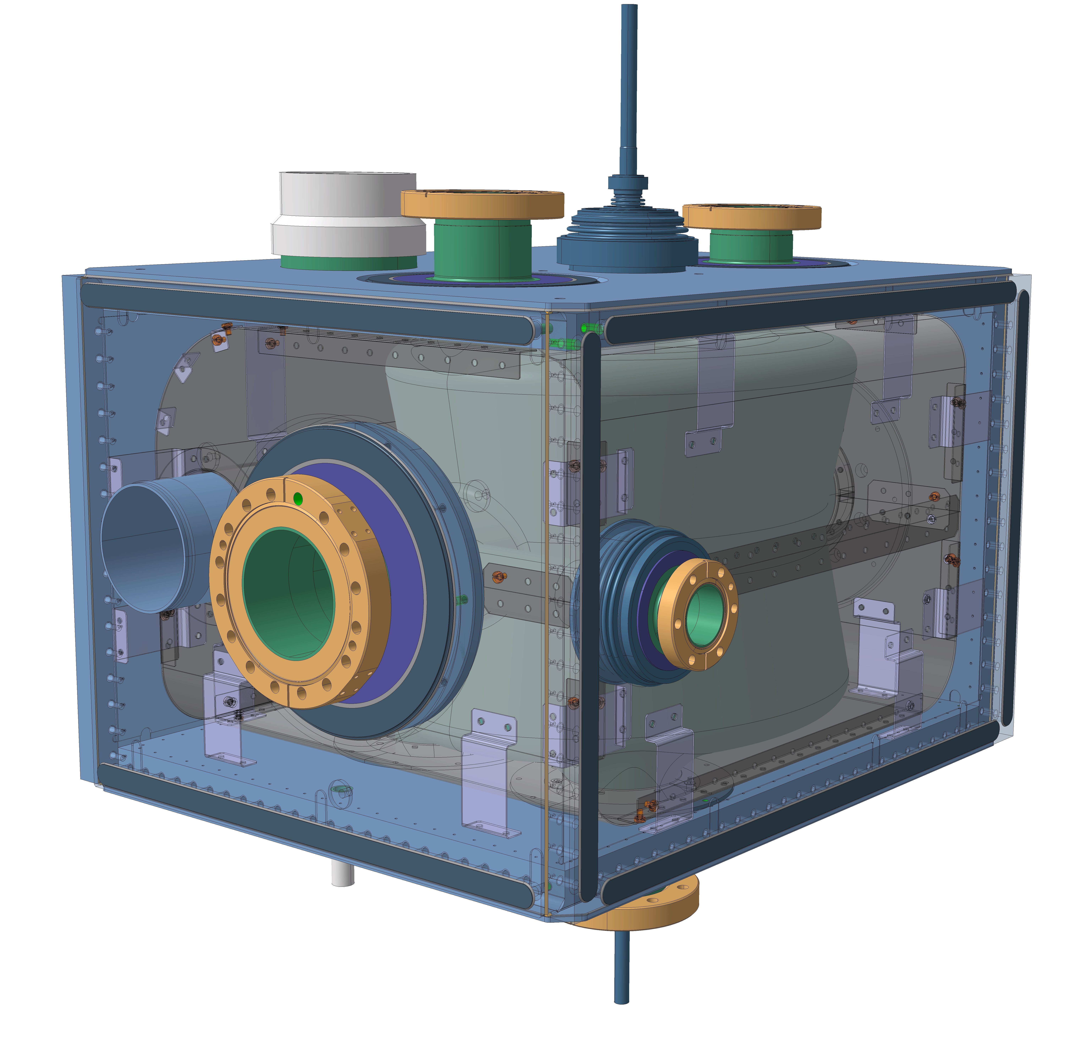
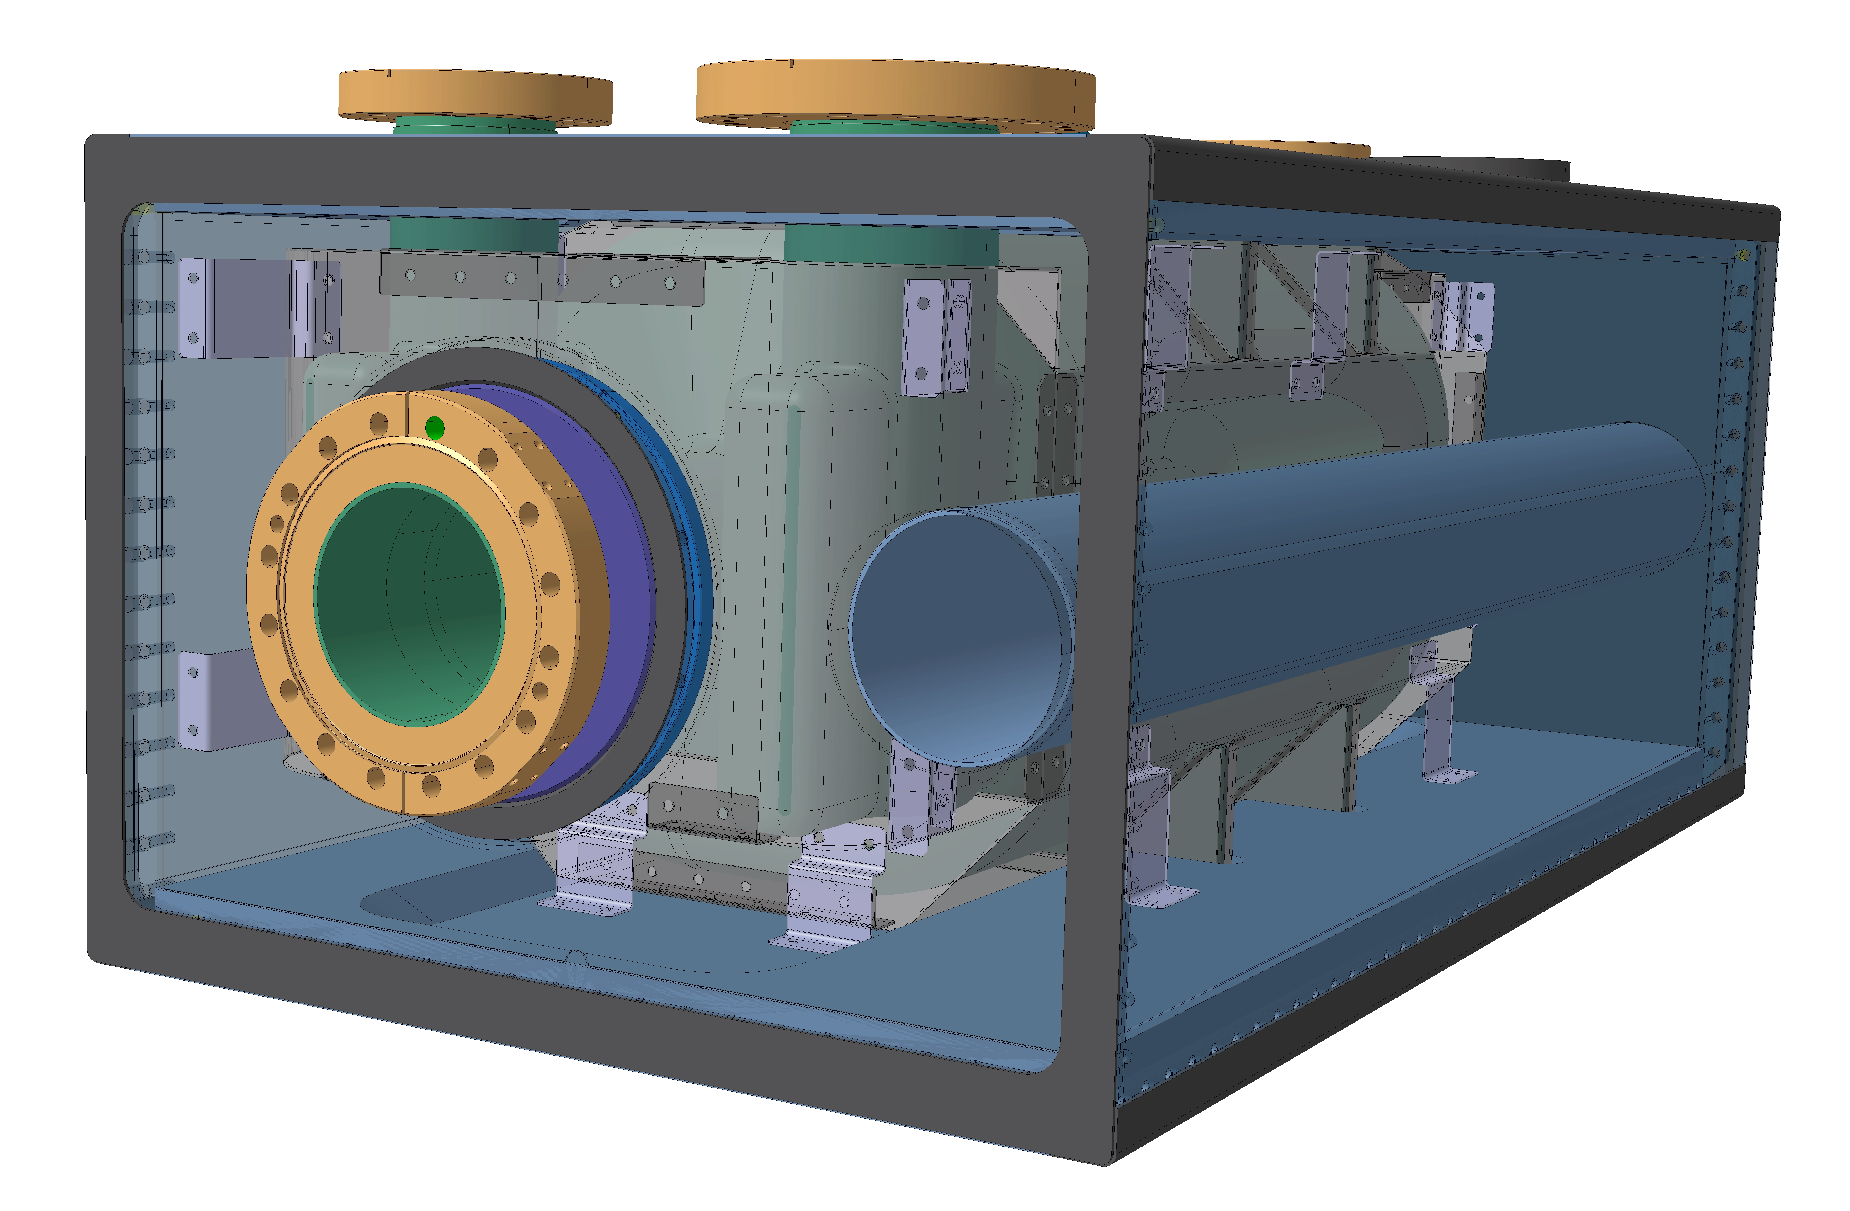
Main Views of DQW & RFD Designs
DQW
RFD

Slide 6
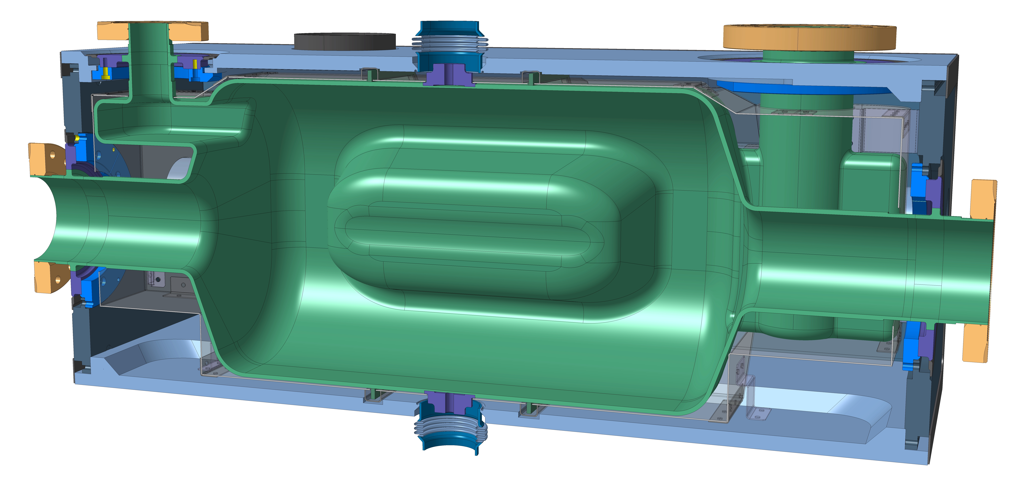
Details of RFD Design
Thin Caps
Half rings reinforcements

Slide 7
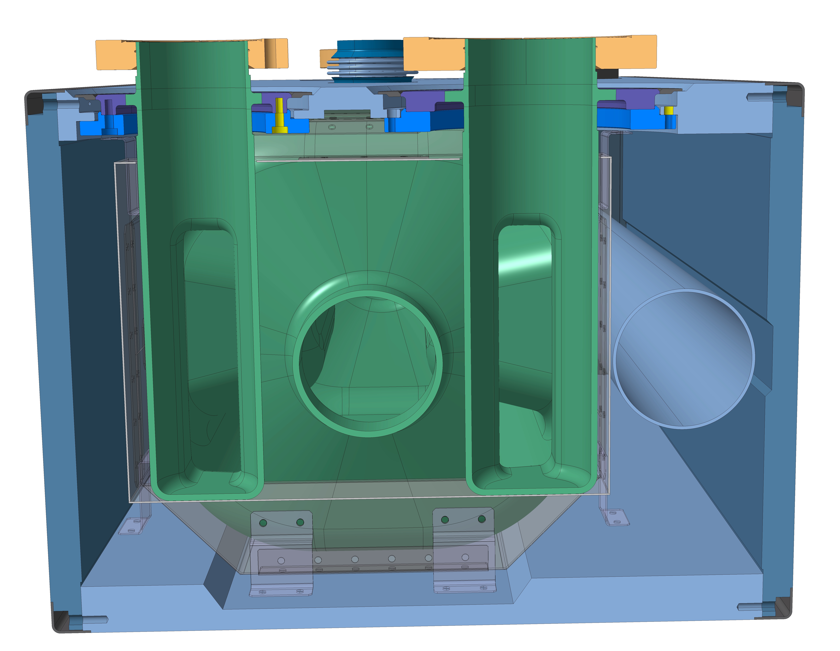
Details of RFD Design
Thin Caps
Half rings
reinforcements

Slide 8
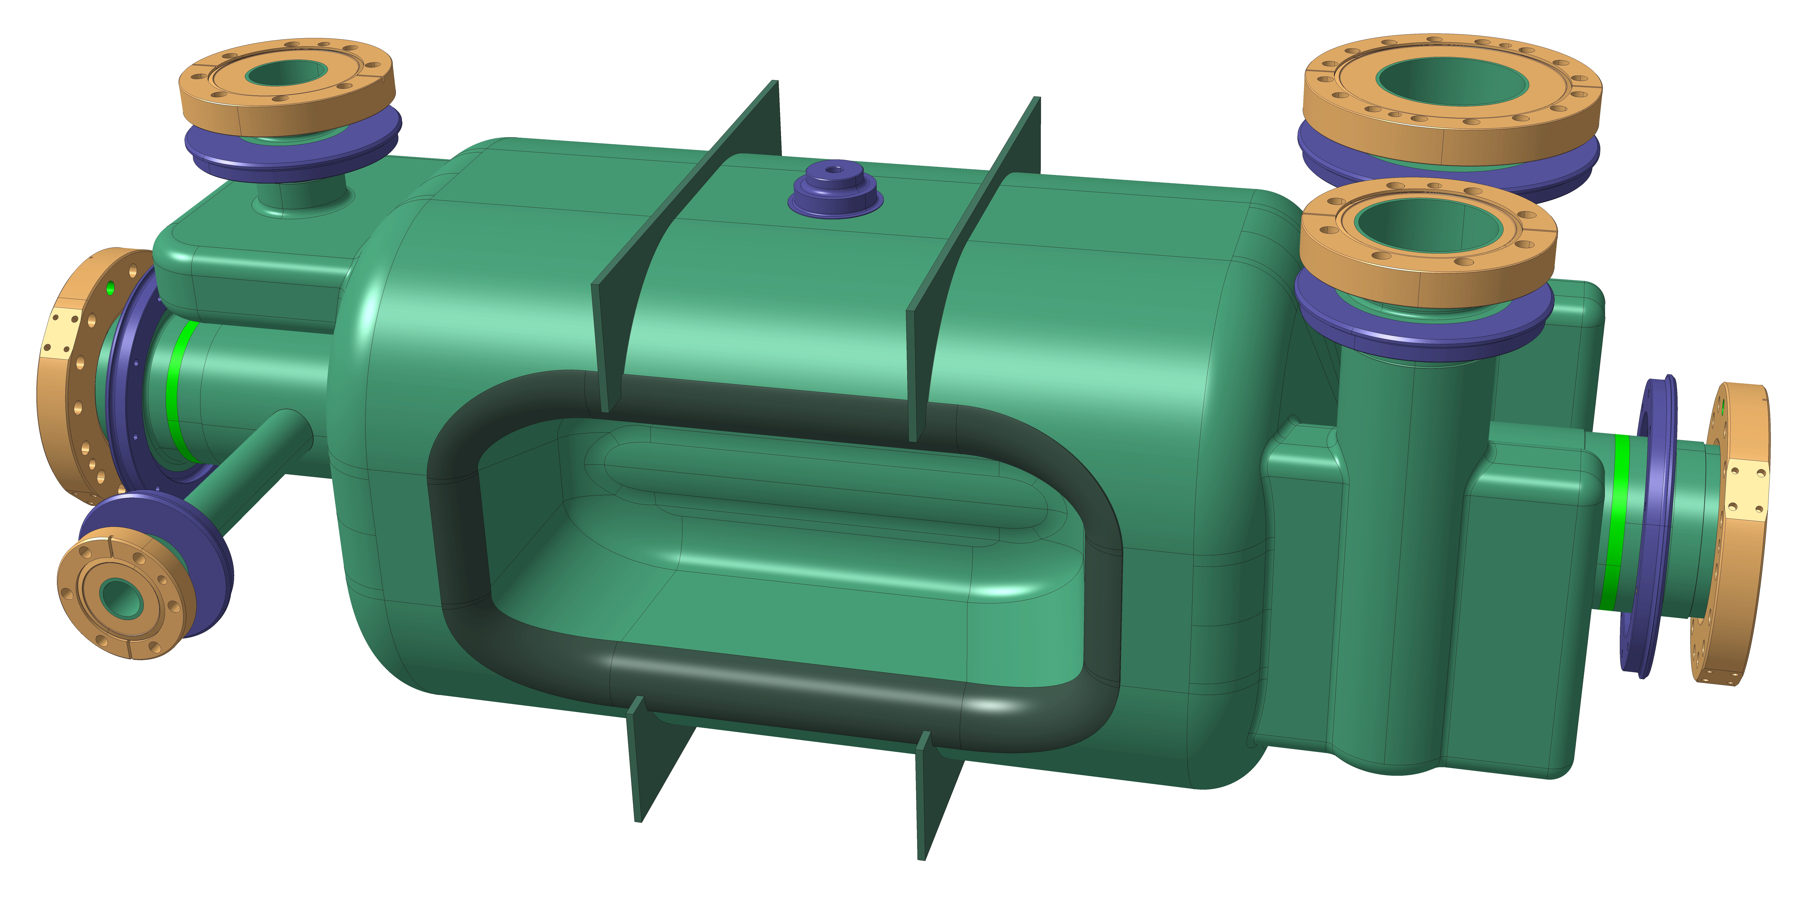
Details of RFD Design
Increase Beam Pipes 7mm each
RFD - Add 2x7mm on Beam Pipes

Slide 9
Details of RFD Design
Gap too tight without Beam Pipe increase
RFD - Add 2x7mm on Beam Pipes

Slide 10
Details of RFD Design
Gap too tight without Beam Pipe increase
RFD - Add 2x7mm on Beam Pipes

Slide 11
Details of DQW Design
Thin Caps
Half rings reinforcements
DQW - Beam Axis Section

Slide 12
Details of DQW Design
Thin Caps
Half rings reinforcements
DQW - Beam Axis Section

Slide 13
Details of DQW Design
DQW - Tuning Details

Slide 14
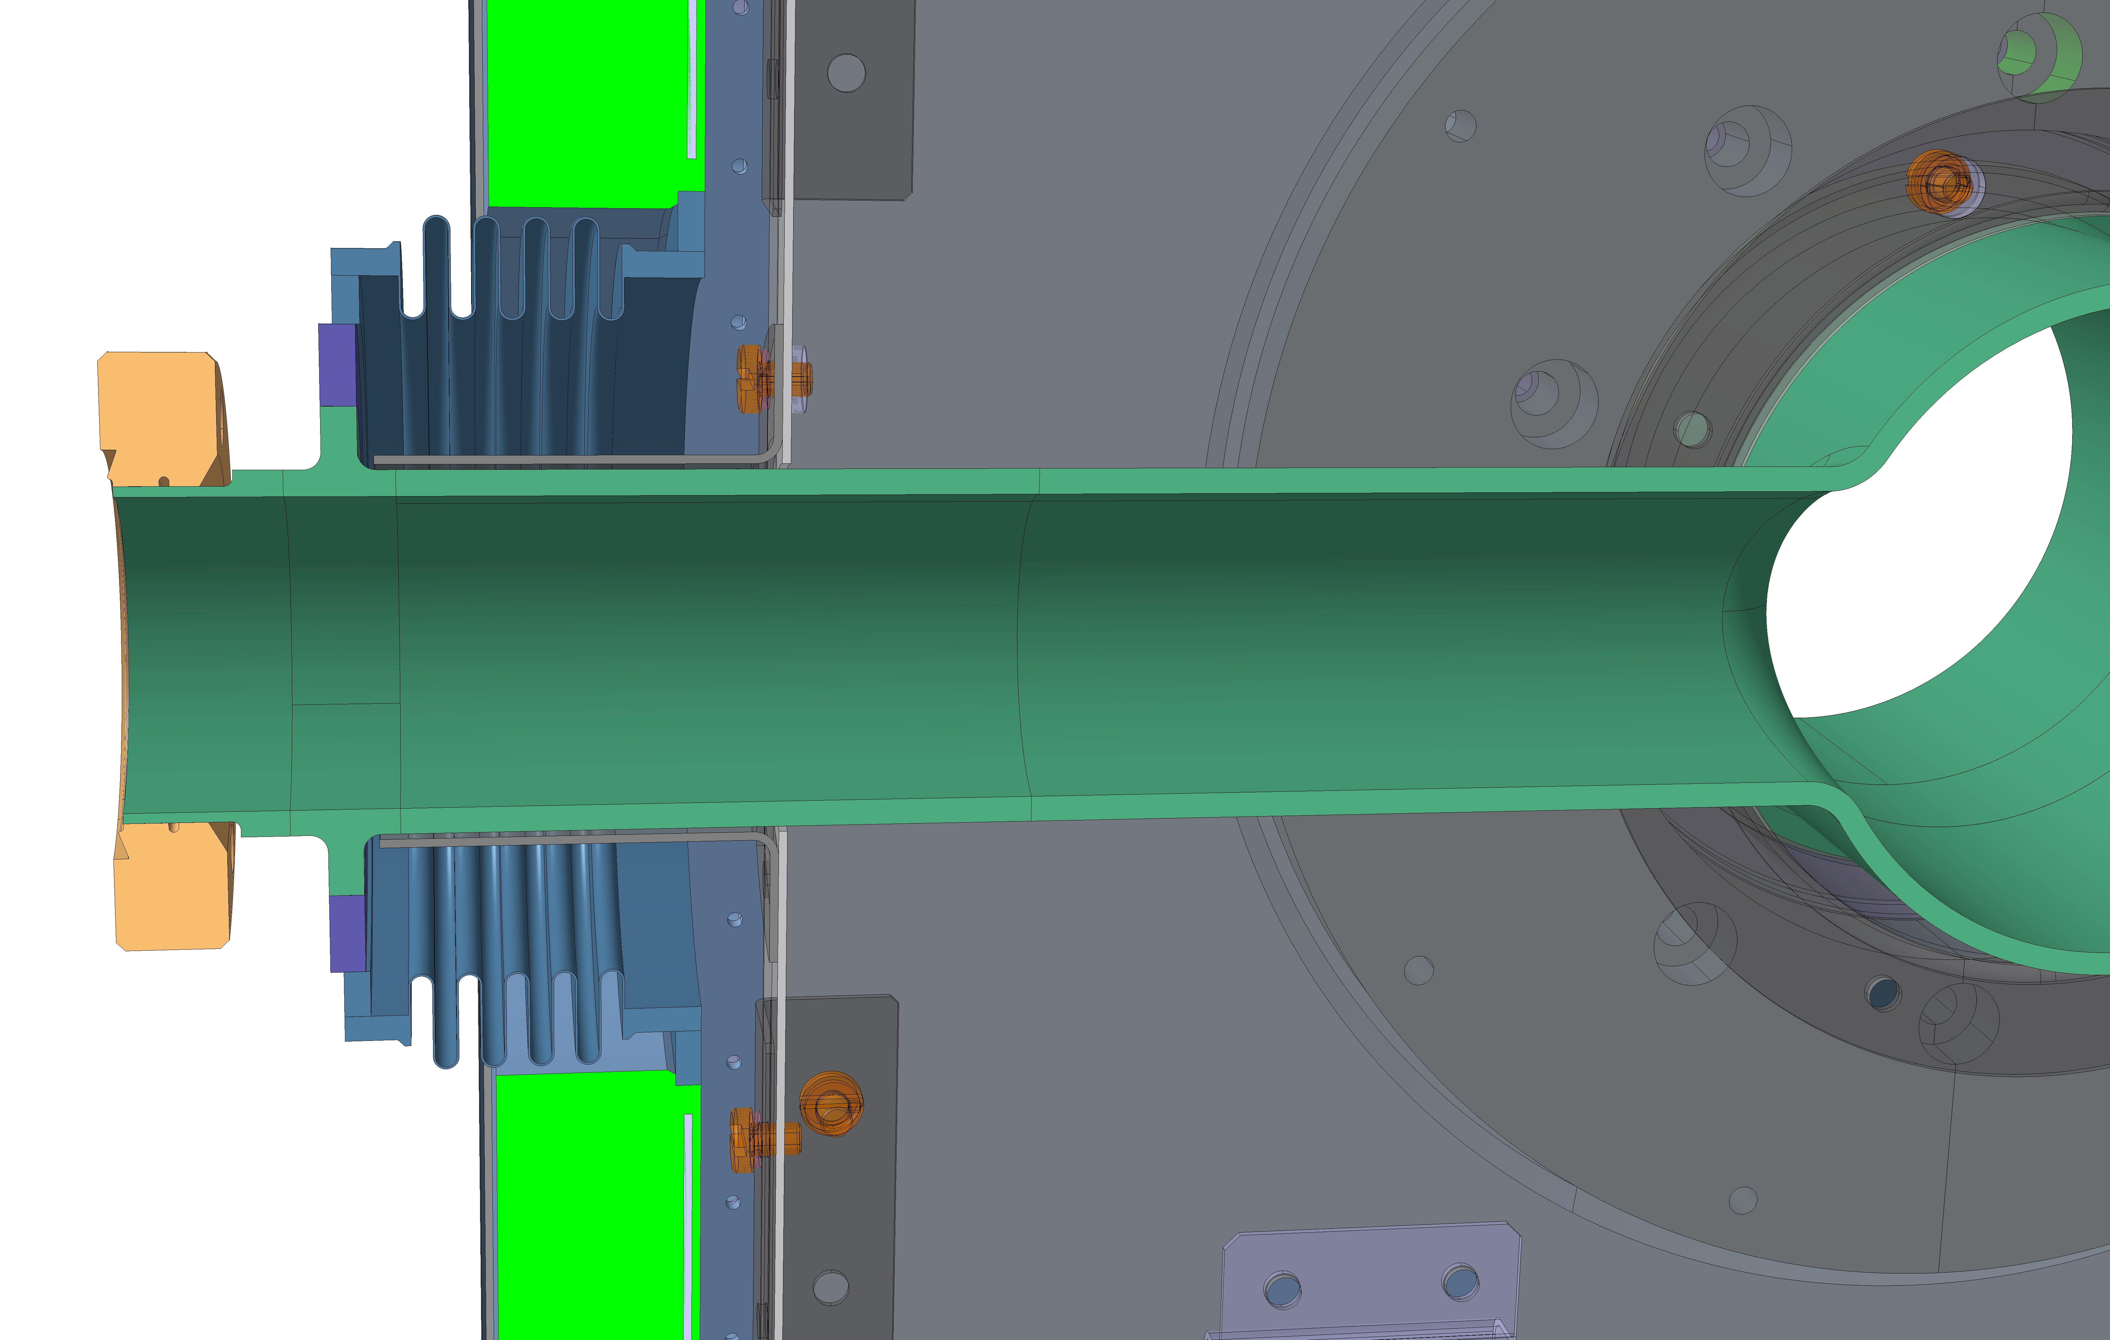
Details of DQW Design
DQW - Pick-Up Details

Slide 15
Thanks for your attention

