Slide 1
Support system
Carlo Zanoni

Slide 2
Goal
Identify a scheme for the support system that:
  Keeps the cavity displacement low during operation
  Avoids clean and predictable contraction during cool down
  Minimizes the thermal load
  Has the highest frequency possible

Slide 3
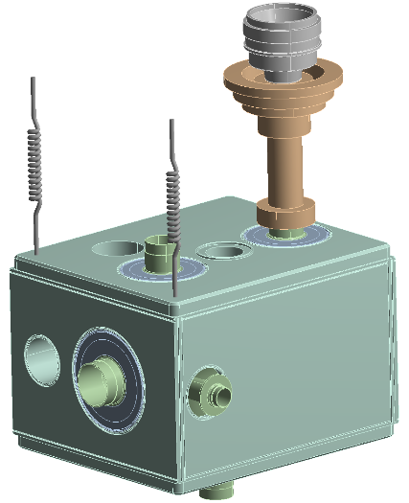
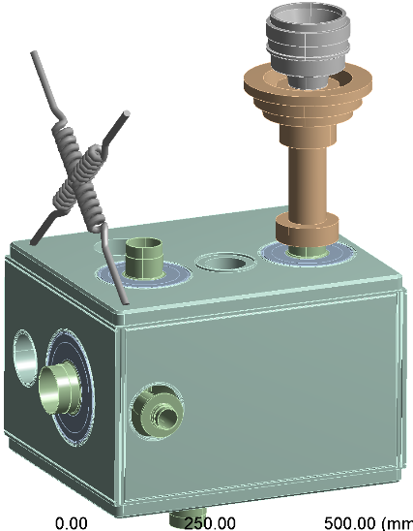
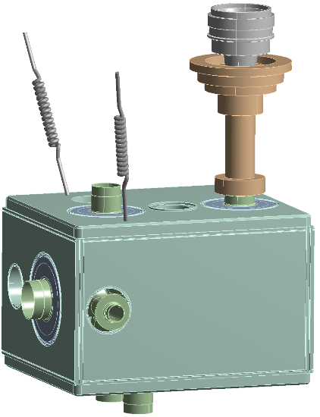
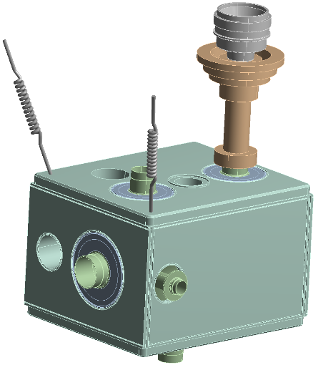
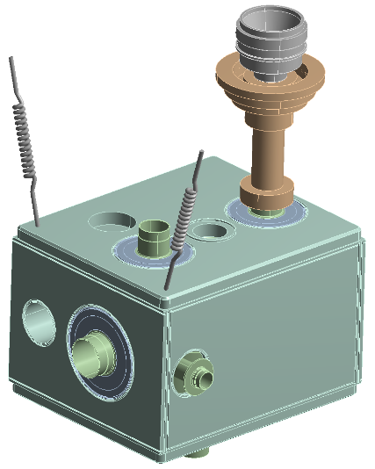
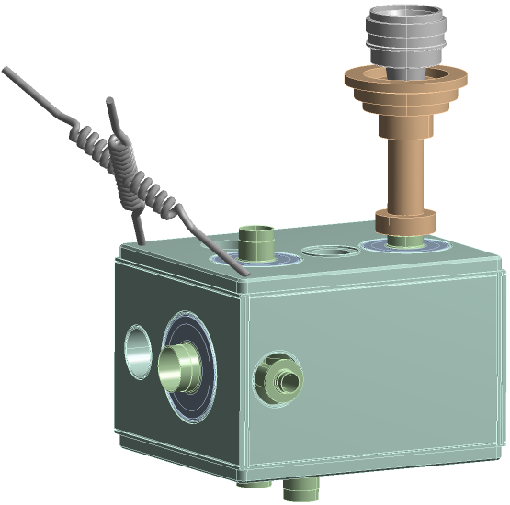
Previously…
 | 1st Mode [Hz] | 2nd Mode [Hz]
Vertical Rods | 16.6 | 32
Crossed Rods | 11.4 | 30.6
Crossed Rods (diagonal) | 11.5 | 45
V Rods | 21.6 | 32
V Rods (diagonal) | 20.2 | 37
Gilles | 20.5 | 36

Slide 4
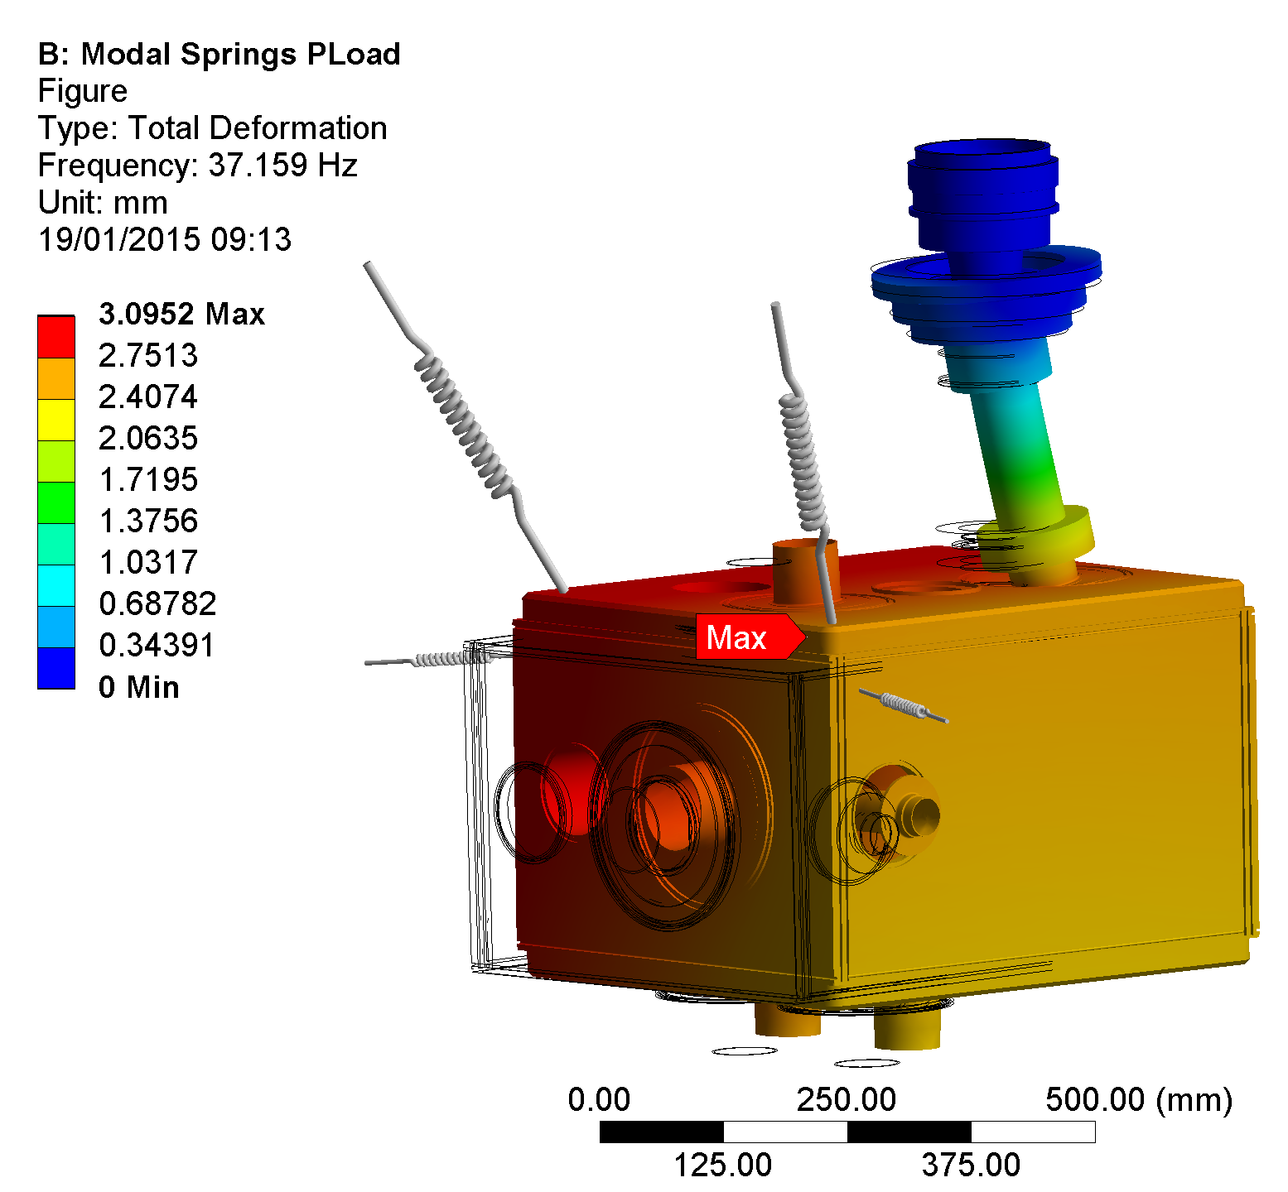
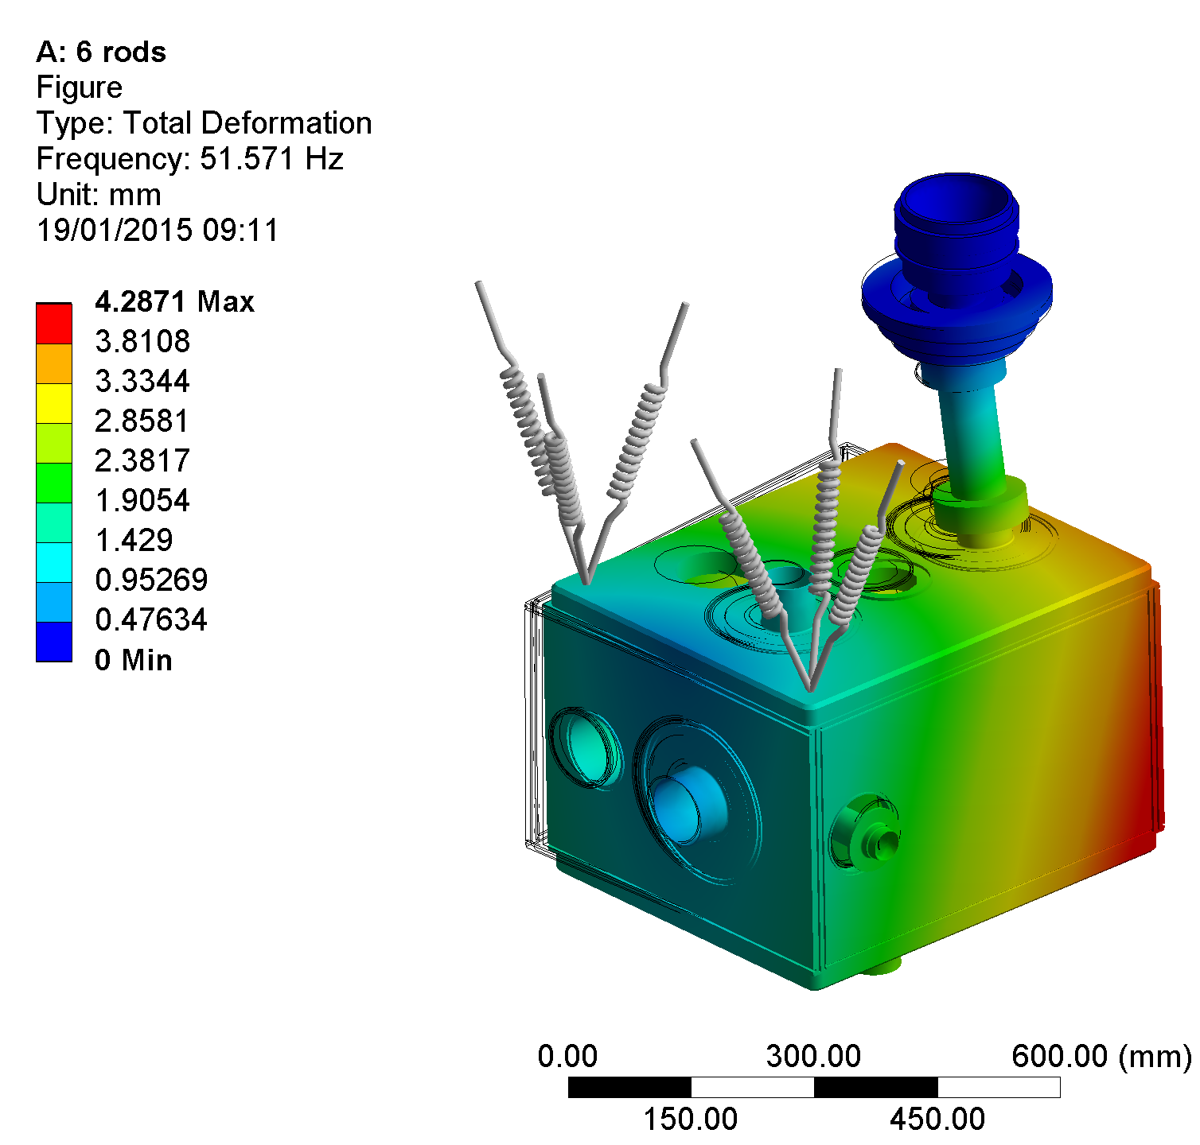
37 Hz (no preload)
Previously…
51.5 Hz

Slide 5
Previously: sensitivity to rod stiffness
*rods are not vertical

Slide 6
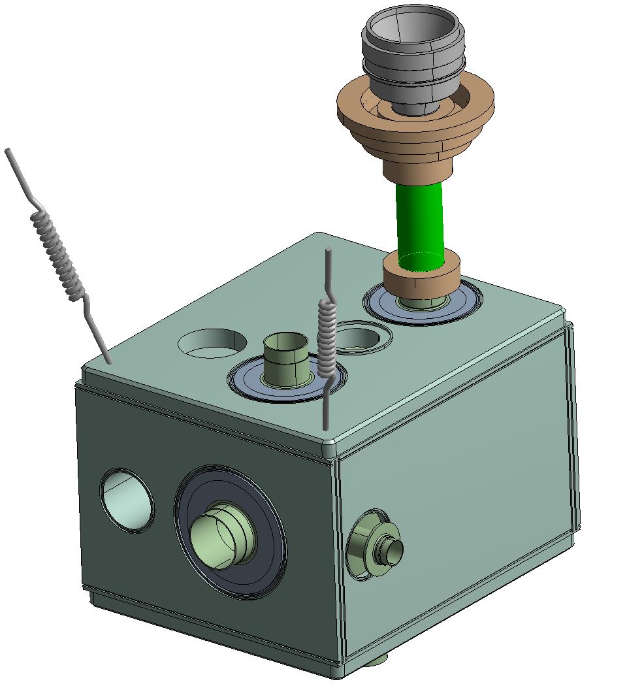
Previously: sensitivity to tube thickness
*rods are not vertical

Slide 7
Previously: lesson learned
Frequency is increased only with a substantial stiffness also in the directions other than vertical
BUT:
  This adds complexity
  Makes the cool down problematic

Slide 8
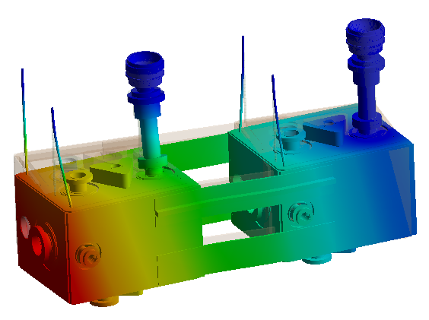
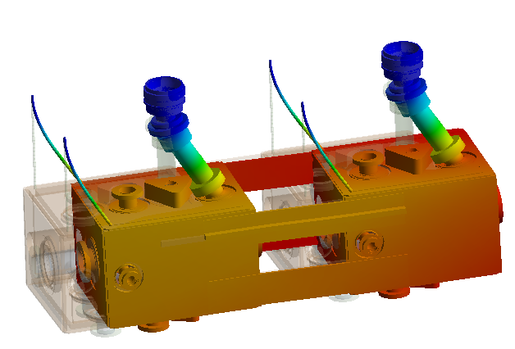
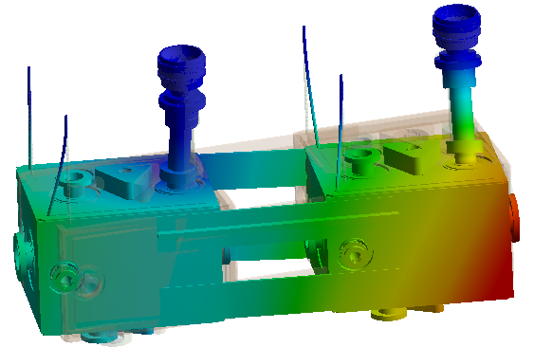
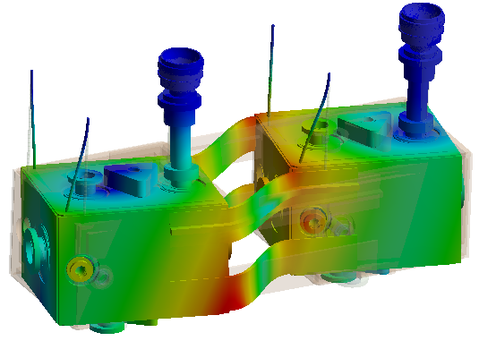
Vertical Rods and Inter-cavity Link
25 Hz
33 Hz
36 Hz
94 Hz

Slide 9
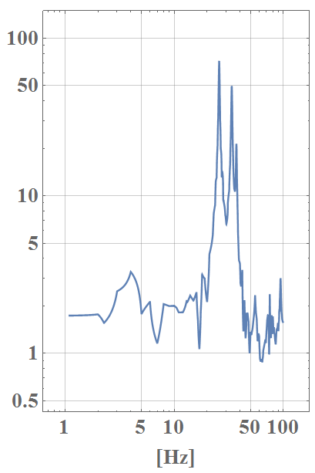
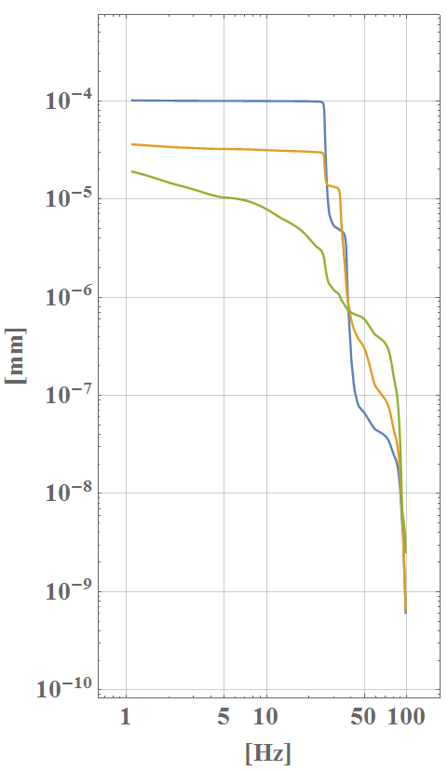
Vertical Rods and Inter-cavity Link
Transfer Function
(ground to total motion)
Integrated Displacement
(Diamond)

Slide 10
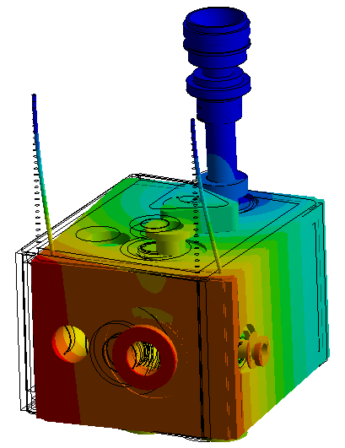
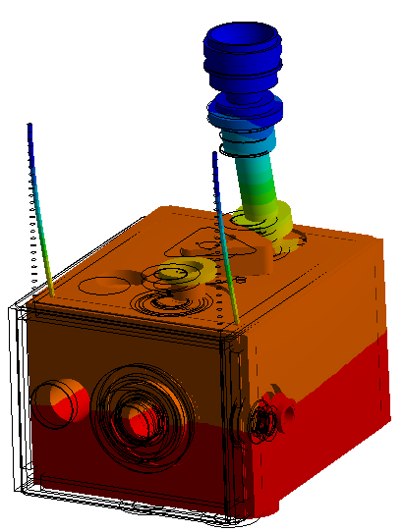
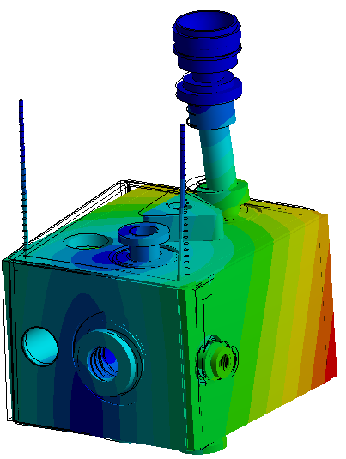
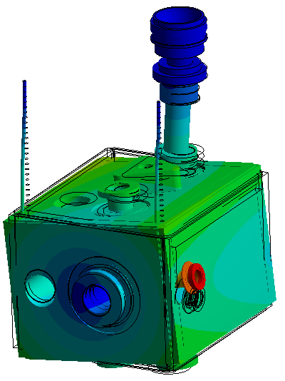
Vertical Rods and No Link
15 Hz
33 Hz
40 Hz
119 Hz

Slide 11
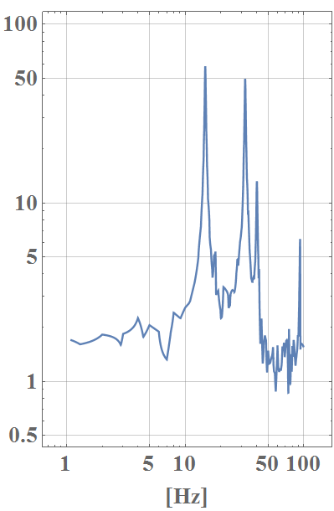
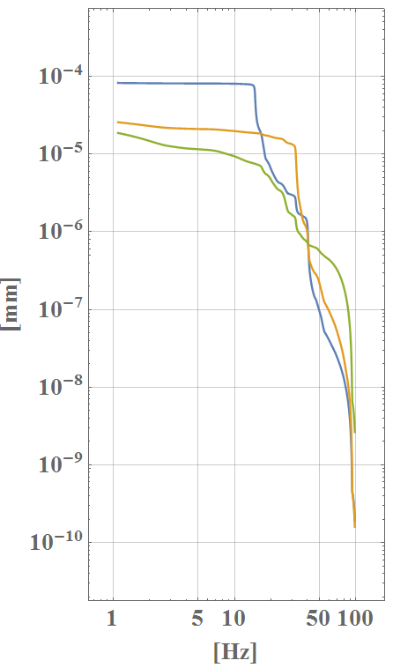
Vertical Rods and No Link
Transfer Function
(ground to total motion)
Integrated Displacement
(Diamond)

Slide 12
Comparison: transfer functions
No Connection
With Connection

Slide 13
Comparison: integrated displacement
No Connection
With Connection

Slide 14
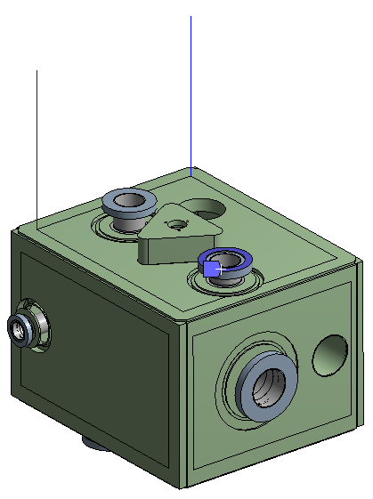
Vertical Rod: extreme cases
Infinite stiff FPC
1st mode: 30.5 Hz

Slide 15
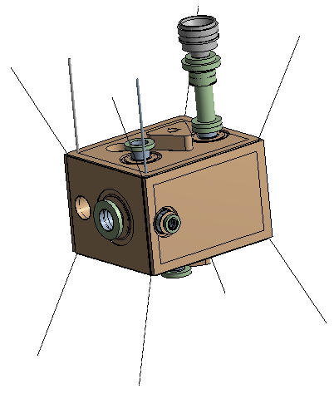
Vertical Rods and No Link
10 mm rods (radius): 17 Hz
10 mm rods (radius) – w/ joints: 15 Hz
1 mm rods (radius): 13.5 Hz
no change using wires on the vertices

Slide 16
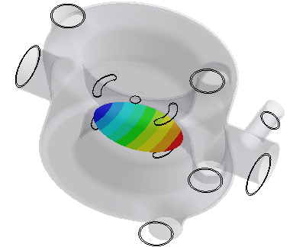
Effect of tuning system
Point mass (20 kg) attached to the centre of the tuned surfaces
1st mode lowered by 1 Hz
Modal surface deformation not affected

Slide 17
Effect of tuning system
Point mass (20 kg) attached to the centre of the tuned surfaces
1st mode lowered by 1 Hz
Modal surface deformation not affected

Slide 18
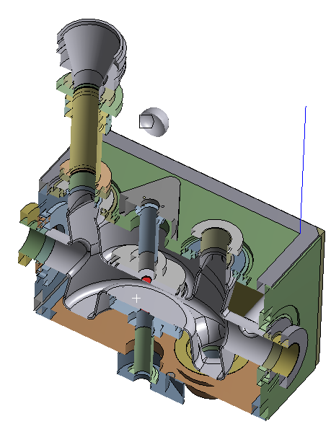
Effect of tuning system
Point mass (20 kg) attached to the centre of the tuned surfaces
1st mode lowered by 1 Hz
Modal surface deformation not affected

Slide 19
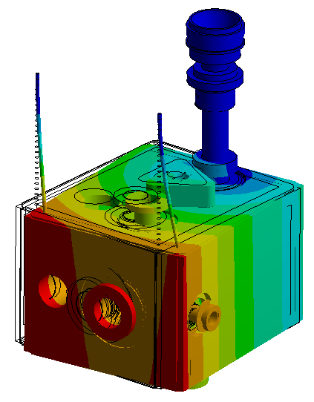
Conclusion
The intercavity connection increases the transferred displacement and the frequency of the 1st mode.
It also adds complexity and uncertainties during cool down
Effect of tuning system seems not big, but proper damping needed

Slide 20
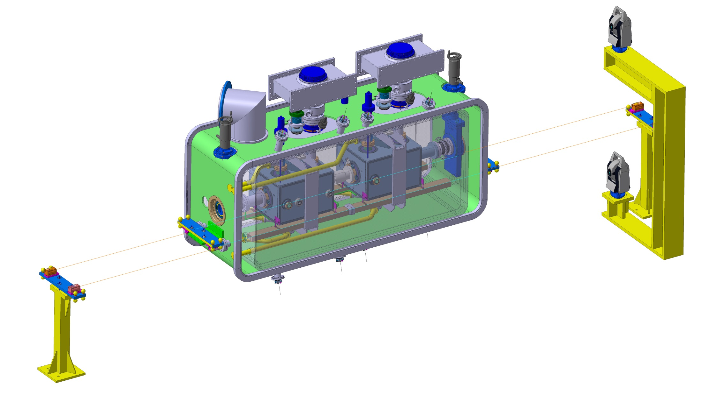
Alignment Monitoring System: BCAM*
*Brandeis CCD Angle Monitor

Slide 21
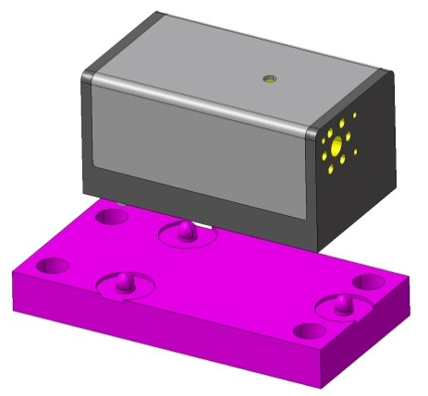
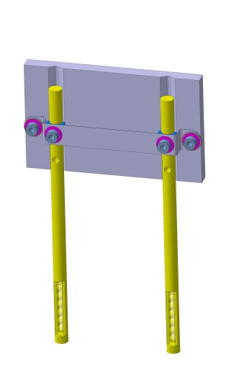
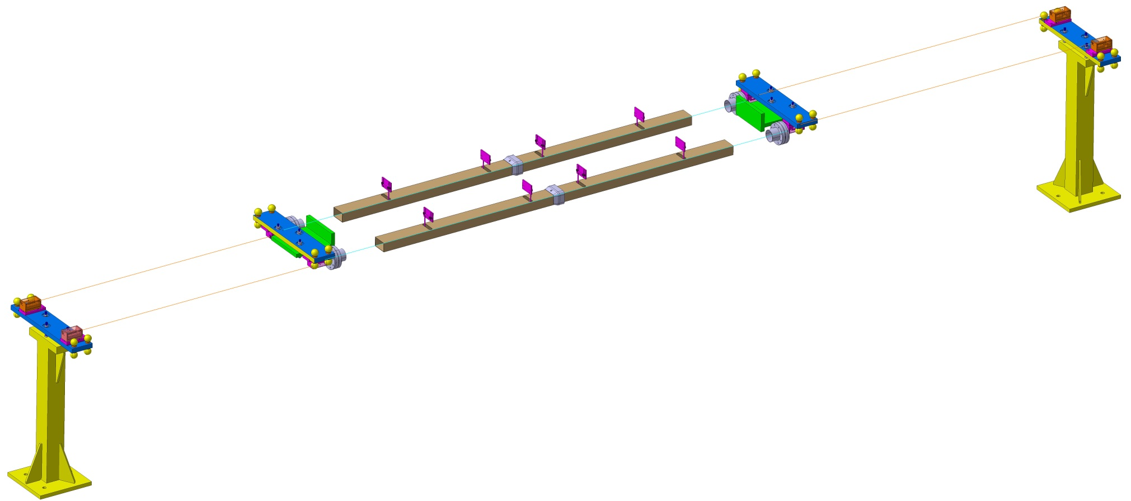
Alignment Monitoring System: BCAM
4X BCAM on floor
4X Targets / Tank
4X Tubes 80 X 50 X 2 mm (avoid reflections)
4X BCAM on Cryomodule
4X Windows

Slide 22
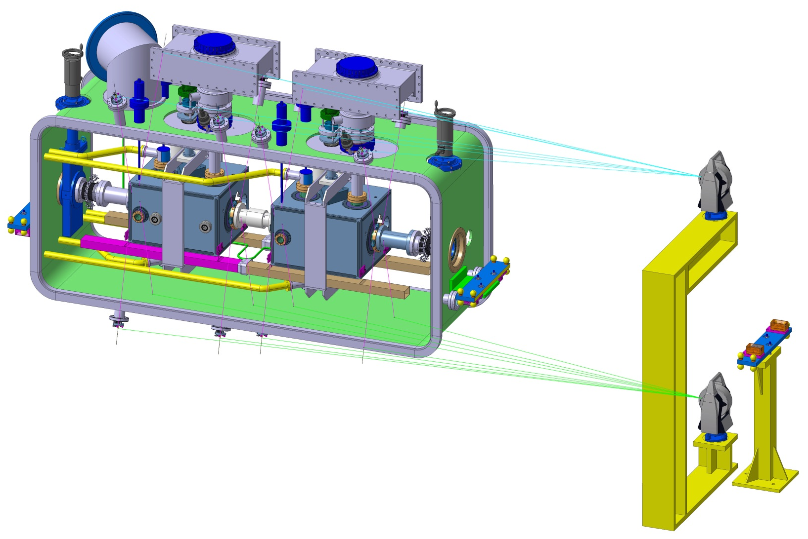
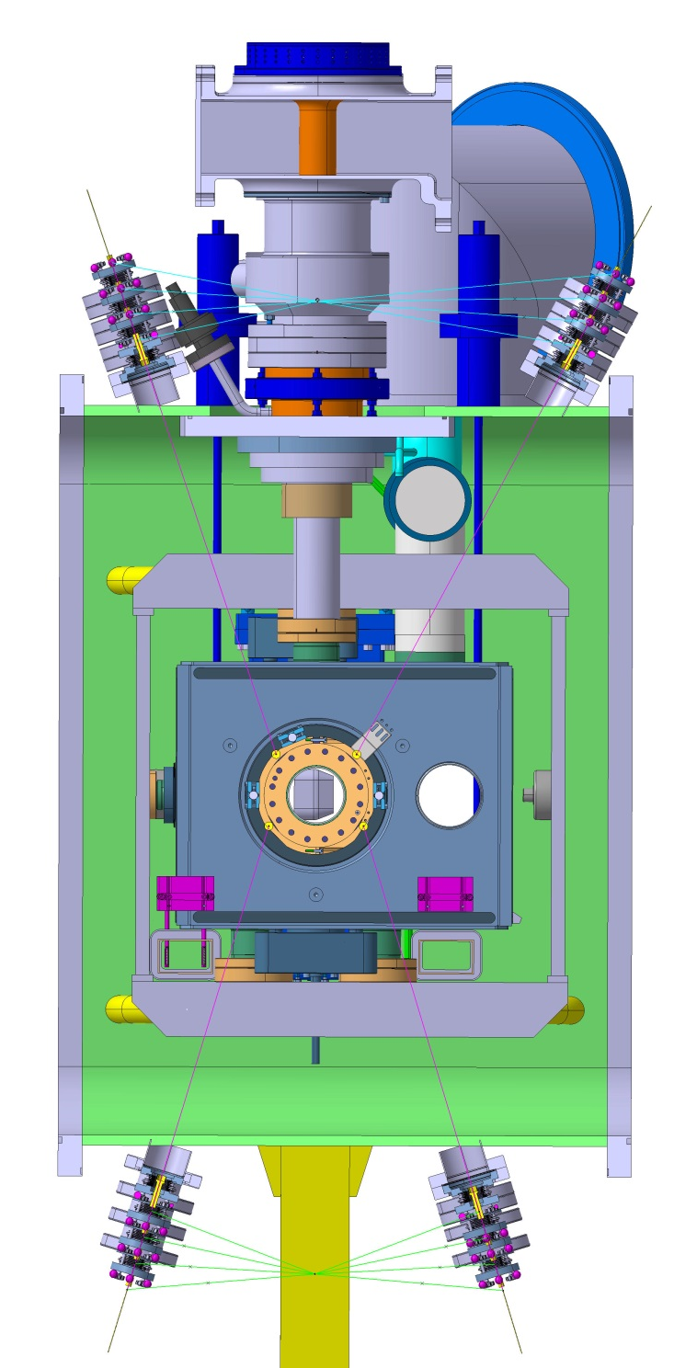
Alignment Monitoring System: FSI*
*Frequency Scanning Interferometry

Slide 23
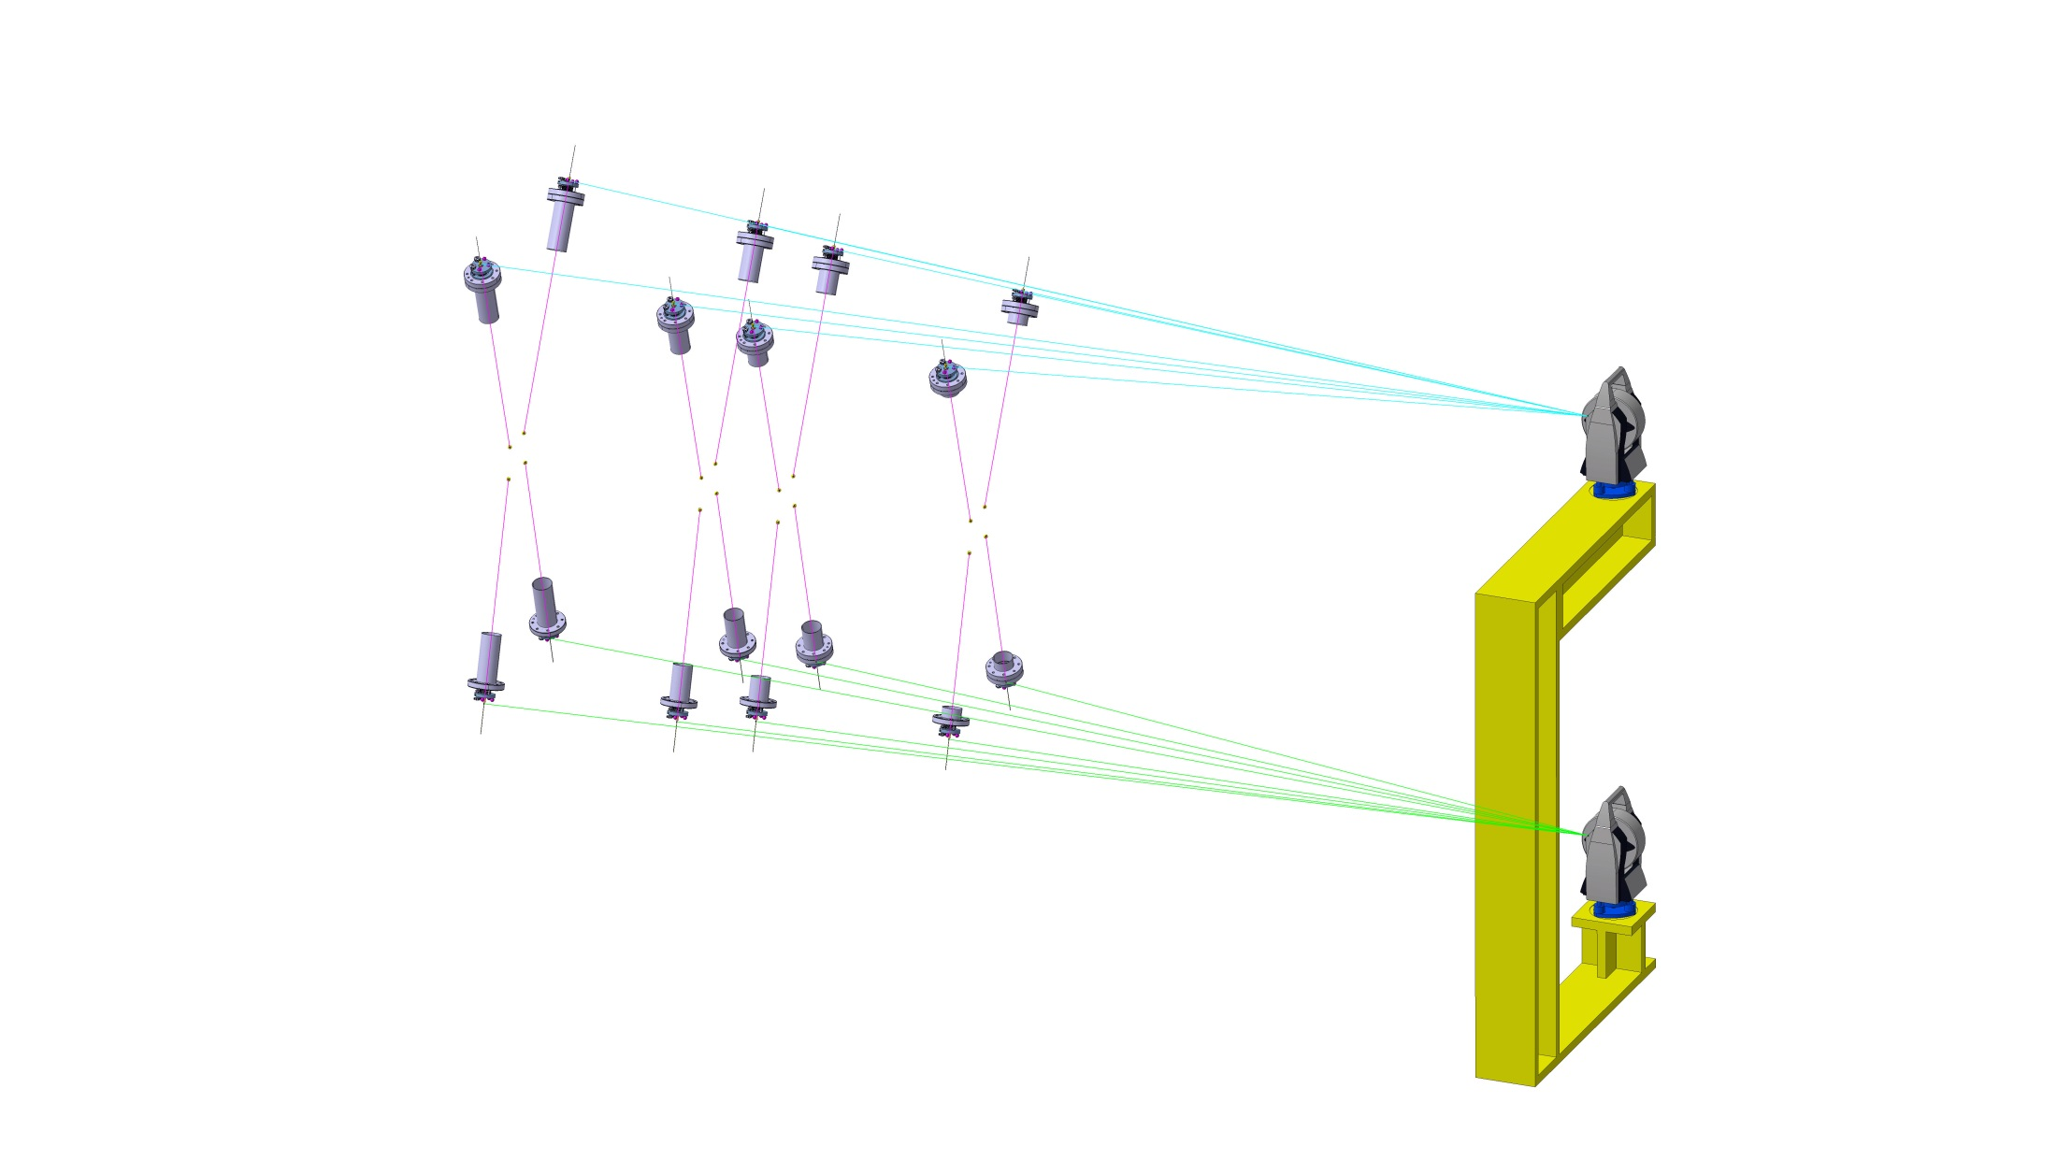
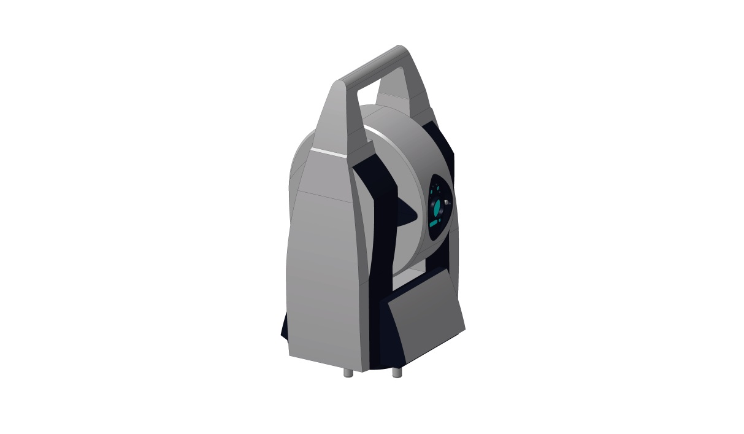
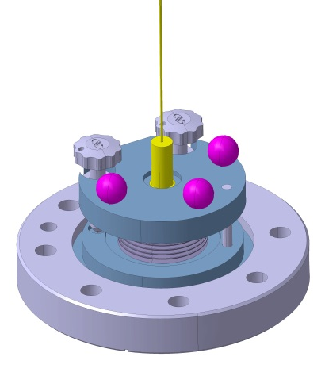
Alignment Monitoring System: FSI
4X targets on flanges
(4 Flanges)
AT 401 Device
(2 positions)
16X FSI devices

Slide 24
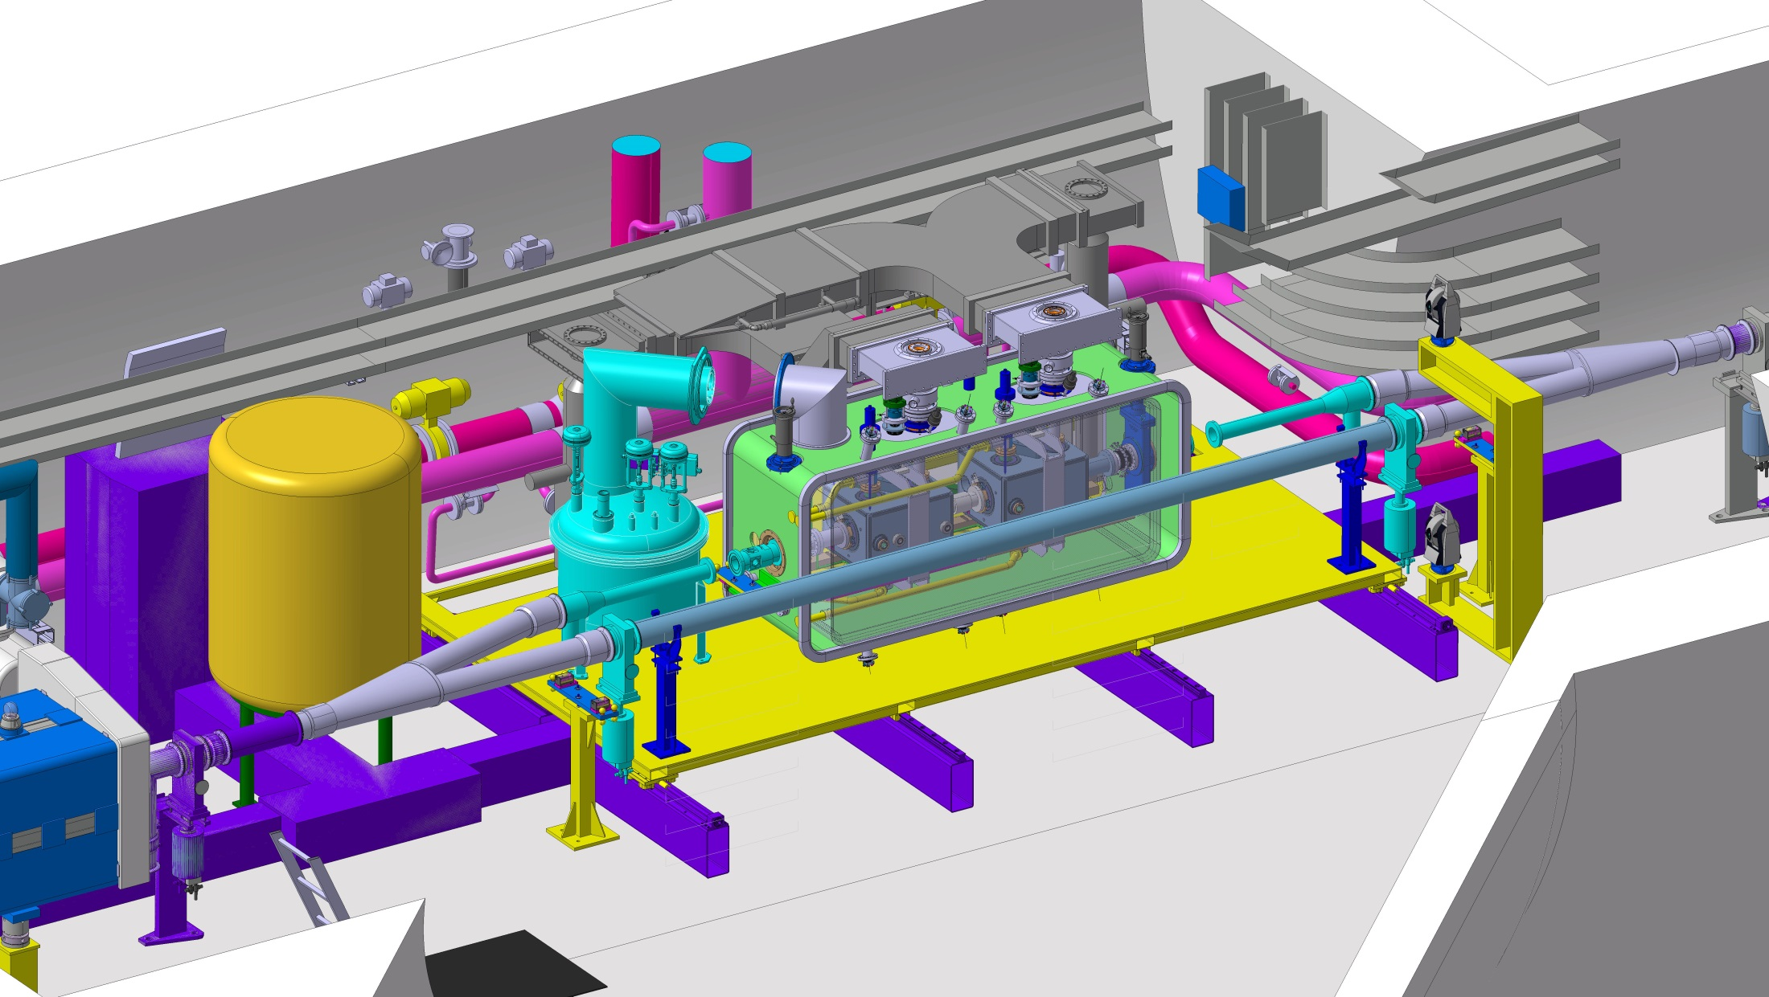
SPS: parking

Slide 25
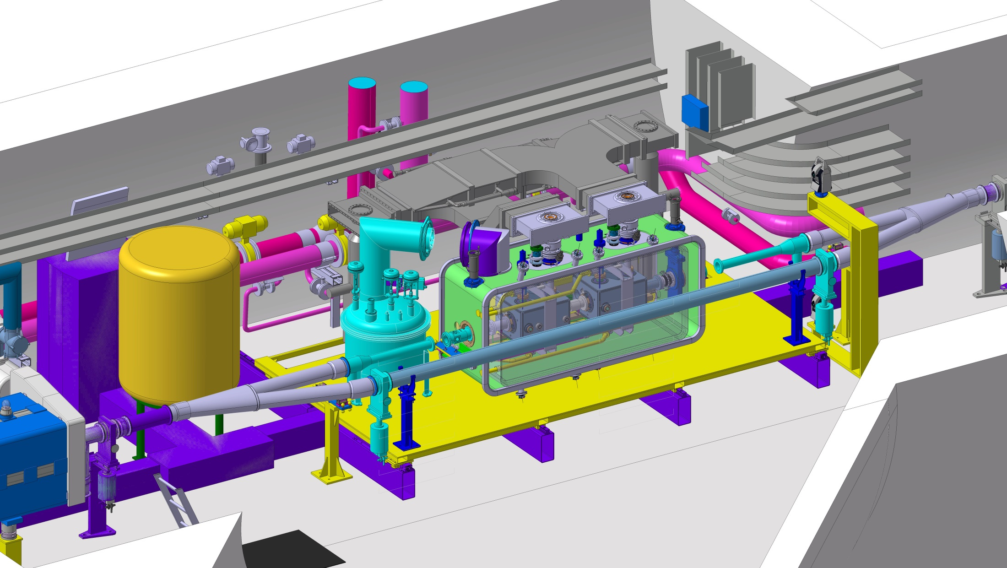
SPS: operation

Slide 26
THANKS FOR YOUR ATTENTION

