Slide 1
DQW Cryogenic Magnetic Shield Internal Review
Niklas Templeton
06/05/15

Slide 2
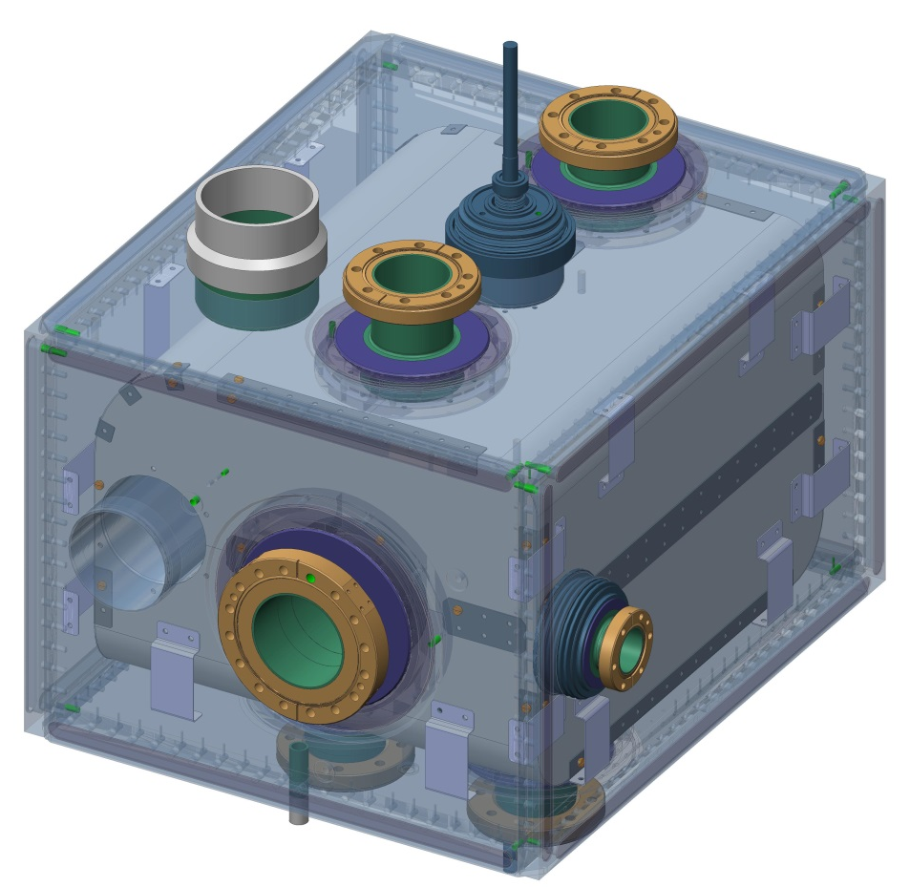
Contents
Specification
Opera Magnetic Analysis
Overview
Design Approach
Common Features
Design & Assembly Procedure
DQW
RFD
Shield Analysis
Thermal Stress
Self Weight XYZ
1

Slide 3
Specification
Less than 1µT on cavity surface
Cold Magnetic Shield
1mm APERM Cryophy (to be used with 3mm Mu Metal outer shield)
Internal to Helium Vessel
Suspended in 2K Helium
Mounted off Helium vessel – no cavity connection
Designed for (worst case) earth magnetic field. Local sources to be isolated separately
Earths South to North Field 48µT
SPS ambient Magnetic field with moderately shielded Busbars <200µT
Magnetic shielding for SPL cavities: T Junginger 2010
Estimate of the Ambient Magnetic Field in the SPS Crab Cavity Location: J Bauche, A Macpherson 2014
2

Slide 4
Summary of Opera Analysis - Kiril Maranov
The magnet group within ASTeC (STFC) have converted the mechanical design CAD files into a simplified geometry acceptable for Opera 3D (Tosca) and then assessed shielding performance based on simulations.
Two shielding solutions were considered: a single-layer solution (mu-metal only) and a double-layer solution (mu-metal + cryoperm)
The conclusion from this work is to go ahead with the double-layer solution. The single layer solution meets the spec by a narrow margin, but there is no room for contingency and the risk is higher.
3

Slide 5
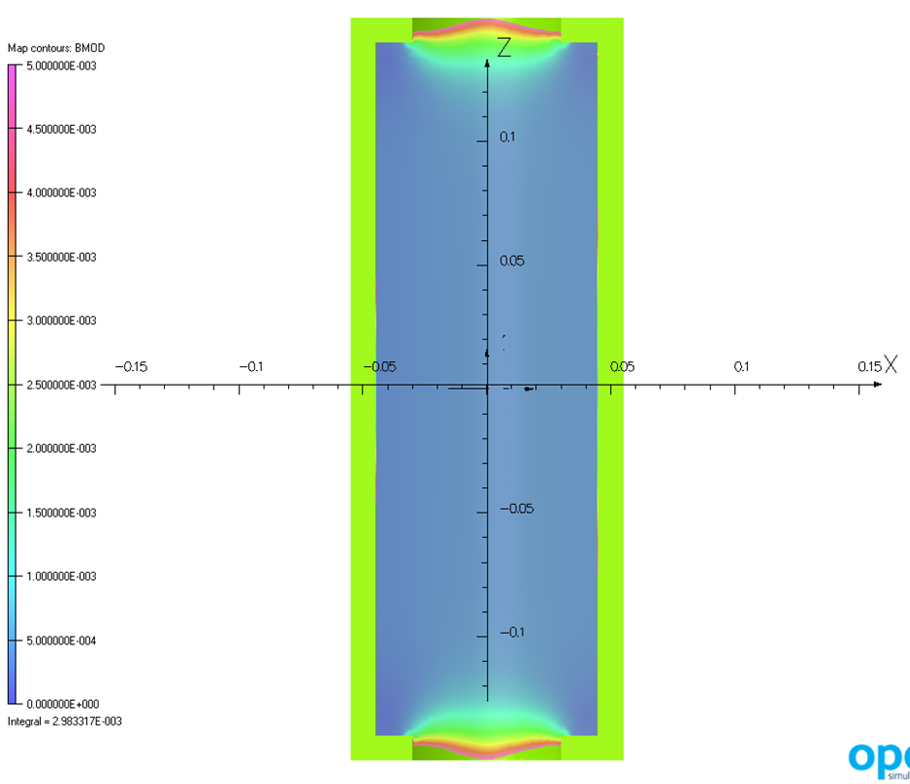
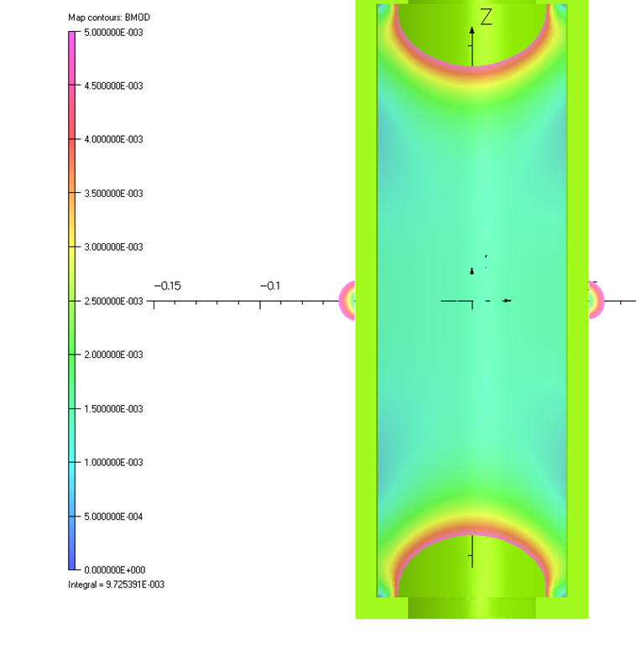
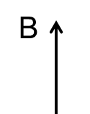

Magnetic shielding effect is anisotropic
A cylinder is twice as effective against radial field as against axial field.
The external field is radial
The external field is axial
4

Slide 6
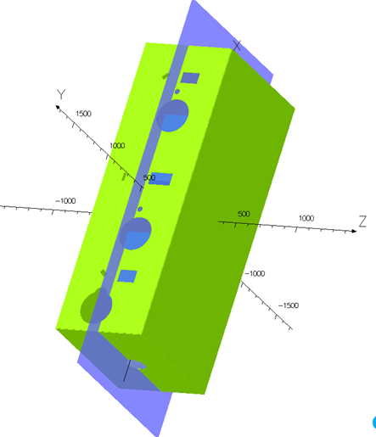
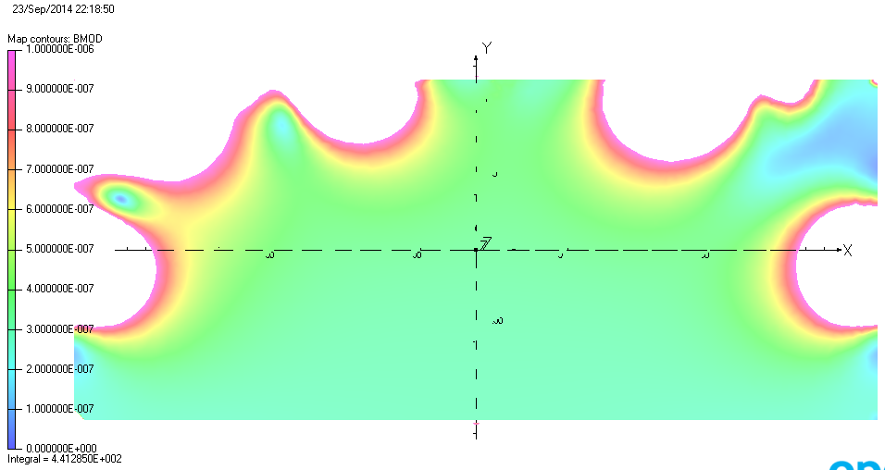
Single layer: the field is parallel to the long side
B_{Earth}=60µT
B>1 µT
B_{Earth}=60µT
A single-layer shield is within spec (~0.5 µT) at the cavity locations, but this gives a limited factor of safety.
5

Slide 7
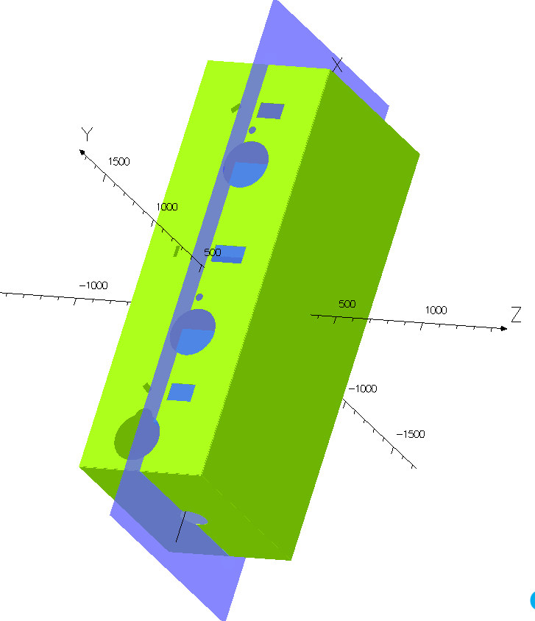
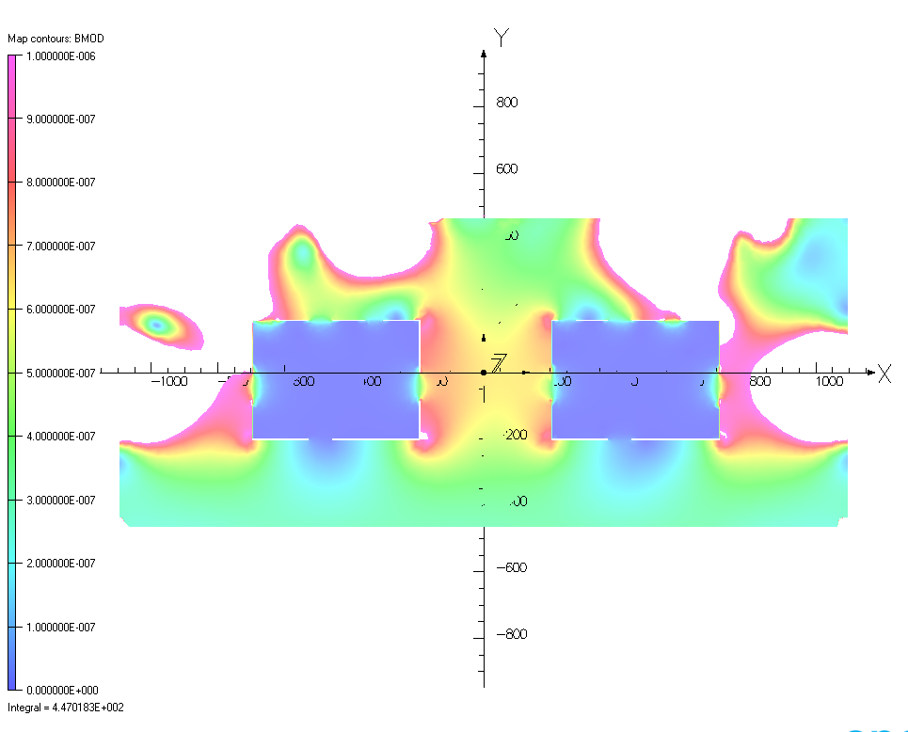
Performance: the field is parallel to the long side
B_{Earth}=60µT
B>1 µT
B_{Earth}=60µT
B<< 0.1 µT (very small!)
6

Slide 8
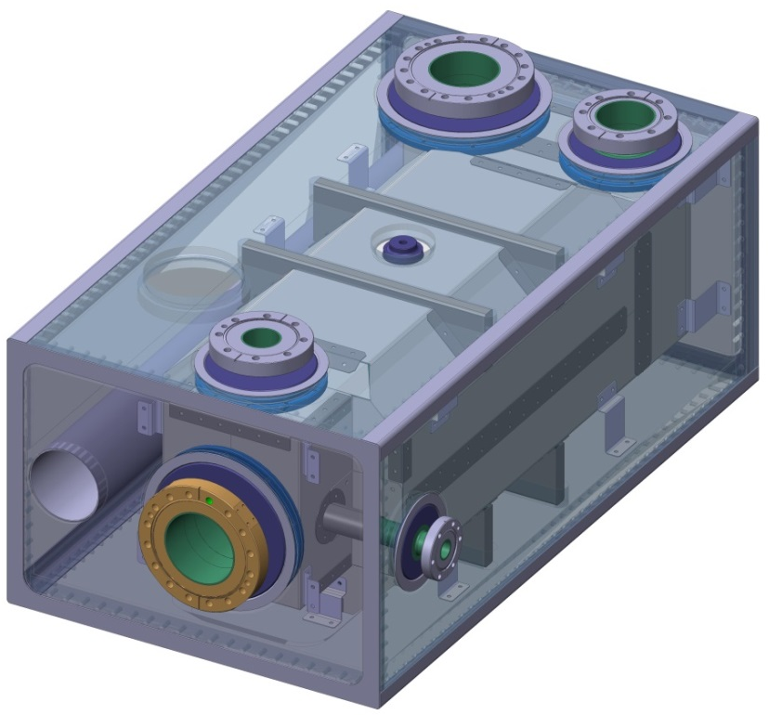
Shield Design Approach
Satisfy space constraints
Internal to Bolted Helium Vessel
Close fitting to cavity
Feasible assembly
Minimise number & size of penetrations
Ease of manufacture & assembly
Minimise number of panels
Bent / Folded sheet
*Pressed / Formed panels possible future batch shield orders
Maximise penetration attenuation
Maximise curvature
7

Slide 9
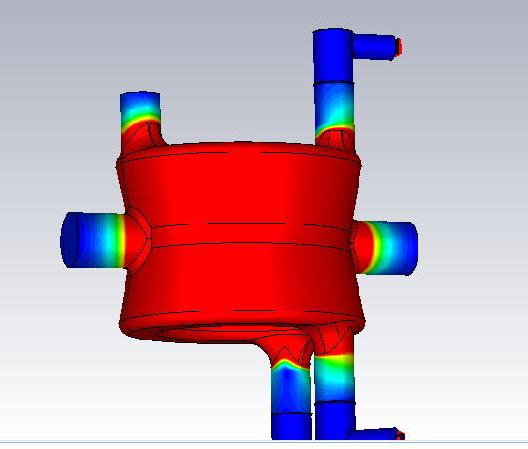
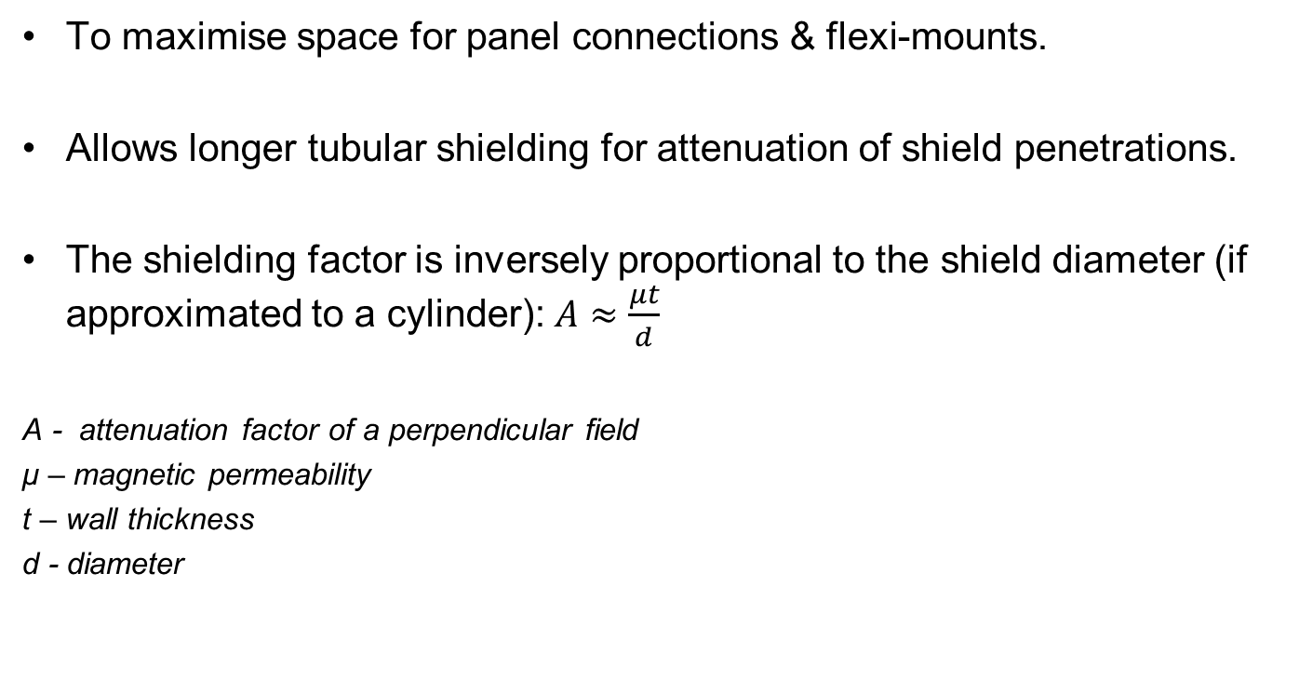
Reason for Close fitting shield
To maximise space for panel connections & flexi-mounts.
Allows longer tubular shielding for attenuation of shield penetrations.
The shielding factor is inversely proportional to the shield diameter (if approximated to a cylinder): $A≈\frac{μt}{d}$
A - attenuation factor of a perpendicular field
μ – magnetic permeability
t – wall thickness
d - diameter
High field regions requiring <1µT
Reference - F. Pobell, Matter and Methods at Low Temperatures. Springer-Verlag, third ed., 2007.
8

Slide 10
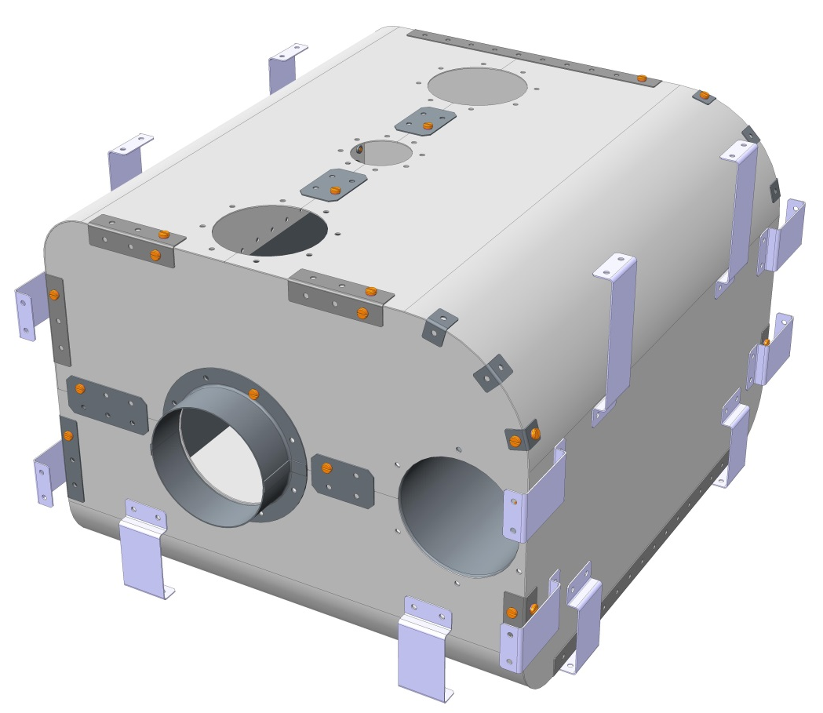
Common Design Features
1mm APERAM Cryophy - Cold Rolled Strip
Panels to be manufactured from Cryophy sheet metal which is cut, bent/folded, and fastened using self clinching nuts & spring washers
Helium Holes
Shield peppered with at least 142 x Ø3mm holes on 50-100mm pitch for helium transfer
142 holes give 10cm² transfer area, so that at worst case heat load (10W) heat flow is at least 1W/cm²
9

Slide 11
Common Design Features
Additional Cover Strips
Overlapping joints prevent gaps & allows magnetic flux to follow a continuous low-reluctance path
Tubular Shielding
Prevents field penetration through openings.
Ideally H = ØD
Flexi-Mounts
Flexible Gr2 Titanium mounts connect the shield to the Helium Vessel. 8 mounting pairs are utilized in 3 orientations for maximum shield stability
Fitted & Curved Shape
More effective at containing channelled magnetic flux
10

Slide 12
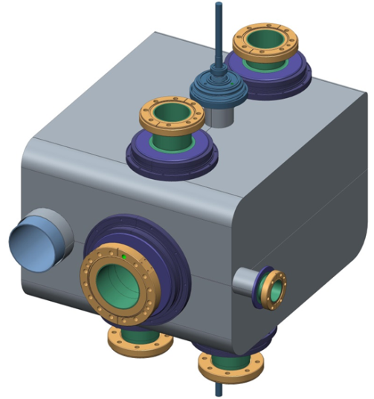
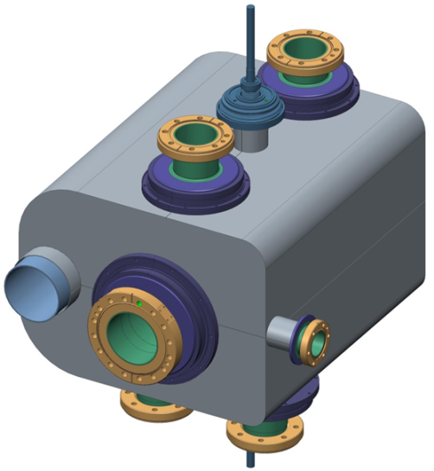
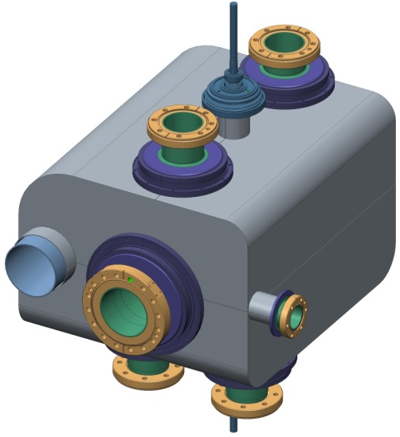
DQW Shield Design & Assembly
A
Concept Analysis
 | Concept A | Concept B | Concept C
No. of panels | 9 | 9 | 7
Curvature YZ | R40, R10, R50, R50 | - | R50, R50
Curvature XY | - | R100, R40, R30, R100 | R100, R40
B
Z
X
Y
C
11

Slide 13
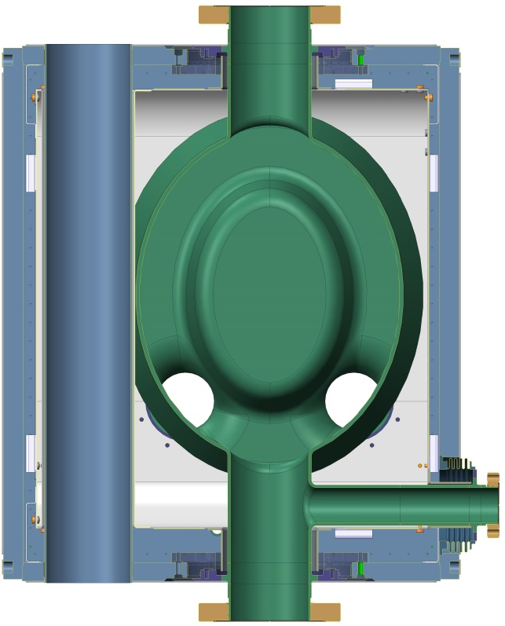

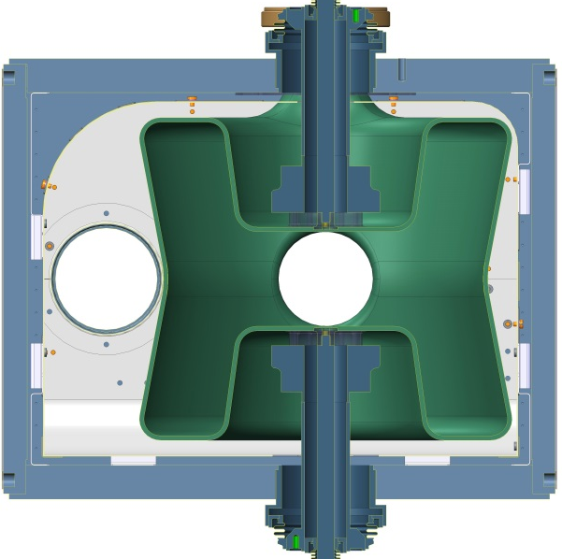
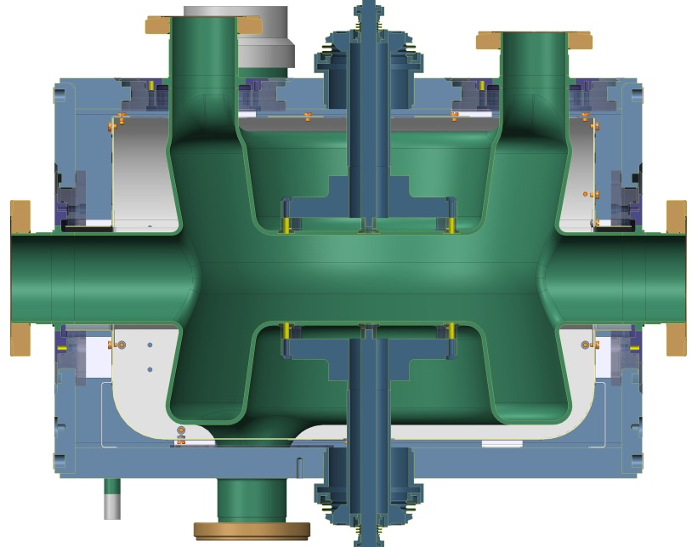
DQW Shield Design & Assembly
470
314
Assembled Shield Mass: ~10kg
420
12

Slide 14
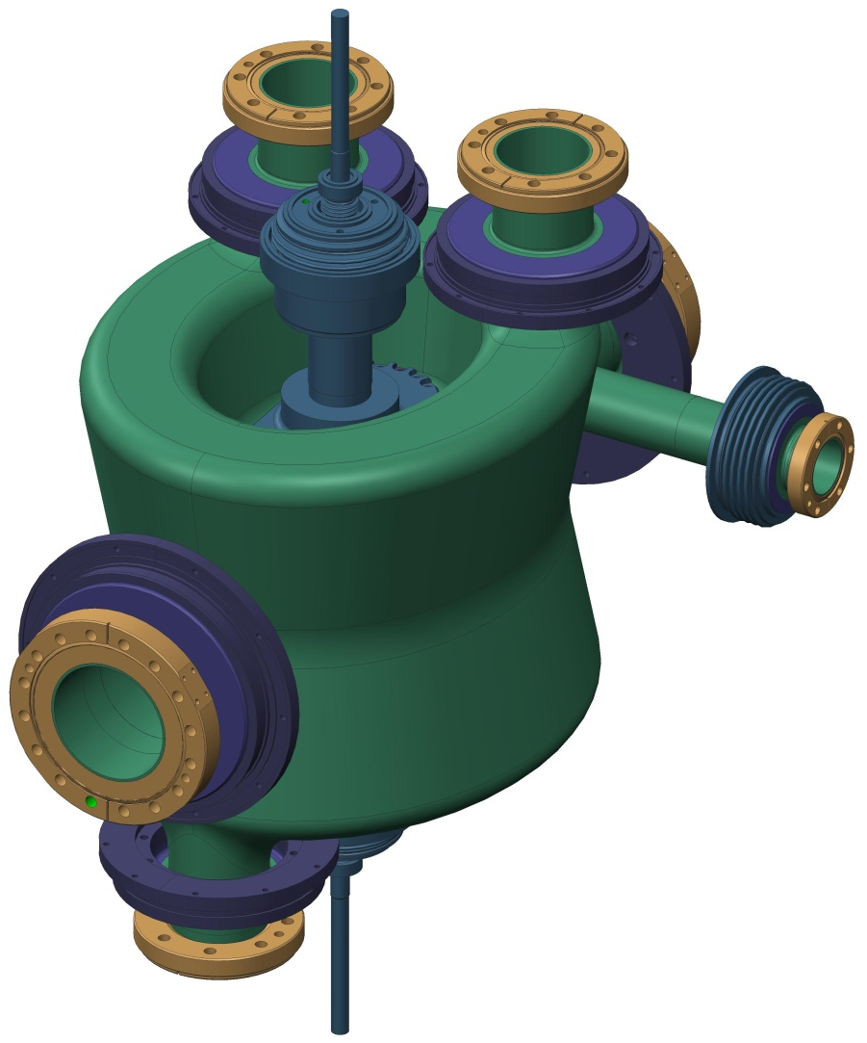
DQW Shield Design & Assembly
Z
X
Y
13

Slide 15
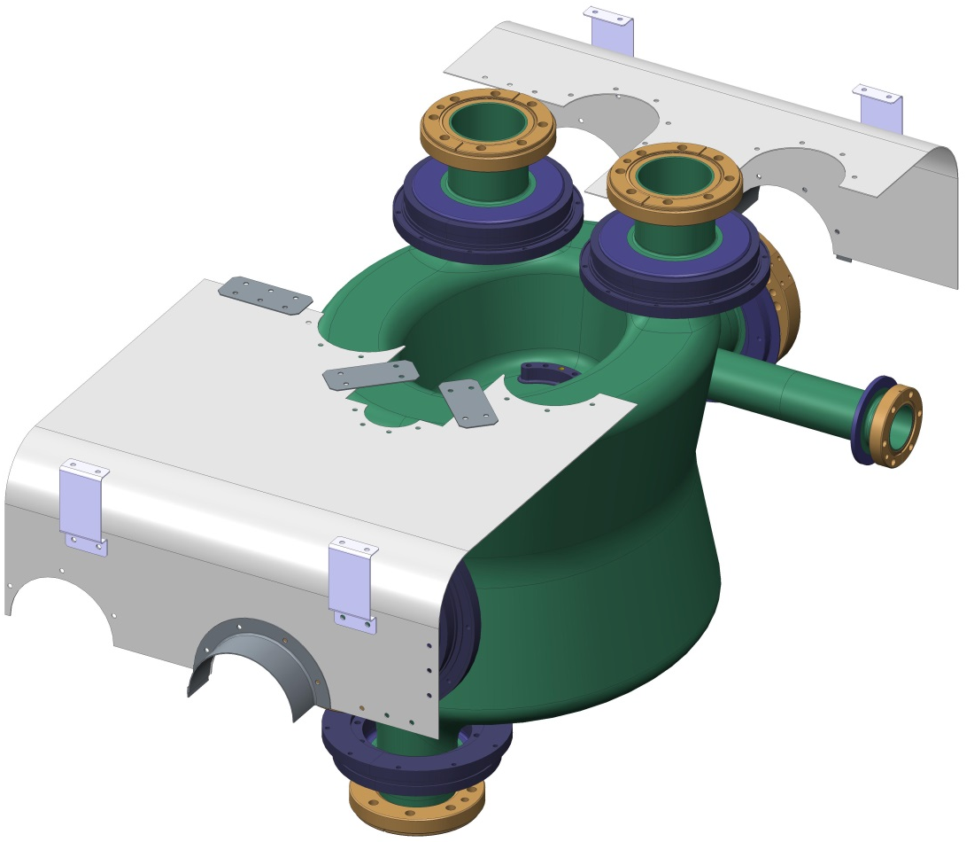
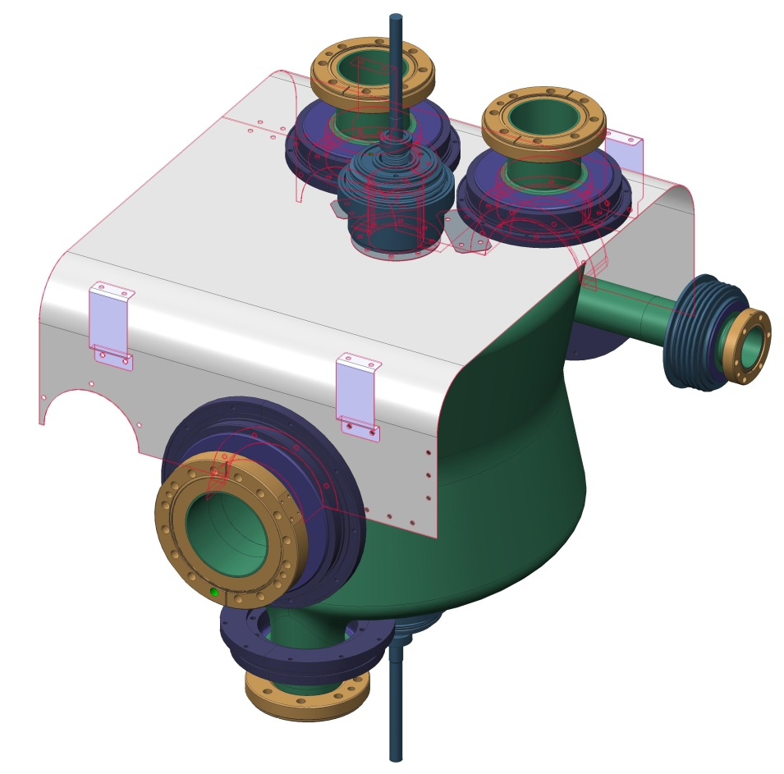
DQW Shield Design & Assembly
Z
X
Y
2 Bottom Panels assembled 1st
Cavity orientation shown upside down for clarity
14

Slide 16
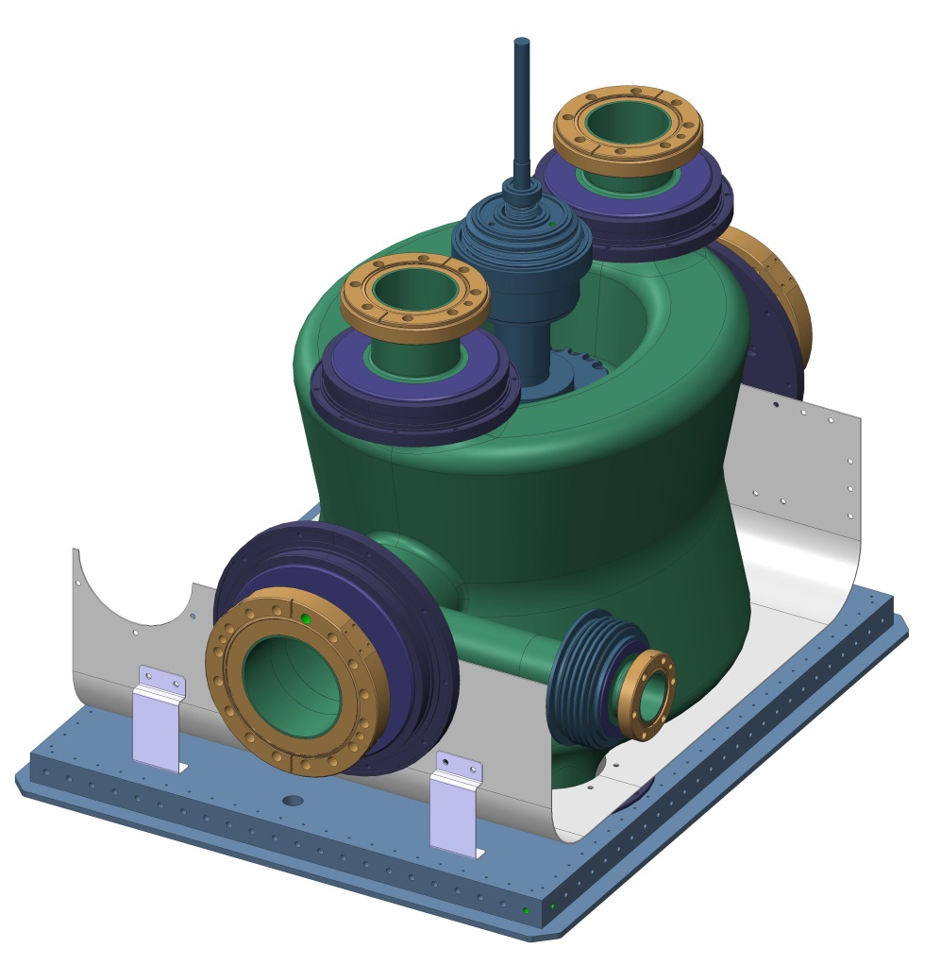
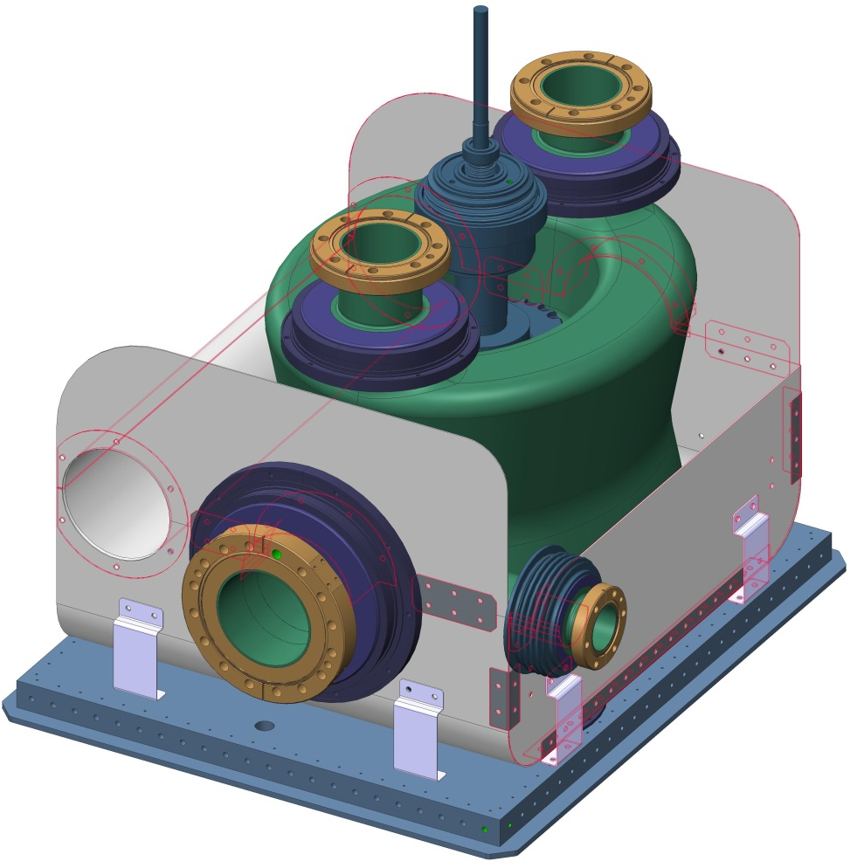
DQW Shield Design & Assembly
Y
Z
X
Shield & cavity mounted to base plate of the Helium Vessel
Top End caps are attached as well as bottom side panel and Dummy beam pipe attenuation sleeve.
15

Slide 17
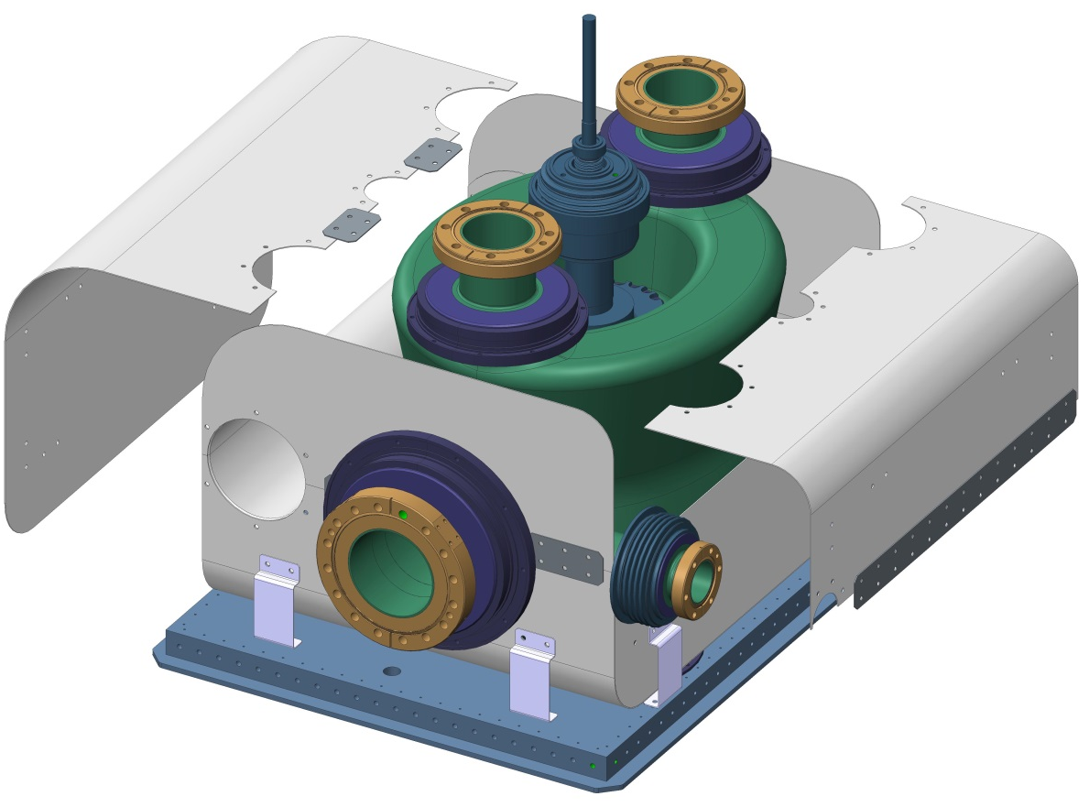
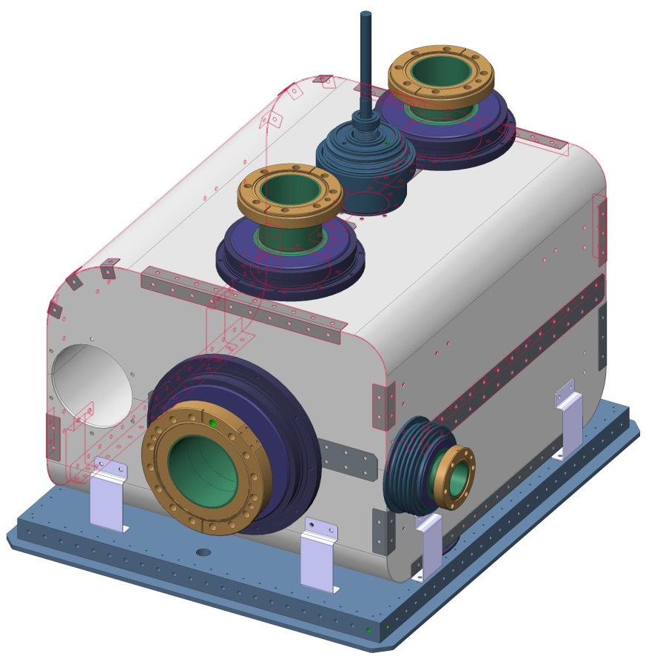
DQW Shield Design & Assembly
Final 2 top panels are brought into place and remaining cover strips and brackets are fastened
16

Slide 18
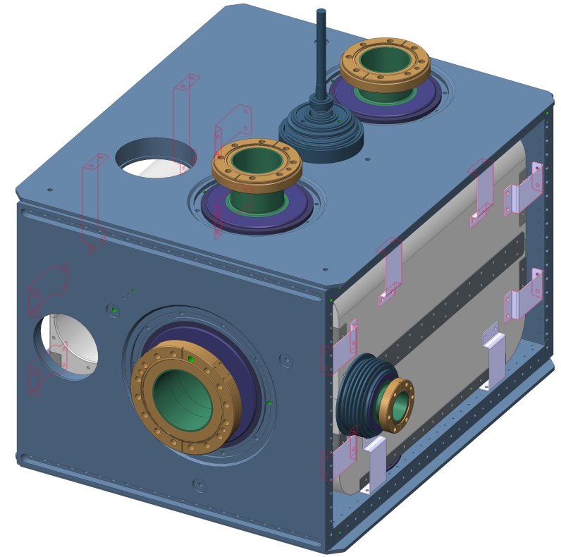
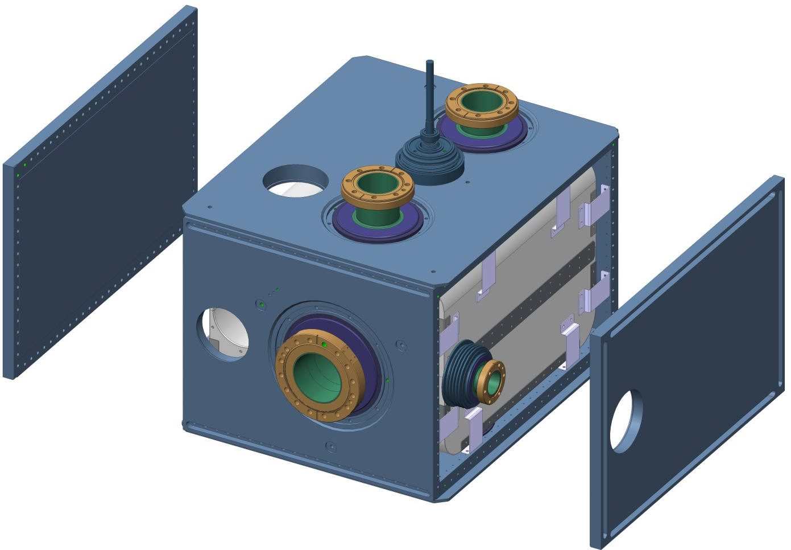
DQW Shield Design & Assembly
Side and top Vessel walls are assembled with remaining Flexi-Mounts before Helium Vessel is closed
17

Slide 19
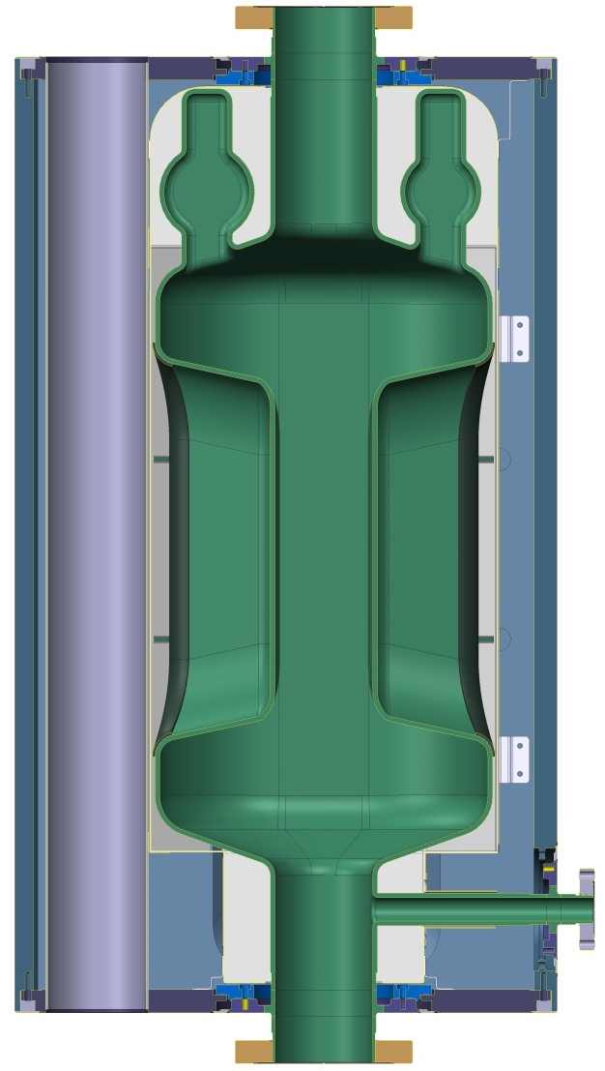
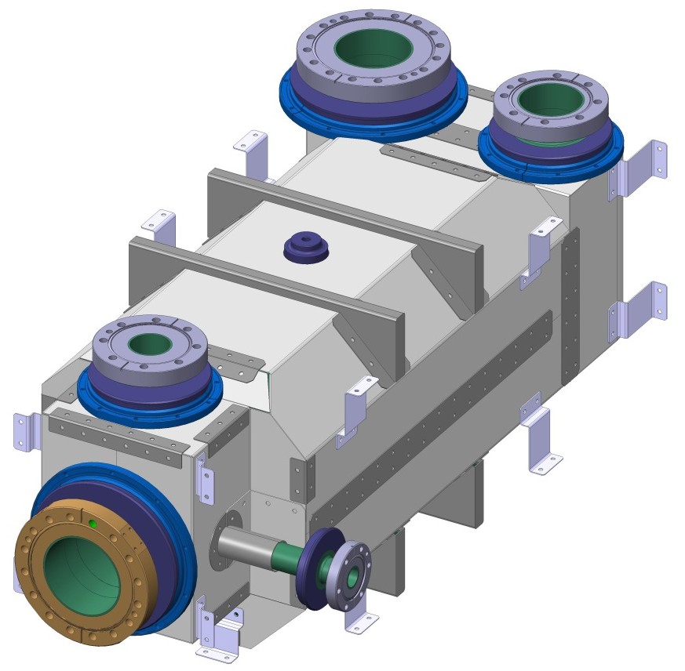
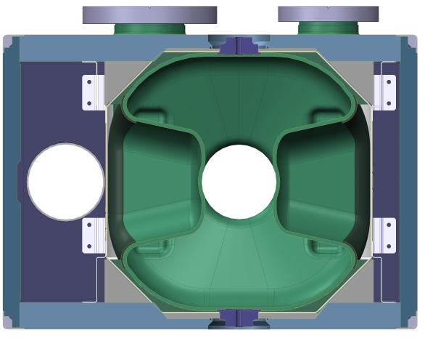
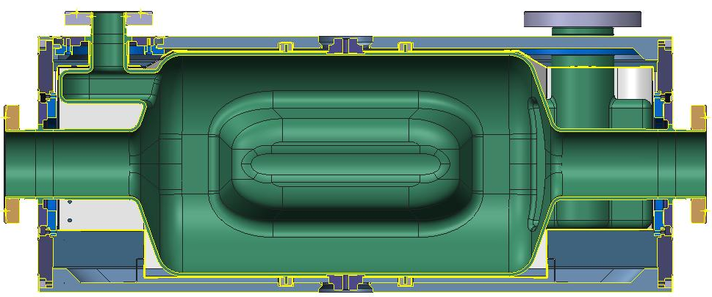
RFD Shield Design & Assembly
Assembled Shield Mass: ~10kg
RFD Helium Vessel 20/04/15
18

Slide 20
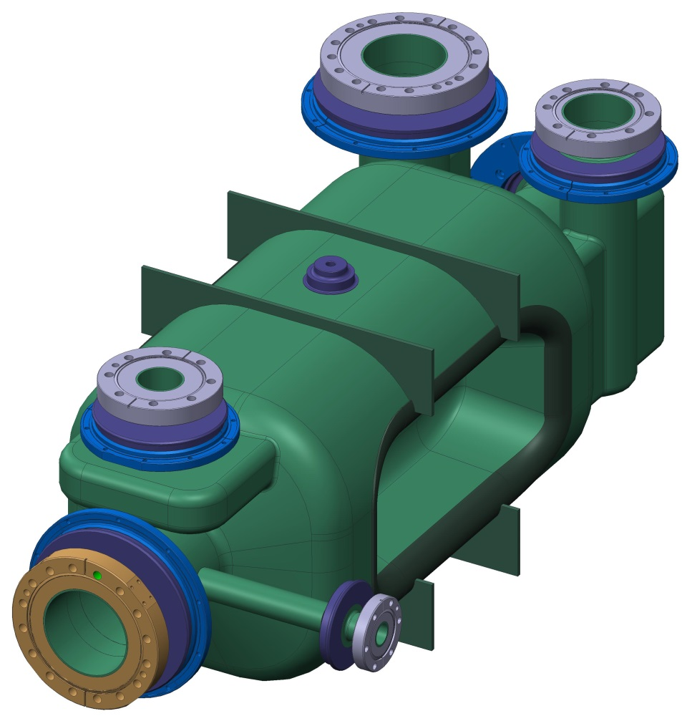
RFD Shield Design & Assembly
19

Slide 21
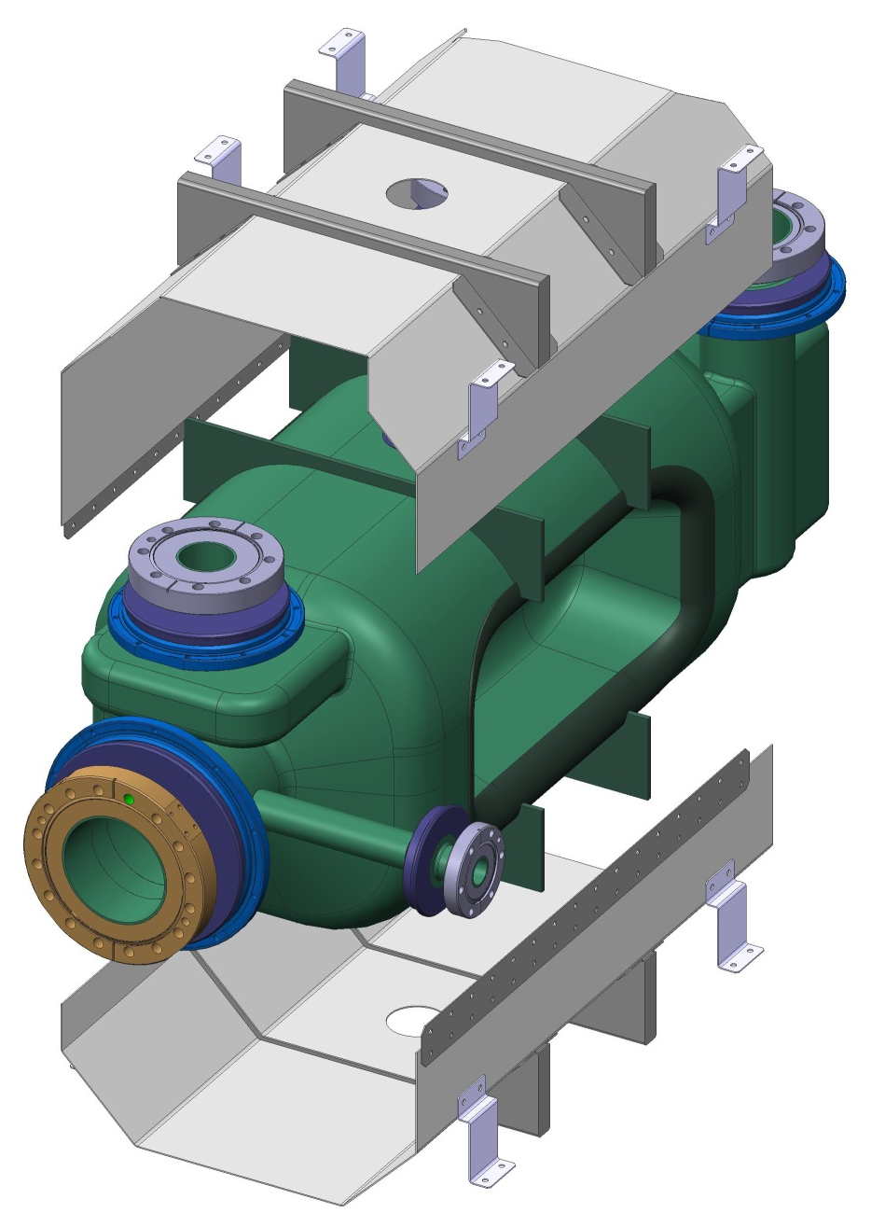
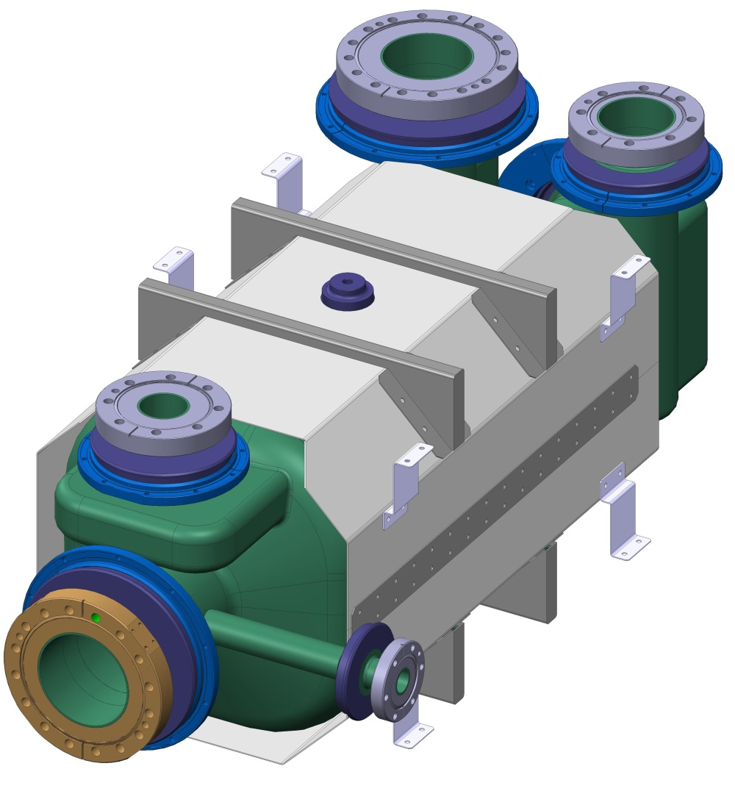
RFD Shield Design & Assembly
Pre-assembled shield body is assembled Top and Bottom
20

Slide 22
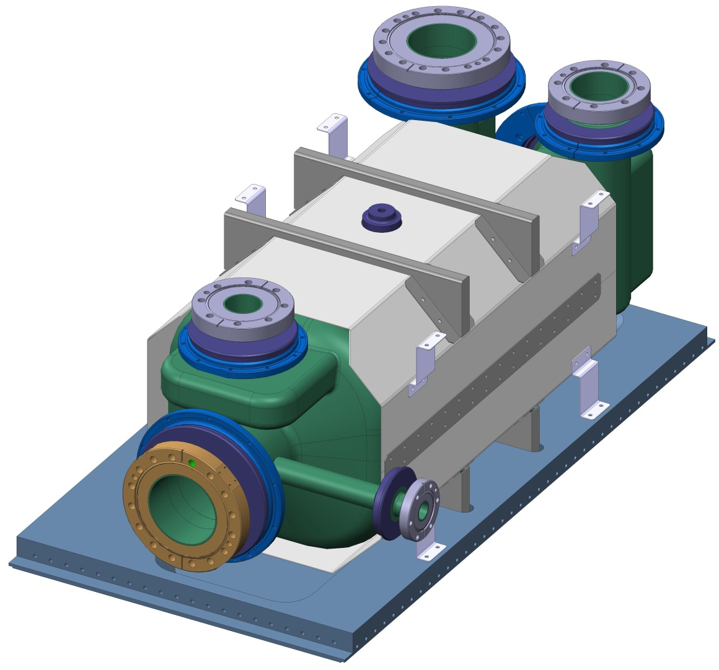
RFD Shield Design & Assembly
Shield Body is mounted to Helium Vessel Base
21

Slide 23
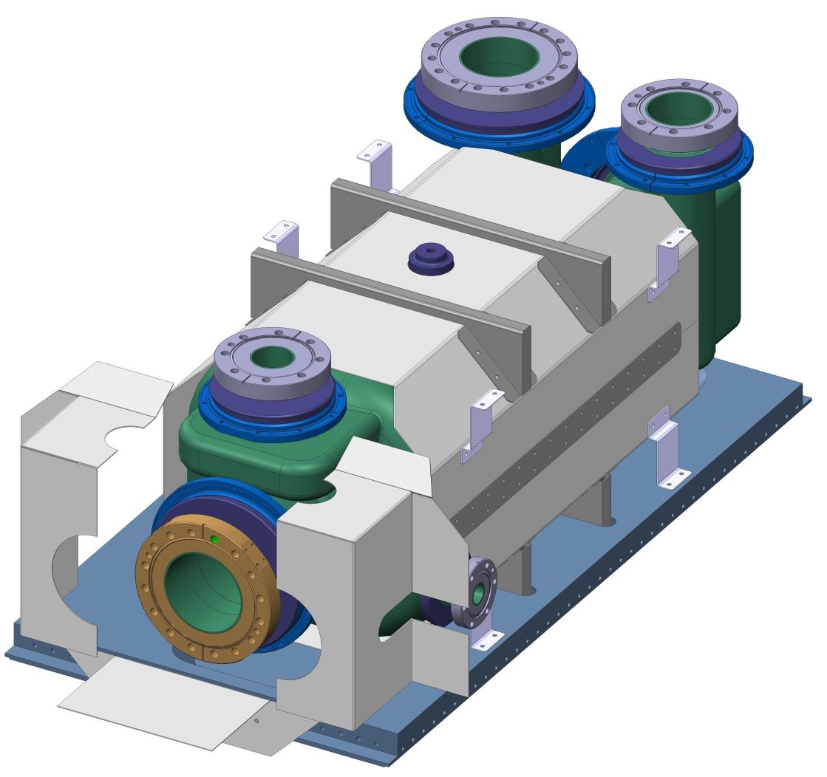
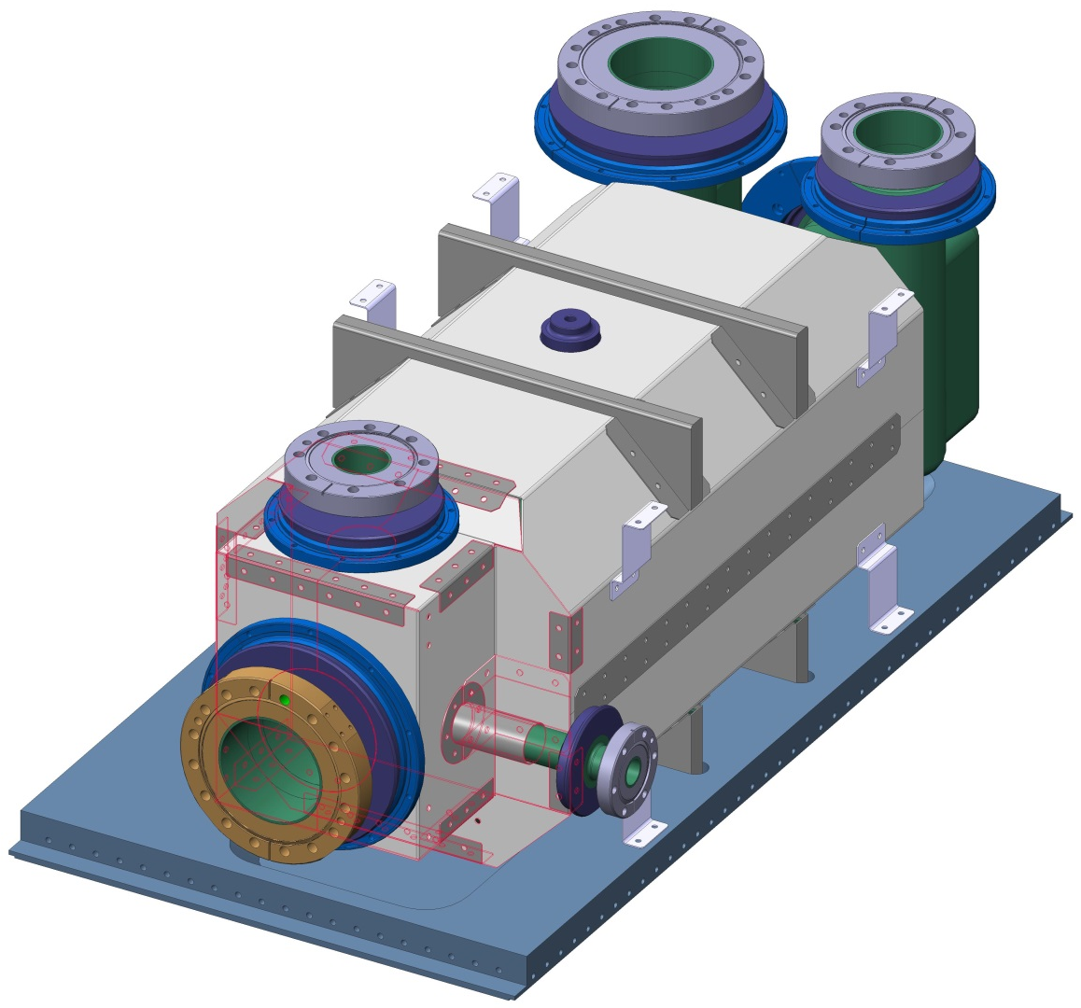
RFD Shield Design & Assembly
Split folded-end panels are assembled around 3 ports
End Cover is assembled to main body and fastened with cover panels and brackets
22

Slide 24
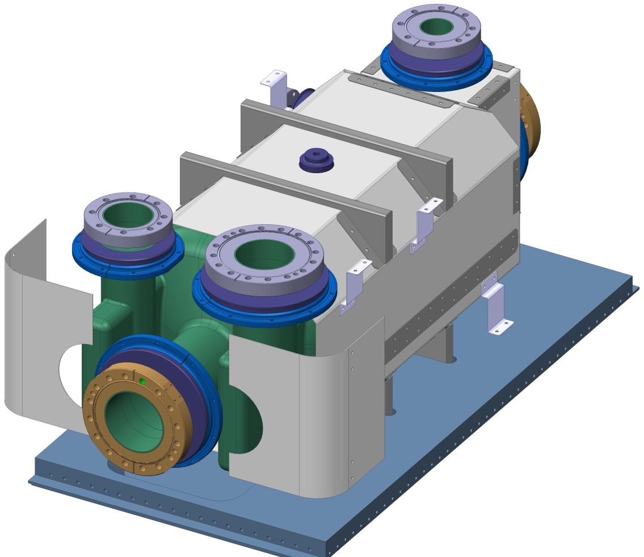
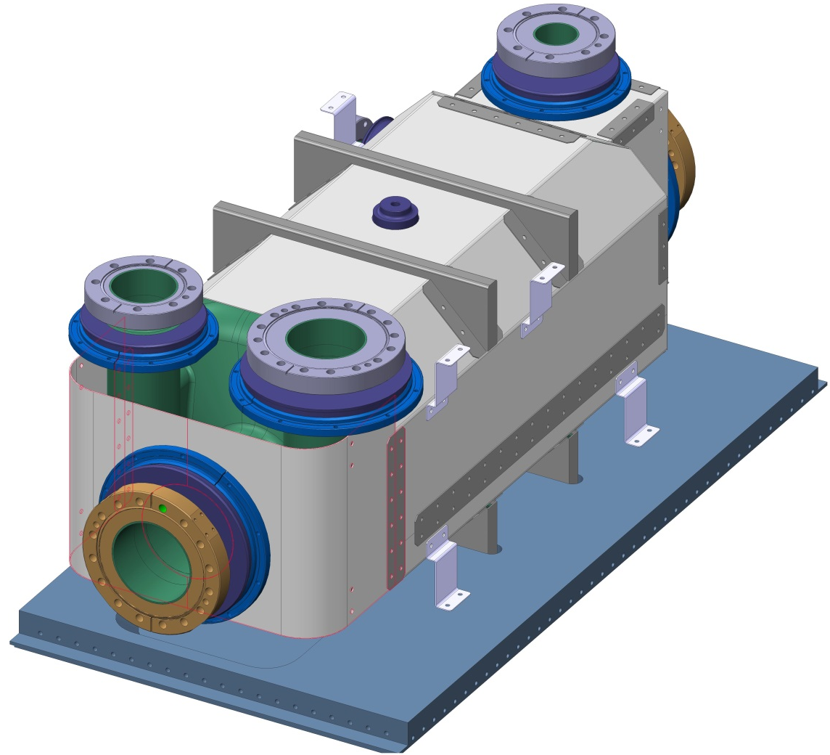
RFD Shield Design & Assembly
2 Curved-End panels are assembled around Beam Pipe
23

Slide 25
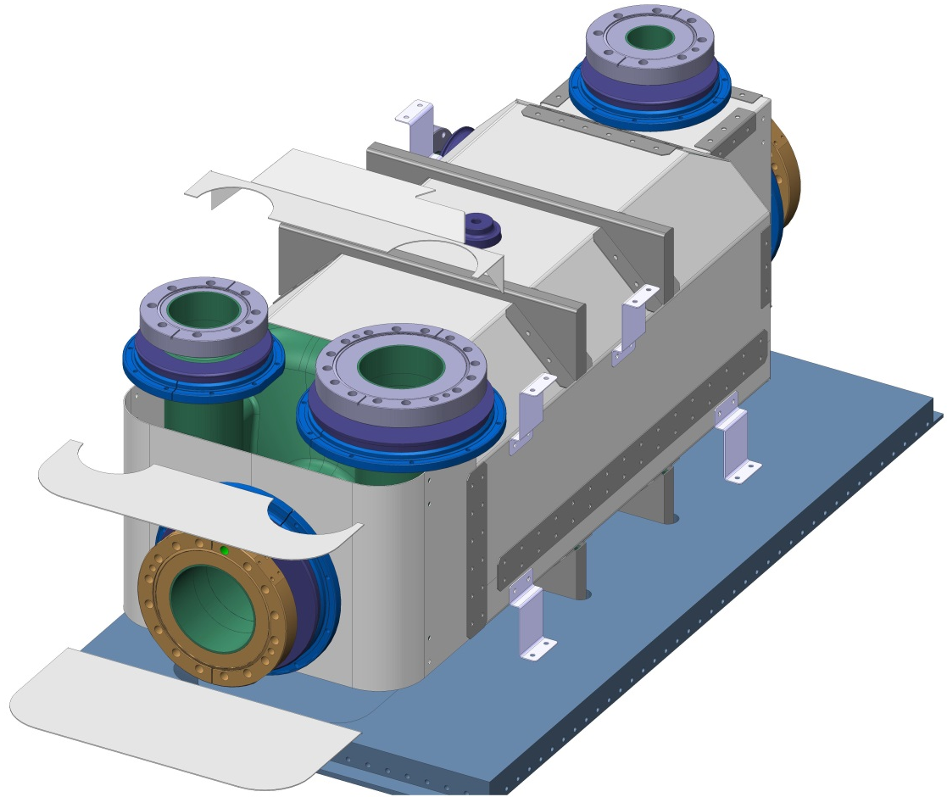
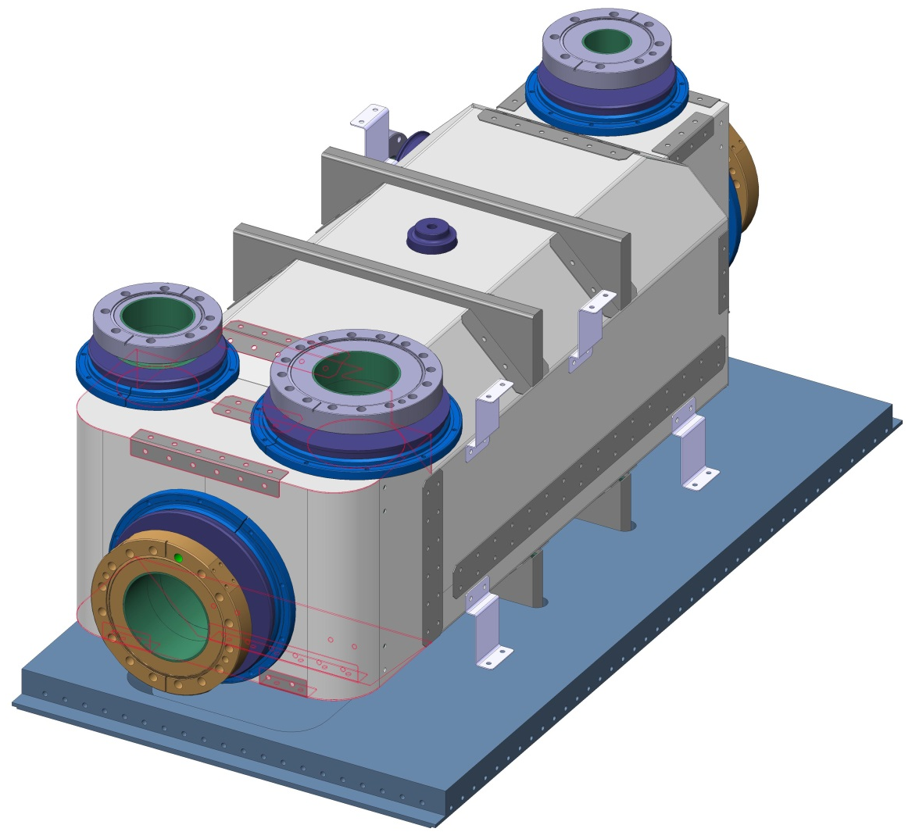
RFD Shield Design & Assembly
Split panels complete the Shield at the FPC & HOM Ports
Remaining cover strips are assembled
24

Slide 26
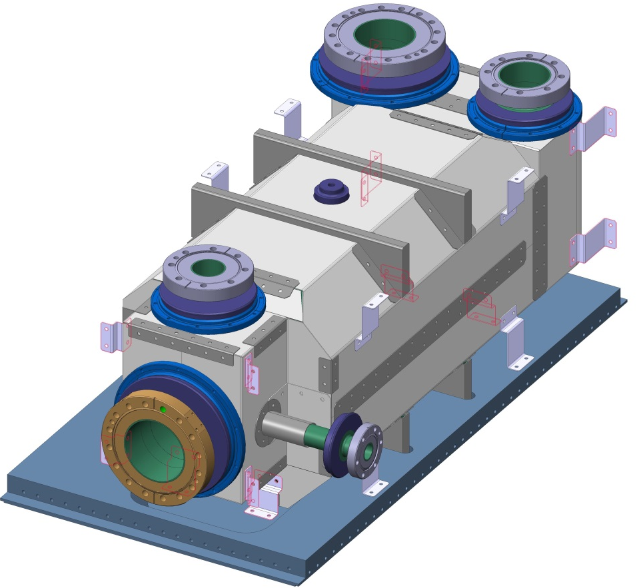
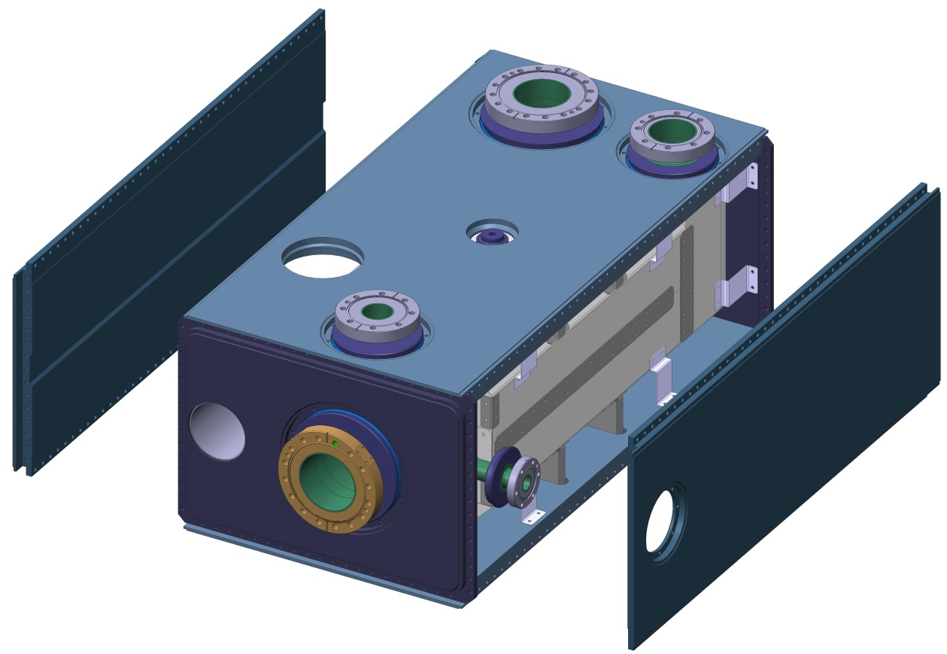
RFD Shield Design & Assembly
Flexi Mounts are connected and Helium Vessel is assembled
25

Slide 27
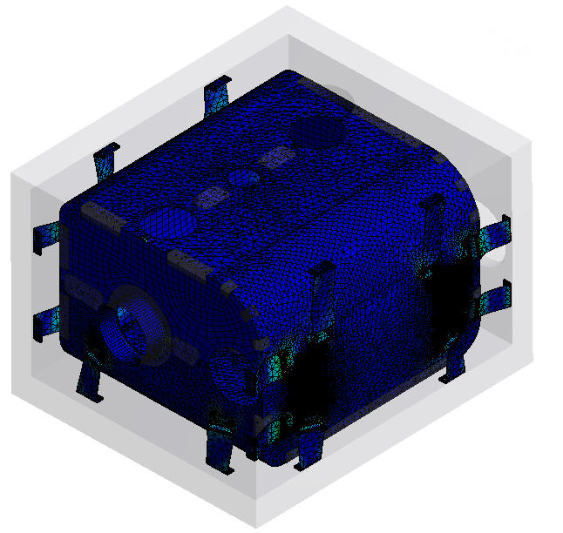
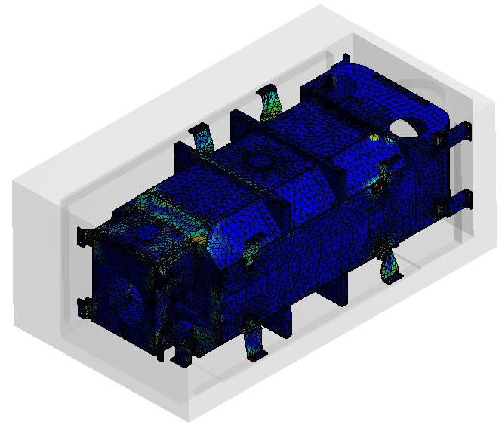
FEA: Cool Down & Self Weight
Material Data
Helium Vessel & Flexi-Mounts: Titanium Grade2 (ES371110)
RT Yield Strength= 275MPa
Thermal Expansion from RT to -269K = -5.2 E-6.K
Magnetic Shield: Aperam Cryophy (Magnetic Shielding LTD)
RT Yield Strength = 280MPa
Thermal Expansion from RT to -269K = -8 E-6.K
26

Slide 28
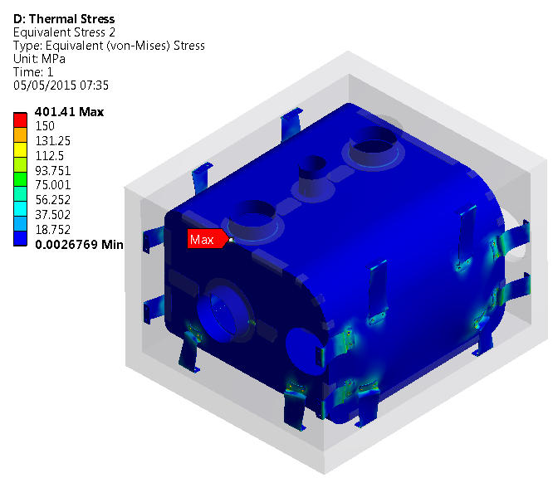
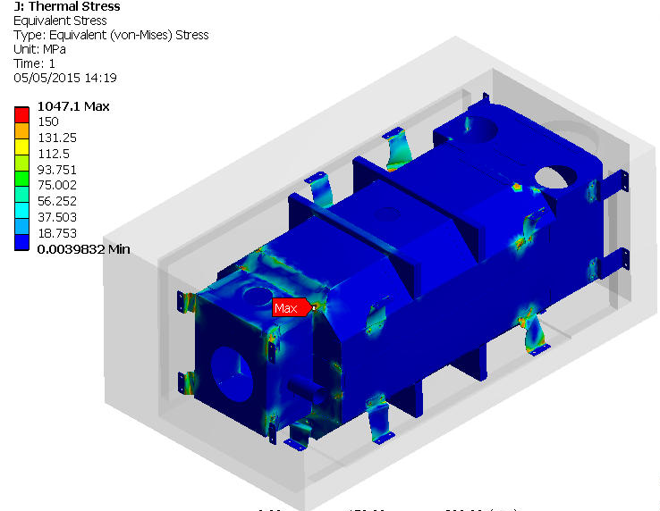
DQW & RFD Thermal Stress
Loads & Constraints
Cool down from RT to 2K
Fixed at input coupler interface
Results
Solution contains erroneous result due to skew mesh geometry
Stress > 150Mpa shown in red
Some localised high stresses at shield connections
Conclusion
Cryophy Stresses affects shielding properties in immediate stress location, localised stresses are (at worst) comparable to a small hole – effect is negligible.
Localised stress can be avoided using sufficient clearance at connections.
27

Slide 29
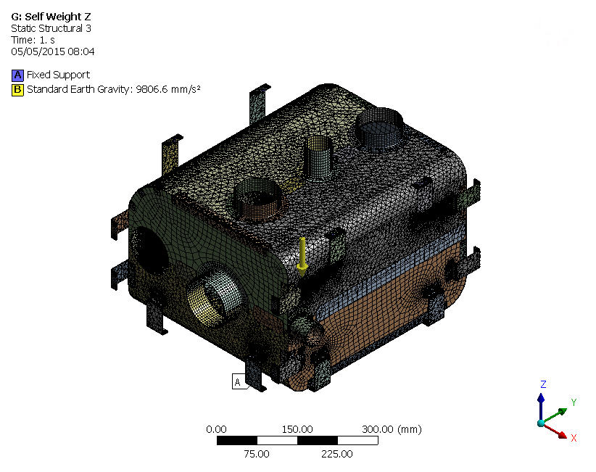
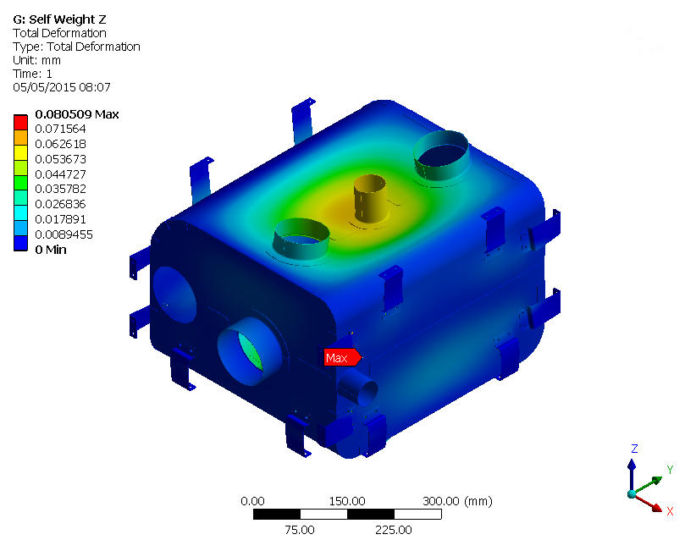
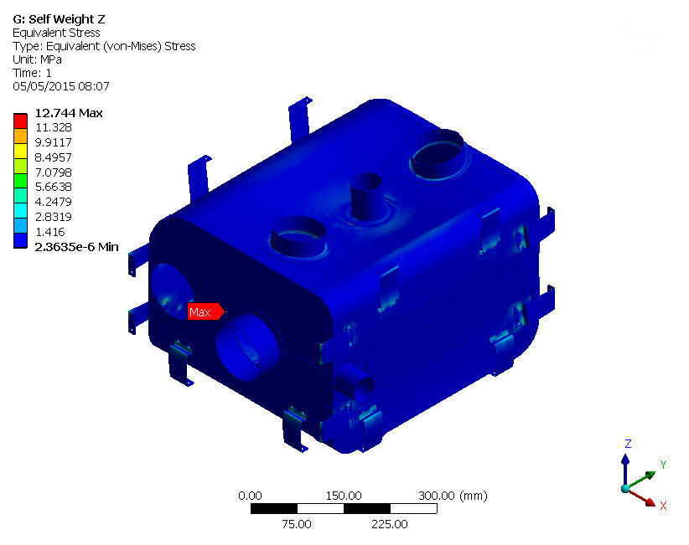
DQW Self Weight Horizontal
Fixed at Flexi Mount – Helium Vessel interface
Gravity applied in ANSYS Z direction
Max shield deformation 0.08mm
Max shield stress 13MPa
28

Slide 30



DQW Self Weight Vertical
Fixed at Flexi Mount – Helium Vessel interface
Gravity applied in ANSYS Y direction
Max shield deformation 0.04mm
Max shield stress 14MPa
29

Slide 31



DQW Self Weight Side
Fixed at Flexi Mount – Helium Vessel interface
Gravity applied in ANSYS X direction
Max shield deformation 0.07mm
Max shield stress 32MPa
30

Slide 32



DQW Self Weight Horizontal
Fixed at Flexi Mount – Helium Vessel interface
Gravity applied in ANSYS Z direction
Max shield deformation 0.01mm
Max shield stress 9MPa
31

Slide 33



RFD Self Weight Vertical
Fixed at Flexi Mount – Helium Vessel interface
Gravity applied in ANSYS Y direction
Max shield deformation 0.01mm
Max shield stress 9MPa
32

Slide 34



RFD Self Weight Side
Fixed at Flexi Mount – Helium Vessel interface
Gravity applied in ANSYS X direction
Max shield deformation 0.02mm
Max shield stress 27MPa
33

Slide 35
Discussions with Magnetic Shielding LTD
We have liaised with Magnetic Shields LTD from the UK throughout the design of the shield.
We obtained a budget cost for the previous shield concepts (welded helium vessel).
Cost estimate was £8-12K (excluding VAT) per shield
New designs could be more expensive, up to ~£15K (€20K)
Formed / pressed shield panels are feasible for larger quantity orders.
34

Slide 36
Thank You!
Questions?

