Slide 1
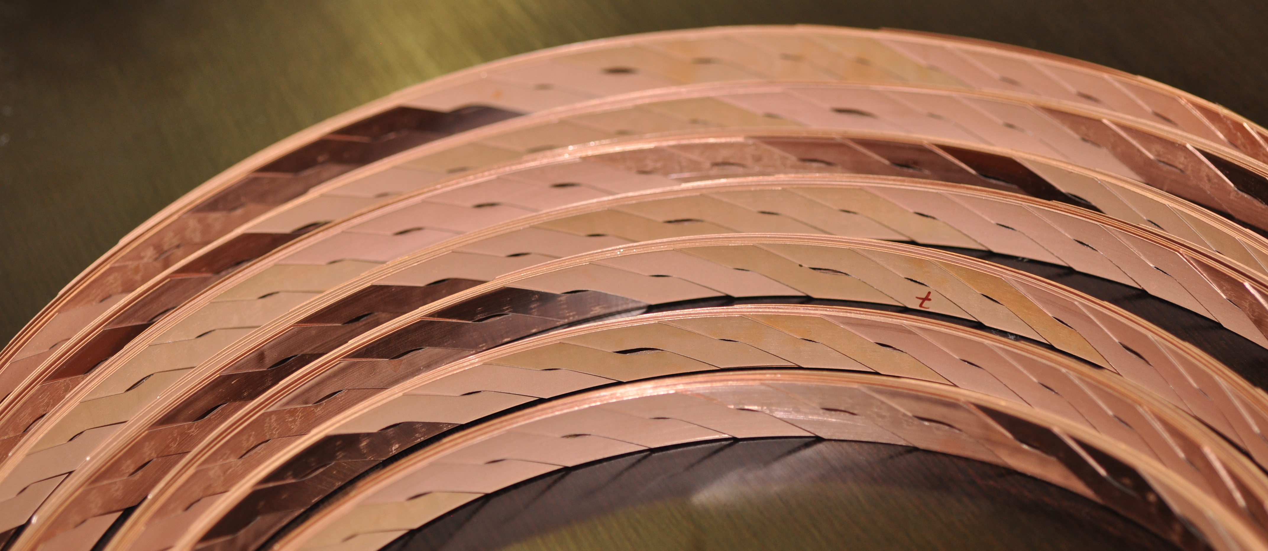
WP10.2 – where do we stand ?
L. Bottura, C. Senatore
Graphics by courtesy of A. Kario, KIT

Slide 2
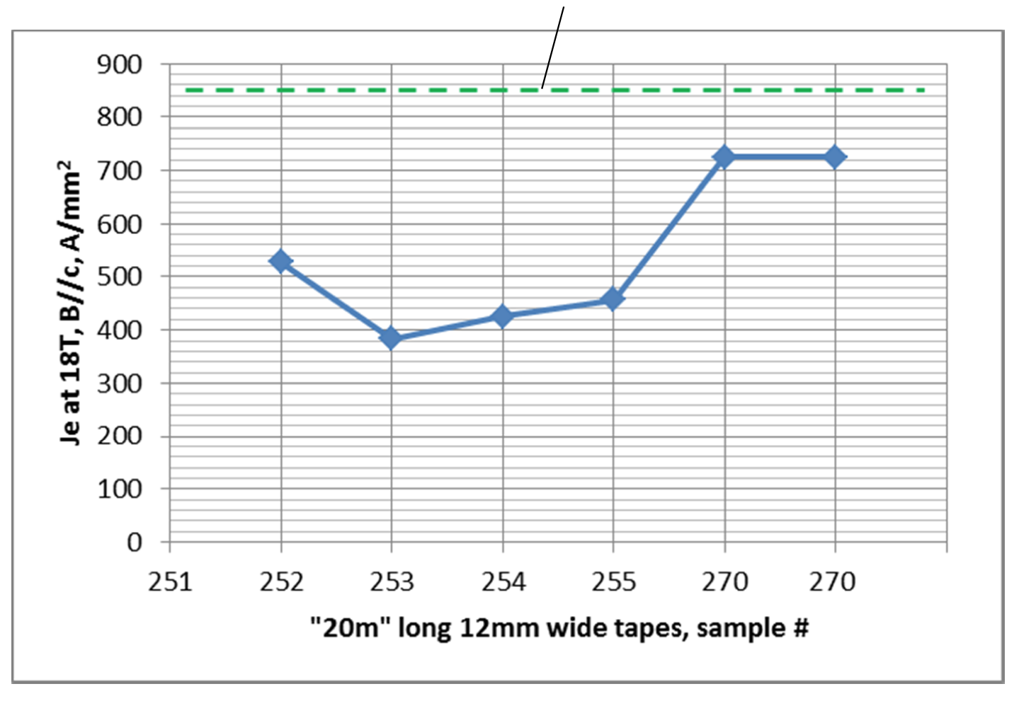
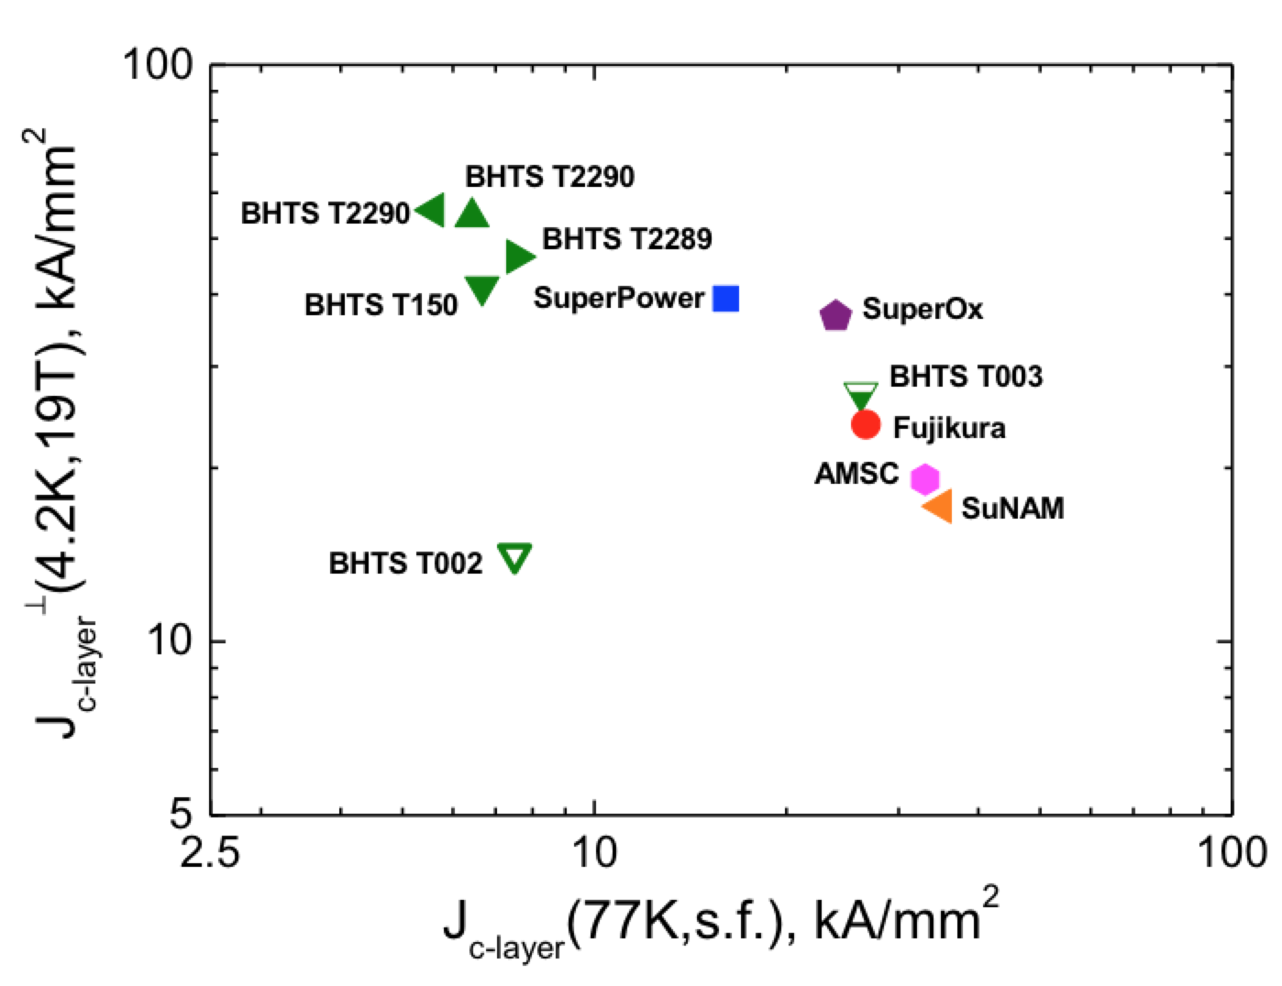
Technical advances – YBCO tape
More than 240 m of tape produced, with good lengths of 20 m and longer
Steady increase of J_{E}, and highest industrial J_{layer} ever
Highest J_{E}
Courtesy of A. Usoskin, Bruker HTS
Courtesy of C. Senatore, U. Geneva

Slide 3
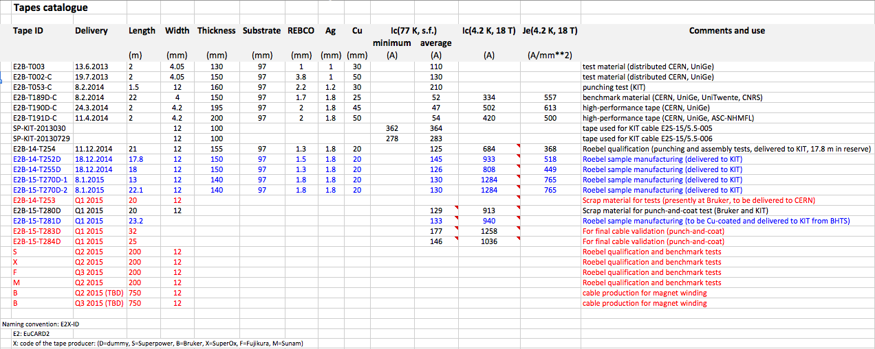
Tape inventory
T253 (20 m) on its way to CERN (splices and transitions, other tests)
T283/T284 (> 50 m) for the next production of final geometry cable (Ic/sigma tests)
Three orders placed for benchmark material (Sunam, SuperOx, SuperPower), one order pending awaiting 12 mm tape offer (Fujikura), for the production of benchmark cable lengths
750 m required for Q2 2015 (magnet UL ?)
750 m required for Q3 2015 (magnet UL ?)

Slide 4
Technical advances – YBCO cable
More than 45 m of dummy cable produced (SS tape)
Two short lengths (1.6 m and 1.8 m) of SC cable delivered (AC loss, other characterization and tests).
Note: stress tolerance verified up to 250 MPa in similar cables (not in WP10.2, but very relevant result)
One winding length (5 m) of SC cable produced and on the way to CERN
Punch-and-coat successfully tested, new baseline for Roebel fabrication ?

Slide 5
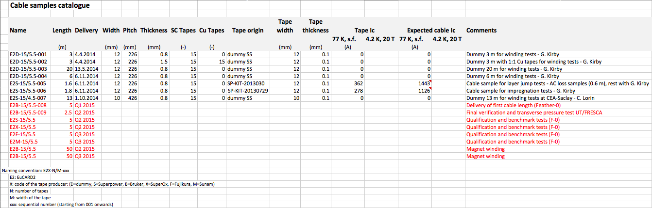
Roebel inventory
E2B-15/5.5-008 (5 m) on its way to CERN (first Feather-0)
E2B-15/5.5-009 (> 2 m) final geometry cable (Ic/sigma tests)
E2S-15/5.5, E2X-15/5.5, E2F-15/5.5, E2M-15/5.5 (> 2 m) benchmark cable length from alternative suppliers
E2B-15/5.5 (50 m, magnet UL ?) required for Q3 2015
E2B-15/5.5 (50 m, magnet UL ?) required for Q4 2015

Slide 6
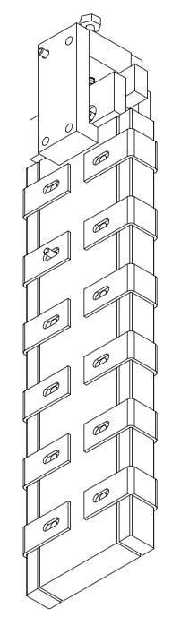
Technical advances – BSCCO-2212
Additional 10 kg of precursor (lot 87) produced and delivered. Reason of hard particle probably found in parameters setting of the jet-milling machine. NSC has closed operations
Use of the powder in OST billets in discussion
Received (pmm-130723-2 – to be confirmed):
Unreacted wire (approximately 20 m)
Reacted wire for material characterization at CERN and transverse stress Ic tests at U. Geneva
Mechanical, crystallographic and electrical characterization of BSCCO-2212 straight wires at CERN/ESRF indicate irreversibility at ε_{longitudinal} = 0.6 %
In preparation a transverse stress Ic test on a cable (U. Twente, LBNL, NHMFL, CERN)
Agreement on cabling work at LBNL, to be followed-up
Take BSCCO-2212 as a special topic for a dedicated meeting

Slide 7
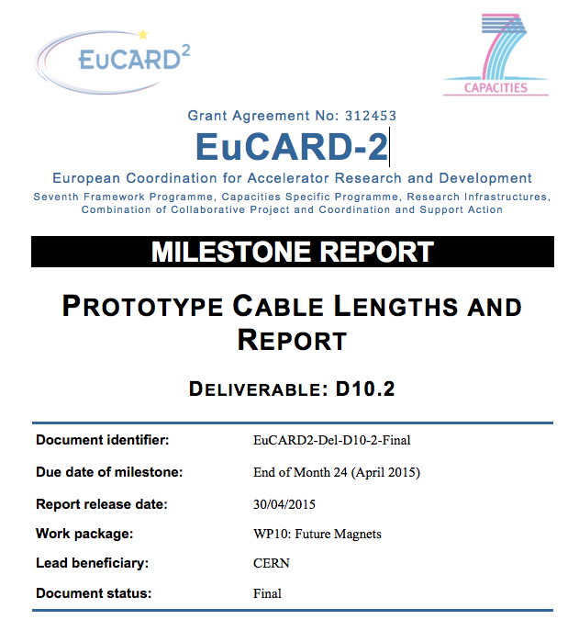
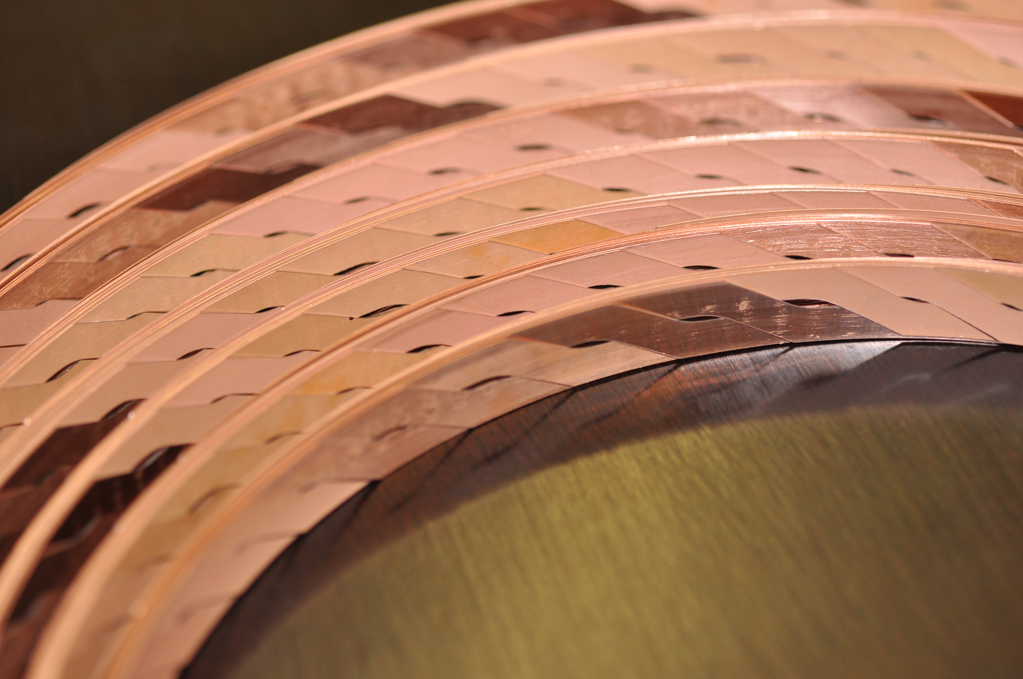
Deliverables and Milestones
D10.2 – Prototype cable lengths and report (month 24): achieved
D10.3 – Parameters for choice of SC type (month 28):
Comparison of YBCO and BSCCO in terms of material performance, cabling, suitability for winding
Organize a dedicated WP10 meeting to report and summarize the conclusions (max two months from now)
MS66 – First Cable length for magnet winding (month 32)
Check production plan (last item in the agenda of this meeting)

Slide 8
Summary at mid-term
Work has steadily advanced with some major achievements – thank you to all contributors !
Now it gets hectic, with production stepping-up, and approaching final deliverables and milestones (MS66)
I propose now to separate:
Baseline activity, based on what we know and need now, targeted at achieving deliverables and milestones, and
Further R&D, based on present unknowns and ideas, targeted at completing the scientific case by the end of the project

Slide 9
Next actions, for discussion - 1
Benchmark measurement of performance to establish variability among labs and in the material
We need a good tape (high performance and homogeneity)
Single sample preparation, write-up procedure for sample mounting, meet to evaluate results
University of Geneva volunteers to drive this activity: identify 5 m from the material coming next, prepare samples, distribute, measure, analyze and de-brief
Presentation from C. Senatore

Slide 10
Next actions, for discussion - 2
Qualify impregnation and transverse strain properties of baseline cable
Sample preparation based on the selected insulation/resin system
Requires only a short length of cable (0.5 m), can be tested on variants of tapes/cables
Measurements at the University of Twente
CERN/KIT/UTwente to drive this activity: use a part of cable E2S-15/5.5-005, sample preparation (CERN), leads and test (UTwente), analysis and de-brief
Planned work KIT/U. Twente

Slide 11
Next actions, for discussion - 3
Measure magnetization of cable
Sample preparation based on the selected insulation/resin system and impregnation pressure (Rc)
Measurements at the University of Twente, University of Southampton
CERN/KIT/UTwente/USouthampton to drive this activity: use a part of cable E2S-15/5.5-005, sample preparation (CERN), measurements (UTwente, USouthampton), analysis and de-brief
Striated tapes, open point. A few m of material are required (produced by KIT) for measurements at CERN (R), KIT, University of Twente and Southampton (M)
On-going

Slide 12
Next actions, for discussion - 4
Quench propagation and protection
Short sample tests are required to provide database and benchmark
Both single tapes (meandered ?) and cables
UTwente and USouthampton can perform measurements
What measurements ?
Which samples ?
Needs allowable and limits to determine minimum Cu quantity and maximum J_{E}. Magnet design to address allowables
To be discussed later

