Slide 1
Beam Synchonous Timing
(BST)
Short Description
Status
New Design
Future ….

Slide 2
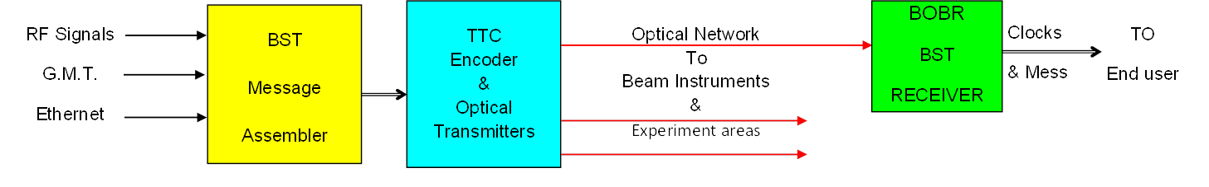
BST - Short description
Broadcast timing signals & messages required to synchronize acquisition systems with beam.
Use the 40MHz & Orbit Turn-clock provided by the RF system.
A message is produced by BST-Master every revolution period.
Distribution to the experiments and BI over optical networks by using TTC components. (TTCex, TTCvx, TTCtx, TTCrx)
The BST Receiver (BOBR) is the interface to the end users installed in each VME beam instrumentation crates .

Slide 3
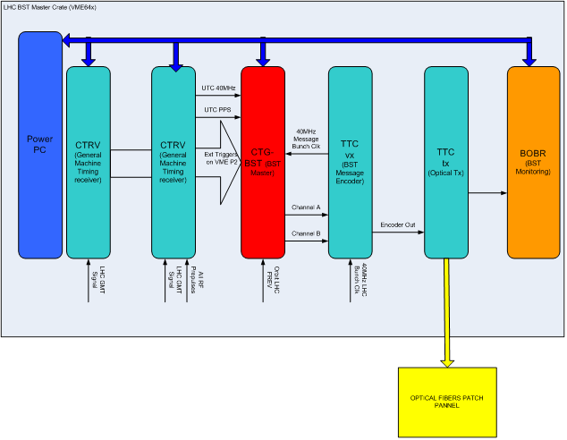
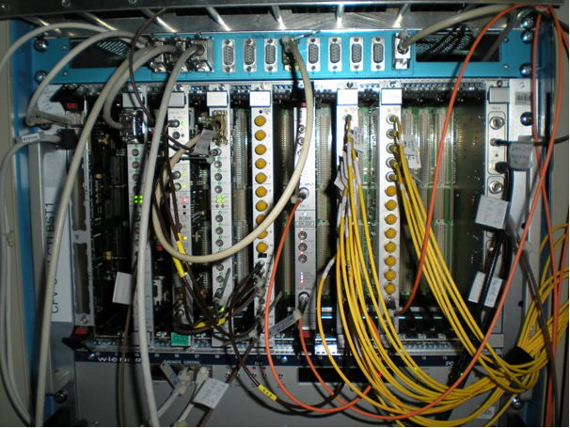
BST - Master
3 x VME Crates:
LHC Ring 1
LHC Ring 2
SPS

Slide 4
BST - Optical Distribution
End Users:
( EA, BI, Labos )
LHC 1 = 157
LHC 2 = 156
SPS = 22
+ pre-pulse
by cable!

Slide 5
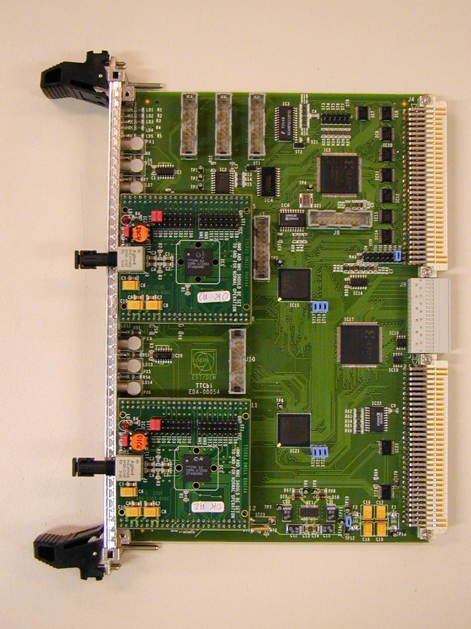
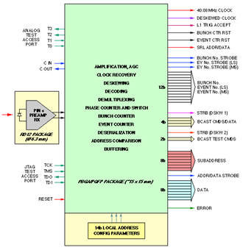
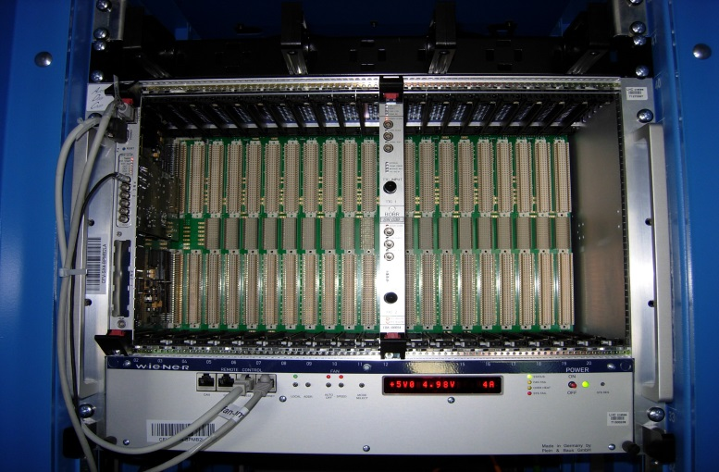
BST - Receiver (BOBR)
2 x TTCrm:
VME64x Board
2 Channels (LHC 1 & 2)
40 MHz Bunch-Clock > P0+FP
Delayed Turn-Clock > P0+FP
Message > DP RAM.
2 x Trigger bytes > P0
8 x Bunch selector > P0
IRQ on specific bytes.
….
P0 BUS
VME-BI
Crate
ONLY !
To be plug into VME-BI crate pos 12:
Installation: E.A.= 10
B.I. = 160
Spare = 40

Slide 6
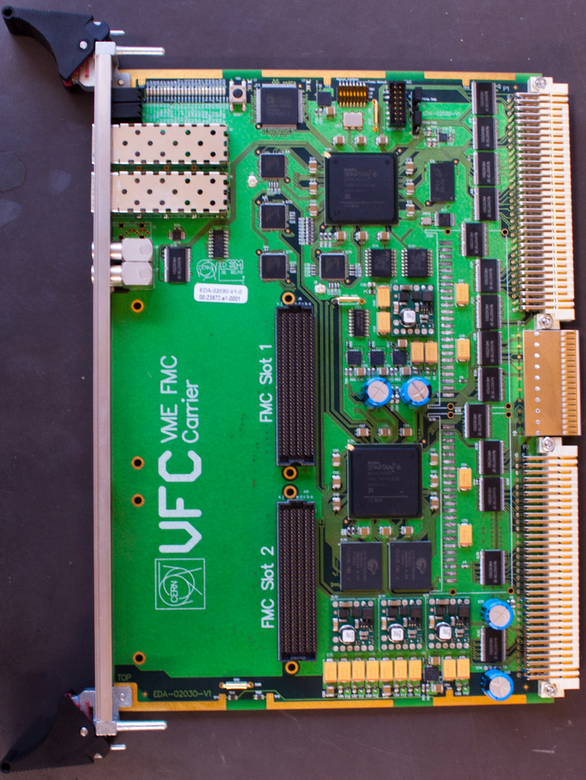
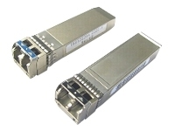
BST- New Design:
BSTR implementation in the VFC
BST Optical network
New Acquisition Board :
VFC ( VME FMC CARRIER)
BST Optical network
.
SFP
1:16 Optical Splitter
CDR
ADN2814
Up to 16 VFC
  Clock + Data + Status
SFPGA
FLASH CONFIG
CDR
Interface
P0
AFPGA
P0
BST Signals From BOBR
P2
Application Firmware
BSTR
Use one of the 2 x SFPs
( Small Formfactor Pluggable)
IF Wiener Crate
P2 Extension Module
BSTR: VHDL package to be put into the Application FPGA.
>> Same functionality as the BOBR module

Slide 7
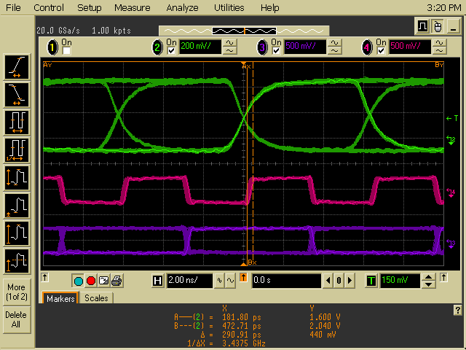
BST- New Design:
TTC Frame >> Clock & Data Recovery
Biphase Mark TTC Frame
( Sync with the 40 MHz x 4)
160 MHz Recovered Clock
160 Mb/s Recovered Data
LHC : Protons & Ions > OK
SPS : Protons > OK (Except Injection pre-pulse)
SPS : Ions > Problem during injection phase !

Slide 8
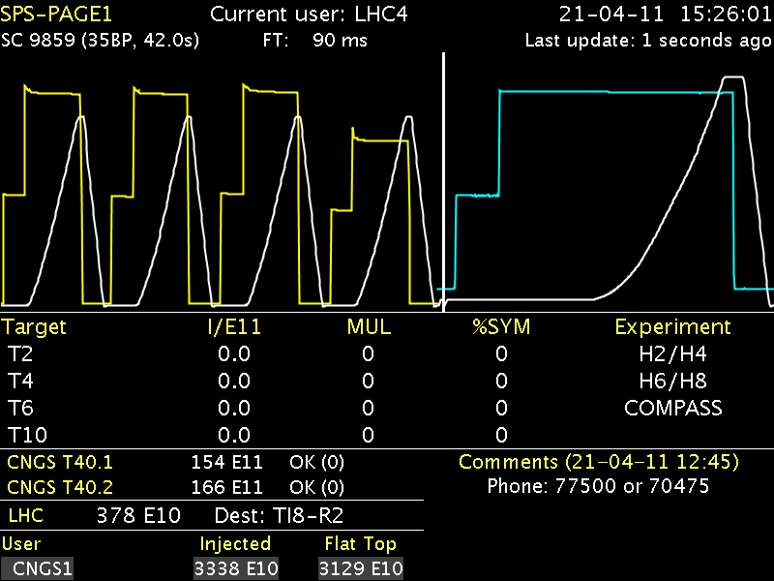
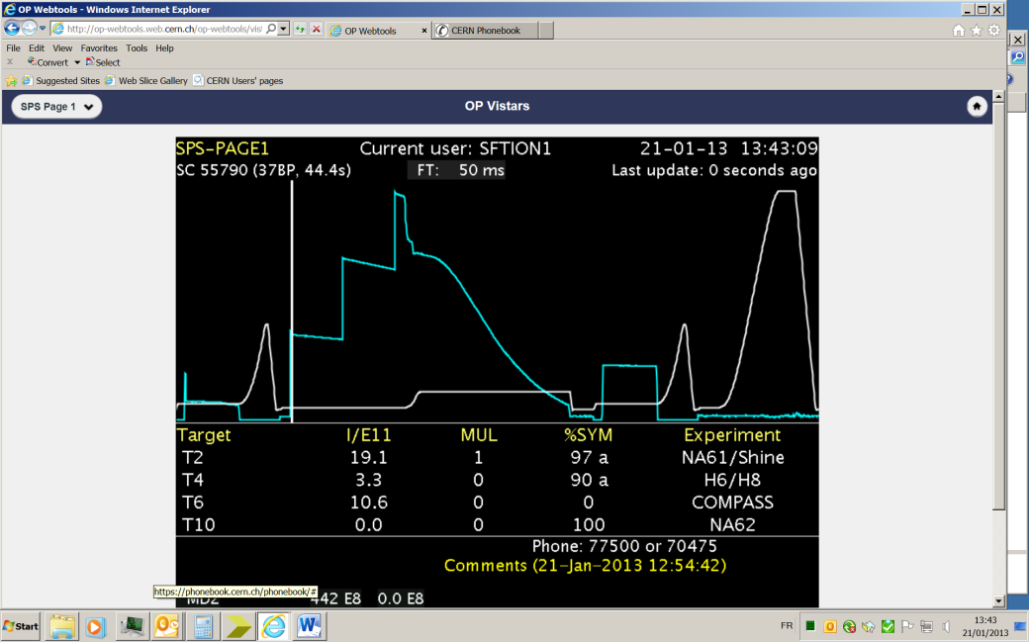
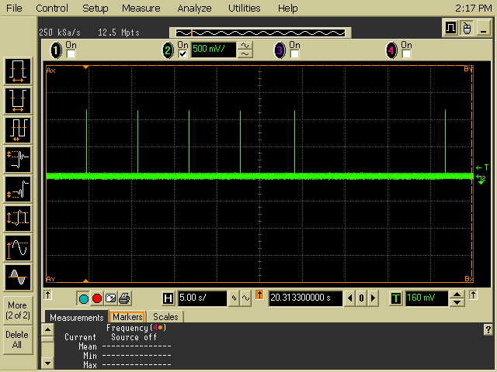
BST- New Design:
SPS : Ions > Problem during injection phase !
SPS Super Cycle
SPS Super Cycle with Ions
Ions injection period
Time interval when the CDR is not locked!
Why? : The RF 200M is active only 12.5 µs over the 23 µs of the SPS rev.
The other 12.5 µs the RF switches to a default freq. (~198 MHz)
=> No BST Message !
=> Bunch-Clock & Turn-Clock from local osc. (not syncro with beam)
Possible solution: Do not use the 40 M clock directly from the RF 200M / 5
=> Modification at the BST Master level ?
CDR Loss of Lock syncro @ RF switching
=> No BST Message for few ms. when no beam !

Slide 9
BST – Future …
BST-Master (BE-CO)
      CPU replacement
      SPS Message restructuration (if needed)
      SPS synchro for ions ?
      New design ?
TTC (Sophie)
      Support (TTCex, vx ,tx, rx)
      New design ?
Optical Network (JJ,Eva, EL-CF)
BST Receiver
    - BOBR (JJ, after 2014 ?)
- New design (JJ, Andrea)

