Slide 1
BI-TB on BST Systems
Introduction (L. Jensen)
Hardware for SPS/LHC masters and receivers (old and new) (JJ. Savioz)
Software for masters and receivers (L. Jensen)
BST systems used for LHC experiments (S. Baron/L. Jensen)
RF signal distribution for SPS and LHC (W. Hofle)
Consolidation ideas for the BST systems (J. Serrano)
Beam synchronous signals for PS (H. Damerau)
Conclusions and outlook (All)

Slide 2
Introduction
Transmission of ‘hardware’ signals (Frev, 40MHz, pre-pulses) + message (LHC: 64 bytes / turn)
Hardware consists of:
  3 central masters:
    SPS
    LHC Beam 1
    LHC Beam 2
  BOBR receivers (+new VFC-based modules)
Main use (BI):
  Acquisition clocks and triggering + time-stamping of BI systems (“DAB64x”) through the BOBR receiver
    BPM, BLM, BRAN, BSRA, BSRT, BCTF ..
    LHC: presently have >130 BOBR devices
Objectives for the meeting today:
  Inform of what’s available today
  Agree on responsibilities (present and future)
  Discuss consolidation plans (SPS/LHC)
  Details concerning PS BST (Heiko)

Slide 3
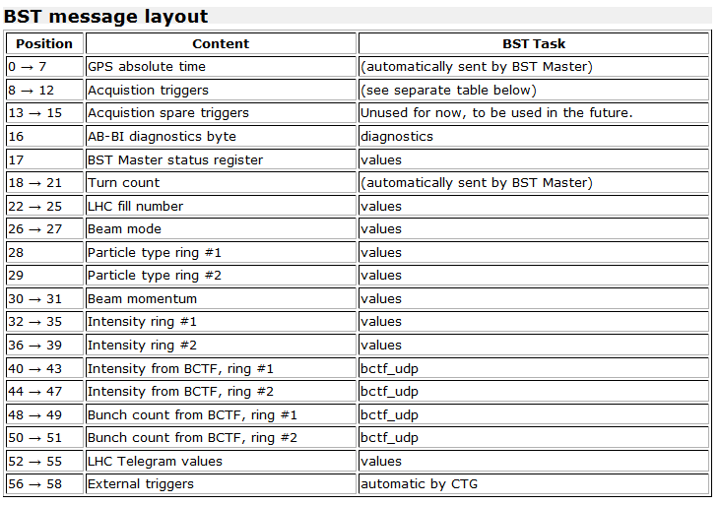
Master Message
LHC Message:
  http://bdidev1.cern.ch/bdisoft/operational/abbdisw_wiki/LHC/BST-config
EDMS document (2008):
  https://edms.cern.ch/document/638899/2.0

Slide 4
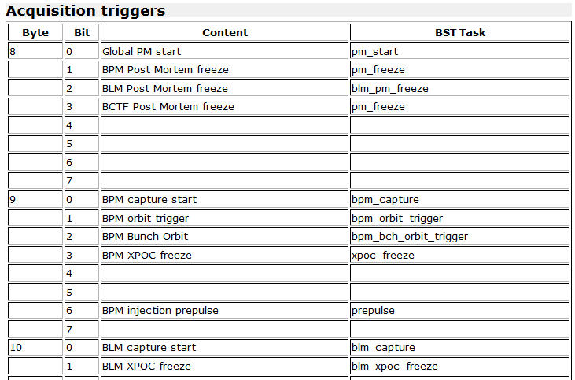
BI acquisition triggers
(defined and used for BPM/BLM)
Allow triggering all distributed systems within n*100ps for timing events on 1msec frame

Slide 5
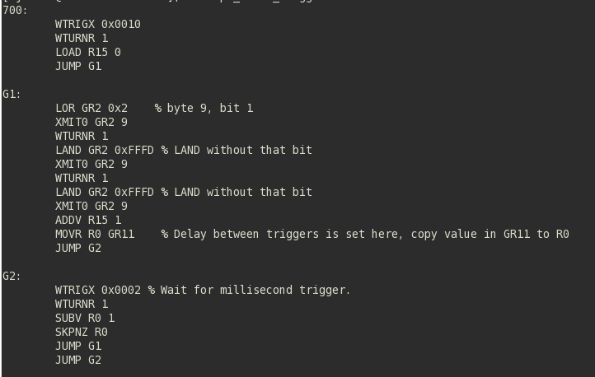
Master software
BST Master project started as collaboration in 2004
  P. Karlsson (BI), D. Dominguez (CO), J. Lewis (CO)
VME hardware clone of “MTG” module -> “BST-CTG” (FPGA micro-controller)
  Tasks with software written in assembler-language, compiled before download
    Global (GR) and per task registers (R)
FESA (2.10) class and BST tasks developed and maintained by BI/SW
  PPC4 OS - port to L865 will likely await 2014
Regular orbit-trigger every “GR11” msec
Initialisation – wait for 1 PPS event
Orbit on bit #2 of byte 9
Count-down

Slide 6
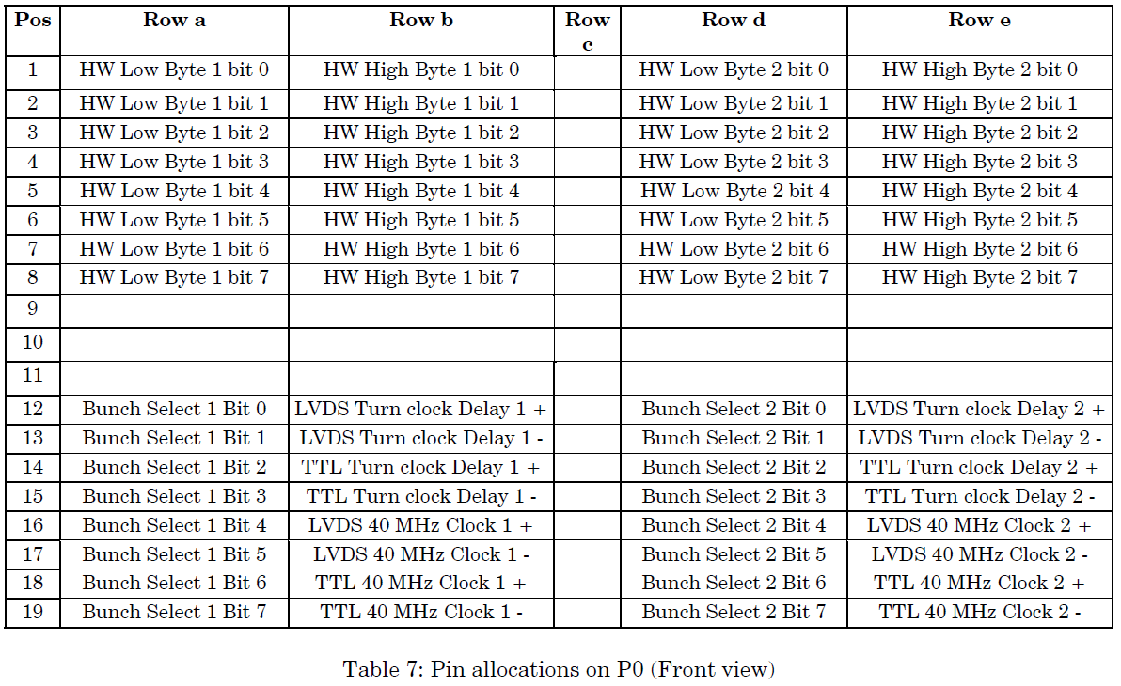
BOBR software
BDI_BOBR hardware-type in CCDB
Device driver for PPC4 and L865 based on ‘dgII’
Handling of two hardware-bytes sent on the BI-only Wiener-crates (P0 lines rows D/E)
VME interrupts based on setup of message byte and bit masks
FESA 2.10 class developed and maintained by BI/SW (ported to L865)

