Slide 1
Beam Synchronous Signals from PS RF Beam Control as Observation Triggers
H. Damerau, R. Steinhagen, J. Emery
BI Technical Board
17 October 2013

Slide 2
Introduction
Significant change of revolution frequency in PS
  10% change for protons
  Factor of 2.7 for Pb⁵⁴⁺
  Phases of beam synchronous signals depend on delays
RF manipulations change number of bunches or position of first bunch
  No marker to specific bunch
Beam synchronous revolution frequency (TREV) or h = 8 (TRF)
  Reproducible phase offsets from cycle to cycle
LHC-type beams after synchronization on flat-top
  All frequencies essentially constant
  Bucket numbering with respect to f_{rev}-marker from SPS

Slide 3
Distributed beam synchronous signals
PS revolution frequency (TREV)
  Square wave, duty cycle depending on source/beam control
  Derived from RF to cavities during acceleration
  Derived from external source (SPS/synthesizer) close to ejection
  Phase with respect to beam depending on:
    User (single bunch, multi-bunch LHC-type beam, etc.)
    RF manipulation, synchronization, ejection bucket number
PS h = 8 (TRF)
  Square wave, ~50% duty cycle
  Generated mainly for triggers to beam transfer elements
‘Fiducial’ frequency for beam transfer (TFID)
  ~20 ns marker, fast rise time
  Common sub-multiple of f_{rev} for sending and receiving machine
  f_{rev,SPS} for PS → SPS, f_{rev,PS}/3 for PS→AD
Convention for extraction of LHC-type beams: 1st bunch at fixed phase with respect to f_{rev,SPS} marker

Slide 4
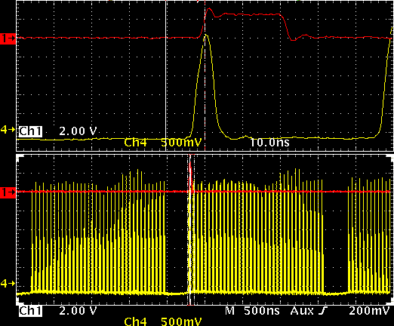
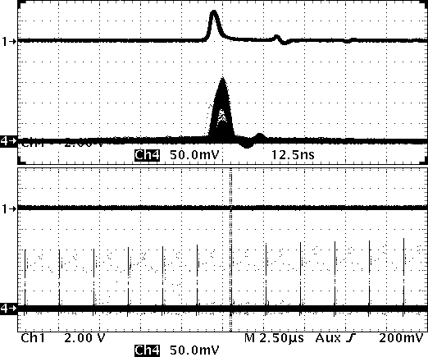

Fixed displays close before ejection
TFID RF train valid for the last ~15-20 ms (LHC-type beams)
Trigger for all ‘fixed’ observations (logging, satellite analysis)?
Requires extra cable connection blg. 353 or 354 → 152 (?)
For all other observations (Tomoscope, BSM, etc.) along cycle: TREV + software based bunch analysis sufficient?
PS ejection video, LHC50 ns
LHCPROBE
f_{rev} marker SPS
1st bunch

Slide 5
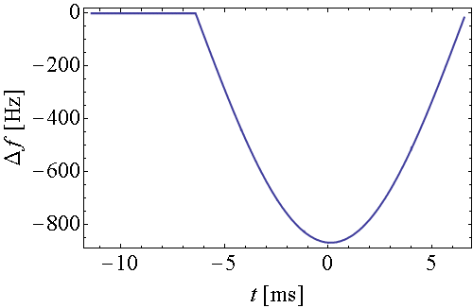
Wire scanners
Bunch-by-bunch wire scanner measurements need beam/bunch synchronous trigger
Measurement time fixed to ~6 ms before ejection
Use of electronics from LHC for tests
  Requires 40 MHz RF in building 368 (next to 353)
Proposal: Distribute beam synchronous 40 MHz (+TFID?)
  Derived from drive signal to 40/80 MHz cavities
  Available during last ~15-20 ms before extraction
  Bunches at reproducible phase from cycle to cycle
  Includes frequency changes for bump compensation
Ejection
Issue with Δf/f ≈ 2·10⁻⁵ frequency excursion for wire scanner acquisition?
40 MHz

