Slide 1
MFT WG8:
Control System & Services.
Activities and responsibilities.
Gines MARTINEZ, Astrid MORREALE, Volodia NIKULIN
for the MFT project

Slide 2
WG8 Activities
LV Power ➔ Astrid Morreale (Subatech)
  Power Supply.
  Power Distribution.
  Power Regulators.
DCS ➔ Kenta Shigaki (Hiroshima)
  DCS Software.
  DCS Hardware.
Cooling ➔ Volodia Nikulin (Gatchina)
  Cooling Plant
  Piping Until A-side of MFT barrel

Slide 3
1.1 Power Supply
Identical to ITS-upgrade.
Needs of MFT detector modest ~300W.
Segmentation in 40 channels of 18W max. 1 digital and analogic channel per half-disk plane.
One crate (4 A3009, 48 channel enough for MFT requirements.
Redundancy? Two or more crates?
Options:
  Sharing with ITS, just additional crates for MFT.
  Replication of the ITS power supply setup.
Backbias voltage (WG4)?
Power supply of Readout Units. Requirements (WG6)?
Astrid Morreale, MFT-TB April 16th 2015

Slide 4
1.2 Power Distribution
Same specification for the MFT LV cables?
40 lines (1 per channel).
Connector on the A-side for the MFT barrel.
LV busbars along the barrel. To be defined (with WG7).
Connectors and distribution lines in the MFT cone. To be defined (WG7 & WG8).
Power distribution for readout units? Which are the needs?
Astrid Morreale, MFT-TB April 16th 2015
Astrid Morreale, MFT WG8 Wiki page, June 2015

Slide 5
1.3 Power Regulators
20 (20) analogic (digital) LV(8V) lines, one (one) per Half-disk plane. 40 lines in total.
4 DC-DC per LV(8V) line. 160 DC-DC converter for the full MFT.
Draft0 of the LVLines-DCDC-ladder mapping has been defined.
Special Power Unit Board for DC-DC converters of Disk#0-2.
DC-DC converters on the PCBs for disk#3-4 (WG6, WG8).
Cooling of the DC-DC converter being defined (WG7 and WG8).
Interlock between DC-DC converter and Read-units (WG6, WG8).
Backbias (WG4)?
Similar DC-DC-ladder mapping as RU maping. Ongoing (WG6, WG8).
Astrid Morreale, MFT WG8 Wiki page, June 2015

Slide 6
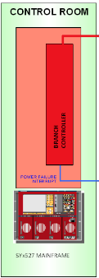

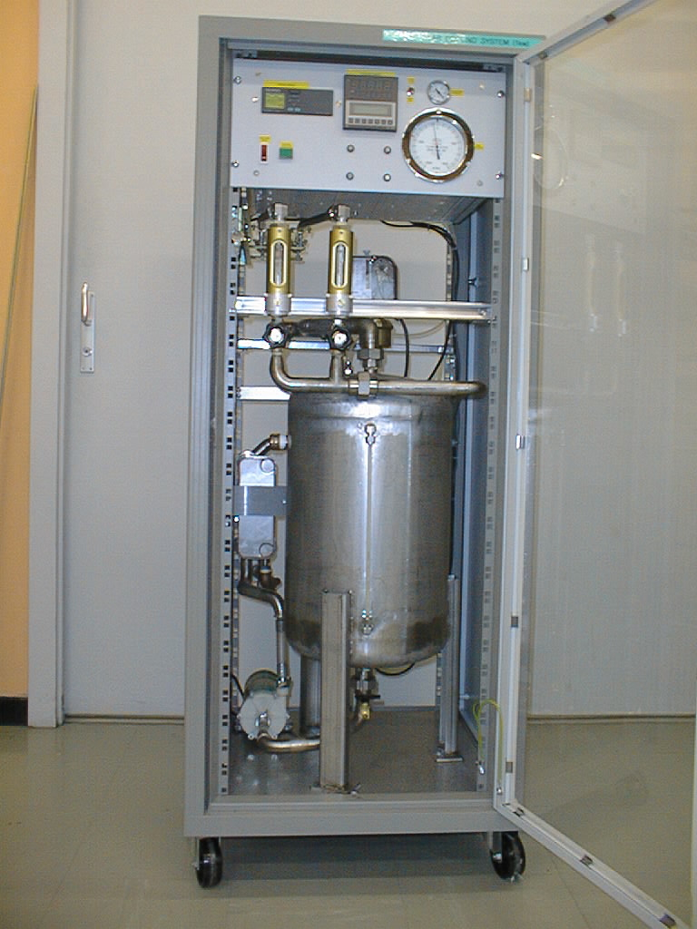
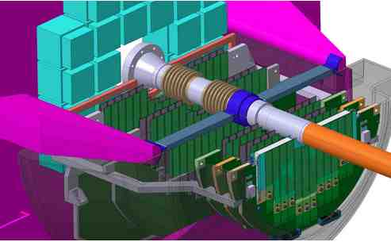
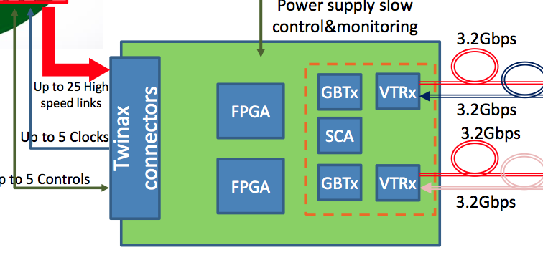
MFT DCS (for discussion)
Power Supply
DCS Software:
  Power Supply
  Cooling Plant
  Detector.
  RU => WG6 ITS?
  CRU => O2?
DCS Hardware
  Probes (temperature, humidity, air flow, …) in the MFT detector. To be defined.
Interlocks
Cooling Plant
DCS
Detector
Readout Unit

Slide 7
Cooling System
MFT Cooling plant emplacement, same as present ITS cooling plant.
About 90m + 90m pipe length between the MFT and the cooling plant.
Leakless water cooling.
Connexion to MFT pipes in the A-side patch panel.
Connexion in the A-side MFT patch panel has to be defined (WG7, WG8). Piping in the MFT detector to be defined (WG7).
Volodia Nikulin, Meeting with ITS people. To be discussed in the MFT-TB.

Slide 8
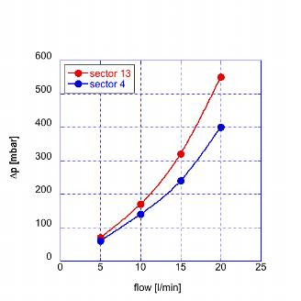
The leakless operation
“Leakless v.2” system
Pout
ΔPdetector
Pin < Patm
It works only if P_{in} < P_{atm}
Not all the loop is under-pressure!!!
ΔP_{detector} vs flow must be known
ΔP_{return} should be calculated
h
ΔP return
ΔP supply
Ptank
Ppump
Volodia Nikulin, Meeting with ITS people. To be discussed in the MFT-TB.
Jose Direito TS/CV/DC, 13.05.2008

Slide 9
ITS cooling plant simplified P&I
P&I stands for
Piping and Instrumentation
The MFT P&I is expected to be very similar ☺
No heaters (as in upgraded ITS)
ITS pipe length (from plant to patch panel) is about 2*90 m (in and out)
Volodia Nikulin, Meeting with ITS people. To be discussed in the MFT-TB.

Slide 10
Leak detection
Each half-disk (2 cold plates) is expected to be connected to separate line.
In case of leak a half-pane should be turned off.
ITS experience: 1 stave leaked during Run-1. Do we need more granularity?
Each line is equipped by flowmeter, 2 temperature sensors (In/Out), 1 pressure sensor (P_{in})
The flow drop in a line indicates leak (air passes through the hole).
Disconnecting the pipes will localize the problem
Volodia Nikulin, Meeting with ITS people. To be discussed in the MFT-TB.

