Slide 1
Module Assembly Machine
MFT plenary meeting
IPNL, 7-8 July 2015

Slide 2
MAM Main features
All machines (proto + series)
  Placement of silicon chips from tray onto HIC Assembly table with an accuracy of ± 5 µm (3σ)
  Check chip edge integrity and pad contamination
  After manual placement of solder balls, inspect amount of solder balls in every contact hole with vision module
  Evacuate HIC assembly vacuum chamber
  Position Laser head above solder balls and solder contacts
  Capture solder joint images
Two machines only (proto + 1x series):
  Placement of silicon chips from tray onto chuck and perform electrical qualification of chip with probe card assy

Slide 3
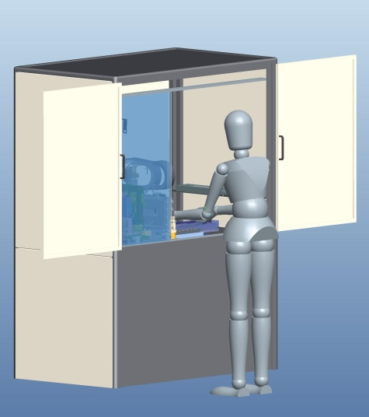
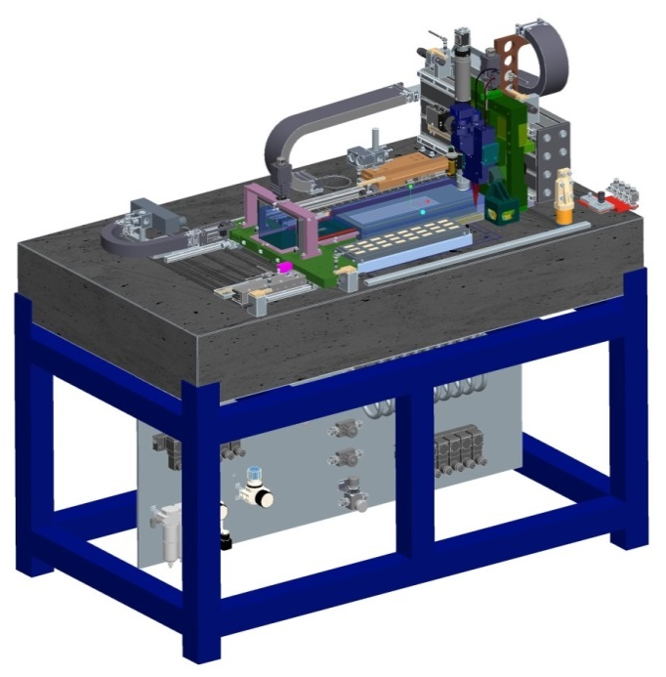
System overview
1600
900
2200
Preliminary
z
y
x

Slide 4
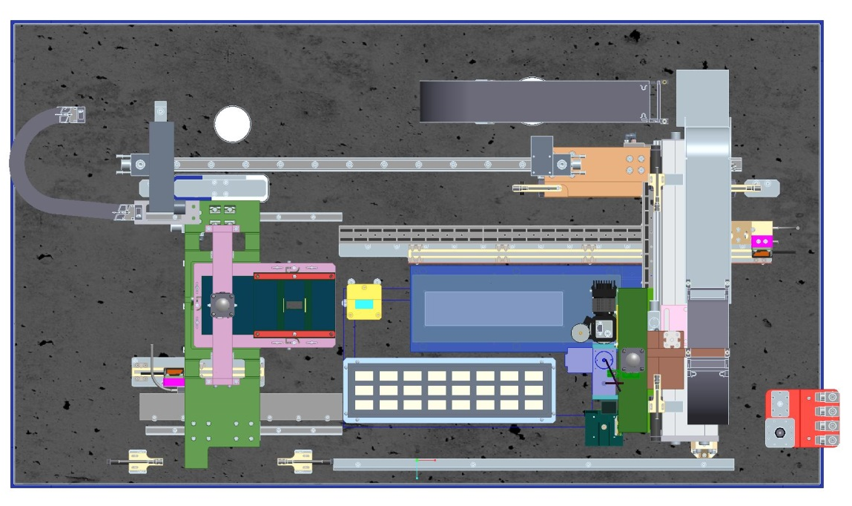
System overview (2)
Top view
HIC Assembly table
Tray
z
y
x
Pre-position chuck
Probe card assy
Chip Handler
Parking position solder ball transfer tool (TBC)

Slide 5
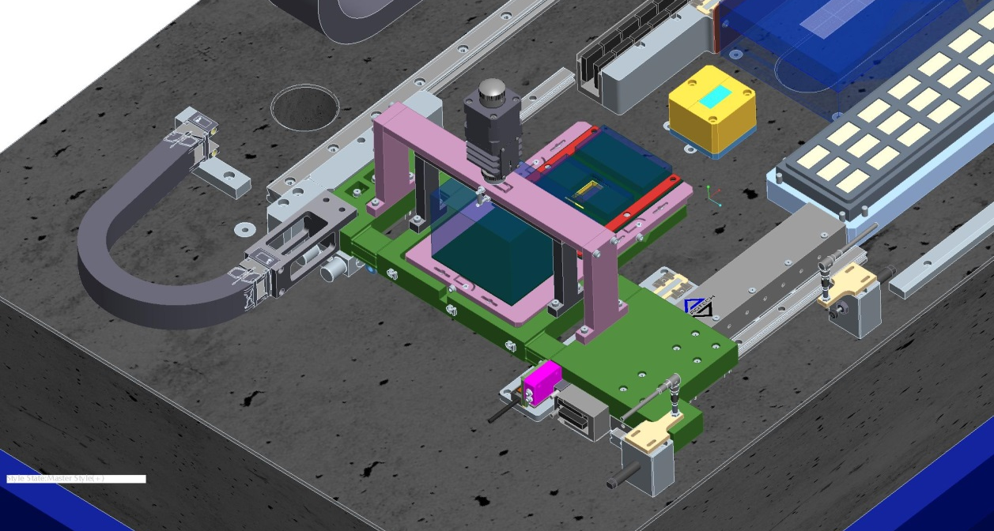
Probe card handler design: Overview
Z actuator
Probe card
Y Motor
Y Guiding
Z Guiding
z
y
x

Slide 6
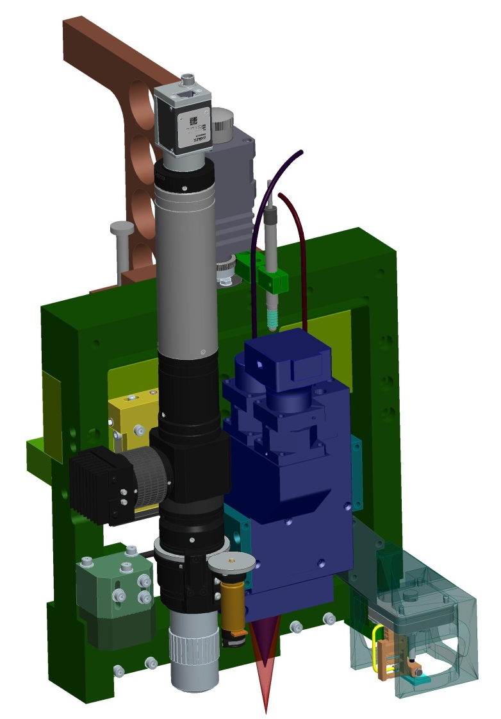
Z stage design: overview
y
z
Z-motor
x
Vision
Flexure guiding
Z-sensor
Laser module
Gripper

Slide 7
Sequence for HIC assembly

Slide 8
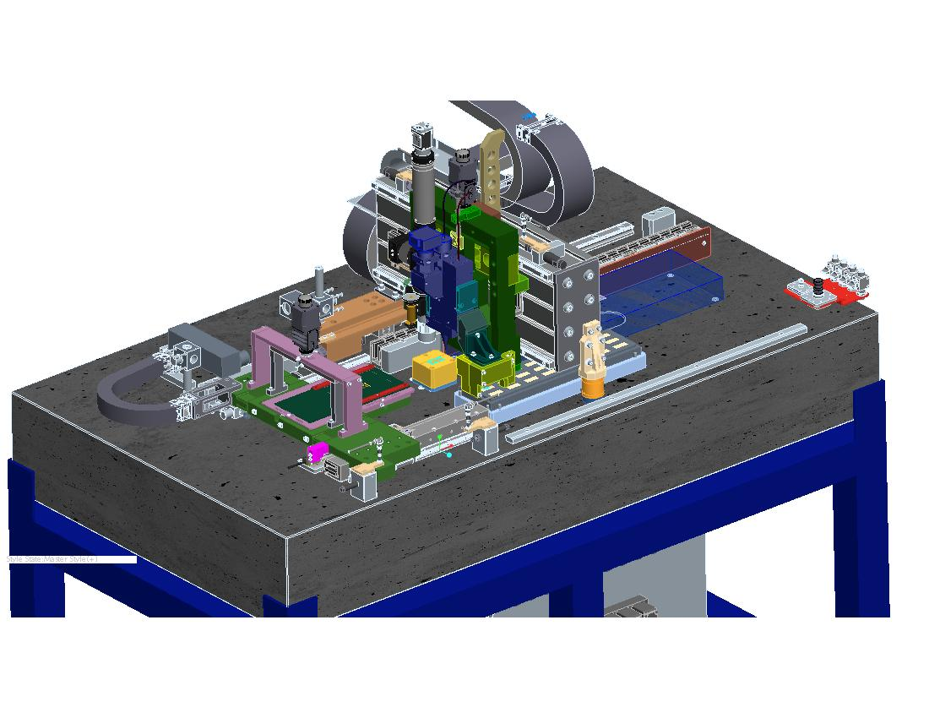
Sequence: Chip pick up from tray

Slide 9
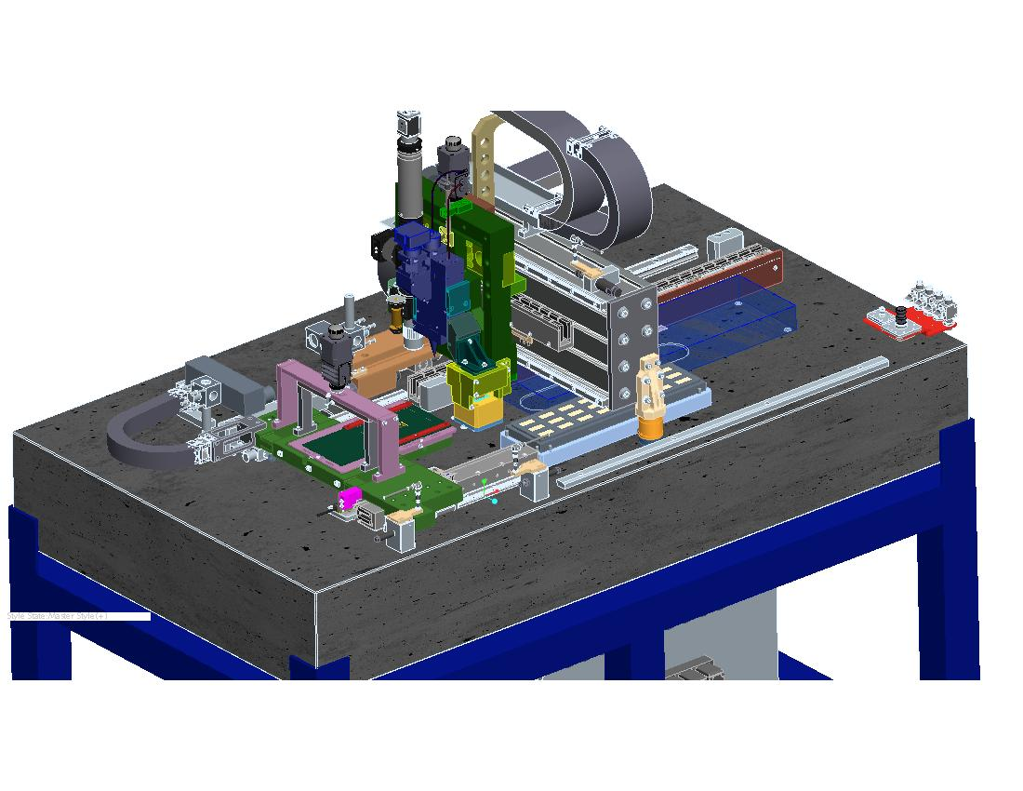
Sequence: Place chip on pre position chuck

Slide 10

Sequence: Measure chip position

Slide 11
Sequence: Reposition chip (optional, TBD)

Slide 12
Sequence: Re-measure chip position

Slide 13
Sequence: Pick up chip

Slide 14
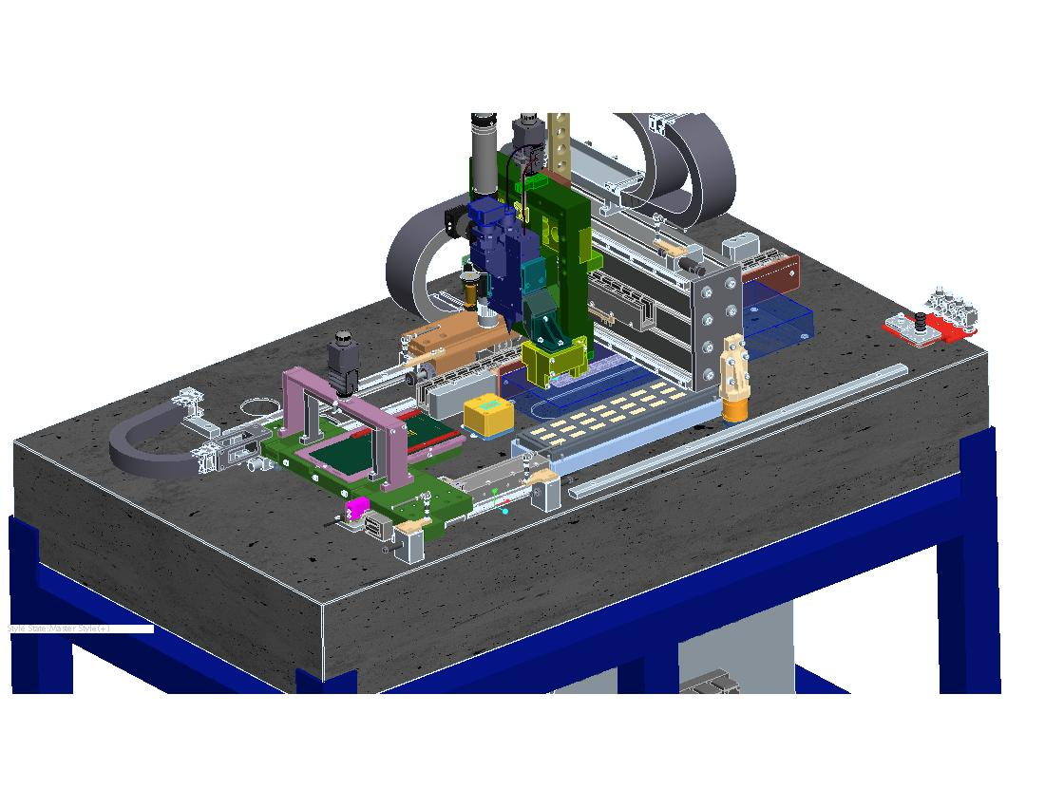
Sequence: Place chip on HIC assembly table

Slide 15
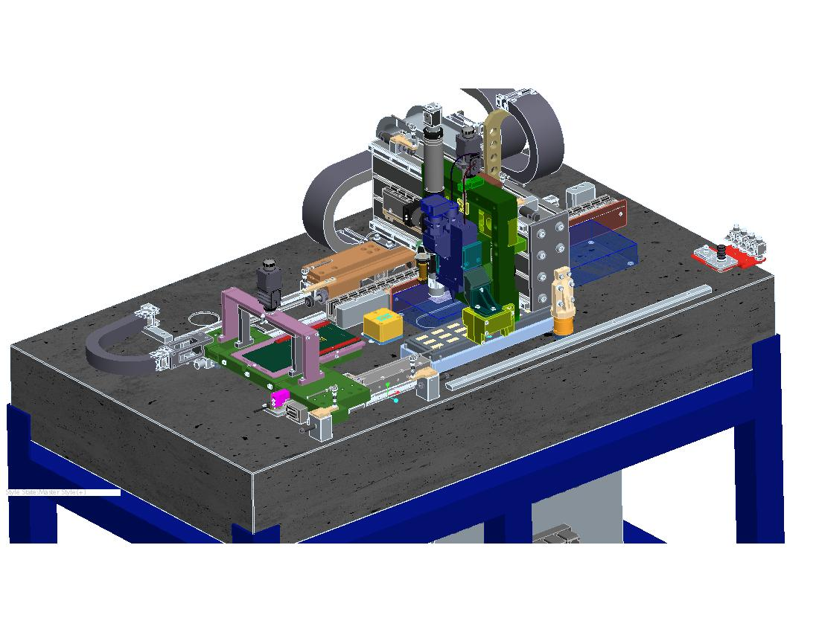
Sequence: Check position chip on HIC assemly table
Also chip inspection:
  Integrity of edge
  Pad contamination

Slide 16
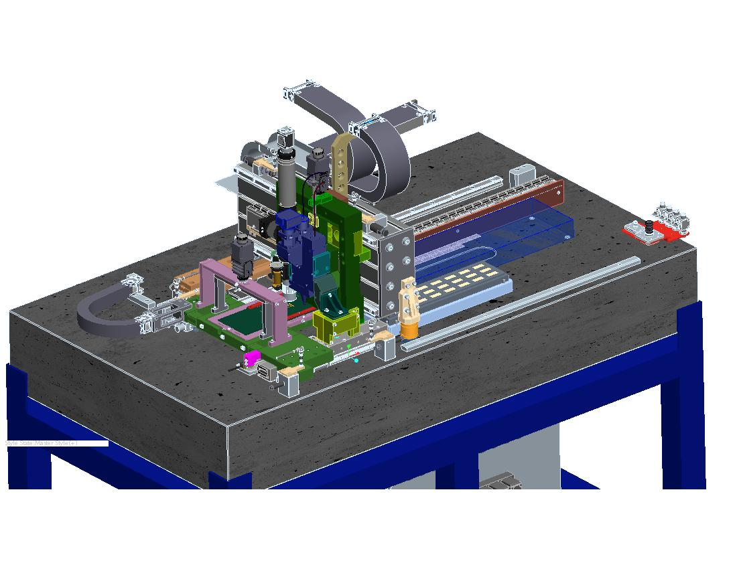
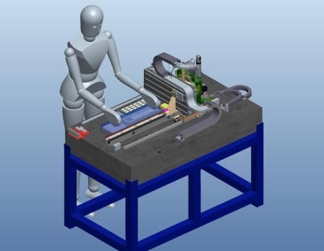
Sequence: place FPC, solder grid and solder balls
Handler in parking position

Slide 17
Sequence: Check solder ball presence
Laser camera

Slide 18

Sequence: Handler in lid placement position

Slide 19
Sequence: place vacuum lid
Handler in parking position

Slide 20
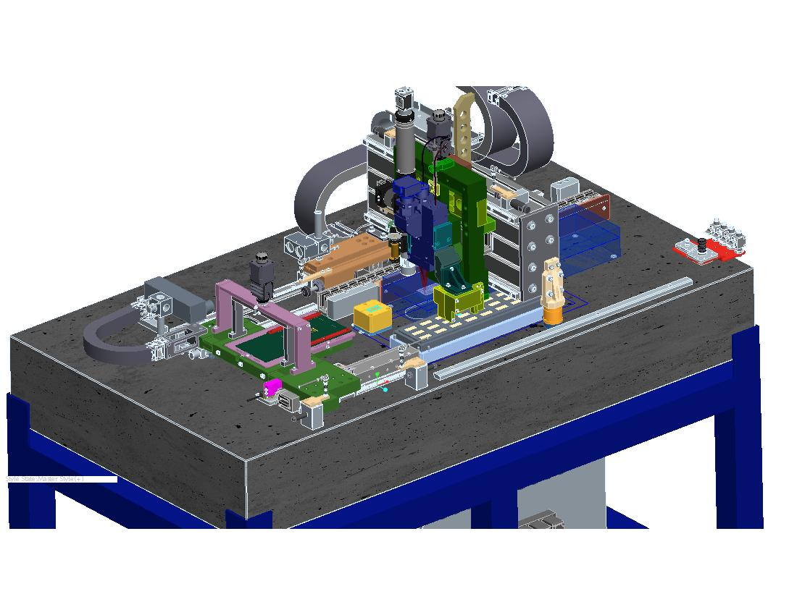
Sequence: Soldering

Slide 21
Sequence: Handler in lid placement position

Slide 22
Sequence: Remove vacuumlid and solder grid
Handler in parking position

Slide 23
Sequence: Check solder connections and chip position

Slide 24
Cycle time OB-HIC assembly
Nr | Description | Time (s)
1 | Chip pick & position (1x reposition on HIC-assembly table) | 533
2 | Chip inspection (edge integrity, contact pad, ball presence) | 9058
3 | Contact soldering (evacuate, solder, vent) | 5211
TOT | Total cycle time (seconds) | 14802
TOT | Total cycle time (minutes) | 247
TOT | Total cycle time (hours) | 4,11
Laser soldering: 3 sec per contact
Handler moving parameters:
  acceleration = 2 m/s²
  speed = 0,1 m/s
No ball corrections, operator overhead or margin accounted for

Slide 25
Cycle time MFTHIC assembly
5 sensor ladder
Nr | Description | Time (s)
1 | Chip pick & position (1x reposition on HIC-assembly table) | 190
2 | Chip inspection (edge integrity, contact pad, ball presence) | 3235
3 | Contact soldering (evacuate, solder, vent) | 1861
TOT | Total cycle time (seconds) | 5286
TOT | Total cycle time (minutes) | 88
TOT | Total cycle time (hours) | 1h 28mn
Laser soldering: 3 sec per contact
Handler moving parameters:
  acceleration = 2 m/s²
  speed = 0,1 m/s
No ball corrections, operator overhead or margin accounted for
TDR time : 2h 34 mn with operator overhead (# 30 mn)

Slide 26
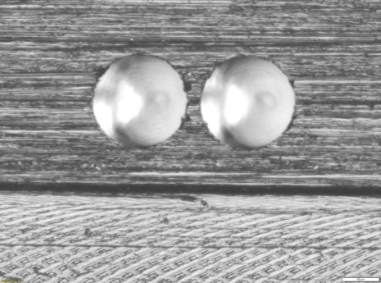
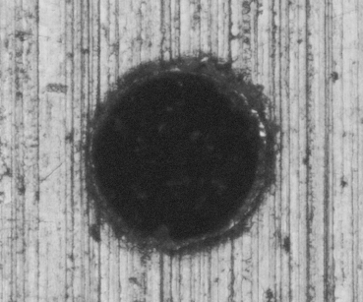
Milestones
Design presentation and approval : 26/06/2015
MFT :
  Design of the assembly table with reference markers ASAP
  A new table in stainless steal with 5µm of flatness and 10 µm of parallelism in September
Delivery of prototypes end of October
Delivery of the other machines between June and September 2016

