Slide 1
ALICE-MFT-WP5-FPC- vidyo-2015-07-08
Flexible Printed Circuit (FPC): old
FPC # | name | sensor | capas | holes | ears | queue | pattern | eyes | Fab Cu | Fab Al | fab stainless | chip cabling | SMD cabling | documentation | goal
1 | meca | 5 LoI type | 30 | 0 | no | no | 0 | 0 | - | 12 CERN (Oct13) | - | ? WG5 | - | ALICE – MFT – FLC13 – R012 – A (12-Dec-2013) | Test manual cutting precision (WG4) Test gluing on a stiffener (WG5)
3 | alim | 5 LoI type | yes | 0 | no | no | 0 | 0 | - | 3 CERN (Dec13) | - | - | 2 Ouestronic (Mar14) | ALICE – MFT – FPC14 – R004 – A (27-May-2014) | Power supply routing constraints (WG4)
4 | lvds | - | - | - | - | - | - | - | - | - | - | - | - | no | Test lvds transmission in aluminium (WG4)
5 | its | 5 ITS TDR type | 82 | 11 | 8 | yes | 0 | 0 | - | - | - | - | - | ALICE – MFT – FPC14 – R001 – A (25-Feb-14) | Verify routability (WG4)
6 | its | 5 ITS TDR type | 82 | 3 | 0 | no | 0 | 0 | - | - | - | - | - | ALICE – MFT – FPC14 – R001 – A (25-Feb-14) | Verify routability (WG4)
7 | tdr | 5 MFT TDR type | 0 | 11 | 8 | no | 0 | 0 | - | - | - | - | - | ALICE – MFT – FPC14 – R001 – A (25-Feb-14) | Verify routability (WG4)
10 | 5alpv0 | 5 alpide-v0 | 2 | 16 | 14 | no | 0 | 0 | - | - | - | - | - | no | Verify routability of alpide (WG4)

Slide 2
ALICE-MFT-WP5-FPC- vidyo-2015-07-08
Flexible Printed Circuit (FPC): actual
FPC # | name | sensor | capas | holes | ears | queue | pattern | eyes | Fab Cu | Fab Al | fab stainless | chip cabling | SMD cabling | documentation | goal
2 | bond | 5 mimosa32-v4 | 10 | 3 | no | no | 0 | 0 | - | 10 CERN (Jul14) | - | ? | ? | no | Test laser cutting (WG4) Test bonding (WG4)
8 | dumy50p | 5 dummy 50pin | 2 | 16 | 14 | no | 0 | 0 | 18+ ACB (Oct 14) | - | - | ? WG5 | 4 WG5 | Submitted 27 March 2015 | Test laser soldering (WG5)
9 | dumy50p | 5 dummy 50pin | 2 | 16 | 14 | no | 0 | 0 | 20 CERN (Nov14) | 0 | - | ? WG5 | ? WG5 | no | Test laser soldering (WG5) Prepare for transmission test in aluminium(WG6)
11 | dumy50p | 3 dummy 50pin | 15 | 13 | 10 | yes | 0 | 8 | 30 ACB (Mar15) | - | - |  | 20 Ouestronic (15) | no | Test assembly on disk (WG5&7)
12 | dumy50p | 5 dummy 50pin | 23 | 17 | 14 | yes | 0 | 12 | 20 CERN (May15) | 0 | - | ? WG5 | 2 Ouestronic (ju15) | no | Test laser soldering (WG5) Test gluing for smd components (WG5)
13b | aspi | 3 dummy 50pin | 0 | 12 | no | no | no | 0 |  | - | 3 Pochoir (May15) | - | - | no | Test laser soldering (WG5)

Slide 3
ALICE-MFT-WP5-FPC- vidyo-2015-07-08
Flexible Printed Circuit (FPC): next
FPC # | name | sensor | capas | holes | ears | queue | pattern | eyes | Fab Cu | Fab Al | fab stainless | chip cabling | SMD cabling | documentation | goal
13 | dumy50p | 3 dummy 50pin | 23 | 3 | 14 | yes | 3 | 8 |  | 21 CERN (oct 15?) | - |  |  | no | Test laser soldering (WG5)
13c | aspi | 3 dummy 50pin | 0 | 12+ | no | no | no | 8 | ? ACB () | - | ? Pochoir () | - | - | no | Test laser soldering (WG5)
14a | 3alpv3 | 3 alpide-v3 | 15 | 3 | 10 | yes | 3 | 8 |  | 7 CERN (oct 15?) | - |  |  | no | Test laser soldering (WG5) Electrical test of full ladder
14b | 5alpv3 | 5 alpide-v3 | 23 | 3 | 14 | yes | 3 | 12 |  | 7 CERN (oct 15?) | - |  |  | no | Test laser soldering (WG5) Electrical test of full ladder

Slide 4
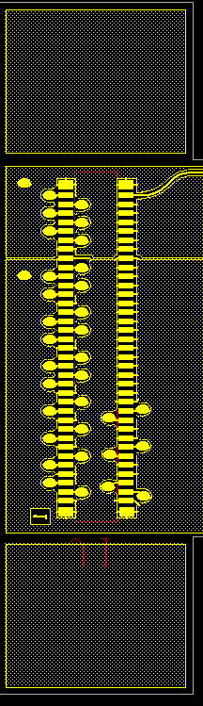
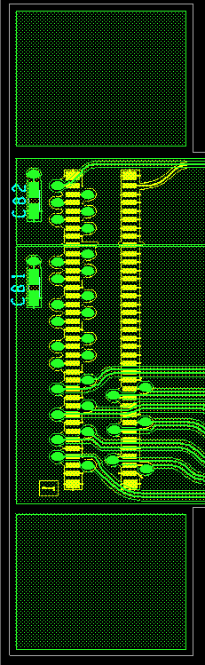
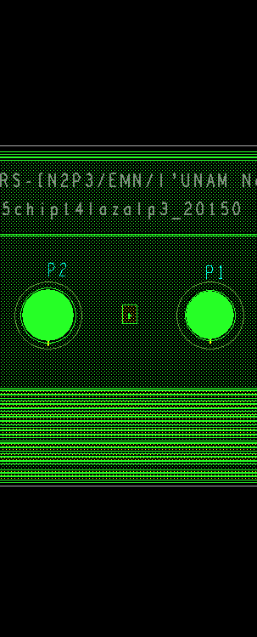
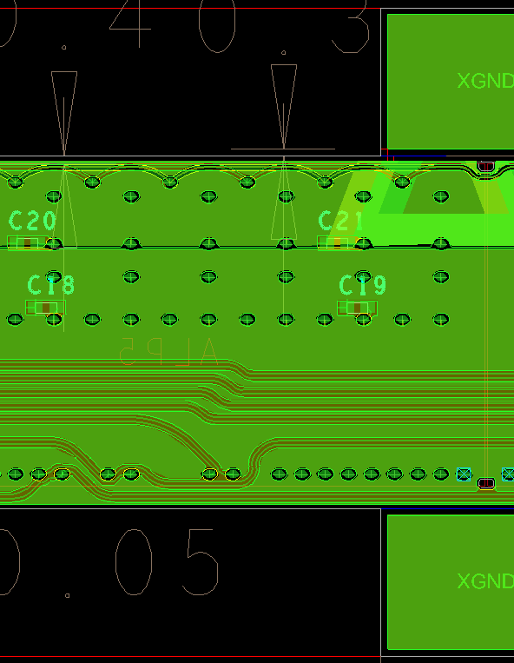

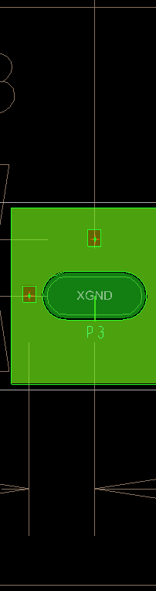
ALICE-MFT-WP5-FPC- vidyo-2015-07-08
Signals, planes, holes, & components on FPC#14
AGND (bottom)
AVDD (top)
Screw hole
Pinhole
Oblong vias for laser soldering
“eye” Opening
PWELL-SUB
pattern
DGND (bottom)
DVDD (top)
pattern
Control bus pair (top)
Clock bus pair (top)
Data pairs (top)
Termination res.
ITS routing constraints: minimum wire width 100µm, minimum gap 100µm, metal 25µm, Kapton 75µm, finished holes 220µm
Footprint of ITS pALPIDE version 3
7 ordered to CERN (aluminium version)
PWELL and SUB lines included
“eye” openings for optical survey of chip position and position on table included

Slide 5
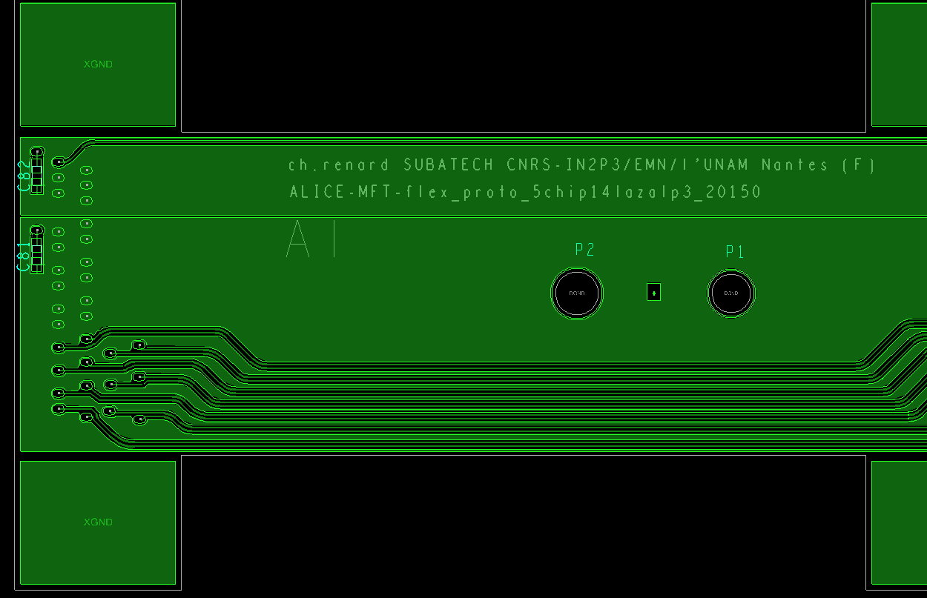
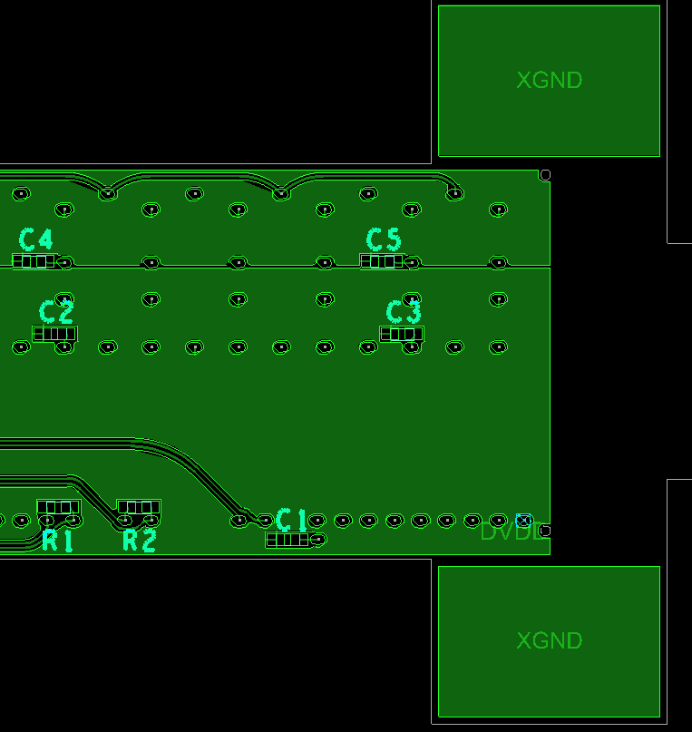
ALICE-MFT-WP5-FPC- vidyo-2015-07-08
2 possible positions for barcode to be engraved on TOP layer of FPC#14

