Slide 1
ALICE - MFT
Status of cooling simulations
Composite simulations

Slide 2
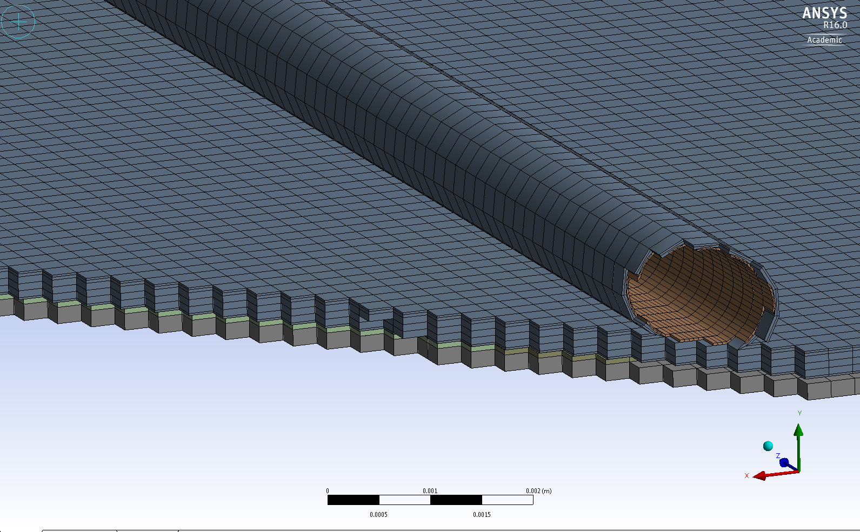
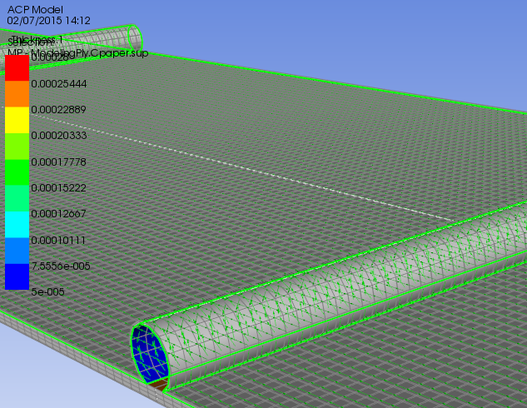
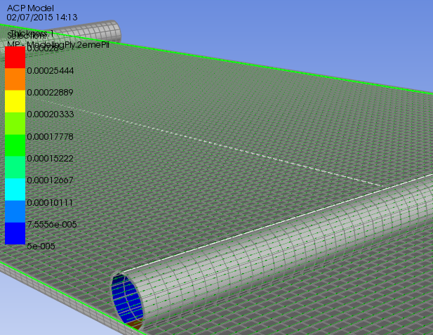
Composite calculations
Ansys ACP simulations
ACP configuration
  Ladder 3/5 sensors model
  Coldplate 0 model
Global mesh
0° ply
90° ply

Slide 3
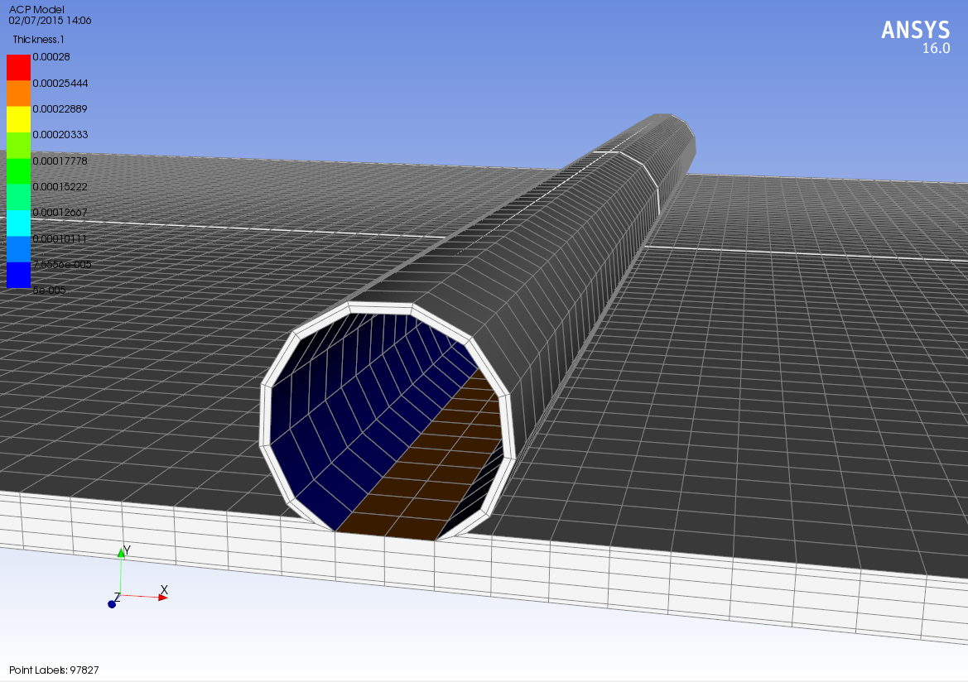
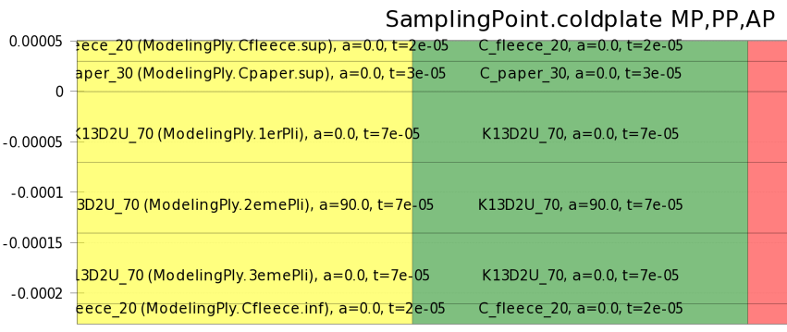
Composite calculations
Ansys ACP simulations
Ply configuration

Slide 4
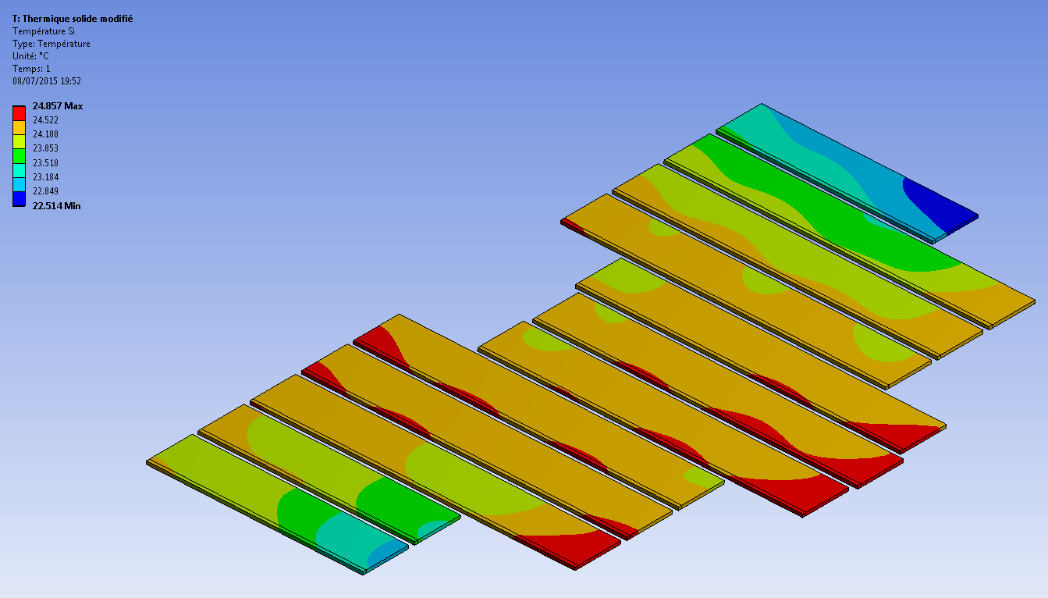
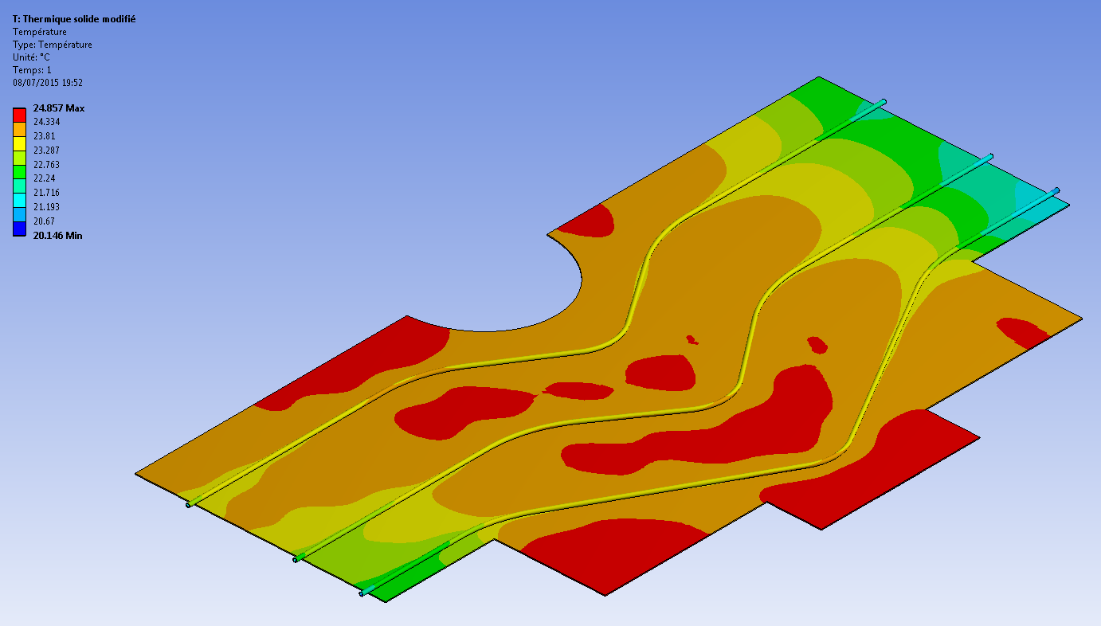
Composite coldplate calculations
Coldplate 0 first simulations
Coldplate model : from catia geometry
  Si : 1 part/ladder
  Coldplate : composite layers
  Pipes : OD 1mm / th. 0.1 mm
  (No flex)
Boundary conditions
  225 mW/chip @ 85% → P = 7.4358 W
  Water @ 20°C / 1 m/s → h = 2200 W/m².K
Firsts results
  Tmax = 24,857°C
  Gradient on all Si = 2,34°C
  Max gradient on a ladder = 1,16°C

Slide 5
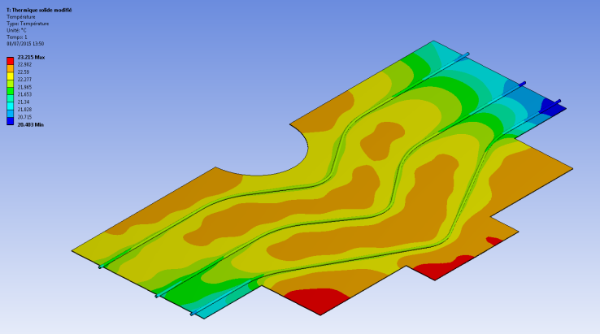
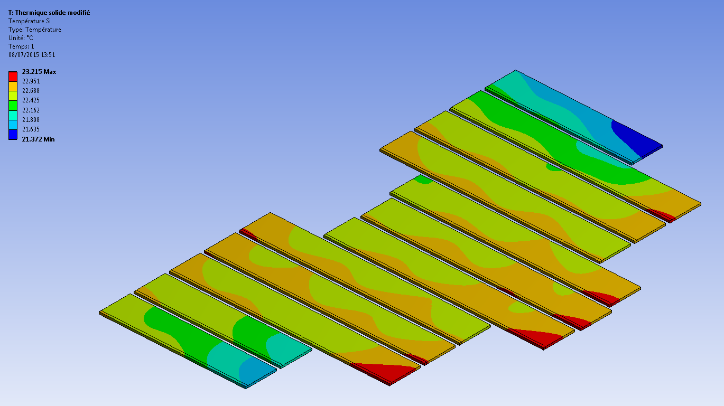
Composite coldplate calculations
Coldplate 0 first studies
Non perfect contact between Coldplate & Si
  No major changes
Influence of Si modelization
  Temperature uniformization begins in Si
Ply orientation (0/90/0 → 90/0/90)
  No major influence on Tmax
  Increase of Tchips & max gradient on ladder (~0.5°C)
Influence of carbon paper (remove ply)
  No major changes for temperature gradient on chips & ladder
  Big increase of Tmax (+8°C)
Pipe material : Polyimide → aluminium (same OD & thickness)
  Decrease of Tmax & ladder gradient (-30% & - 15%)
Very long simulations
No possible geometry change
→ Need to go back to ladder simulation for more complete studies
Aluminium simulation

Slide 6
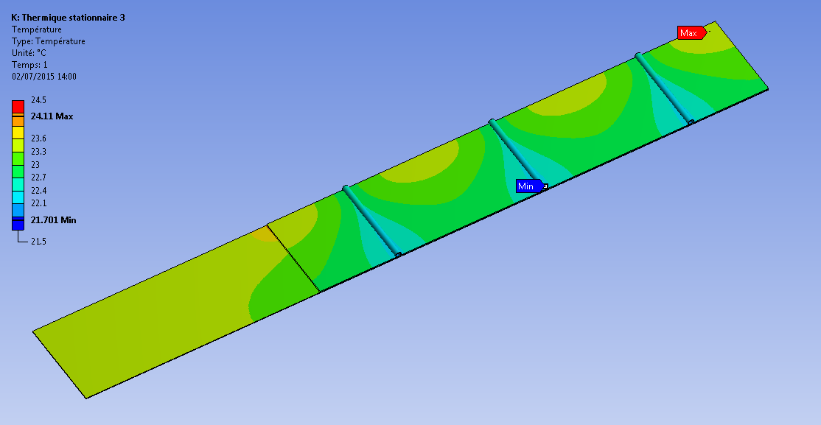
Composite ladder calculations
Parameters studies
Ladder 3 sensors
  Model : Pipe/ composite coldplate / Si / Flex
  3 sensors / 3 pipes in the middle of each sensor
Pipe material
  Influence on Tmax, especially if k is degraded
  Copper (k400) is not better than Aluminium (k150) but just better thermal kapton (MT™ k0,45) is half better
Convection coefficient
  Influence on Tmax, especially if h is degraded
Contacts
  Pipe/coldplate : Light influence on Tmax, only if k is very degraded
  Coldplate/Si: Light influence on Tmax&chip gradient, especially if it’s degraded
Total power
  -20% on P (225→175 mW) : -20% on Tmax and chip gradient

Slide 7
Composite ladder calculations
Composites studies
Ply orientation
  0/90/0 is still better,
  45/0/-45 is quite the same → might be better for entire coldplate
Carbon paper influence
  We gain on chip gradient by adding layers of C paper (-25% with bottom layer)
  We lose a lot by removing it : Tmax >30°C chip gradient +30%
  Even ply of carbon fleece (structural ply – k=1) is useful (without : Tmax > 36°C)
Coldplate material
  K13D2U (k800) → K13C2U (k600) or M55J (k150)
  + 1°C on Tmax
  + 1°C (33% !!) on chip gradient

Slide 8
Composite ladder calculations
Geometrical studies
One pipe removed (3 sensors ladder)
  Remove external or internal pipe is equivalent
  Remove middle pipe is less worst
  Tmax > 30°C & chips gradient ~4°C (x2.5 !!)
  Maybe new orientation 45/0/-45 could improve results
  Straight pipes configuration appears to be very difficult :
    still an option ?
    Not with present configuration (↗ pipe diameter, more C paper ?)

Slide 9
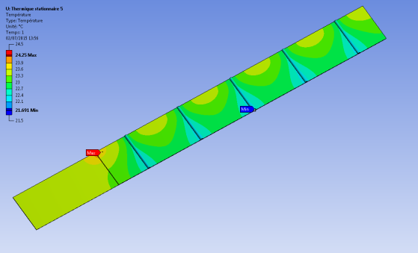
Cooling calculations
Next steps
Continue ladder studies
  More pipe configuration studies (5-sensors ladder)
  Coupled pipe/ply orientation studies
  …
  Important parameters for coldplate simulations
Recalibration with ladder thermal tests

