Slide 1



MFT – WG7
Mechanics and cooling
MFT plenary meeting in Lyon
Outline:
Disk and cone mechanical design.
Ladder first thermal tests.
Status of Cold plate prototype.
Interface Control Drawing (ICD).
Questions and comments.
G. Bouvet, J.M. Buhour, A. Bonnevaux, S. Fresneau, M. Guillamet, G. Guilloux, P. Le Ray, E Schibler
Jean-michel.buhour@subatech.in2p3.fr
09/07/2015

Slide 2
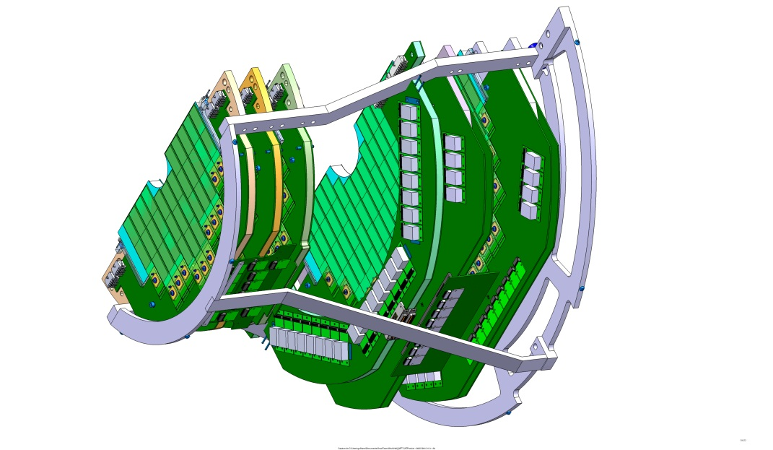
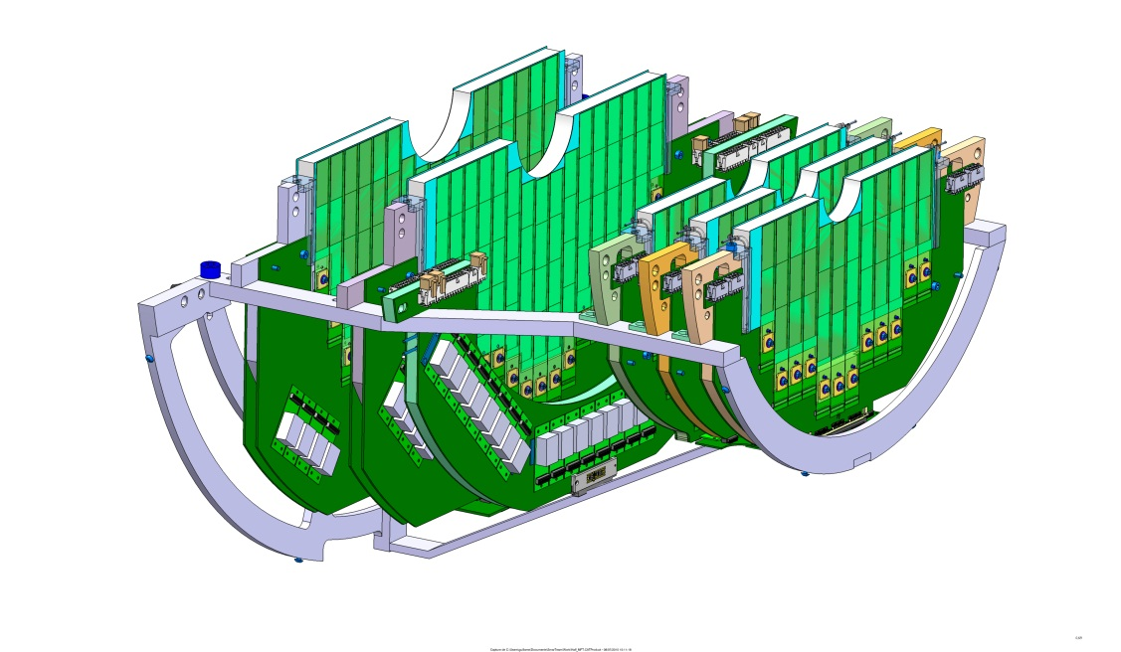
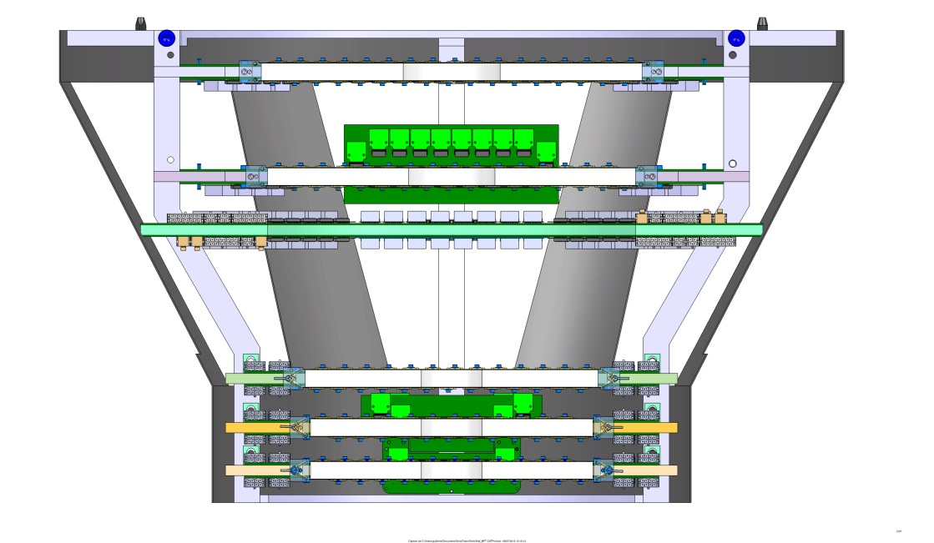
Disk and cone mechanical design.
Disk and cone general view.
* On going detail design of the disks and the PCB.
* First sketch of the cone.
Next steps:
- Disk support prototype (sept15)
- Studies of the cables integration inside cone.
09/07/2015

Slide 3
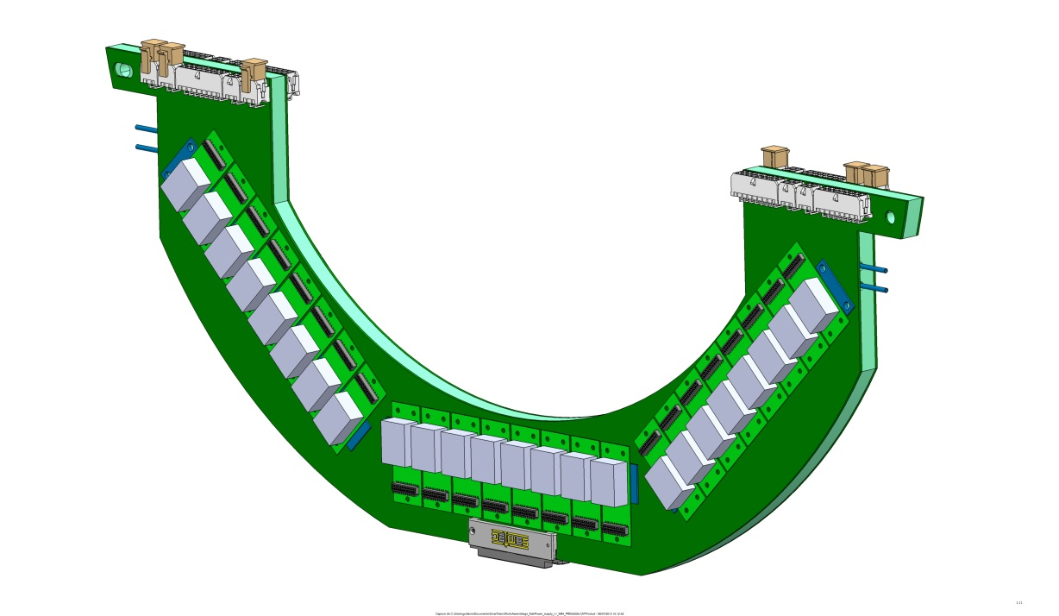
Disk and cone mechanical design.
Power Supply Unit (PSU)
On going detail design of the PSU.
Some changes sheduled: DC/DC separated in groups of 4, new models of connectors.
09/07/2015

Slide 4
Ladder first thermal tests.
ThermoCouple
Thermal camera
Tc recorder
HIC
Power unit
Water pipe
Cold plate
Pomp and chiller
Diagram of the sheduled test

Slide 5
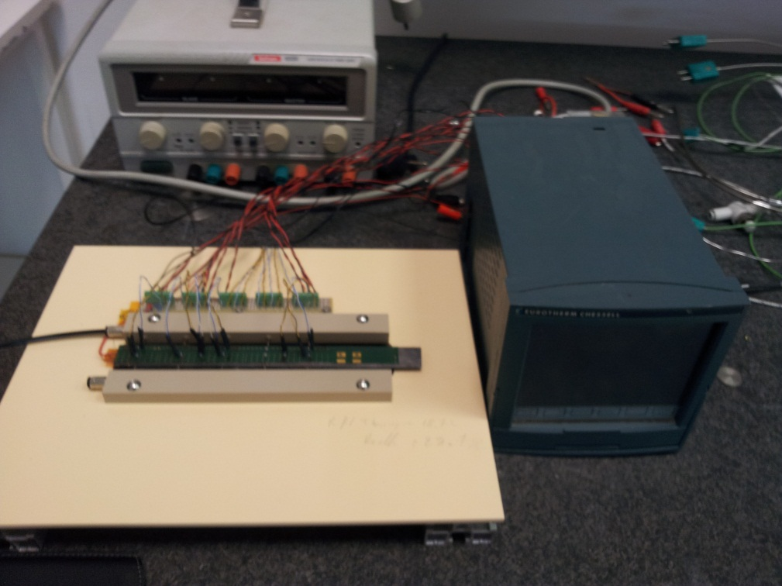
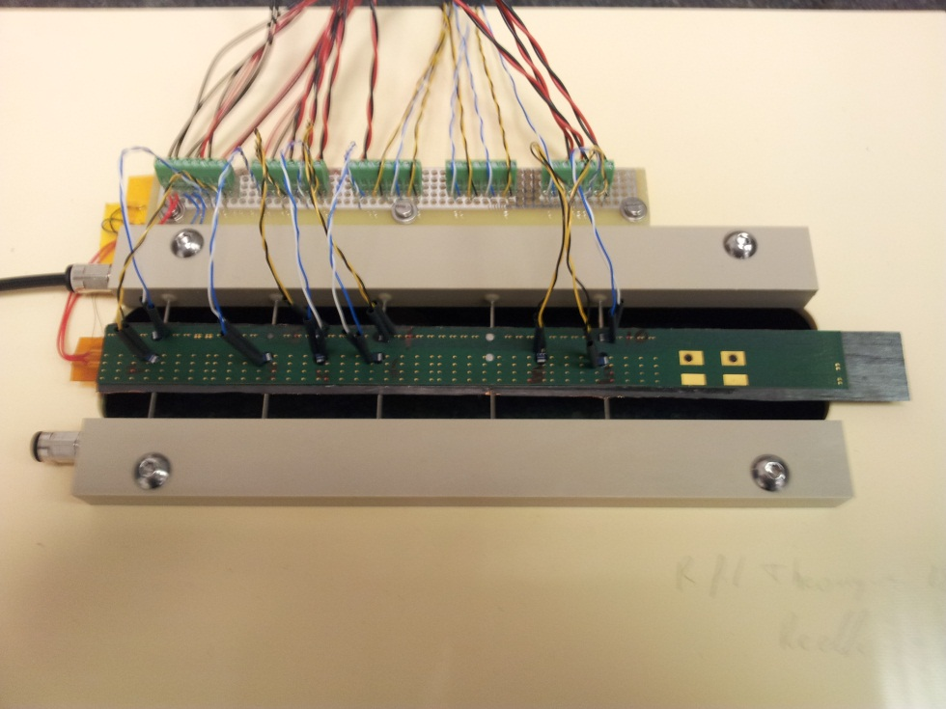
Ladder first thermal tests.
First results:
Water flow temperature: 25°C
Room température 26°C
Max température:33°C
Min temperature: 27°C
Water speed: 1m/s
More detailed tests sheduled in July15
Sensors temperature will decrease with colder water.
Test setup:
K13D2U cold plate
Power: 169mW (analog) 956 mW (digi)
10 probes PT100
1 recorder 12 ways

Slide 6
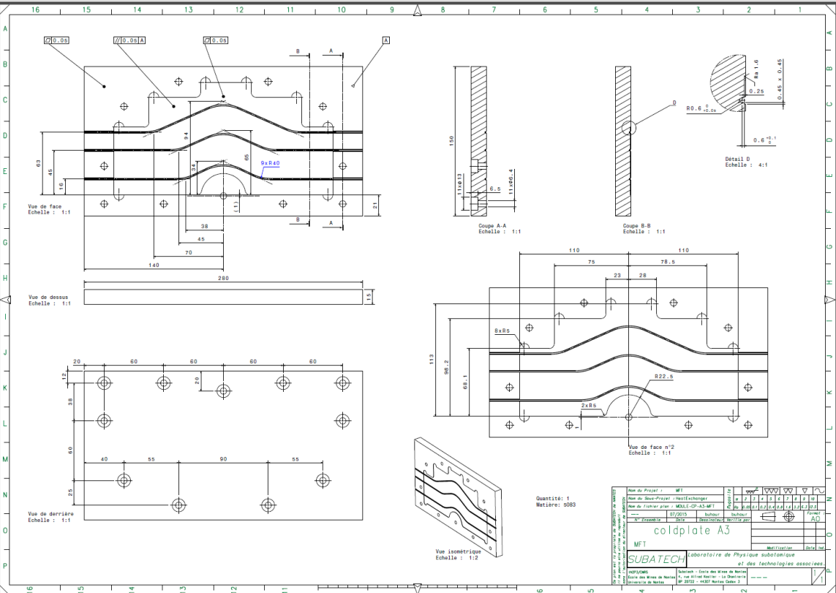
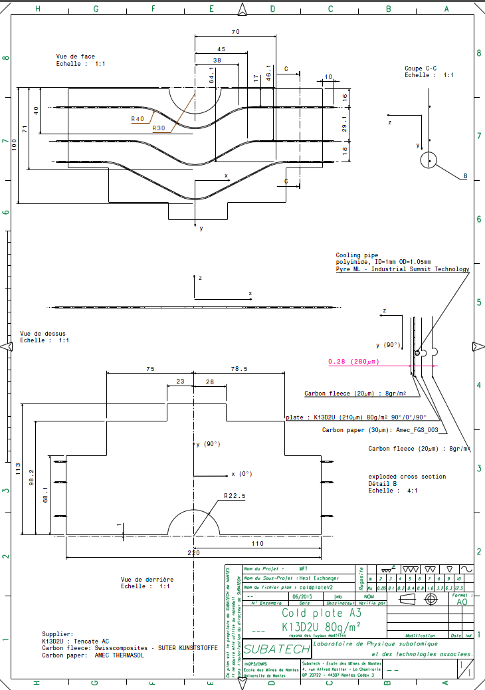
Status of Cold plate prototype.
Cold plate and mold drawing done, send for advice to CERN.
* Return expected before the end of July.
* Manufacturing of the mold sheduled in Nantes (material available, pay attention to the technician’s holidays)
* Deadline of coldplate manufacturing up to CERN
K13D2U available from French supplier (AIC, Nantes). Roughly 15 Keuros for the total coldplate serie production (minimal quantity issue).

Slide 7
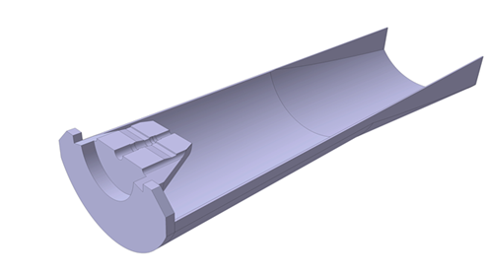
Interface Control Drawing (ICD).
What is the status?
New maximum volume alowed for MFT furnish by Corrado (end of June15)
=> Ongoing check of Interface.
=> Barrel Patchpannel => Alain.
=> Cone/disk => Meriadeg (with Cyrille).
Goal :
* Accept CERN ICD (difficult, main issue on disk00).
* Propose a new ICD (MFT ICD).
* Try to negociate with ALICE Team to have some additionnal room for disk00.
Define MFT ICD before the end of July.

Slide 8
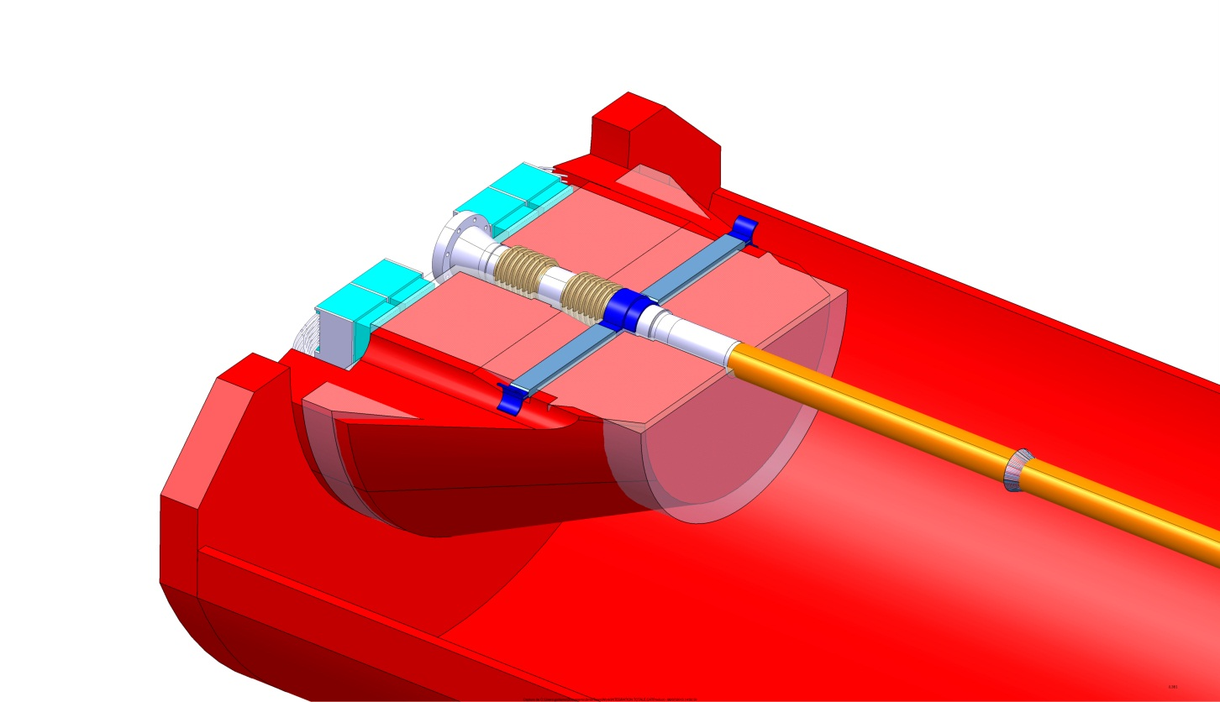
Interface Control Drawing (ICD).
Modification possibles
Modification not possibles now
Modification possibles
Somes details:
In red : CERN ICD
In pink MFT ICD
Small changes of the diameter of the cone.
Small move of the disks (1 to 2 mm along the beam pipe, have to be check with other WG).
Displacement of disk04 (6 to 12 mm)
Main issue is the disk 00 and its mother board, we have to do our best to decrease MFT ICD in this area.
=> decrease external diameter of the disk.
=> decrease size of the PCB, size of the mother board.
=> shorten the tail of the HIC.
=> decrease size of mechanical support (of disk and motherboard).
We have to be carefull! : Services aren’t still put on the cone, we don’t have a lot of room now (twinax ,busbar,water pipe)

Slide 9
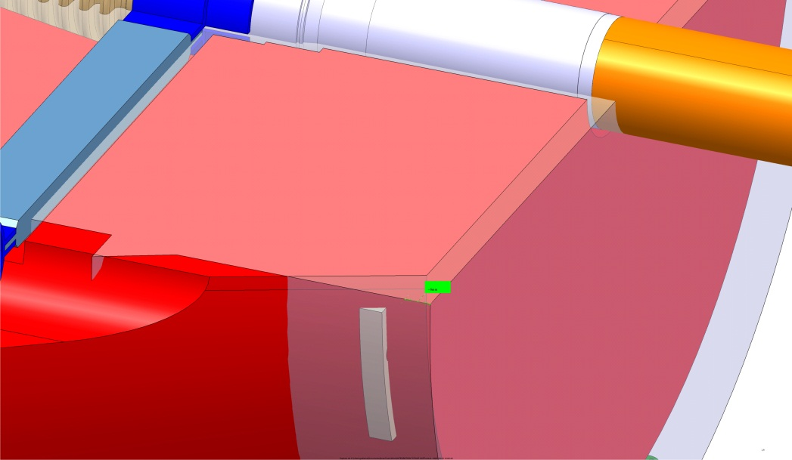
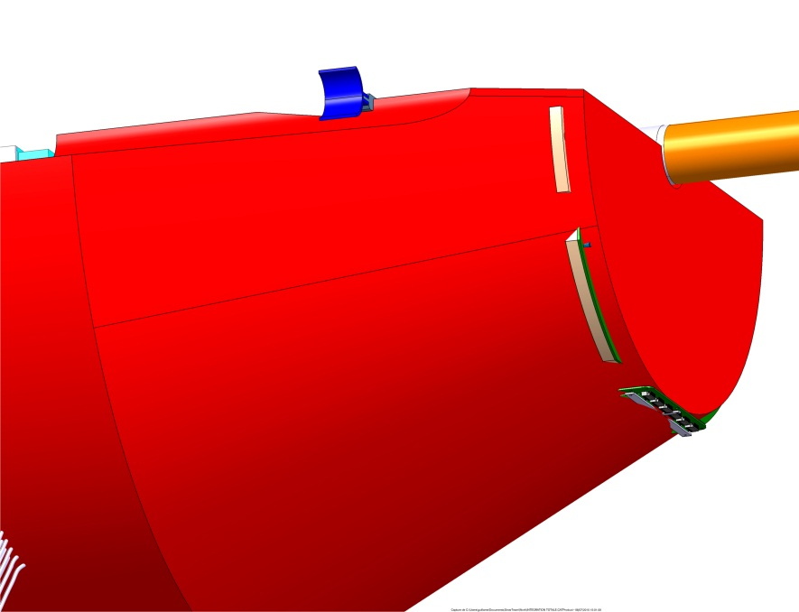
Interface Control Drawing (ICD).
Disk00 support
Disk00 area
Disk00 and mother board, without mechanical support and cables

Slide 10
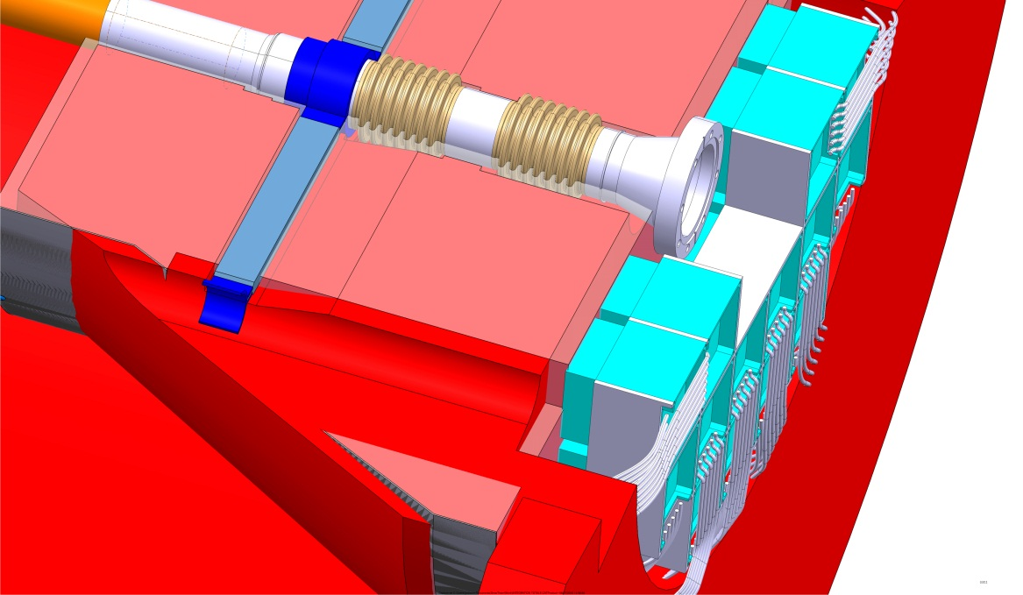
Interface Control Drawing (ICD).
Disk movements
Disk 02 and 03 small move (1 or 2mm)
Disk04 move (6 to 12mm)

Slide 11
MFT – WG7
Mechanics and cooling
MFT plenary meeting in Lyon
Thank you
Questions and comments.
G. Bouvet, J.M. Buhour, A. Bonnevaux, S. Fresneau, M. Guillamet, G. Guilloux, P. Le Ray, E Schibler
Jean-michel.buhour@subatech.in2p3.fr
09/07/2015

