Slide 1
Test beam results of 3D detectors based on scCVD and pCVD diamonds
Felix Bachmair on behalf of the RD42 collaboration
VCI 2016, 18th February 2016

Slide 2
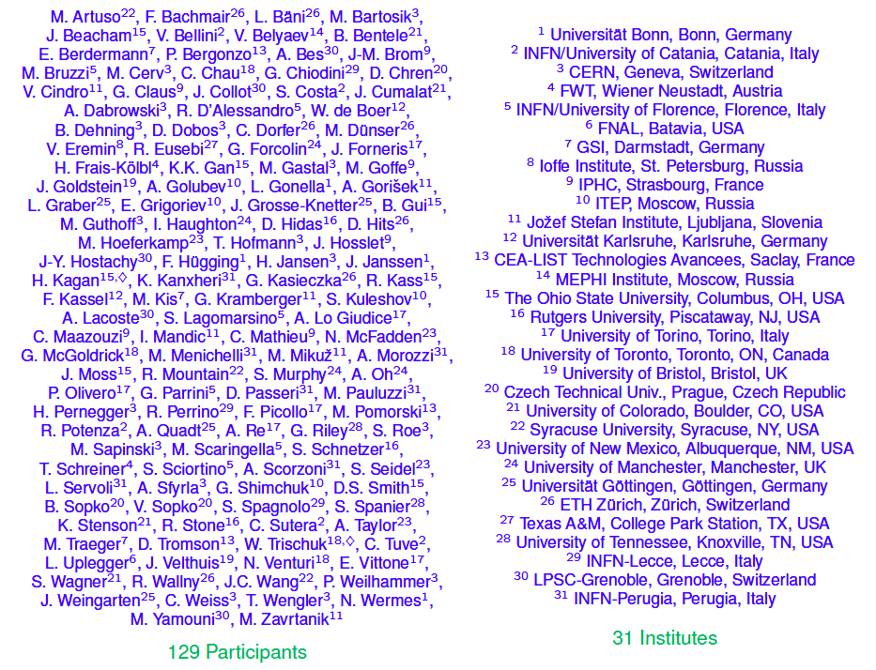
The RD42 Collaboration
Notes:
Working on the Development of CVD Diamond Tracking Detectors for Experiments at High Luminosity
Improvement of pCVD and scCVD material with the suppliers
Testing the radiation hardness of highest quality pCVD and scCVD diamonds
Develop diamond pixel modules useful at the LHC.
Industrialize the module process.
Perform beam tests with diamond strip and pixel detectors.
Continue to develop pCVD (poly-crystalline Chemical Vapor Deposition diamond)
and scCVD (single crystal) material.
• Expand sensor grade manufacturing capability for use at LHC.
• Test radiation hardness of highest quality pCVD and scCVD material

Slide 3
Overview
Diamond as a sensor material
  Newest developments in chemical vapor deposition (CVD) diamonds
3D diamond detectors
  Single-crystalline (sc)CVD diamond
  Polycrystalline (p)CVD diamond
Summary & Outlook

Slide 4
Why diamond?
advantages of diamonds w/r/t silicon
  large displacement energy
  large bandgap
  high thermal conductivity
there are some disadvantages though
  Large bandgap
  Size of diamonds (scCVD)
  Radiation hard
  less leakage current & noise
  less cooling, good heatspread
  less signal
  R&D: Material more expensive than Si

Slide 5
Diamond Manufacturers
In the past diamonds via DDL from ElementSix (De Beers)
  DDL out of business, now directly via ElementSix
Two new suppliers
IIa-Technologies
  Right now: high quality scCVD
  In the future: pCVD
II-VI Incorporated
  High quality pCVD
  Finished detector parts typically reach 275 - 300 μm charge collection distance
Notes:
Add d’Bears/E6/DDL
II-VI Cooperation
----- Meeting Notes (22/09/15 16:20) -----
why is ccd figure of merrit?
title ?

Slide 6
3D diamond detectors

Slide 7
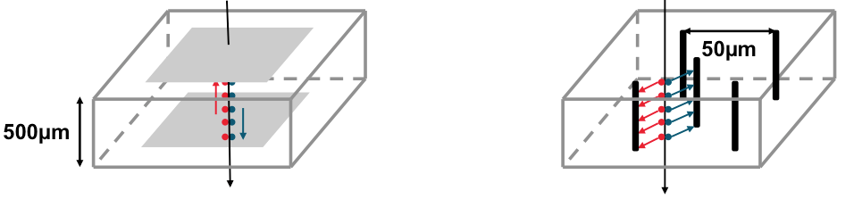
3D diamond detectors
  Supported by
  US DoE Grant DE-SC0010061,
  ETH Grant 45 12-1,
  Swiss NF Grant #20FL20_147466,
  Royal Society Grant UF120106.
Improve charge collection by reducing the drift distance of the charge carriers
Tested Cell Sizes: 150 x 150 μm
Drift distance shorter than in planar (< 100 μm vs. 500 μm)
Comparable to mean free path of charge carriers in irradiated diamond
150 µm
Notes:
Production by University of Manchester
----- Meeting Notes (22/09/15 16:20) -----
laser phase transission diamond -> conductive diamond like carbon
supported by top right corner

Slide 8
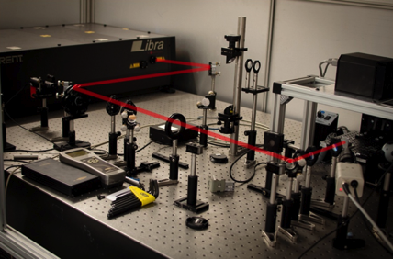
Fabrication
Poster by Steven Murphy:
Laser processing in 3D Diamond Detectors
Using a femto second laser
phase transition of diamond into a combination of
  diamond-like carbon,
  amorphous carbon
  graphite
Notes:
At Manchester University
PICTURE LASER Beam goes through the diamond moves upwords
Describe the Process
run with plexi glas
Wavelength = 800 nm
Repetition rate = 1kHz
Pulse duration = 100 fs
Spot size = 6 μm
Pulse Energy:
E = 1 – 23 μJ/pulse
Φ = 1 – 30 J/cm²
20 mum per second --> 30 sec/ column
TODO: SPOT SIZE, CHECK PARAMETERS

Slide 9
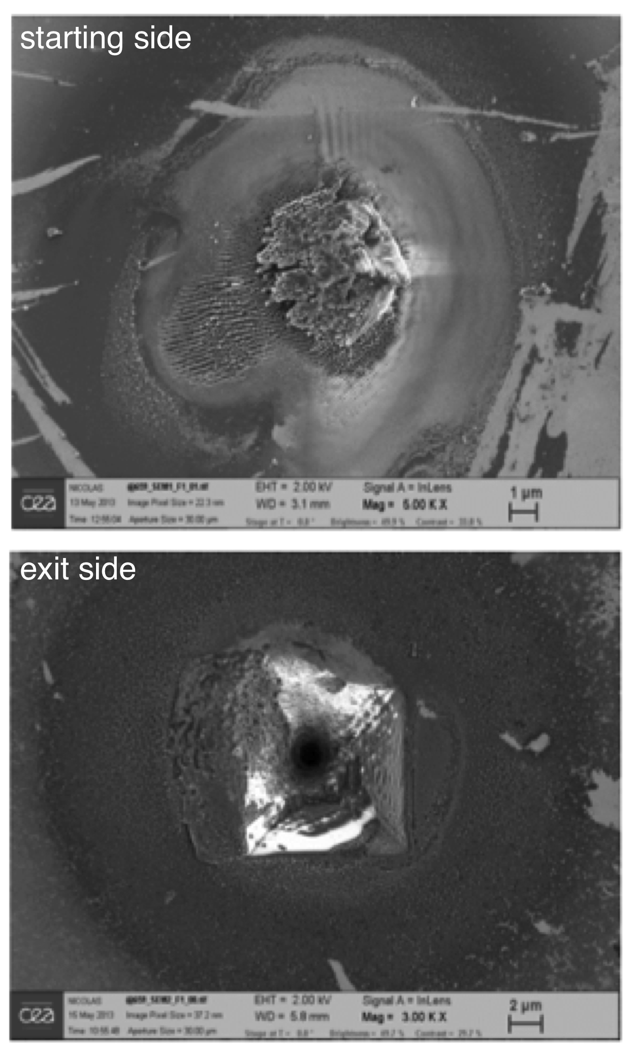
Fabrication
Using a femto second laser
phase transition of diamond into a combination of
  diamond-like carbon,
  amorphous carbon
  graphite
“bump”
“crater”
Notes:
In Manchester
run with plexi glas
Wavelength = 800 nm
Repetition rate = 1kHz
Pulse duration = 100 fs
Spot size = 6 μm
Pulse Energy:
E = 1 – 23 μJ/pulse
Φ = 1 – 30 J/cm²
20 mum per second --> 30 sec/ column
TODO: SPOT SIZE, CHECK PARAMETERS
PICTURE LASER Beam goes through the diamond moves upwords

Slide 10
Conducting Columns - Resistivity
Resistance: 45 kΩ & Electrode Diameter: 6 μm
➔ Conductivity: 0.29 ± 0.1 Ωcm for a typical electrode
Notes:
Measurment with probe needles
----- Meeting Notes (16/02/16 14:30) -----
Resistivity Graphite: 9.8–41 µΩm = 9.8 *100 mu Ohm cm = 0.98 mOhm cm
Graphite: 3 - 60 x 10-5 ohm m
0.29 1e-2 ohm m = 2.9e-3 ohm m

Slide 11
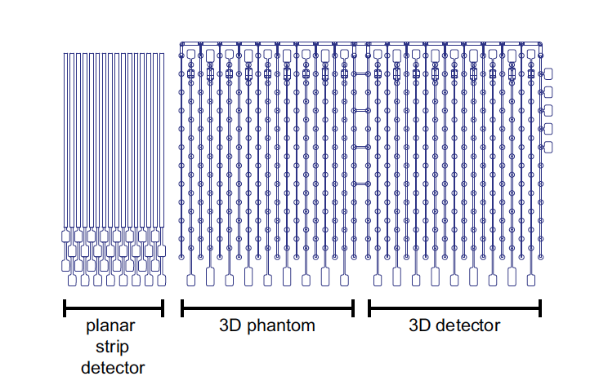
Fabrication – Mask Layout
Three different detector regions on one diamond sensor for comparison
  strip pitch 50 μm
  Bias: 500V
  3D Cell size: 150 x 150 μm²
  Bias: 25V
Notes:
differentiate planar
Planar Top & Bottom Electrode
3D only TOP Electrode
1. 2D/Planar with a Backplane
2. Pure Surface Device
3. Surface + 3D Electrodes
----- Besprechungsnotizen (19.06.13 15:15) -----
Ohio: Titanumium, platium, gold
----- Meeting Notes (16/02/16 14:30) -----

Slide 12
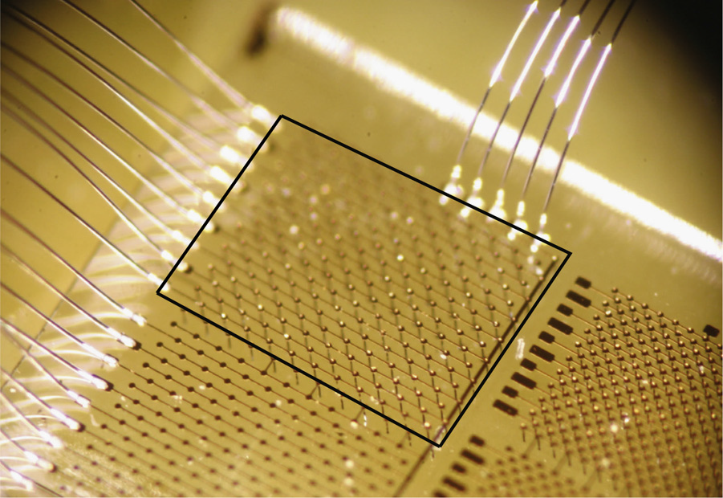
Fabrication
Cr – Au Metallization for contacting – Wire bonding of sensor
Notes:
----- Besprechungsnotizen (19.06.13 15:15) -----
Ohio: Titanumium, platium, gold

Slide 13
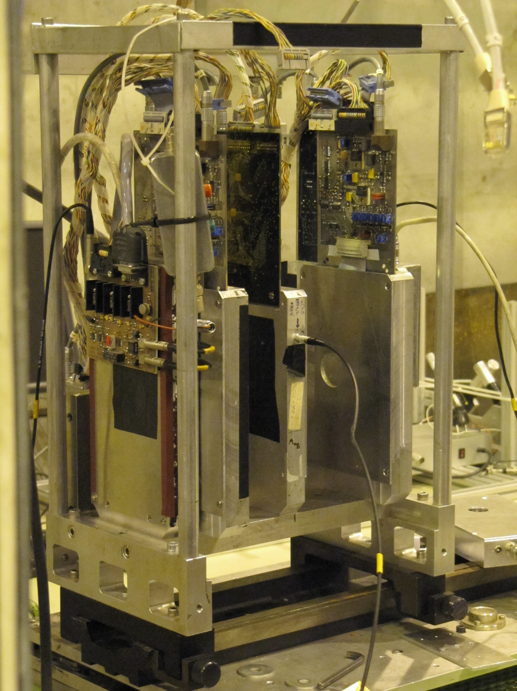
Test Beams at CERN
H6 Beam Line at CERN
  120 GeV/c protons
Strasbourg Telescope for Tracking
  4 X + 4 Y Silicon Reference Strip Detectors
  Resolution: < 5μm at the DUT
Tested
  scCVD: Autumn 2012
  pCVD: Autumn 2015
Notes:
----- Besprechungsnotizen (19.06.13 15:15) -----
Ohio: Titanumium, platium, gold

Slide 14
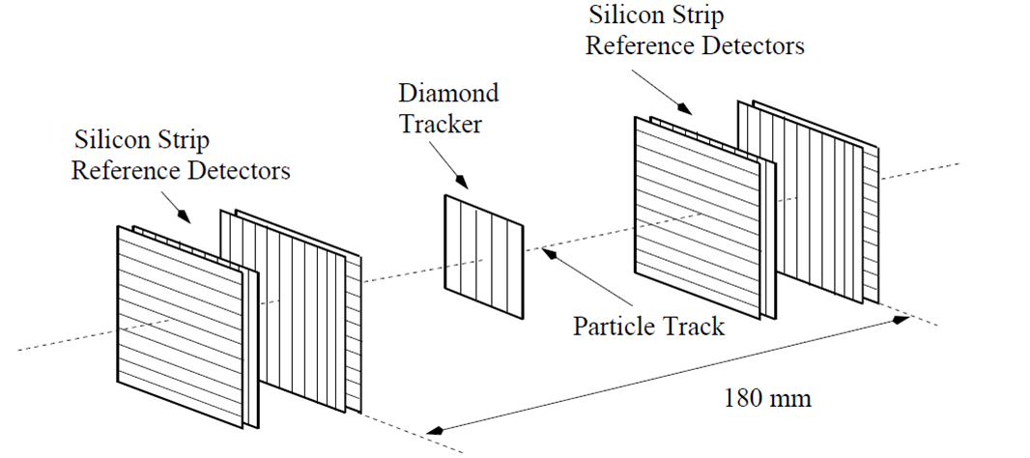
Test Beams at CERN
H6 Beam Line at CERN
  120 GeV/c protons
Strasbourg Telescope for Tracking
  4 X + 4 Y Silicon Reference Strip Detectors
  Resolution: < 5μm at the DUT
Tested
  scCVD: Autumn 2012
  pCVD: Autumn 2015
Notes:
----- Besprechungsnotizen (19.06.13 15:15) -----
Ohio: Titanumium, platium, gold

Slide 15
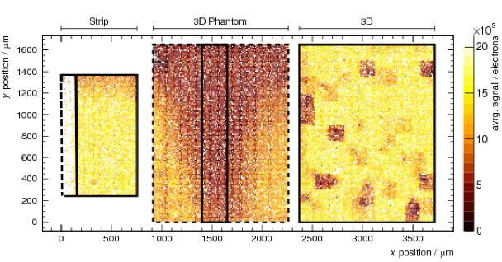
Results
  strip pitch 50 μm
  Bias: +500V
  3D Cell size: 150 x 150 μm²
  Bias: +25V
scCVD results published in NIM A 786 (2015) p97
Notes:
Describe the plot in more detail

Slide 16
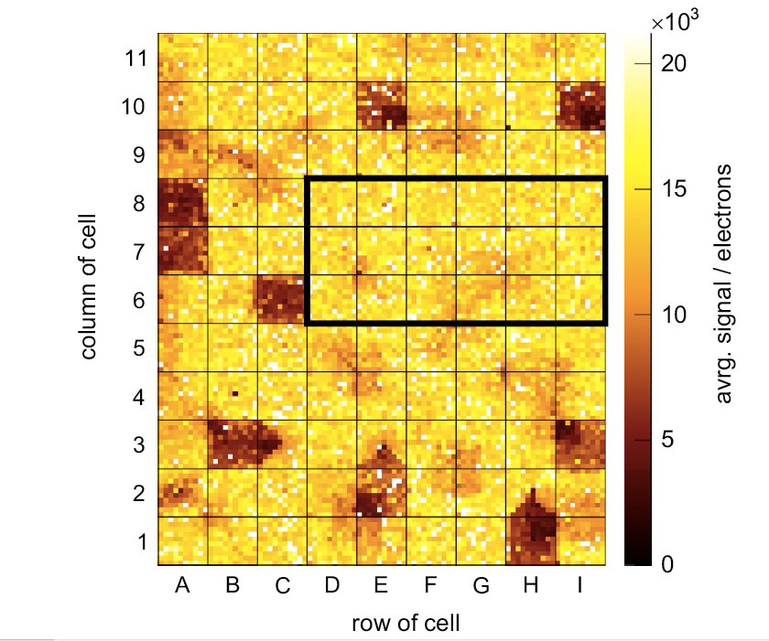
3D diamond detectors
Missing charge around ~9 broken readout columns
  In agreement with other measurements
See effects of missing bias columns

Slide 17
3D diamond detectors
Missing charge around ~9 broken readout columns
  In agreement with other measurements
See effects of missing bias columns

Slide 18
3D diamond detectors
Missing charge around ~9 broken readout columns
  In agreement with other measurements
See effects of missing bias columns

Slide 19
3D diamond detectors
Missing charge around ~9 broken readout columns
  In agreement with other measurements
See effects of missing bias columns

Slide 20
3D diamond detectors
Missing charge around ~9 broken readout columns
  In agreement with other measurements
See effects of missing bias columns

Slide 21
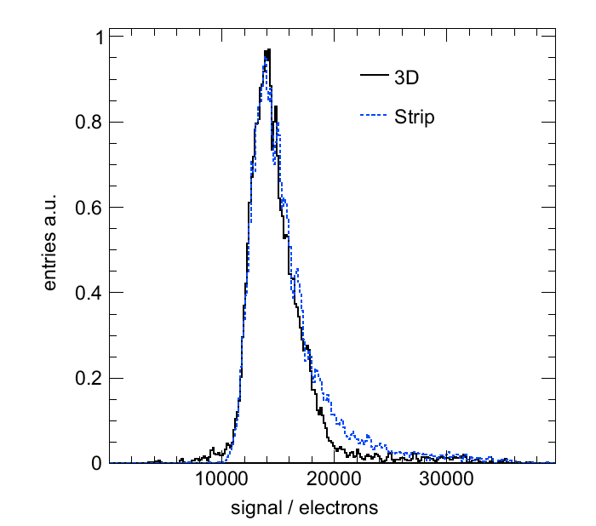
3D diamond detectors
Full Charge Collection for both detectors
Remarkable agreement between signals in 3D and planar strip geometries
full charge at lower avrg. E-Field
  3D: 25 V , < 100 μm
  Planar: 500 V, 440 μm
@ +25V
@ +500V
Notes:
----- Meeting Notes (16/02/16 14:40) -----
AddCollect Full Charge

Slide 22
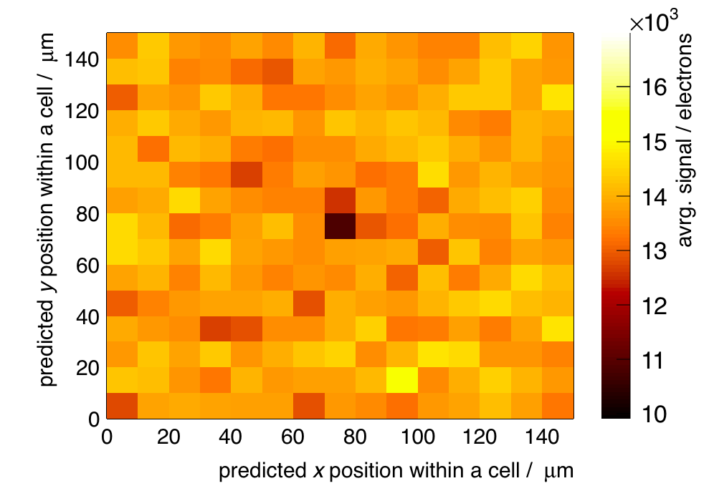
Uniformity and resolution
split each cell into 10 x 10 µm² and overlay each subcell
  nice uniformity ~3% across cell observed (ignoring cells with columns)
Notes:
----- Meeting Notes (16/02/16 14:40) -----
move up plot - too see slide number
Uniformity: Zero surpressed plot
Put the other plot in the backup
Resolution: Charge Weighted

Slide 23
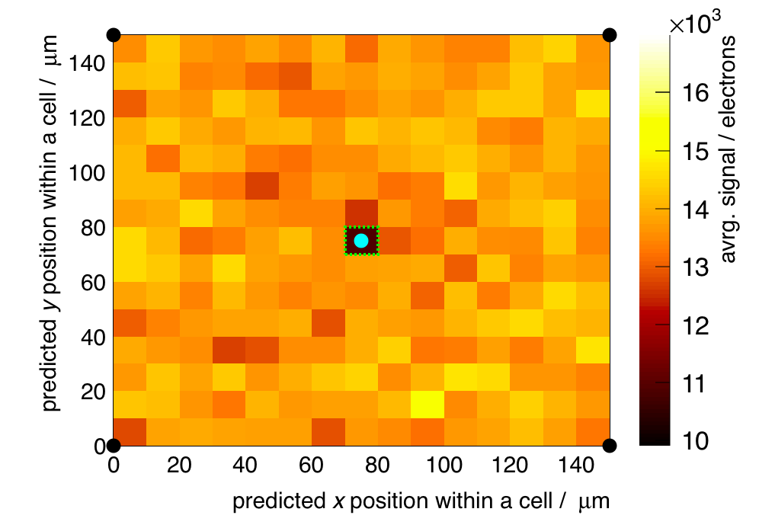
Uniformity and resolution
split each cell into 10 x 10 µm² and overlay each subcell
  nice uniformity ~3% across cell observed (ignoring cells with columns)
Notes:
----- Meeting Notes (16/02/16 14:40) -----
move up plot - too see slide number
Uniformity: Zero surpressed plot
Put the other plot in the backup
Resolution: Charge Weighted

Slide 24
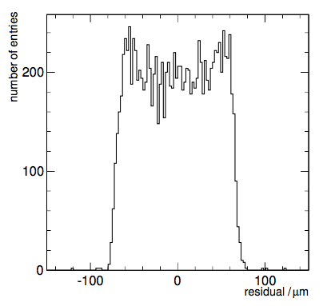
Uniformity and resolution
split each cell into 10 x 10 µm² and overlay each subcell
  nice uniformity ~3% across cell observed (ignoring cells with columns)
Residual distribution
    2 Strip - Charge Weighted
  40.2 ± 0.3 µm (expect 43 µm for digitial)
  Very little charge sharing
Notes:
----- Meeting Notes (16/02/16 14:40) -----
move up plot - too see slide number
Uniformity: Zero surpressed plot
Put the other plot in the backup
Resolution: Charge Weighted

Slide 25
Test of first 3D pCVD diamond detectors
Same layout/mask as for 3D scCVD diamond
  Planar Strip @ 500V
  3D-Phantom @ 75V
  3D-Detector @ 75V
Smaller yield in fabrication & contacting of columns than for scCVD
Preliminary result without calibration to electrons
  3D-Detector & 3D-Phantom biased @ 75V, planar strip @ 500V
  Comparison between 3D detector and planar strip
  First results on residual/charge sharing
Notes:
pCVD diamond around 220 mum ccd
Used similar masks, strip phanom, 3d
----- Meeting Notes (22/09/15 16:20) -----
smaller yield than scCVD

Slide 26
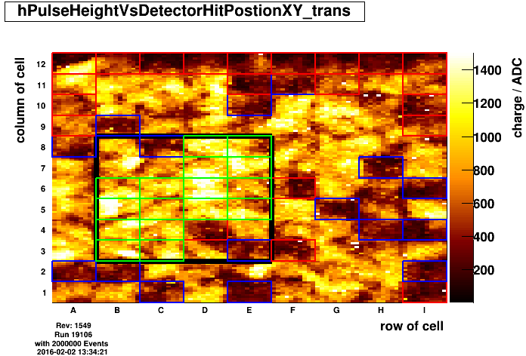
Selection of Good Cells
Selected 16 adjacent cells
Notes:
Describe red/Blue
----- Meeting Notes (16/02/16 14:40) -----
change range of plot such that nothing is white

Slide 27
Selection of Good Cells
Poster by Giulio Forcolin: Simulation of 3D Diamond Detectors
Selected 16 adjacent cells
Notes:
Describe red/Blue
----- Meeting Notes (16/02/16 14:40) -----
change range of plot such that nothing is white

Slide 28
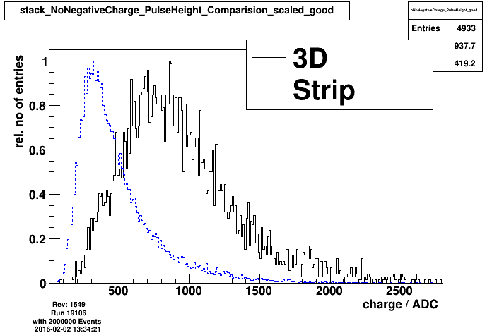
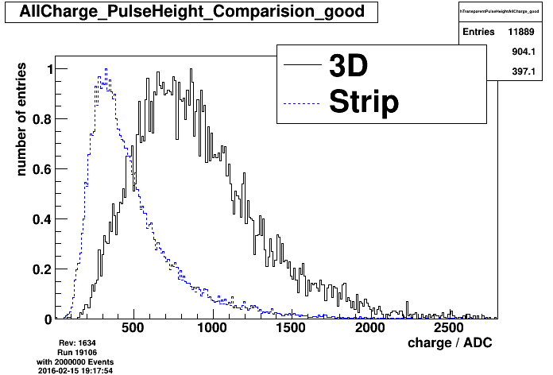
Final Comparison
Low estimate for charge collection
Measured
Mean 904

Slide 29
Final Comparison
Better charge collection than planar (mean 488 ADC)
Measured
Mean 904

Slide 30
Final Comparison
Red line estimate the Mean for Full Charge Collection (500μm)
Measured
Mean 904
Full Charge Mean: 1269

Slide 31
Final Comparison
Red line estimate the Mean for Full Charge Collection (500μm)
71% of
Full Charge Collection, corresponding to 356 μm
Measured
Mean 904
Full Charge Mean: 1269
Highest charge collection ever measured for pCVD diamonds
Notes:
scCVD 1117 @ 440 um
1117/440*500 = 1269 ADC

Slide 32
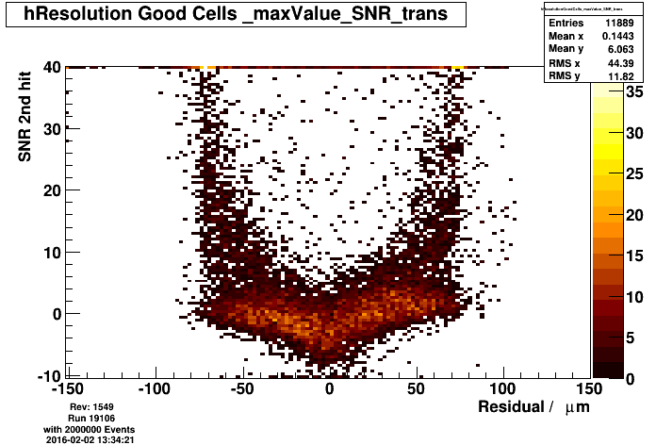
Residual
Blue: 1 Strip
(digital)
σ = 44.0 μm
Red: 2 Strip
Charge Weighed
σ = 36.8 μm
Slight improvement due to small charge sharing in between the cells
Notes:
Track goes perpendicular no tilting/no magnetic field,.... no charge sharing

Slide 33
Summary
New diamond suppliers, IIa & II-VI, improved situation on the market
Quality of diamonds has improved strongly over the last years
  Now reaching 275 - 300 μm CD in pCVD diamonds
Notes:
more material, more competition (less price), better quality

Slide 34
Summary
New diamond suppliers, IIa & II-VI, improved situation on the market
Quality of diamonds has improved strongly over the last years
  Now reaching 275 - 300 μm CD in pCVD diamonds
Results for 3D scCVD diamond have been published
  Collecting same charge as planar configuration at a much smaller bias voltage (25 V vs. 500V)
Notes:
Mention Iia II-VI First results of 3D pCVD diamonds show more collection than the strip detector

Slide 35
Summary
New diamond suppliers, IIa & II-VI, improved situation on the market
Quality of diamonds has improved strongly over the last years
  Now reaching 275 - 300 μm CD in pCVD diamonds
Results for 3D scCVD diamond have been published
  Collecting same charge as planar configuration at a much smaller bias voltage (25 V vs. 500V)
Results of first 3D pCVD diamond look very promising
  Highest Charge Collection measured in pCVD diamond
  ≧ 71% of full charge collection (356μm) at 75 V
  Slight Charge Sharing between cells
Notes:
Mention Iia II-VI First results of 3D pCVD diamonds show more collection than the strip detector
----- Meeting Notes (16/02/16 14:40) -----
more

Slide 36
Outlook
Further improvement of diamond quality in cooperation with suppliers
R&D on 3D devices
  Improve micromachining for conductive columns
    Higher yield
    Smaller resistivity
    Bigger detectors
  Test of different cell structures
    Honeycomb, rectangular
    Different sizes
  TCAD Simulations 3D diamond detectors
  Studies of irradiated 3D CVD diamonds
Notes:
Papyrus?
Giulio → TCAD Simulation → Manchester

Slide 37
Outlook
Further improvement of diamond quality in cooperation with suppliers
R&D on 3D devices
  Improve micromachining for conductive columns
    Higher yield
    Smaller resistivity
    Bigger detectors
  Test of different cell structures
    Honeycomb, rectangular
    Different sizes
  TCAD Simulations 3D diamond detectors
  Studies of irradiated 3D CVD diamonds
Poster by Steven Murphy:
Laser processing in 3D Diamond Detectors
Notes:
Pictures?
Giulio → TCAD Simulation → Manchester

Slide 38
Outlook
Further improvement of diamond quality in cooperation with suppliers
R&D on 3D devices
  Improve micromachining for conductive columns
    Higher yield
    Smaller resistivity
    Bigger detectors
  Test of different cell structures
    Honeycomb, rectangular
    Different sizes
  TCAD Simulations 3D diamond detectors
  Studies of irradiated 3D CVD diamonds
Poster by Steven Murphy:
Laser processing in 3D Diamond Detectors
Poster by Giulio Forcolin: Simulation of 3D Diamond Detectors
Notes:
Pictures?
Giulio → TCAD Simulation → Manchester

Slide 39
Thank you

Slide 40
BACKUP

Slide 41
Why diamond?
 | Si | diamond
Band Gap [eV] | 1.12 | 5.45
Electron Mobility [cm²/V s] | 1450 | 2200
Hole Mobility [cm²/V s] | 500 | 1600
Saturation Velocity [cm / s] | 0.8 · 10⁷ | 2 · 10⁷
Breakdown Field [V / m] | 3 · 10⁵ | 2.2 · 10⁷
Resistivity [Ohm] | 2.3 · 10⁵ | > 10¹¹
Dielectric Constant | 11.9 | 5.7
Displacement Energy [eV] | 13-20 | 43
e-h creation energy [eV] | 3.6 | 13
Average e-h pairs per MIP per μm | 89 | 36
Charge Collecting Distance [μm] | ~full | scCVD: ~full pCVD: ~ 250-300
Thermal conductivity [W/cm K] | 1.5 | 22
Low leakage current
Low capacitance
Operation at high voltages
Operation without cooling
Radiation tolerant
Lower signal
Single crystals small in size
Efficiency < 100% (pCVD)
More expensive
Notes:
s=not similar properties
Once if it is irradiated: Mean free path is longer than the drift distance
----- Meeting Notes (22/09/15 16:20) -----
Highlights markieren
reihenfolge anschauen
smaller signal/lower signal

Slide 42
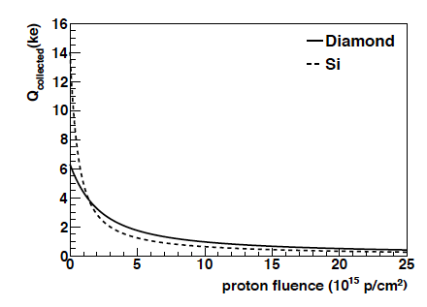
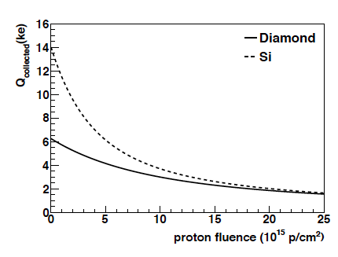
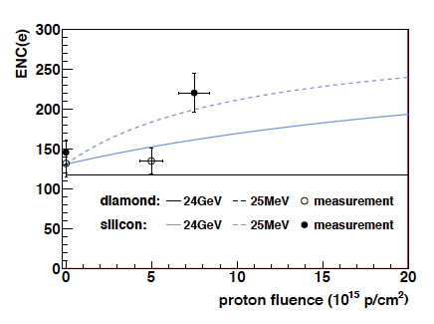
Diamond vs. Silicon
Expected signals (MPV) of MIP for 200 um sensor
ENC vs. irradiation – simulation & measurement (25 MeV)
25 MeV proton
irradiation
24 GeV proton
irradiation
ENC for
Si & Dia
arxiv.org/pdf/1206.6795v2.pdf
Notes:
Noise:
the best method (transient noise simulation)
is shown for diamond (CD = 35 fF, dashed) and for silicon (CD = 120 fF, solid) as a function of the radiation
fluence for 25 MeV and 24 GeV protons, respectively. The measurements are obtained from diamond (open
circles) and silicon (full circles) devices irradiated by 25 MeV protons.

Slide 43
pulse height maps
first check if the diamond works: map of pulse height
small fiducial loss due to scintillator trigger
dead cells already visible due to faulty readout columns
roughly 9 broken readout columns (expect 8 from 92% efficiency)

Slide 44
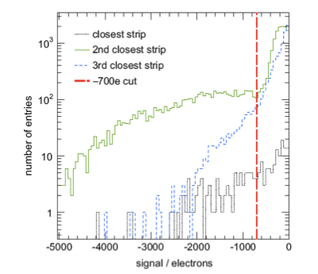
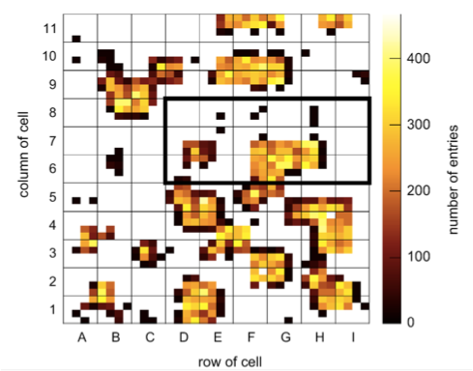
3D Diamonds – Negative Charges
Observed unexpected negative charge tail
Negative charge clustered around center of cells
Identified to be due to missing bias column

Slide 45
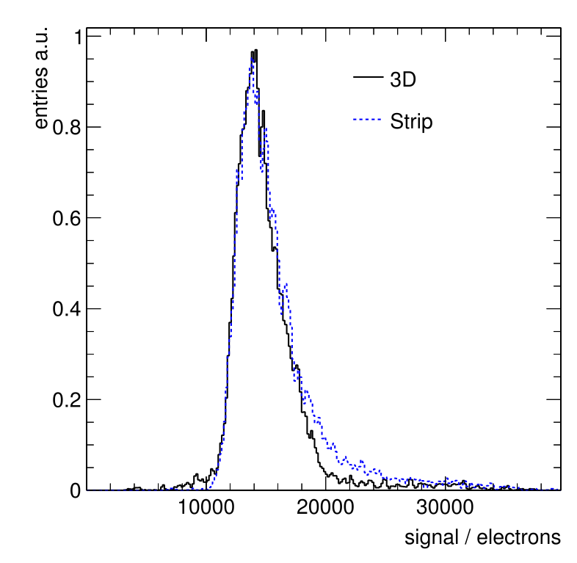
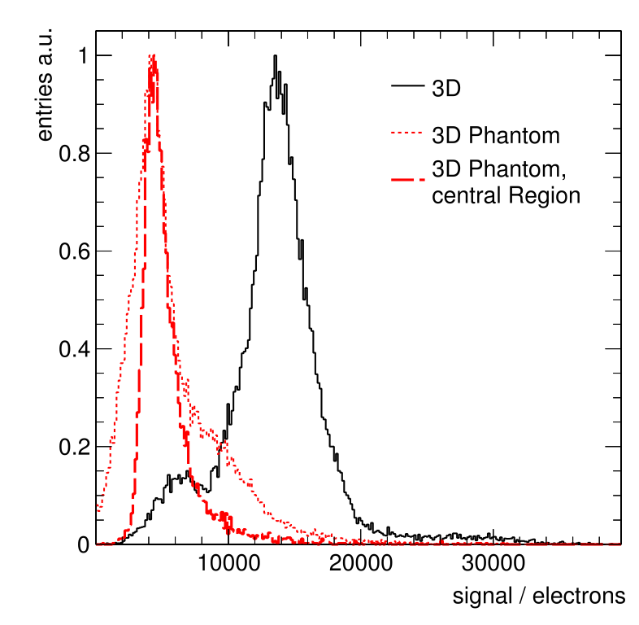
results on charge collection
strip part should collect full charge at 450 V
this expectation is confirmed
3D collects same charge at 5% of the voltage!
    great confirmation of expectation
3D phantom collects significantly less charge
    theory is that it collects charge only at
    surface, not in the bulk
strip part should collect full charge at 450 V
  this expectation is confirmed
3D collects same charge at 5% of the voltage!
  great confirmation of expectation
3D phantom collects significantly less charge
  theory is that it collects charge only at surface, not in the bulk

Slide 46
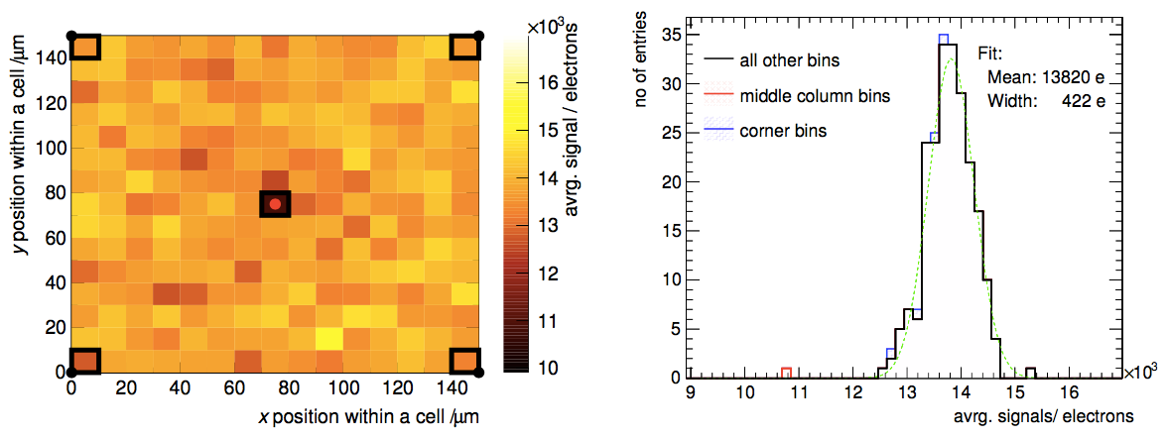
Uniformity
Notes:
----- Meeting Notes (16/02/16 14:40) -----
move up plot - too see slide number
Uniformity: Zero surpressed plot
Put the other plot in the backup
Resolution: Charge Weighted

Slide 47
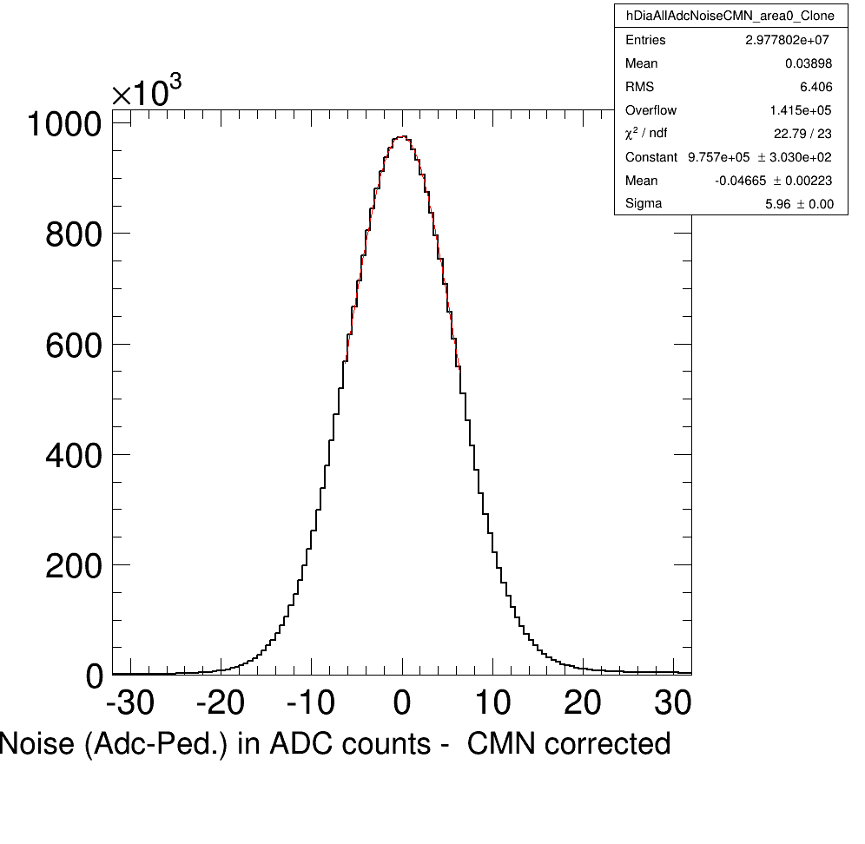
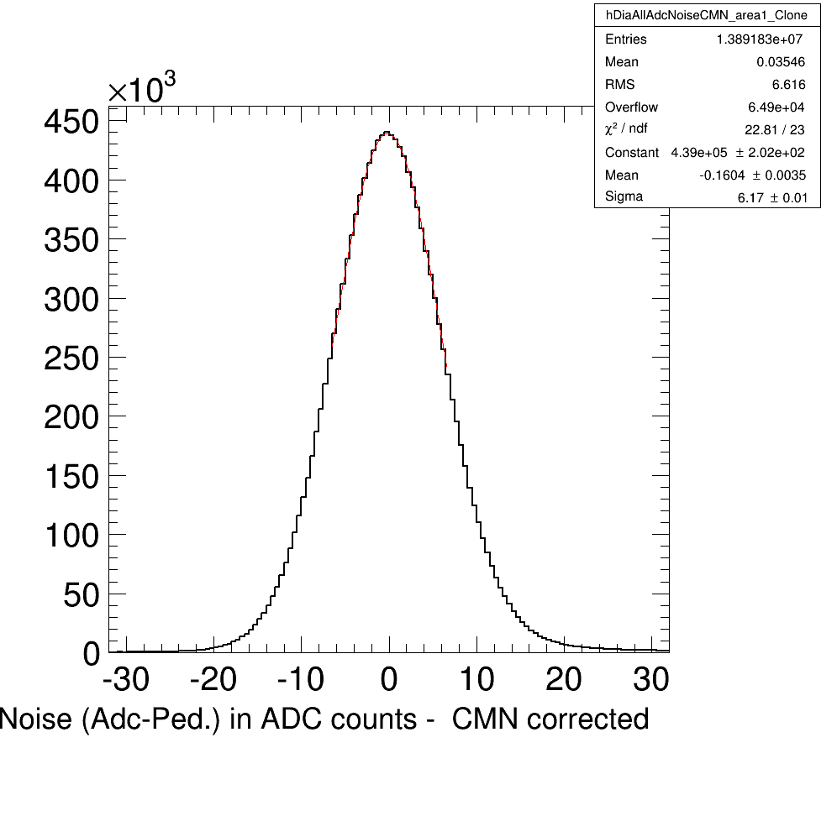
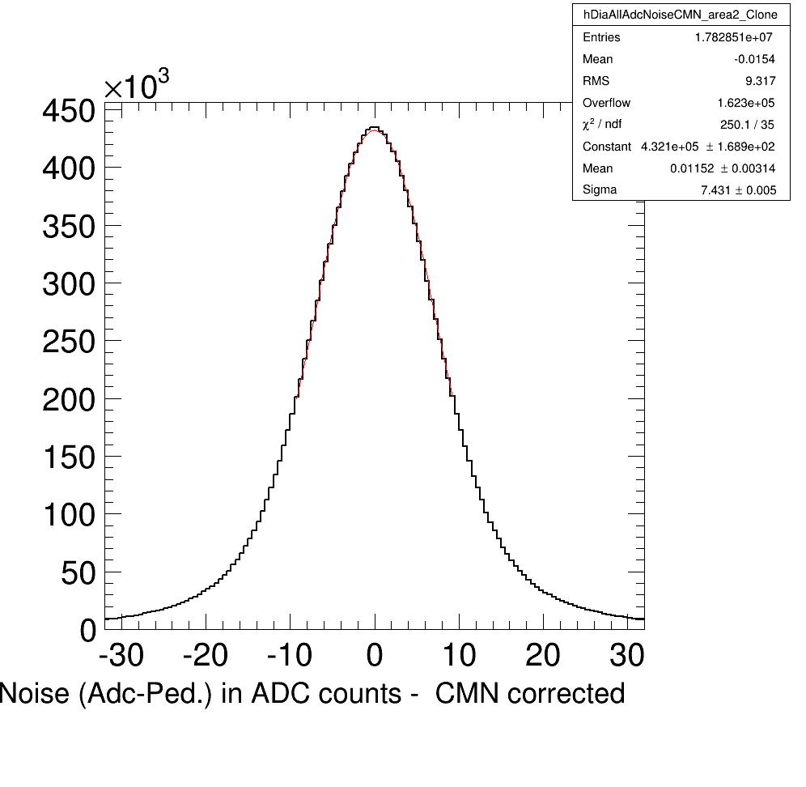
3D pCVD Results
pCVD diamond from II VI
  Thickness 500 μm
Noise
Strip
3D Phantom
3D Detector
σ = 5.96 ADC
σ = 6.17 ADC
σ = 7.43 ADC

Slide 48
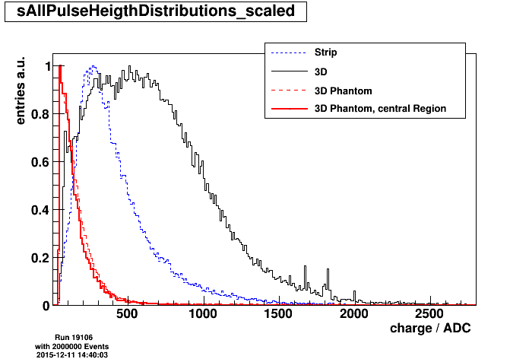
Charge in whole detector
Cluster analysis:
  strip detector: Landau
  3D Phantom: very low signals
  3D Detector:
  Wide distribution
    More charge in 3D detector than within strip detector
Region of ‘working Cells‘ must be selected

Slide 49
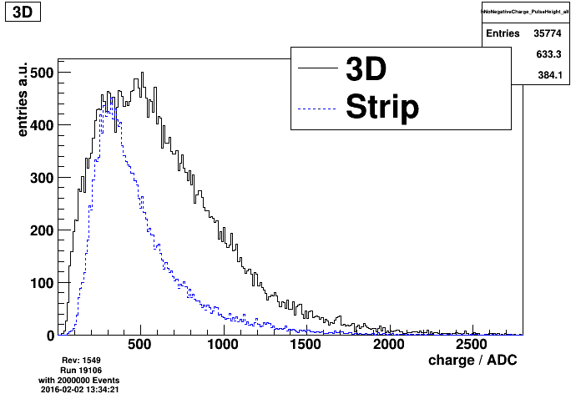
Final Comparison
All Cells
Good Cells (16 cells)
Notes:
----- Meeting Notes (16/02/16 14:40) -----
Put into backup

