Slide 1


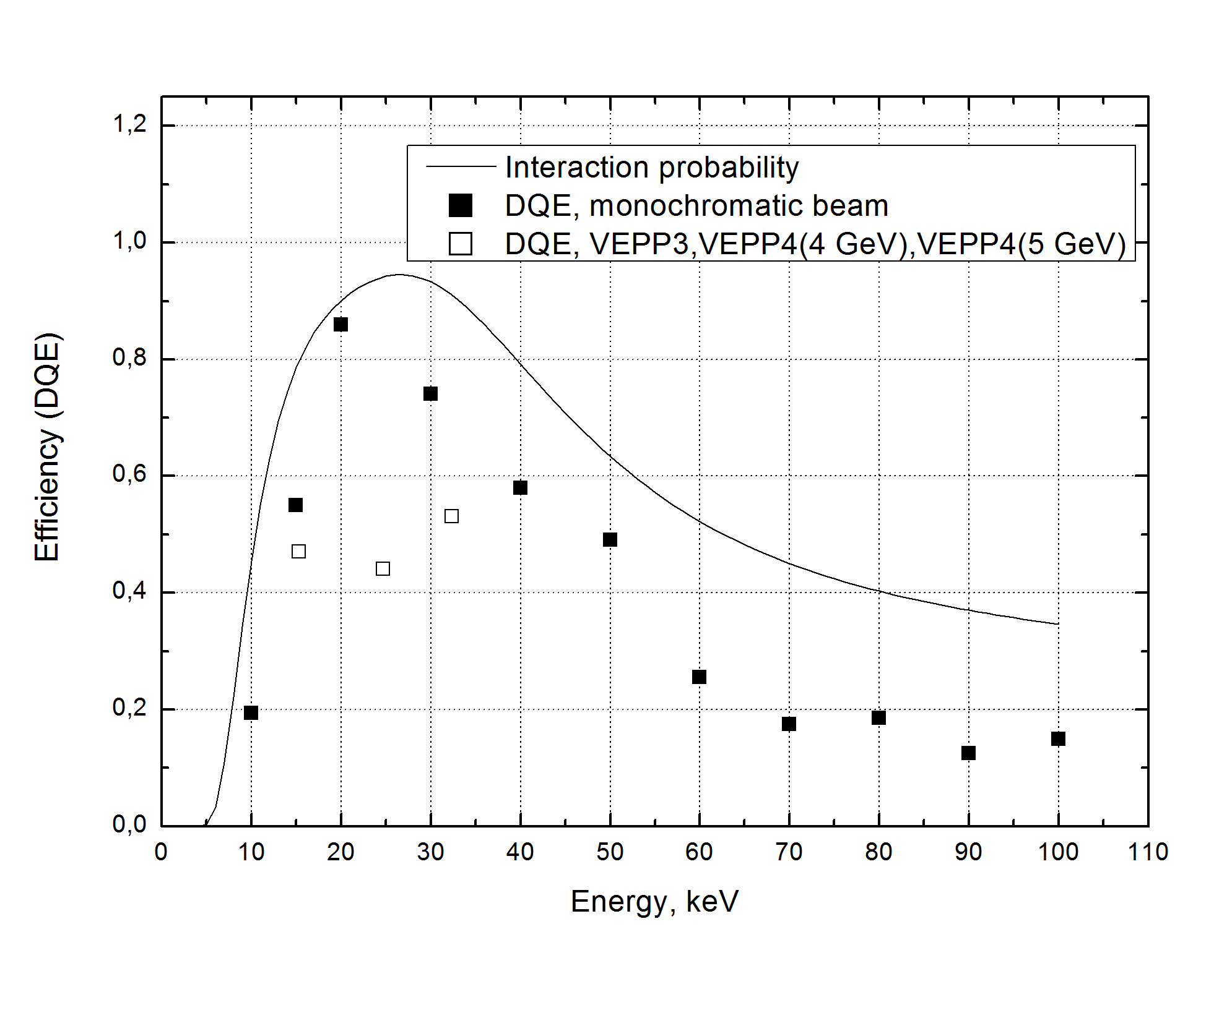
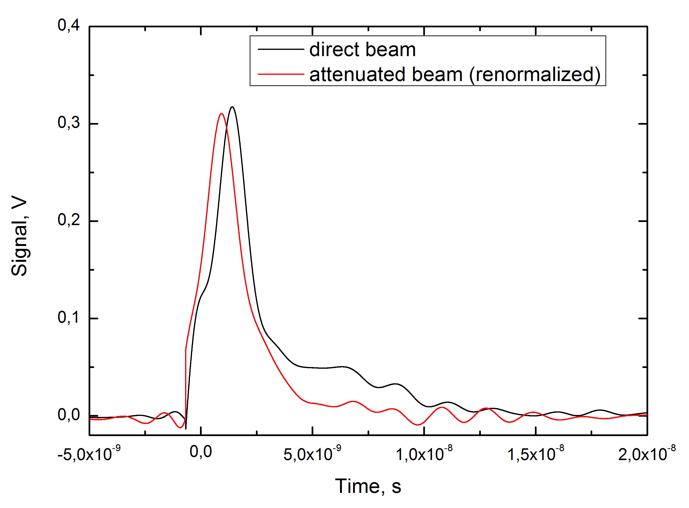
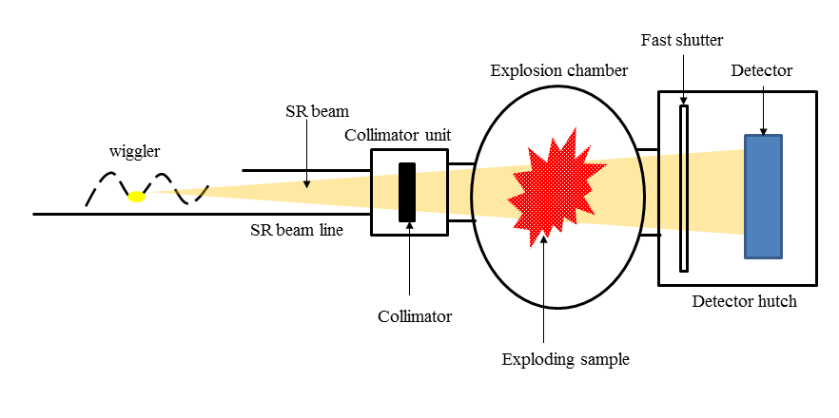
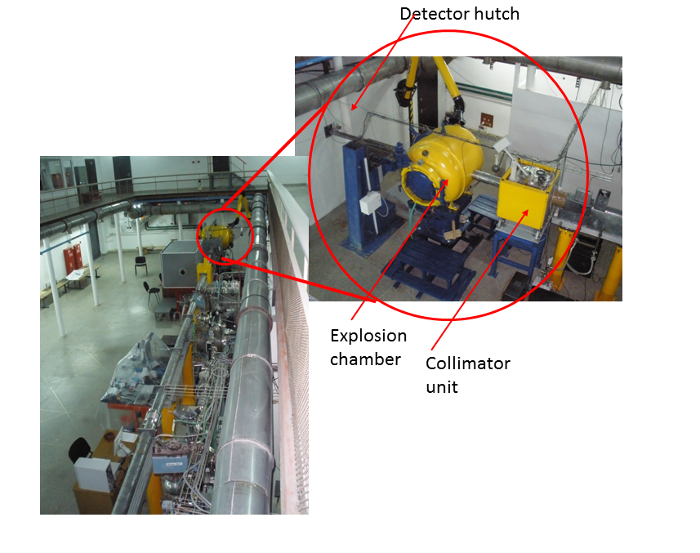
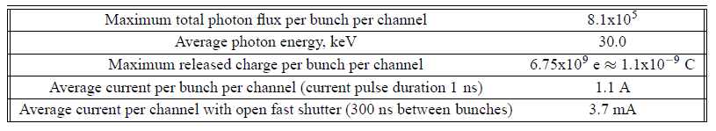
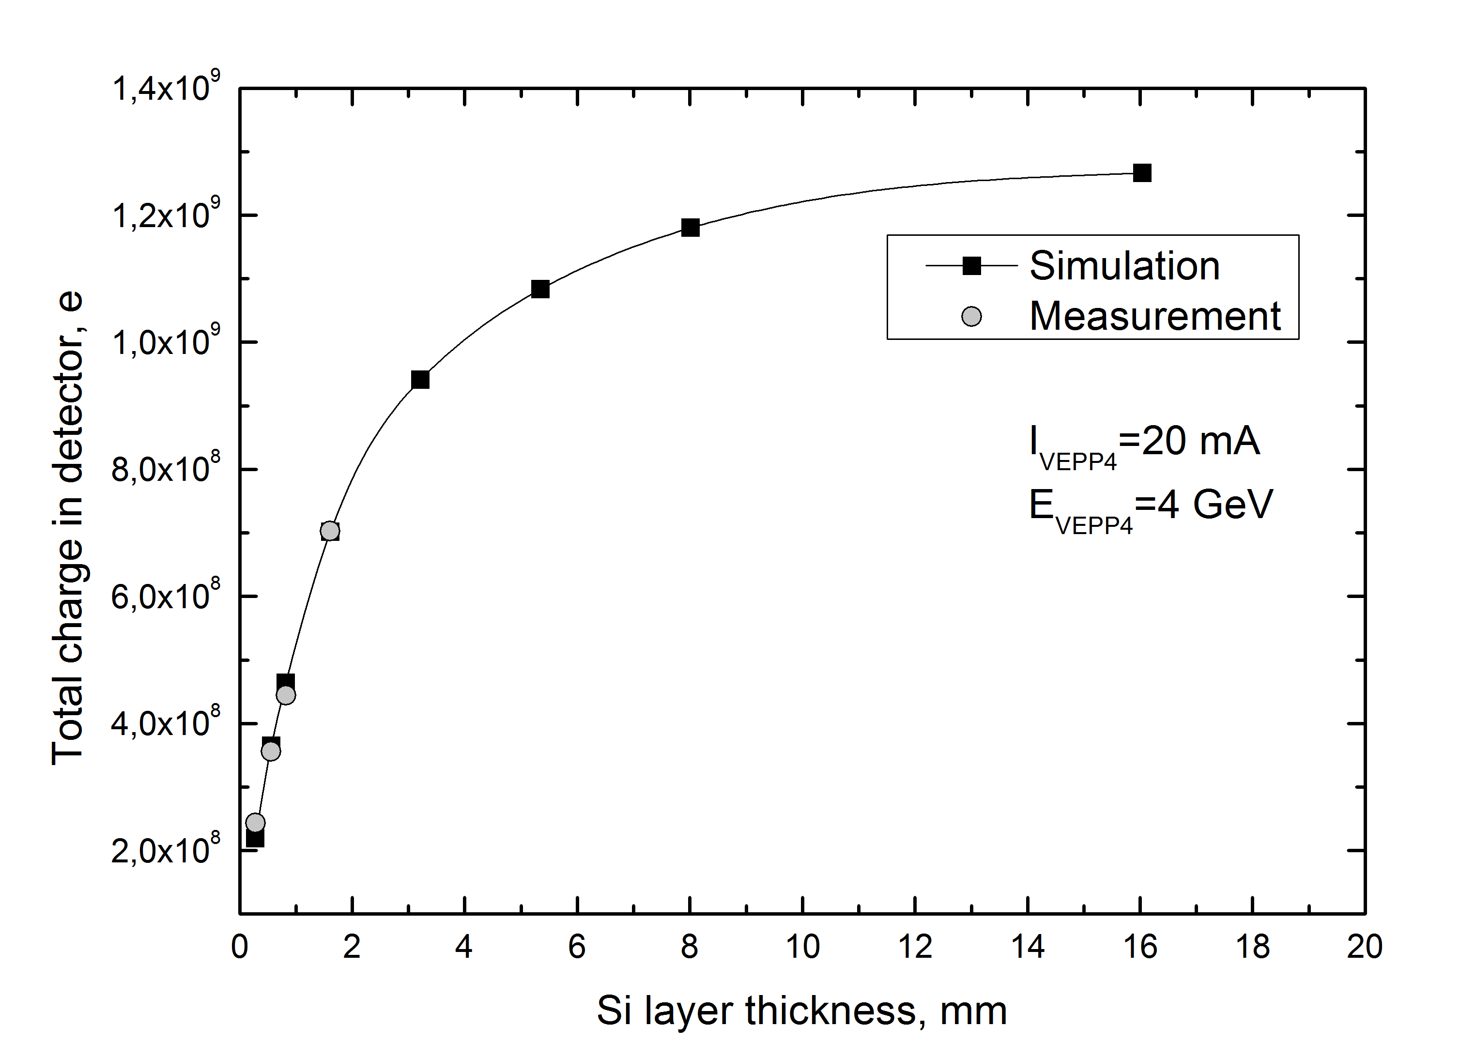
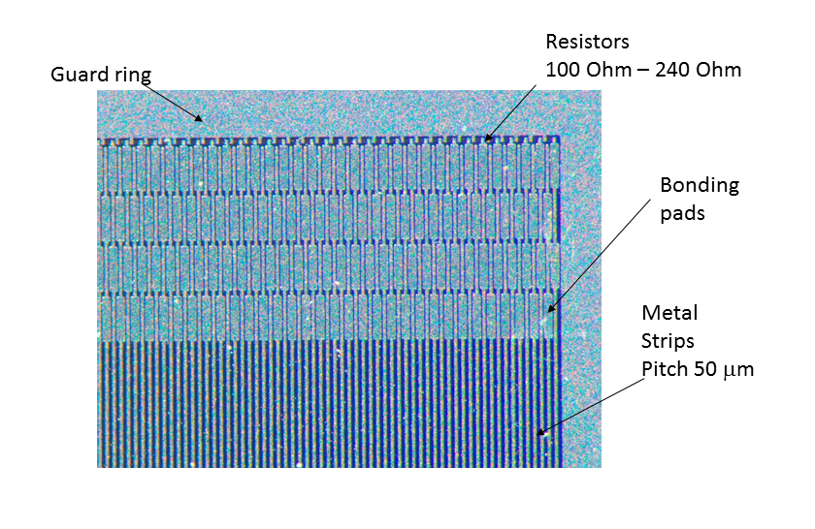
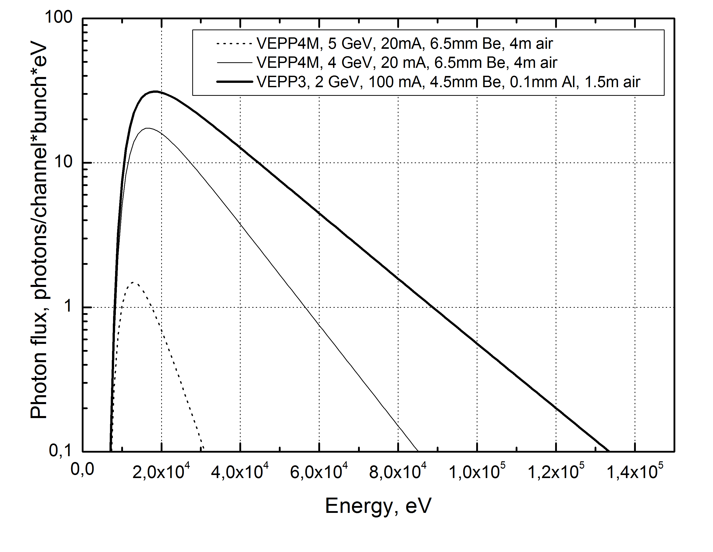
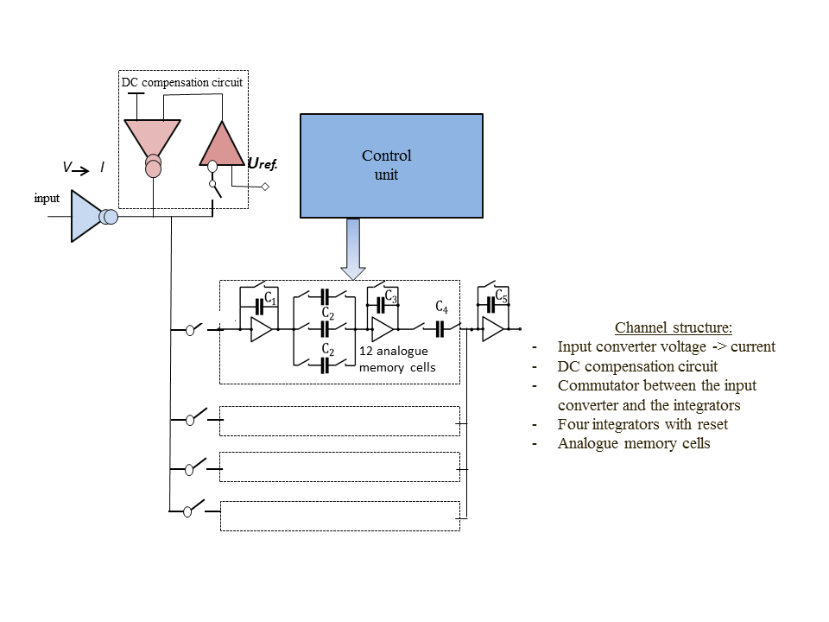
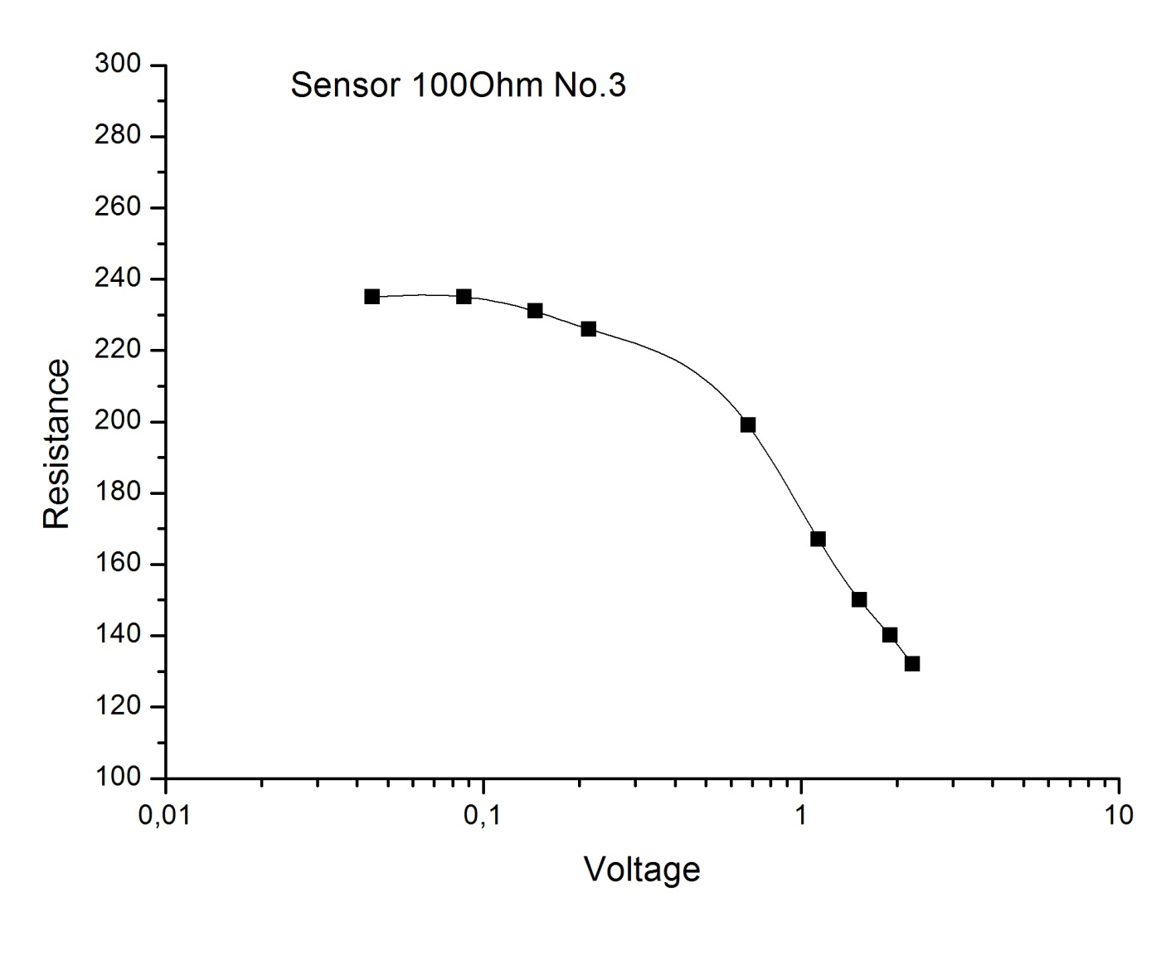
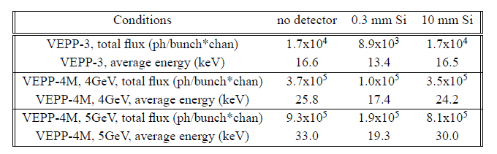
Development of the microstrip silicon detector for imaging off
fast processes at a synchrotron radiation beam.
Budker INP
V.Aulchenko^{1,2}, L.Shekhtman^{1,2}, B.Tolochko^{3,2}, V.Zhulanov^{1,2}
Budker Institute of Nuclear Physics, 630090, Novosibirsk, Russia
Novosibirsk State University, 630090, Novosibirsk, Russia
Institute of Solid-State Chemistry and Mehanochemistry, 630090, Novosibirsk, Russia
Abstract
In situ imaging of explosions allows to study material properties under very high pressures and temperatures. Synchrotron radiation (SR) is a powerful tool for such studies because of its unique time structure. Flashes of X-rays from individual bunches in a storage ring are so short that an object under study does not move more than 1-10 μm during exposure. If a detector is able to store images synchronously with bunches of an SR source the time resolution of such method will be determined by the duration of SR flash from individual bunch. New beam line at the VEPP-4M storage ring will allow to get X-Ray flux from each bunch close to 10⁶ photons/channel where channel area is 0.05x0.5 mm² and average beam energy is about 30 keV. Bunches in the machine can be grouped into trains with 20 ns time gap. In order to meet these requirements a new detector development was started based on Si microstrip technology. The detector with a new dedicated front-end chip will be able to record images with maximum signal equivalent to 10⁶ photons/channel, with signal to noise ratio of ~10³, spatial resolution of 50 μm and maximum frame rate of 50 MHz. The detector has to draw very high peak and average currents without affecting the front-end chip, therefore a specific design of Si sensor should be developed. The front-end chip has to provide signal measurements with the dynamic range of about 10⁴ or more and recording of the signal to an analogue memory with the rate of 50 MHz. The concept of such detector is discussed in the presentation. The results of the simulations of the main detector parameters and the results of the first measurements with the prototype sensors are presented.
Experiments on imaging of fast dynamic processes (explosions, combustion) with a synchrotron radiation beam are performed in the Budker INP at the VEPP-3 storage ring for more than 10 years [1]. The DIMEX (Detector for IMaging of EXplosions) based on gas technology is used for this purpose [2]. The DIMEX allow to measure photon flux up to ~5000 photons/channel (channel area is 0.1x0.5 mm², average photons energy ~20 keV), with spatial resolution of ~0.2 mm and frame rate of 10 MHz. In order to improve all detector parameters, namely, maximum measured photon flux up to 10⁶ photons/channel, spatial resolution down to 50 μm and maximum frame rate up to 50 MHz, a new development was started based on Si microstrip technology. A new beam line with ~100 times higher flux and higher X-ray energy is constructed for this purpose at the VEPP-4M storage ring.
Schematic view of the experimental set-up is shown in Fig.1. The SR beam is provided by a 7-pole wiggler with 5 poles having 1.2 T field and the first and the last poles having 1.0 T field. The beam passes through the collimator block forming a flat narrow beam, the explosion chamber that can withstand an explosion of 200 g of thrinitrotoluene (TNT) and then passes to the detector hutch .
Si microstrip detector with a thin sensor aligned at a small angle with respect to the beam plane and with the strips parallel to the beam direction can meet all requirements. Calculated interaction probability and DQE obtained by the simulation for monochromatic beams and for the beams with the energy spectra shown in Fig.3 are presented in Fig.4 for a sensor with 10 mm sensitive Si depth and 10 μm dead zone before the sensitive material. Such depth of the sensitive region can be obtained if a 0.3 mm thick sensor would be inclined at an angle of 1.5 degrees with respect to the beam plane.
When the silicon sensor is exposed to SR beam a very short pulses of current are recorded from each bunch. In Fig.7 the signal from oscilloscope at 50 Ohm load is shown recorded from a single strip. The black curve corresponds to the open beam with the current of 10.4 mA in the machine and beam energy of 4 GeV. Total charge injected into the sensor by a single SR flash is around 10⁸ electrons. The sensor was installed perpendicular to the beam axis in this measurement. The red curve in Fig.7 corresponds to 5 times attenuated beam. The curve was renormalized to the peak value of open beam curve in order to compare the curves shapes. We can see that some slow component of the current appears in case of open beam that corresponds to the beginning of space charge effects in Si (plasma effects). However this effect is small and all charge is collected within 15 ns.
Fig.4. Interaction probability and DQE of the sensor with 10 mm of sensitive Si depth and 10 μm of dead material before the sensitive region. Open squares are the DQE for the spectra shown in Fig.3 pointed at the energies from Table 1 (see for 10 mm Si).
Fig.1. Schematic view of the station for the experiments on imaging of explosions.
SR beam produces very high peak and average currents in a Si sensor (Table 2). In order to draw this current out of the sensor, sufficiently low resistors should be provided between the strips and the guard ring that is connected to ground.
Fig.7. Pulse shape from SR flash measured from a single strip. The shapes from an open beam and 5 times attenuated beam (renormalized to a peak value) are shown. Beginning of plasma effect is observed .
Table 2.Calculated peak and average currents induced by a SR beam from an electron beam of 20 mA and 5 GeV.
Several p-on-n 300 μm thick sensors with DC-coupled metal strips of 50 μm pitch and with polysilicon resistors in the range of 100 Ohm to 1000 Ohm introduced between each strip and the guard ring were manufactured for us by the Hamamatsu Photonics company. The sensors are 55x35 mm² in size and contain 1024 30 mm long strips each.
Fig.8. Signal in the Si sensor (full injected charge in a single strip) from a SR flash as a function of the depth of sensitive Si layer. Black points and curve – results of simulation; grey points – results of the measurements recalculated to 20 mA current.
Fig.2. Photo of the beam line 8 at the VEPP-4M storage ring with the station for the experiments for imaging of explosions.
The results of the measurements of the signal from a single strip of the sensor very well corresponds to the simulation performed for the inclined sensor (Fig.8).
A dedicated ASIC was developed for this detector that allows to measure the signal at the resistor at each strip with 20 ns duty cycle. The block diagram of one channel of this ASIC is shown in Fig.9. It contains voltage to current converter at the input, DC compensation circuit, commutator to four integrators with reset circuit and analog memory. The prototype ASIC was manufactured with 6 channels, each containing 12 analogue memory cells. We expect to start tests of the sensor with the prototype ASICs this year.
The VEPP-4M storage ring operates at present with electron beam energy up to 4 GeV and beam current up to 20 mA (in two bunches). In future the energy will be increased to 5 GeV and the beam current will be increased to 20 mA in each bunch. The bunches can be grouped in trains of 4-5 bunches with 20 ns time gaps. Calculated energy spectra at the entrance of the detector in comparison with the spectrum in the VEPP-3 beam line are shown in Fig.3.
Fig.5. Photo of the prototype sensor with low value resistors between the strips and the guard ring produced by the Hamamatsu Photonics company.
Three sensors with the resistors around 100 Ohm were tested. All tested sensors reached full depletion at ~100 V bias and demonstrated stable operation up to 500 V bias. However the polysilicon resistors are not constant and depend on the current through them (Fig.6). This will result in non-linear dependence of the signal on the flux registered by the detector. We will need to use dedicated calibration procedure or change the resistor technology.
Fig.3. Energy spectra of the SR beam before the detector in the beam line 8 of the VEPP-4M storage ring (at 4 GeV and 5 GeV in the storage ring) in comparison with the spectrum in the VEPP-3 beam line 0.
Fig.9. Block-diagram of one channel of the ASIC for the Si microstrip detector for imaging of explosions.
Fig.6. Polysilicon resistor value as a function of the voltage drop on it.
References:
Titov V. M.; Pruuel E. R.; Ten K. A.; et al., COMBUSTION EXPLOSION AND SHOCK WAVES V.47 (2011), 6, P.615-626
V.M. Aulchenko, O.V. Evdokov, L.I. Shekhtman, et.al., J. of Instrum. 2008. V. 3. P05005.
Table 1. Main parameters of the beams: total fluxes before the detector and absorbed in the detector and average energy of the beam for different beam conditions. Beam currents are the same as in Fig.3. Detector channel is 0.05x0.5 mm² in all cases.

