Slide 1
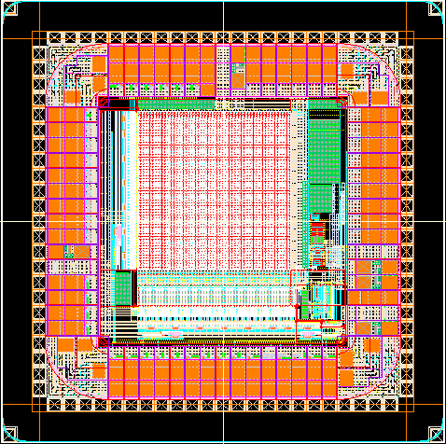
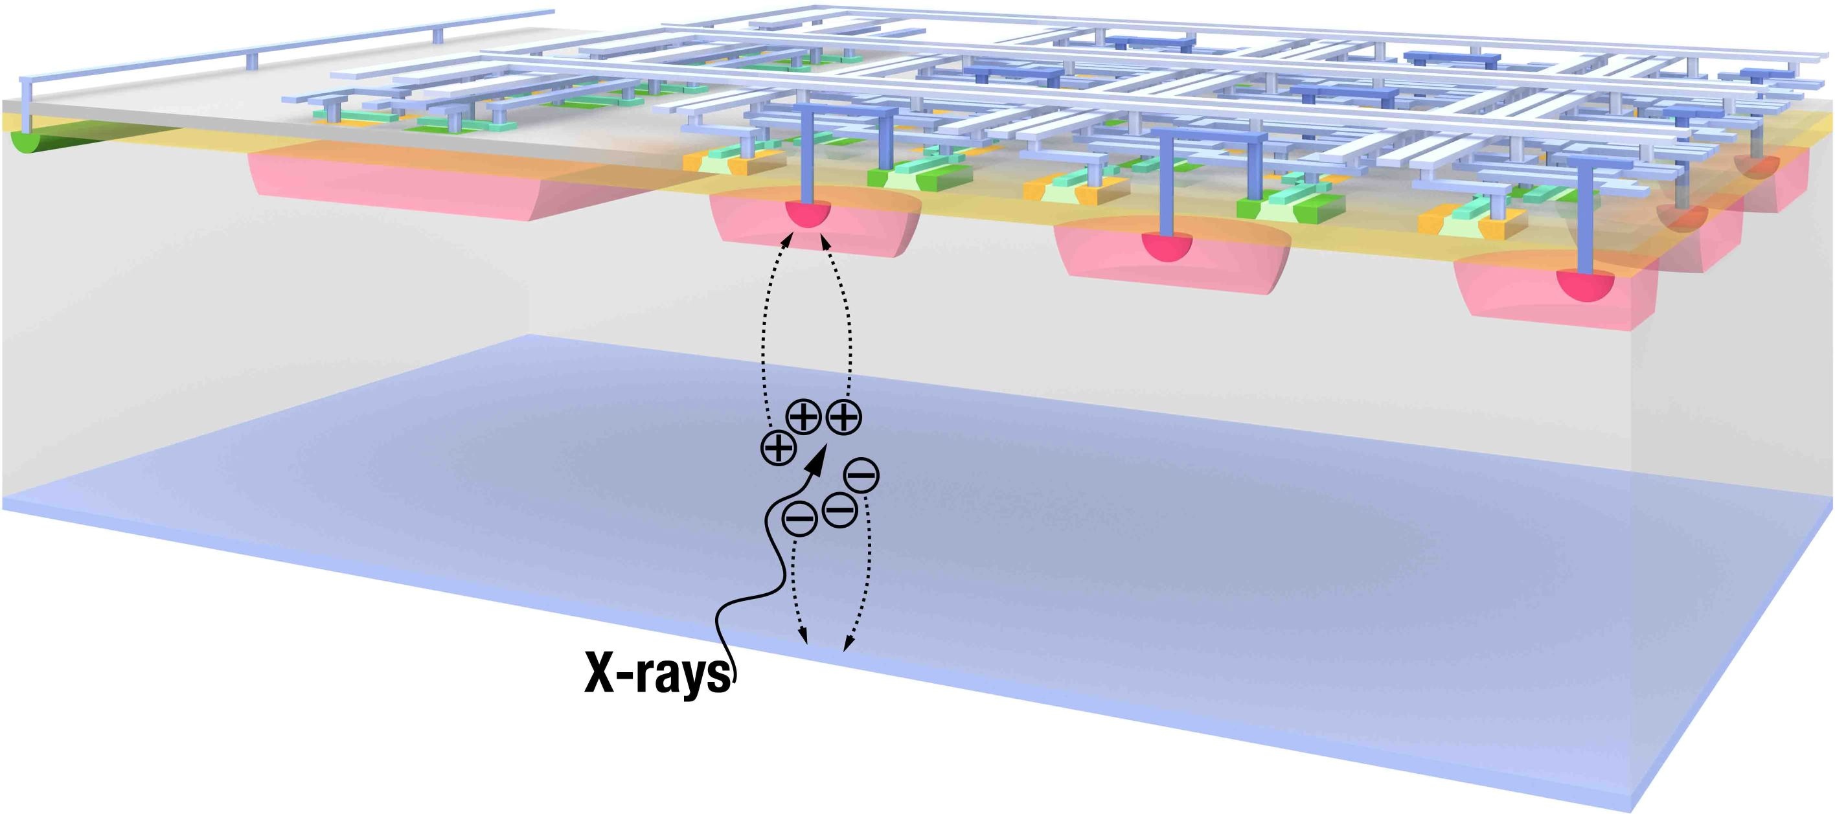
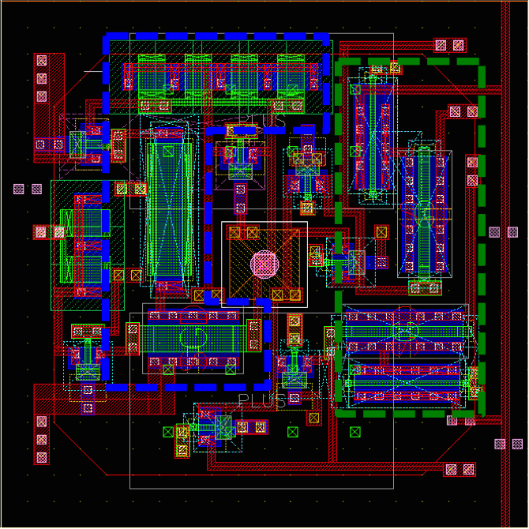
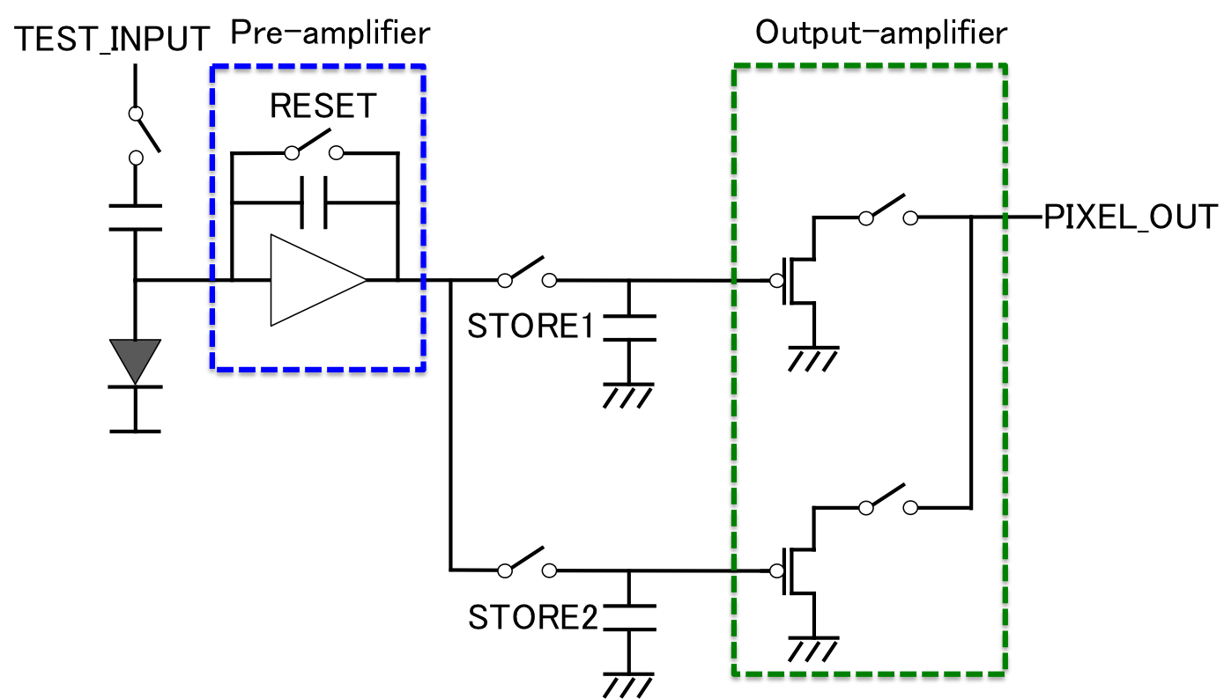

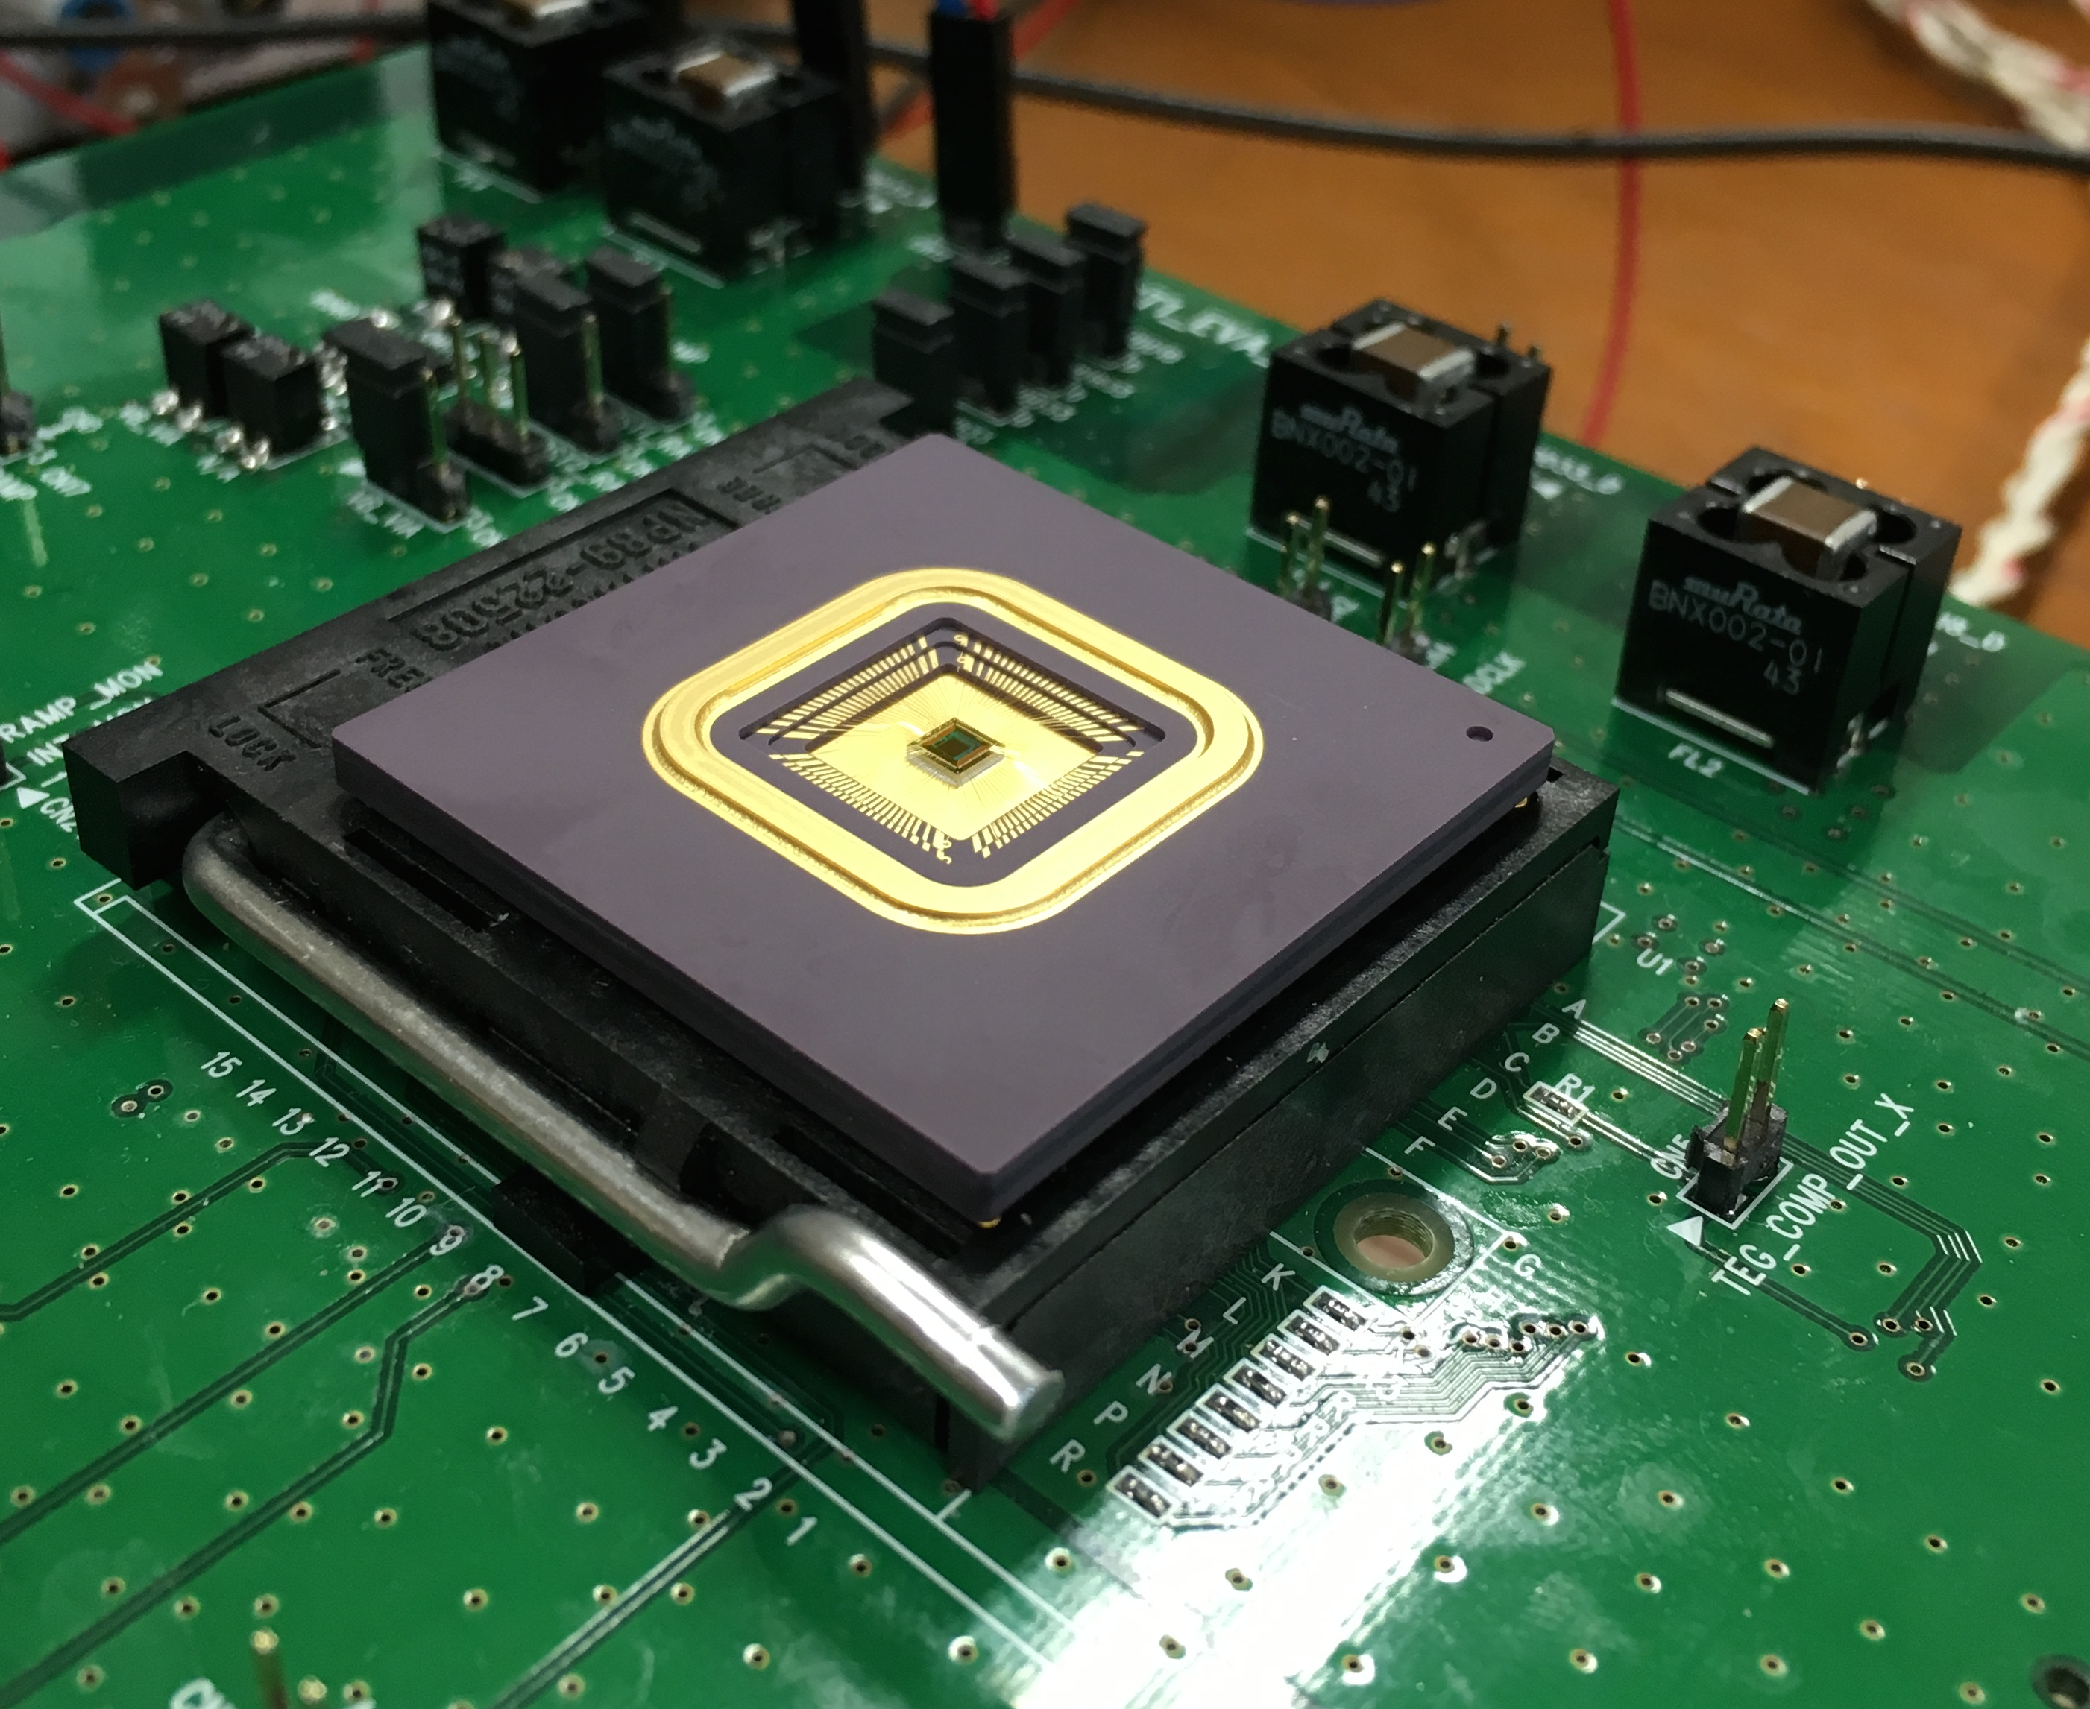
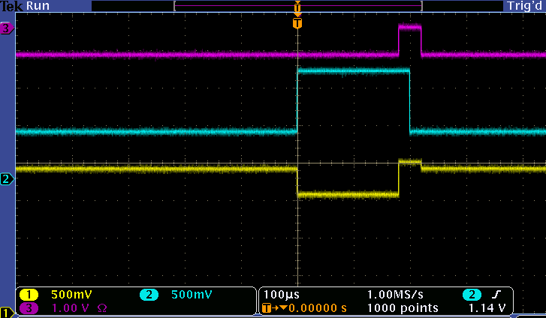
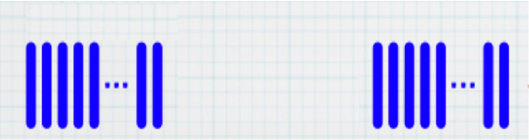
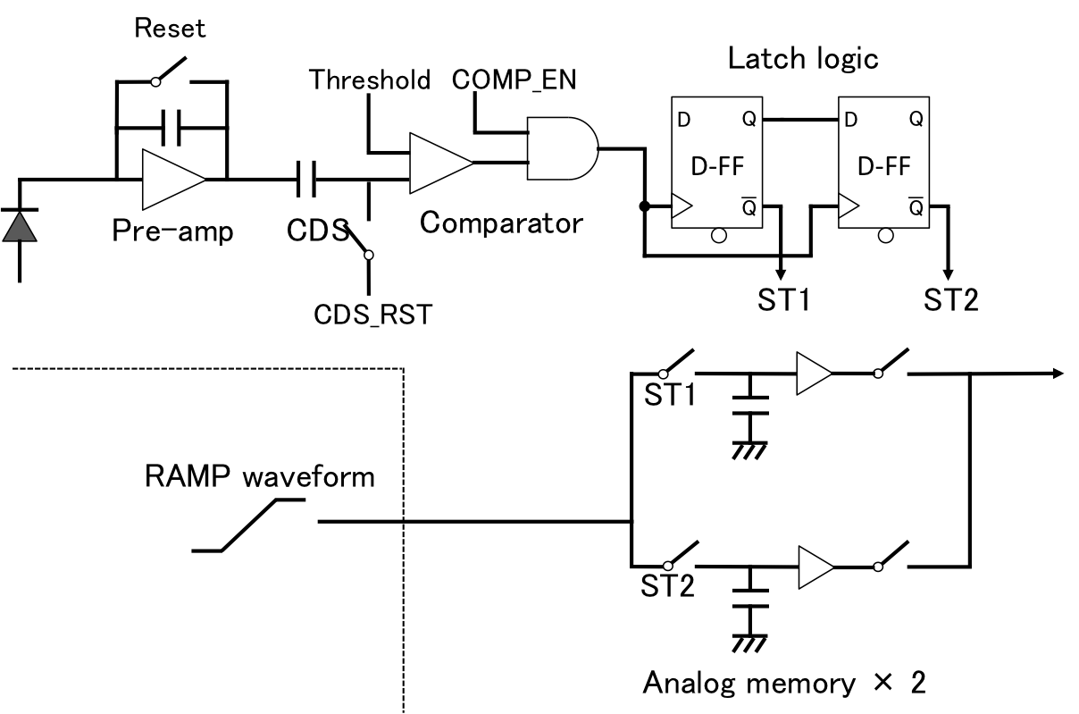
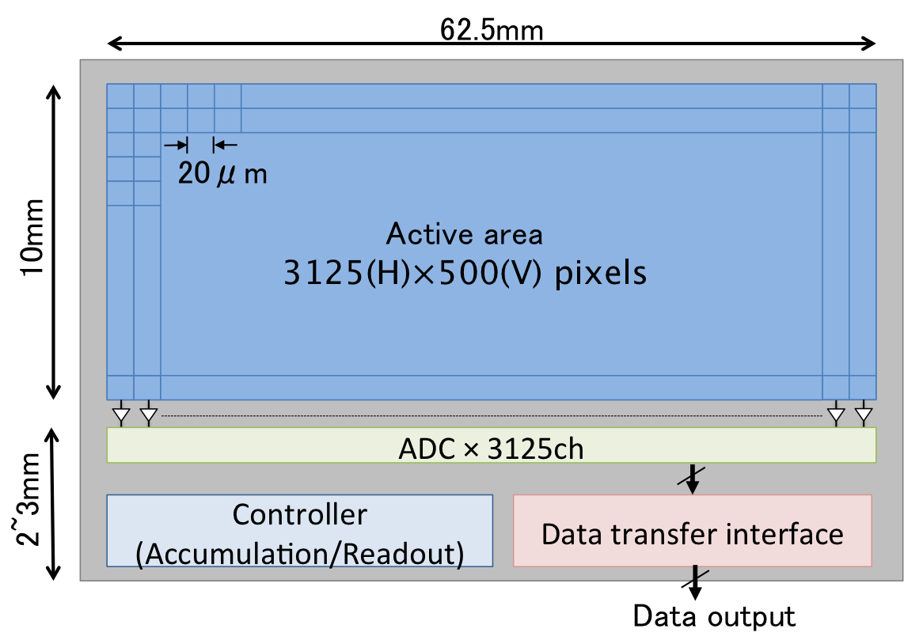
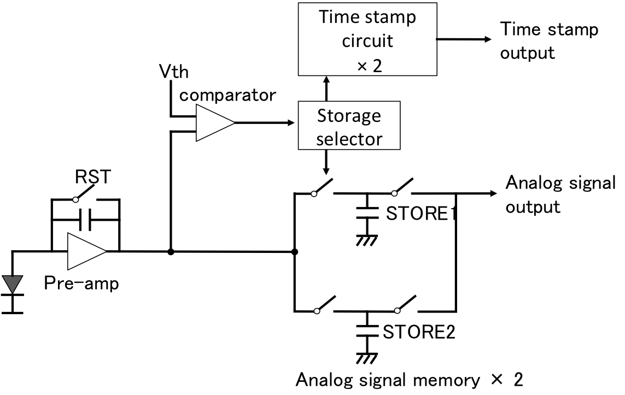
Development of a pixel sensor with fine space-time resolution based on SOI technology for the ILC vertex detector
Shun Ono^{A}, Manabu Togawa^{A}, Ryoji Tsuji^{A}, Teppei Mori^{A}, Miho Yamada^{B}, Yasuo Arai^{B}, Toru Tsuboyama^{B},
Kazunori Hanagaki^{B}, Junji Haba^{B}, Kazuhiko Hara^{C}, Akimasa Ishikawa^{D}, Yosuke Takubo^{D}
Introduction
Osaka University^{A}, KEK^{B}, University of Tsukuba^{C}, Tohoku University^{D}
Summary
Target
New Si pixel sensor optimized for ILC Vertex detector system
  Development of SOI pixel sensor with fine position and time resolution
Background
International Linear Collider
  Requirement of vertex detector system in order to achieve precise vertex-measurement of generated particles.
Study of the detector implementation by monolithic pixel sensor with SOI wafer technology.
SOFIST: New pixel sensor optimized for ILC vertex detector system
  Monolithic pixel sensor by SOI wafer technology
  Storing both position and timing information
Development status
  SOFIST Ver.1: Chip-evaluation ongoing
    Analog signal pixel: 20x20μm²
  SOFIST Ver.2: Chip-design ongoing
    Time-stamp and hit detection pixel: 25x25μm²
Future prospect
  Pixel integration with both functions within less than 25x25μm²
Motivation
Development status of sensor chips
ILC: International linear collider
  Precise measurement of Higgs boson and the search for new particles
  Vertex detector system by Si pixel sensor
  Reconstruction of the tracks of generated particles
Requirement of pixel sensor with
SOFIST Ver.1 chip
Pixel with analog signal readout, Column-ADC circuits
  Pixel operation with 2 analog memories
  Digital conversion by Wilkinson-ADC
Higher position resolution
Fine time resolution
Fast readout speed
…etc
Pixel
(50x50)
Process | Lapis 0.2μm SOI
Pixel size | 20×20μm²
Column-ADC | Output: 8bit, Clock: 100MHz
Column-ADC
SOI (Silicon-On-Insulator) wafer and pixel sensor
3mm
Low-resistivity Si (CMOS circuitry)
Pixel circuit schematic
Pixel circuit layout
BOX (Buried Oxide)
pre-amplifier
2 analog memories
Pre-amp
High-resistivity handle wafer
(Si sensor)
Monolithic Si pixel sensor with LSI.
20μm
Output
amplifier
Advantages of SOI pixel sensor
Monolithic detector: Low material budget
No mechanical bump bonding: Smaller pixel
Standard CMOS: Complex functions in pixel circuit
Low parasitic capacitance: High conversion gain, Low noise
2 analog-memory capacitors are located on the upper layer of the FET circuits
Fabricated chip
SOFIST: SOI sensor for Fine measurement of Space and Time
Chip evaluation is ongoing
Pre-amplifier response by test-pulse input
SOI sensor optimized for ILC vertex detector system
Reset
Target performances
Single point resolution: σ ~ 3um
  Smaller pixel size (20~25um)
  Position weighted with the charges spread to multiple pixels.
Event separation during beam train injection
  Hit timing detection in each pixel
Data readout within next beam train injection
  Column-parallel A-D conversion
  Zero-suppression of signal data
Test pulse
Pixel output
ILC beam structure
  ~2600 bunches (every 366nsec)
SOFIST Ver.2 chip
Pixel with time stamp、Zero-suppression logic circuit
  Repetition rate: 200msec
Pixel circuit schematic
Sensor design and specifications
Digital block: Hit detection and latch
  Comparator, D-FF × 2
  Storing 2 hit-events
Analog time-stamp
  Holding ramp voltage
  Time-to-voltage conversion
SOFIST overview
SOFIST Pixel architecture
  Storage in a pixel
  Charge signal and Hit-timing information
  Storing 2 hit-events information
Pixel circuit layout
Ongoing: Target of implementing area → 25×25μm²
Number of circuits in a pixel: ~50 FETs
Development issue: Implementation of the pixel circuit
Optimization and minimization of pixel circuit layout
Future prospect
Further optimization of pixel circuit
Pixel integration with both analog signal readout and time-stamp
  Implementation of smaller pixel circuit; less than 25x25μm²
  3D circuit technology: stacking some circuit layers on SOI wafer
  Multi-pixels unit: common time-stamp and hit detection circuits for adjacent pixels
Development plan of the prototype sensor
SOFIST Ver.1: Pixel with analog signal readout, Column-ADC circuit: 2014/10~
SOFIST Ver.2: Pixel with time stamp、Zero-suppression logic circuit: 2015/10~
SOFIST Ver.3: Pixel integrated both analog signal readout and time-stamp

