Slide 1



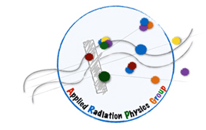

Design of a tracking device for on-line dose monitoring in hadron therapy
S. Muraro
for
INSIDE collaboration

Slide 2
Outline
Particle Therapy (PT) and monitoring
The INSIDE Project: the Dose profiler
The Dose profiler performances

Slide 3
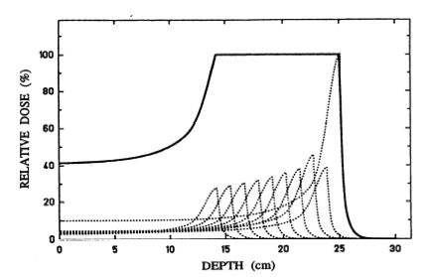
Particle therapy VS Photon RT
Protons and ¹²C beams are presently used to treat many different solid cancers.
Photon RT: small, reliable and not so expensive, 40 years R&D
Particle therapy:
Peak of dose released at the end of the track, sparing the healty tissues
Accurate conformal dose to tumor with Spread Out Bragg Peak
Greater RBE (radioresistant tumors)

Slide 4
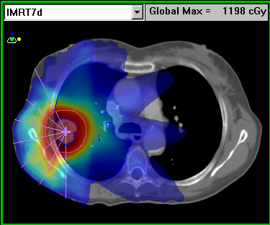
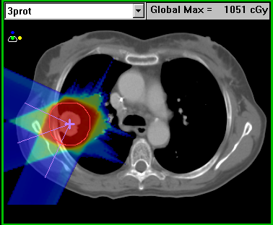
Examples of Photons vs Particle therapy
Particle therapy can show better selectivity with respect to photon techniques
IMRT
Particle therapy

Slide 5
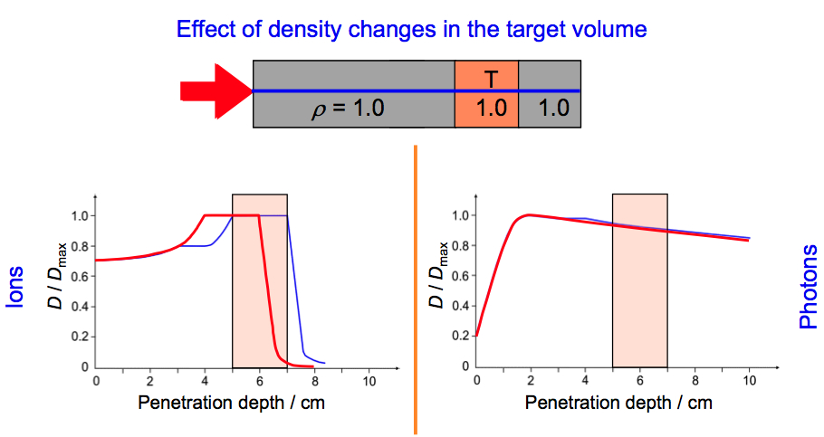
Quality Assurance & Range monitoring in PT
The peculiarity height dose release at the end of the range in PT with respect to photon RT, make crucial the dose monitoring in PT.
Inhomogeneities, metallic implants, CT artifact, HU conversion, inter session anatomical/physiological changes -> range variations
a little mismatch in density by CT ➔sensible change in dose release

Slide 6

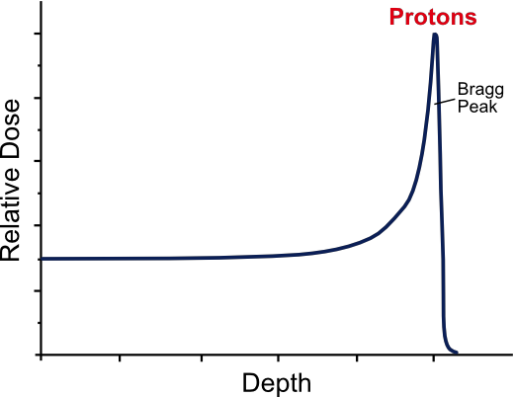





Beam range & secondary products
511 keV
The p,¹²C beam is dumped inside the patient. In order to monitor the beam the secondary particles generated by the beam interaction in the patient can be used: prompt γ’s, annihilation γ’s, neutrons and charged particles
proton
Beam
Activity of β⁺ emitters
Baseline approach
Isotopes of short lifetime ¹¹C (20 min), ¹⁵O (2 min), ¹⁰C (20 s) with respect to diagnostic PET (hours)
Low activity → long acquisition time (~minutes) with difficult in-beam feedback
Metabolic wash-out of β⁺ emitters
511 keV
prompt
neutron
Charged secondary particles (ion therapy):
The detection efficiency is almost one
Can be easily back-tracked to the emission point -> can be correlated to the beam profile & BP
They are forward peaked
Enough energy to escape from patient
MS inside the patient -> worsen the back-pointing resolution
Prompt nuclear de-excitation γ’s
~1-10 MeV
emission profile correlated with dose profile
Specific detector at present under development: collimated slit cameras or Compton cameras

Slide 7
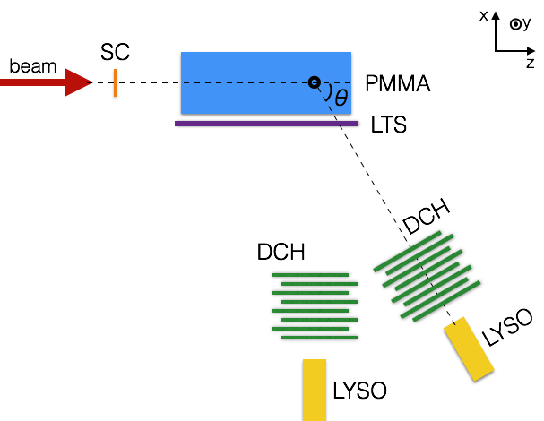
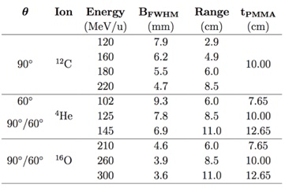
Experimental campaign
Charged fragments production
is an high cross section process
in the interactions of He, C and O beams
and is hence particularly suited for
monitoring applications of those beams.
The experimental campaigns:
Since 2011 the ARPG collaboration started a systematic characterization of the beam interaction with PMMA phantoms:
@LNS 80 MeV/u ¹²C
@GSI 220 MeV/u ¹²C
@HIT several energies: ⁴He, ¹²C, ¹⁶O

Slide 8
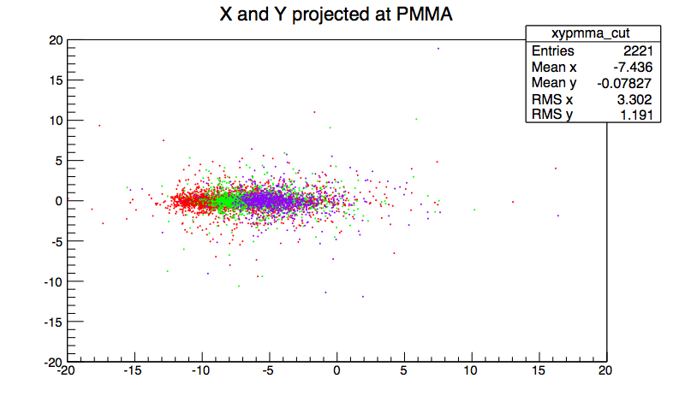
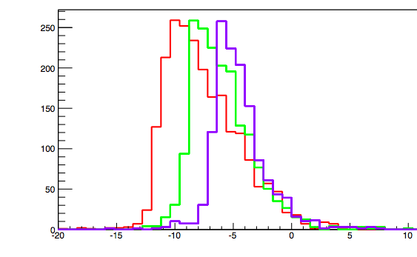
BP monitoring
A non negligible production of charged particles at large angles is observed for all beam types
The emission shape is correlated to the beam entrance window and BP position
𝚽 = Nall/(Nions ε Ω)
data
preliminary
Y (cm)
BP
He 145
He 125
He 102
Z (cm)
data
preliminary
# of tracks/0.4 cm
preliminary
BP
Z (cm)

Slide 9


Which detector should be used?
A large area detector.
The resolution of the back-tracking is limited by the multiple scattering in the patient, not by the detector resolution.
Beam
Diff between true and reconstructed emission point = Δx
Bragg
Peak
Secondary
proton
θ₀
Typical resolution on Δx is of the order of 6-8 mm
Integrating enough statistic (~ 10³ events) helps to lower the accuracy on the emission point distribution ( and then on the beam profile) to mm level ➔ detector size

Slide 10
Outline
Particle Therapy (PT) and monitoring
The INSIDE Project: the Dose profiler
The Dose profiler performances

Slide 11

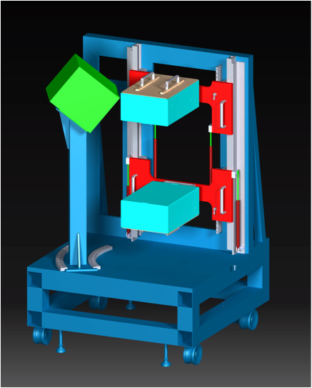






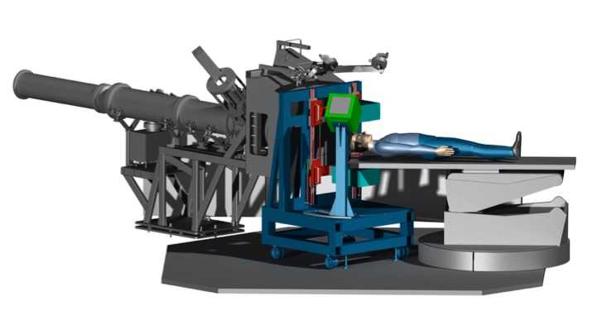
The Project @
INnovative Solutions for In-beam DosimEtry in Hadrontherapy
proton emission
Tracker +
Calorimeter =
DOSE PROFILER
β⁺ activity distribution
IN-BEAM PET HEADS
Integrated in treatment room of Centro Nazionale di Adroterapia Oncologica (CNAO)
Operate in-beam
Give an IMMEDIATE feedback on the particle range
Effective both on proton and ¹²C beam
Notes:
Based on the combination of a in-beam PET scanner and a tracking system
Aim to produce a sistem to be integrated...

Slide 12
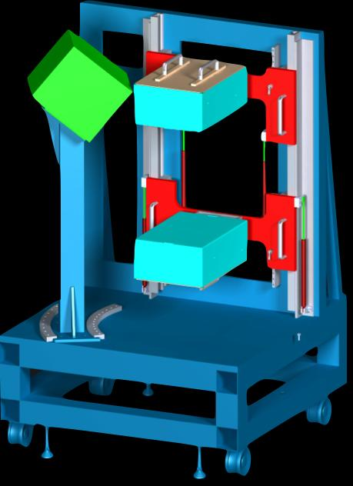
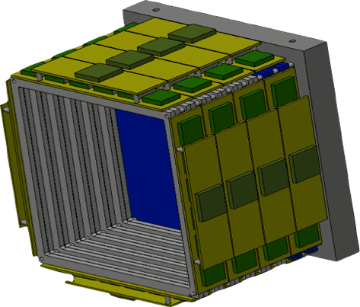
Dose Profiler (DP)
Elettronics: BASIC32, FPGA
water cooling
28 x 28 x 35 cm³
multi anode PMTs
6/8 fibre planes
calorimeter
6/8 planes of orthogonal squared scintillating fibers coupled to SiPMs
a calorimeter coupled to Position Sensitive PMTs.
Notes:
plastic scintillator: to avoid electron back scattering
Calorimeter: LYSO crystals
2 layers of 192 fibers (0.5x0.5 mm^2)
1mm ^3 sipm

Slide 13
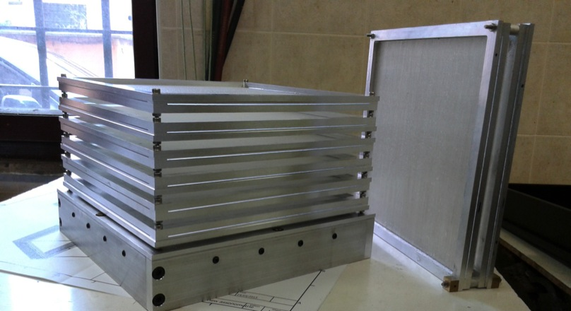
Tracker
6/8 XY tracking planes: 384 scintillating fibers (0,5 mm) per side, with the minimal plane separation (2 cm) allowed by fibers front-end electronics readout in order to increase the geometrical acceptance and the compactness of the detector.
FPGA
Readout:
Hamamatsu 1mm SiPM.
Each SiPM coupled with two adjacent fibers.
In total the 19.2 x 19.2 cm² sensitive area is read by 192 channels per layer.
32 SiPMs feed a 32 channels custom ASIC (BASIC32_ADC; F.Corsi, C.Marzocca et al. Politecnico and INFN Bari).
Plane controller: 1 FPGA every 6 BASICS32
BASIC32

Slide 14
Tracker
The system is designed to sustain a rate of 20 kHz.
rate of single p.e. is 100kHz per SiPM
BASIC integration time of 100 ns noise rate of 10 Hz
threshold of 3 p.e.
The overall noise will be reduced at trigger level
to a negligible rate by using the coincidence of 3 planes.
The spatial single hit resolution is ~ 300 μm (double fiber readout).

Slide 15
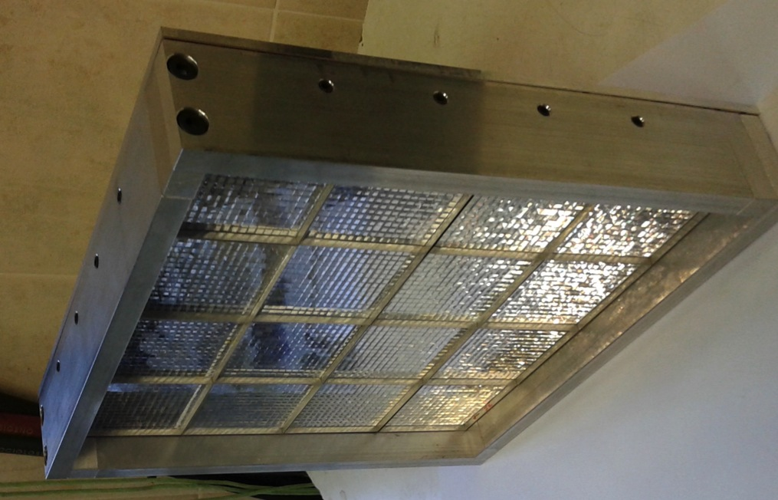
Calorimeter
The role of the high density compact crystal scintillator placed behind the tracker is to measure the protons energy helping in track reconstruction
(trigger and event selection).
64 x 64 matrix of pixelated LFS (Lutetium Fine Silicate) crystals arranged in 4 x 4 blocks (16 x 16 matrices 5 cm x 5 cm x 2 cm from Hamamatsu).
The crystal readout will be performed by means of Multi Anode Photo-Multiplier (MAPMT H8500 from Hamamatsu).
On the back, the MAPMT (MultiAnode PhotoMultiplier Tubes), the acquisition board (based on BASIC32_ADC) and the data concentrator.

Slide 16
Outline
Particle Therapy (PT) and monitoring
The INSIDE Project: the Dose profiler
The Dose profiler performances

Slide 17
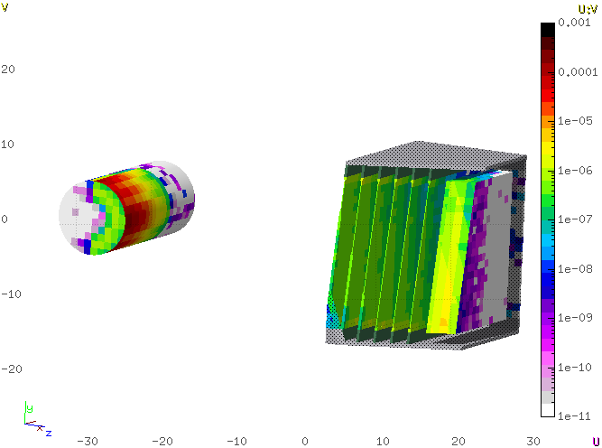
Simulation
The Monte Carlo software used for simulations is
FLUKA (release 2011.2)
The real data from the GSI data taking has been used to parametrize a MC generator.
FLUKA
L. Piersanti et al. Phys. Med. Biol. 59 (2014) 1857
Secondary
Proton
Primary Beam
The average kinetic energy of the protons of interest
is about 75 MeV.

Slide 18
Event reconstruction and analysis
Charged secondary particles are reconstructed with a track finding algorithm that starts from deposits in the fibers grouped together to form 3D clusters.
2D clusters:
fiber hits in the xz and yz views are clustered
separately by grouping consecutive hit fibers.
3D clusters: formed with all the possible
combinations of x and y clusters in a plane.
Track finder algorithm: starts from the list of 3D clusters.
Initial guess: a simple linear fit and Kalman filter is applied to take into account the multiple scattering in the detector material.
A backtracking extrapolation towards the patient is performed
to reconstruct the point of closest approach (x,y,z coordinates)
of the proton to the primary beam axis.
Notes:
Fiber hits in the x and y views are clustered
separately by grouping consecutive hit
fibers to form 2D clusters (xz and yz views).
The z coordinate of the cluster is given by the middle position of the fiber plane while the x and y coordinates are given by the middle coordinate of the two fibers read out by the same SiPM.
3-dimensional (3D) clusters are formed by taking all the possibile combinations of x and y clusters in a plane. A track finder algorithm is run to build track candidates starting from the list of 3-D clusters:
Track seeds are made from two hits in consecutive layers.
Each seed is prolonged to the subsequent layer.
The closest hit (a 2-dimentional distance is computed) to the seed prolongation is added to the track.
This is iterated until the last plane is reached and a list of track candidate is formed.
The track candidates are first parametrized as straight lines and a simple χ² fit is performed to obtain an estimate of the track parameters. A Kalman filter is also applied to take into account the multiple scattering (MS) in the detector material.
Once that an event is classied as a proton event according to the event
selection described in 4.1 the track is extrapolated back to the PMMA and
the x,y,z coordinates of the proton origin are computed as those of the point of
closest approach of the track to the beam axis.

Slide 19
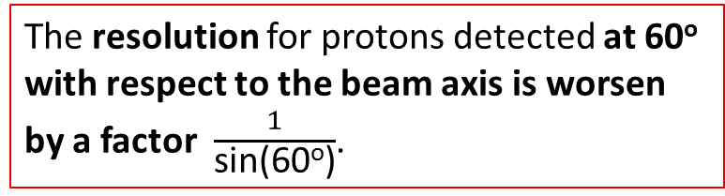
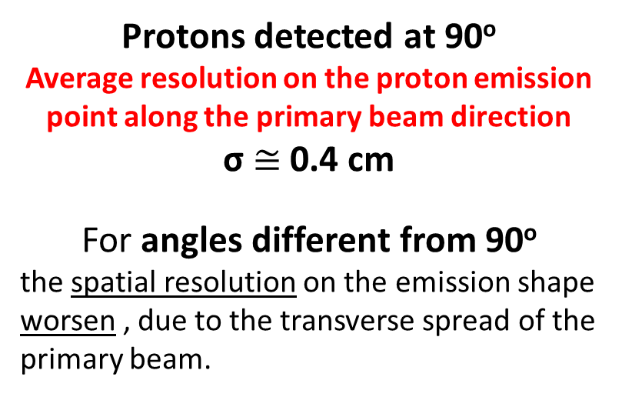
Performances
Resolution along the beam direction for protons detected at 90º
Protons detected at 90º
Average resolution on the proton emission point along the primary beam direction
σ $≅$ 0.4 cm
For angles different from 90º
the spatial resolution on the emission shape worsen , due to the transverse spread of the primary beam.
The resolution for protons detected at 60º with respect to the beam axis is worsen by a factor $\frac{1}{\text{sin}\text{(60}\text{o}\text{)}}$.
Proton track angular resolution in agreement with the expected Multiple Scattering of the proton in the patient and in the tracker.

Slide 20
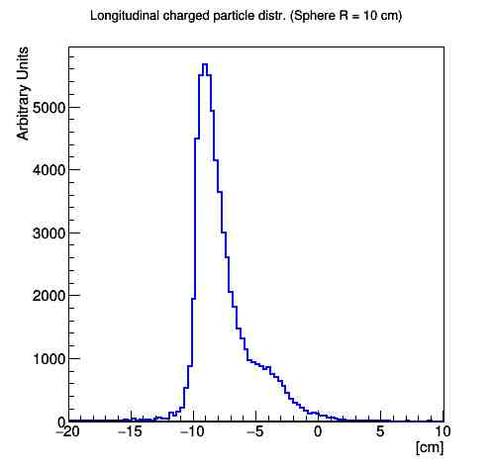
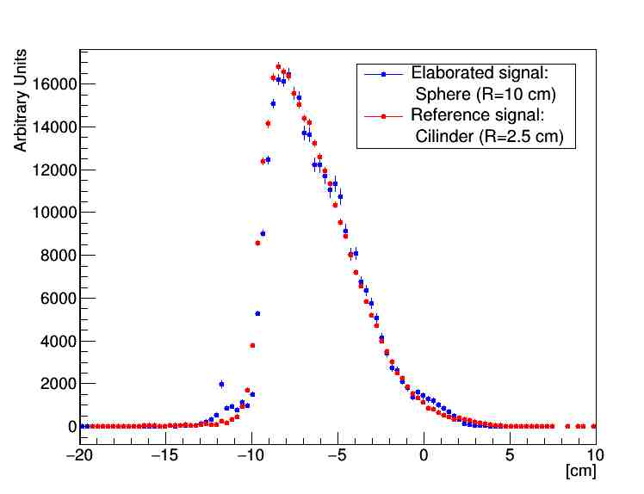
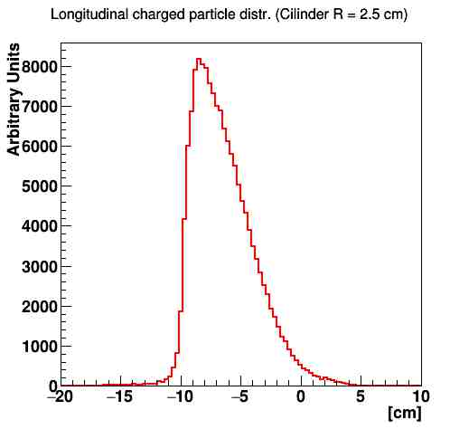
Proton emission shape attenuation inside the patient
By means of the attenuation study of the proton emission shape for different material thickness, we get a method to correlate the shape detected by the profiler coming out from the patient with the Bragg Peak position.
We apply to each reconstructed track a weight which takes into account the thickness and density of the material crossed by the proton.
Example:
inhomgeneous PMMA sphere containing a smaller sphere of lighter material
x
BEAM
L
Detector
Elaborated shape
True emission shape
True
emission
shape
Measured shape

Slide 21
Conclusions
1/2
We designed a new device
capable of dose pattern online measurements that is tailored for particle therapy applications.
It detects and reconstructs charged particles, mainly protons, coming out from the patient.
The software tools needed for the full simulation and the event reconstruction have been developed.
The detector expected resolution,
estimated by means of a detailed MC simulation,
meets the requirements set for online dose range monitoring applications for particle therapy.

Slide 22
Conclusions
2/2
We develop a method to correlate the charged particles emission shape with the measured one,
taking into account the matter absorption effect
and complex geometries.
This detector, particularly suited for carbon ion beams,
is under construction.
At present readout electronics is under test.
A prototipe will be installed at CNAO within 2016.

Slide 23
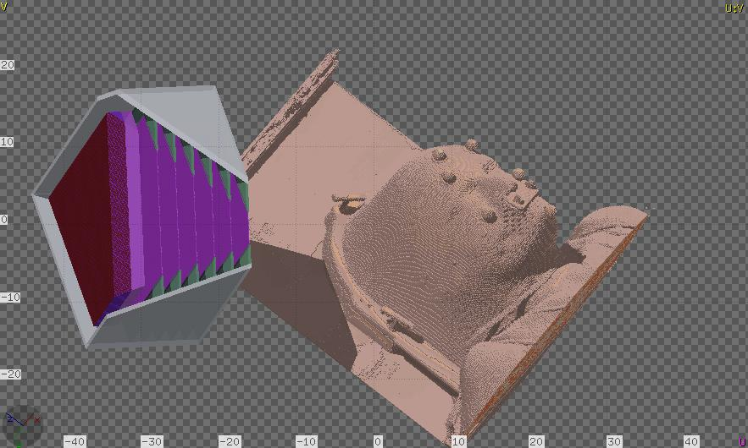
Thank you for the attention
The collaboration:
G. Battistoni, F. Collamati, E. De Lucia, R. Faccini, M. Marafini, I. Mattei,
S. Muraro, R. Paramatti, V. Patera, D. Pinci, A. Rucinski, A. Russomando,
A. Sarti, A. Sciubba, E. Solfaroli Camillocci, M. Toppi, G. Traini, C. Voena

