Slide 1

PS Booster longitudinal dynamics simulations
D. Quartullo

Slide 2
CONTENTS
Introduction
MD of 18/03/2015 on ring 3
The injection with Linac2
First simulation of the ramp
Conclusion and next steps

Slide 3
INTRODUCTION
By the end of 2015 (Finemet cavity review in Sep 2015) we should know if the current ferrite cavities C02 and C04 could be replaced safely by Finemet cavities as planned by the LIU project. The Finemet cavities have very different (broad-band) impedance.
We are planning to simulate PSB beam longitudinal dynamics to compare with the MDs results for the two different cavity configurations.
The results given one year ago (2014) at the Finemet review were not very realistic (and indeed the stability thresholds were quite low) and need to be reconsidered:
    Injection and extraction simulated separately (no ramp), initial distributions guessed by looking at the ELOGBOOK pictures.
    No feedbacks included into the simulations.
    Space charge contribution to the impedance model was scaled from the value at 100 MeV (paper by S. Hancock et al., 2000).
Nowadays BLonD is able to simulate the ramp in reasonable execution time thanks to several code optimizations.
The feedback routines have been included.
Better understanding of the PS Booster dynamics and parameters.

Slide 4
CONTENTS
Introduction
MD of 18/03/2015 on ring 3
The injection with Linac2
First simulation of the ramp
Conclusion and next steps

Slide 5
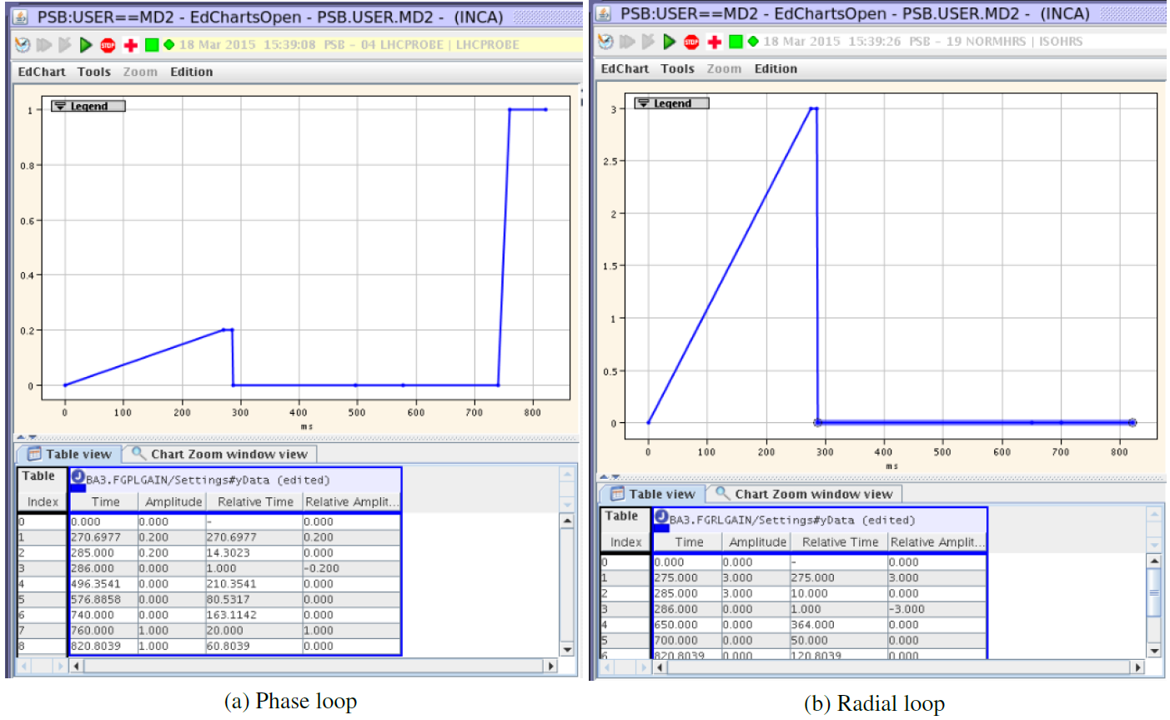
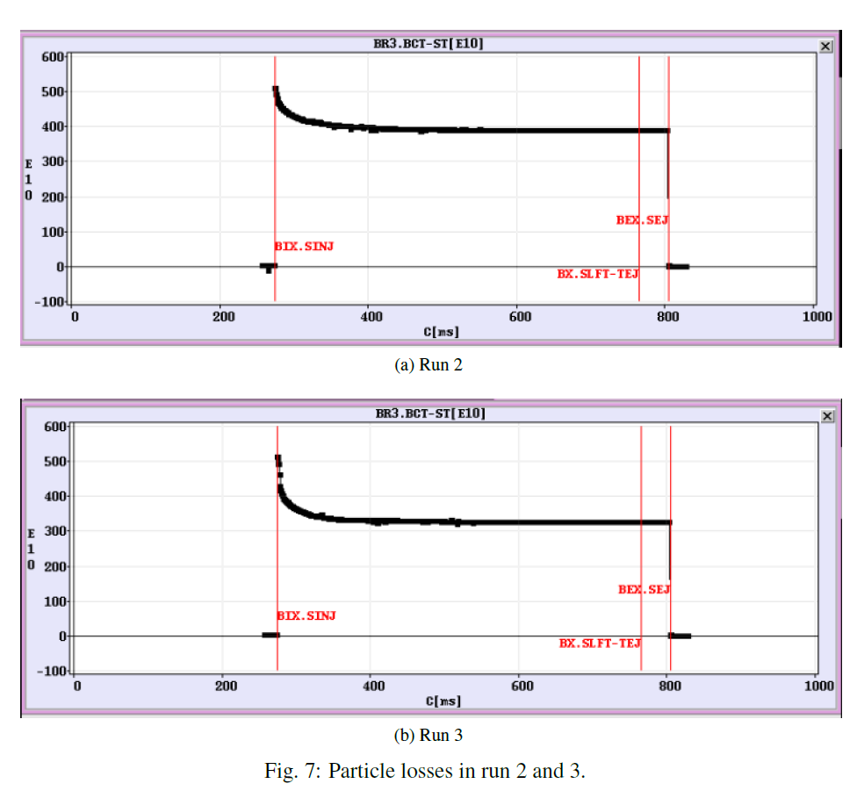
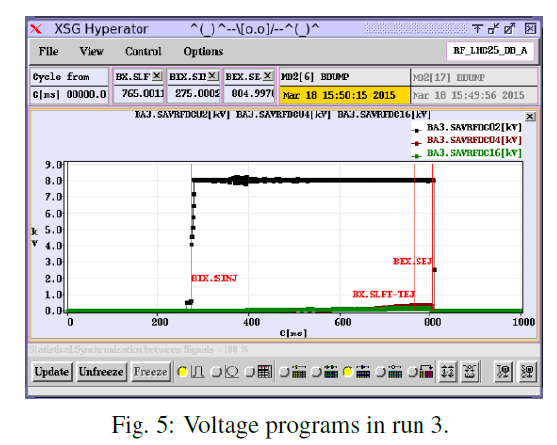

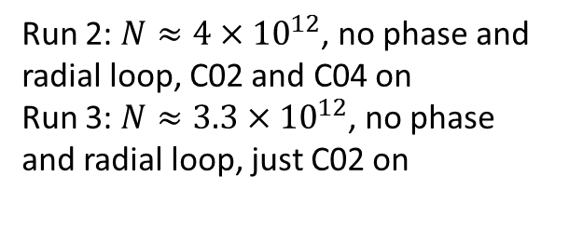
MD OF 18/03/2015 ON RING 3
MD take away: the beam seemed stable up to $N≈4×{10}^{12}$, even without feedbacks and C04 (S. Albright, A. J. Findlay, S. Hancock, J. E. Muller, D. Quartullo and E. Shaposhnikova …).
Run 2: $N≈4×{10}^{12}$, no phase and radial loop, C02 and C04 on
Run 3: $N≈3.3×{10}^{12}$, no phase and radial loop, just C02 on

Slide 6
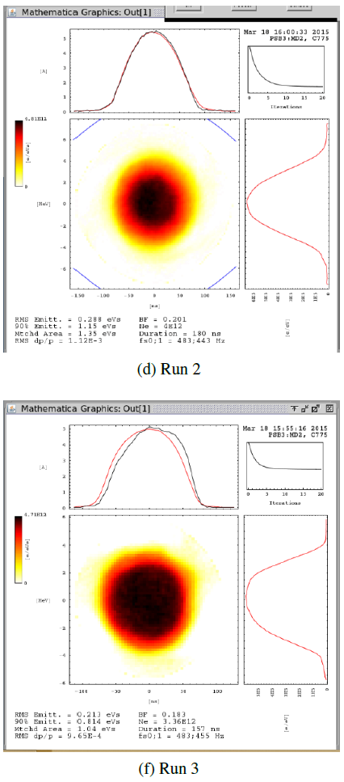
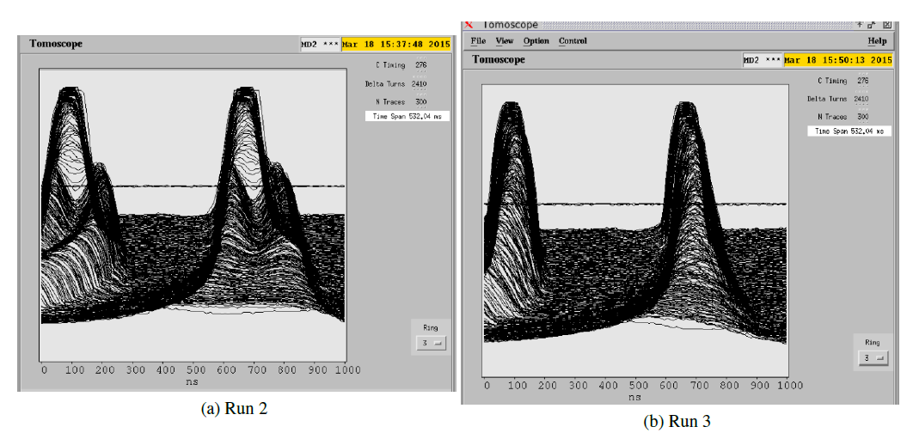
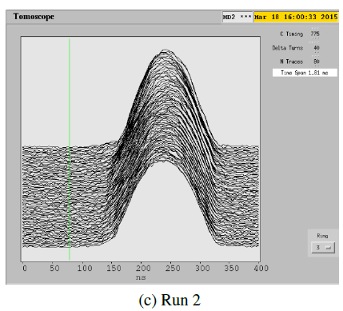
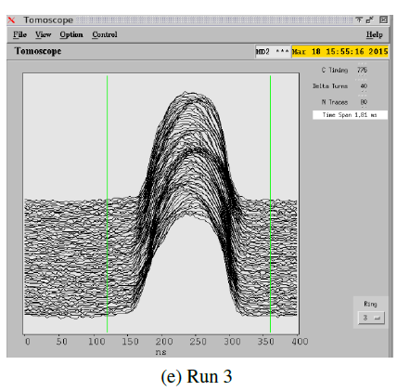
MD OF 18/03/2015 ON RING 3
More particle losses at capture on Run 3, in any case the beams were stable.
Ramp from C276 to C275
End of cycle from C275 to C276.81
Tomograms at C275

Slide 7
CONTENTS
Introduction
MD of 18/03/2015 on ring 3
The injection with Linac2
First simulation of the ramp
Conclusion and next steps

Slide 8
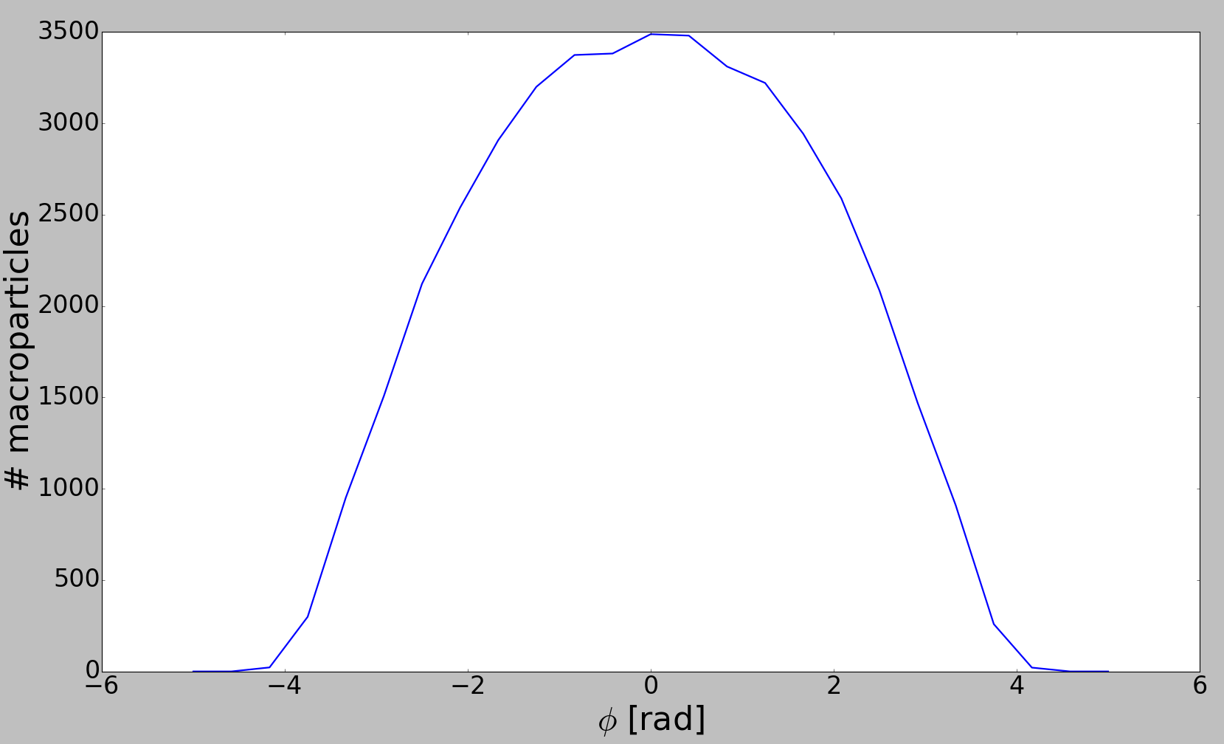
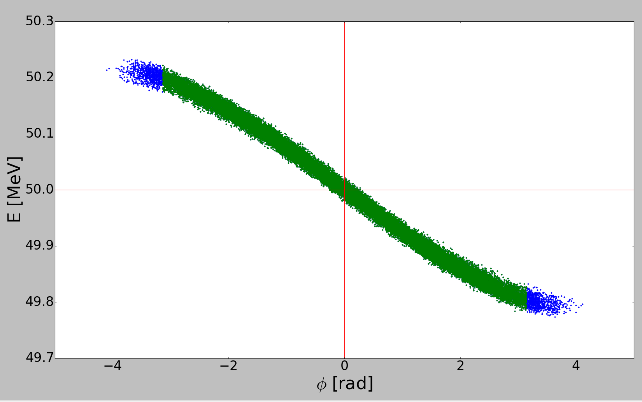
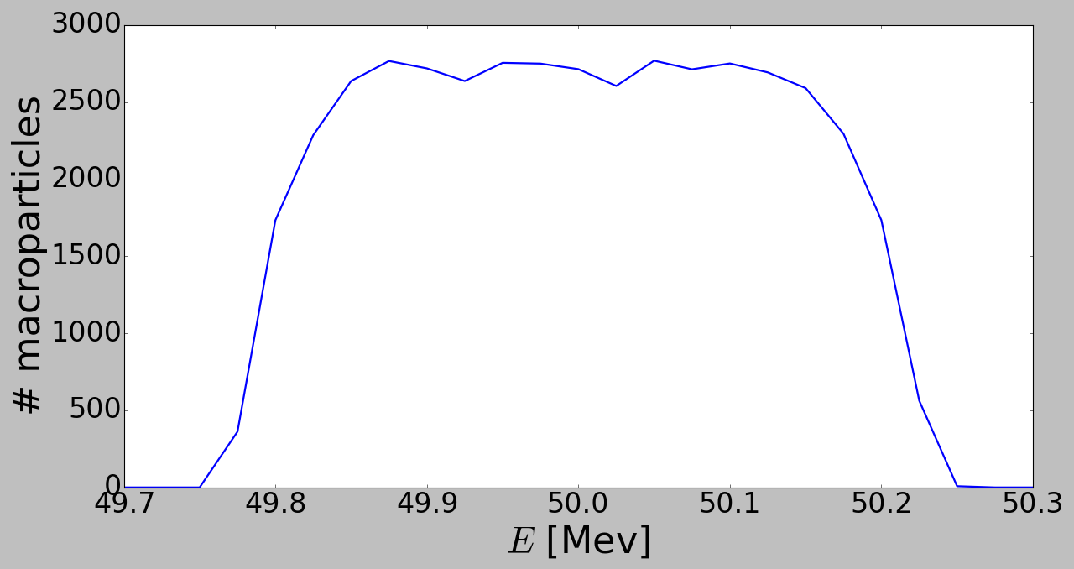
THE INJECTION WITH LINAC 2
Bunch time profile
Microbunches time profile
cavity
100 μs
90 KeV -> 50 MeV
5 ns
A. Lombardi gave the coordinates in phi-E phase space of one of these microbunches.
At the exit from Linac2 the blue ‘left-overs’ out of the frame (-π, π) mean that consecutive microbunches have not-empty intersections.
Linac2 phase space
5 ns
-π
π
Projections onto the two axis

Slide 9

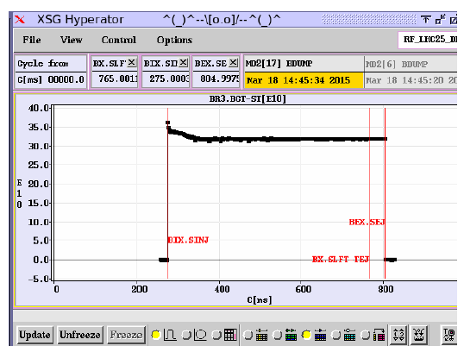
THE INJECTION WITH LINAC 2
How does the injection mechanism work? (PSB convention: Cxxx = xxx ms)
Injection of microbunches
Cavities are turned on
Unbunched beam inside the PSB, cavities off
PSB ring is empty,
cavities off
Capture terminated
C275
C276
C285
C275 + x μs
In reality the MD user doesn’t choose the number of microbunches to inject but how many turns of injections he wants:
First example from MD of 18/03/2015.
The bucket length at C275 is ≈ 1676 ns, so 1676 x 0.4 = 670.4 is the total length that the several microbunches should cover:
# microbunches ≈ 670 / 5 = 134
# particles per microbunch ≈ 2.68e9
# particles injected ≈ 134 x 2.68e9 ≈ 36e10

Slide 10
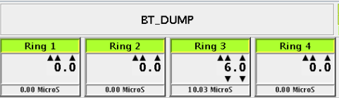
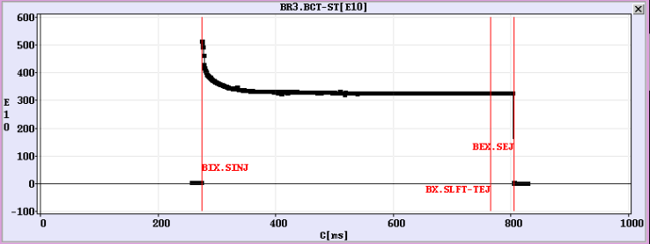
THE INJECTION WITH LINAC 2
Second example from MD of 18/03/2015:
≈ 1676 x 6 = 10056 ns is the total length that the several microbunches should cover.
# microbunches ≈ 10055 / 5 = 2011
# particles per microbunch ≈ 2.68e9
# particles injected ≈ 2011 x 2.68e9 ≈ 539e10
In BLonD the user has to define the number of macroparticles and the number of injection turns he wants to have.
Then the code calculates how many microbunches should be present in phase space and how many macroparticles each microbunch should contain to match the user input.

Slide 11
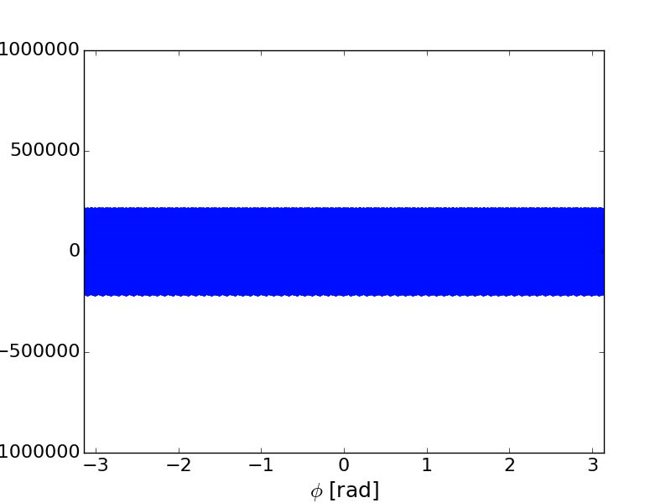
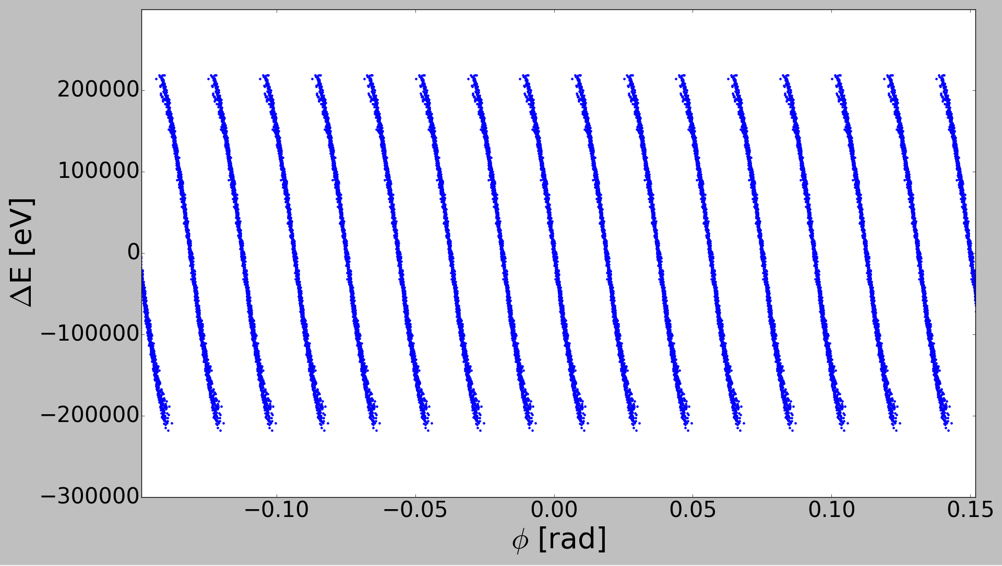
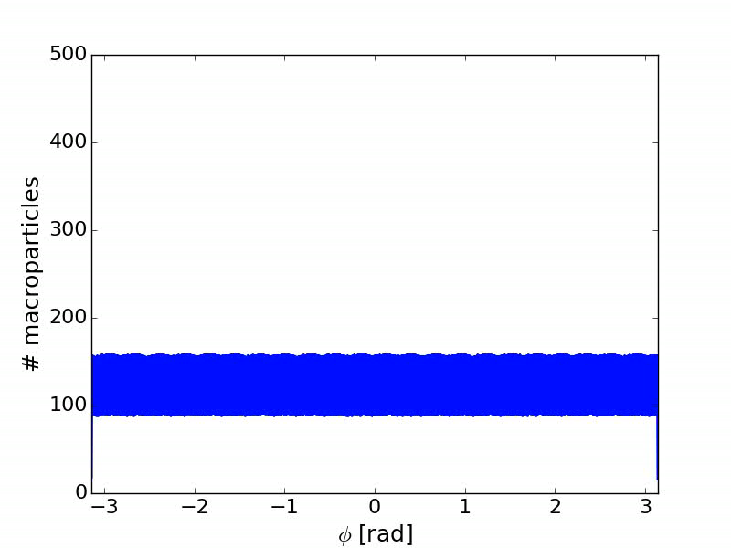
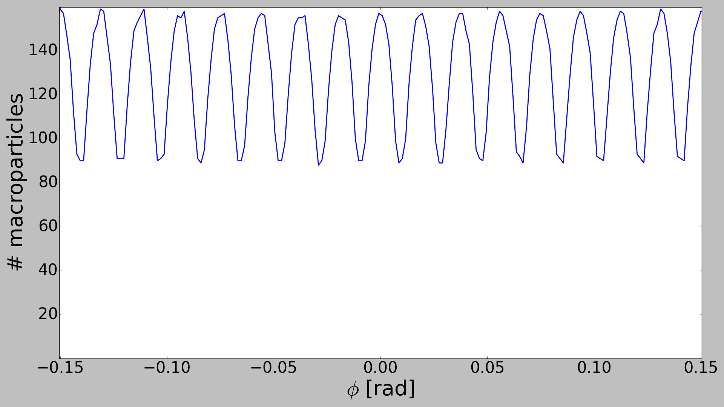
THE INJECTION WITH LINAC 2
Example: 1 injection turn = 335 microbunches, double RF (constant phase shift = π), no impedances, 4000 slices in (- π, π) to have a good resolution of the microbunches.
ΔE [eV]
zoom
C275 + 1.67 μs
zoom

Slide 12
CONTENTS
Introduction
MD of 18/03/2015 on ring 3
The injection with Linac2
First simulation of the ramp
Conclusion and next steps

Slide 13
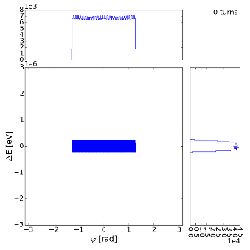
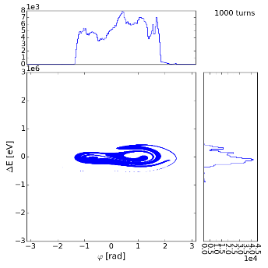
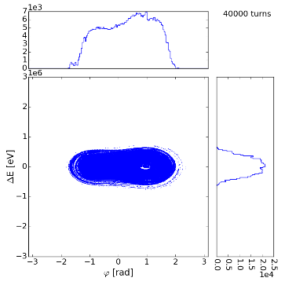
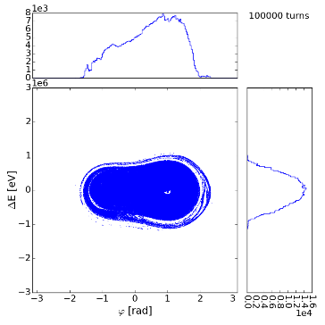
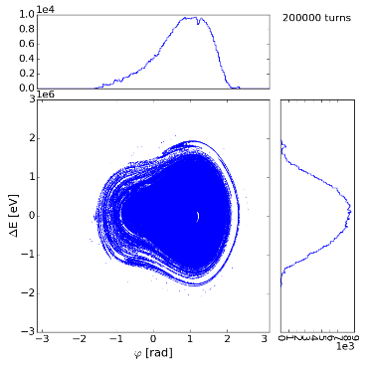
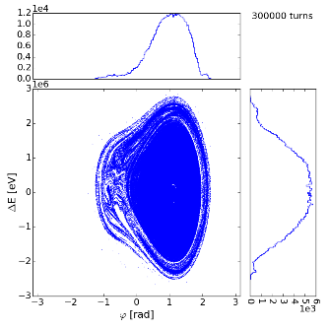
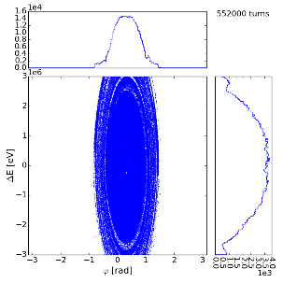
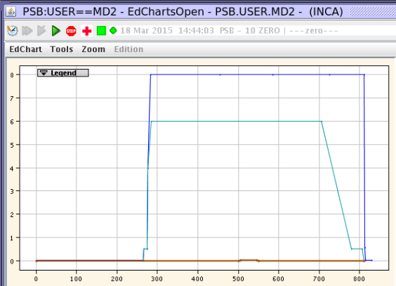
FIRST SIMULATION OF THE RAMP
Time frame: C275 – C775, number of revolution turns = 664013
Injection of microbunches
Cavities are turned on
PSB ring is empty,
cavities off
Unbunched beam inside the PSB, cavities off
Capture terminated
ramp
Bunch synchronization for PS
Extraction
C276
C775
C805
C275
C275 + x μs
C285
Example 2:
double RF with shift = π, no impedances and feedbacks, 0.4 injection turn, 5e5 macroparticles, 4000 slices.
…
The voltage of C04 cavity starts decreasing linearly in the last part of the cycle.

Slide 14
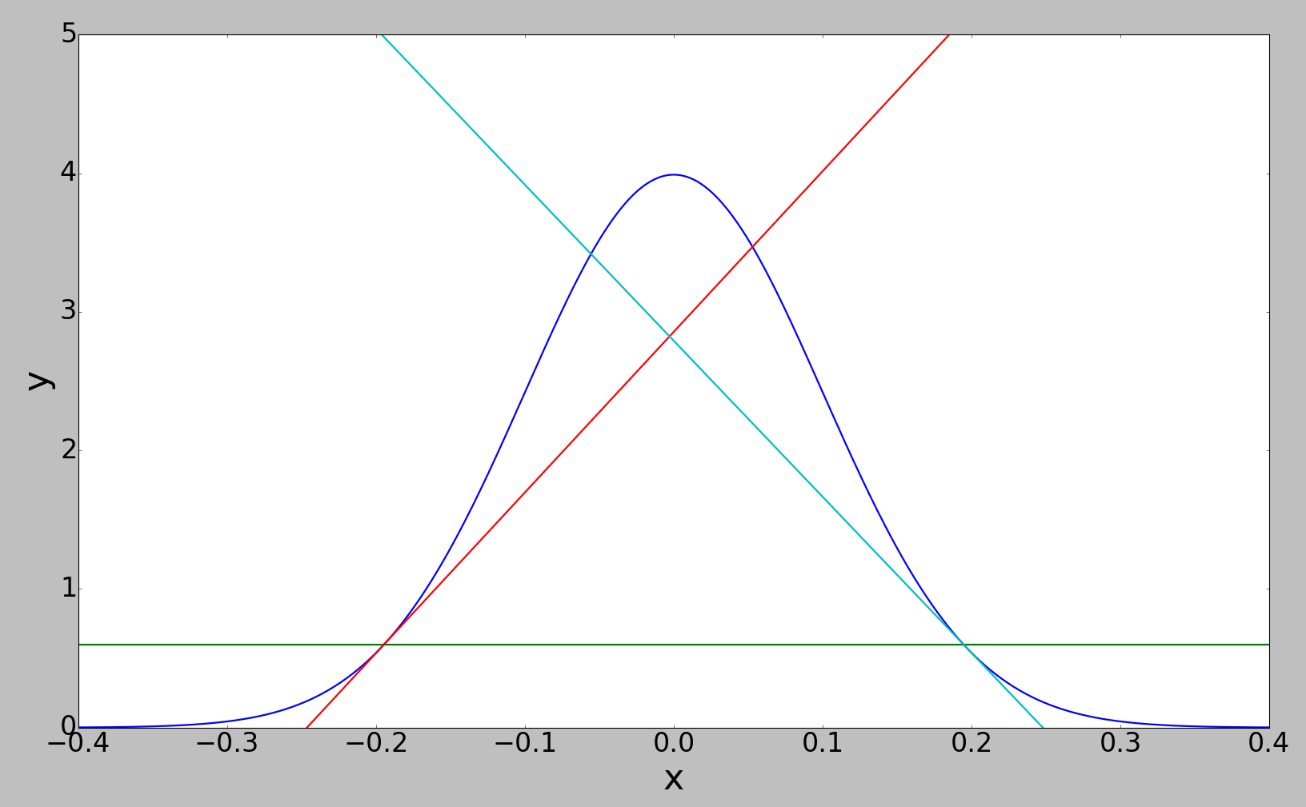
FIRST SIMULATION OF THE RAMP
The FTM (Foot Tangent method) used by S. Hancock in the tomogram to estimate the bunch length has been implemented in BLonD.
Linear fitting of the four or six nearest points
15% of maximum profile amplitude
Bunch length
From now on FTM will be used to calculate the bunch length evolution through cycle.

Slide 15
CONTENTS
Introduction
MD of 18/03/2015 on ring 3
The injection mechanism with Linac2
First simulation of the ramp
Conclusion and next steps

Slide 16
CONCLUSIONS AND NEXT STEPS
The injection from Linac2 has been implemented into BLonD.
A first simple example of ramp simulation has been presented.
The Foot Tangent Method has been introduced.
NEXT STEPS:
Periodicity and particle losses
Phase program between the two cavities
Impedance model
Multi-turn wake
Phase loop

