Slide 1
Double Phase LAr LEM-TPC Detector
Ian Broderick
Advisors:
Sebastien Murphy
Shuoxing Wu

Slide 2
Concept
Liquid Argon
  Cheap
  Dense
  Scintillation properties
  Electrons are not reabsorbed after ionization
Double Phase
  Electric field causes electrons to drift through liquid to gas
  Multiplied and extracted through Large Electron Multipliers

Slide 3
Time Projection Chamber
Anodes collect free electrons, read current pulses
  X-Y plane
Z coordinate obtained through electron drift velocity
Three dimenisonal view of particle track

Slide 4
Qscan
C++/ROOT software for reconstructing and analyzing particle trajectories
Identifies hits above specified threshold
Groups hits into clusters
Strings clusters into tracks

Slide 5
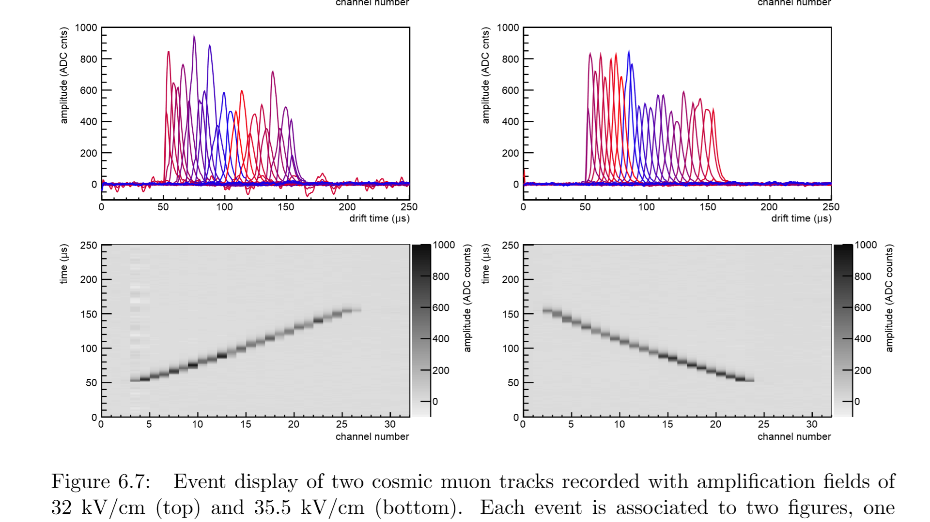
Qscan

Slide 6
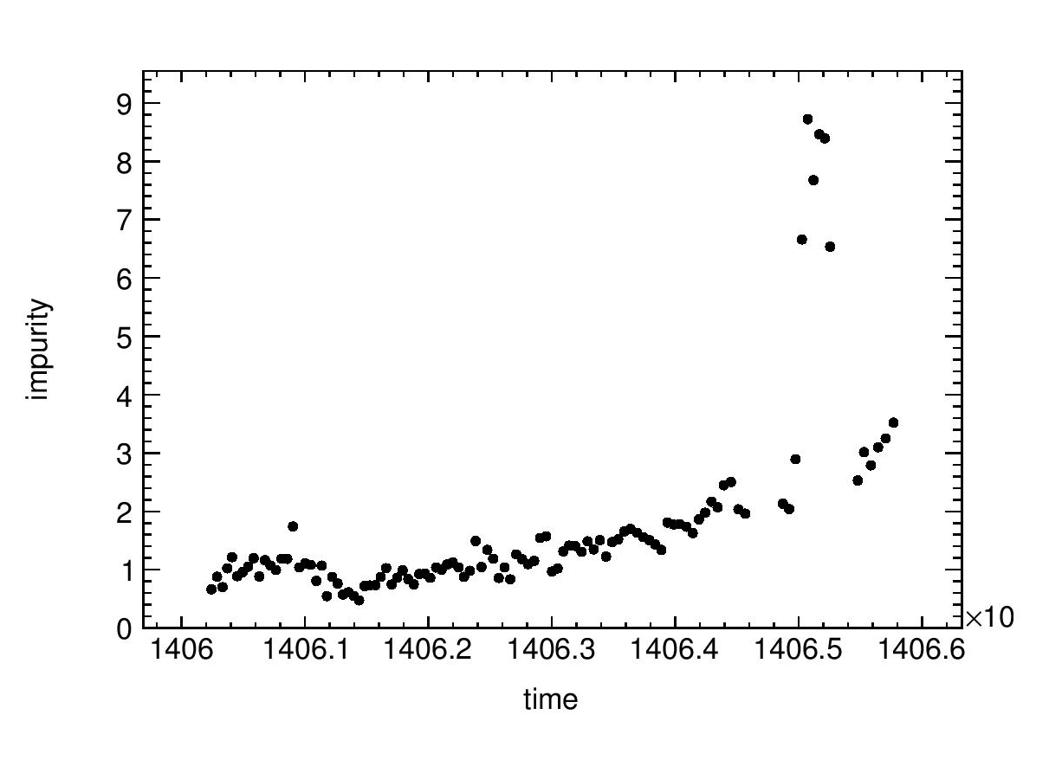
Purity Correction
Over time, oxygen leaks into detector
Oxygen absorbs electrons
dE/dx decreases over time, must be corrected

Slide 7
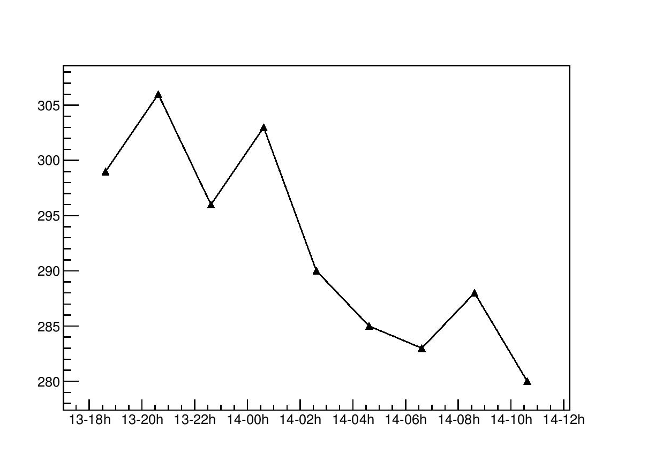
LEM Sparking
Apply high voltage to LEM
Sparking at breakdown voltage cleans LEM
Test for imperfections

Slide 8
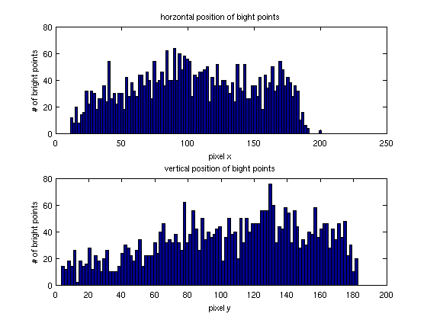
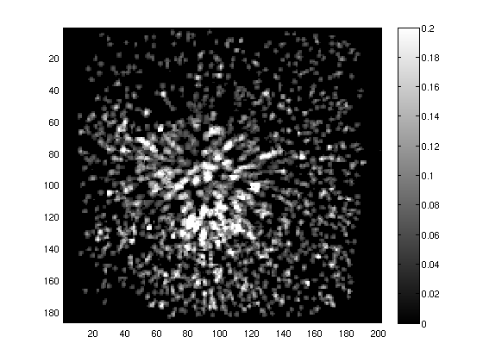
LEM Sparking

