Slide 1
Design of Beam Line for Ion Transport at Low Energies and The Ejection of Specific Ions From Electron Beam
Brice Cannon†**
Research Advisor (s): Fredrik Wenander **, Anna Gustafsson**
Supervisor: Alexander Herlert**
CERN**,Norfolk State University†

Slide 2
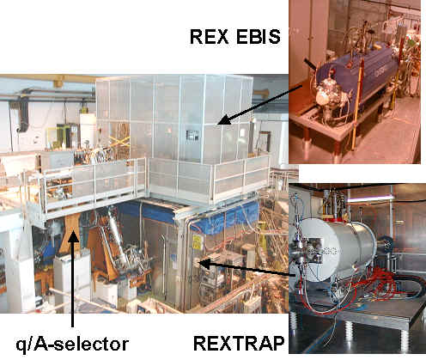
Introduction
ISOLDE
REX-ISOLDE
  Beam Line
EBIS
  RF-Field
Conclusion
Experiences

Slide 3
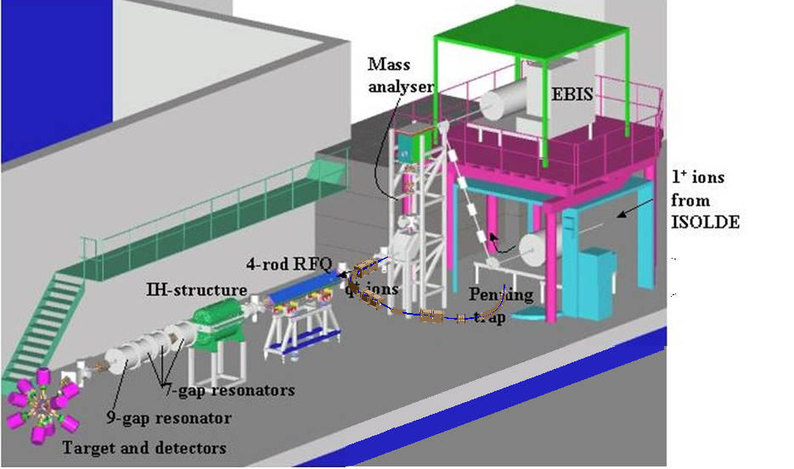
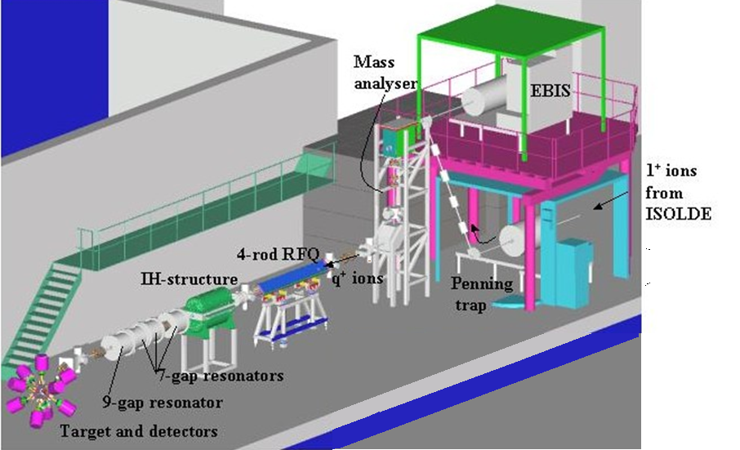
ISOLDE & REX-ISOLDE
Notes:
3

Slide 4
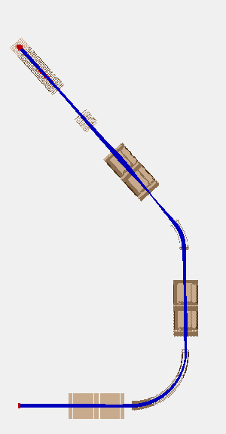
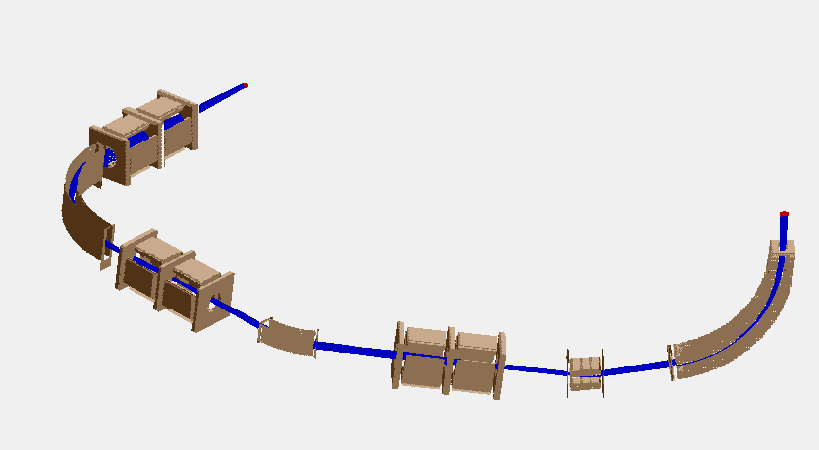
Initial Beam Line
Ions from REX-EBIS
2.96m
Ions to WITCH
Ions from REX-EBIS
1.56 m

Slide 5
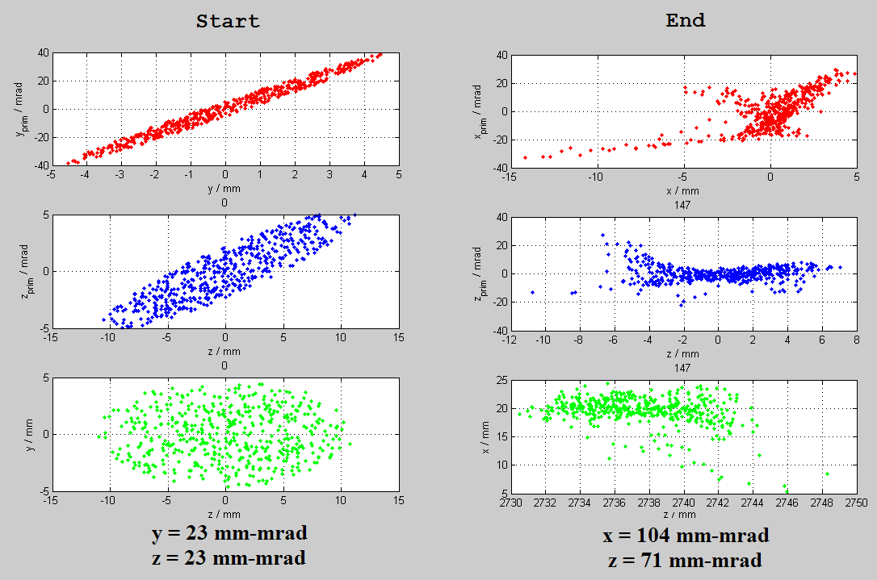
Emittance: Initial Design

Slide 6
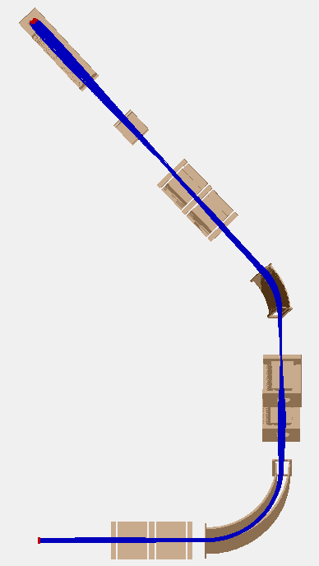
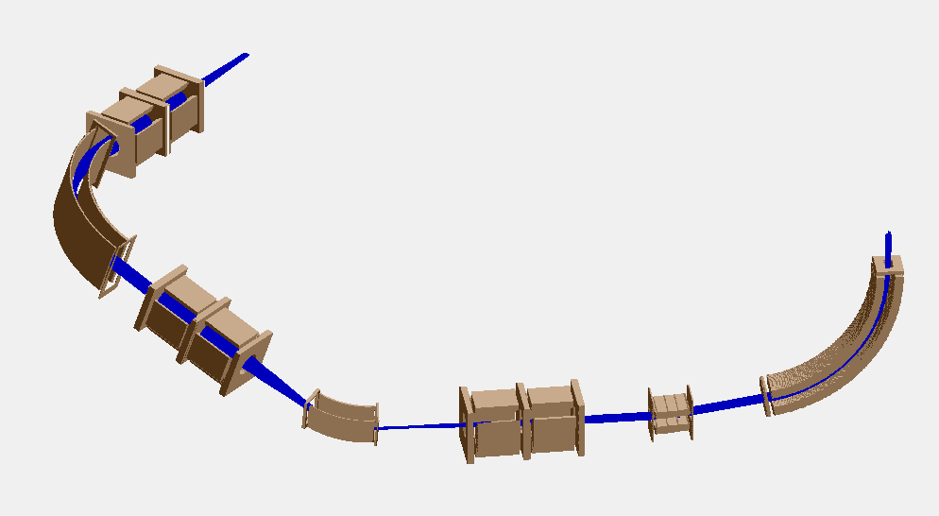
Final Beam line
Ions from REX-EBIS
Ions to WITCH
2.96m
Ions from REX-EBIS
1.56 m

Slide 7
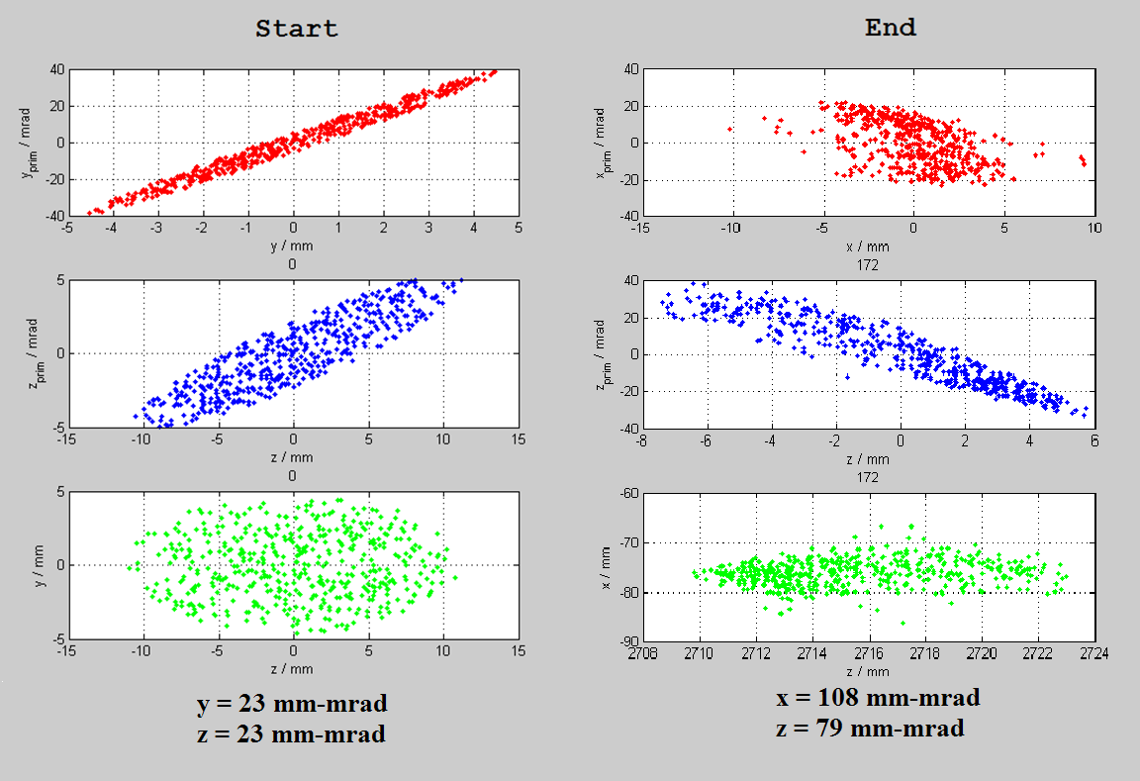
Emittance: Final Design

Slide 8
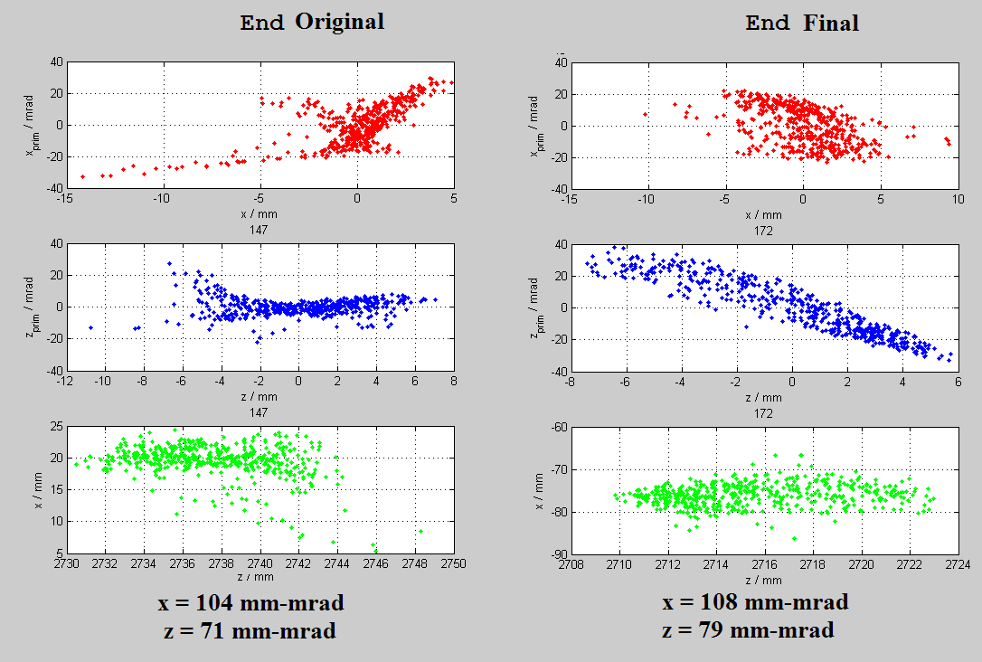
Original vs. Final Design

Slide 9
Design of Beam Line for Ion Transport at Low Energies and
The Ejection of Specific Ions From Electron Beam
Brice Cannon†**
Research Advisor(s): Fredrik Wenander **, Anna Gustafsson**
Supervisor: Alexander Herlert**
CERN**,Norfolk State University†

Slide 10
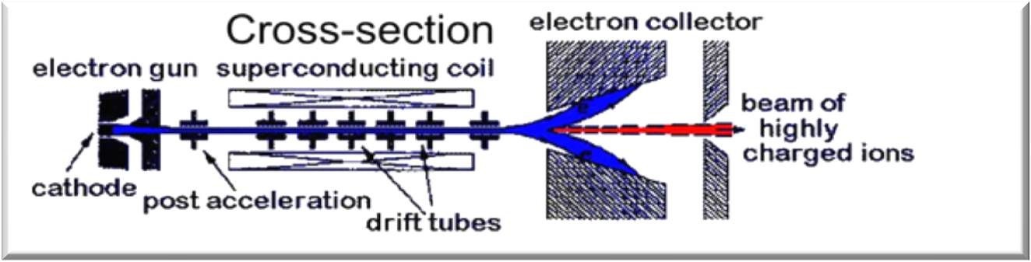
Electron Beam Ion Source
1+
xn+
4+
Maximum efficiency is ~25%
  Charge state distribution
Eject ions from electron beam
  Orbit around beam
Higher efficiency
6+
1+
4+
A/q
2+
1+
A/q

Slide 11
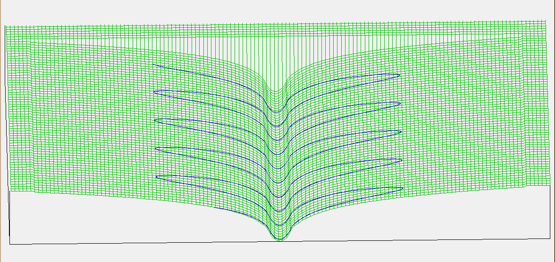
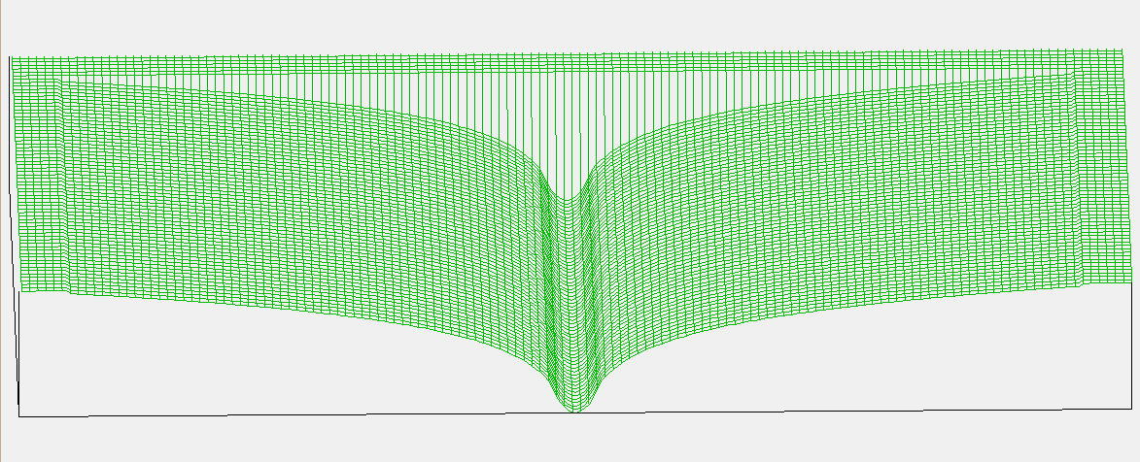
Electron Beam Potential
Direction of Electron Beam
0 V
-490 V

Slide 12
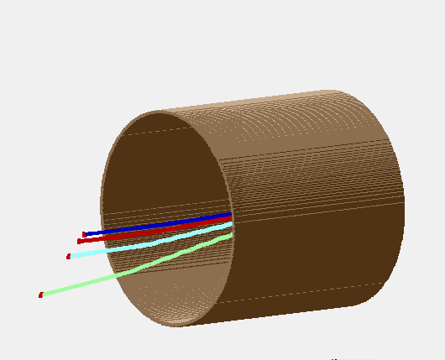
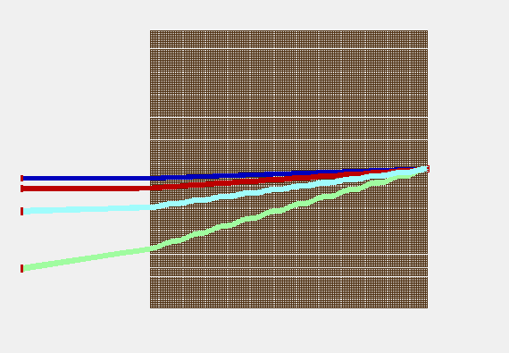
Results of EBIS RF-Field
Angular velocity of 15 rad/µsec
RF voltage of 250 V
¹⁶O
1+
10 cm
2+
4+
8+

Slide 13
Conclusion
100% transmission for beam line to WITCH experiment
  Further development of the beam line and construction
All components of the EBIS simulation with RF-field are complete individually
  Implement the EBIS with RF-field into different program and test

Slide 14
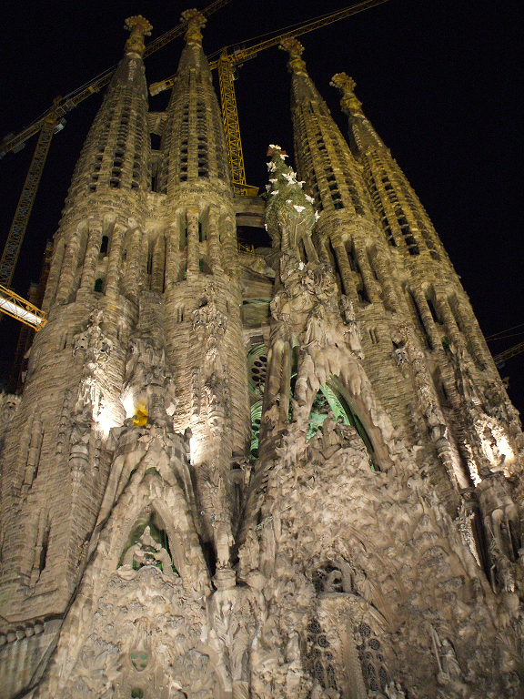

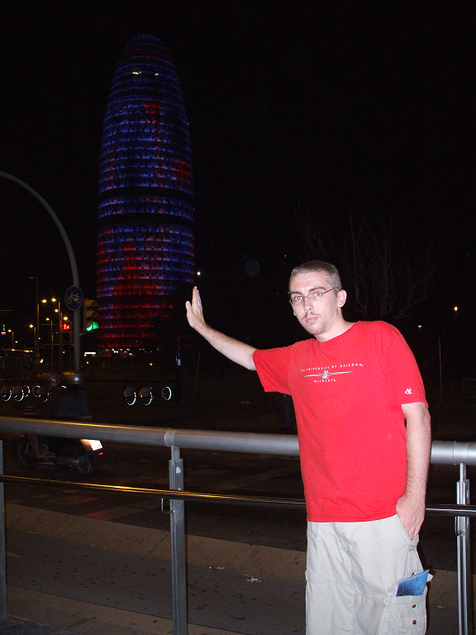
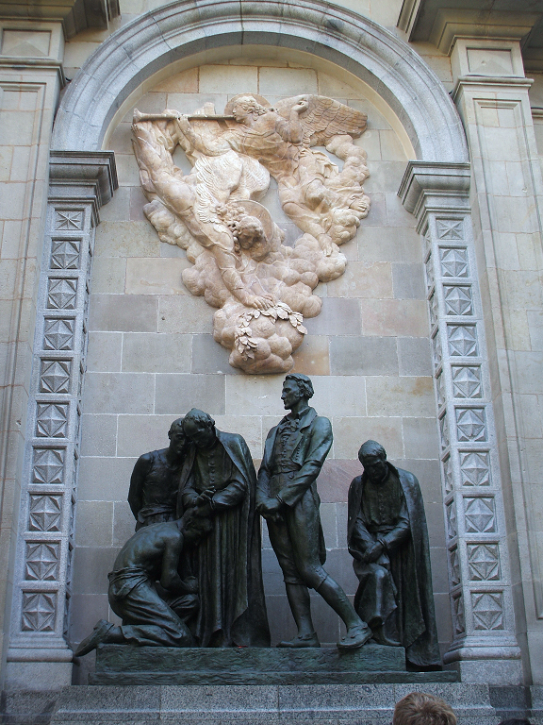

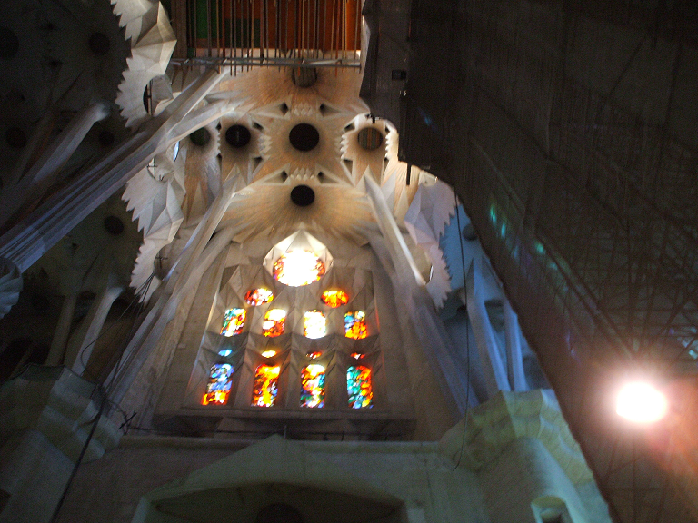
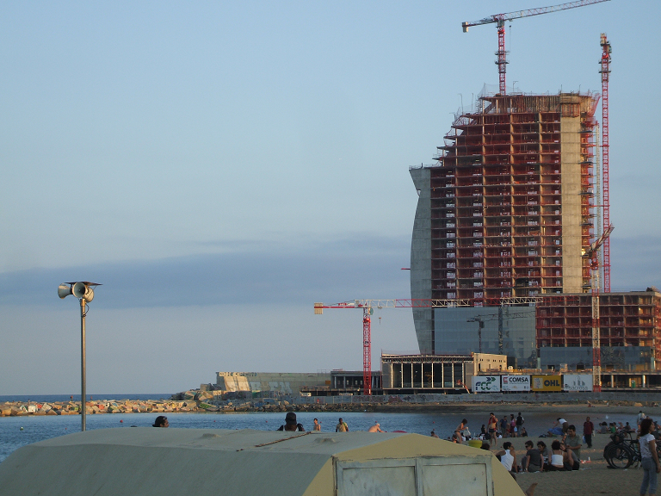

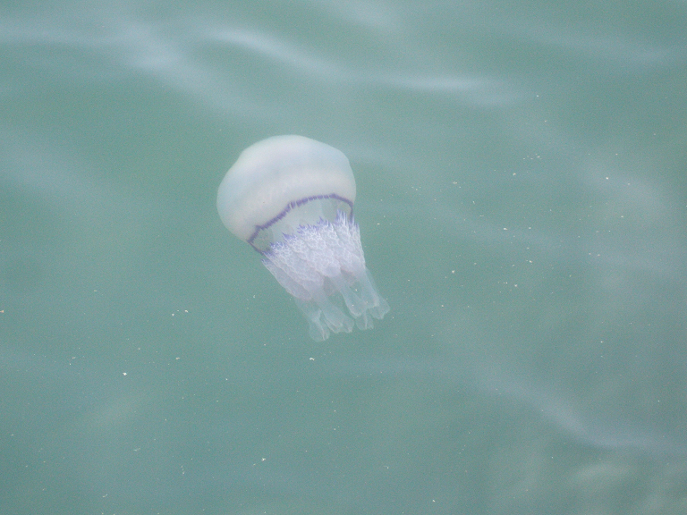




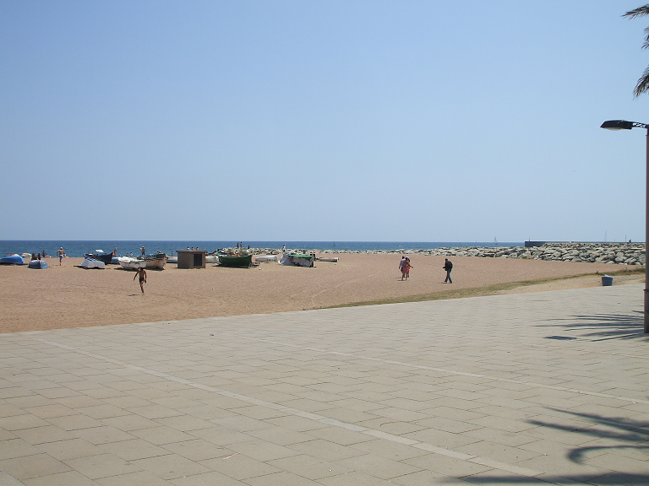
Experiences

Slide 15
Questions
Questions?

