Slide 1
Status of fabrication
Anastasiya Solodko

Slide 2
Fixed Gap System (existing)
N | Requirements | Status | Responsible
1 | New spacers (t=0.5 mm) CLIASTND0137, 10 pieces to be ordered from Andalo Gianni | https://edh.cern.ch/Document/SupplyChain/DAI/6005300 DAI – rejected by Michael John BARNES | Hugo Alistair Day
2 | New LE, CLIASTND0077, 20 pieces | In progress: Said was contacted, TS prepared, launch price inquiry | Anastasiya Solodko, Lukas Pazdera
3 | Additive manufacturing of the LE | Drawings are in progress, gap is not guaranteed | Anastasiya Solodko
4 | Increase the holes in the next dielectric spacer from 10 to 17 mm | To be confirmed

Slide 3
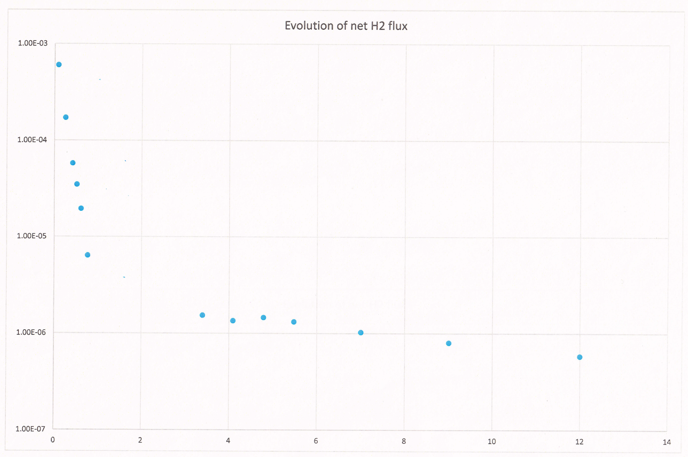
Baking results (9 electrodes + 8 small samples)

Slide 4
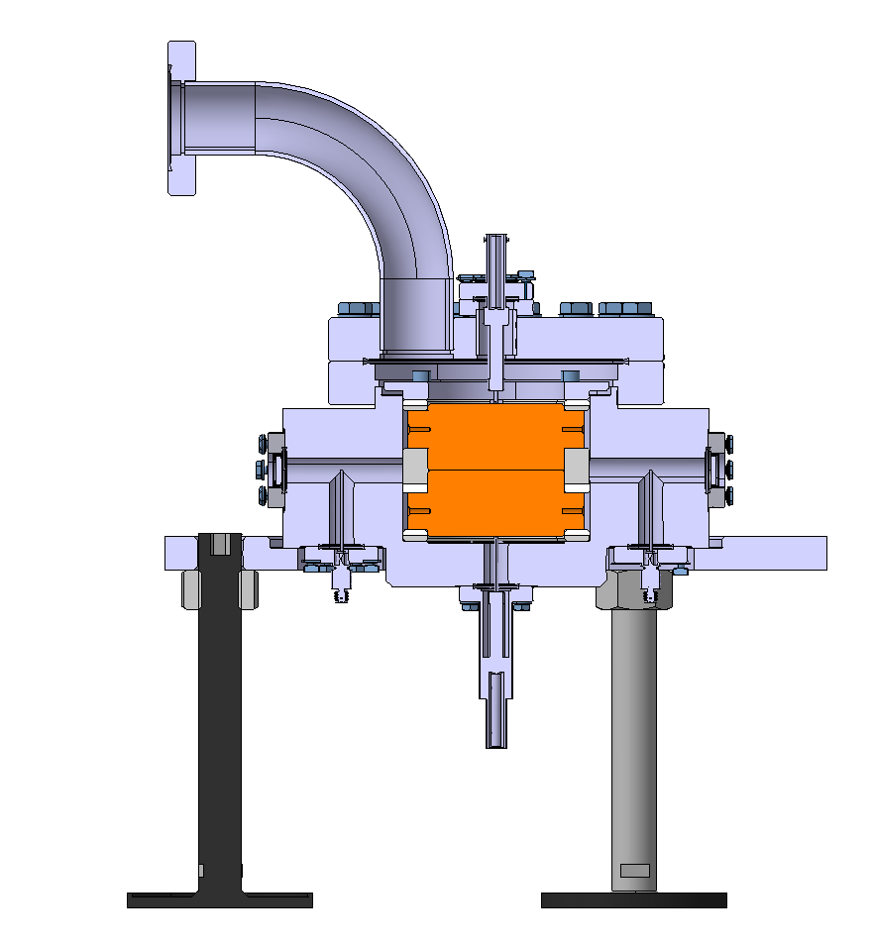
Fixed Gap System (new)
N | Requirements | Status | Responsible
1 | Increase the windows 30-40 mm windows (diameter) and 40 mm holes in the spacer
2 | Smaller electrodes
3 | Bigger chamber
Windows

Slide 5
Fixed Gap System (handling)
N | Requirements | Status | Responsible
1 | Transport/storage box to be designed for LE |  | Anastasiya, Serge
2 | Handling instruction to be created |  | Anders

Slide 6
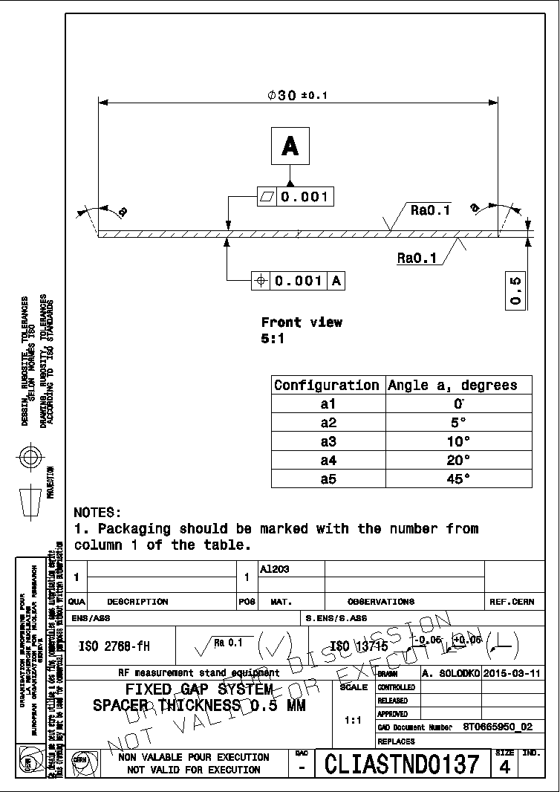
EXTRA (new spacer)
(x2) problem with Budget code
“Dear Maria,
This DAI should be kept “on-hold”, please, for the present time. Thanks.
Regards,
Mike” – Mike Barnes

Slide 7
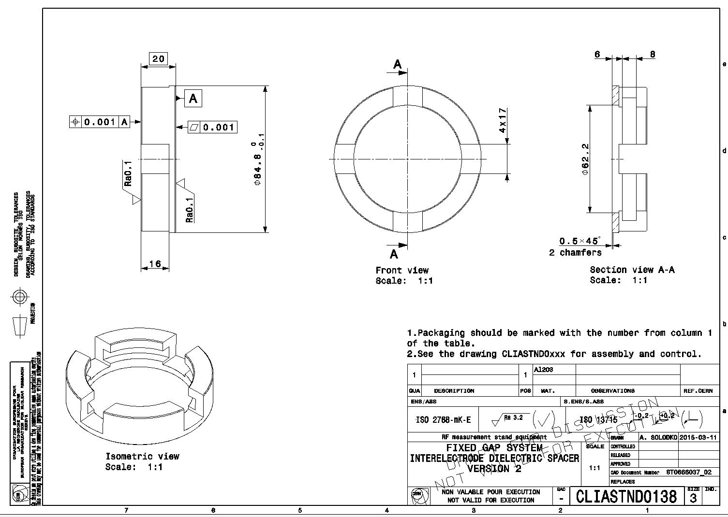
EXTRA (new dielectric spacer)

Slide 8
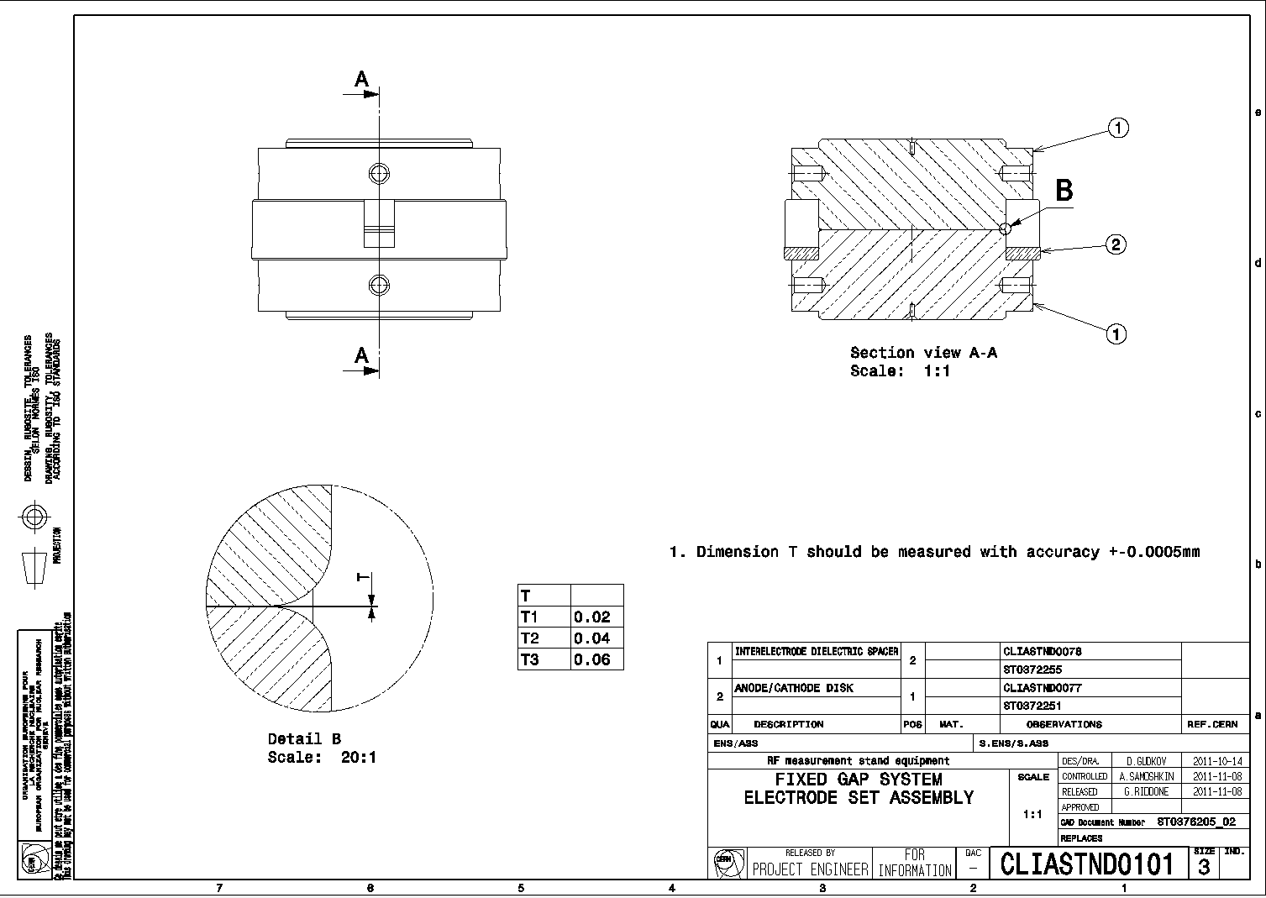
EXTRA (assembly)

