Slide 1
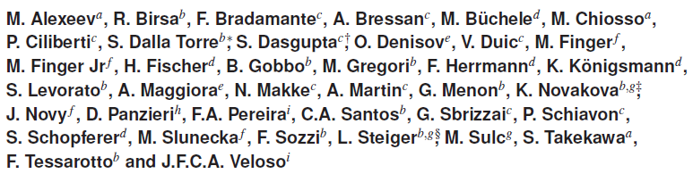
The gain in THGEM multipliers and its time-evolution
S. Dalla Torre
based on the M. Alexeev et al. 2015 JINST 10 P03026
also published as RD51-NOTE-2015-001

Slide 2
INTRODUCTION
It is a SUMMARY of our studies about gain in THGEMs
Its dependence on geometrical parameters
Its time evolution
  Relevant to evaluate its impact in experiments
  Gain time-evolution observed in detectors with open insulator surfaces ( Iarocci tubes, MSGCs, GEMs, …)
Part of the material has already been shown in past RD51 meetings

Slide 3
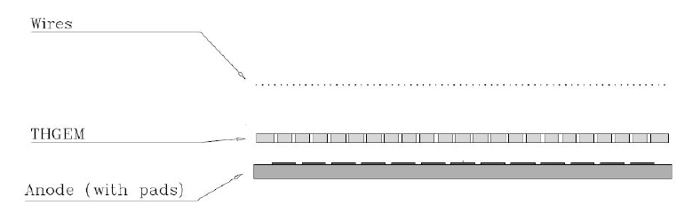
METHOD
Single layer
Gas: Ar : CO₂ = 70 : 30
X-ray source
measuring anode amplitude and/or
the current absorbed by all the electrodes
~50 different geometries studied over yaers → here a summary of the conclusions with examples

Slide 4
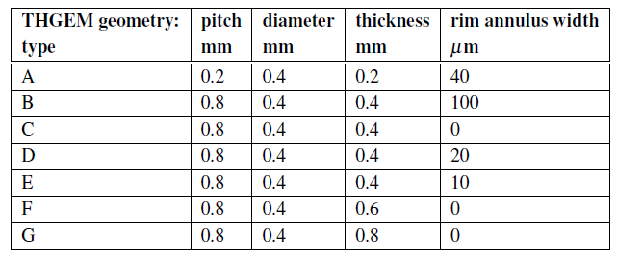
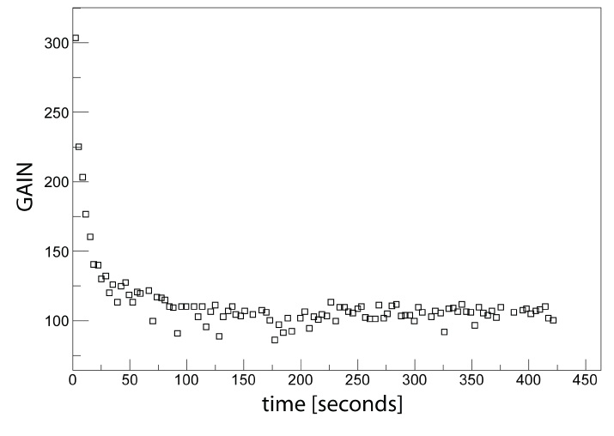
TIME-EVOLUTION OF THE GAIN:
2 DISTINCT PHENOMENA
Fast evolution (~ 1’-20’)
  Due to charge accumulation at the free dielectric surface
  Time duration depends on open surface, HV, irradiation rate
  Due to the accumulated charge: E reduction
    If HV is applied too quickly, discharges at switching on
  Qualitatively understood
  Quantitatively: simulation approaches started
    M. Alfonsi et al., Nucl. Instr. and Meth. A671 (2012) 6
    P.M.M. Correia et al., JINST 9 (2014) P07025.

Slide 5
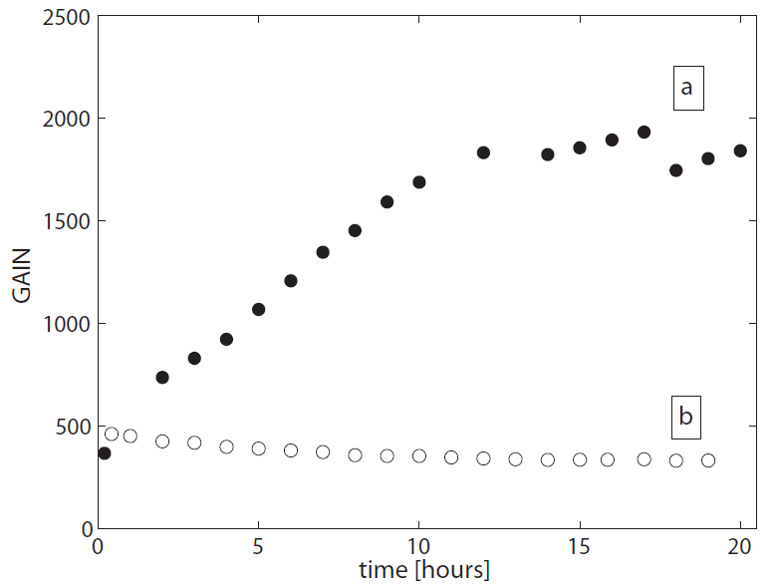
TIME-EVOLUTION OF THE GAIN:
2 DISTINCT PHENOMENA
2. Long-term time-evolution (d)
  It takes one or more days
  Δ Gain covers a large range:
  x 1.2 - 5
  The gain can rise/decrease vs time
  Understanding ?
    Due to charge mobility inside the dielectric (?)
    See later
Continuos irradiation (X-ray)
Type B, DV = 1750 V
Type C, DV = 1330 V

Slide 6
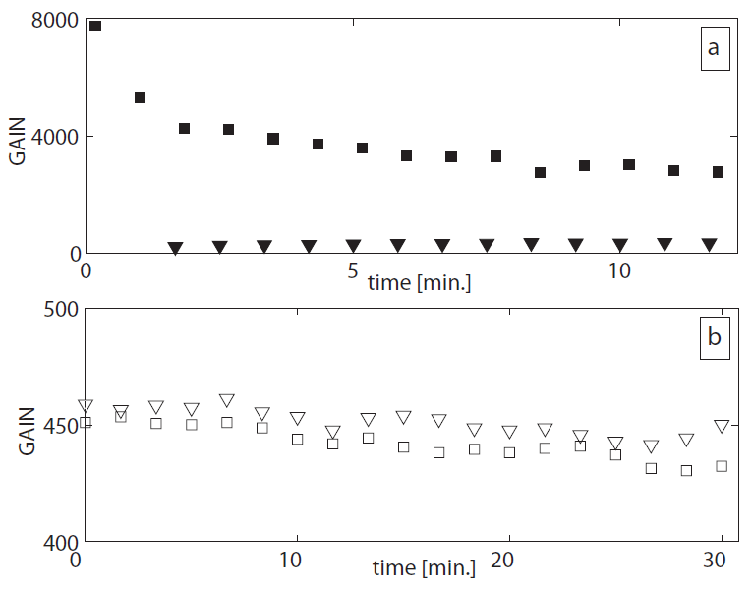
GAIN & RIM
Large rim : ~ 100 μm
  introduced to obtain large gains, up to 1 order of magniture more !
Small rim (< 20 μm) or no rim
  Largely reduced gain-evolution
irradiating with X-ray after keeping nominal voltage for 10 h without irradiation
Type B
Type C
exposing to X-ray irradiation at voltage switching on, after 24 h off

Slide 7
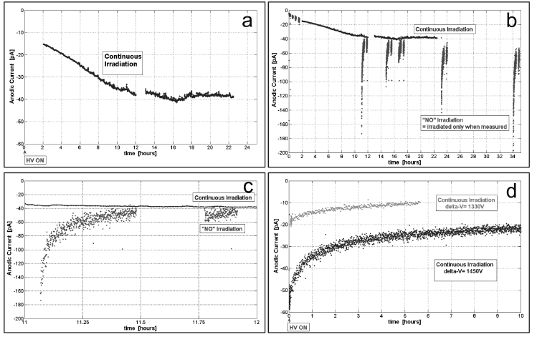
MONITORING BY CURRENTS
Type B
Type B
ZOOM
Type B
Type D
ΔV = 1330 V
ΔV = 1450 V

Slide 8
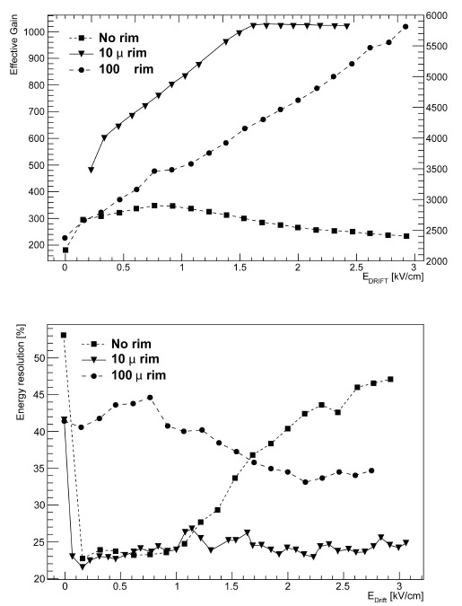
RIM & CHARGE COLLECTION
Up to E_drift as high as 3 kV/cm good resolution is not reached in spite of the large gain
→
incomplete electron collection is suggested
GAIN vs drift field
RESOLUTION vs drift field

Slide 9
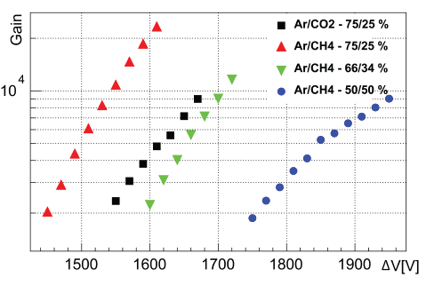
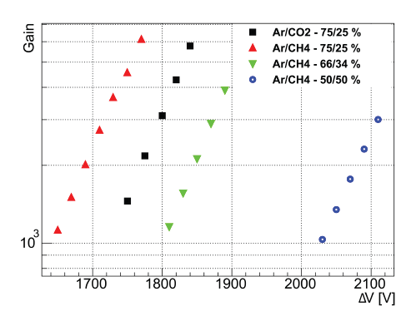
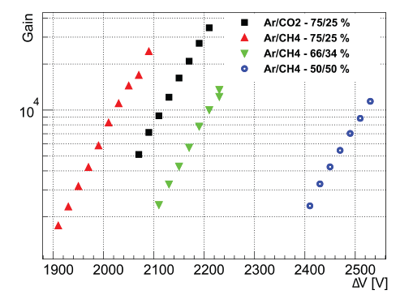
GAIN & THICKNESS
increasing the THGEM thickness, larger
maximum gain can be obtained
Type D
Type F
Type G

Slide 10
LONG-TERM GAIN-EVOLUTION:
A QUALITATIVE MODEL
A SLOW movement of ions in the PCB fibreglass when power is applied (not dielectric polarization)
EFFECTS:
The field inside a THGEM hole is modified due to the presence of a net charge distribution along the cylindrical hole wall
at the PCB faces, charge migration from the uncoated rim region toward the metallized area takes place
  REMARK: the charge accumulation is screened in the metallized region, not at the uncoated rim annulus and along the hole wall
no rim or small rim THGEMS: the charge distribution due to (i) generates an electric field opposite to bias one, while effect (ii) is absent or non dominant → gain decreases versus time
large rim THGEMS: the net charge at the rim surface due to effect (ii) reinforces the bias electric field → gain increases vs time
  When the detector is irradiated, the accumulated charge distribution partially compensates this gain

