Slide 1
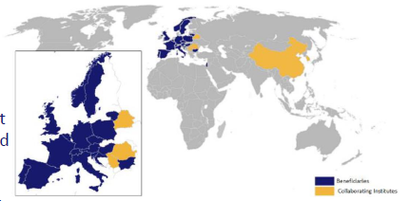
AIDA2020- GENERAL NEWS
AIDA2020
4-year programme
Project selected: 18/1/2015
Starting date 1/5/2015
Global EC grant : 10 M€
Global budget : 30.2 M€
Involved community: ~450 scientists
Project host lab: CERN

Slide 2
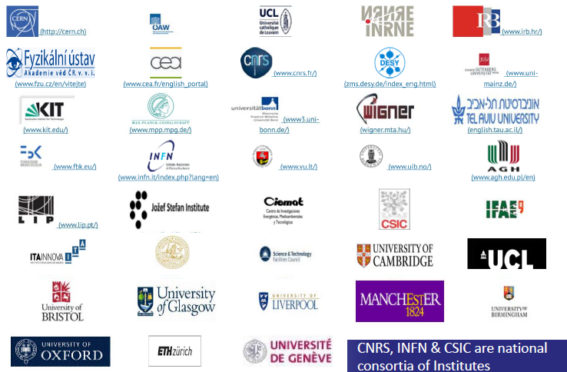

AIDA2020 - GENERAL NEWS
BENEFICIARIES (38)
+ PARTNERS &
COLLABORATORS

Slide 3
POTENTIAL INTEREST for RD51
WP13 = JRA1:
  Innovative gas detectors (next slides)
TN (Transnational access)
    support for access to test beams (also @CERN) and irradiation facilities
    You do not need to be AIDA2020 partner
    You do not need to be European
TT activities
  5-6 “Academia meats Industry” events
  Events corganized by AIDA2002 7 RD51 ?

Slide 4
POTENTIAL INTEREST for RD51
WP13 = JRA1 = Innovative gas detectors
WP COORDINATORS:
Silvia Dalla Torre, Imad Laktineh
BUDGET:
from EC GRANT: 806 k€ (MPGDs: 525)
global budget: 1900 k€ (MPGDs: 1180)

Slide 5
WP13, SCIENTIFIC ASPECTS
1/4
2 TECHNOLOGIES: the future of GAS DETECTORS
  RPCs
  MPGDs
TASKs grouped in 3 major sectors
  Advanced detector developments, namely detector R&D:
    TASK 13.2, including 5 activities
  Tools to facilitate the detector development, namely technological R&D oriented to detector development by realizing dedicated lab instruments:
    TASK 13.3, including 3 activities
  Preparation for large series production, namely establishing techniques and protocols for large size/series construction, QA, production transfer to industry:
    TASK 13.4, including 7 activities
RELEVANT points:
TT perspectives in the large majority of the WP13 activities
Work already started in the large majority of the WP13 activities

Slide 6
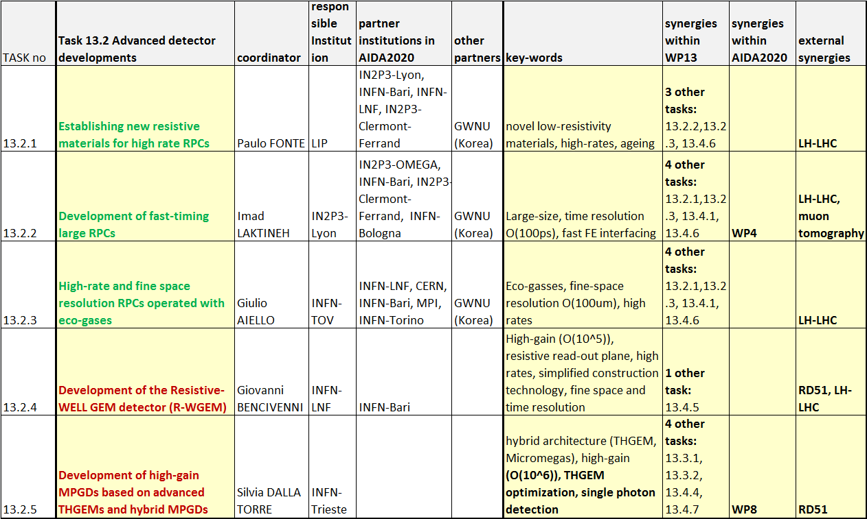
WP13, SCIENTIFIC ASPECTS
2/4

Slide 7
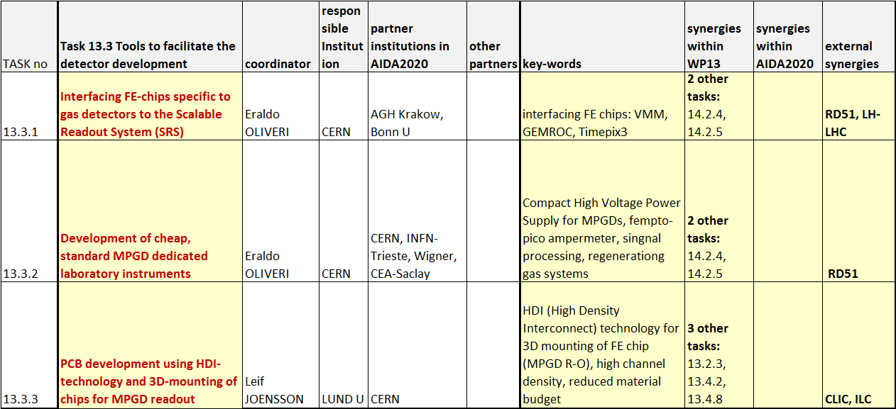
WP13, SCIENTIFIC ASPECTS
3/4

Slide 8
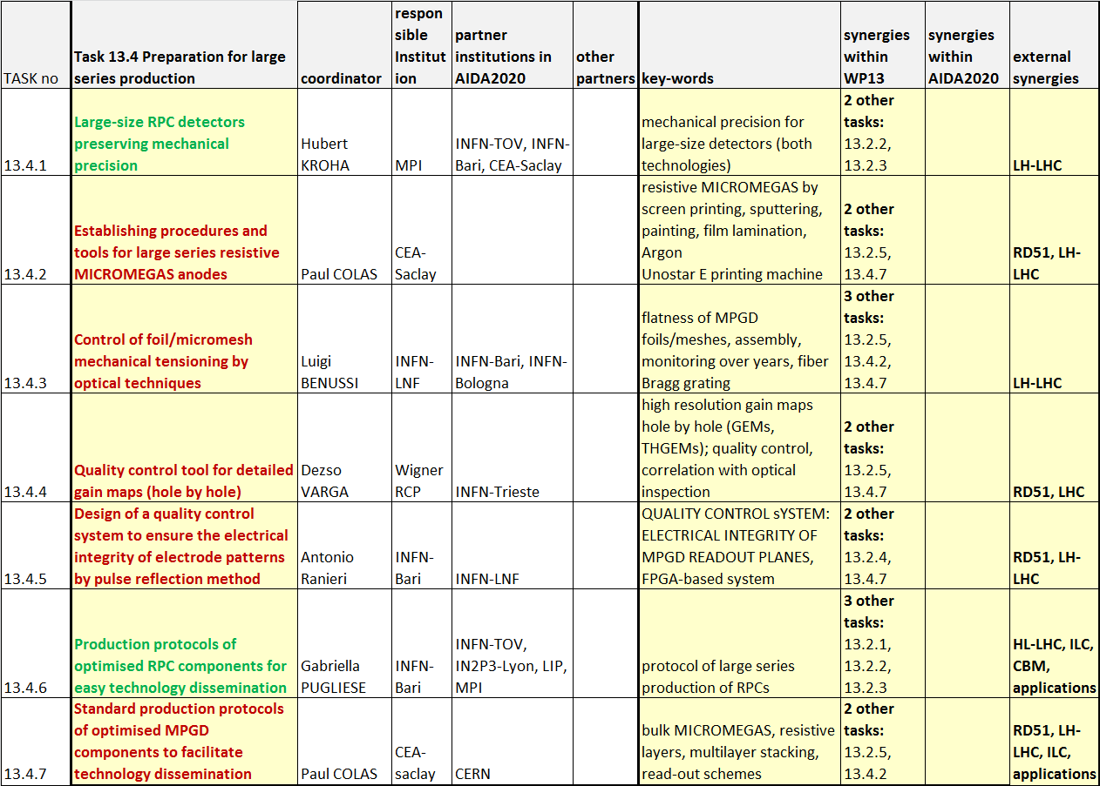
WP13, SCIENTIFIC ASPECTS
4/4

