Slide 1
R&D on resistive technology for Micromegas Bukl
Stephan Aune
03/06/2015. S.Aune

Slide 2
Goal: screen printing
Saclay MPGD workshop realizes Micromegas bulk detector since 3 years (~ 150 bulk).
In 2014 the workshop was upgraded with a serigraphy machine in order to manufacture resistive layer on top on PCB before the bulk process.
Goal of the serigraphy @ Saclay:
        Find the ad hoc process to make thin strips (thin inter strips, < 100 µm) on large surface (600 mm x 600 mm)
        Realize detector for IRFU experience with nominal resistive strips
        Make R&D with different patterns of resistive coating (strips, plain layer, pad,…)
        Make R&D with different resistive paste (dilution or carbon adding)
        Make R&D with use of insulating paste and/or silver conductive paste
        This new machine coming in addition to bulk workshop and several detector test benches in the same geographic place will allow us to make R&D iteration on resistive technology.

Slide 3
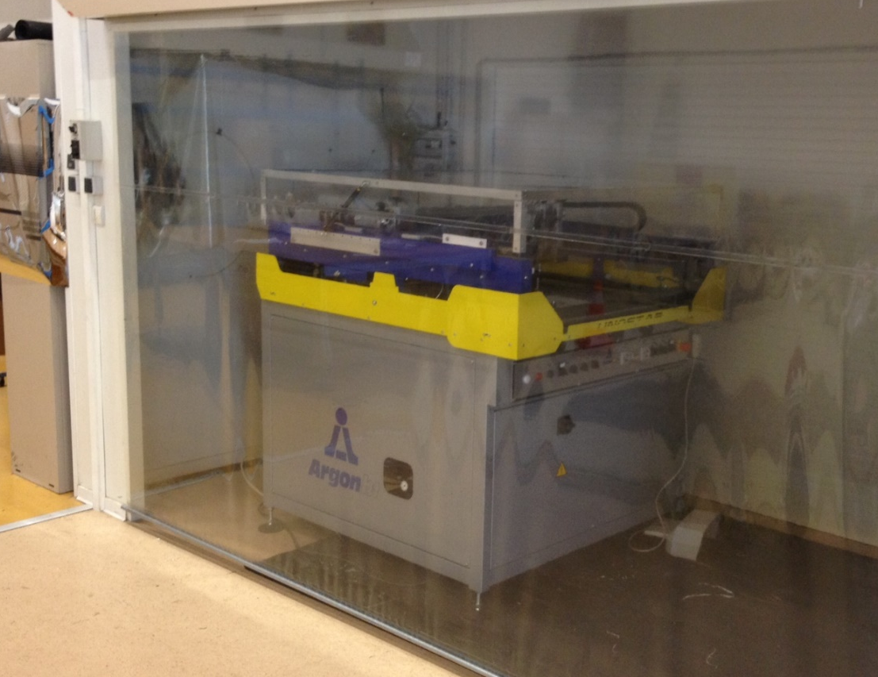
Machine
investment
investment
investment
  The Argon Unostar E serigraphy machine is a professional tool well suited to the type of resistive polymer to be used. The investment is ~ 30 k€ (ANR Splam)
The maximum possible area is 700 mm * 700 mm
End 2014 a first test was done with a demonstration screen with serval pattern. The goal was a training of the IRFU technician with serigraphy professional.

Slide 4
Test parameter
Screnn:
      Mesh stainless steel inox M325, SD90/40 at 15°
      ENDUCTION on screen of 6-8μ (measure = 8 µm)
      Theoretical thickness of paste deposition ~ 48 µm
      measure tension of the screen mash = 28 N/cm in both direction
  Resistive polymers :ESL RS 12115
  Use without addition of solvant
  Substrat for deposition: Kapton of 50µm and mylar of 60µm
  Parameters of machine Argon Unostar E:
    hors contact” minimum,
    Average speed,
    Average pressure

Slide 5

Test screen
 | Strip (µm) | Inter (µm)
Zone 1 | 50 | 650
Zone 2 | 100 | 600
Zone 3 | 150 | 550
Zone 4 | 200 | 500
Zone 5 | 250 | 450
Zone 6 | 300 | 400
Zone 7 | 350 | 350
Zone 8 | 400 | 300
Zone 9 | 450 | 250
Zone 10 | 500 | 200
Zone 11 | 550 | 150
Zone 12 | 600 | 100
Zone 13 | 650 | 50
The test screen had serval type of strip with a pitch of 700 µm, from very thin strip to very thin inter-strip. The strip length was 500 mm.
Various other patterns (square, circle, connector, …) of various seize where also on the same screen
Zone 1
Zone 13

Slide 6


Result zone 1
Z1
Strip of 50 µm on screen
Result = strips of ~100 µm

Slide 7
Result zone 2
Z1
Strip of 100 µm on screen
Result = strips of ~153 µm

Slide 8
Result zone 3
Z1
Strip of 150 µm on screen
Result = strips of ~275 µm
Thickness: 22 µm

Slide 9
Result zone 6
Z1
Strip of 300 µm on screen
Result = strips of ~482 µm
Thickness: 36 µm

Slide 10
Result zone 9
Z1
Strip of 450 µm on screen
Result = strips of ~630 µm

Slide 11
Result zone 6
Z1
Strip of 650 µm on screen (inter = 50 µm)
Result = plain resist
Thickness: ~ 51 µm

Slide 12
Z1
Z2
Z3
Z4
Z5
Z6
Z7
Z8
Z9
Z10
Z11
Z12

Slide 13
Strips metrology
With this very first test we where able to print strips of 500 mm length very uniform.
The seize of the strip can be adjusted by the seize of the screen opening (ratio ~ 1,5)

Slide 14
Further test: summer/fall 2015
Serigraphy + resistivity measurement
Two dedicated screens (different mesh down to SCS 45/18 ) with long strips + pads for resistivity measurement
backing test (resistivity versus temperature)
TF1O- R prototype (Active area 12x12 cm, 128 channels)
  Several resistive coating (strip, plain, mesh, pixel ) will be tested:
      Serigraphy
      Metrology
      resistivity measurement
      Bulk
      test with Fe55 and cosmic bench
      Large 2D prototype (500 mm * 500 mm) with different deposition pattern.

Slide 15
R&D on thin Mesh
A other R&D at Saclay workshop: Thin mesh bulk
Paris Saclay University funding for R&D: call for ~60 k€
Goal : find a process to allow bulk manufacturing with thin mesh
      Serval type of mesh will be tested on 12x12 cm²
      Copper mesh (Rui)
      electroformed mesh
      woven mesh with extra lamination
In order to find the ad hoc amplification gap versus the pressure (0 to 4 bar), we will realize a small Micromegas setup (4 mm anode = no pillars) allowing a scanning of the gap from 20 µm to 500 µm by steps of 10 µm. Serval meshes will be tested.
For 2016: Prototype of 30x30 cm² using thin mesh
For 2017: Harpo TPC prototype (thin mesh at high pressure Bar)

