Slide 1
Modelling the response
of microbulk Micromegas
in Xe-TMA admixtures
E. Ruiz-Choliz (Zaragoza University)
and
Diego Gonzalez-Diaz (Zaragoza University and CERN)
on behalf of the Zaragoza group
diegogon@cern.ch
CERN, 12-06-2015

Slide 2
what we wanted to understand:

Slide 3
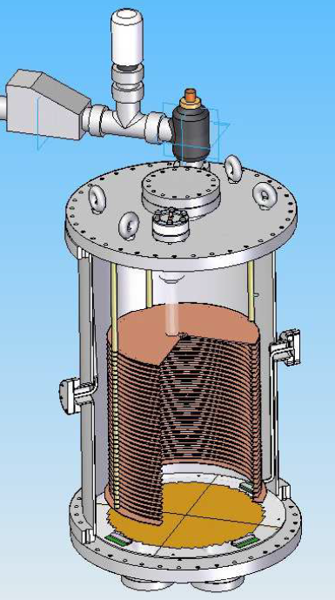
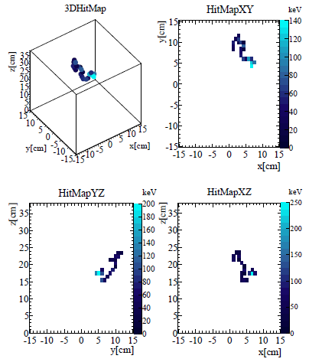
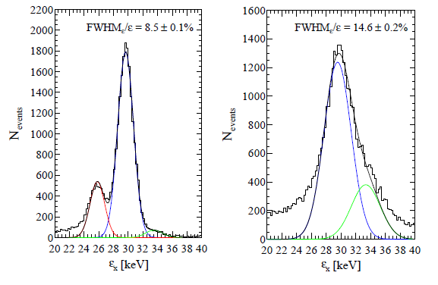
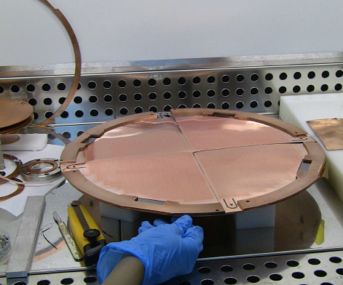
1kg of Xe at 10bar
38cm
γ
e-
30cm

Slide 4
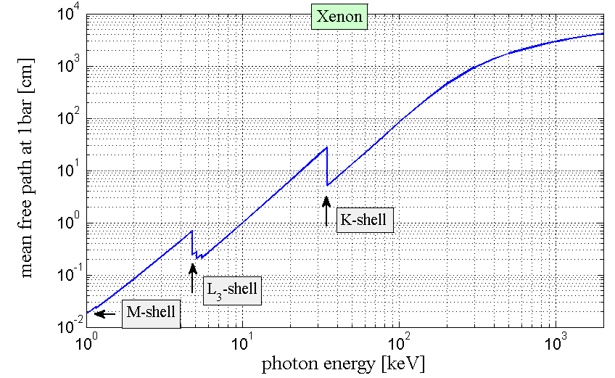
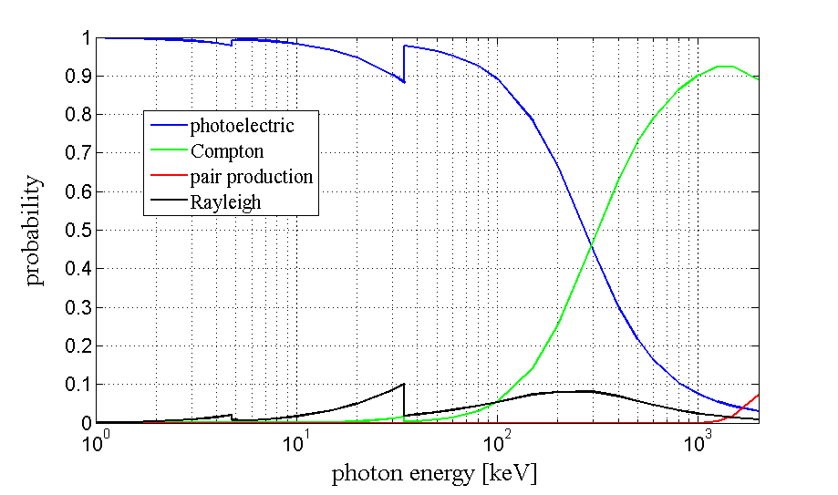
What we knew:
What we did not know:
simulation code
Track topology ↔ Characteristics of the primary electron ionization trail.
Drift properties ↔ Properties of electron ionization trail in electric field:
diffusion, drift, attachment.
Readout properties ↔ Properties of multiplication structures:
transmission, energy resolution, gain.
(DEGRAD)
Magboltz
Garfield++
+ recombination and Penning transfer processes

Slide 5
1. Drift data from the 38cm x 700cm²-setup (NEXT-MM)

Slide 6


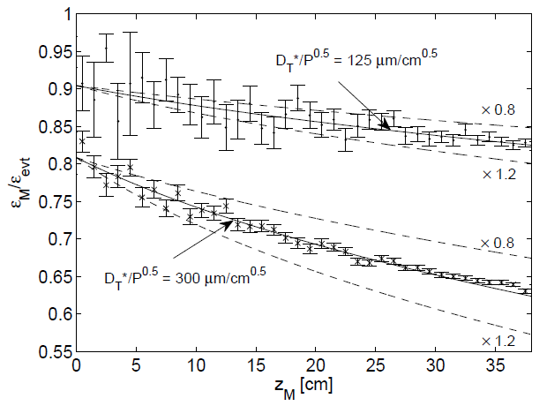
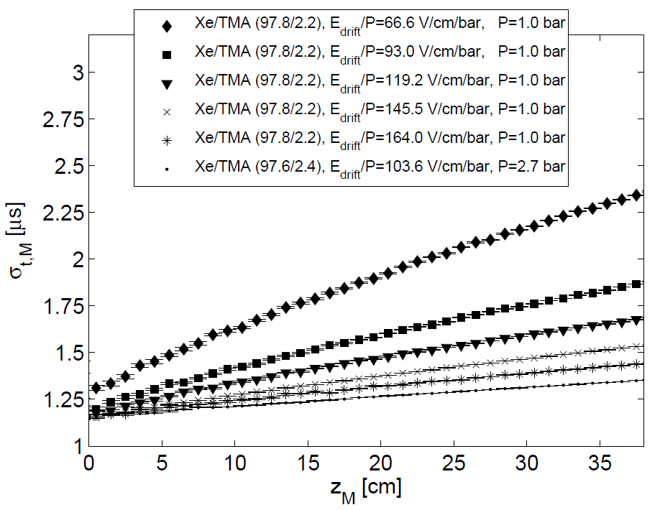
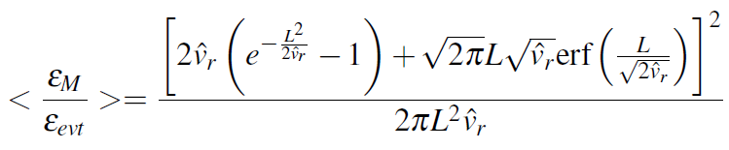





drift properties
time t_{i}
width
σ_{t,i}
agreement with Magboltz??
z_{i}=v_{d}t_{i}
across the field
ε_{i} =integral
typical x-ray event
along the field
t
$${D_{L}^{}}^{∗}/P^{0.5}=340μm/{cm}^{0.5}$$
$$\sqrt{{\hat{v}}_{L,0}}=0.6mm$$
$${D_{L}^{}}^{∗}/P^{0.5}=649μm/{cm}^{0.5}$$
$$\sqrt{{\hat{v}}_{r,0}}=1±0.1mm$$

Slide 7
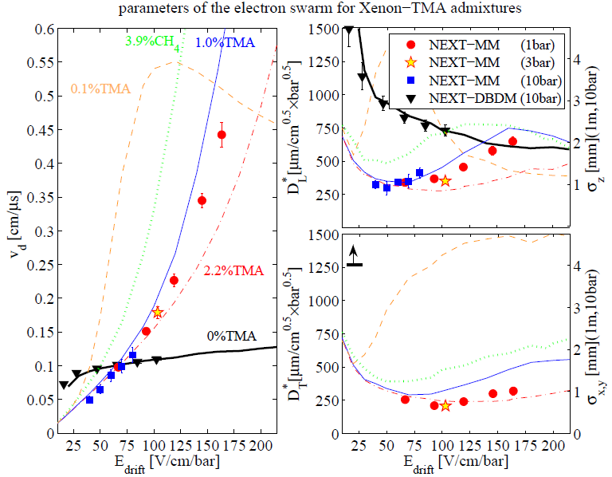
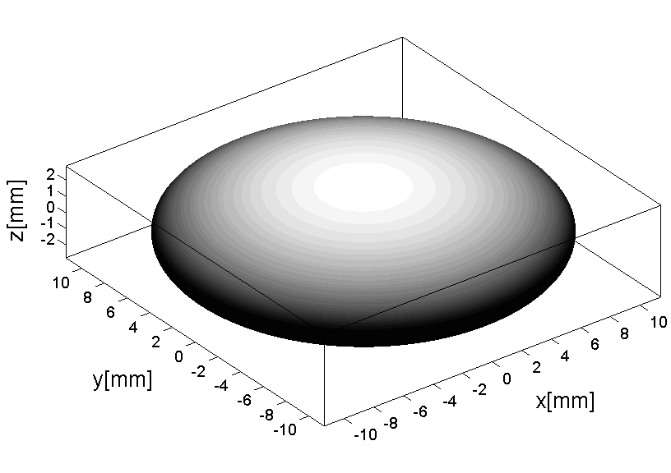
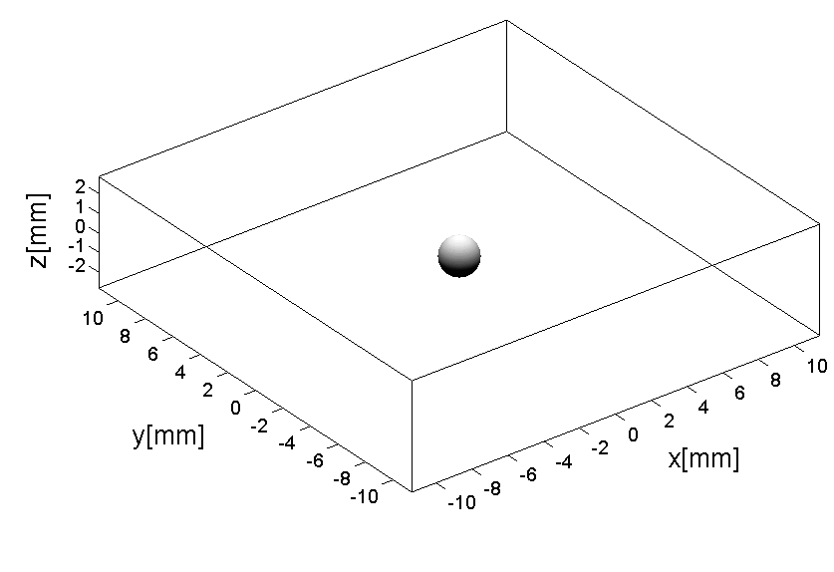
drift properties (data and Magboltz simulation)
σ_{z,xy}
Spatial spread of point-like charge deposits
z_{drift}=100cm, P=10bar
pure Xe
Xe/TMA(99/1)
E_{drift}~50-100V/cm/bar

Slide 8
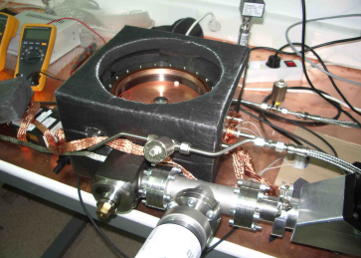
2. Data from the 1cm x 10cm²-setup (NEXT-MM0)

Slide 9
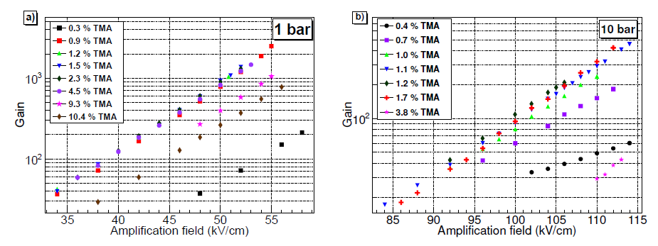
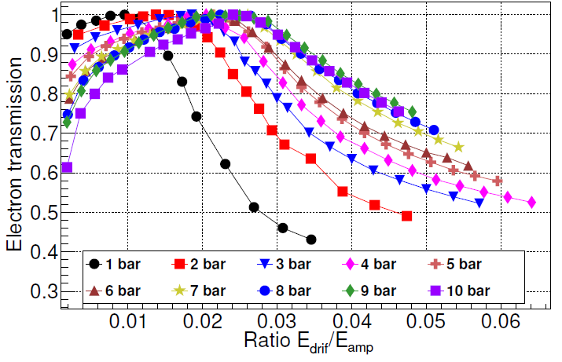
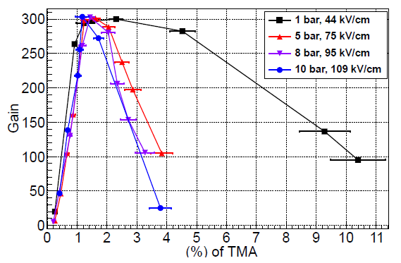
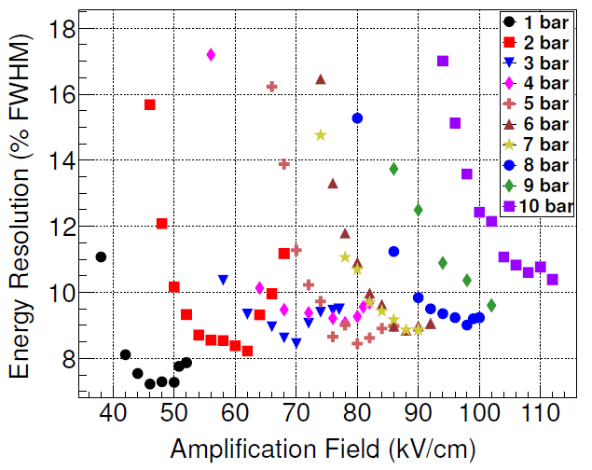
charge readout properties
clear indication of Penning effect!
reduction of field flux through holes?
recombination?
Xe/TMA at ~99/1
too little
too much
resolution worsening with pressure?
Xe/TMA at ~99/1
too much
too little

Slide 10
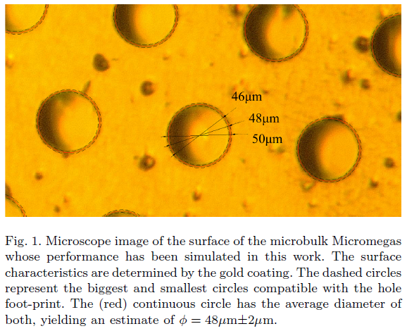
electric field modelling (3D) and Garfield++
Gmsh + ELMER
(Garfield++ interface provided by J. Renner)

Slide 11
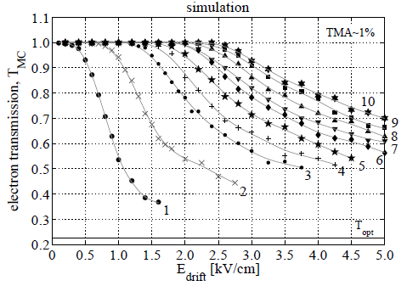
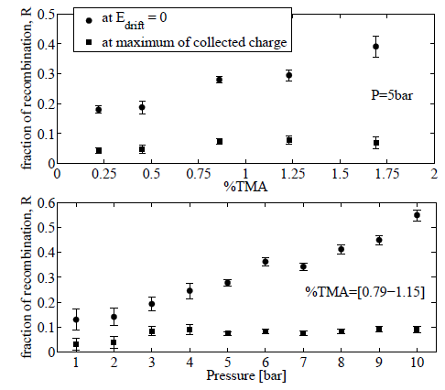
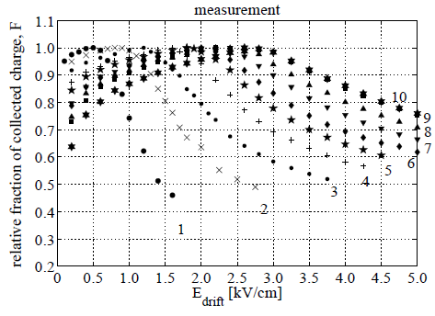


fraction of collected charge/electron transmission
(measured attachment <0.1%)
?

Slide 12
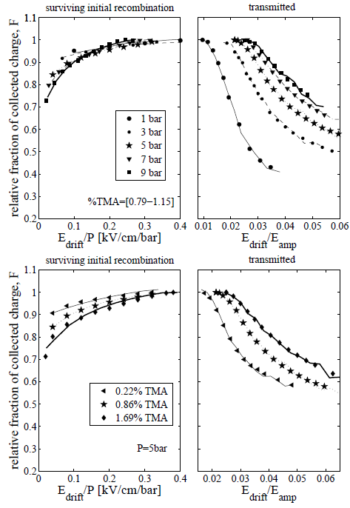
variation with pressure
(global fit to data)
variation with concentration

Slide 13

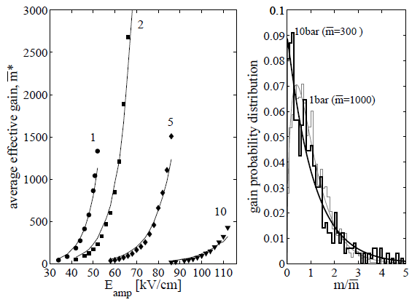


effective gain
( $m≡f(r_{p}$) )

Slide 14
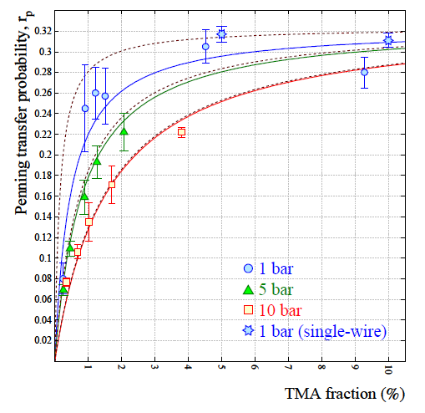
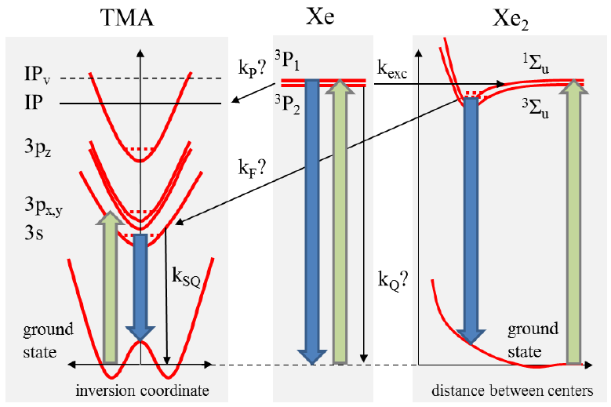
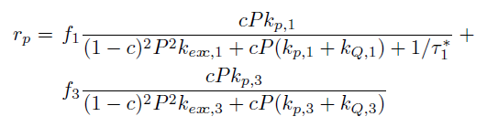


Penning transfer probability
simplified level diagram including only low-lying states
Simplified model (only Xe* singlet-state can make the transfer):

Slide 15
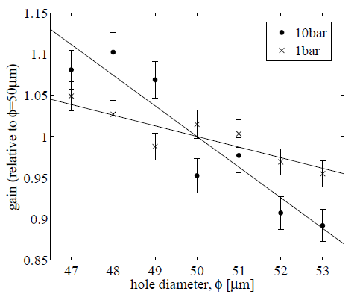
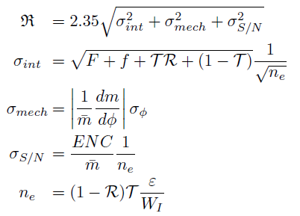
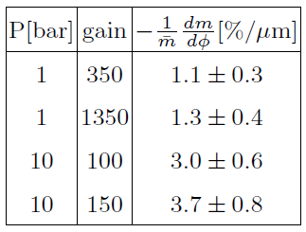
energy resolution (for 22keV X-rays)
Not viable to simulate 22keV/W_{I}~900 primary electrons, we assume independent fluctuations:
Higher sensitivity at high pressure!

Slide 16
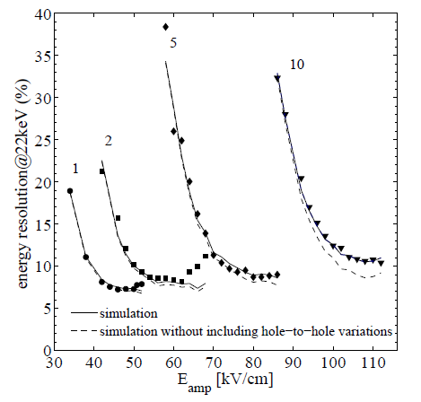
comparison with data (I)
σ_{φ}=0.6μm

Slide 17
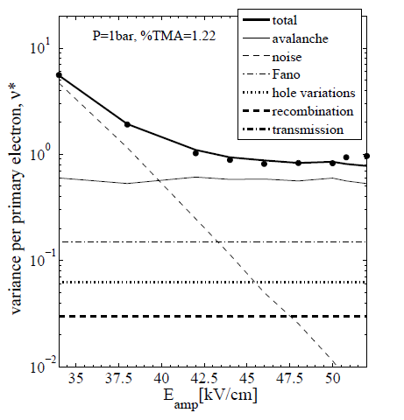

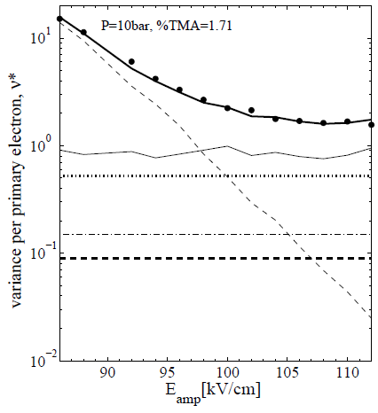
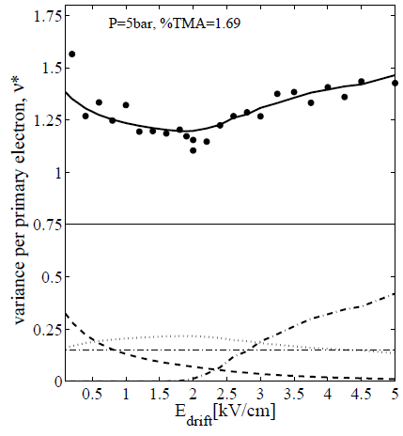
comparison with data (II)

Slide 18
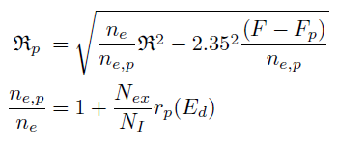



extraction of Fano factor (1bar)

Slide 19
3. Energy resolution data from the 38cm x 700cm²-setup (NEXT-MM)

Slide 20
understanding the energy resolution in a realistic system (I)
P=1bar
P=10bar
NEXT-MM
can be understood in terms of the contributions
identified in the small setup
?

Slide 21
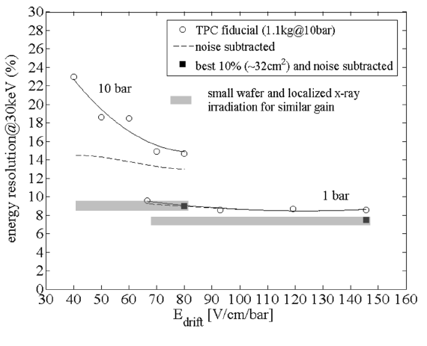
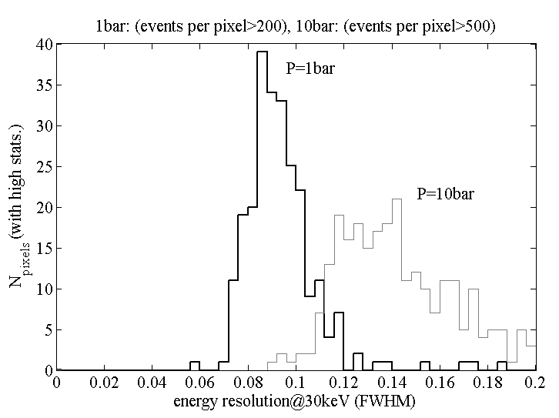
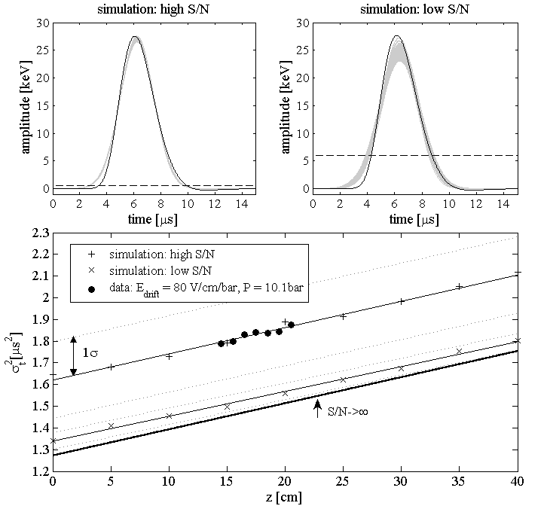

understanding the energy resolution in a realistic system (II)
mechanics
S/N
$${σ_{intr}}^{2}+{σ_{S/N}}^{2}$$
best 10%
P=1bar
Gain=2000
P=10bar
Gain=200

Slide 22






understanding the energy resolution in a realistic system (III)
P=1bar
P=10bar
NEXT-MM
$$σ_{int}=0.075$$
$$σ_{int}=0.09$$
$$σ_{S/N}=0.002$$
$$σ_{S/N}=0.07$$
σ_{φ}=1.0μm
$$σ_{mech}=0.035$$
$$σ_{mech}=0.09$$

Slide 23
conclusions
‘Electron transmission’ at high pressures requires both recombination (drift region) and hole-transmission (readout region) to be included. Measured data can be described by combining a recombination model (Bolotnikov, Ramsey) and the simulated electron transmission.
Penning-effect in Xe-TMA can be interpreted through a simple model that assumes resonant energy transfer from the Xe* singlet state to TMA.
Energy resolution well explained by known sources except for a small deviation at high pressure.
Strong evidence of sensitivity to mechanical variations in the hole diameter at 0.5μm level! (important at 10bar)

Slide 24
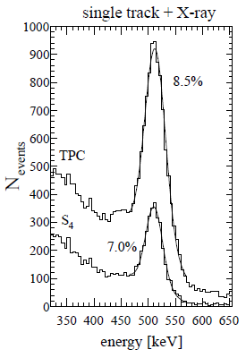
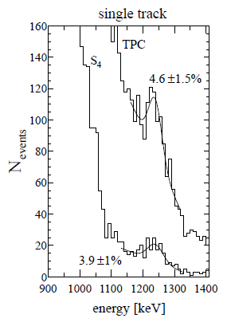
appendix

