Slide 1
A new transparent XY-MicroMegas neutron beam profiler: first beam profiles at n_TOF
M. Diakaki¹, E. Berthoumieux¹, T. Papaevangelou¹, F. Gunsing^{1,2}, E. Dupont¹,
M. Kebbiri¹, S. Anvar¹, P. Sizun¹, E. Monmarthe¹,
D. Desforge¹, D. Jourde¹, M. Sabarte-Gilarte²,
T. Geralis³, T. Daphni⁴, E. Ferrer-Ribas¹, L. Tassan-Got⁵, L. Audouin⁵,
J. Heyse⁶, P. Schillebeeckx⁶, C. Paradela⁶, F. Belloni⁶
¹ IRFU / CEA-Saclay, France.
² CERN, Geneva, Switzerland.
³ INPP / NCSR « Demokritos », Athens, Greece.
⁴ University of Zaragoza, Spain.
⁵ IPN, Université d’ Orsay, France.
⁶ IRMM, Geel, Belgium.

Slide 2
outline
XYMGAS with segmented mesh + anode development.
Application: quasi-online neutron beam profiler + flux monitor.
First profiles at the n_TOF facility at CERN : Analysis and Results

Slide 3
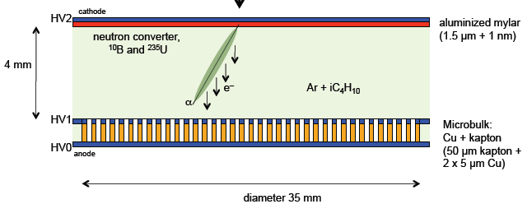
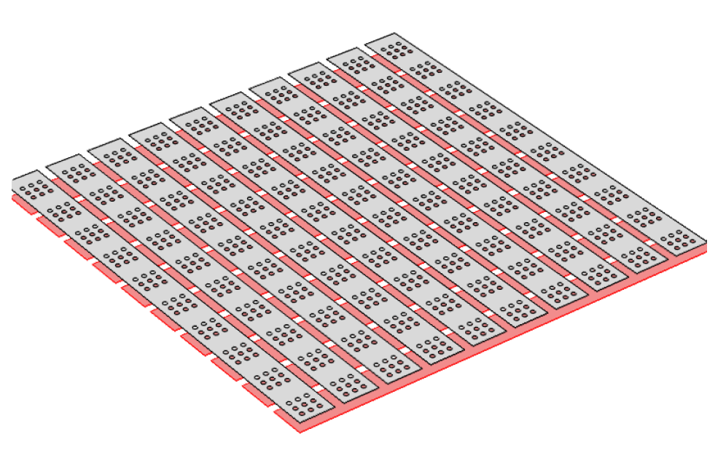
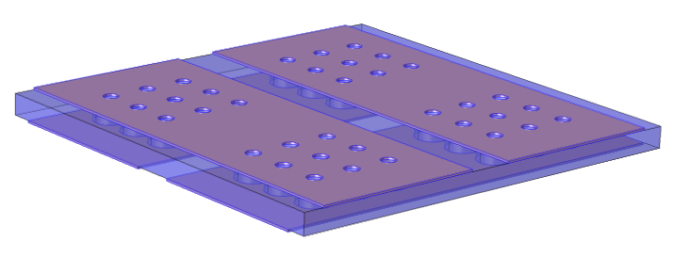
Segmented MESH microbulk development
Mass minimisation
(5um Cu - 50um kapton - 5um Cu).
Large surface detectors.
High radiopurity.
Drift region
mesh
anode
« A low mass microbulk with real XY structure »,Th. Geralis, RD51 Common Fund Project
Segmented mesh microbulk:
1) No extra layers
2) Production simplification
3) Real XY structure
mesh
strips
anode strips

Slide 4
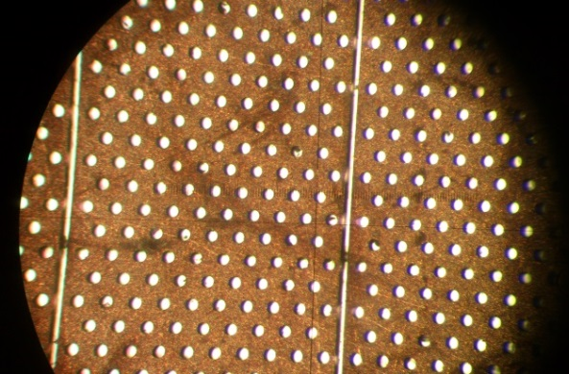
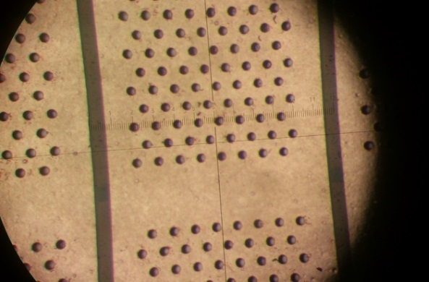
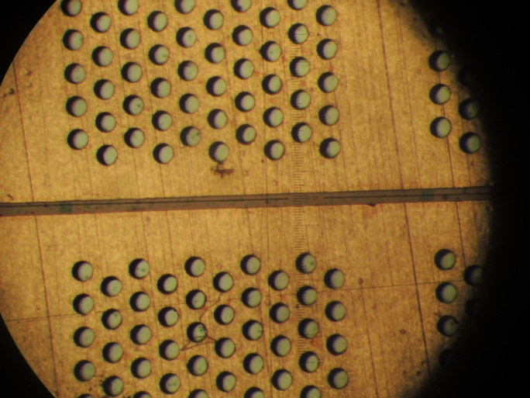
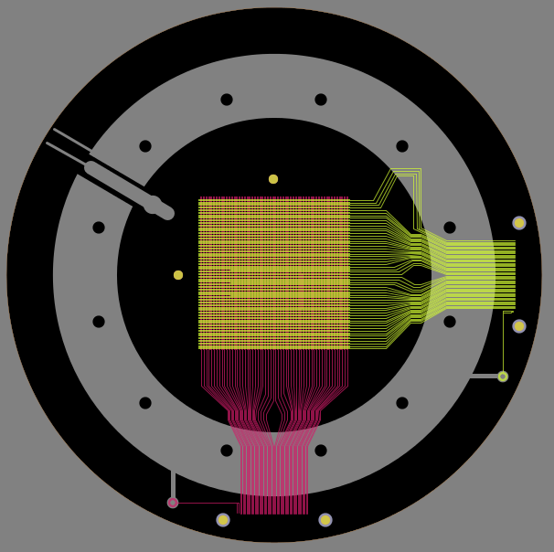
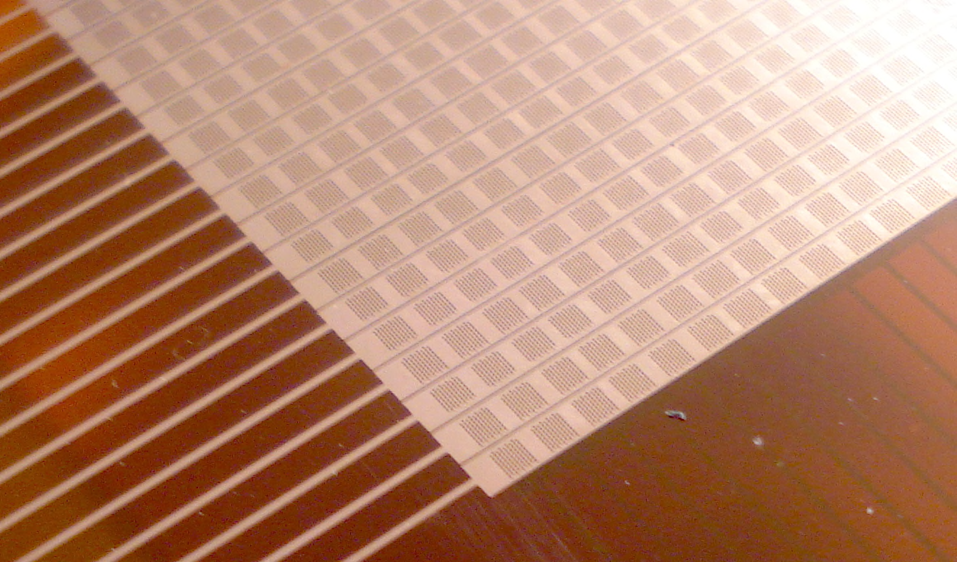
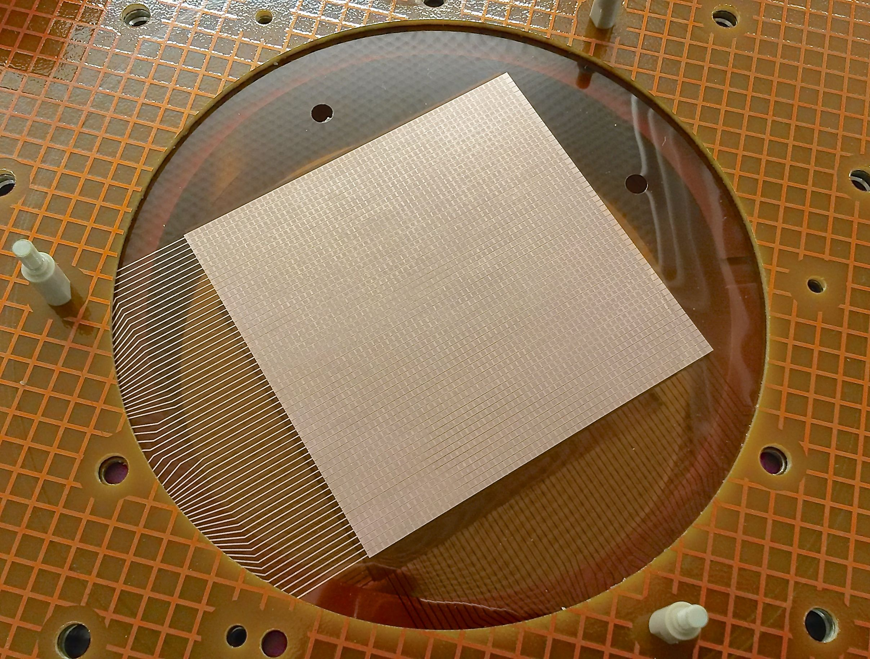


Prototype evolution
First batch:
  Problems during etching
  due to holes topology.
  Many strips in short circuit.
Third batch
  Holes ∅ 60/50 μm
  Gaps reduced to 35 μm
  Energy resolution OK!
Second batch
  Etching OK with the new
  topology
  All detectors working
  Bad energy resolution due to
  large gaps (~150 μm)
The first detectors produced:
58 x 59 strips on a 6 x 6cm² area (1mm thickness)
Mesh hole:~ 60μm / Pitch: 100 μm.
Drift HV
Notes:
Challenge: etching of the mesh strips without completely removing the material in between the mesh strips.

Slide 5
NEUTRON beam MONITOR + profiler
Accurate neutron cross section measurements require:
Neutron fluence/Beam interception factor
    Number/fraction of neutrons hitting the area covered by the sample.
Shape of the beam profile
Beam optics misalignment => Beam fluence variations.
For non-monoenergetic neutron sources:
=>Dependence of profile on the neutron energy
sample
sample
Neutron production point
Neutron flight path
Neutron interaction point
pulsed
neutron source
n_TOF facility (CERN)
(thermal-GeV)
GELINA (IRMM)
(1meV-20MeV)
NFS (GANIL)
sample
TOF ⇒ neutron energy
Requirements:
Quasi-online neutron flux + beam profiler as well
Minimal perturbation of the neutron beam / Minimal induced background
Stay permanently in the beam

Slide 6
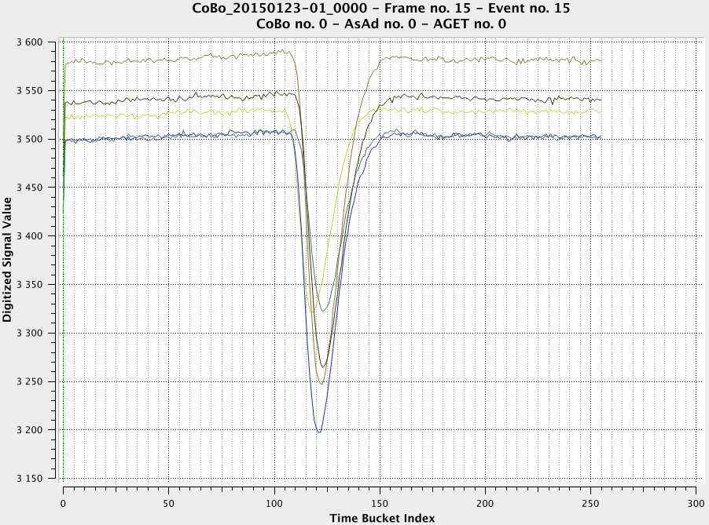
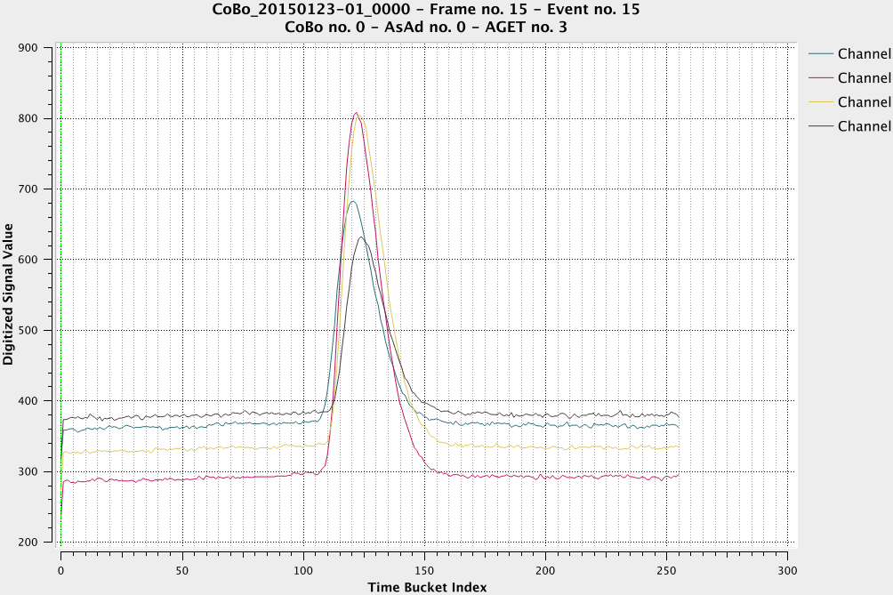
Principle of NEUTRON BEAM profileR + MONITOR OPERATION
neutron beam
The longest electron
drift time corresponds
to the point of the
interaction of the neutron
with the target.
consecutive strips
Strips 45/44/43/42
anode
mesh
Strips 35/36/37/38/39/40
The neutron flux will be simultaneously extracted from the SUM SIGNAL.

Slide 7
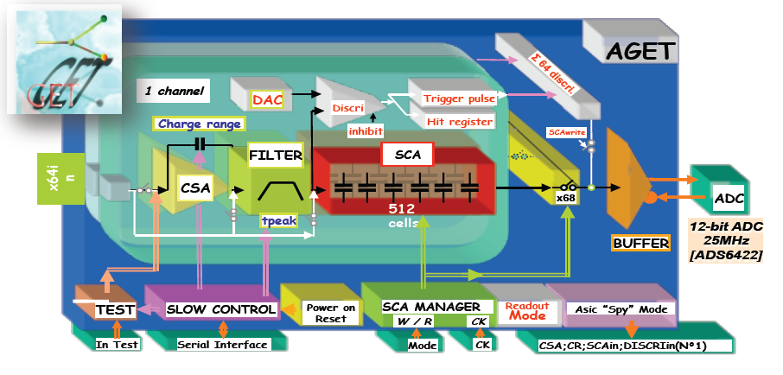
ELECTRONICS
Challenge:
No global trigger signal => AGET electronics* + Reduced CoBo configuration
Self triggering mode / timing difference between strips.
64 analog channels /chip.
Auto trigger: discriminator and threshold
Multiplicity signal: analog OR of 6discriminators
Address of the hitted channels
SCA readout mode (all/hitted/selected channels)
Max sampling rate: 100 MHz.
16 peaking time values: 50 ns-1us.
4 charge ranges/channel: 120fC/ 240fC/
1pC/ 10 pC.
*GET, General electronics for TPC, ANR proposal / GET-QA-000-0005, AGET Data Sheet.

Slide 8
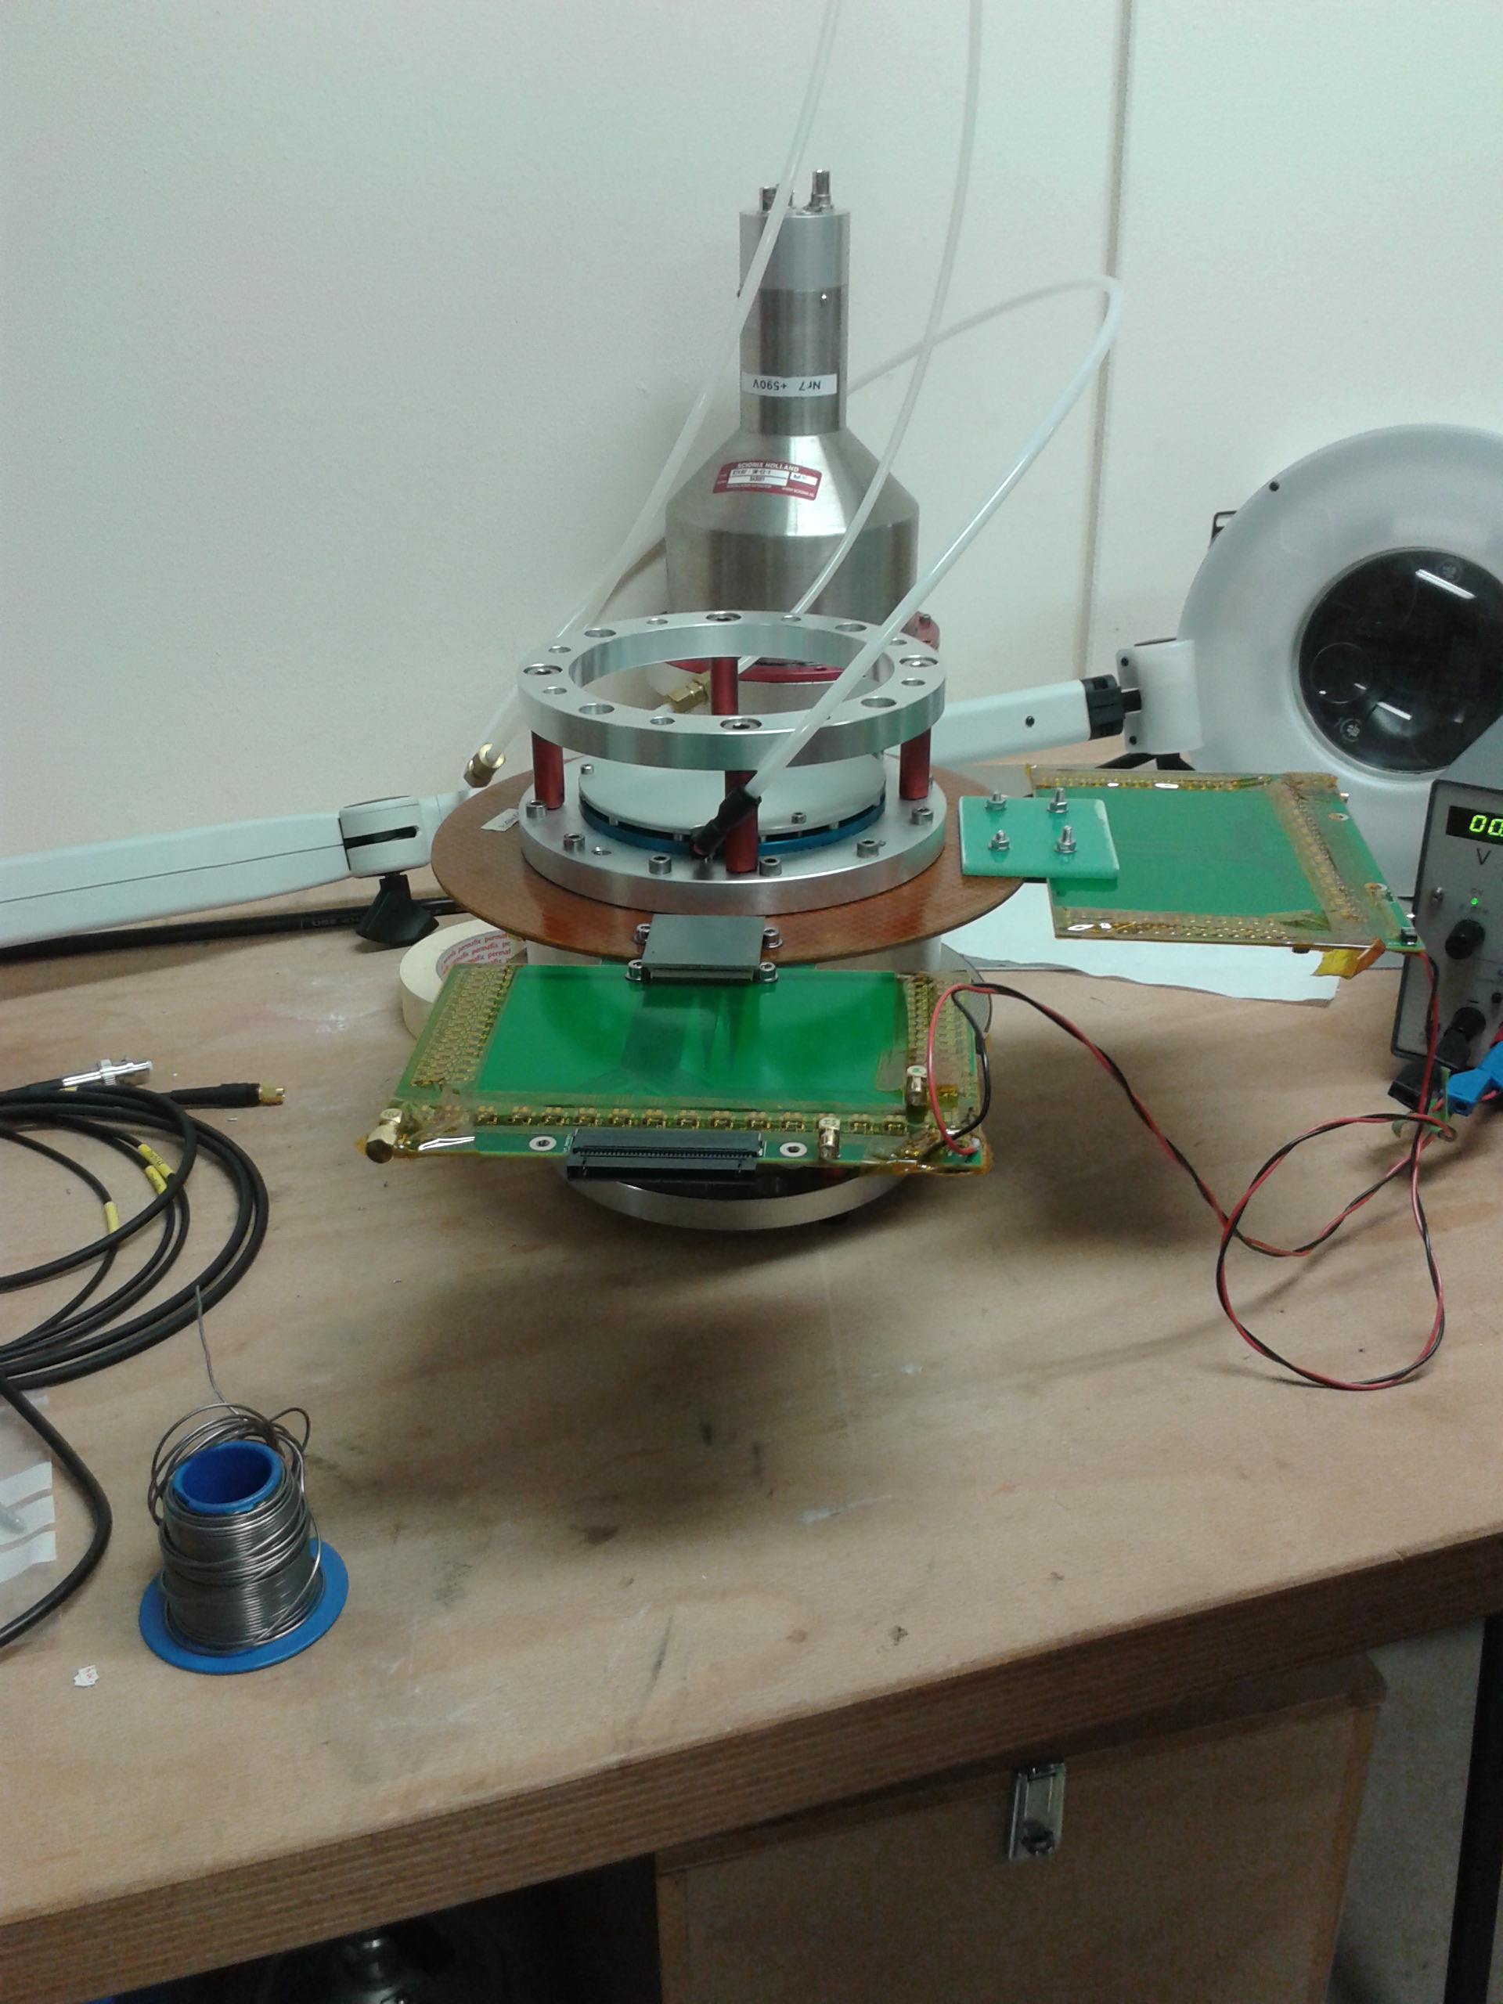
PREVIOUS front-end CARDS SETUP
Front end electronics: protection card, able to
take the signal from the strips (mesh+anode)
distribute the HV (mesh)
take the sum signal (recorded with conventional electronics).
Acquisition
AGET chips
mesh
anode
Problems: missing strips, wrong routing, noise from low voltage supply module

Slide 9
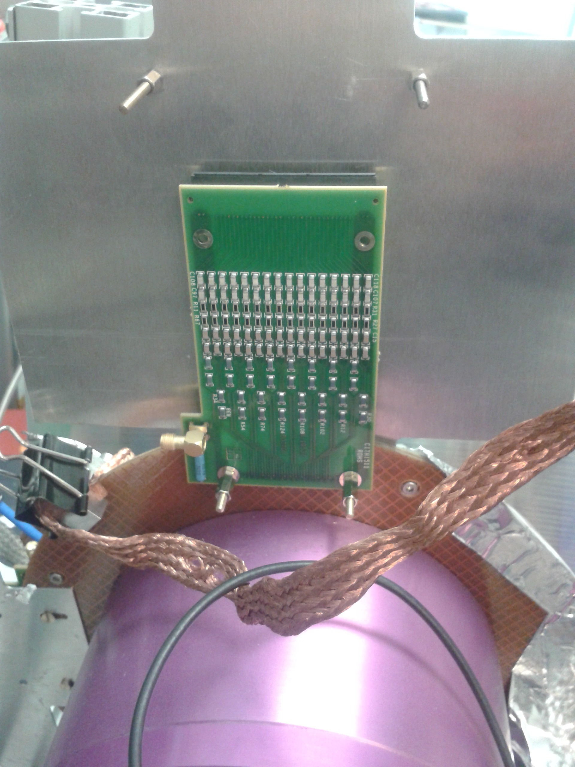
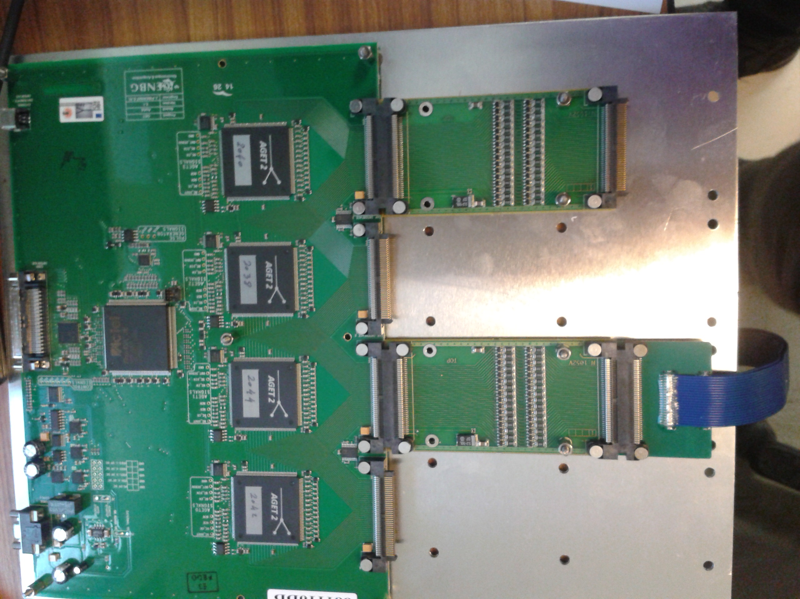
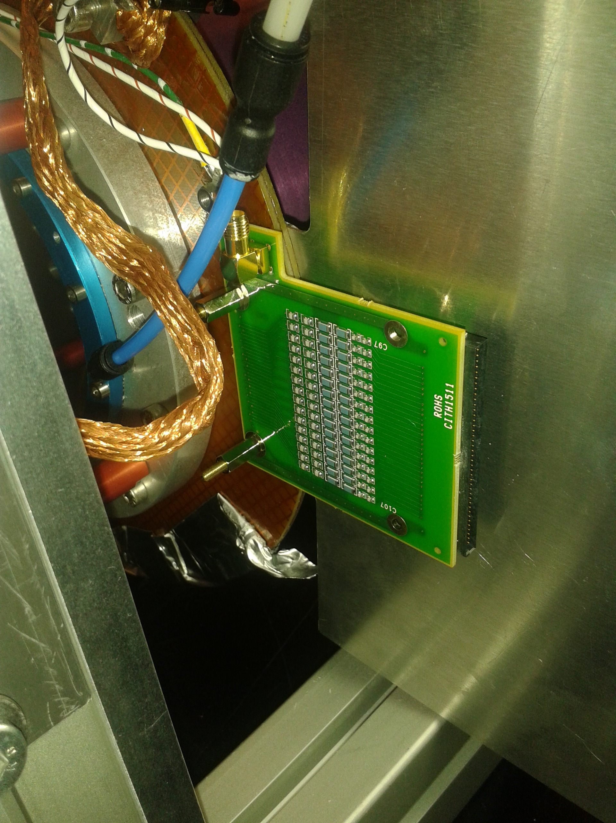
NEW FRONT END CARDS
HV in
AGET CHIPS
MESH STRIPS
HV splitting + strip signals
DETECTOR
Sum signal to preamp+n_TOF DAQ
Protection Diodes
ANODE STRIPS
Protection Diodes
Strip signals+Sum signal

Slide 10
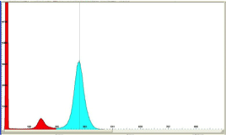
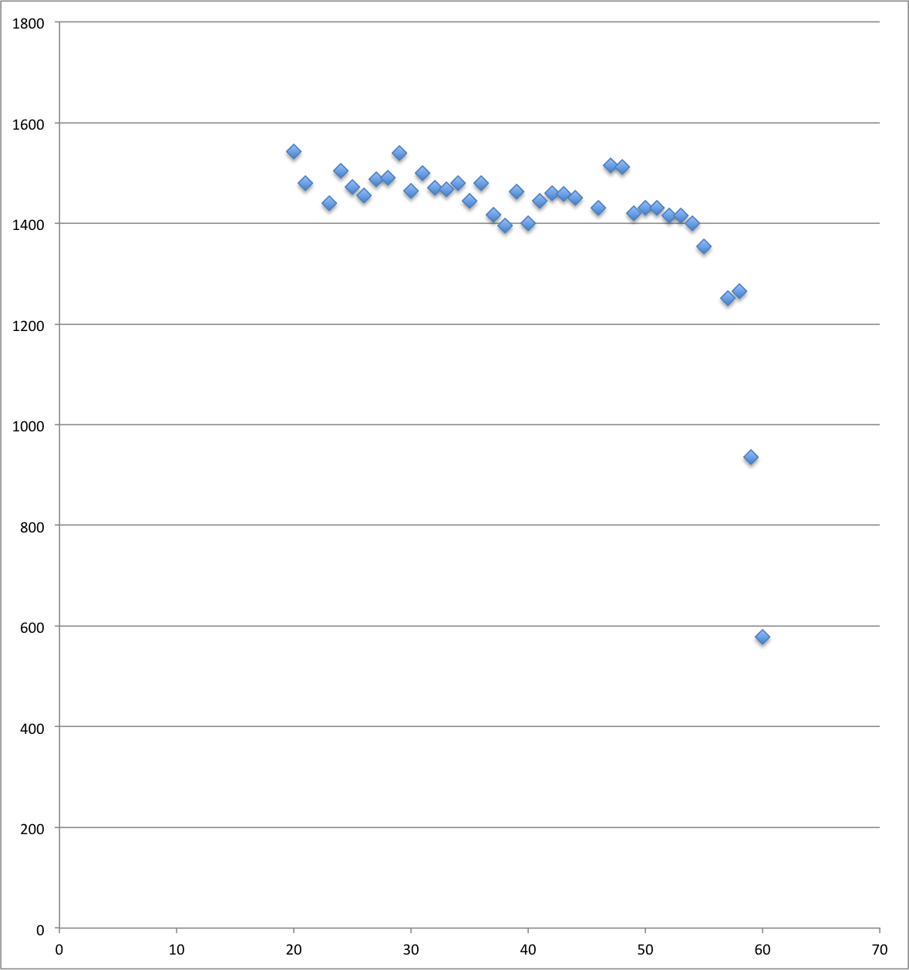
Detector performance WITH Xrays
If all strips shortcutted:
X-ray source : ⁵⁷Fe
Ar escape
Peak
(P= 1 atm)
No stripped microbulk
at good transparency: ~11%.
Resolution 13.5%
Peak position
Resolution 15%
Gain variations within 7-8%
(not at the edges=>Detector issue)
strip no
Notes:
Dependence of the resolution on the
threshold applied (Voltage threshold+
multiplicity threshold)=>
multiplicity<3 problem.

Slide 11
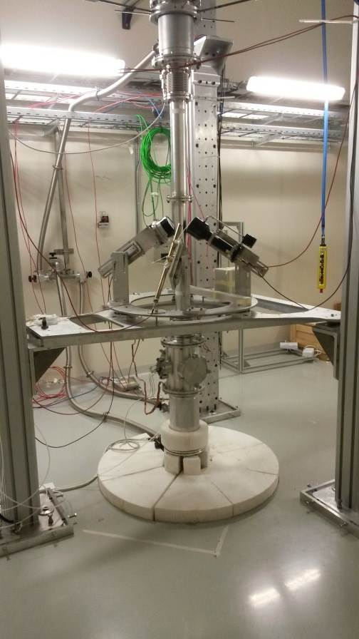
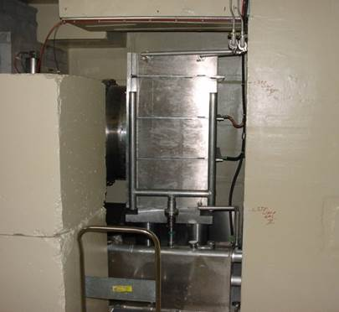
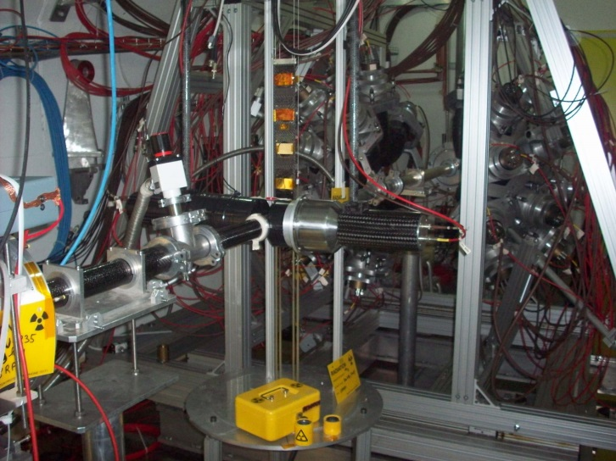
The n_tof facility (cern)
EAR-2
Neutron beam characteristics:
1. White neutron beam (0.025 eV-1 GeV).
2. Neutron energy defined by the Time-Of-Flight.
3. High instantaneous flux.
4. 7ns width proton pulse every > 1s
5. Excellent energy resolution
~20 m flight path
~200 m flight path
PS Protons
(20 GeV/c)

Slide 12
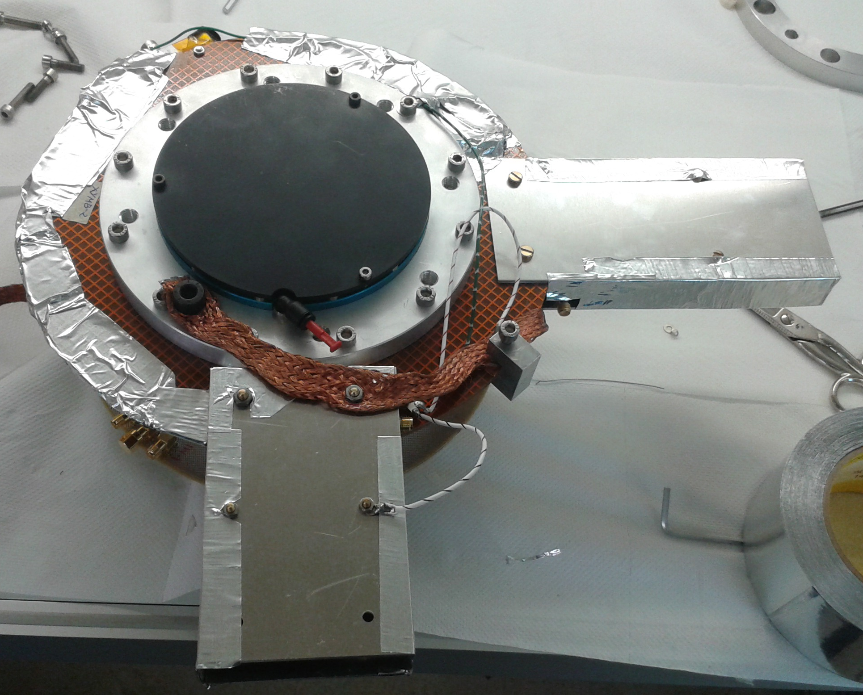
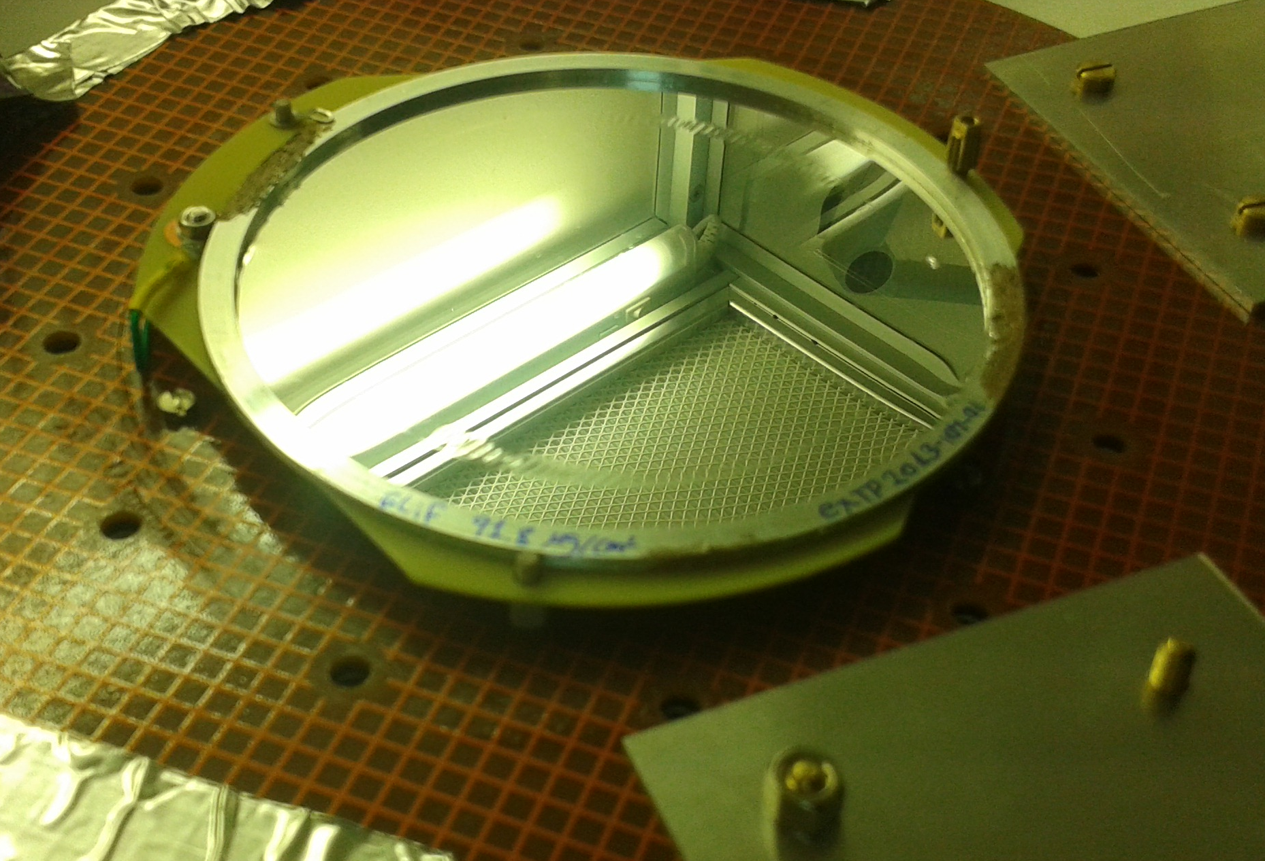
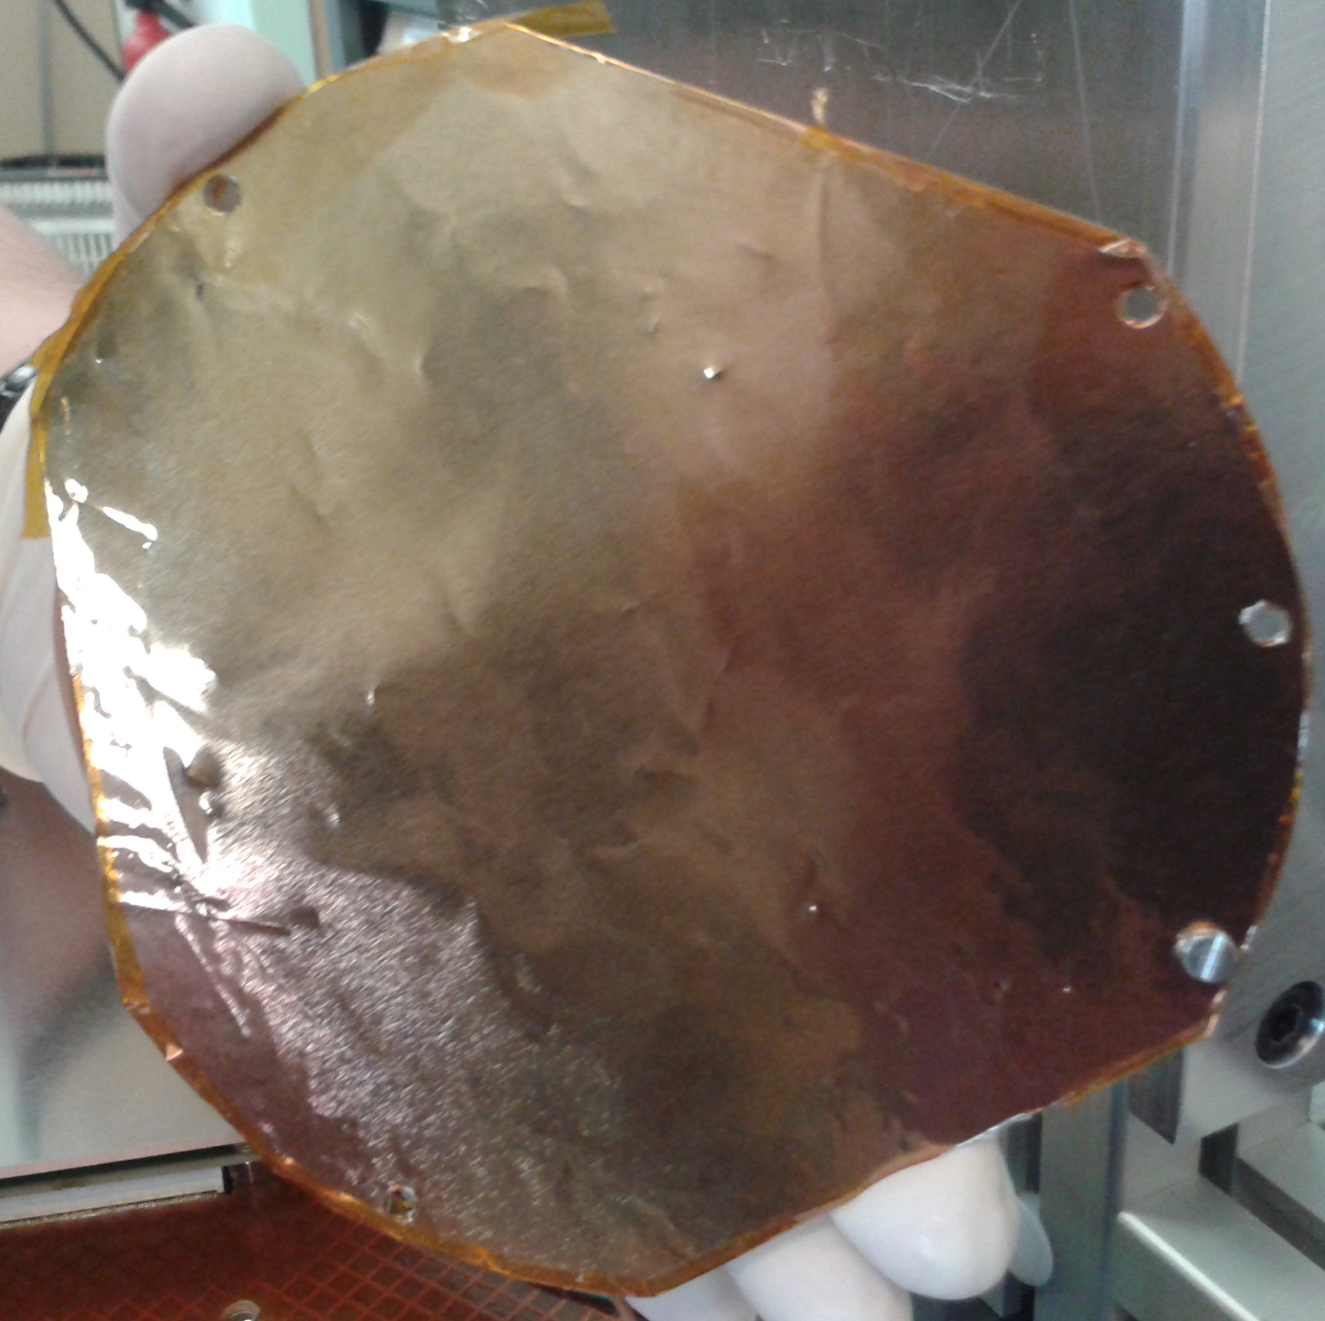
MOUNTING THE DETECTOR in ear-2 (1)
Mesh strips
Proper grounding + shielding essential.
anode
strips
⁶LiF target,
91.8μg/cm²
(EXTP 2013-104-01)

Slide 13
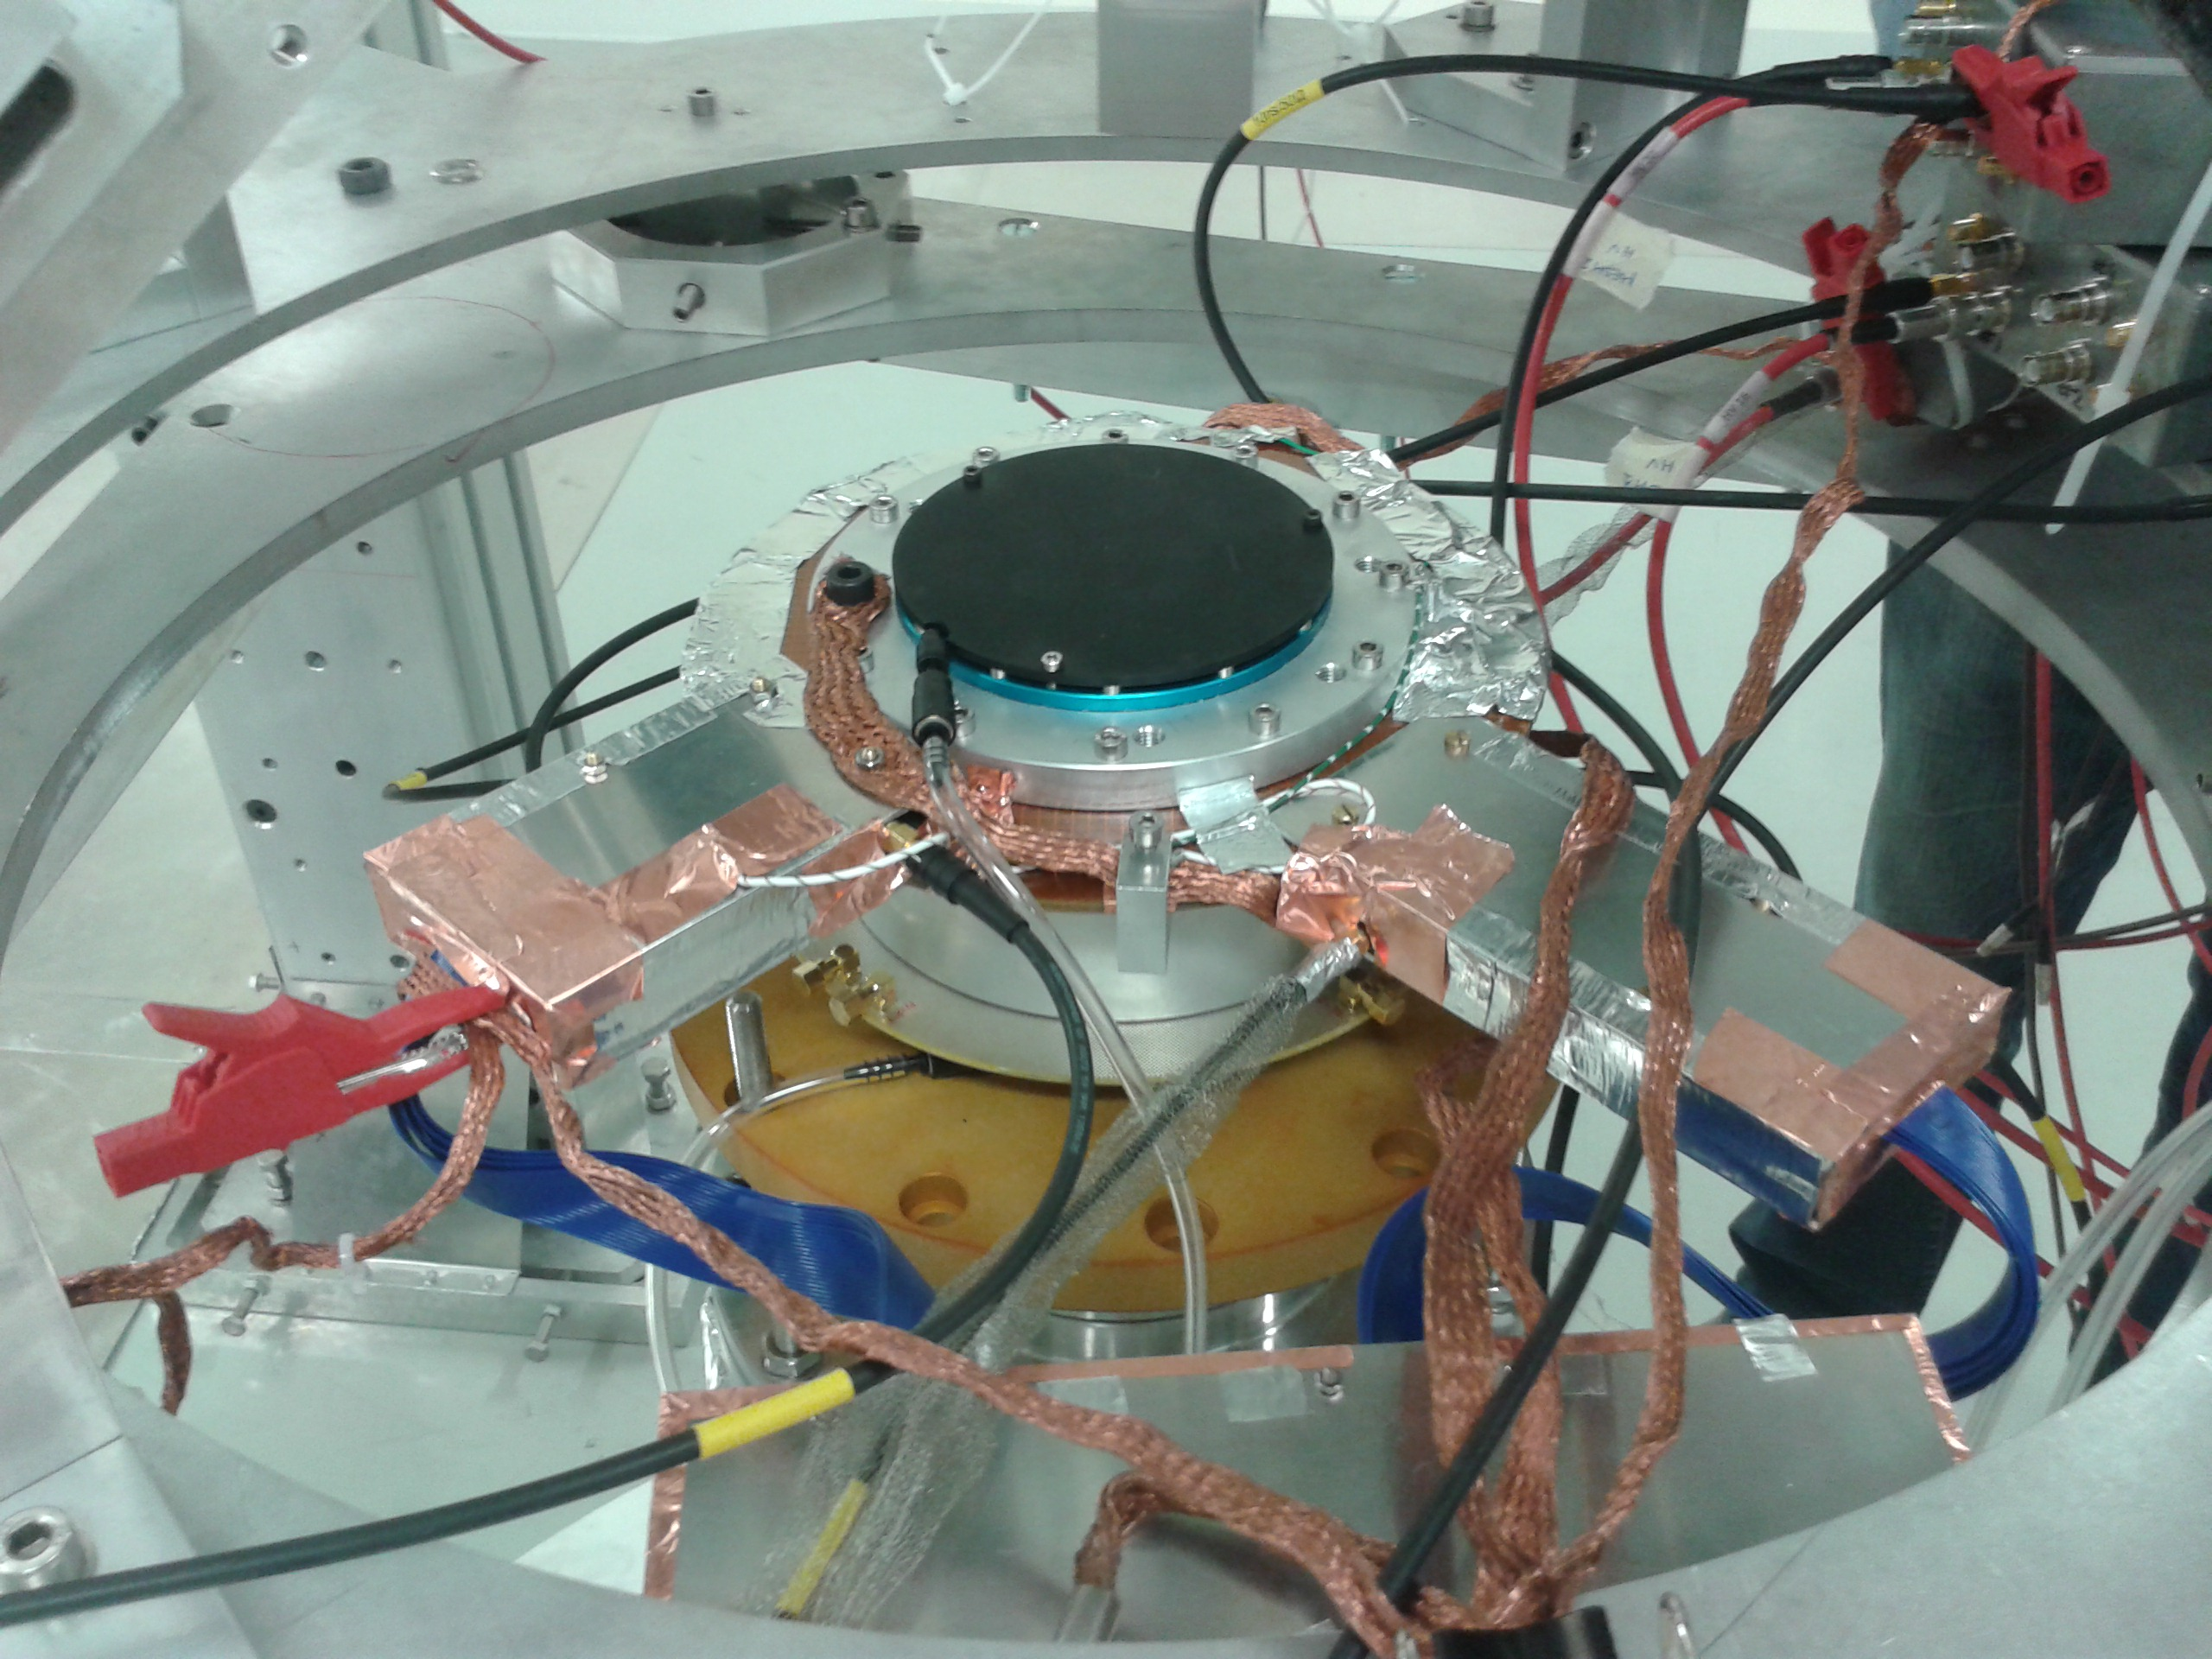
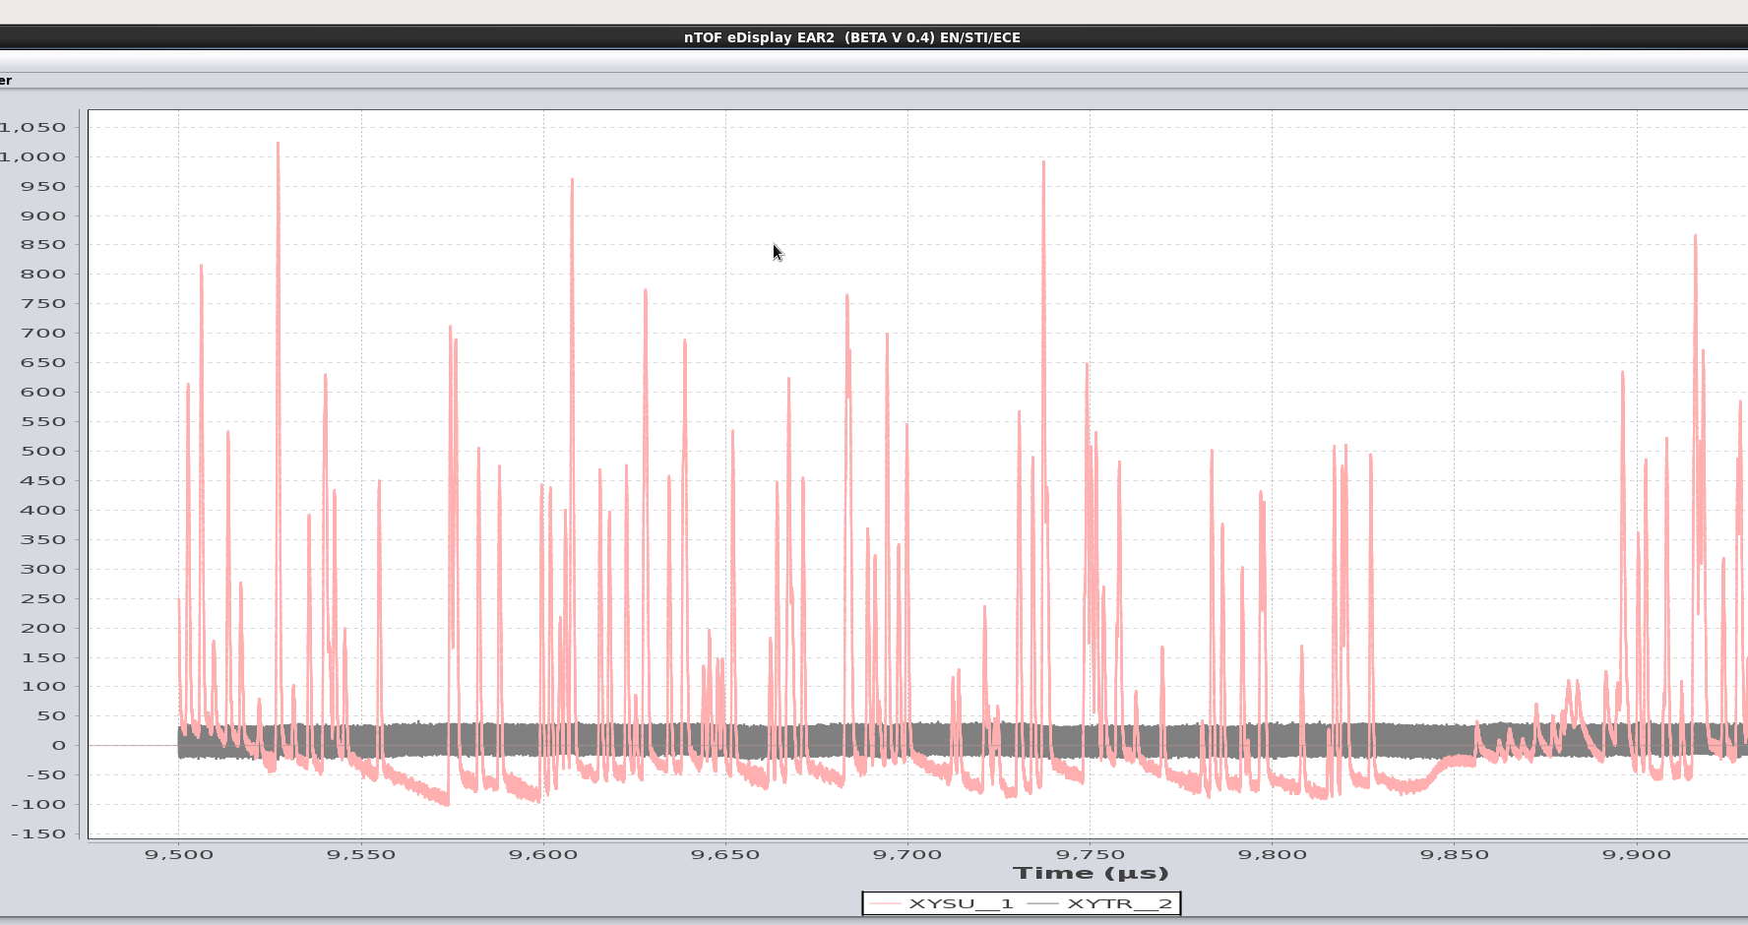
MOUNTING THE DETECTOR in ear-2 (2)
Neutron
beam
AsAd card very close to
beam.
V_{m}=310 V / V_{d} =750 V.
Through n_TOF DAQ:
Sum signal
(neutron flux)
Trigger signal
(with conventional preamps)
Anode
Strips (Y)
Mesh strips (X)
AsAd card
SUM signal

Slide 14
SIGNAL ANALYSIS
Initial pulses
Smoothed pulses
Derivative pulses
MESH
CONDITION:
If both mesh
and anode had
at least one strip
with signal.
ANODE
Peak useful parameters are stored (Amplitude, Peak position, TOT etc)
Event useful information is stored (Time of event, multiplicities etc)

Slide 15
SOME RESULTS
(multiplicity)x(10us)
Interval time between
consecutive events:
gamma-flash
2) Total Amplitude histogram (sum of strip amplitudes for each event):
Good energy resolution,
(Similar for mesh+anode)
Pile-up.
ANODE
MESH
Low energy
deposition
events =>
to be cleaned.

Slide 16
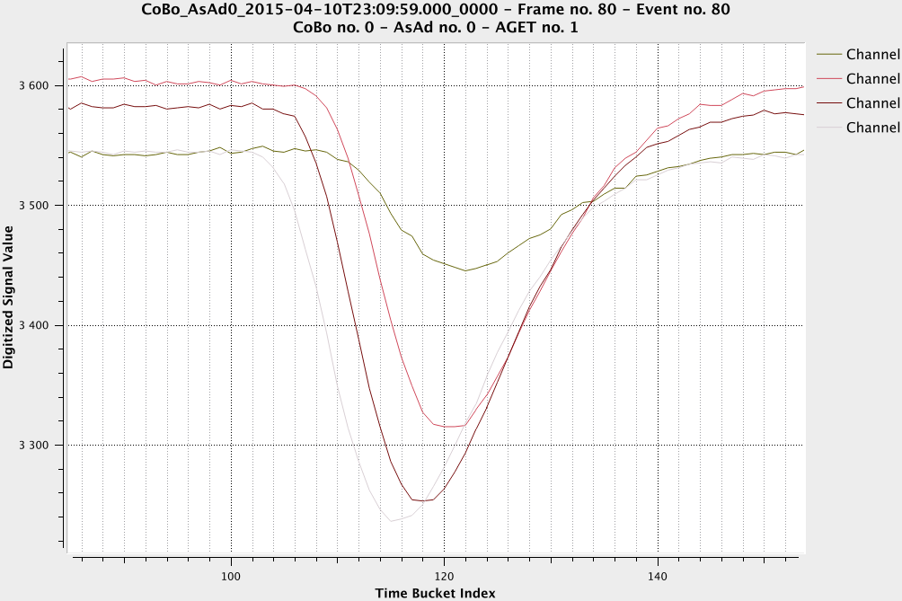
EVENT SELECTION CRITERIA FOR BEAM PROFILE (1)
From each event + for each dimension we calculate the time difference between first and last strip hit (Δt)
Criterion 1:
Δt <= (drift space)/(drift velocity)
Δt
4
Δt for mesh events
3
1
2
Criterion 2: 0.5 < tot amp ratio<1.5
Final total amplitude hist much cleaner:
mesh

Slide 17
EVENT SELECTION CRITERIA FOR BEAM PROFILE (2)
Point of interaction (strip X,strip Y)
Criterion 3: strips hit have to be
consecutive=> pile-up events
rejected
1 2 3 4
Criterion 3: Only alphas

Slide 18
Towards the Beam profile
1) Taking the last strip that gave signal:
2) Particle track fitting:
Δt
strip no
Better spatial resolution

Slide 19
OUTLOOK –FUTURE PERSPECTIVES
XYMGAS neutron beam profiler in operational mode.
The electronics were improved / Dead time
Will stay permanently in-beam at n_TOF.
Further improvements in the design of the detector for the next production,
based on the tests performed is foreseen.
Complete characterisation of the detector at the nuclear reactor Orphee,
CEA-Saclay (spatial resolution etc).
Challenging physics measurements (neutron induced charged particle reactions,
angular distributions etc) will be investigated with this detector.
…………...Thank you…………….

Slide 20
EXTRA SLIDES

Slide 21
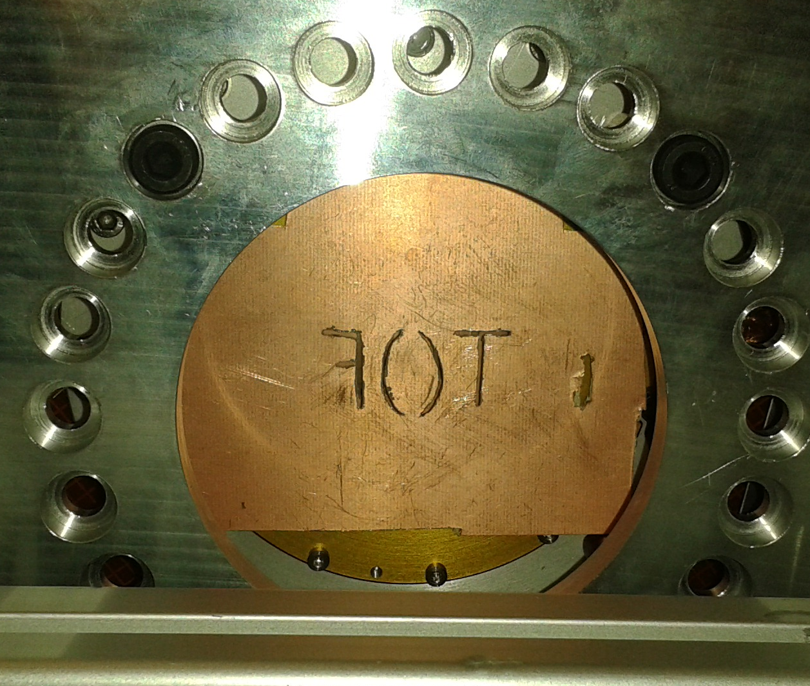
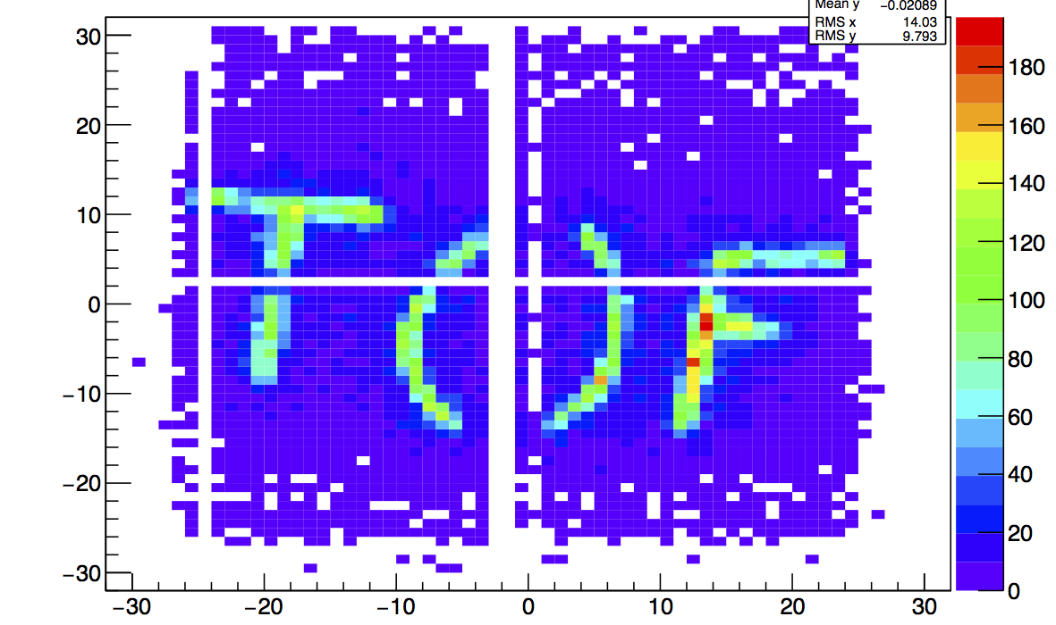
Reconstructed mask image x-rays
X-ray
1 cm
Cu mask
Micromesh

Slide 22
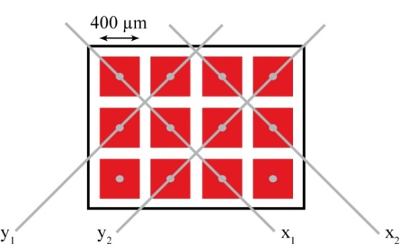

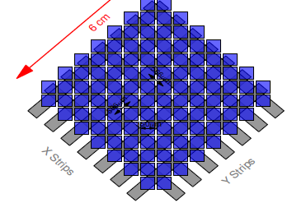
Previous 2D ubulks
1) Anode square pads connected through 2 extra layers.
2) Anode pads/strips connected through 1 extra layer.

