Slide 1

Update on THGEMs and Micromegas production for RICH-1 COMPASS Upgrade on behalf of THGEM Trieste group
INFN - Sezione di Trieste
S . Levorato

Slide 2
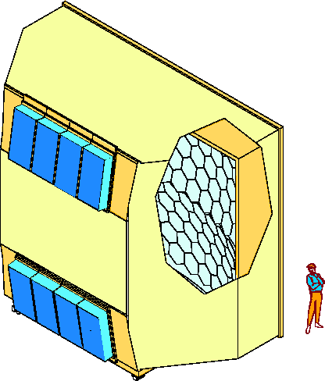
RICH-1 at COMPASS experiment at CERN→ Upgrade starting fall 2015: Reminder
3 m
Photon detectors system now:
              12 MWPC + CsI 600 x 600 mm²
              4 MAPMT 600 x 600 mm² (2006)
6 m
UV mirror
wall
MWPC + CsI
MAPMT
… in 2016
To improve the detector performance
in view of the COMPASS phase 2
5 m
Photon Detectors
radiator:
C₄F₁₀
4 New 600 x 600 mm² MPGD based photon detector
will be installed for a total sensitive surface of ̴ 1.1 m²
Remark → mechanical constrains to guarantee compatibility with the present structure
radiator gas: C₄F₁₀

Slide 3
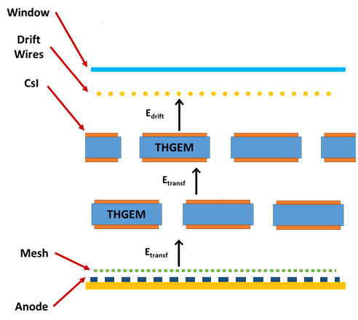
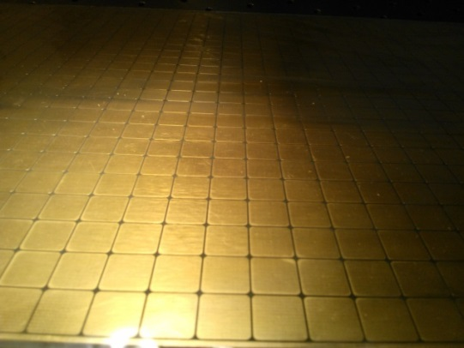
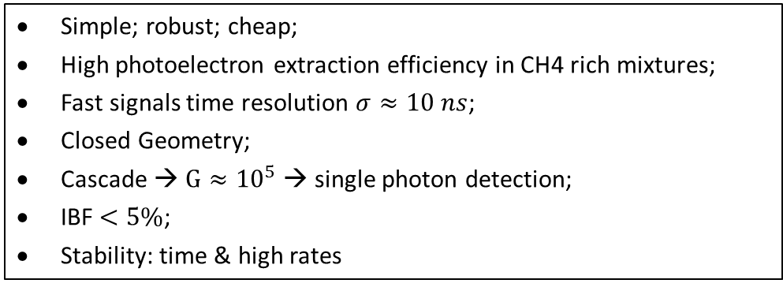
Detector concept: architecture chosen a reminder
Hybrid Detector (2 x THGEM + B-Micromegas)
Simple; robust; cheap;
High photoelectron extraction efficiency in CH4 rich mixtures;
Fast signals time resolution $σ≈10 ns$;
Closed Geometry;
Cascade → $G≈{10}^{5}$ → single photon detection;
IBF $<5\%$;
Stability: time & high rates
Staggered THGEMs
Multi-Pad Anode
(8mm pitch 500 μm interpad )
Each 600mmx600mm detector is made of 2 modules
Each of them consisting of:
          2 300mmx600mm THGEMs
          1 300mmx600mm Bulk Micromegas
Double THGEM: t = 0.4 mm; p = 0.8 mm; h = 0.4 mm

Slide 4
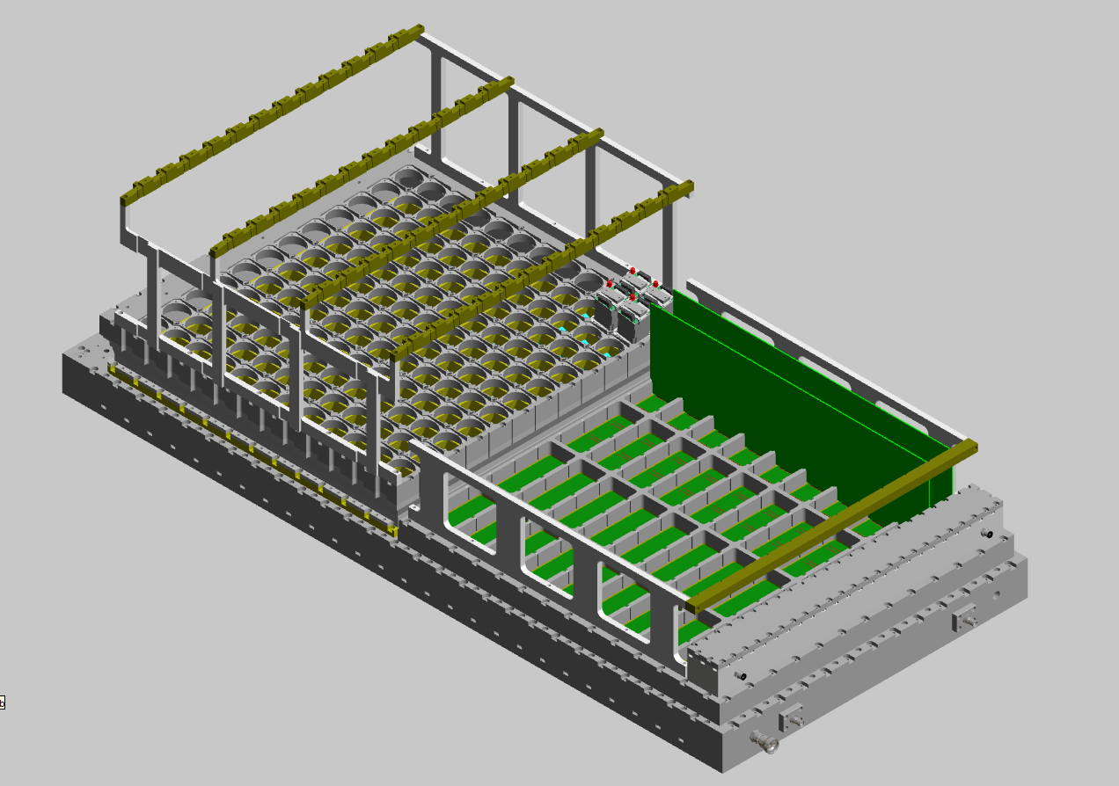
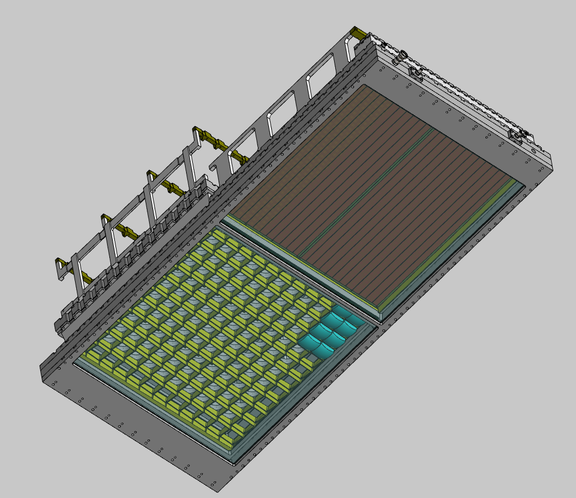
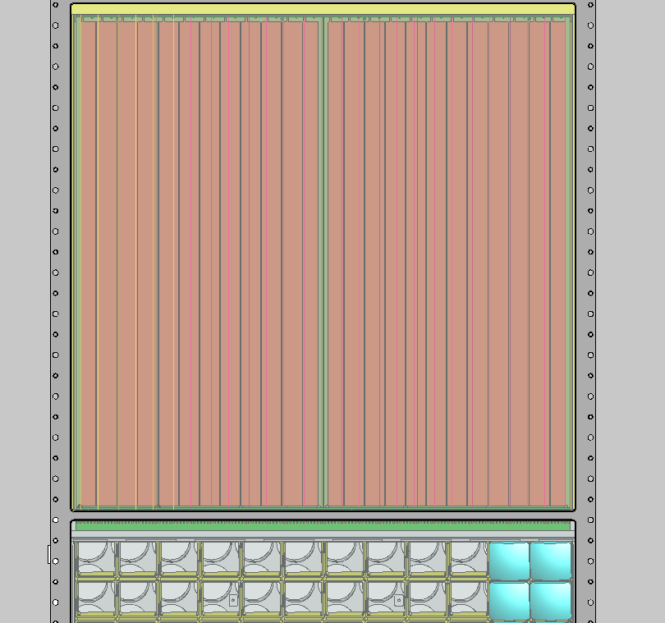
Detector: integration of the new architecture

Slide 5

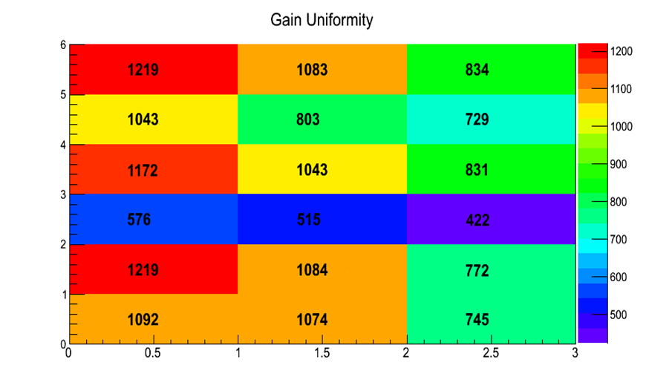
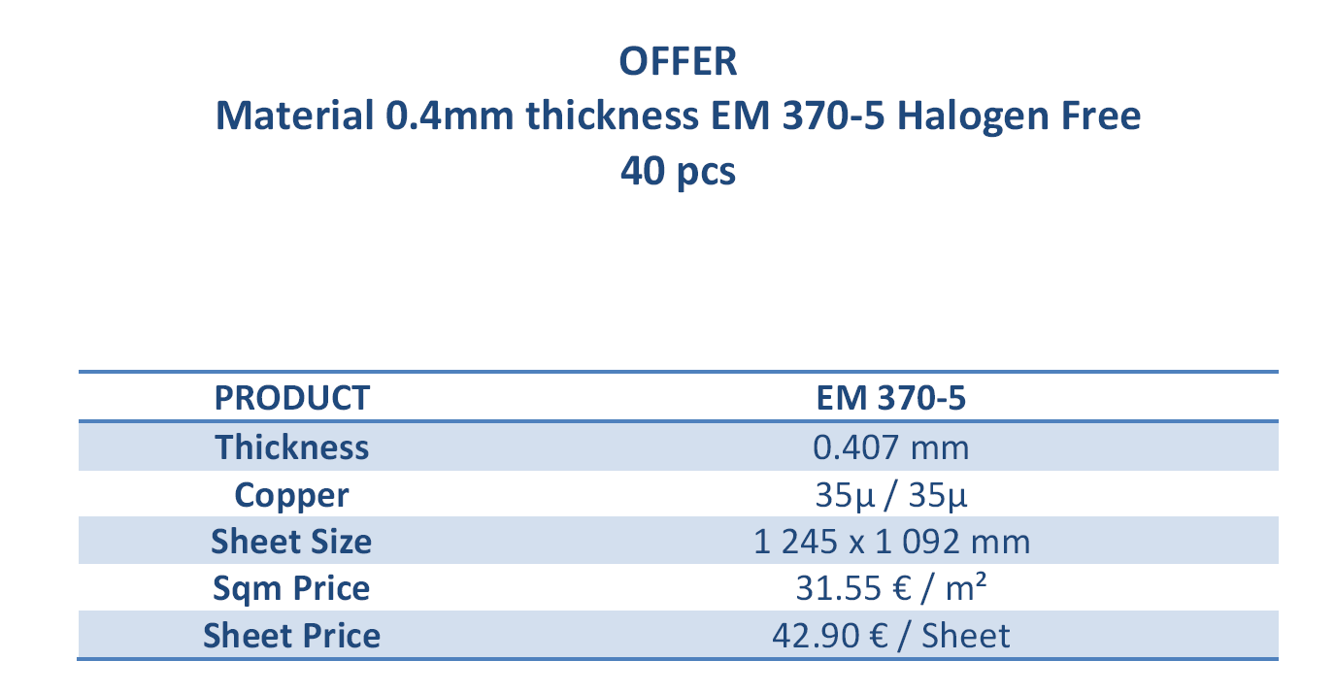
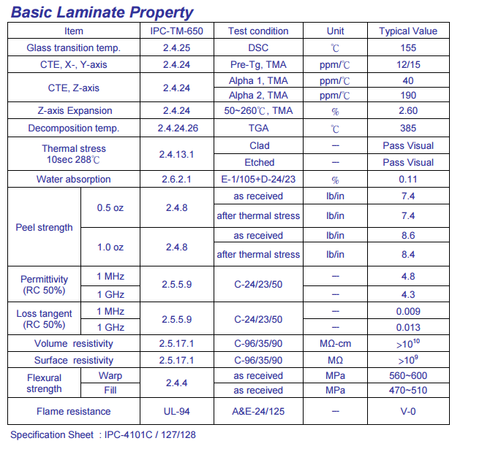
Detector: THGEM production material
Thickness PCB variance as big as 15% for non selected PCB
Need of material preselection
50 foils of raw PCB material bought
Gain Variance > 40%*
example THGEM: t = 0.8 mm; p = 0.8 mm; h = 0.4 mm
*Standard daq chain Cremat+Ortec+MCA, Ar/CO2 70/30 atmosphere

Slide 6
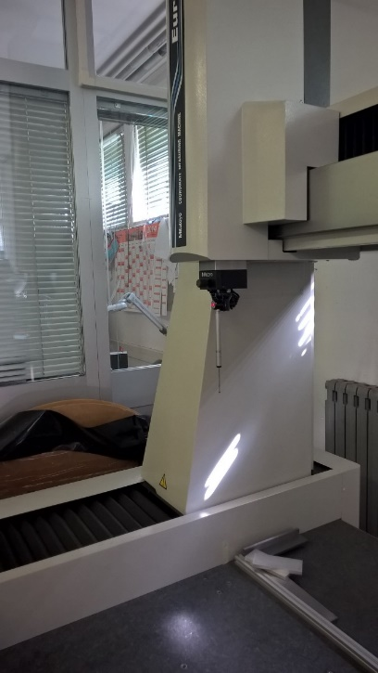
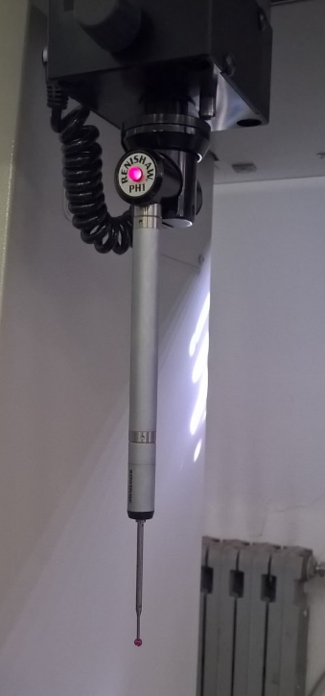
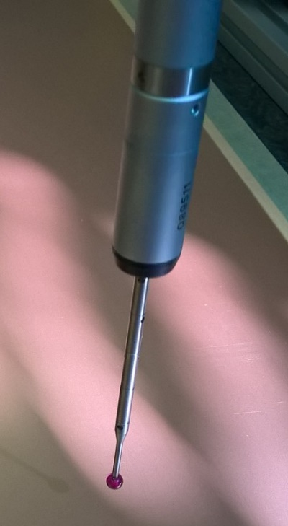
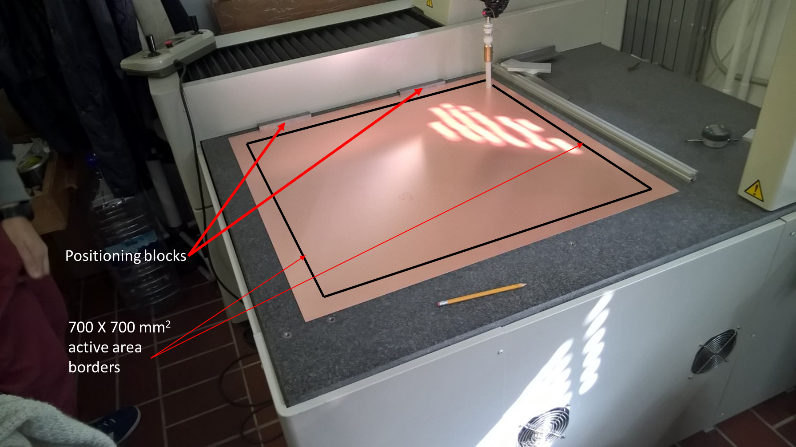
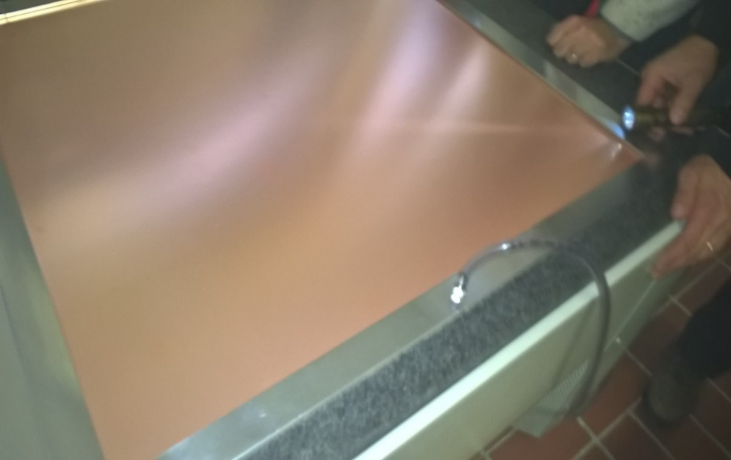
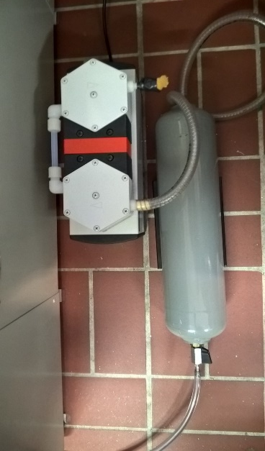
THGEM production: thickness measurement
Thermalized room with Mitutoyo EURO CA776
Top View
(0,0)
Y
#No.
36 x 36 points in square pattern from (0,0) to (700,700)
From 1245 mm x 1092 mm
Raw PCB foil XY reduction
Expected more uniform in
thickness ( production procedure)
On average 3 measured pcs/day
Each foil has its unique n identifier
800 mm
X
800 mm

Slide 7
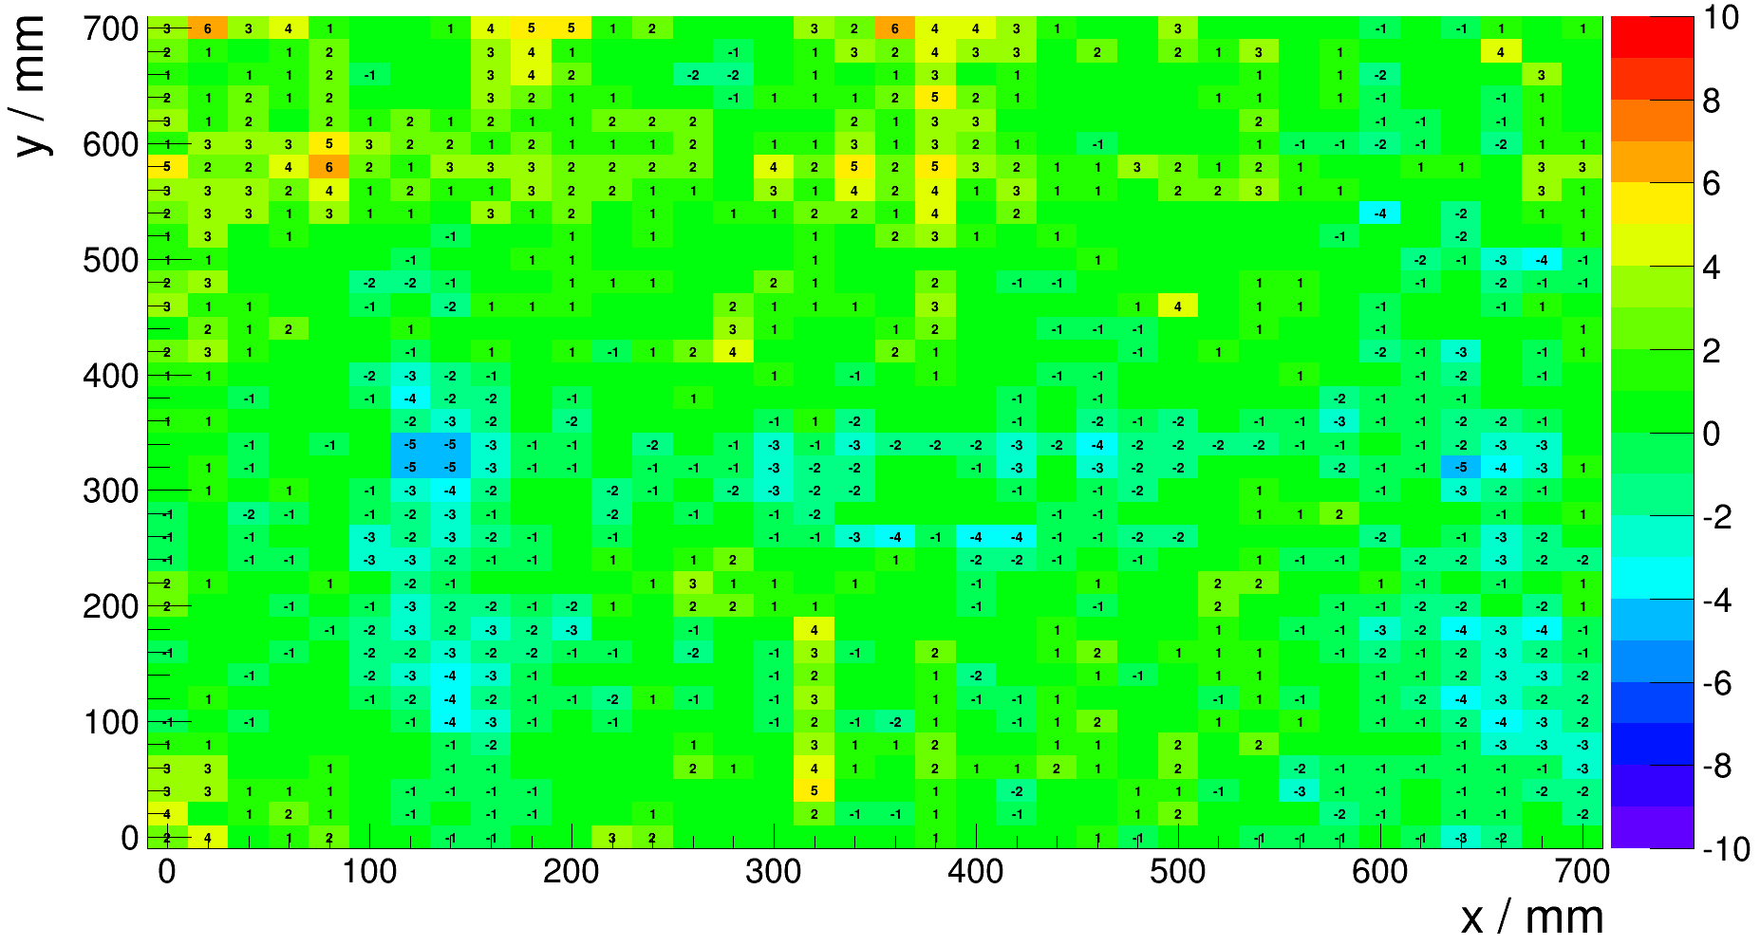
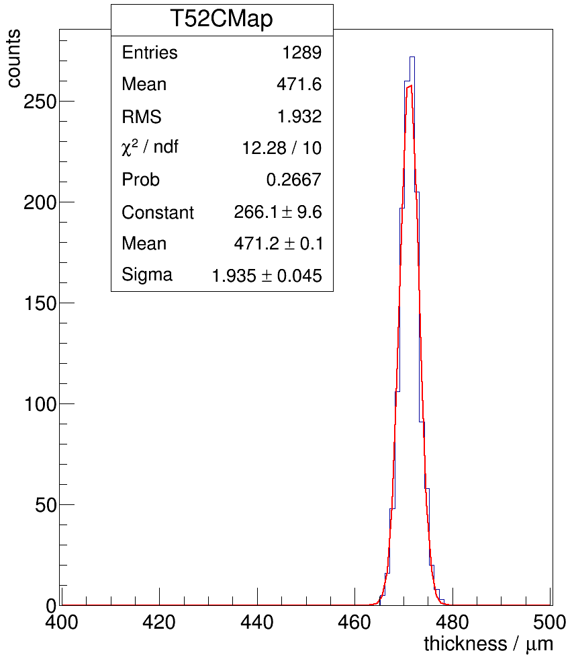
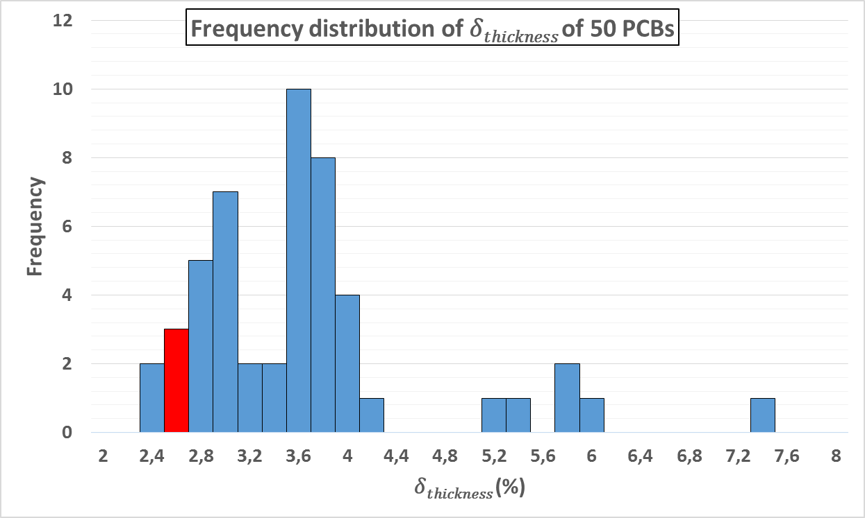

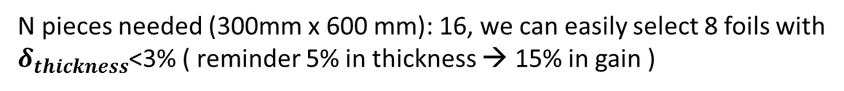
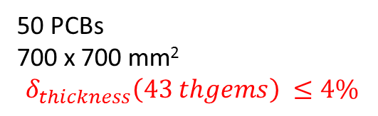

THGEM production, material seection
$$δ_{thickness}\sim 2.6\%$$
50 PCBs
700 x 700 mm²
$$δ_{thickness}\left(43 thgems\right) ≤4\%$$
N pieces needed (300mm x 600 mm): 16, we can easily select 8 foils with
$δ_{thickness}$<3% ( reminder 5% in thickness → 15% in gain )

Slide 8
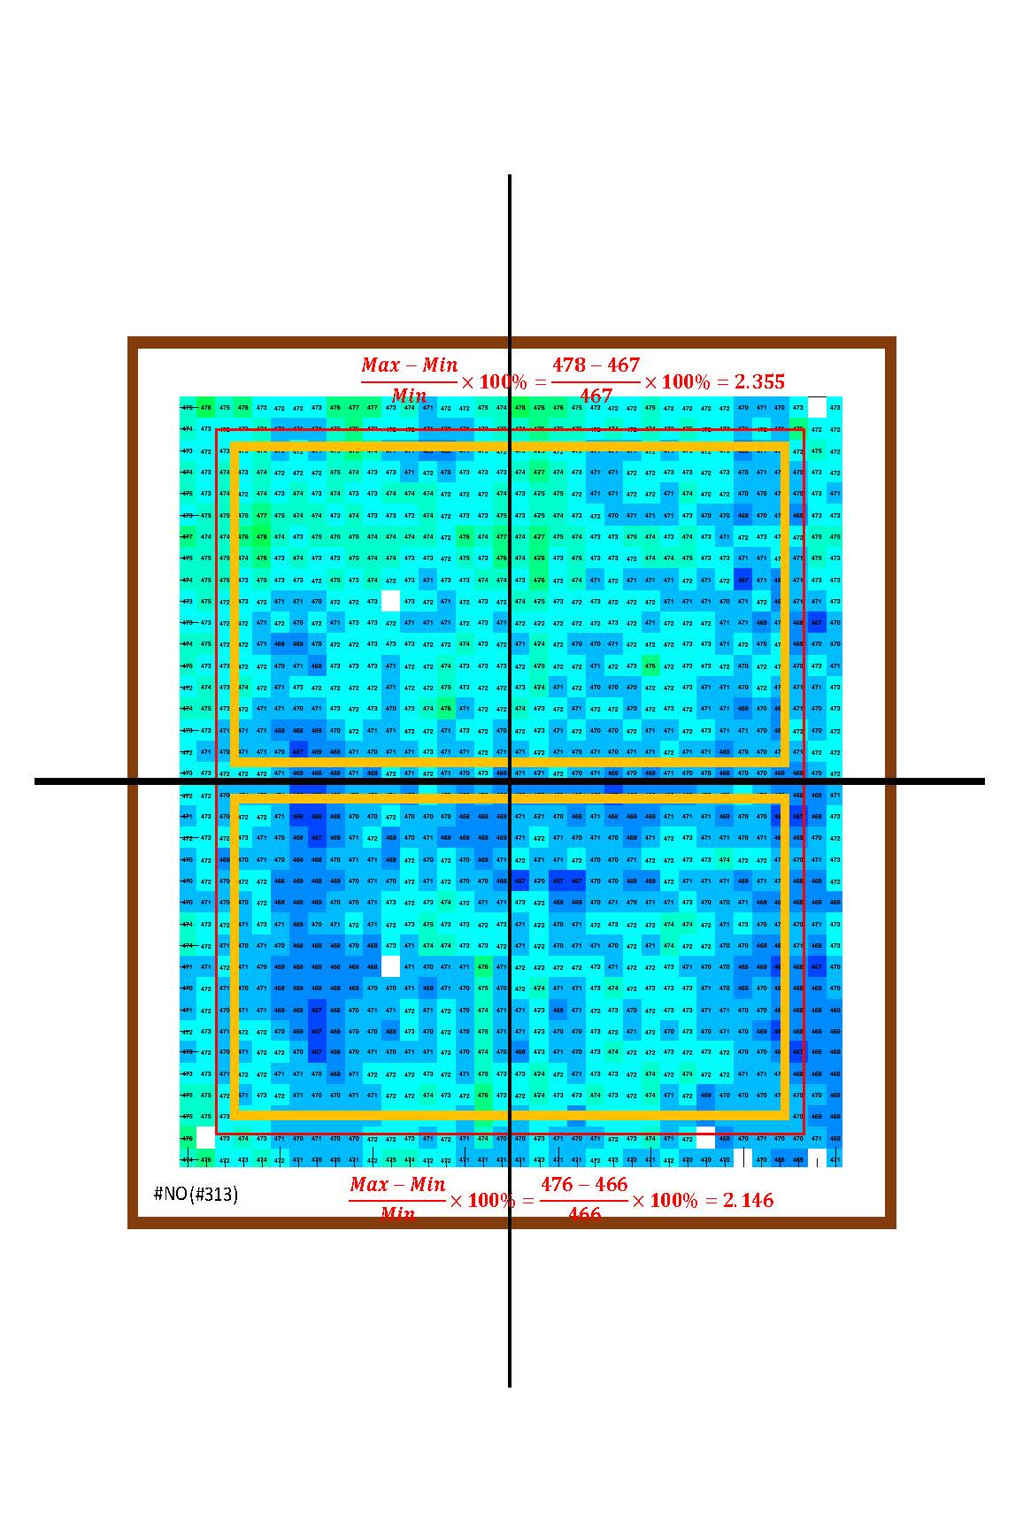
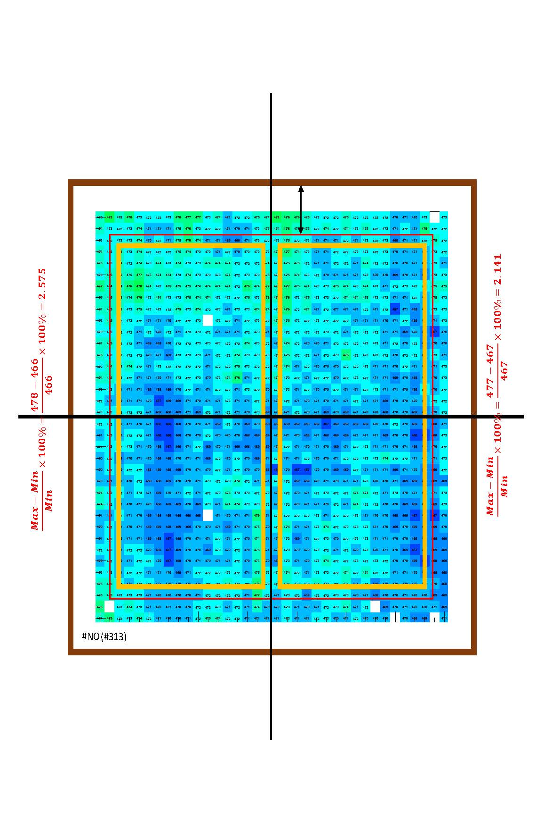
THGEM production, material selection

Slide 9
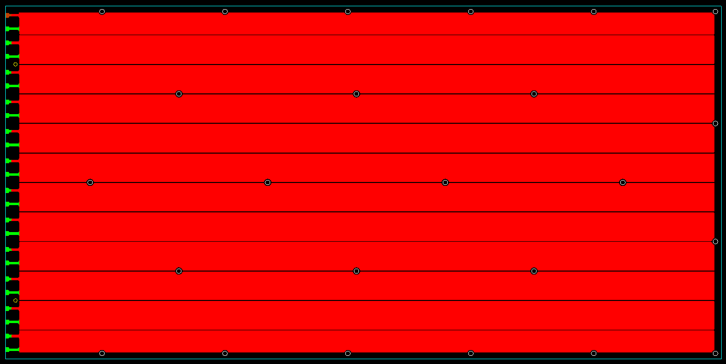

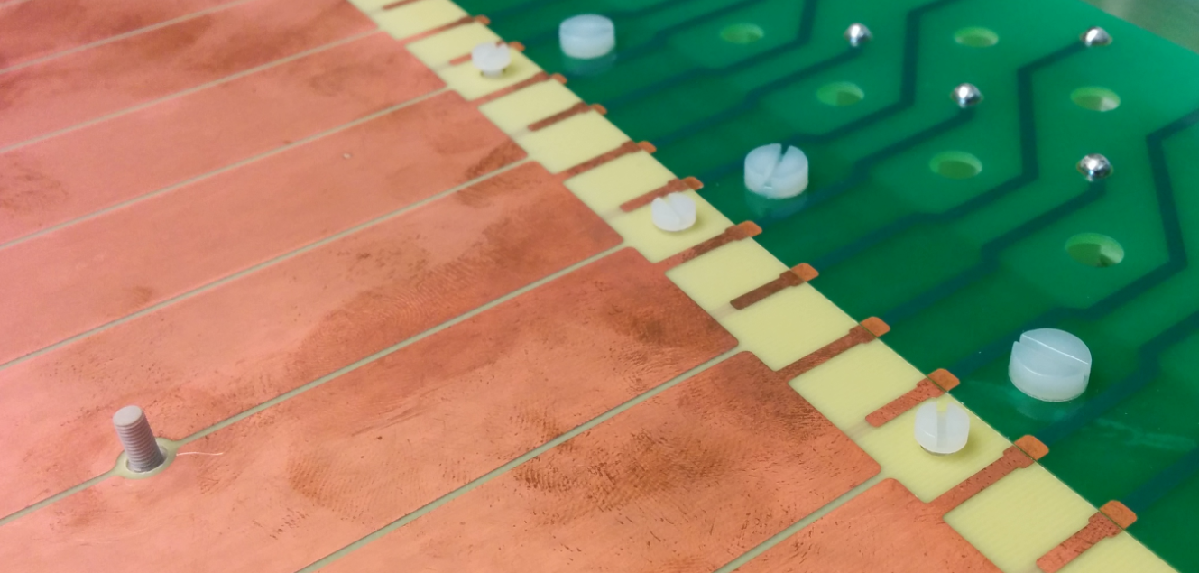
THGEM production
24 fixation points to guarantee
THGEMs flatness and positioning
Pillars in PEEK
t = 0.4 mm; p = 0.8 mm; h = 0.4 mm
Segmentation in 12 sectors
0.7 mm
sector
separation
2 reference holes to guarantee
the THGEMs staggering
PCB for alignment and spacing

Slide 10
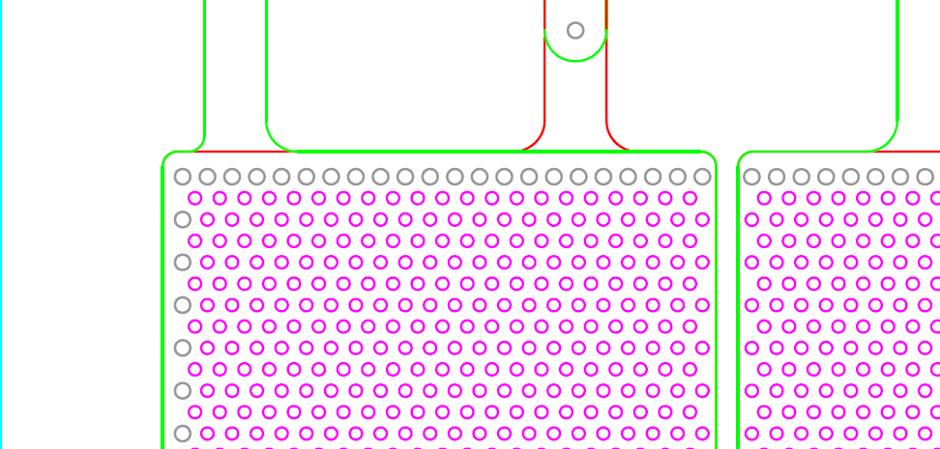
THGEM production
24 fixation points to guarantee
THGEMs flatness and positioning
Pillars in PEEK
Segmentation in 12 sectors
0.7 mm
sector
separation
2 reference holes to guarantee
the THGEMs staggering
PCB for alignment and spacing

Slide 11
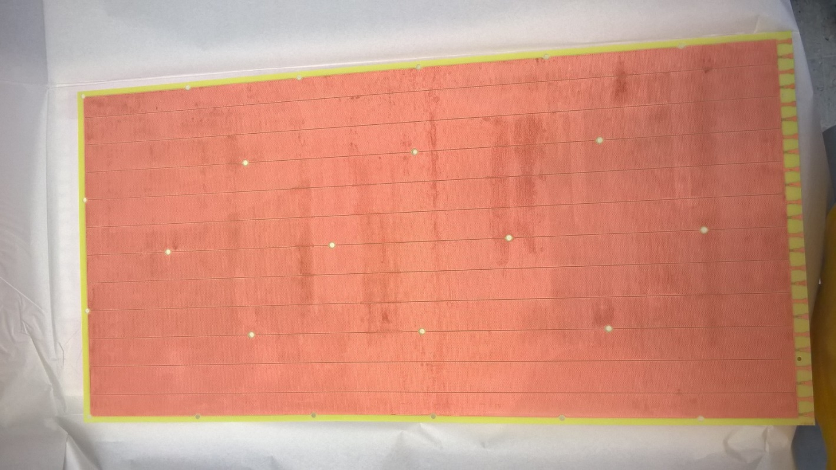
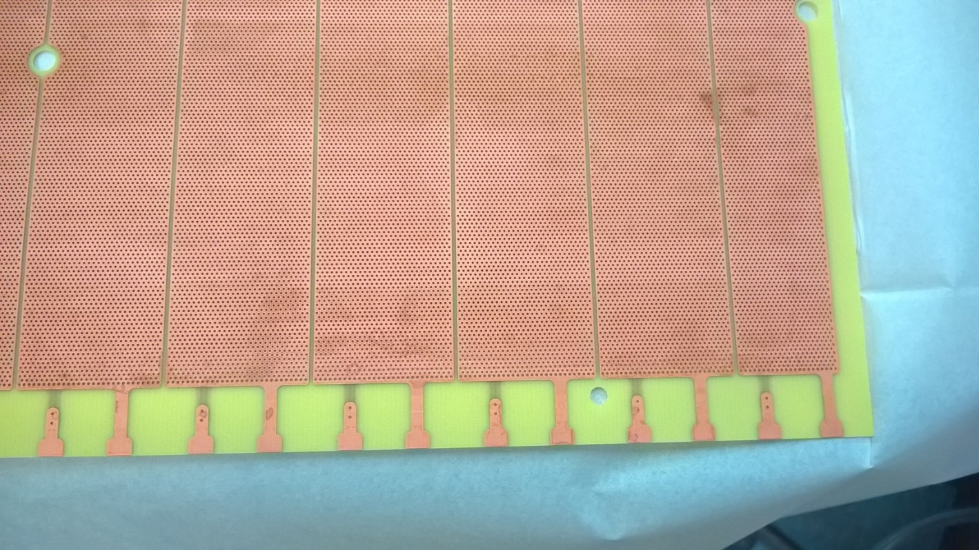
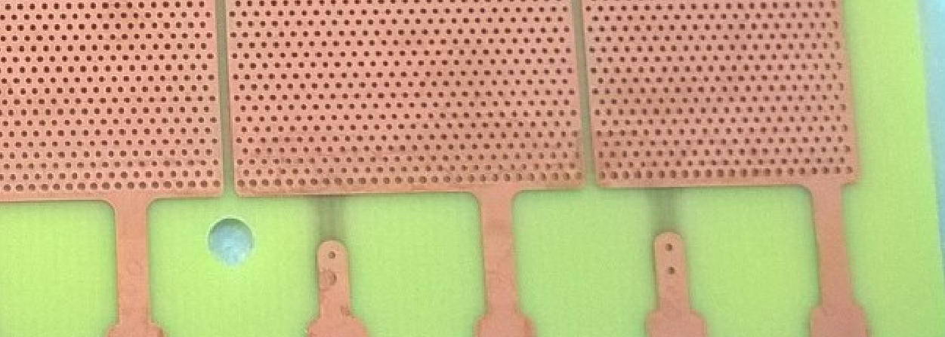
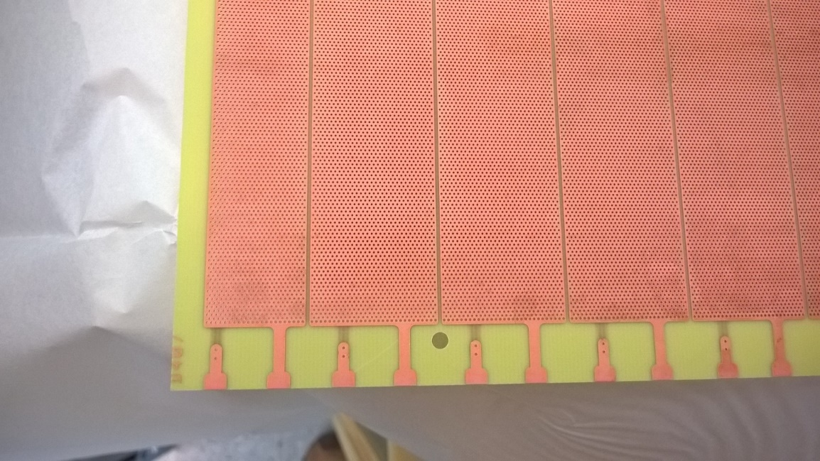
THGEM production
PCB material Sent to ELTOS for production, Agreed on procedure with ELTOS first batch delivery 08/06/2015:

Slide 12
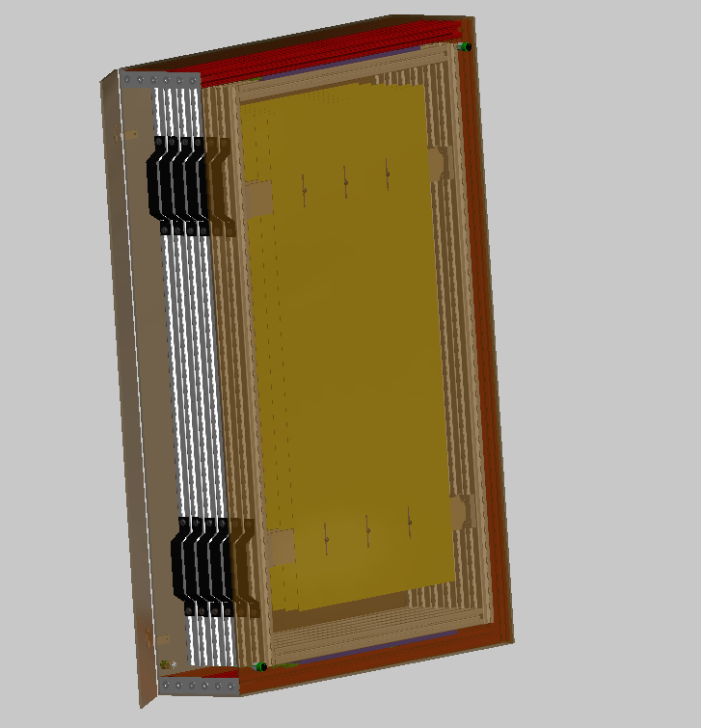
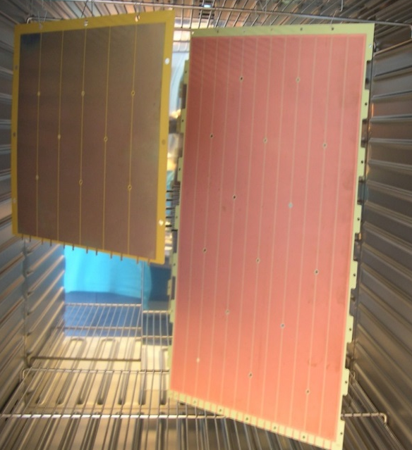
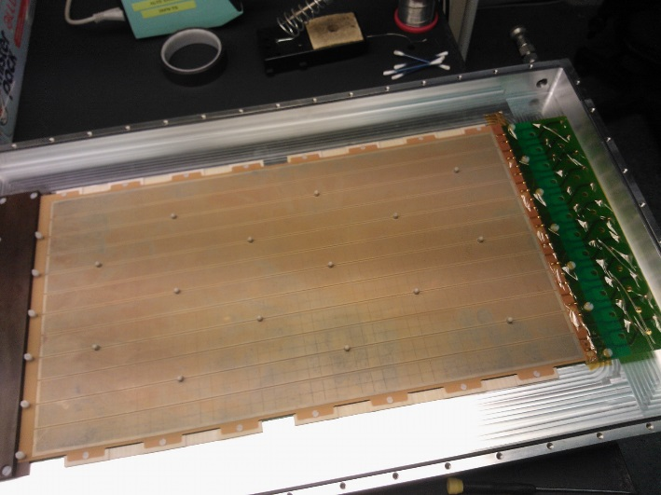
THGEM characterization
In Trieste Cleaning procedure will be applied : polish, high pressure water cleaning, ultrasonic Bath + microetching, distilled water rinsing and oven @ 160 ºC, final step Gain Characterization
THGEMs stored for transport in dedicated boxes for gold coating to CERN.

Slide 13
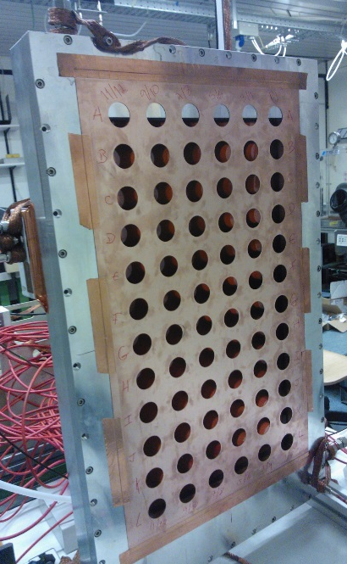
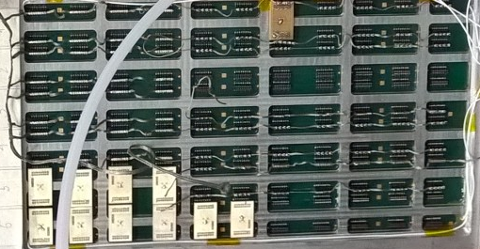
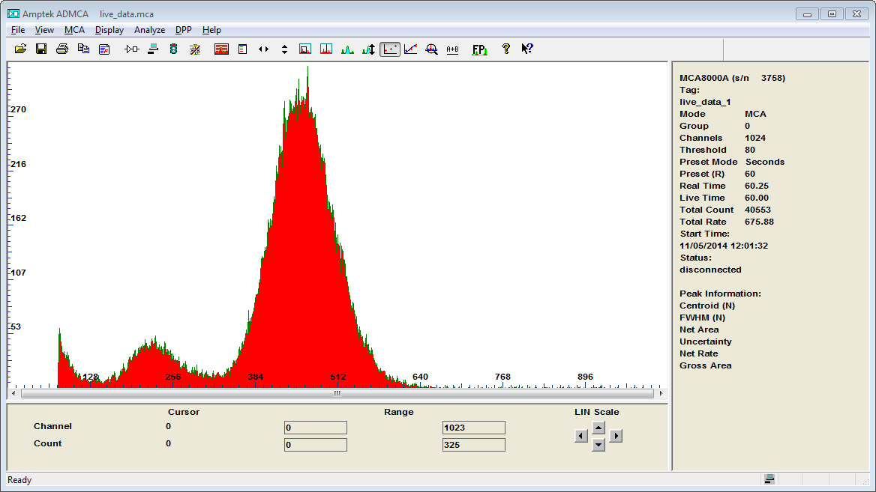
THGEM characterization: proof of the principle
Ar/CO₂ (70:30);
Pre-amplifier + Amplifier
+ MCA; ⁵⁵Fe
⁵⁵Fe main peak
Uniformity gain, E res. spectra
Escape Peak
⁵⁵Fe positioning
Corresponding connector
selection
Spectra collection
Operation is time consuming, and affected by gain variation due to the P,T gas/environmental changes

Slide 14
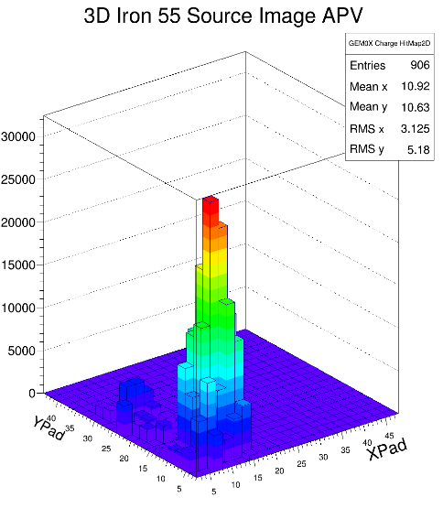
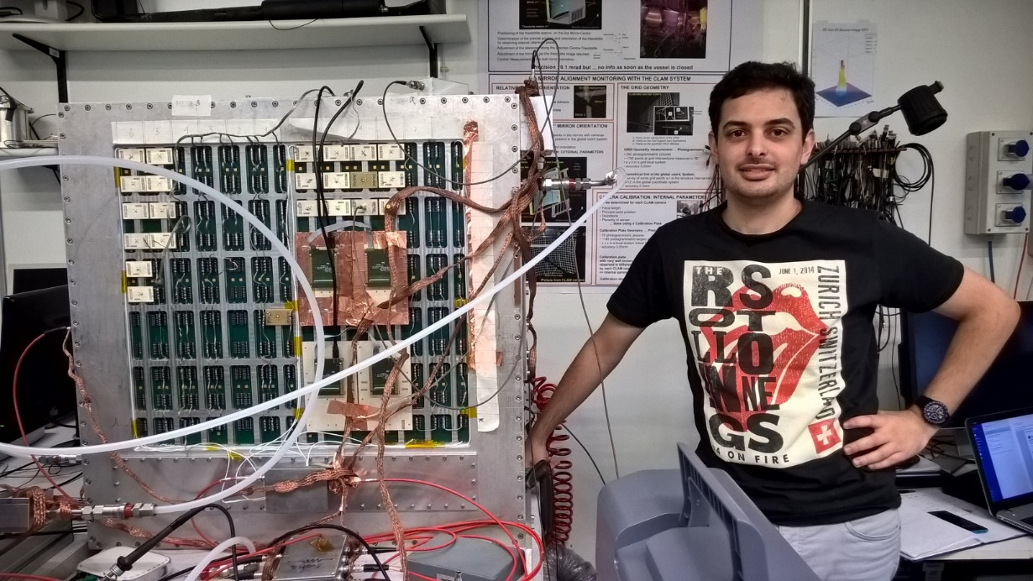
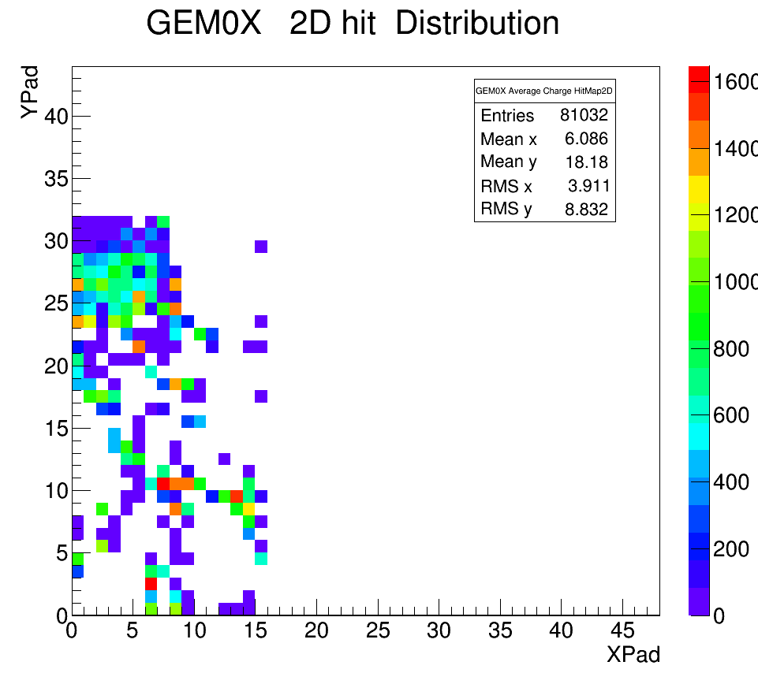
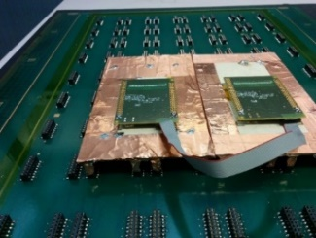
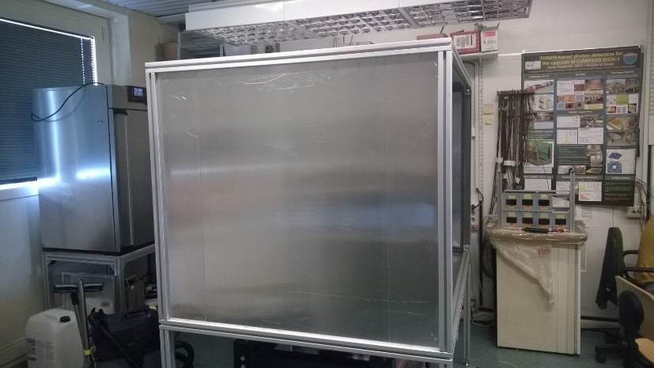
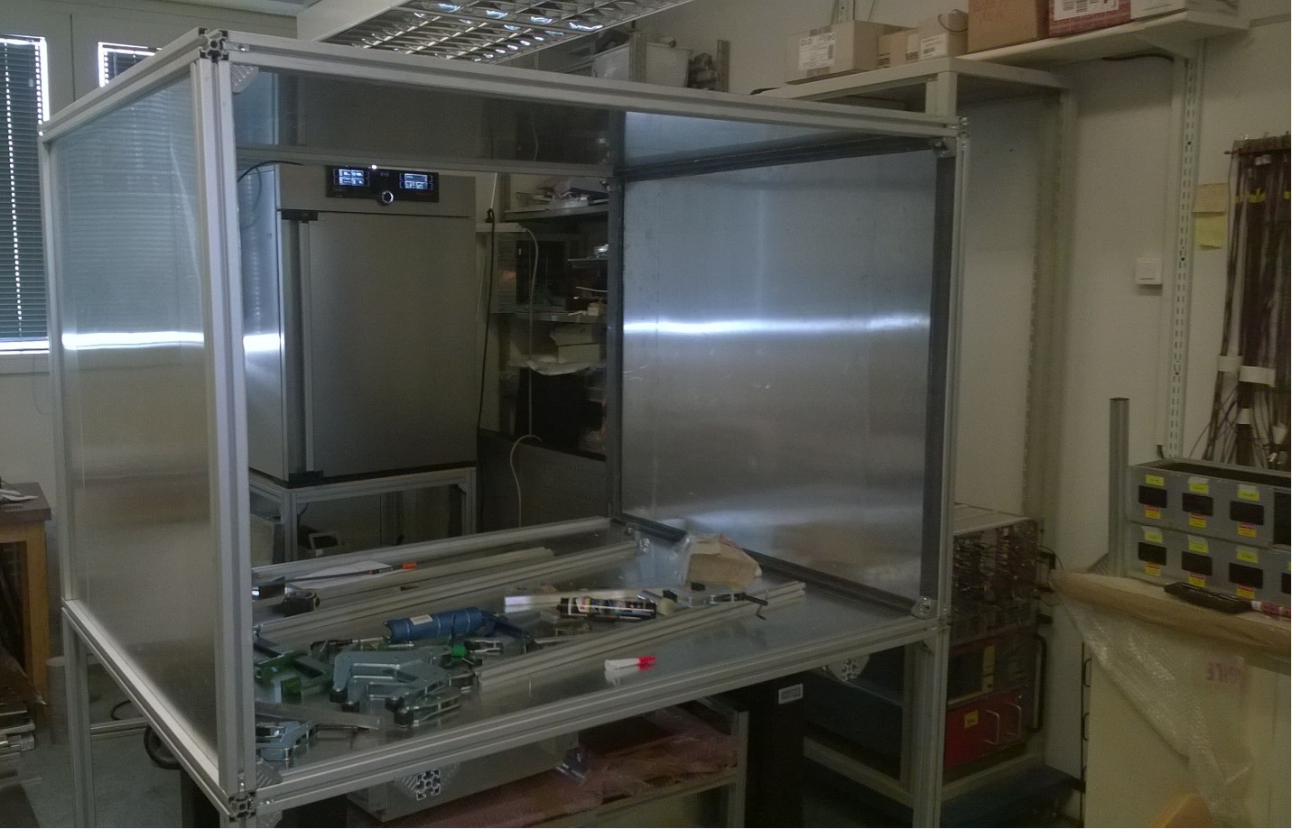
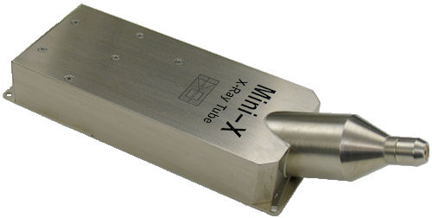
THGEM characterization
Gain Uniformity will be measured with X-Ray source (up to now ⁵⁵Fe), Data collected with SRS system.
Each THGEM will be fully characterized. Amore software adapted, Different Mapping Option added to have Pads: Thanks to Eraldo for borrowing us the FEC!
Next weeks ⁵⁵Fe →X-rays gun

Slide 15
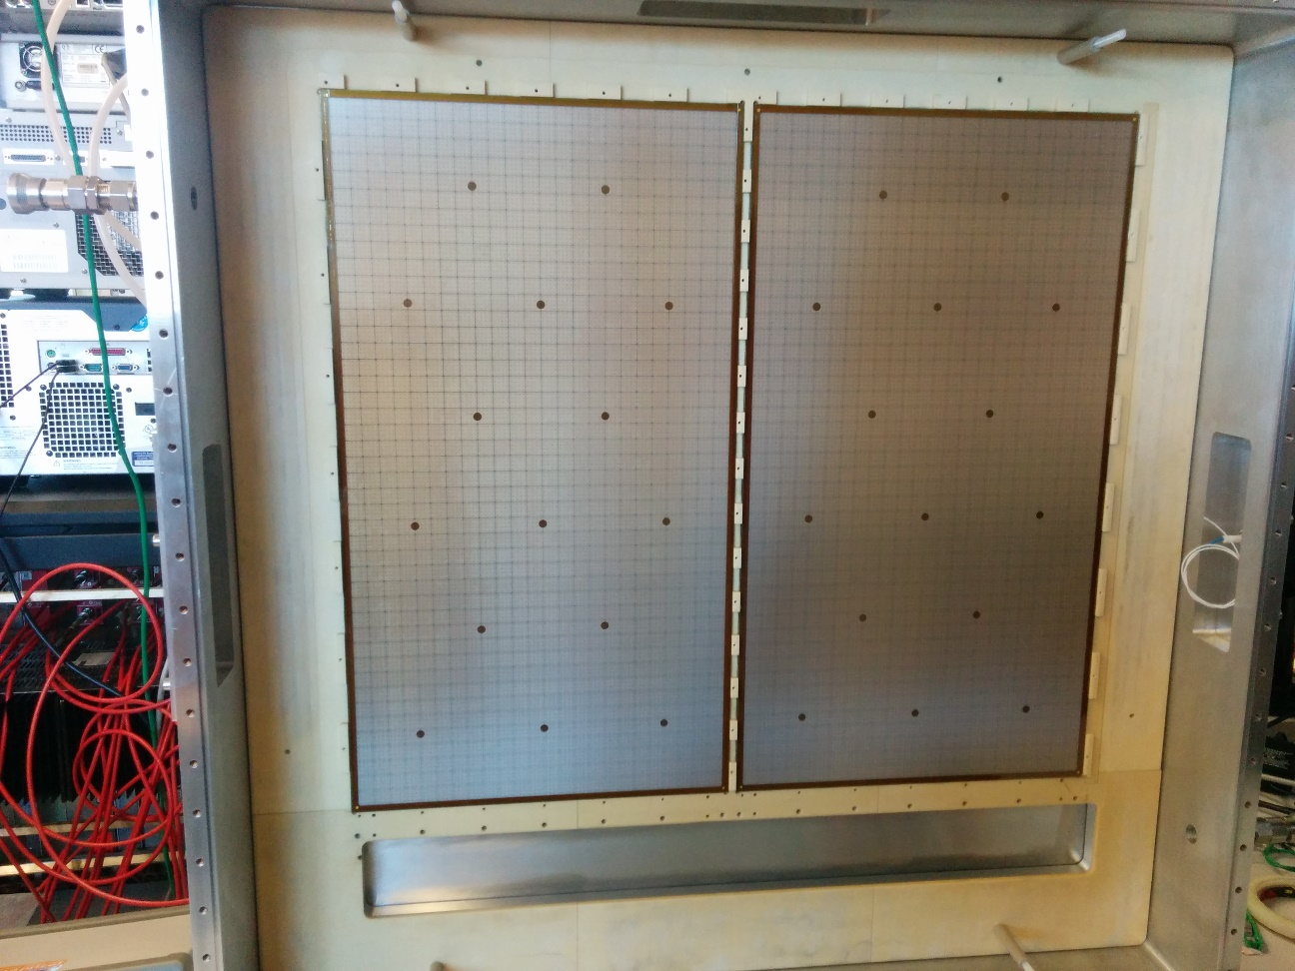
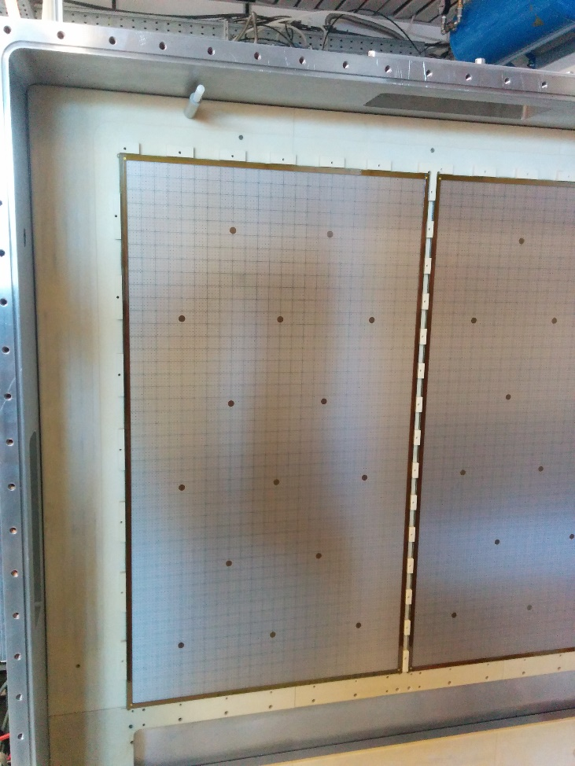
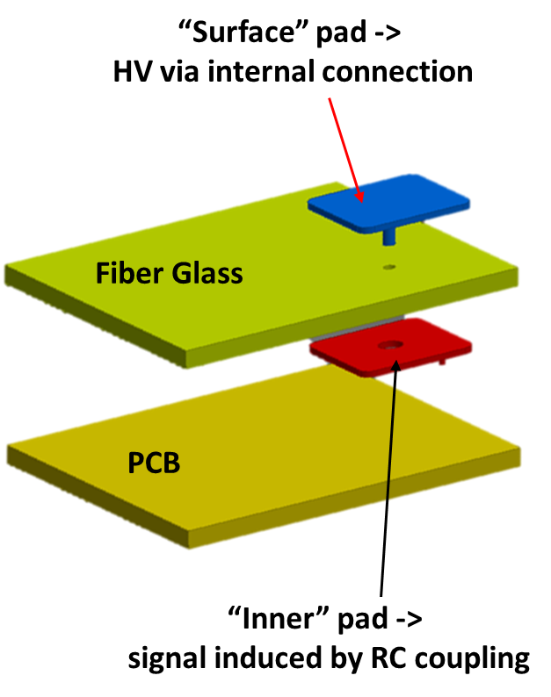
Detector Micromegas production
Final anode design to be completed in the next weeks for production at TVR company,
first delivery foreseen for half of July, they will be delivered to CERN for BULK Micromegas production (Agreed with RUI)
Prototypes have already been produced @ CERN with good results in terms of gain uniformity and detector stability
Start of production
of BULK MM (final pieces)
at the end of July
Then 2 pieces for month

Slide 16
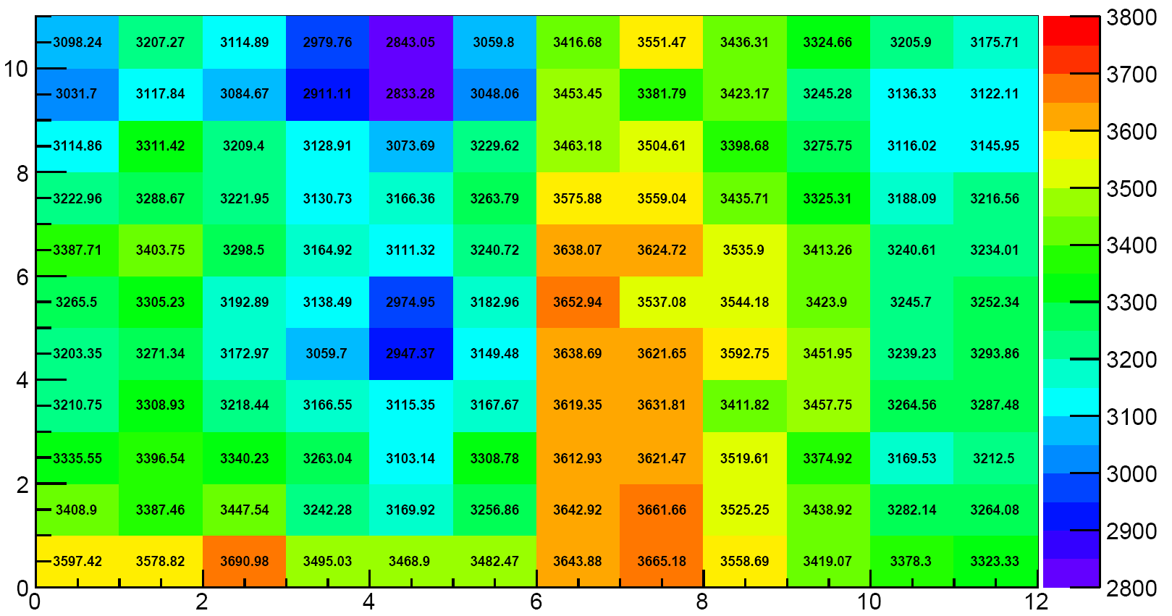
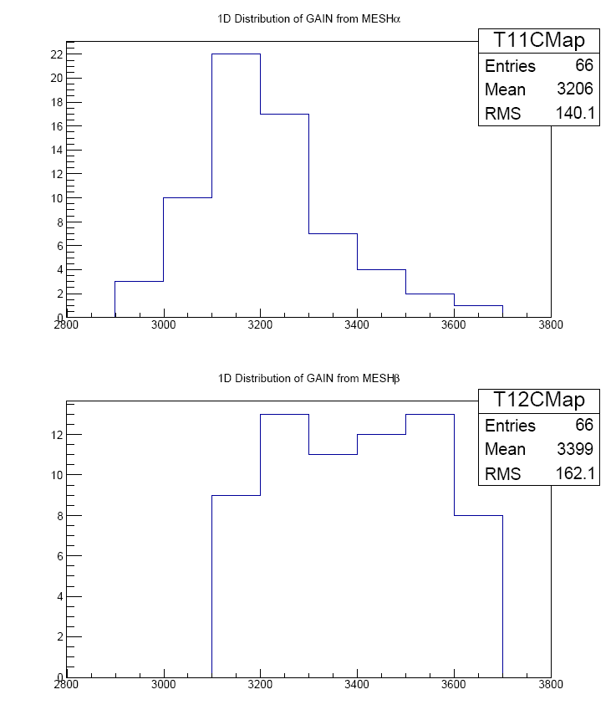
Detector Micromegas production
55Fe source Ar/CO2 Cremat+Ortec+Amptek
Final anode design to be completed in the next weeks for production at TVR company,
first delivery foreseen for half of July, they will be delivered to CERN for BULK Micromegas production (Agreed with RUI)
Prototypes have already been produced @ CERN with good results in terms of gain uniformity and detector stability
Start of production
of BULK MM (final pieces)
at the end of July
Then 2 pieces for month
OK

Slide 17
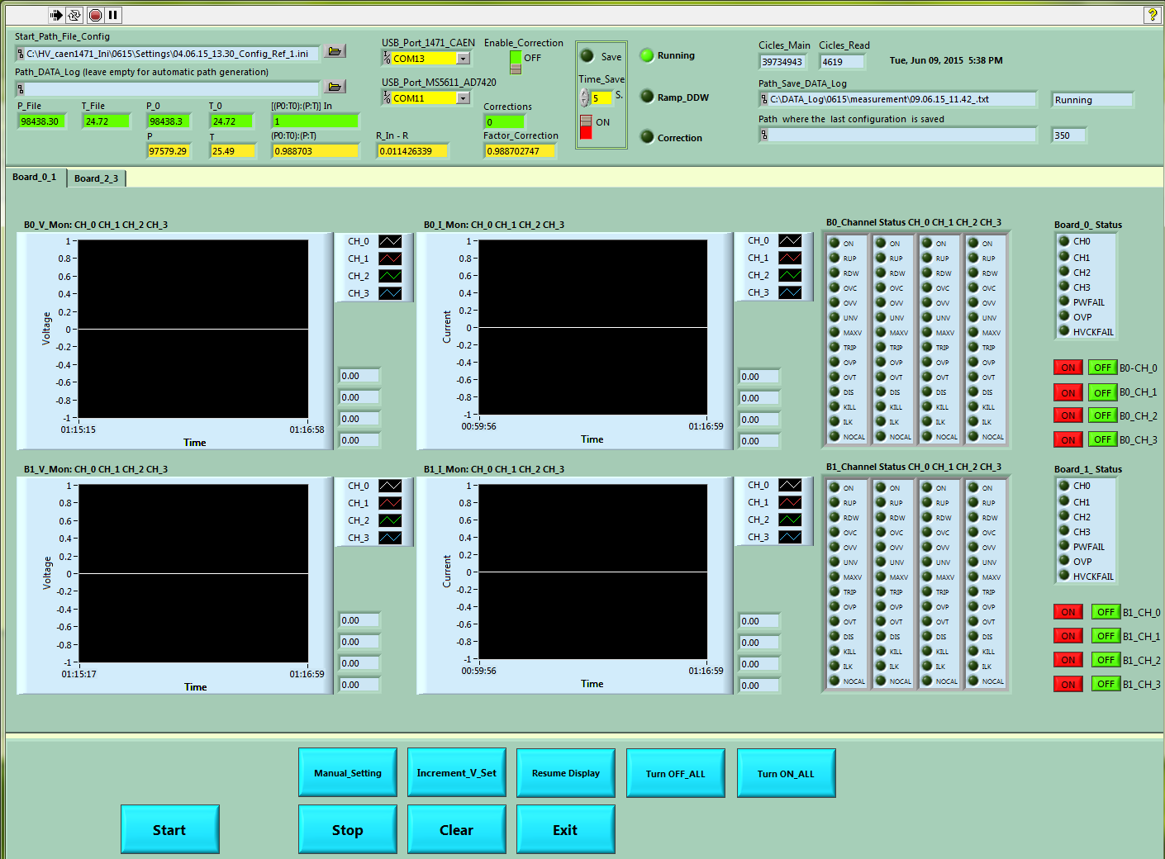
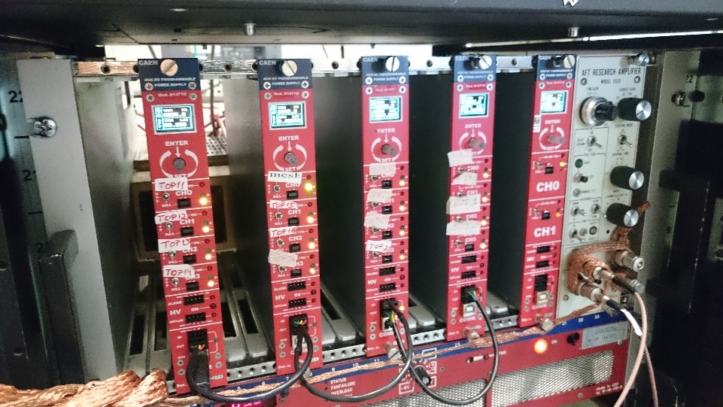






Full detector characterization: Gain Uniformity, HV monitoring, PT variation
Caen HV 1471 A
Correction of Voltage $f\left(P,T\right)$
according to linearized exponential law
System fully automated + logging
LabVIEW based
Thanks to P. Ciliberti
wireless PicoAmmeter + automated logging Linux SW QT-based
The correction under study but encouraging results!
Hybrid prototype 2 THGEMs + Micromegas
w/o PT correction ± 20% gain variation during the day
with PT correction ± 5%.

Slide 18
Full detector characterization: Gain Uniformity, HV monitoring, PT variation
Thanks for your attention!
Thanks to B.G.

