Slide 1
How to hack,earn money and stay out of jail.
IOANNIS CHALKIADIS
CERN IT SECURITY TEAM
IT LIGHTNING TALK 04.12.15 CERN

Slide 2


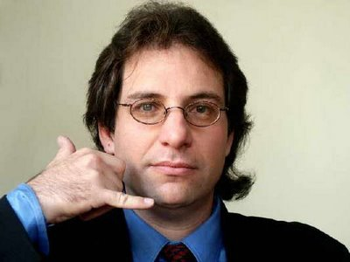





Hacking started about curiosity and knowledge, now it is just business.

Slide 3
How much is the global spending in IT Security?
^{υ}Up to 77$ Billion in 2015*.
^{υ}Is it enough?
*http://cybersecurityventures.com/cybersecurity-market-report/

Slide 4
I ask you again is it enough?

Slide 5


Slide 6
Biggest data breaches in the last decade *
Company | Users
JP Morgan Chase | 76.000.000
Sony | 77.000.000
Ebay | 145.000.000
Adobe | 36.000.000
Apple | 12.400.000
US Military | 76.000.000
Yahoo | 22.000.000
*http://www.informationisbeautiful.net/visualizations/worlds-biggest-data-breaches-hacks/

Slide 7

Hacking and arrests
24 year old Algerian –ZEUS BOTNET-
3.600.000 million infected machines
70 million $$ loss

Slide 8
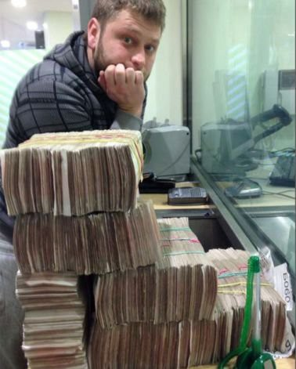
Hacking and arrests
27 year old Russian –BLACKHOLE EXPLOIT KIT-
97% of 2014 browser threats was from blackhole. (AVG)
Was making 70.000$ per month selling his kit
←----- He was smart huh?
You know how he got arrested?
He posted this picture in his Facebook profile.. Meh..

Slide 9

What is bug bounty, terms/rules
You report ->They reply -> Fix or will not fix -> Reward/Thank you

Slide 10
Rules*
99% of the companies have this list of rules:
Do not cause DOS (Denial of service) to their services.
The vulnerability should not affect the user data or critical information.
Responsible and ethical disclosure to the company.
Do not share it with any third parties.

Slide 11
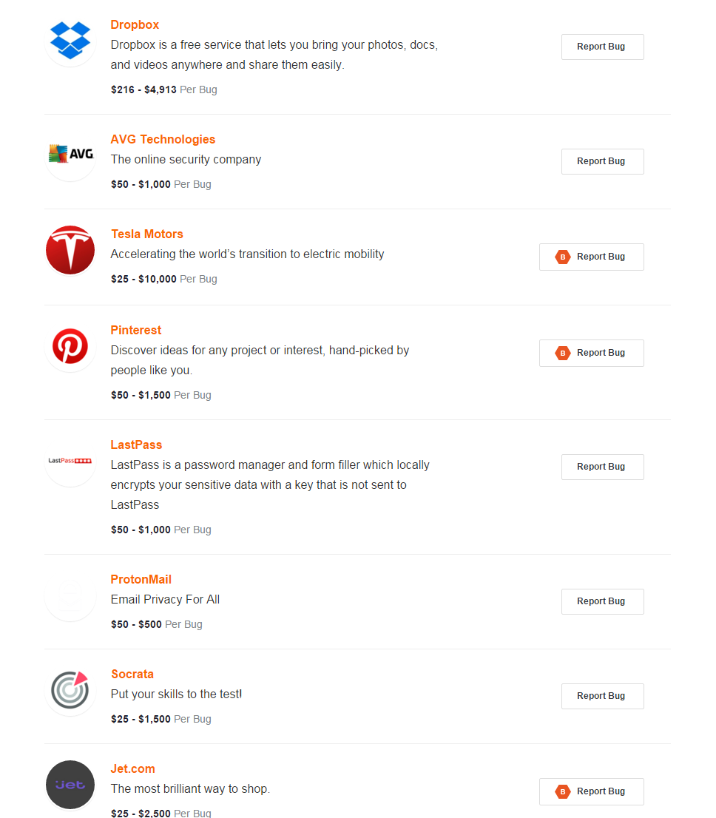

Slide 12
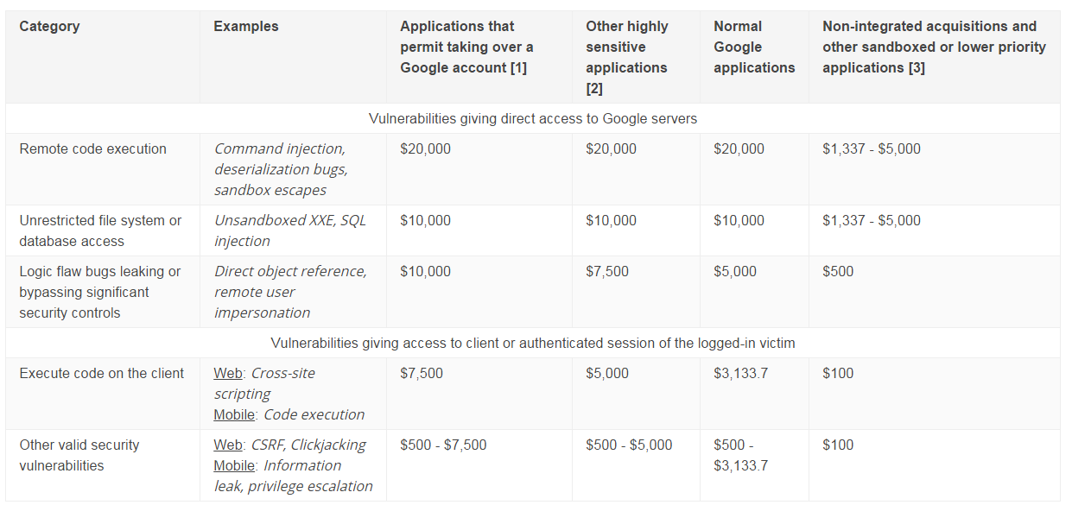

Slide 13
My Personal Adventures
Google:
Contacted them 17.10.14
Got Response 18.10.14
Triaged Situation ( implementing fix) 19.10.14
Fixed Reward $$ and thank you email. 21.10.14

Slide 14
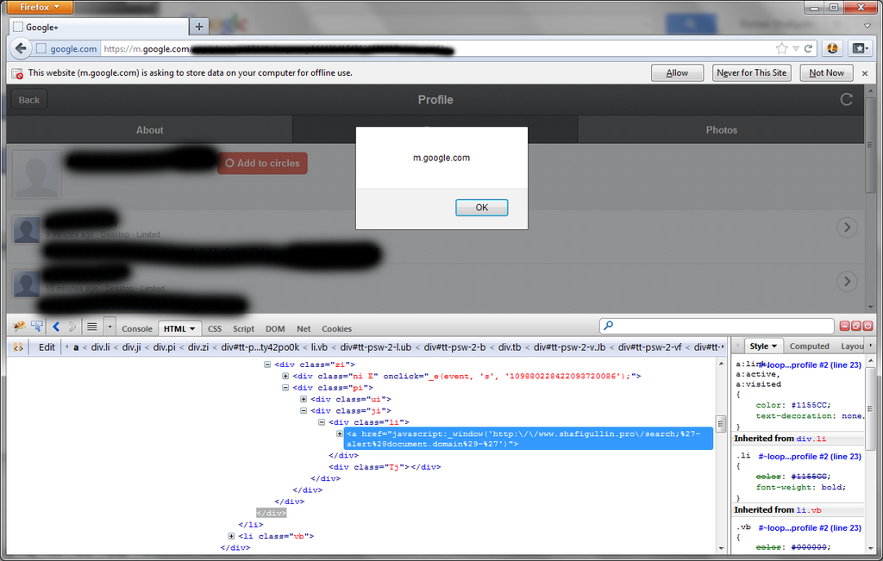

Slide 15
My Personal Adventures
Western union:
Contacted them 11.05.15
Got Response 16.05.15
Triaged Situation ( implementing fix) 24.05.15
Fixed Reward $$ and thank you email. 03.06.15

Slide 16
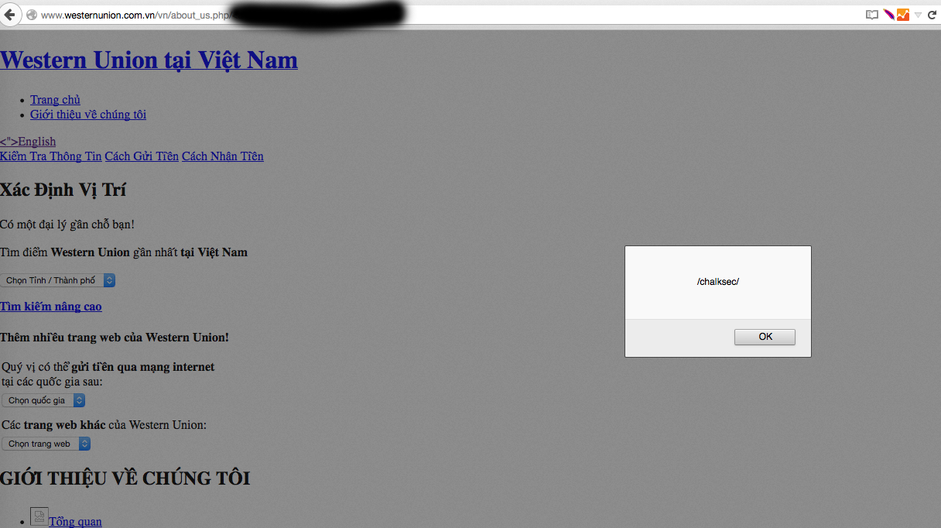

Slide 17
Sites that host bug bounty programs
https://bugcrowd.com/programs
https://hackerone.com/directory

Slide 18

Want to learn more and improve?

Slide 19

Questions

