Slide 1
TS1
BE-BI interventions

Slide 2
Contents:
TS1 overview
PS activities
PSB activities
SPS activities
LHC activities
AWAKE-GIF activities

Slide 3
TS1 overview
24 hours technical stop for the injector complex
5 days technical stop for the LHC
45 activities: 6 in the PS , 4 in the BOOSTER , 4 in the SPS,
30 in the LHC, 1 in AWAKE, 1 in GIF
Monday the 15th of June very busy day: all the activities with vacuum will take place that day

Slide 4
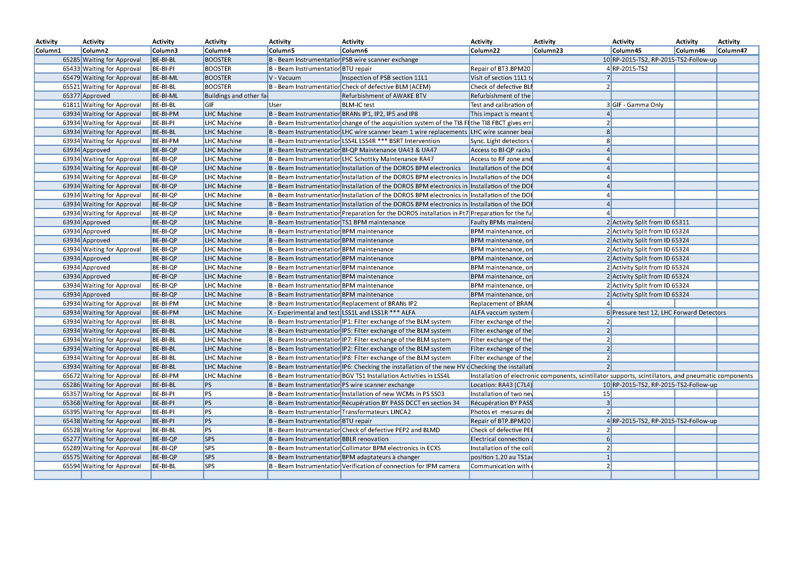

Slide 5
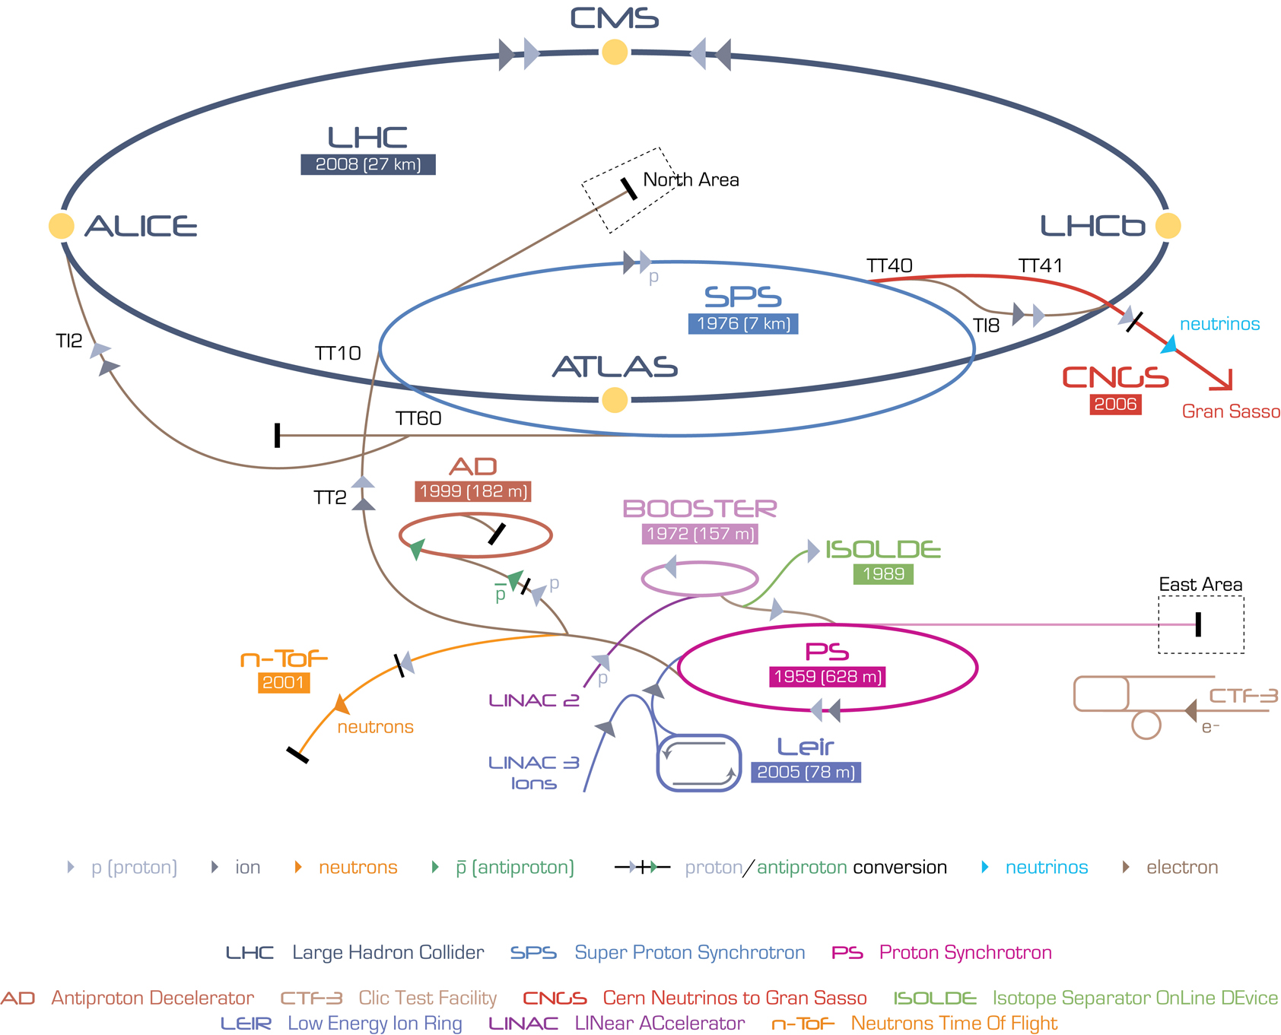
PS ring:
6 activities

Slide 6
Impact #65286(BL, ML), PS wire scanner installation
installation of the WS in the SS68
Impact # 65357(PI, ML), installation of two WCM in SS03
Vacuum acceptance test on going, due to be ready by the end of week24
Impact # 65368(PI), Récupération BY PASS DCCT en section 34
Récupération BY PASS DCCT en section 34 laissé vers le DCCT et mise en Zone tampon du PS pour futur transfert vers 867 R-T21.

Slide 7
Impact # 65438(PI), BTU repair
Impact # 65528 (BL), Check of defective PEP2 and BLMD
Check of defective PEP2 and BLMD:
MU15: PEP2 needs to be checked.
MU42: BLMD needs to be checked, evt replaced.
Impact # 65395(PI), Transformateurs LINAC 2
Photos et mesures des diametres des chambres a vide et des
transformateurs dans la zone inflecteur du PS (lignes LTB, LBS, LBE)

Slide 8
BOOSTER:
4 activities

Slide 9
Impact #65285(BL,ML), PSB wire scanner exchange
Replacement of the vertical WS on the ring 3(broken wire)
Impact # 65479(ML), Inspection of PSB section 11L1
Inspection for future installation of the WS
Impact # 65433(PI), BTU repair
Impact # 65521(BL), Check of defective BLM (ACEM)
Check of defective BLMs (ACEMs): the BT.MBL10 doesn't show any losses, evt. ACEM needs to be replaced.

Slide 10
SPS:
4 activities

Slide 11
Impact #65277 (QP), BBLR renovation
Electrical connection and test of the BBLR pick-ups
Test of the water cooling system
Test of the stepping motor controller
Impact # 65289 (QP), Collimator BPM electronics in ECX5 Installation of the collimator BPM electronics in a rack in ECX5
Impact # 65575 (QP), BPM adaptateurs à changer
position 1.20 au TS1 adaptateurs BPM à changer

Slide 12
Impact # 65594 (BL), Verification of connection for IPM camera
Communication with one of the IPM cameras is not working. Need to access in order to verify connections.

Slide 13
LHC:
30 activities

Slide 14
Impact #63934 (PM), BRANs IP1, IP2, IP5 and IP8
Impact # 64278 (PI), change of the acquisition system of the TI8 FBCT
the TI8 FBCT gives erratic reading, the acquisition system will be changed and common mode chokes will be installed to lower the noise on the measured signal
Impact # 65048 (BL), LHC wire scanner beam 1 wire replacements
LHC wire scanner beam 1 wire replacements.

Slide 15
Impact #65075 (PM), LSS4L LSS4R *** BSRT Intervention
Current setup:
  Beam 1: Hybrid detector + APD
  Beam 2: APD
To do:
  Beam 1: Replace the hybrid detector
    Spurious “bursts” of high count rate => Increased baseline
    Faulty hybrid will be shipped back to manufacturer for inspection
    APD will remain installed
  Beam 2: Replace APD with Hybrid detector
    New hybrid modified to cope with a higher count rate

Slide 16
Impact # 65266 (QP), BI-QP Maintenance UA43 & UA47
Access to BI-QP racks in UA47 & UA43 for maintenance on BBQ, Schottky, MIM, WCT, Head-Tail systems during TS1. Accesses will be arranged over the 5 days according to availability.
Impact # 65268 (QP), LHC Schottky Maintenance RA47 Access to RF zone and gallery in UA47 & RA47 for maintenance on Schottky and WCT.
Schottky:
Beam 2 Vertical: Upgrade of frontend electronics. Installation of a new RF gating circuit and a new bandpass filter (tunnel only).
Beam 2 Horizontal: Identifying and replacing a damaged and saturating component in the signal path. (tunnel and gallery)

Slide 17
Impact # 65290=>65294 (QP), Installation of the DOROS BPM electronics .
Installation of the DOROS front-ends in BI racks, No tunnel access required.
Impact # 65295 (QP), Preparation for the DOROS installation in Pt7
Preparation for the future installation of the DOROS front-ends in BI racks.
No tunnel access required.

Slide 18
Impact # 65314 (QP), TS1 BPM maintenance
Faulty BPMs maintenance. Electronic maintenance only
Impact # 65324 =>65332 (QP), BPM maintenance
BPM maintenance, only electronic
Impact # 65464 (PM), Replacement of BRANs IP2
Replacement of BRANs IP2 to the new BRAN C type.
Maintenance of BRANs IP1, IP5 and IP5.

Slide 19
Impact # 65465 (PM), LSS1L and LSS1R *** ALFA
ALFA vaccum system in mainly in sector 1-2, but maybe also in sector 8-1 and gobal maintenance of the ALFA system
Impact # 65579 =>65584 (BL), IP: Filter exchange of the BLM system
Filter exchange of the BLM system.

Slide 20
Impact # 65585 (BL), IP6: Checking the installation of the new HV cables
Checking the installation of the new HV cables:
Monday : Signpost of the concerned HV boxes. (2h)
Wednesday: Connection of the new HV cables. (2h)
Thursday: Verification of the functionality of the BLM system. (2-4h)
Impact # 65672(PM), BGV TS1 Installation Activities in LSS4L
Installation of electronic components, scintillator supports, scintillators, and pneumatic components
Location: RA43 (C7L4) and UA43

Slide 21
AWAKE-GIF:
2 activities

Slide 22
GIF
Impact # 61811 (BL), BLM-IC test
Test and calibration of 830 Ionization Chambers
Only 137Cs irradiation + may time access to irradiation zone top change the detector

Slide 23
AWAKE
Impact # 65377 (ML), Refurbishment of AWAKE BTV
Refurbishment of the BTV CR-020852, which is old CNGS name BTV.412424 and new AWAKE name BTV.412426
The following actions are to be made:
- Functional Check (BE-BI)
- Change of internal screens (BE-BI)
- Alignment check (BE-BI)
- Vacuum check (VSC)
- Installation in AWAKE (Transport, (BE-BI)
The task are described in the BTV assembly specification EDMS 1299319

Slide 24
Status SPS BBLR
19th March 2015

Slide 25
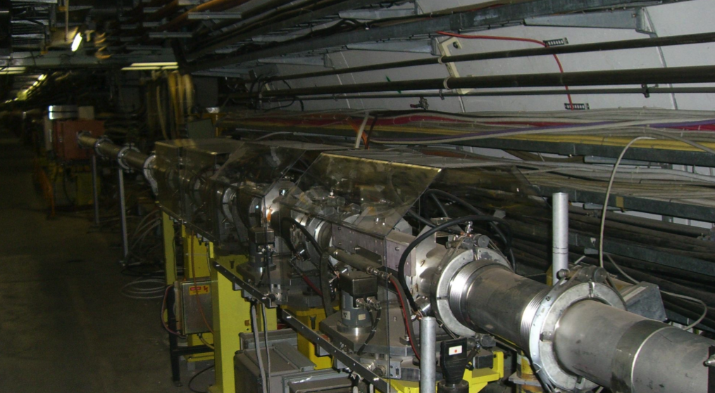
BBLRs in LSS5

Slide 26
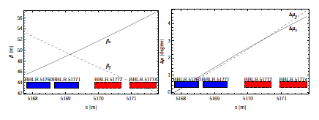
2 BBLRs – 4 pick-ups in LSS5
BBLR 1: Fixed installation installed in 2002
  Pick-ups: BBLR 51760 & BBLR 51771
  Power supply BBLR5176M – Cable connected but no number visible
BBLR2: Vertically movable (over 5mm ) installed in 2004
  Pick-ups: BBLR 51771 & BBLR 51774
  Power supply BBLR5177M – Connected with Cable numbers 1582745 and 1582747
  Motor cables: 3500941A and 3500942A
    Question for a new motor controller !
    Non- conformity of the present electrical installation : PS not designed for BBLR

Slide 27
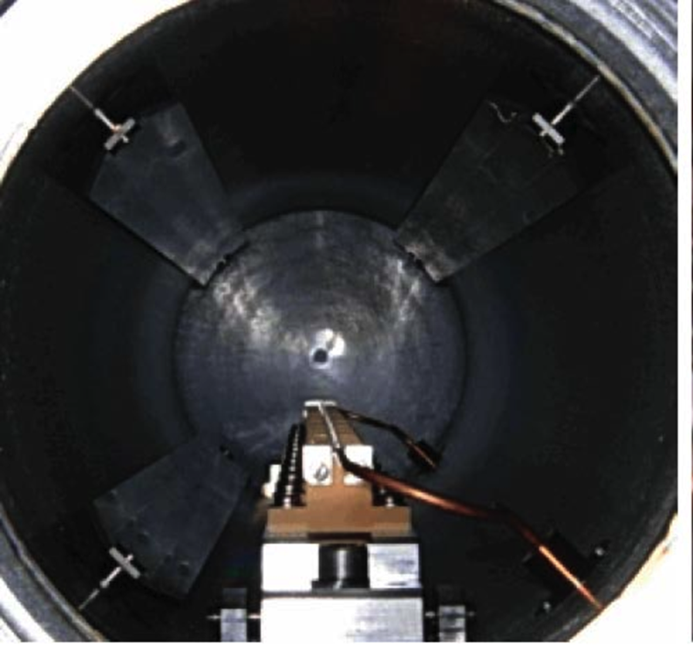
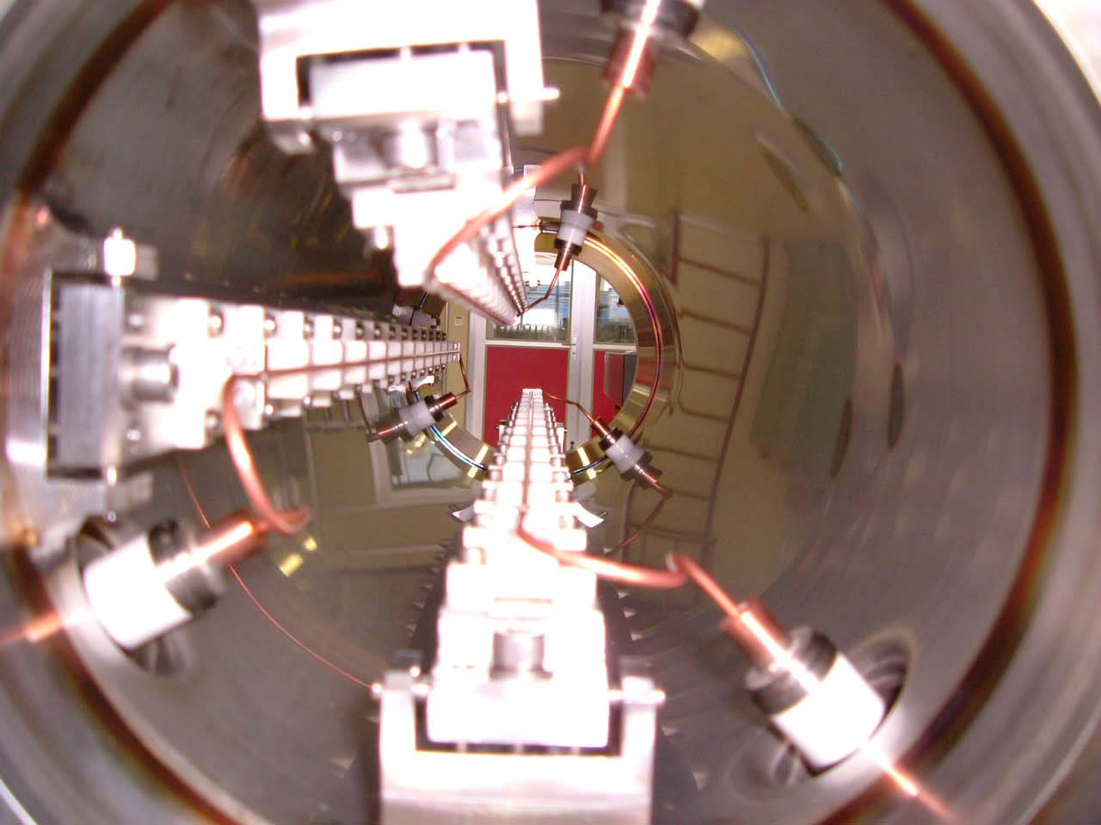
SPS wire “BBLRs”
BBLR 1st - 2002
BBLR 2nd - 2004
The wire diameter is 2.54mm – They are water cooled
The I_{MAX} is 250A on an effective length of 1.2m per BBLR (2x0.6m)
The wires are positioned vertically below the beam
  BBLR1’s upper edge at 19mm from beam ref orbit
  BBLR2’s upper edge at 20mm from beam ref orbit

Slide 28
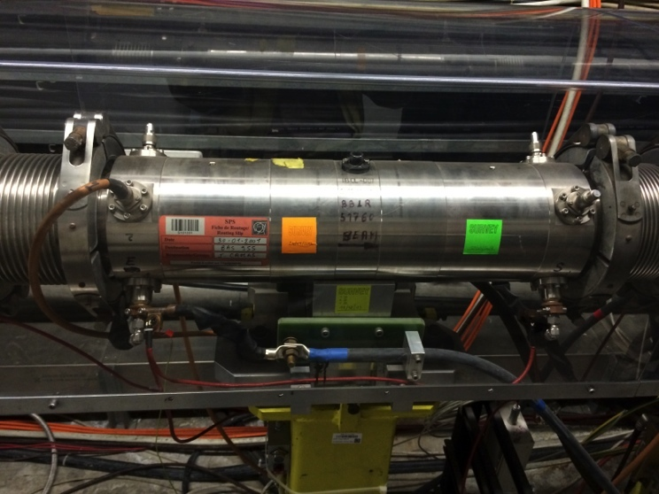
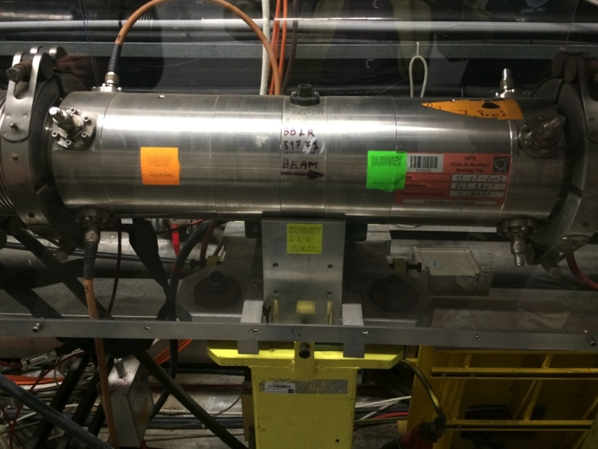
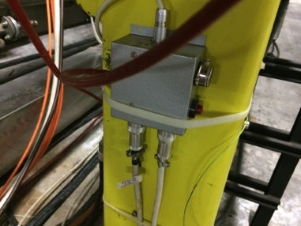
BBLR 1
BBLR 51760
BBLR 51771
Water flow and Tp interlocks: cable 3500877 - Rack 1445
Tp probes only on BBLR1

Slide 29
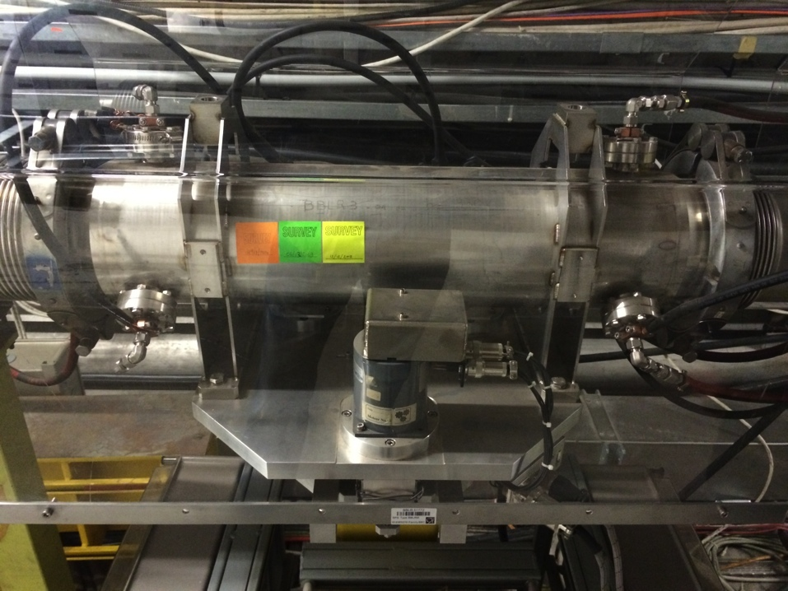
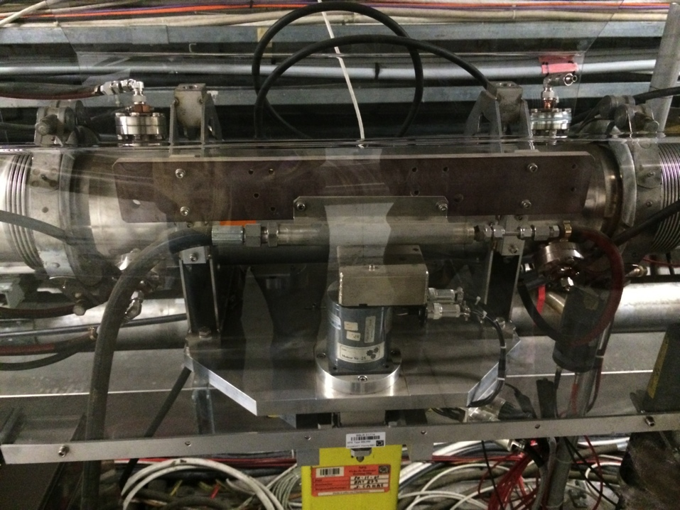
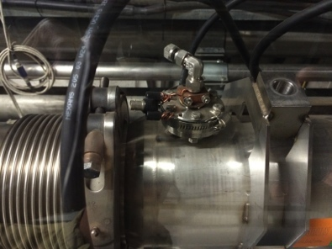
BBLR 2
BBLR 51772
BBLR 51774
Three wires : Only one wire cabled
Other wires not properly terminated !

Slide 30
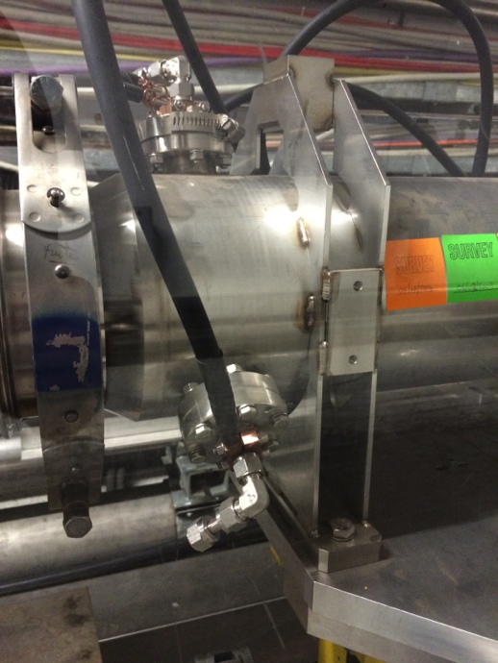
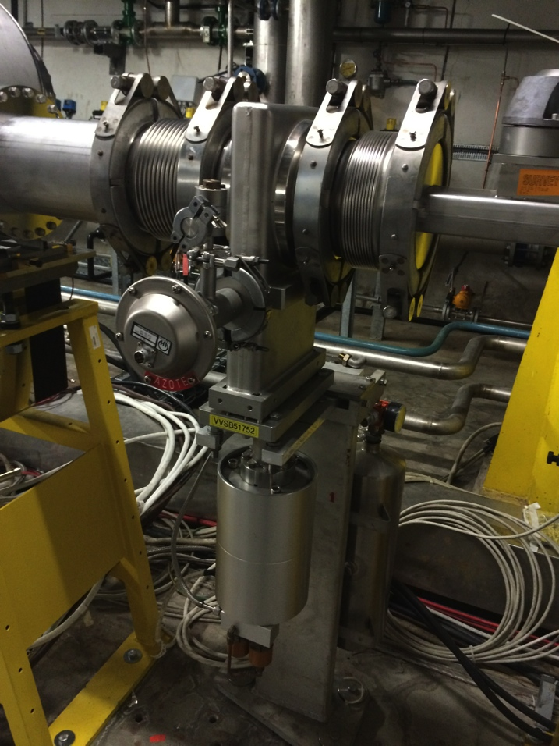
Leak checks
Inject He in the Water pipe
Leak detection possible 10m away at the next vacuum valve
Mechanical adaptation pieces required

Slide 31

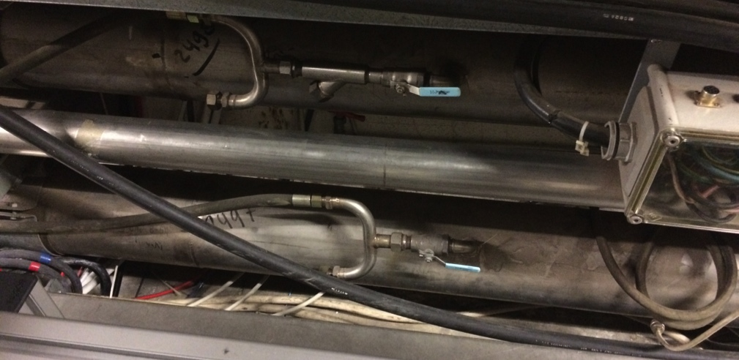
Water connection
Water cooling circuit only done
for one wire
Water valves in cable tray
It needs to be redone to have two wires water cooled permanently

Slide 32
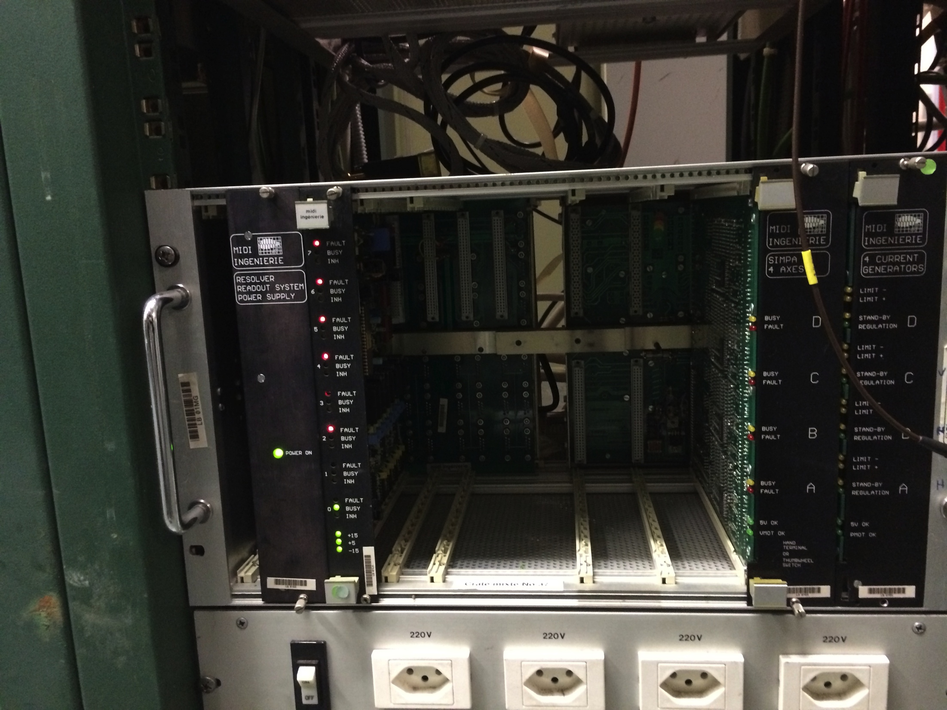
Motor controller
Midi controller in the BI room in BA5
  Need to check it is still working
  Motor cables: 3500941A and 3500942A

