Slide 1
BI-QP Technical board
LHC Schottky
4.6.2015

Slide 2
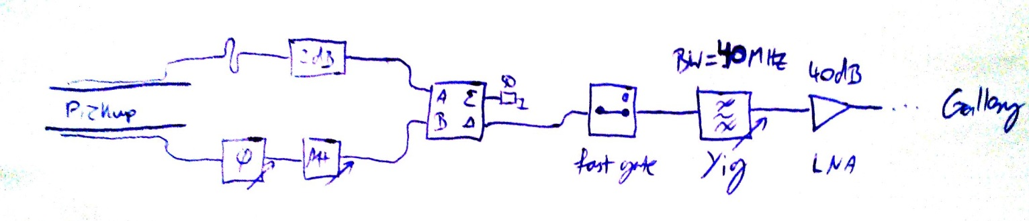
Schottky 2015 – what changed
Mechanically improved pickups
Operating frequency 4.8 GHz
B2V: frequency adjustable over ~ 1 GHz
  To look for a `sweet spot` in the pickup response
B2V: new frontend
  Fast gate
  YIG filter (40 MHz BW.)
B2V: Signal analyzer for wideband observation
Realigned compensation paths (matching of electrical delay)
Notes:
Compensation path to maximize common mode rejection (which is orbit depended)
Fast gate for selectring individual bunches before narrowband filtering (filter has long impulse response!)
YIG filter = electrically adjustable. Minimize `peak` power over time for the next amplifiers
Miteq amp. = minimize noise figure of the whole system

Slide 3
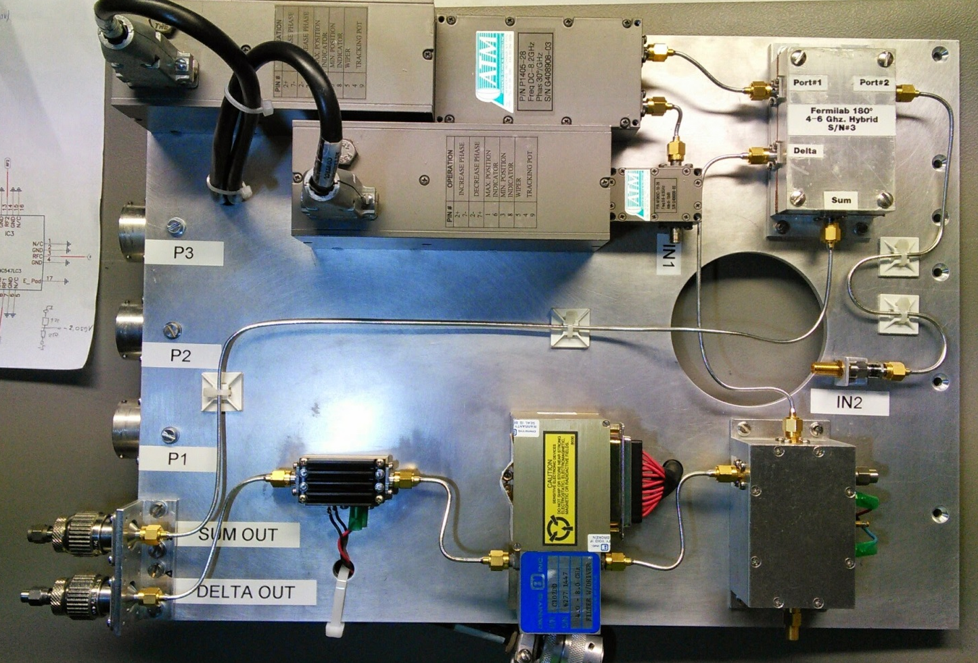
New Frontend
Compensation path
Hybrid
fixed delay & fixed att. (2 dB)
37 dB amp.
YIG - filter
`Fast gate`
Notes:
No Switches!
Minimized “phase matched” signal path before hybrid!

Slide 4
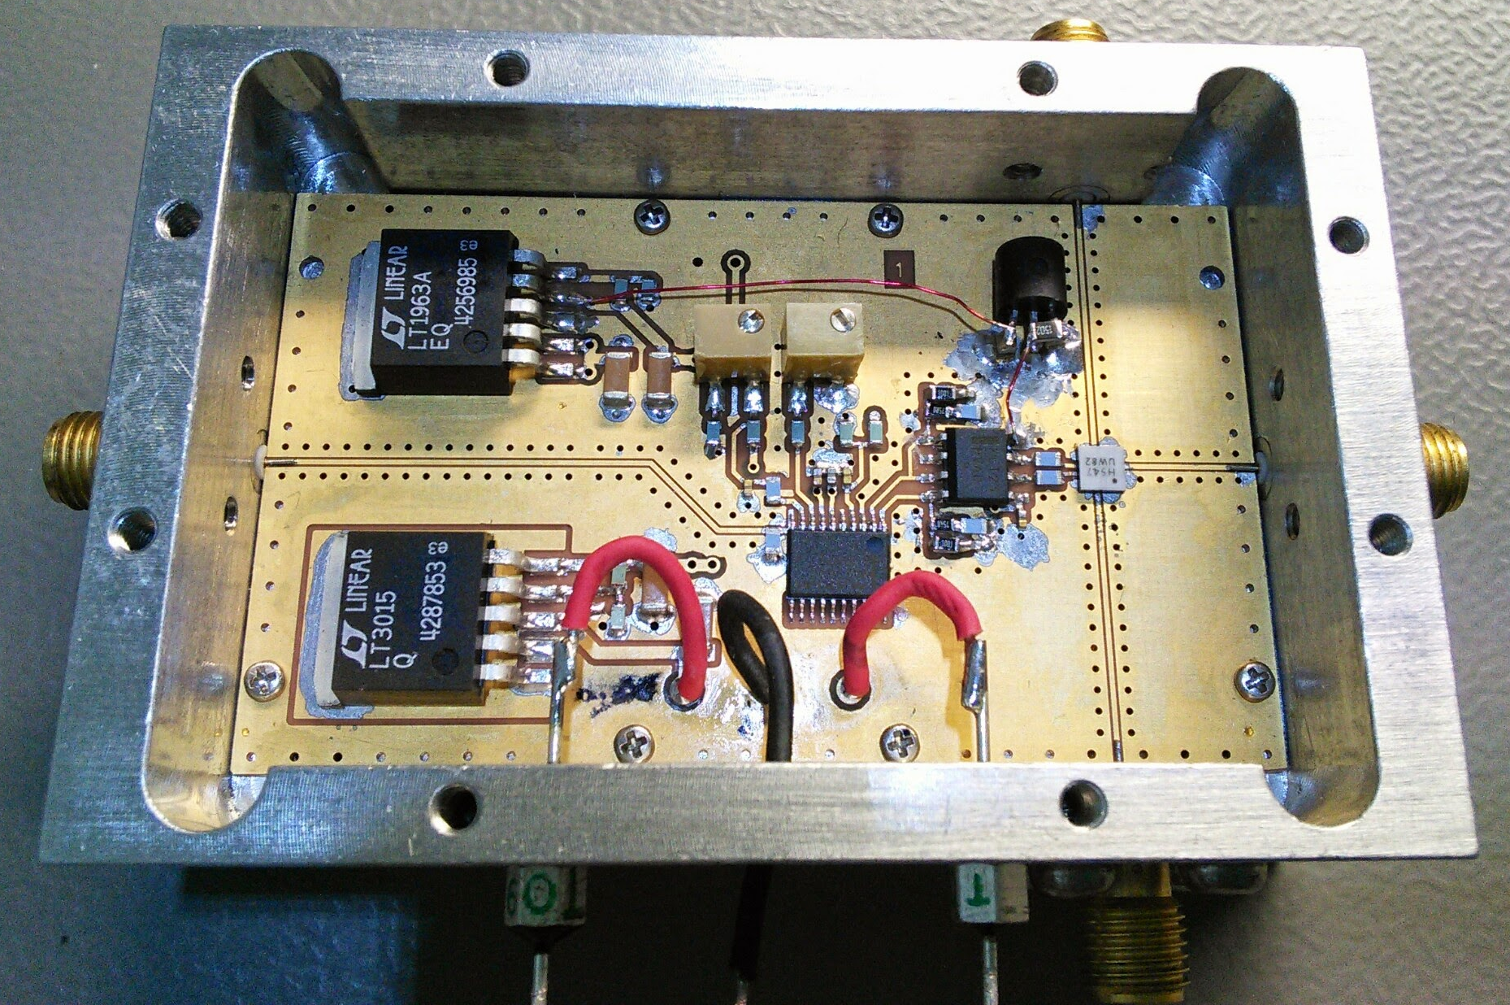
Fast gate
HMC547LC3
< 2 dB loss [ON]
~ 50 dB isolation [OFF]
@ 4.8 GHz
~ 6 ns switching time
(10 % - 90 %)
TTL input
MC100ELT23
Converts ECL levels to
0 V [ON] … -5 V [OFF]
MAX9600
ECL `Ultra high speed` comparator

Slide 5
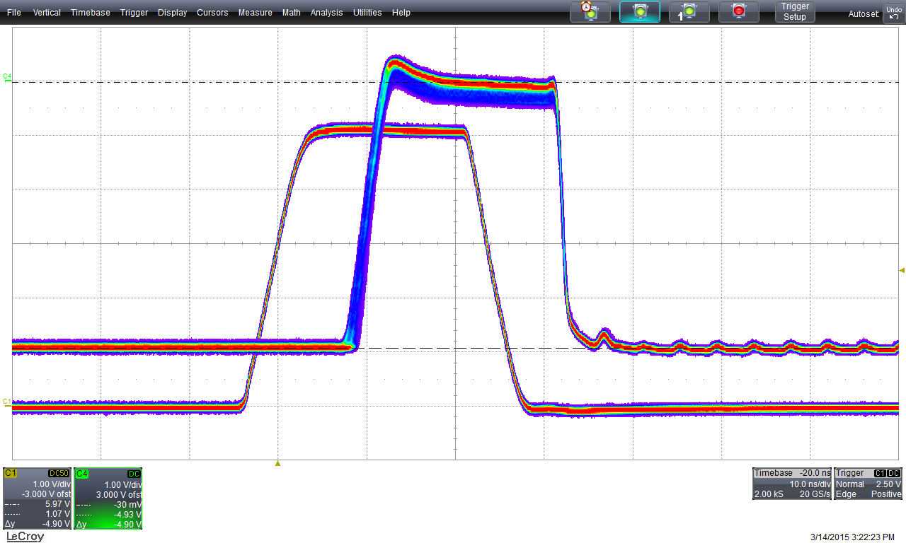
Issue: driving voltage
The gate needs a drive voltage of at least -5 V [OFF] … 0 V [ON]
We could only achieve this by overdriving the supply voltage of the MC100ELT23
Meas. at 4.8 GHz:
S21 = 3.3 dB / 50 dB
S11 = -16 dB
S22 = -18 dB
A gate with a new driving circuit based on a fast OP-Amp will be installed during TS1
Gate control signal
-4.93 V … -0.03 V
Note the large amplitude jitter for each pulse !
Input signal
Observation:
Values drift by 0.5 dB over ~20 s after a switching transition
Notes:
Decided to install it anyway

Slide 6
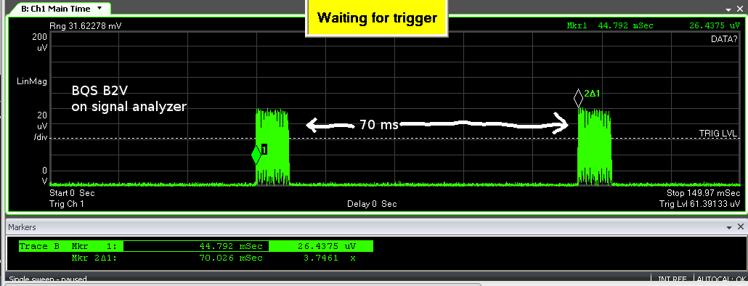
First beams on 6.4.15
Turned out to be a broken power supply
(pulsing output voltage)
We replaced it and saw the first `real` signals …
On the scope we saw strange `bunch trains` repeating every 70 ms
Was the LHC circumference extended by an order of magnitude? ;)

Slide 7
The good

Slide 8
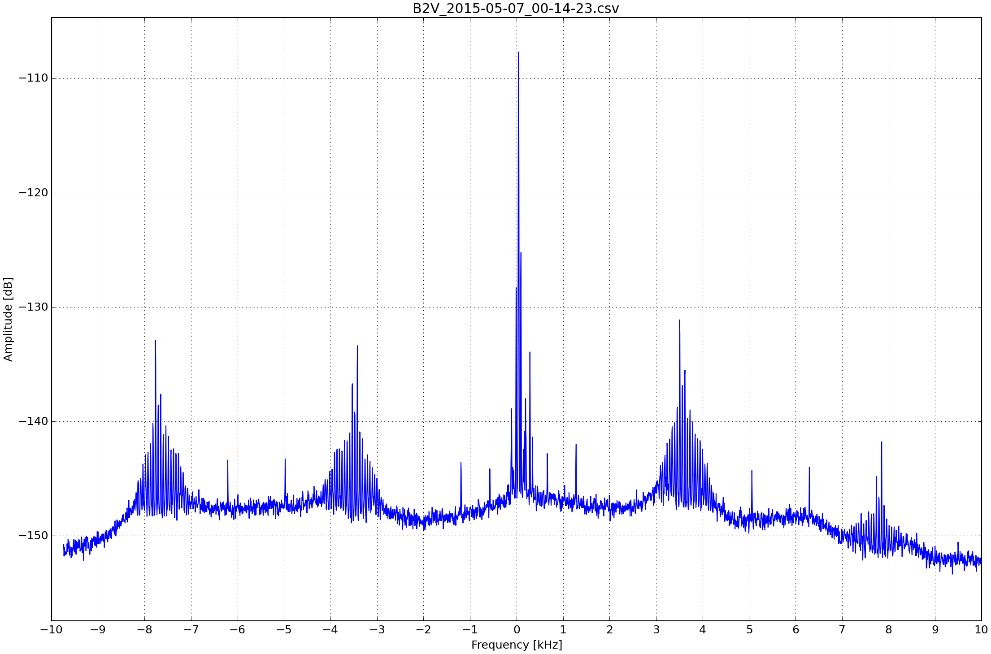
7.5.2015: First collisions at 450 Gev
B2V
(new frontend)
Bunch intensity:
~ 1e10
Notes:
We noticed a lower sensitivity of the new frontend compared to the others.
This is due to the additional high insertion loss of Gate (3 dB) + YIG (2 dB)
We want to ompensate with a high power preamp

Slide 9
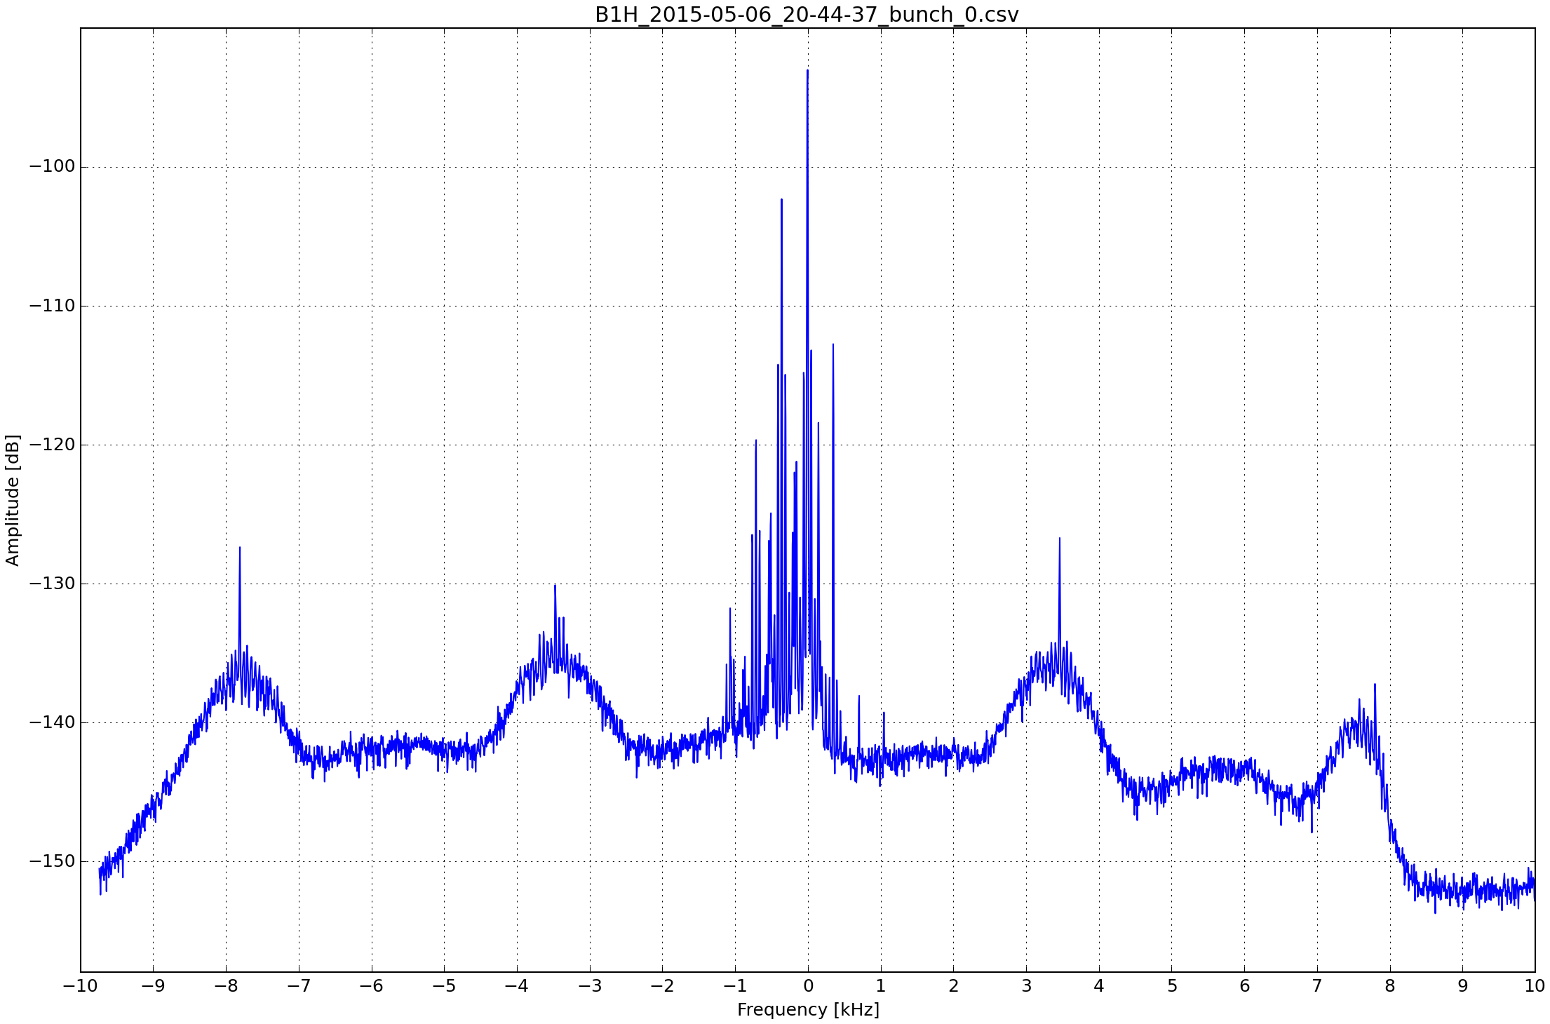
7.5.2015: First collisions at 450 Gev
B1H
Bunch intensity:
~ 6e10
For low bunch intensity we usually get nice spectra. Averaging time 2 … 5 min.

Slide 10
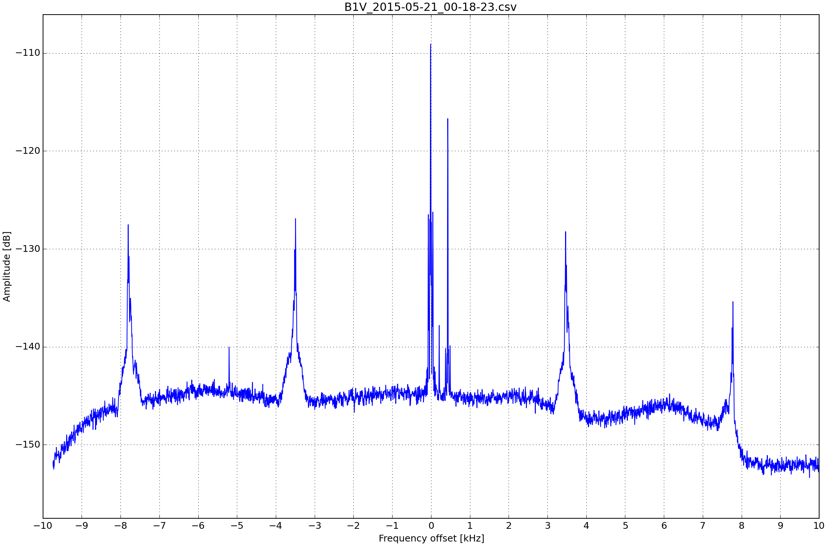
20.5.2015: Collisions at 6500 Gev
B1V
Bunch intensity:
~ 8e10

Slide 11
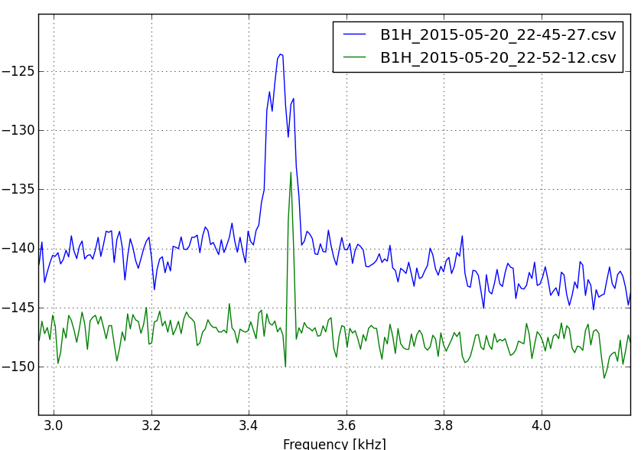
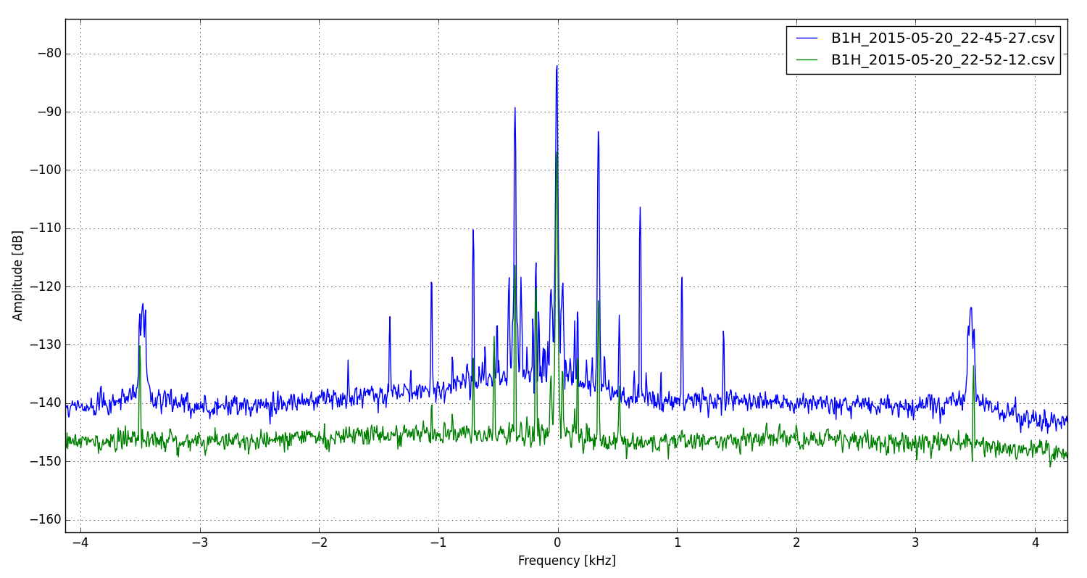
Tune shift due to collision
For colliding bunches, the incoherent
tune lines appear slightly broader (~100 Hz) than for not colliding bunches (< 20 Hz)
B1H
intensity = 8e10
colliding!
intensity = 5e9
not colliding

Slide 12
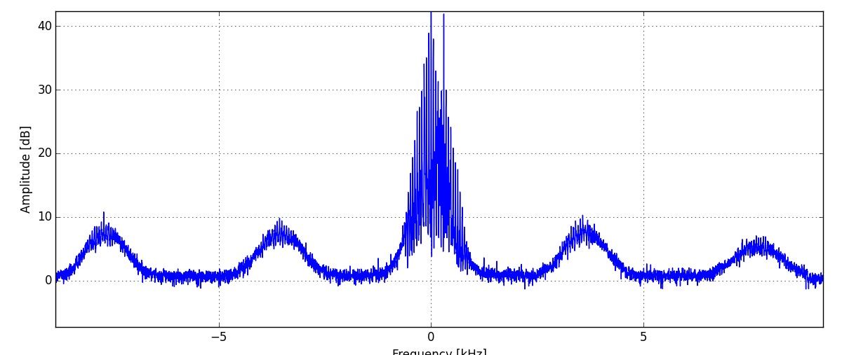
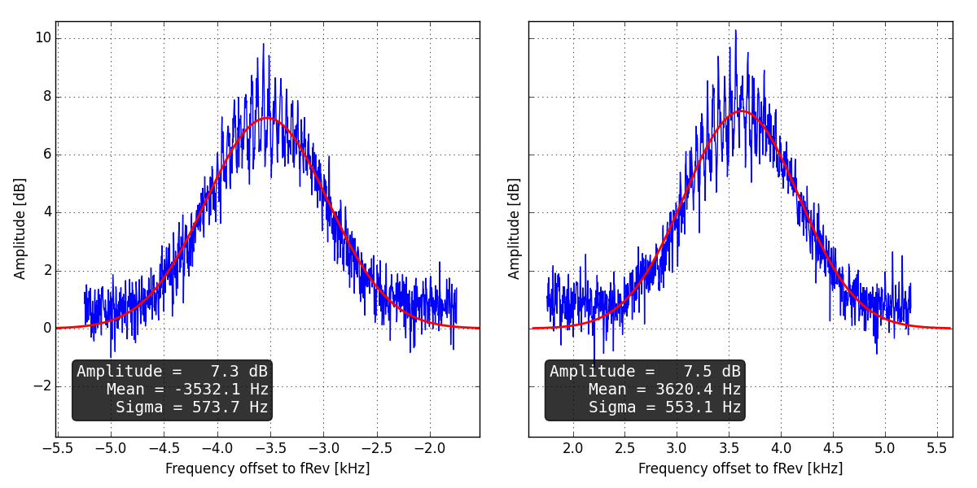
A naive attempt at fitting Gaussians
Baseline subtraction to remove IF filter ripple
The two Schottky sidebands are extracted and a Gaussians function is fit to each
Observations:
  Width differs slightly (Sigma)
  Not yet understood why sidebands are not symmetrical in frequency offset
  Fitting algorithm needs more work
B2V
Bunch intensity:
~ 6e9
Y = A*exp(-(x-mu)^2/(2*sigma^2))
B2V_2015-05-26_23-05-37.csv

Slide 13
The Bad

Slide 14
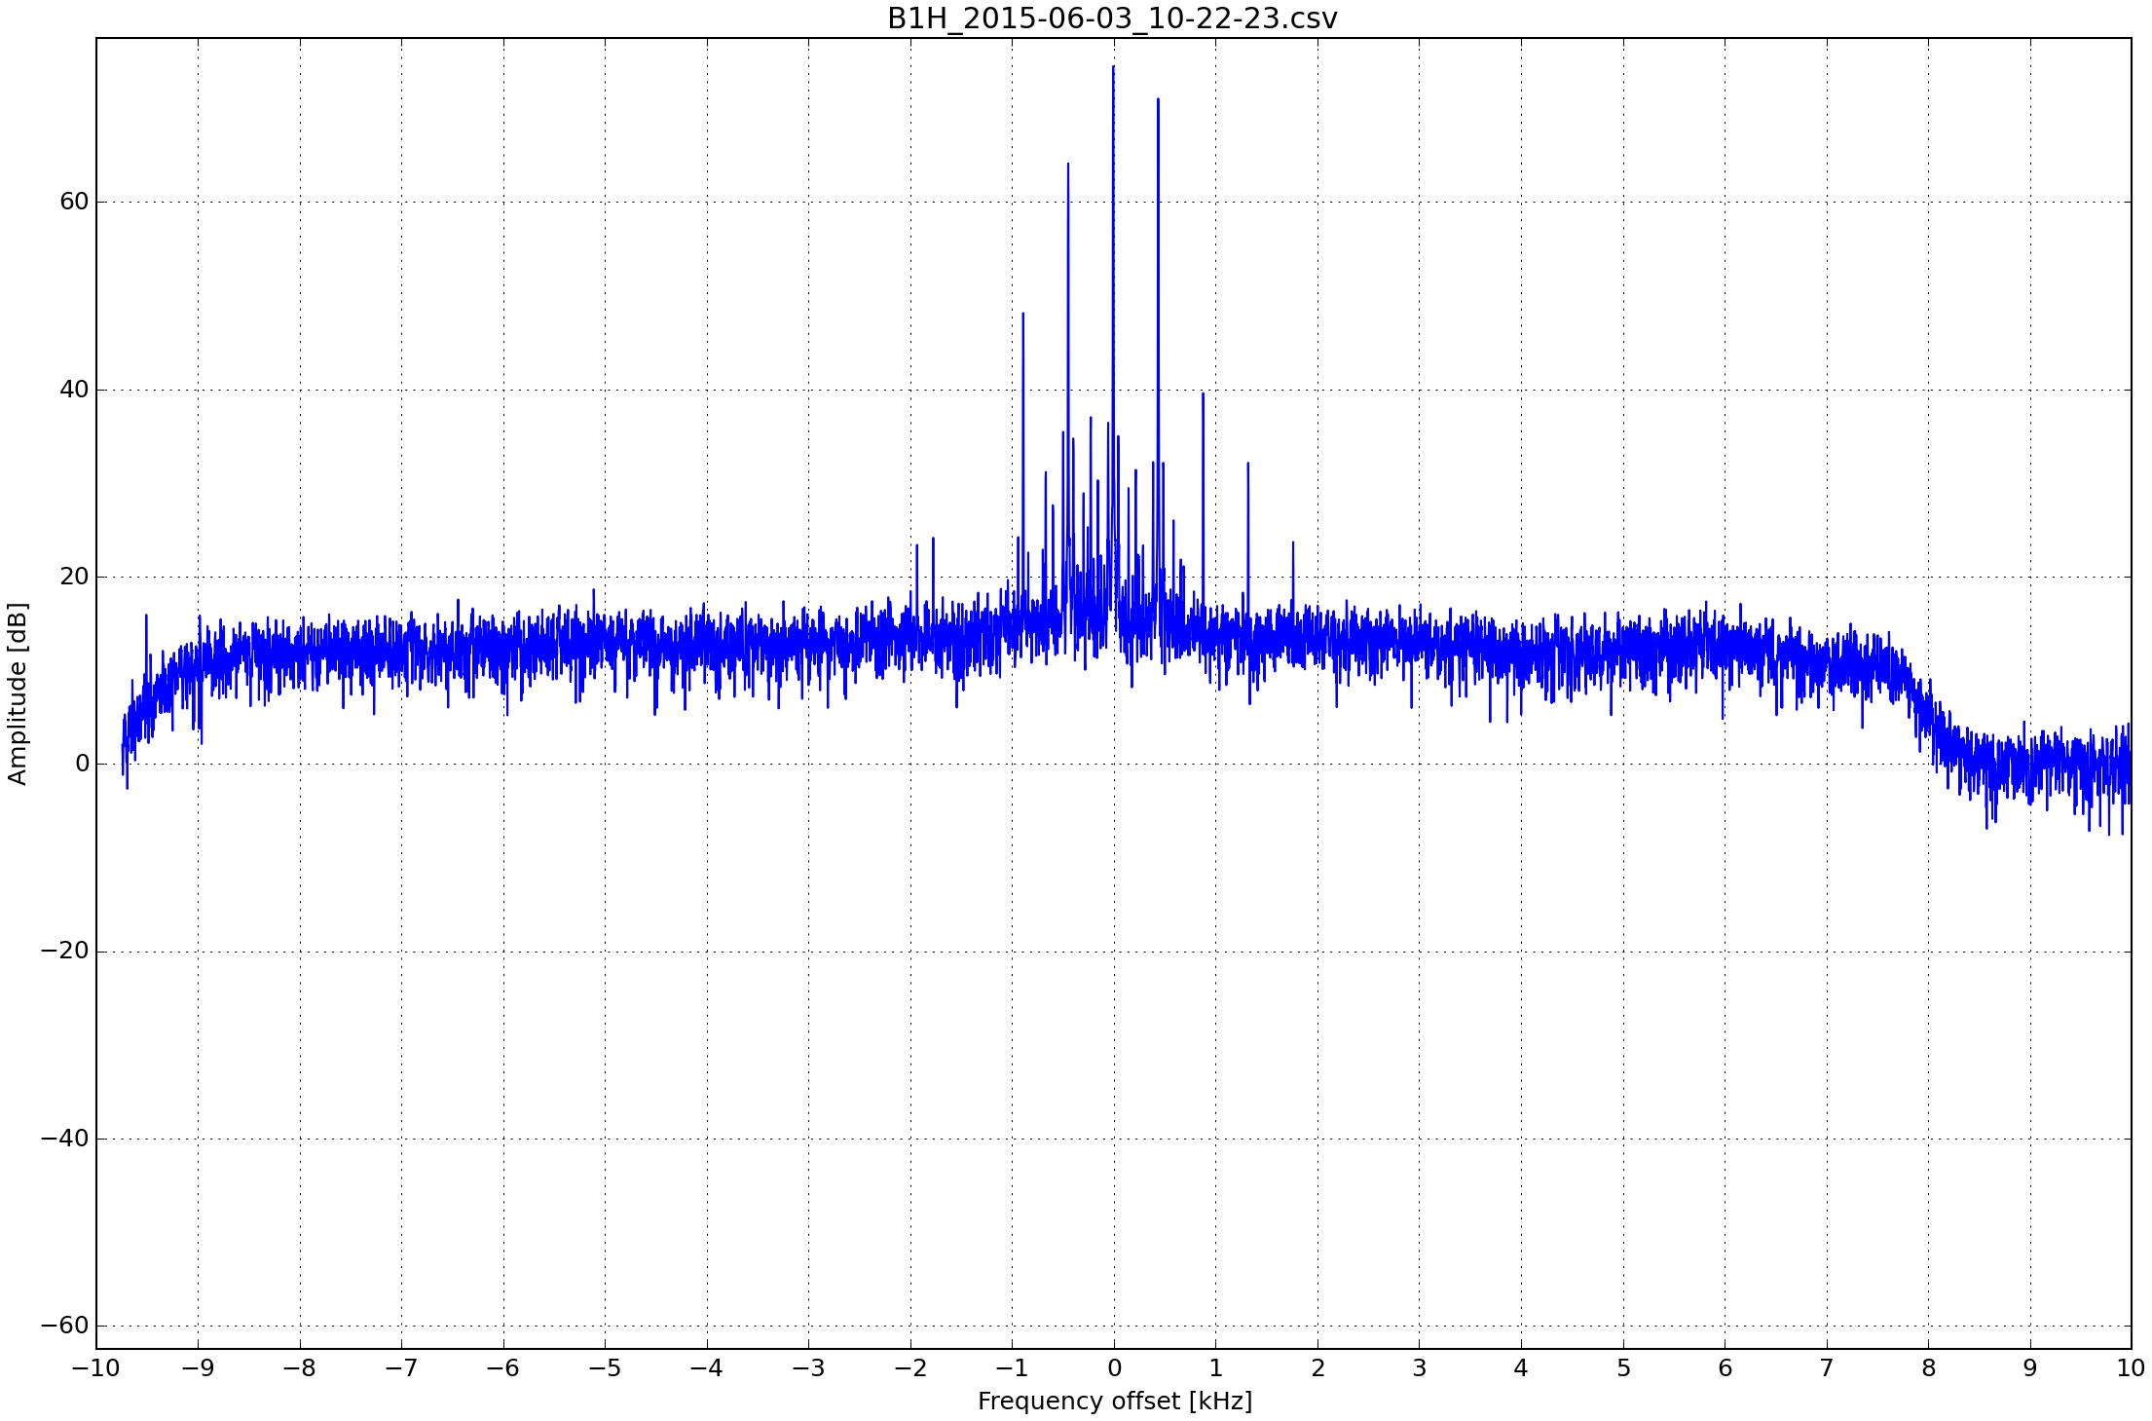
Saturation of frontend
B1H
Bunch intensity:
9e10
75 dB
When the frev line becomes > 70 dB over the noise floor, amplifiers compress
… reduced gain, higher noise figure, Schottky sidebands below noise floor
Notes:
Add some more examples with high intensity bunches

Slide 15
Saturation of frontend
How to reduce amplifier compression?
  Less gain in the frontend
  results in lower signal levels but also a trade-off with sensitivity to Schottky signals
  More narrow filter in the frontend
  more narrow = less power in passband & longer transient response. Both will help to reduce peak power to the amplifier. Can only be done after the gate. We will have to give up on the YIG filter.
  Better compensation path
  important concept! should give us a reduction in coherent power over a wide band for free!
  There’s still room for improvement!

Slide 16
The Ugly

Slide 17
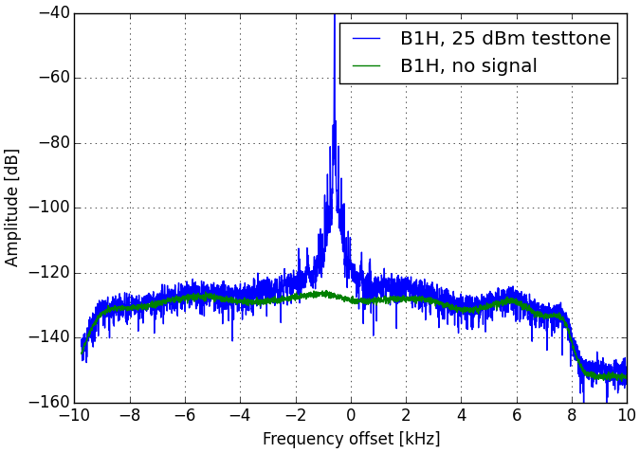
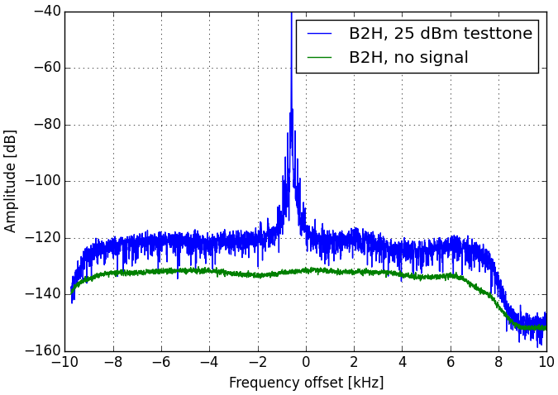
Issue: B2H saturation
B2H compresses much faster than the other Schottkies. We suspect a defect component
In the Fermilab `Signal Processing Chassis`
Test procedure: we apply a test-tone (+25 dBm at generator, ~ -70 dBm at pickup) and
observe changes of the displayed noise level.
B2H: not OK
Noise-floor
degrades
B1H: OK
Noise-floor stays
the same
No Beam!
No Beam!
So far we have tested the gain and noise figure of the first 3 amps. which were OK:
Miteq frontend LNA, Endwave LNA before gate, Endwave LNA after gate

Slide 18
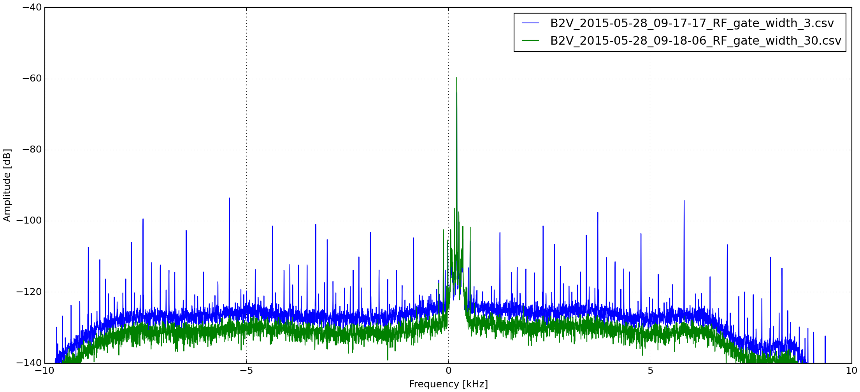
B2V shows a lot of spurs
The one with modified frontend (YIG filter + fast gate)
Opening both gates for > 60 slots makes the spikes disappear

Slide 19
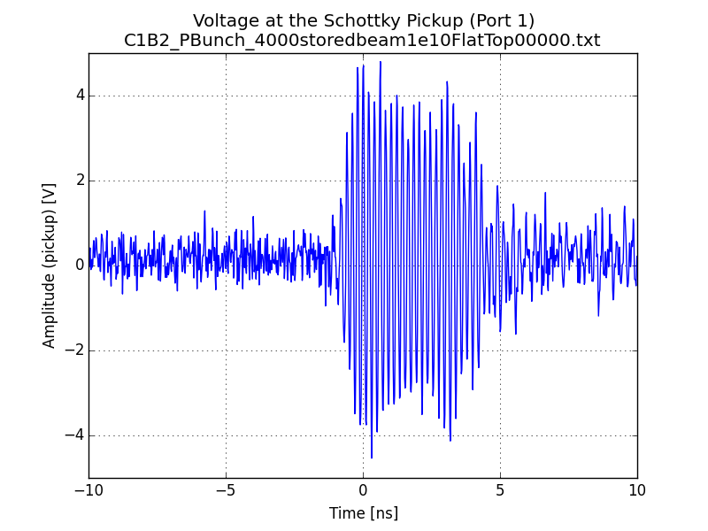
Issue: B2V ringing
We observed: The spurs only appear when the gate `cuts into the signal`
Transient response of the Schottky pickup should be << 10 ns !
The delta signal from B2V suffers from ringing in the order of μs !
Response of a 2013 Schottky pickup
to a Bunch of intensity 1e10
Measured with a 60 GS/s scope

Slide 20
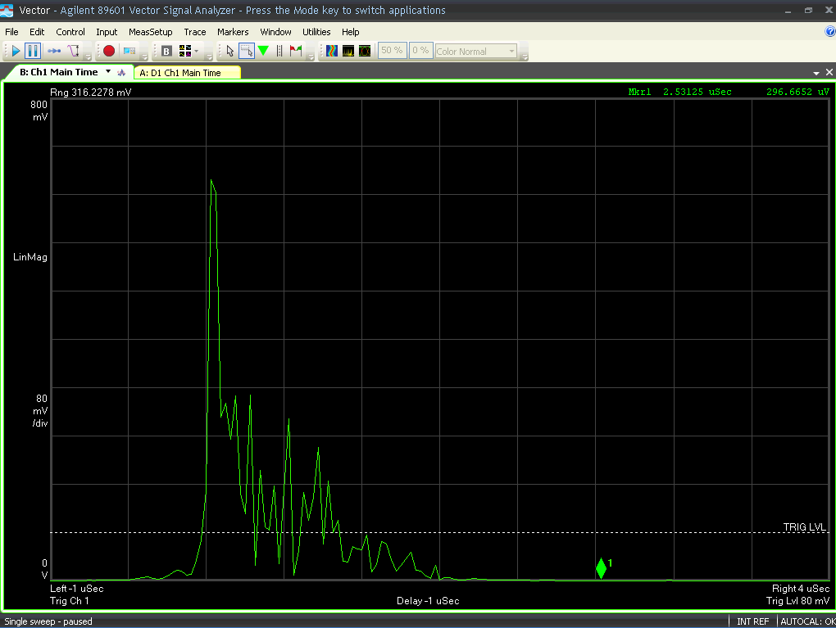
Issue: B2V ringing
Delta signal from B2V frontend on VSA
Time domain!
Measured with 25 MHz bandwidth,
centered at 4.8 GHz
0.5 μs / div
Nominal
bunch,
no gating
Ringing for 1.5 μs – explaining
Why we have to open ~60 slots
on the gates

Slide 21
Issue: B2V ringing
Reason not yet understood …
Other (unmodified) Schottkies only show ringing in the order of < 50 ns
  Verified by gating on empty slots
Ringing must originate somewhere before the fast gate
  Verified by gating on an empty slot after a bunch and observing the `tail` of the ringing
This only leaves the compensation path, the hybrid or the pickup itself
Ringing is likely to be multiple reflections due to a strong impedance mismatch
  Damaged cable / connector?

Slide 22
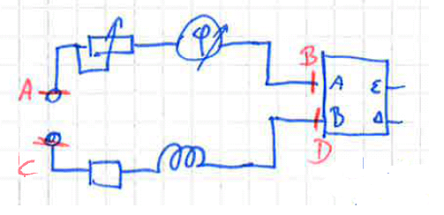

Compensation path
Adj. delay & Att.
Hybrid
Hybrid will supress coherent signals (common mode)
Requires well matched input signals in ampl. & phase
Motorized phase shifter / attenuator
τ₁
Pickup
τ₂
Fixed delay & Att.
Note on bandwidth
Phase error (Δϕ) at the hybrid depends on the electrical delay (τ₁, τ₂) of the two input paths
Only if τ₁ = τ₂ we get wideband suppression
Otherwise Δϕ becomes freq. dep. and we will see notches!
$$Δφ\left(f\right)=−360° f (τ_{1}−τ_{2})$$
Notes:
Notches can fool us, as we only see a very narrowband part of the spectrum. If we shift a notch into the observed band, we might think we have achieved good compensation – but the frontend amplifiers might see the full power!

Slide 23
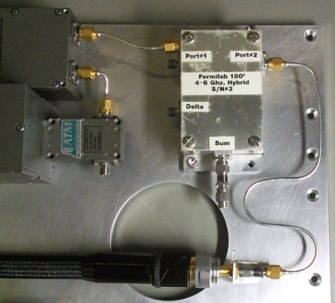
Compensation path
Phase shifter adj. range: Δτ = 176 ps
For comparison: SMA conn. τ ~ 40 ps
This needs to accommodate all mismatches before the hybrid
  Cables & connectors of the frontend
  Patch cables to the pickup
  Cables inside the pickup
  The pickup itself
  Beam orbit
  Phase change of var. Att.
Before the TS, all frontends were disbalanced by more than Δτ
We realigned them for an initially centered position
Notes:
The hybrid can suppress the coherent signal at the very beginning of the chain
This is required to prevent amplifiers and mixers from saturating
To ensure that signals to the hybrid are matched, we use a motorized phase and amplitude shifter (=compensation path)

Slide 24
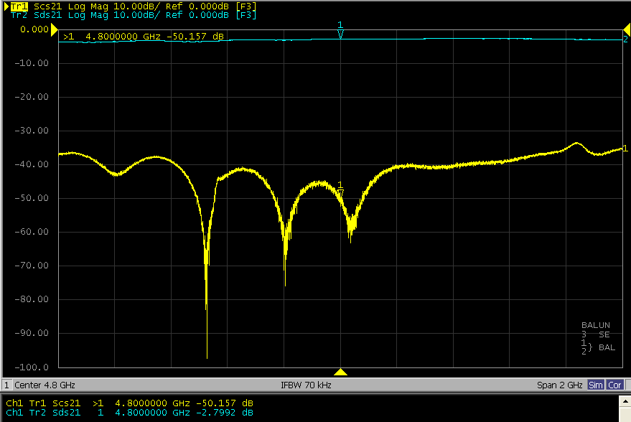
Compensation path: LAB
Measuring common mode rejection in the lab with VNA
Input:
Pickup A/B
(differential port)
Output:
`delta out` on hybrid
(single-ended port)
When tuned: common mode rejection
by ~ 40 dB
over ~ 2 GHz
Differential mode insertion loss: ~3 dB
Common mode rejection:
~40 dB over 2 GHz

Slide 25
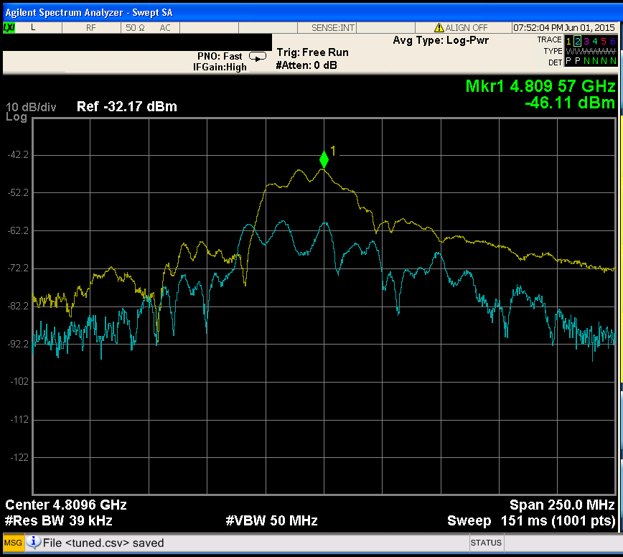
Compensation path: BEAM
We can observe the `delta` signal from the frontend on a spectrum analyzer in the gallery
Tuning the compensation path reduces signal power only by ~ 15 - 20 dB
Reasons unclear …
  Outside adj. range?
  Reflections?
  Saturation effects of amplifiers after the compensation path?
Out of tune
Tuned
only ~20 dB improvement

Slide 26
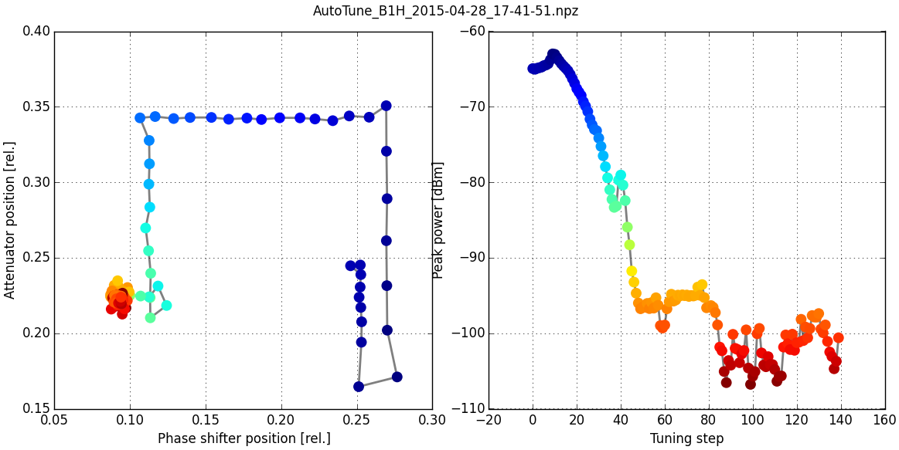
Typical tuning procedure with beam
Phase shifter / attenuator position
Peak power of BBQ spectrum

Slide 27
Good news
With the Anapico as first LO, Phase noise is not a limiting factor

Slide 28
Summary and future actions
Compensation path
  Only achieves ~ 20 dB signal rejection
  Mechanical backlash! Limited accuracy
  Coupling between phase and att. adjustments
  A dream: continuous closed loop control
B2V
  Will install new gate with less insertion loss
  Long ringing of the pickup signal
  Will do VNA meas. during TS
  Low sensitivity due to high insertion loss
  Install `Guerilla` preamp
B1H
  Damaged component in the fermilab signal path (saturating)
  Will investigate during TS
Saturation with intensity > 1e11
  Install fixed narrowband (<< 10 MHz) filter after the fast-gate to reduce transient peak power

Slide 29
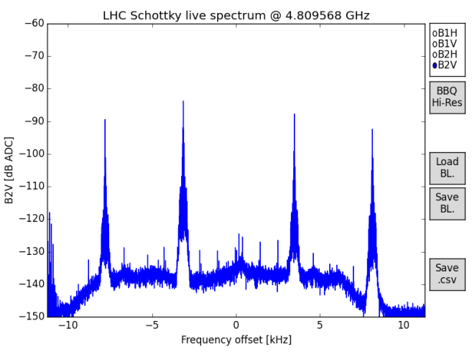
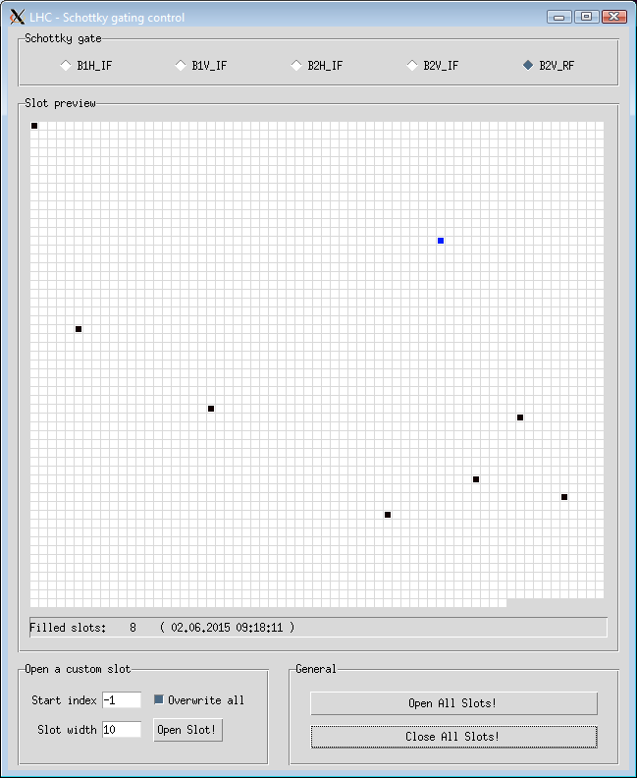
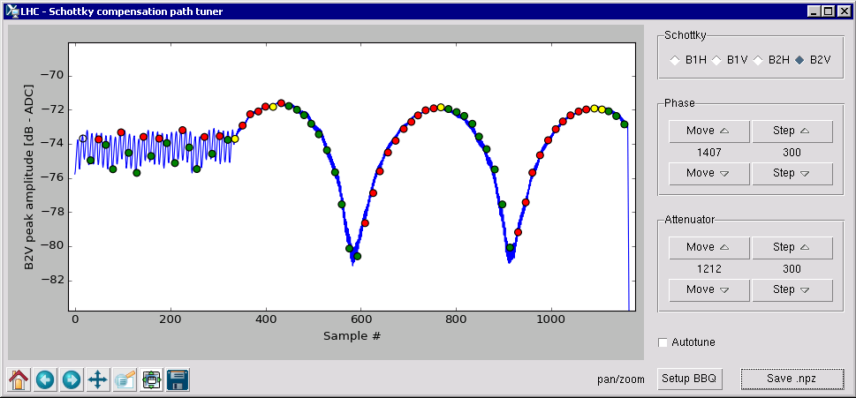
Python GUIs
Monitoring the acquisition
Setting up the gating
Setting up the compensation path

Slide 30
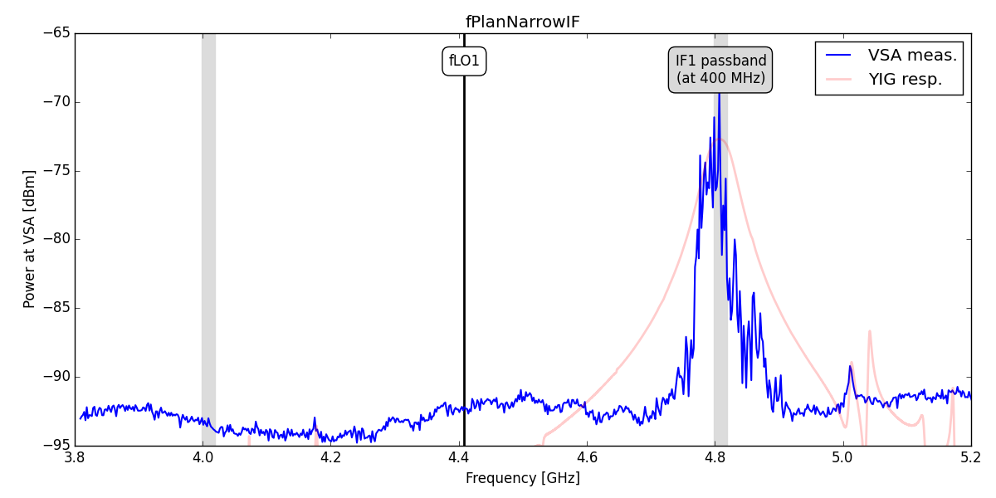
Frequency plan

Slide 31
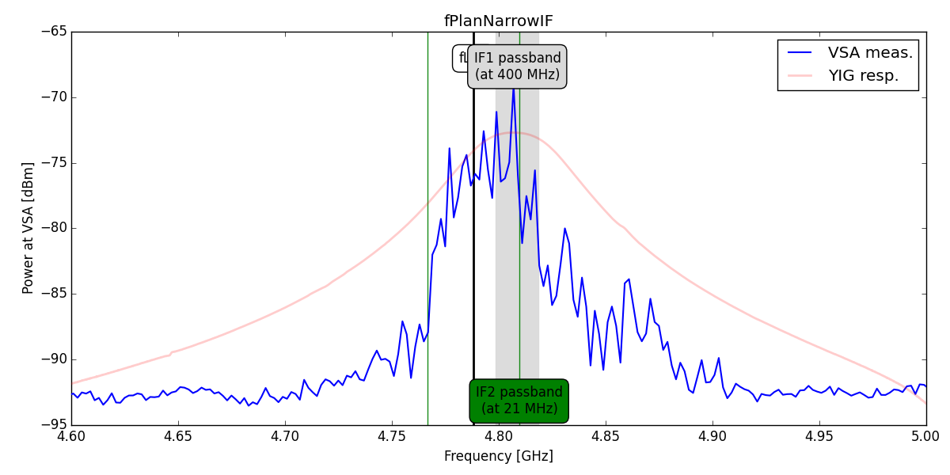
Frequency plan

