Slide 1
ALICE Detector Control System
ALICE DCS is responsible for safe, stable and efficient operation of the experiment
Central monitoring and control of all sub-detectors; interface to online and offline; monitoring of external services and infrastructure
To be operated by a single operator from the ALICE Control Room
The core of the ALICE DCS is based on a commercial SCADA system: WinCC OA
A tailored framework is build on top of that to allow sub-detector experts to build their control applications

Slide 2
External Services and Systems
Alice Systems
OFFLINE
Conditions
Database
ECS
TRIGGER
Electricity
DAQ
HLT
Ventilation
Cooling
Detector Control System
Magnets
Gas
Archival
Database
Access Control
SCADA
LHC
1000 ins/s
Safety
Infrastructure
Up to 6GB
Configuration
Database
B-field
Devices
Space Frame
Devices
Devices
Beam Pipe
Devices
Environment
Radiation
DETECTORS & detector-like
systems
SSD
TPC
TRD
TOF
HMP
PHS
FMD
T00
CPV
AD0
PIT
LHC
TRI
AD0
SPD
SDD
V00
PMD
MTR
MCH
ZDC
ACO

Slide 3
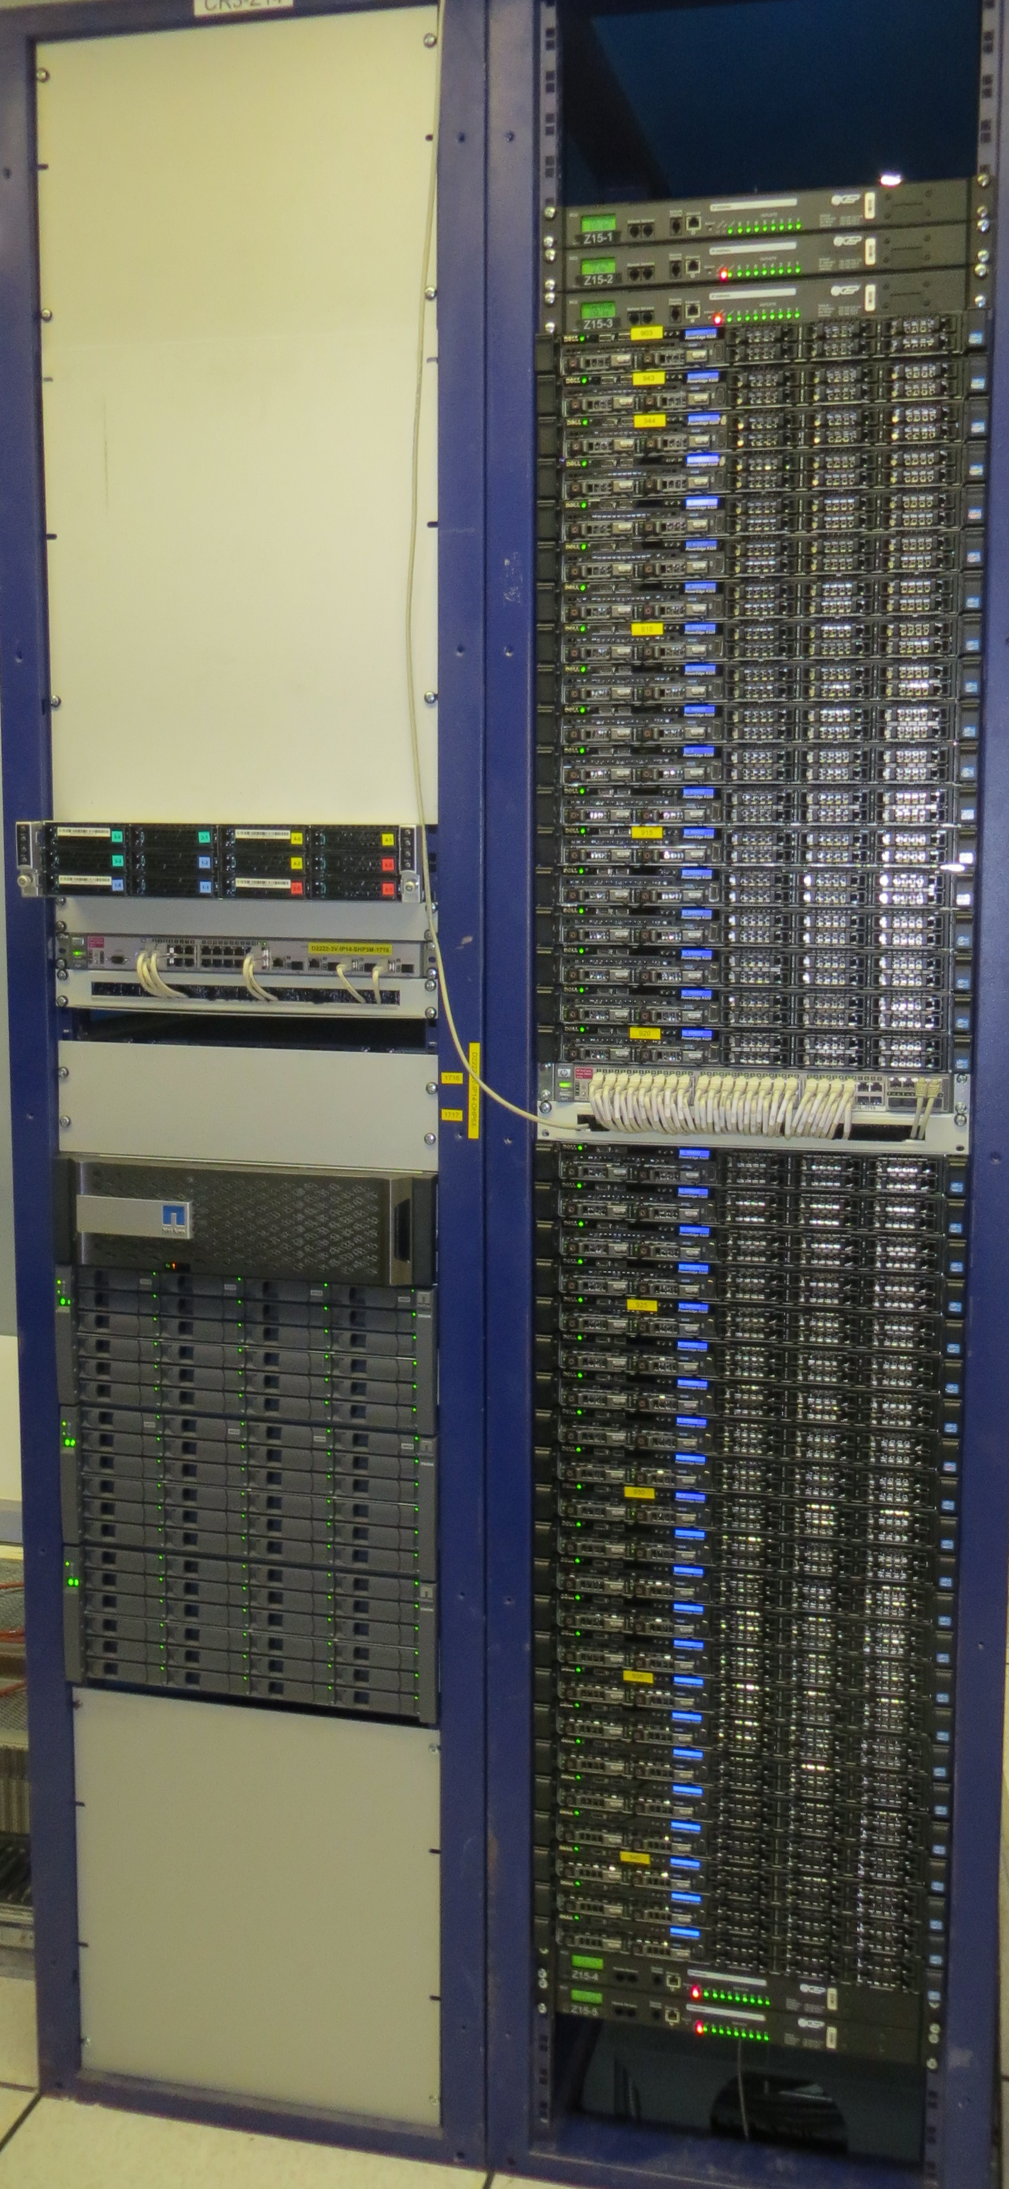
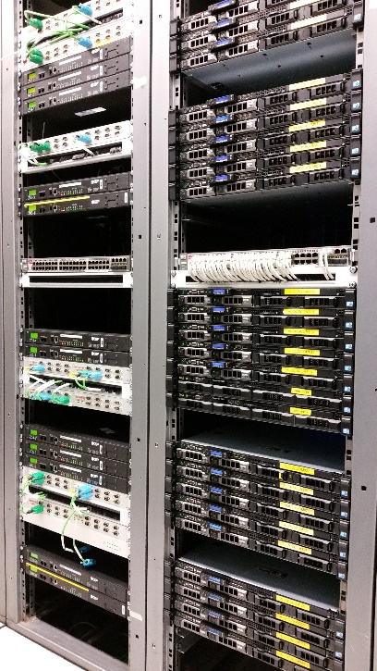
ALICE Detector Control System
The DCS cluster consists of ~170 servers installed at P2
In addition 750 on-detector, embedded computers
In total over 1200 networked devices
Nearly 3000 WinCC OA managers forming a distributed system on over 100 computers
> 1 000 000 channels monitored
The cluster provides services
(file storage, database, central SCADA
system, networks and communication
exchange, etc.) in 24/365 mode.

Slide 4
ALICE Detector Control System
Standard devices (power supplies, VME, PLCs, monitoring devices), standard communication protocols (OPC, DIM)
Abstraction to hide device dependent operation details on the higher levels
Control behaviour implemented using Finite State Machines
Data relevant for physics analysis (conditions data), stored in a database, is available for offline system

Slide 5
ALICE Detector Control System
Future (Run2)
Already entered ‘routine’ operation after LS1
Several projects to improve operation
  Alarm handling
  Operator tools
  System internals monitoring
  Log file analysis
  Quality monitoring of archived data
  Integration of external systems

Slide 6
ALICE Detector Control System
Future (for ALICE upgrade, LS2 and beyond):
Core of the DCS will remain
Dataflow will change
  Part of DCS data will be embedded in physics data stream
  Conditions data will need to be available ‘online’ to allow online data processing
Integration of new devices and new front-end electronics
Starting effort in prototyping and validating new dataflow in context of O2 project
Started integration of new devices and interfacing to new front-end electronics in the context of the ITS upgrade project

Slide 7
ALICE Detector Control System
Hardware related
Prototyping new technologies for sensors
  Wireless sensors, sensor networks
New general purpose I/O devices
Integration of newest generation PLCs

