Slide 1
ALICE-HMPID performance in pp and Pb-Pb collisions at √𝑠 = 13 TeV and √𝑠_{𝑁𝑁} = 5.02 TeV during 2015-2016
Giacinto de cataldo
Infn Bari, Italy
On behalf of the alice collaboration

Slide 2
Outline
ALICE -HMPID description,
Detector performance
PID performance
Perspectives for the HMPID in LHC Run3 (2021-2023)
Summary

Slide 3
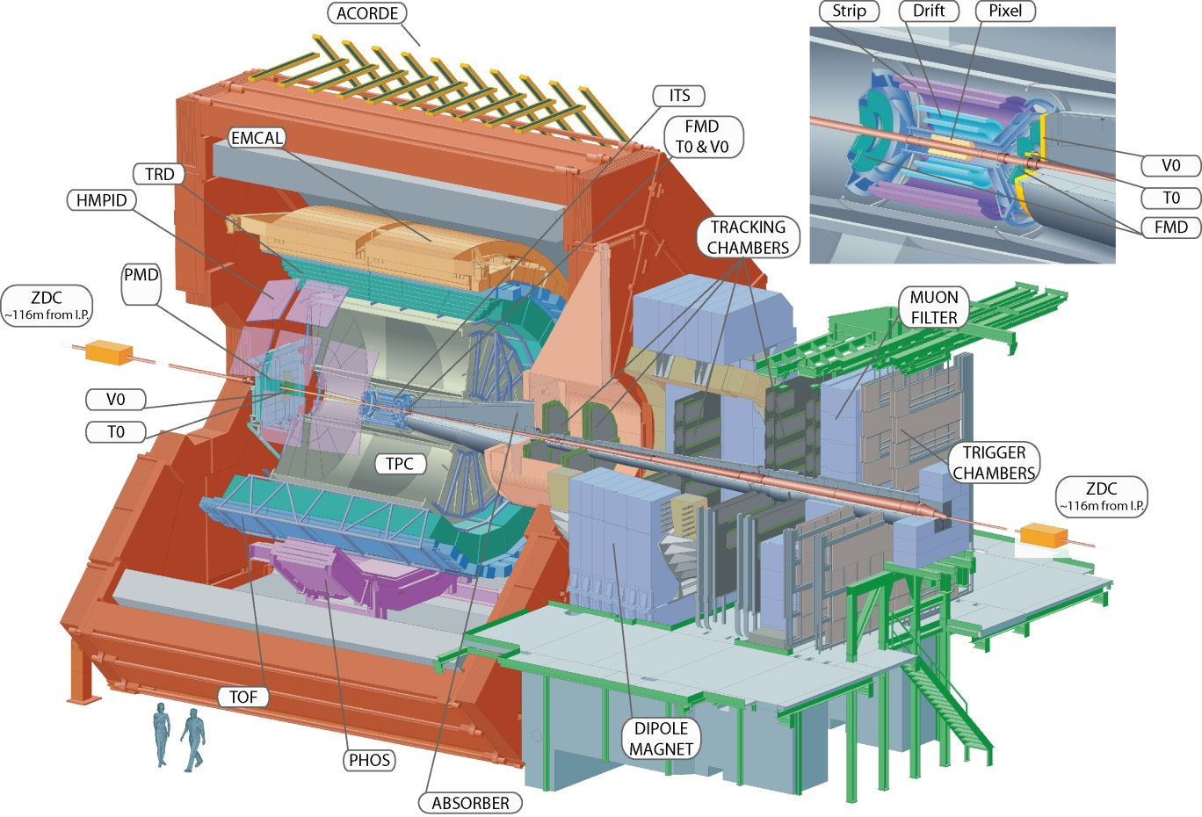
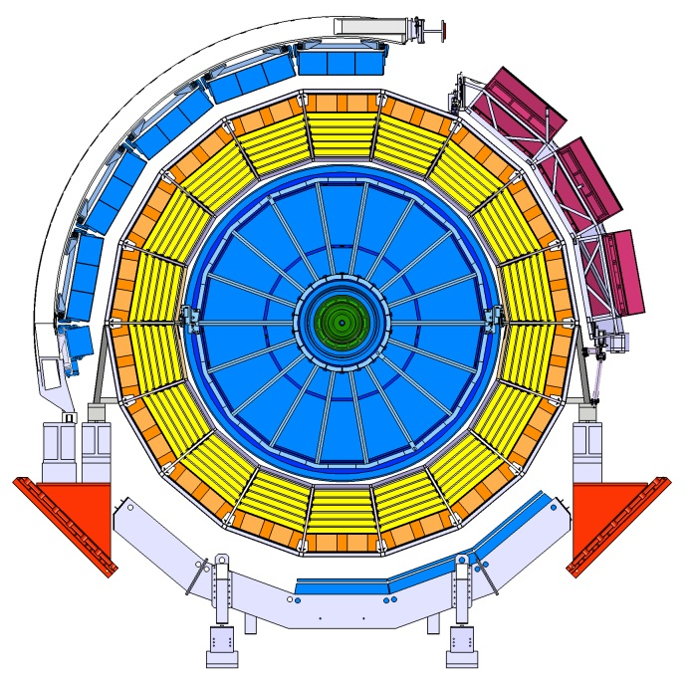
ALICE-HMPID
ALICE:
A
Large
Ion
Collider
Experiment
HMPID
ALICE was built to characterize the high density, high temperature phase of strongly interacting matter known as Quark-Gluon-Plasma state;
Excellent PID capabilities are required.
A-side view
Notes:
A LARGE ION COLLIDER EXPERIMENT to study the deconfined hadron matter and the parton-hadron transition. Its excellent PID relays on ITS TPC TOF TRD and HMPID: location

Slide 4
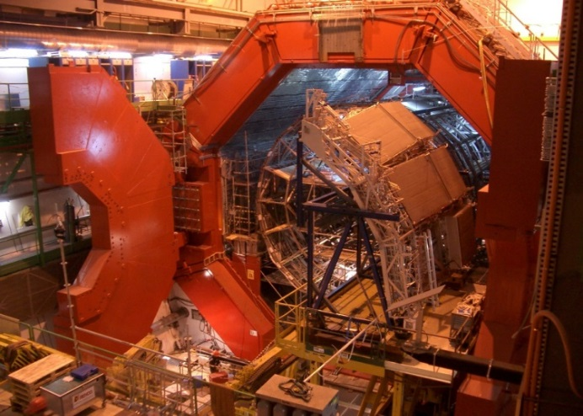
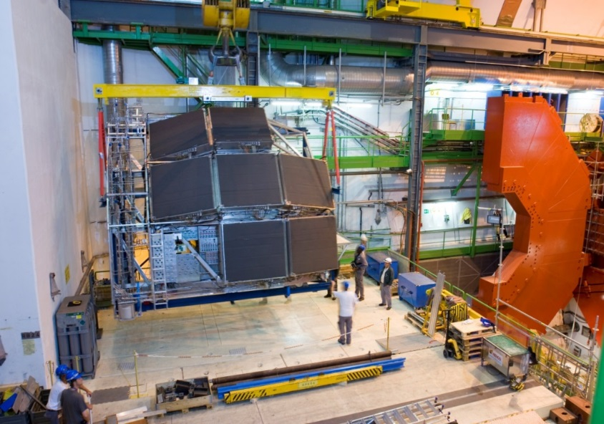
HMPID: High Momentum Particle IDentification detector
PID range:
1 < p < 3 GeV/c π, K
1.5 < p < 5 GeV/c p
7 RICH modules ~1.3 x1.3 m² for a total CsI active area of ~11 m²
September 2006: HMPID installation in the ALICE magnet!
Institutions:
INFN and Dip. Of Physics, Bari (Italy);
Politecnico of Bari (Italy);
CERN Geneva (Switzerland);
Wigner Research Institute Budapest (Hungary);
University of Malta, Msida, (Malta).
Notes:
HMPID insertion in the ALICE MAGNET , M0-M6 HMPID layout, services bottom right, C6F14 distribution station, cooling panels, collision points behind the photo plane,

Slide 5
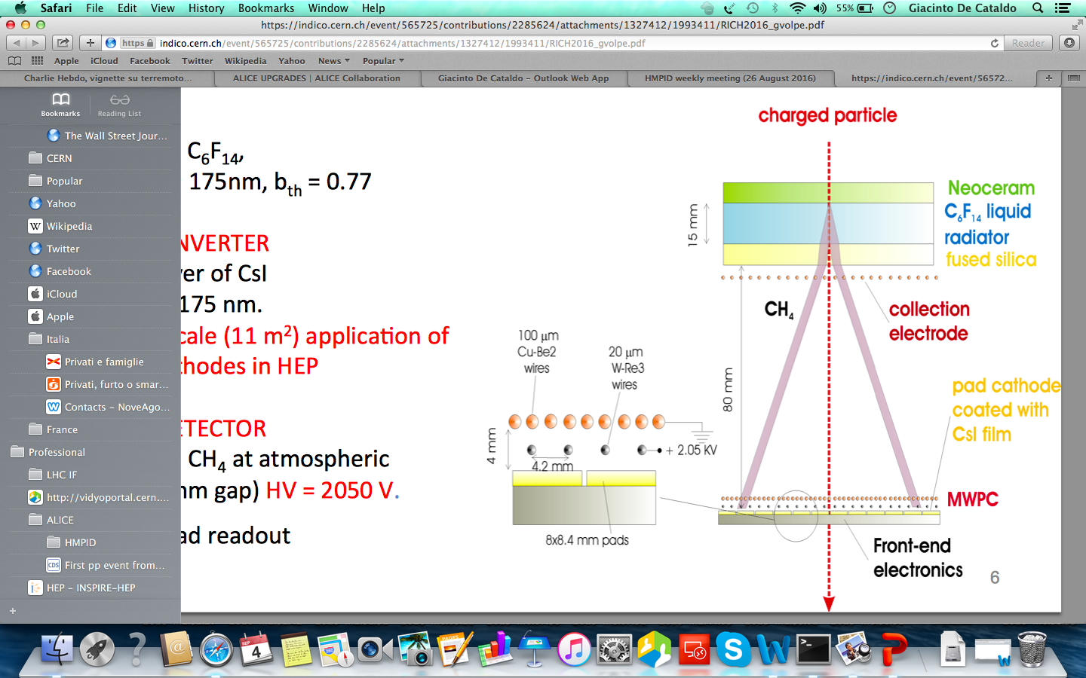
HMPID basic elements
Proximity-focusing geometry;
cosθ=1/nβ
Cherenkov Radiator
15 mm C₆F₁₄; n=1.2989 @ 175 nm;
Photon converter:
300 nm thick reflective layer of CsI; QE ≈ 25% @ 7.1 eV (175 nm)
Photoelectron detector:
MWPC 2,2-2.5 mm asymmetric gap with CH₄ at atmospheric pressure, gas gain ≈ 4 10⁴ ;
analogue pad read-out ( pad size = 8x8.4 mm²), total number of channels ≈ 160 K.

Slide 6
Detector performance in Run2

Slide 7
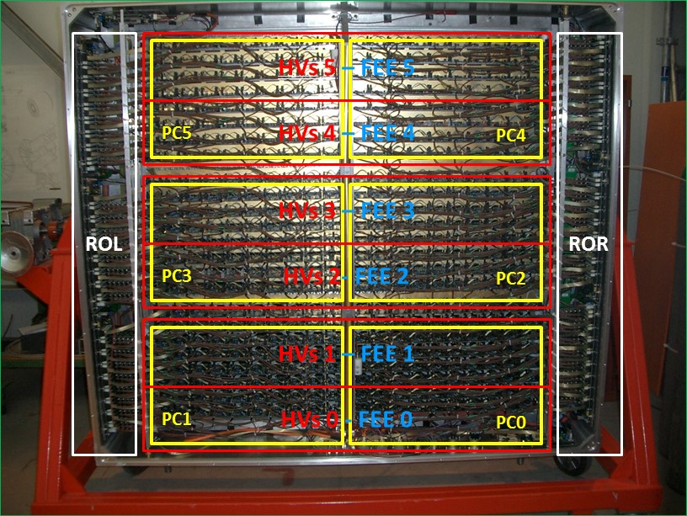
Sub-system segmentation in one RICH module
6 CsI pad Photocathodes (PC’s);
6 x HV sector of 48 anodic wires (HV’s);
6 x FEE sectors (FEE’s);
2 RO sectors (ROR-L)
Details : CERN/LHCC 98-19 ALICE TDR 1 14 of August 1998.
Notes:
To minimize hardware failure the HV, FEE and RO electronics on each module have been segmented; one HV sector covers two pc’s

Slide 8
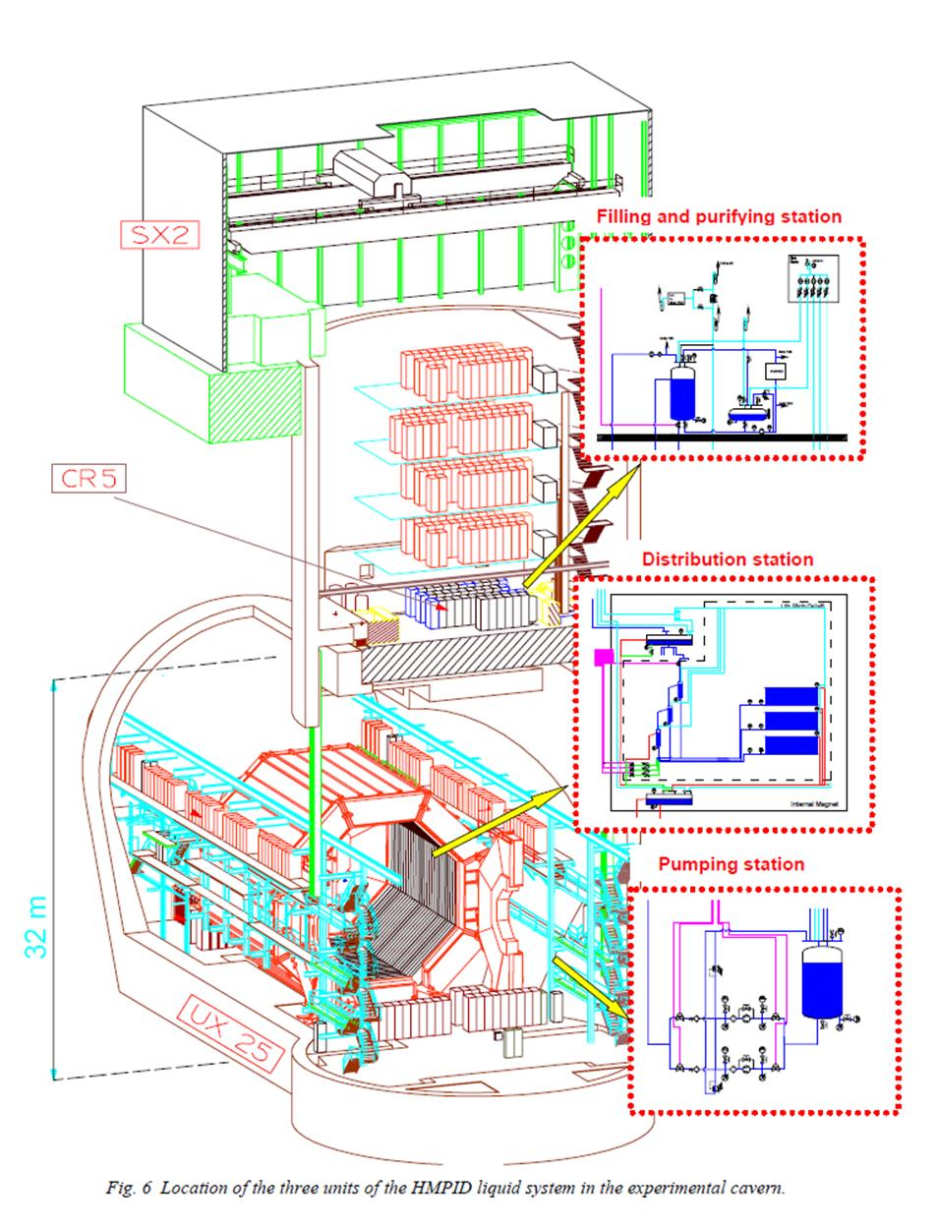
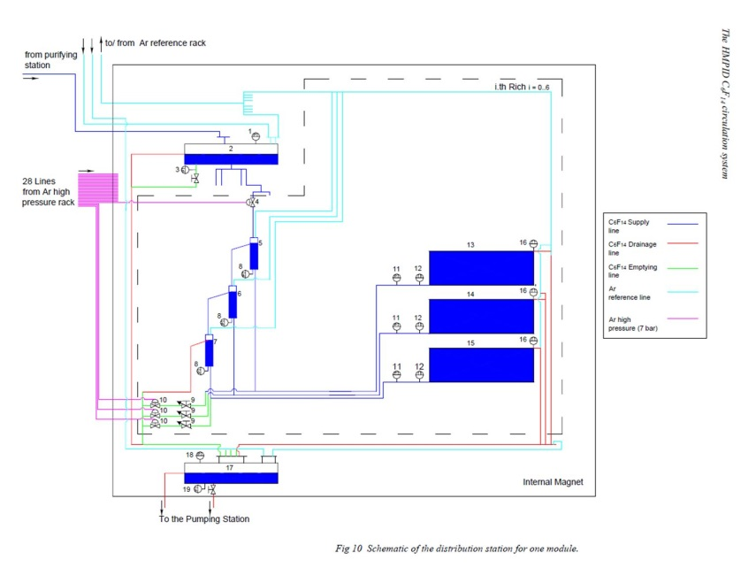
C₆F₁₄ circulation and purifying systems
Safe C₆F₁₄ circulation by gravity flow;
Stable transparency to Č photons;
Separated control for each radiator vessel;
C₆F₁₄ : 3M PF5060DL.
Notes:
Detail: Distribution station for one RICH module

Slide 9
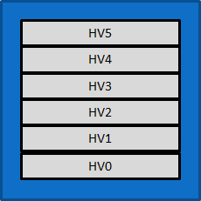
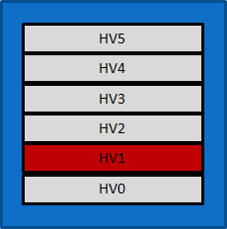
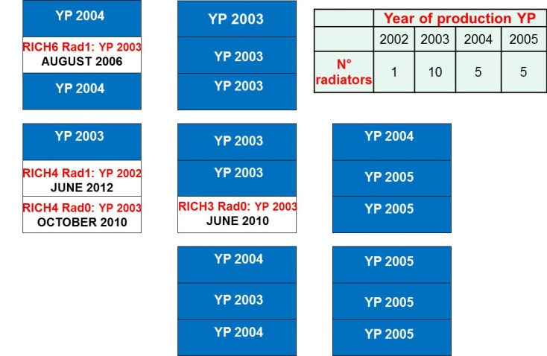
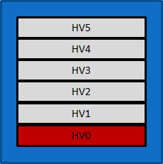
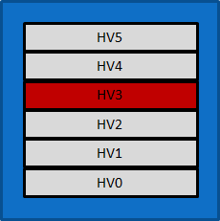
Detector status
Leaking radiator vessels
HV failing sector
RICH6
RICH5
R2
RICH4
RICH3
RICH2
M6R1 : leaking 2006
M3R0 : leaking 2010
M4R0 : leaking 2010
M4R1 : leaking 2012
M5HV1 : failing 2006
M4HV0 : failing 2009
M0HV3 : failing 2009
M1HV1 : failing 2016
R1
R0
HV1
RICH1
RICH0
Faulty sub-system segments:
Combining leaking vessels and failing HV sectors, the detector acceptance is ~ 70% after 10 years of operation.

Slide 10
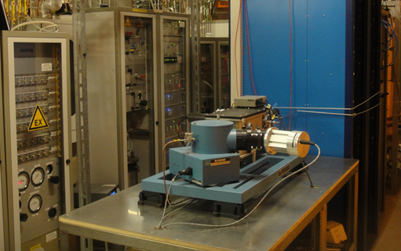
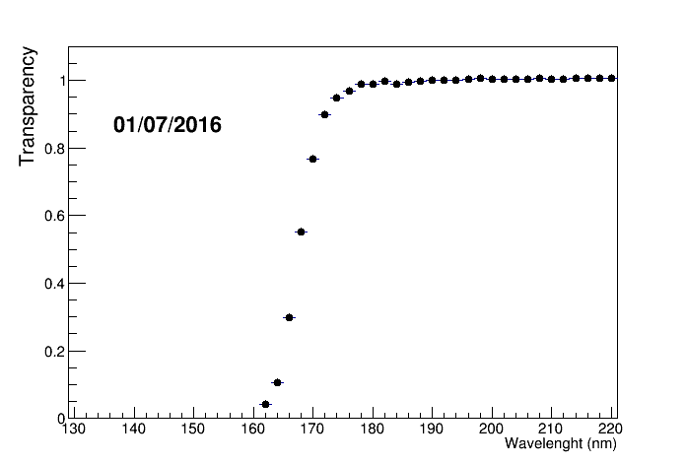
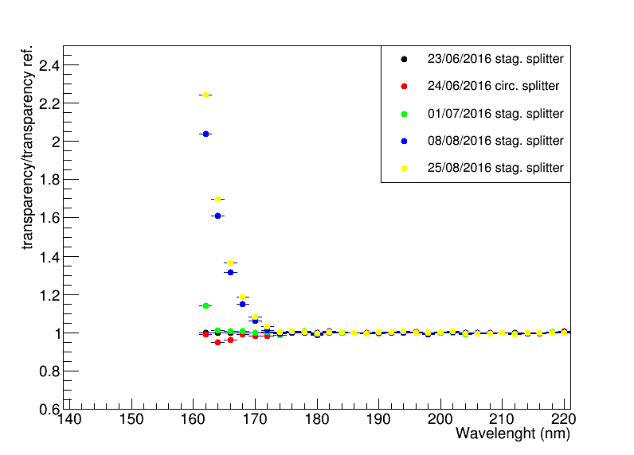
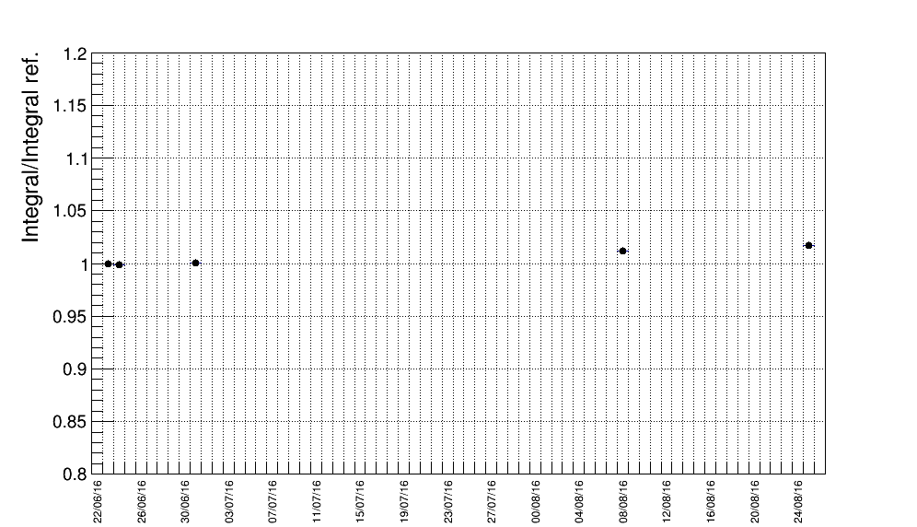
C₆F₁₄ Transparency monitoring
H₂O filter replaced
On August the 4th , after replacement of H₂O molecular severs , the transparency improved around the water absorber peak of 165 nm. Anyway no Npe variation expected.

Slide 11
MWPC SE-PHD , MIP and Npe @ θ_{MAX}
SE-PHD
MIP
Npe @ θ_{MAX}
Npe at θ_{MAX} (β=1) depends only from the optical property of the radiator: cosθ_{MAX} =1/n

Slide 12
MWPC gain monitoring
HV equalization (Sept. 2011) to set A₀ ≈ 35;
Gain variations ≈ ± 15%;
A reduction of 20% on A₀ -> photoelectron detection efficiency loss of 3% (A_{th}/A₀ ≈ 4/35) . No effects on the PID performance.

Slide 13
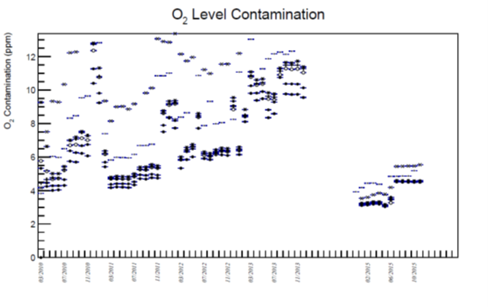
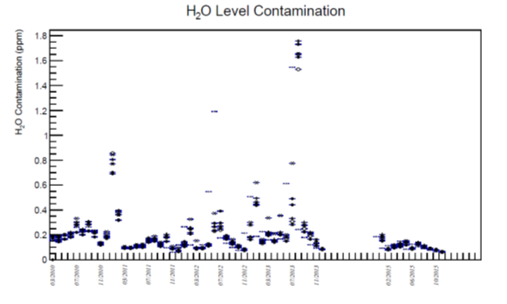
Monitoring of CH₄ contaminants
2010
2012
2015
2010
2012
2015
H₂O and O₂ in the MWPC CH₄ can degrade the UV transmission and damage the hygroscopic CsI layer;
At he level of few ppm they are well below the threshold to impact the detector performance.
Notes:
(100mm C6F14, ~180 mm CH4transmission, 5 mm quartz, O2 and H2O in ordinary value of ppm

Slide 14
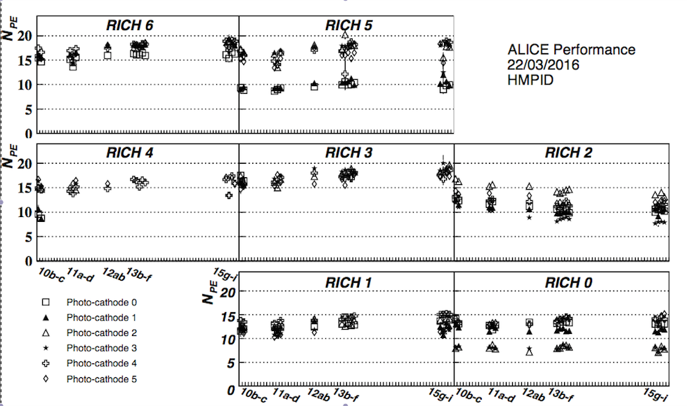
Monitoring of N_{PE} stability
2010
2011
2012
2013
2014
2015
Good Npe stability infers a CsI QE stability;
Except RICH2 PC 2 and 3 with a drop of 30%. After cleaning, PC’s were
re-evaporated during 2005, maybe procedure not optimised;
Empty space between blobs represents LHC technical stops from 2010 up to 2015.

Slide 15
PID performance in Run2

Slide 16
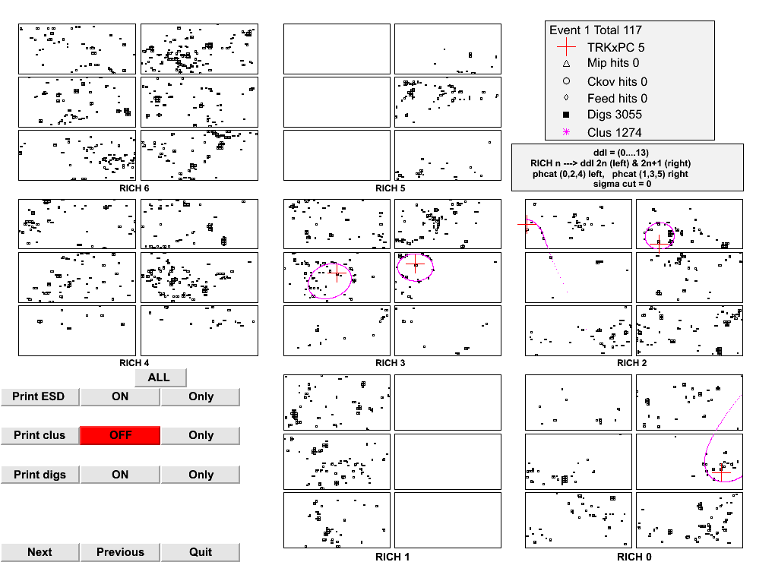
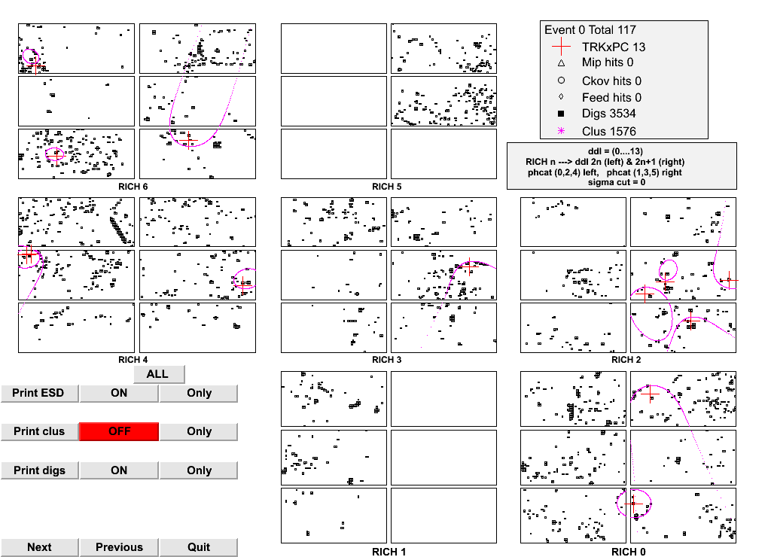
Pb-Pb events at √𝑠_{𝑁𝑁} = 5.02 TeV/c
HMPID Calot-like design optimized for 0.2 Tesla but experiment operation @ B=0.5 Tesla;
Deformation/opening of the circular Cherenkov patterns. Some degradation of the angular resolution anyway PID performance ensured (3σ separation in the momentum ranges).

Slide 17
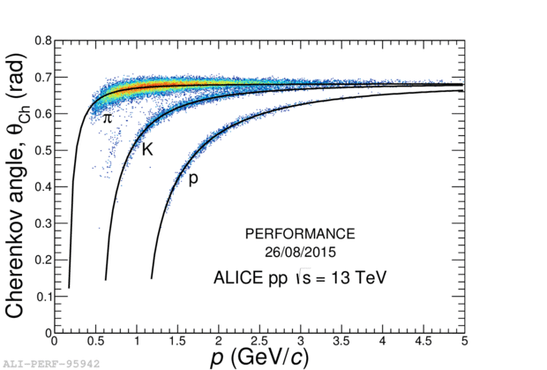
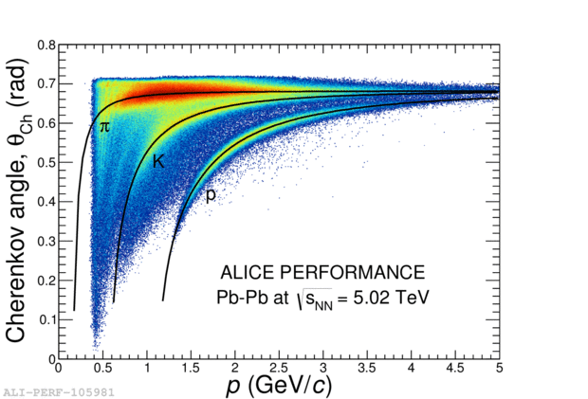
PID performance on pp √𝑠 =13 TeV and Pb-Pb √𝑠_{𝑁𝑁} =5.02 TeV
HMPID Cherenkov angle vs track momentum for pp √𝑠 =13 TeV (left panel) and Pb-Pb √𝑠_{𝑁𝑁} = 5.02 TeV (right panel);
Continuous lines represent theoretical Cherenkov angle values vs. track momentum.

Slide 18
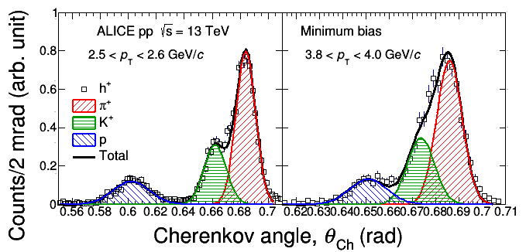
Statistical PID in pp collisions
Two PID techniques possible: statistical (Gaussians fits as in figures) or event-by-event which needs an effective background rejection;
For the contribution of HMPID to the ALICE physics see G. Volpe presentation, session Pattern recognition and Data Analysis.

Slide 19
Perspectives for the HMPID in HL-LHC Run3 (2021-2023)

Slide 20
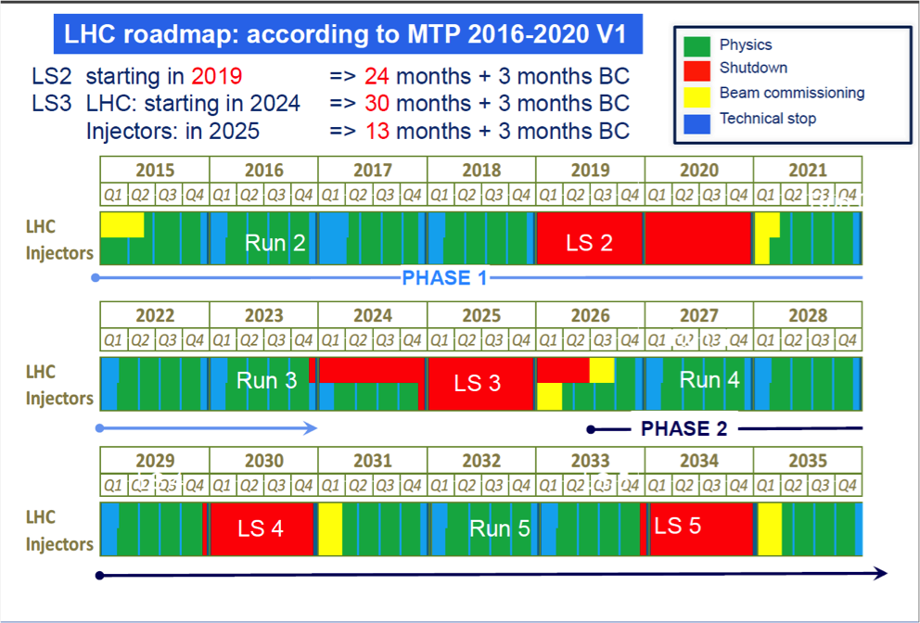
LHC long term program
LHC Run 1: 2010-2013
LHC Run 2: 2015-2018
HL-LHC Run 3: 2021-2023

Slide 21
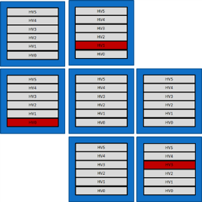
Specific charge dose vs. time
Study of charge dose for potential CsI ageing by avalanche ions;
During Run2, ~70 % of charge dose from pp collisions and ~30% from Pb-Pb.

Slide 22
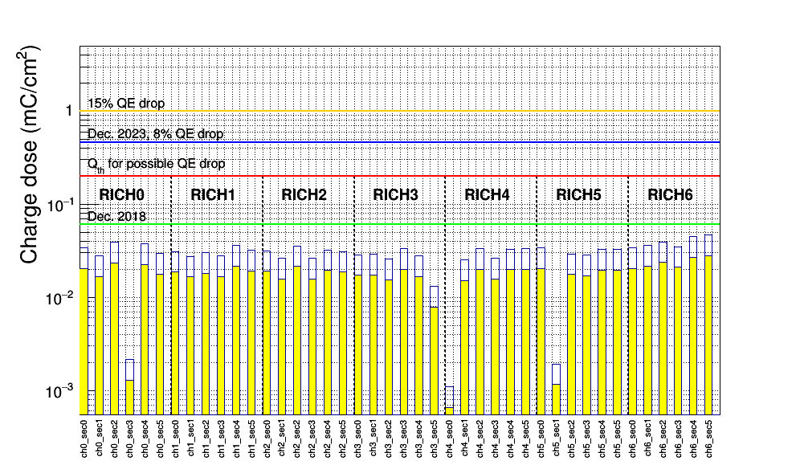
Charge dose on the CsI photocathodes
PC with Npe dropping
Charge dose threshold (Qth red line) for possible CsI QE loss: 0.2 mC/cm^{2;}
Still far during Run2;

Slide 23
Delivered luminosity in ALICE and charge dose
Qth=0.4 mC/cm² Expected at the end of Run3 with a possible CsI QE reduction of 8%.

Slide 24
New trigger schema and HMPID Read-out rate
pp
Pb-Pb
During Run3:
Detectors with continuous read-out @ 50 KHz in Pb-Pb collisions;
HMPID still triggered detector;
Preliminary tests results with RO firmware Run3 compliant: 10KHz and 6 KHz respectively in pp and Pb-Pb collisions, two times higher than in Run2 (four times w.r.t. LHC Run1);
New trigger modules, Run3 compliant, already under development.

Slide 25
Summary
Detector status: stable since LHC Run1(2010-), a small further acceptance loss 72% -> 70% in 2016 (one HV sector OFF);
Number of detected photoelectrons per ring stable (<N_{PE}>=~14). No ageing effects of CsI photocathode observed, except evidences on the re-evaporated RICH2, PC2 and 3;
Specific charge dose from ion bombardment: at the end of Run2, well below the threshold of 0.2 mC/cm² for possible CsI QE loss. At the end of Run3, a QE loss of 8% is expected;
Very good preliminary results with new RO firmware:10KHz and 6 KHz in pp and Pb-Pb collisions. RO rate doubled w.r.t. Run2 (four times w.r.t. LHC Run1);
Good perspective for the HMPID operation in LH-LHC Run3!

Slide 26
Back-up slides

Slide 27
N_{PE} vs. ALICE run periods
Good Npe stability inferring a CsI QE stability.
Except RICH2, PC 2 and 3, with QE drop of ~30%

Slide 28
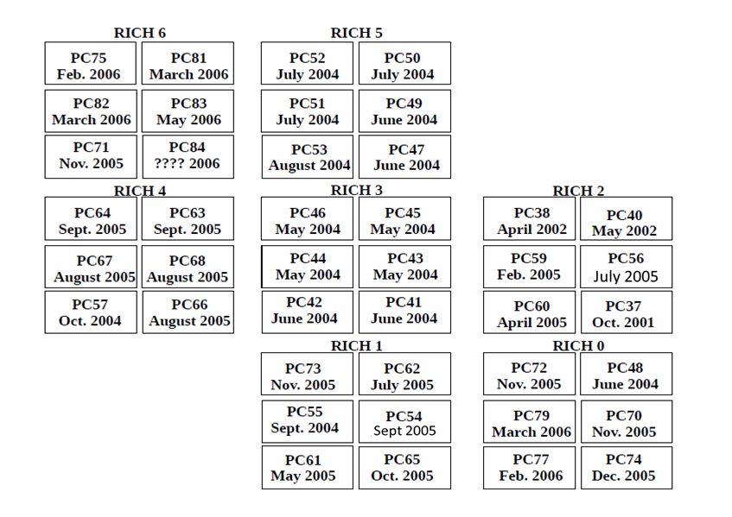
Year of production of the CsI PC’s
5
4
3
Npe dropping
2
1
0
Production date of the CsI photo-cathodes and location in the RICH modules

Slide 29
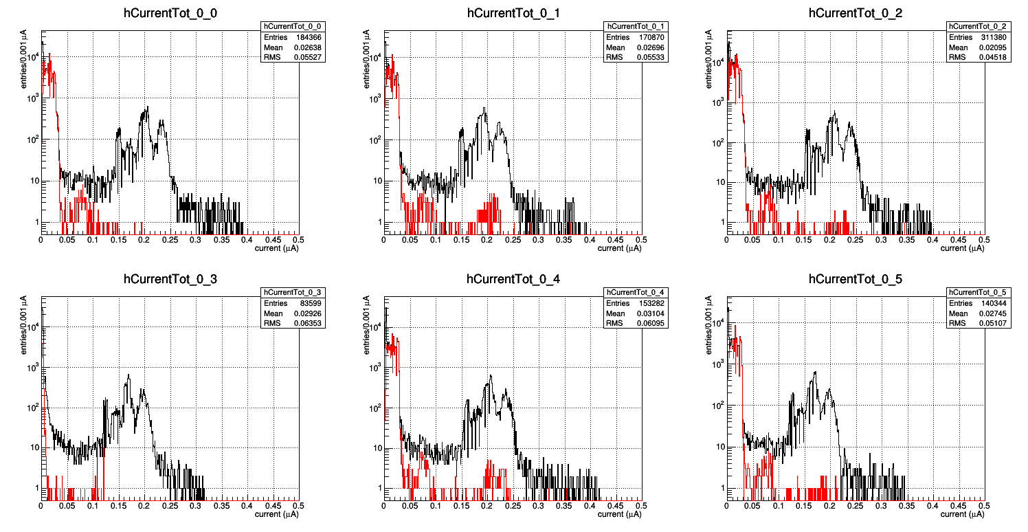
MWPC anodic current
2010-2016
50nA 200nA
50nA 200nA
50nA 200nA
50nA 200nA
50nA 200nA
50nA 200nA
Black curve: MWPC anode current I_{a} in the six HV sectors of the RICH0 during 2010-2016;
Black curve double peak: I_{a} distribution during HV setting between STANDBY -> BEAM TUNING and BEAM TUNING -> READY (charging of cables and capacitors);
Red curve: I_{a} with HV sectors at the nominal value of 2050 V during collisions.

