Slide 1
ILC Calorimeters →FCCee Calorimeters
Imad Laktineh
Institut de Physique Nucléaire de Lyon, France

Slide 2
Outline
→ILC detectors philosophy
→ILC calorimeters options :
SiD, ILD
ILC calorimeters for FCCee
Examples: SDHCAL, Si-W ECAL

Slide 3
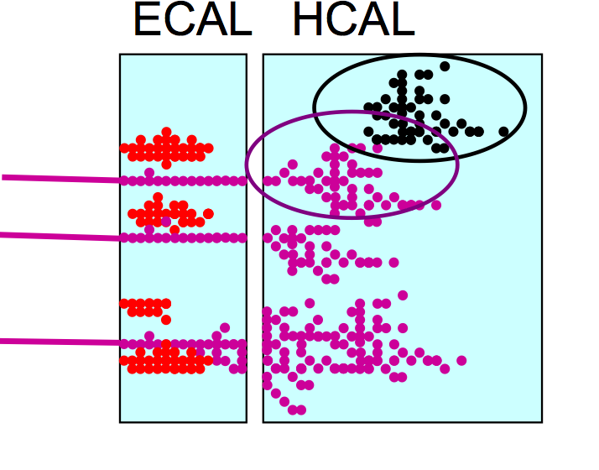
Philosophy of the ILC detectors
Detectors should be precision and discovery
tools beyond the LHC scope.
Relevant Physics phenomena in the TeV
energy range are associated to multi jet
final states → Jet energy measurement
is the most important item.
Particle Flow Algorithm is adopted in both
SiD and ILD concepts. PFA: Construction of individual
particles and estimation of their energy/momentum
in the most appropriate sub-detector.
PFA requires the different sub-detectors including calorimeters to be highly granular.
PFA uses their granularity to separate neutral from charged contributions and exploits
the tracking system to measure with precision the energy/momentum of charged particles.

Slide 4
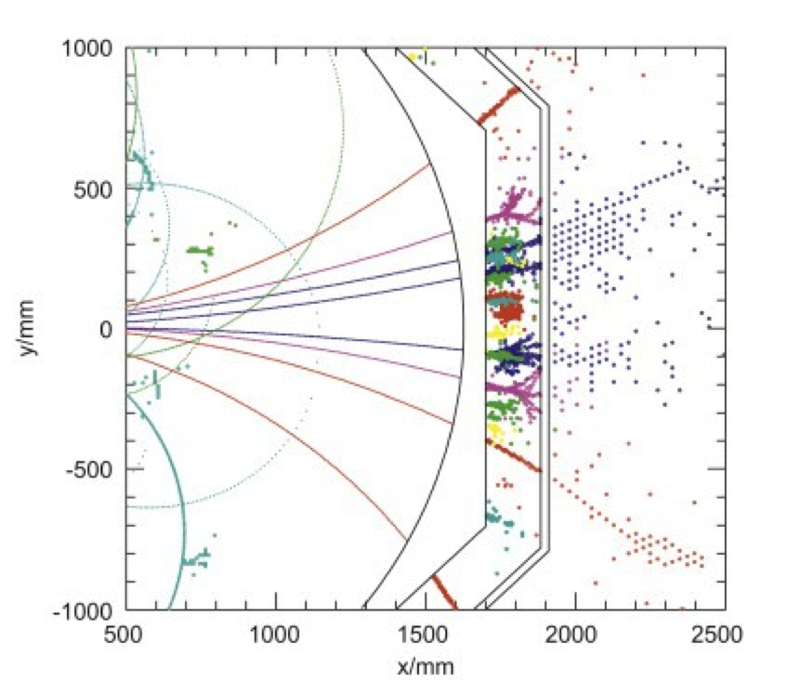
Philosophy of the ILC detectors
Detectors should be precision and discovery
tools beyond the LHC scope.
Relevant Physics phenomena in the TeV
energy range are associated to multi jet
final states → Jet energy measurement
is the most important item.
Particle Flow Algorithm is adopted in both
SiD and ILD concepts. PFA: Construction of individual
particles and estimation of their energy/momentum
in the most appropriate sub-detector.
PFA requires the different sub-detectors including calorimeters to be highly granular.
PFA uses their granularity to separate neutral from charged contributions and exploits
the tracking system to measure with precision the energy/momentum of charged particles.

Slide 5
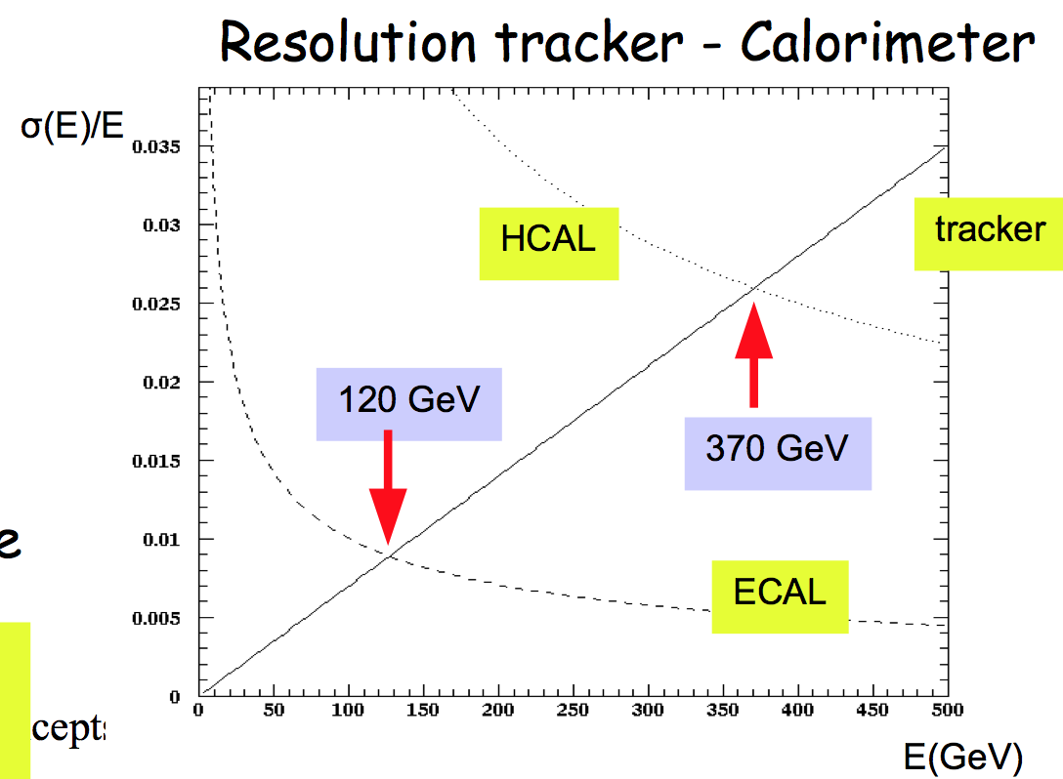
Why tracking is so important?
E_{jet} = E_{charged t} + E_{γ} + E_{h0}
fraction 65% 26% 9%
Charged tracks resolution ∆p/p ~ few10⁻⁵
Photon(s) energy resolution ∆E/E ~ 12% / √E
Neutral hadrons energy resolution ∆E/E ~ 45% / √E

Slide 6
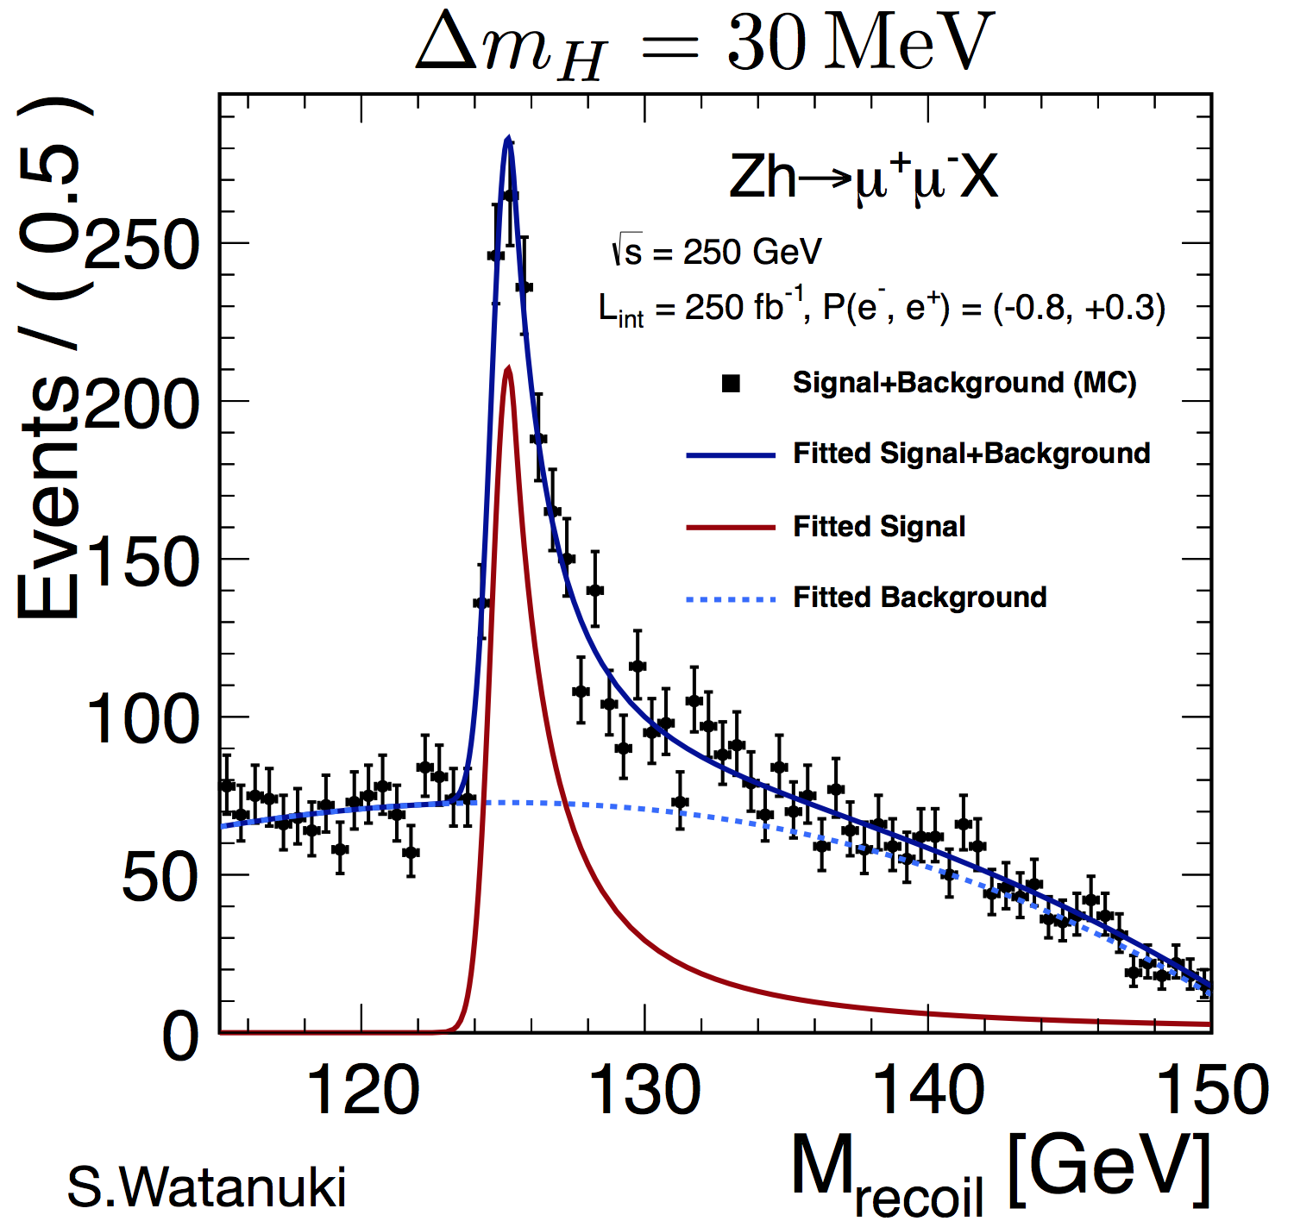
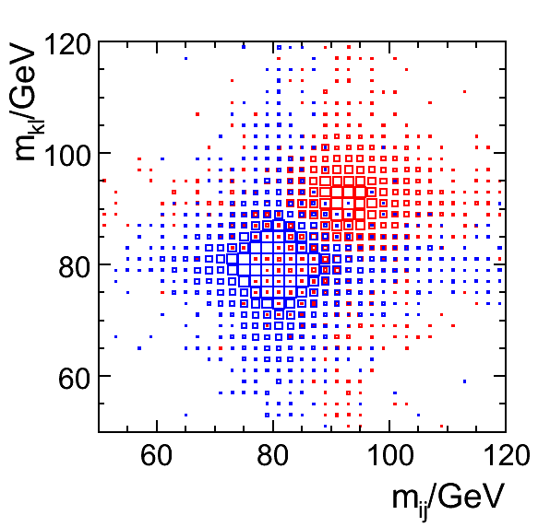
Philosophy of the ILC detectors : Requirements
Vertex detector : excellent resolution
σ_{IP}(rφ) = 5+10/(p sin^{2/3}(θ)) μm
b-tag, c-tag,… for H → bb, cc, ττ studies
Τracker : excellent precision measurement of p_{t}
σ(1/p_{t}) =10⁻⁵ GeV⁻¹
H mass recoil, e⁺ e⁻ → H Z→ μ⁺ μ⁻ + anything
Calorimeters : highly granular but still providing
good measurement of neutrals
σ_{E}/E = 30%/√E
The whole detector should be hermitic, compact
with moderate power consumption
30%/√E

Slide 7
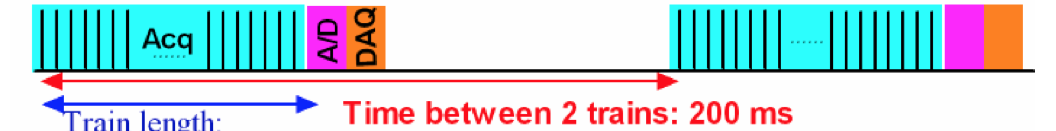
Power-Pulsing
Important feature of ILC detectors to reduce power consumption and heating for highly-granular detectors
Electronics switched on just before the bunches train and off after
A factor 100-200 power reduction could be achieved.
2820 bc by train
337 ns separating two bc.

Slide 8
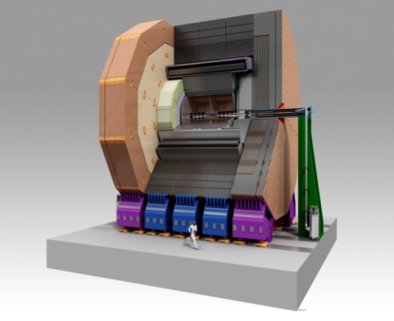
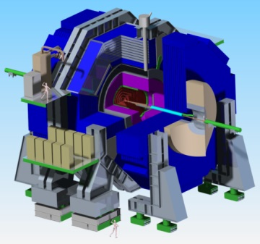
ILD SiD

Slide 9
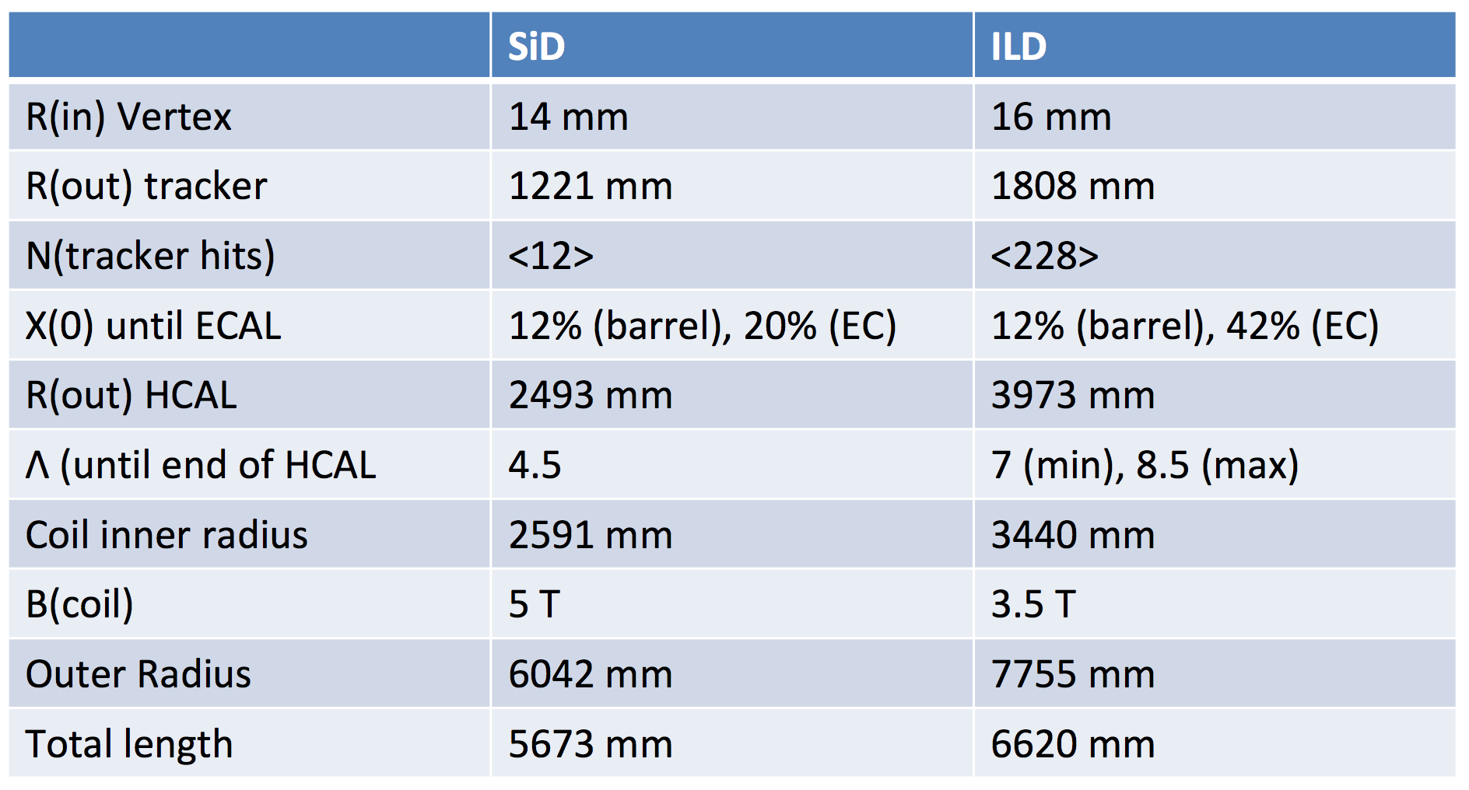
)

Slide 10
ILD SiD
Precision vertex detectors
CMOS MAPs, FPCCD, DEPFET 3D, chronopixel,DEPFET, MAPs
Tracker
TPC (GEM,MMEGAS,MAPs) Silicon
many measurement points Few points but very precise
Calorimeters
ECAL: Si-W, Sc-W ECAL: Si-W
AHCAL: Sc-Steel, SDHCAL-GRPC,.. DHCAL-GRPC
Size&Magnet
Large size, 3.5 Tesla Compact, 5 tesla

Slide 11
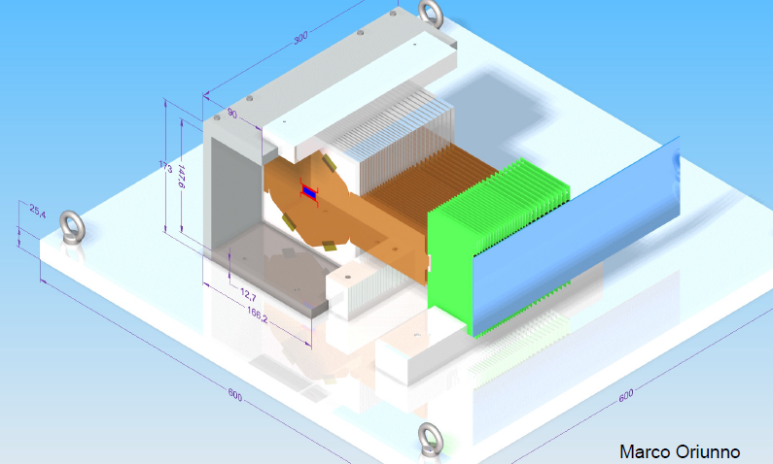
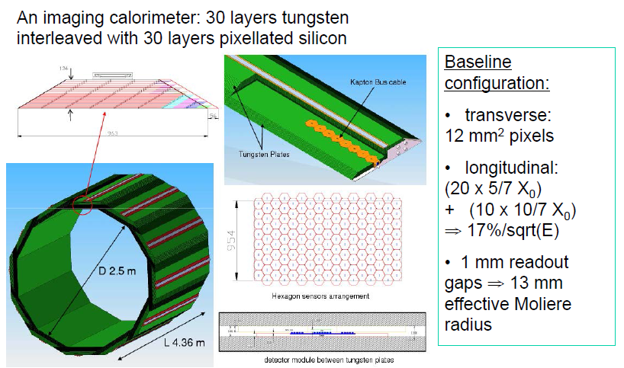
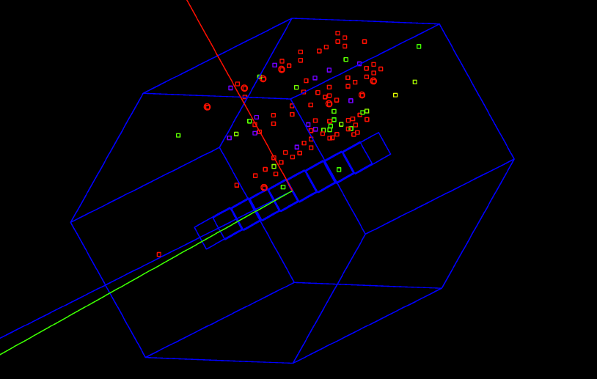
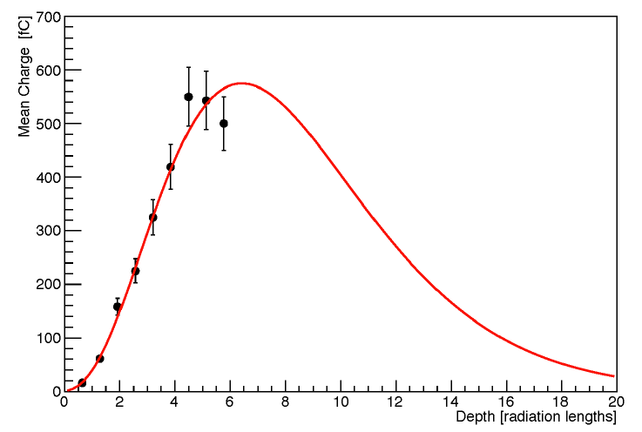
Technologies proposed for ILD&SiD calorimeters
ECAL for SiD
TB scheme : 9 layers SiW
3-electron event
1024 KPiX ASIC
Power-pulsed
X-talk to be reduced by better shielding
New scheme to have rectangular sensor (modified cells on the edge)
Mechanical structure study needed

Slide 12
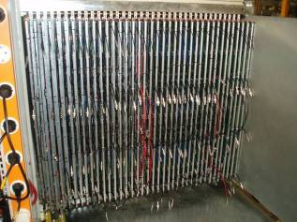
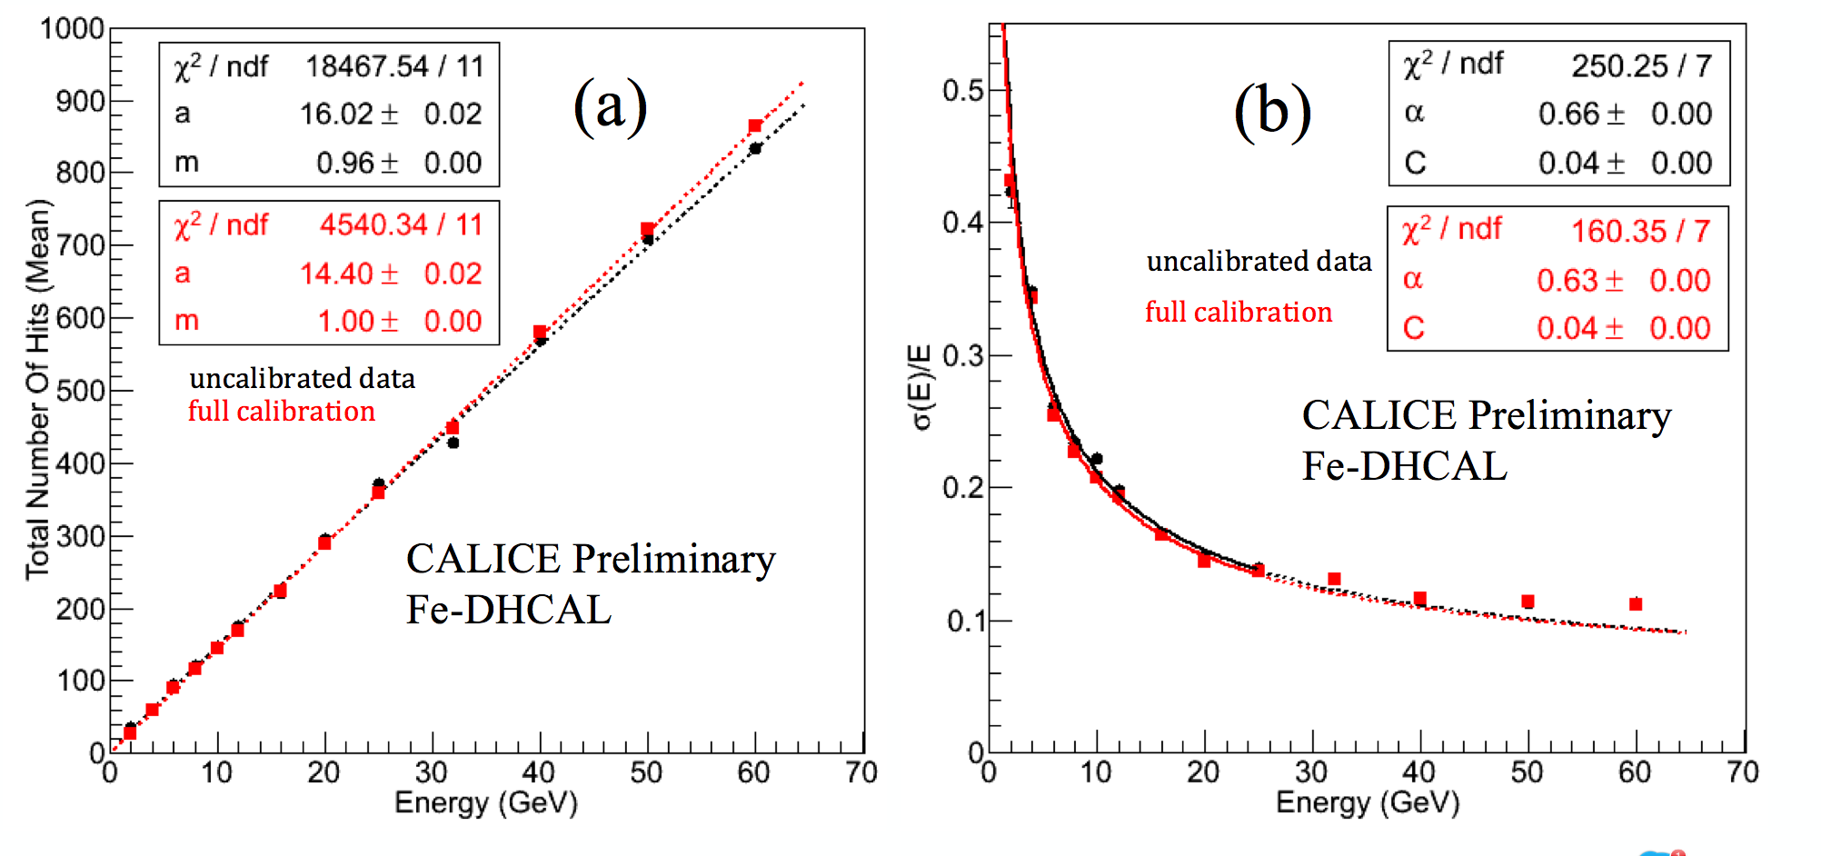
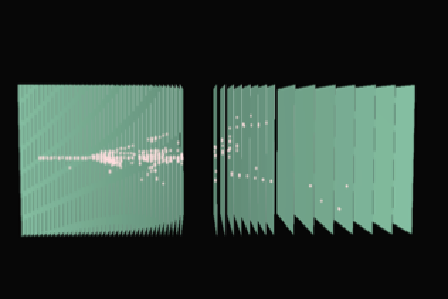
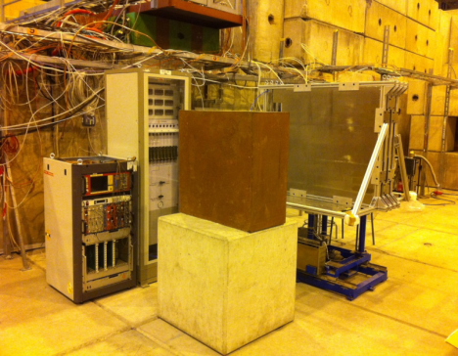
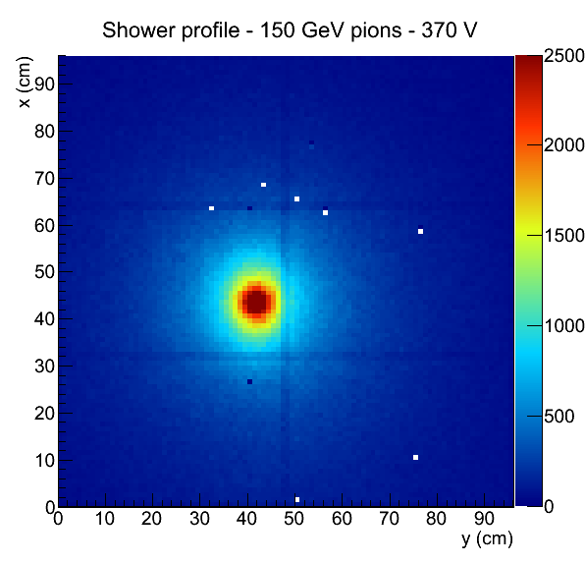
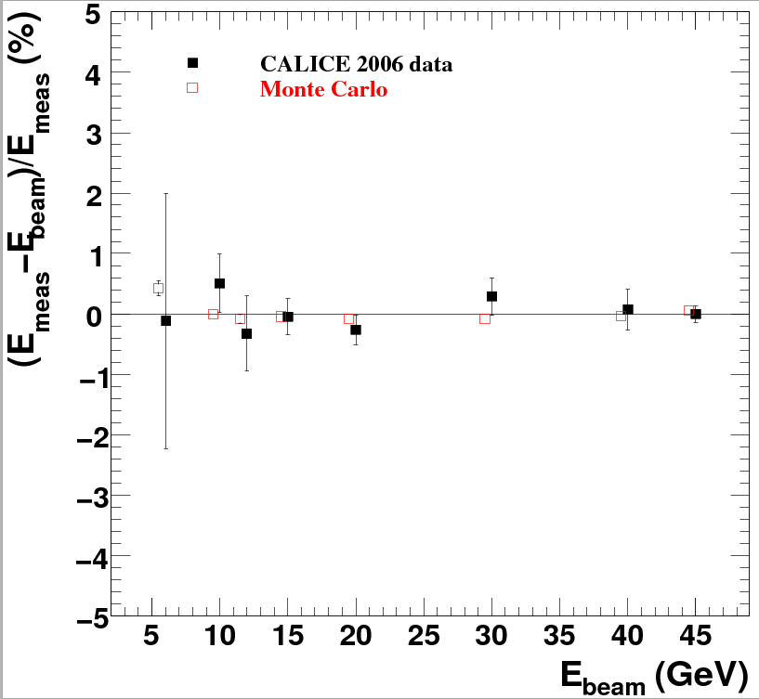
electron data (2006)
MOKKA (geant4) simulation
electron data (2006)
MOKKA (geant4) simulation
non-linearity<1%
non-linearity<1%
Ebeam
Ebeam
Technologies proposed for ILD&SiD calorimeters
HCAL for SiD
40 layers of 2 cm stainless steel interleaved with
planes made of Glass RPC and their embedded readout 1-bit electronics allowing a lateral segmentation of 1 cm²
An advanced physical (embedded electronics) prototype of 54 was built and successfully run.
Other options with GEM and micromegas detectors are also proposed as active layers for the SiD HCAL
Several layers of mm were built and tested using 2-bit readout electronics. Few GEM planes are also in preparation.
Scintillator tiles is an option.
Dual readout is also an option for both ECAL&HCAL

Slide 13
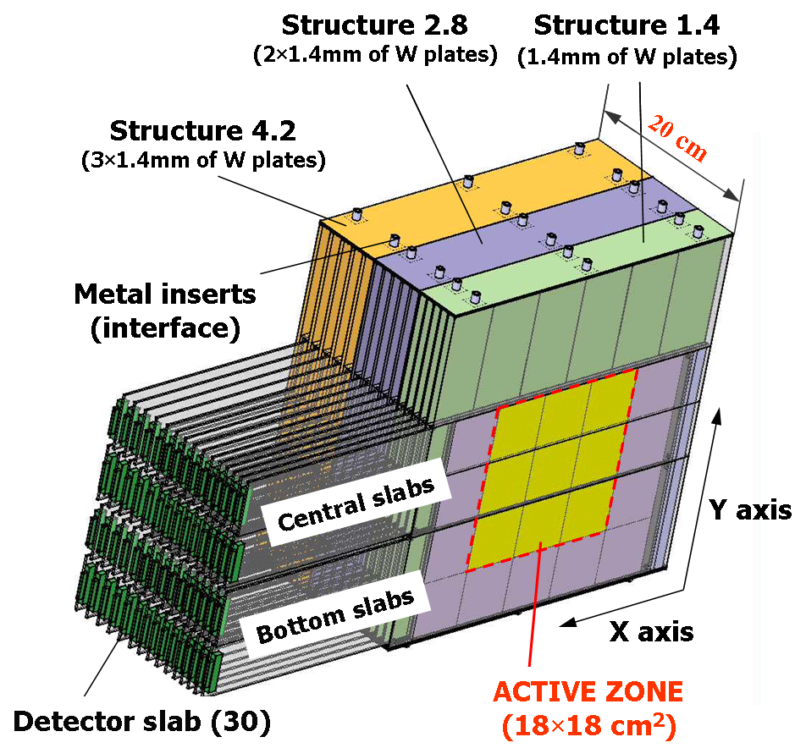
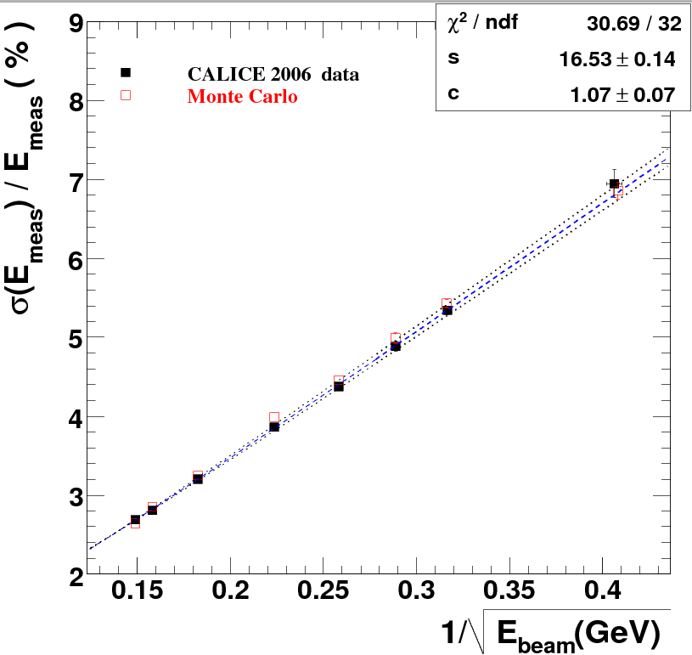
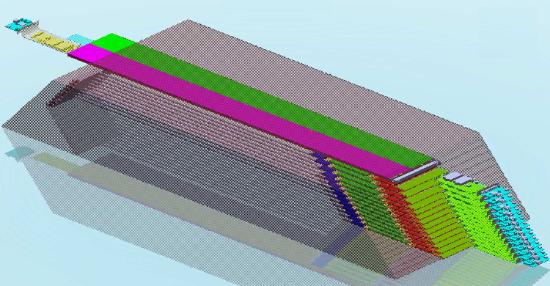
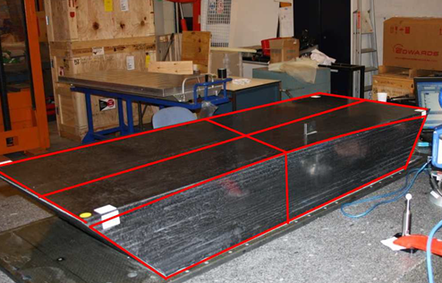
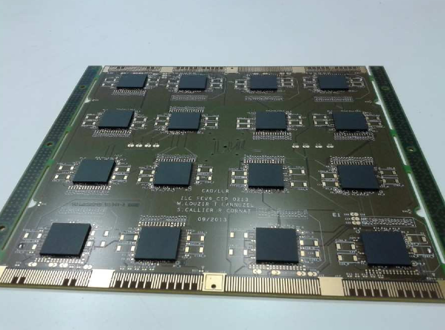
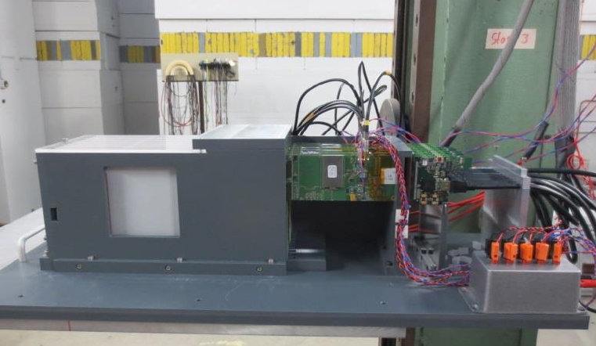
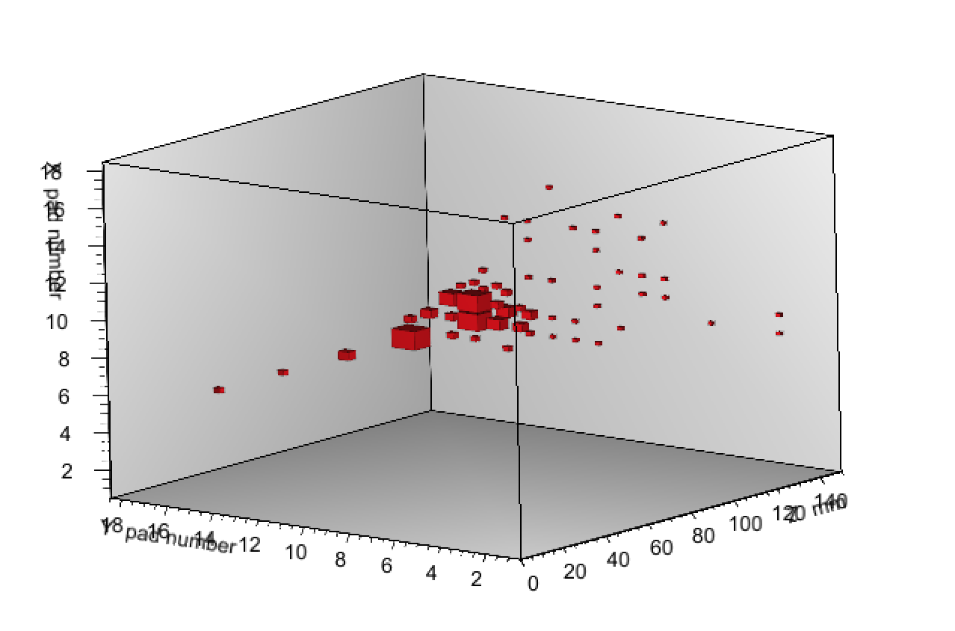
electron data (2006)
MOKKA (geant4) simulation
electron data (2006)
MOKKA (geant4) simulation
non-linearity<1%
non-linearity<1%
Ebeam
Ebeam
Technologies proposed for ILD&SiD calorimeters
ECAL for ILD
Energy resolution =
16.5/sqrt(E)+1.1%
30 layers of tungsten (24X₀) interleaved with
-Pixellated Silicon of 5x5 mm²,
A physics prototype (1x1 mm² cell size) with a deported electronics was built and successfully tested.
A technological prototype fulfilling the ILD DBD requirement is being developed :
Self-supporting structure (alveolar)
Embedded power-pulsed electronics
Large surface detector
Linearity <1%
Several TB took place at DESY

Slide 14
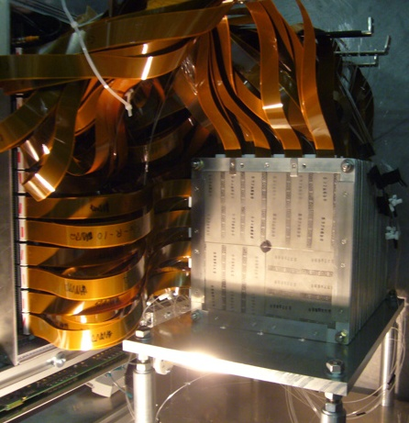
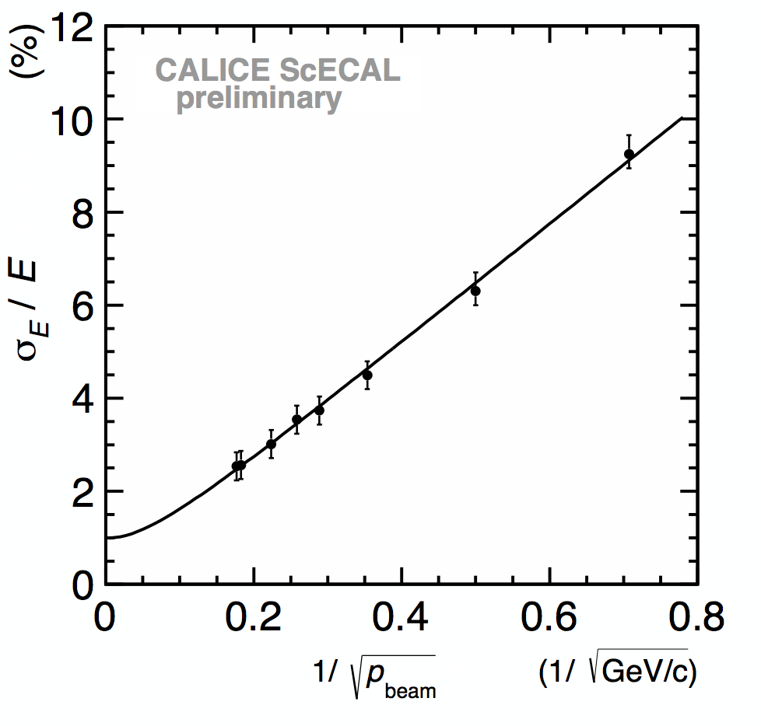
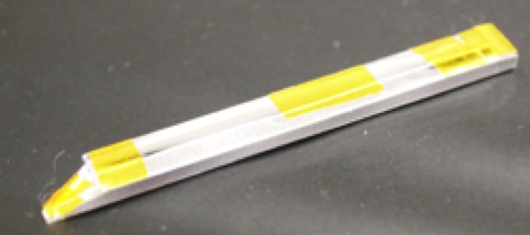
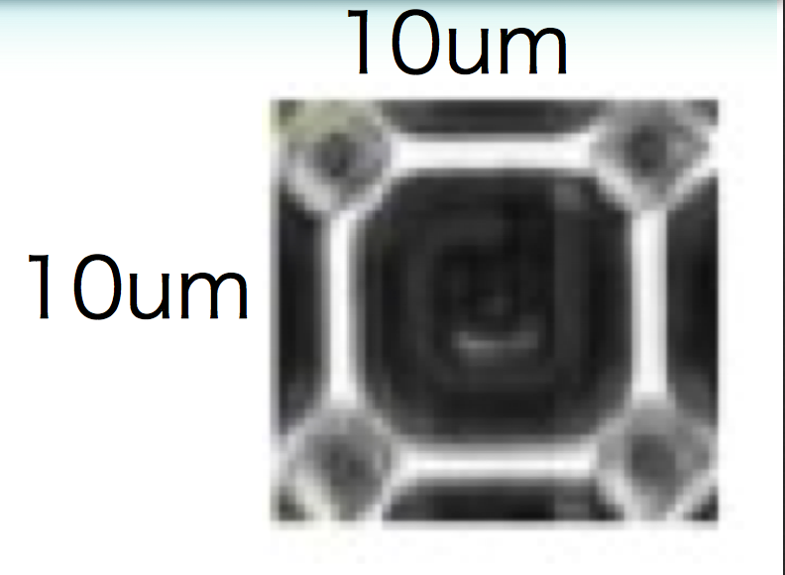
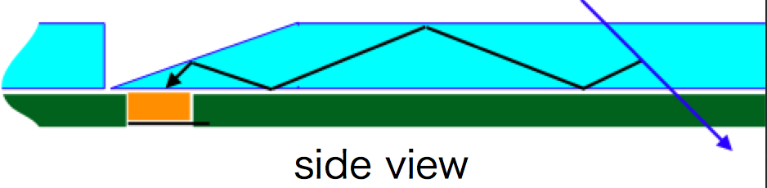
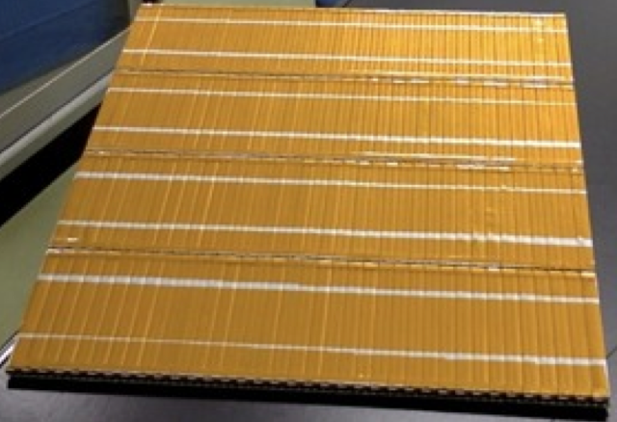
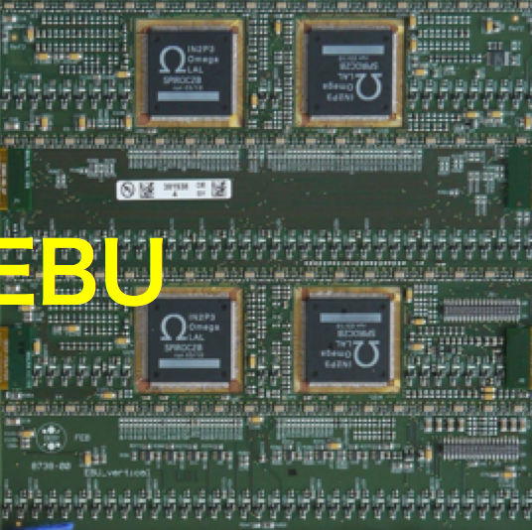
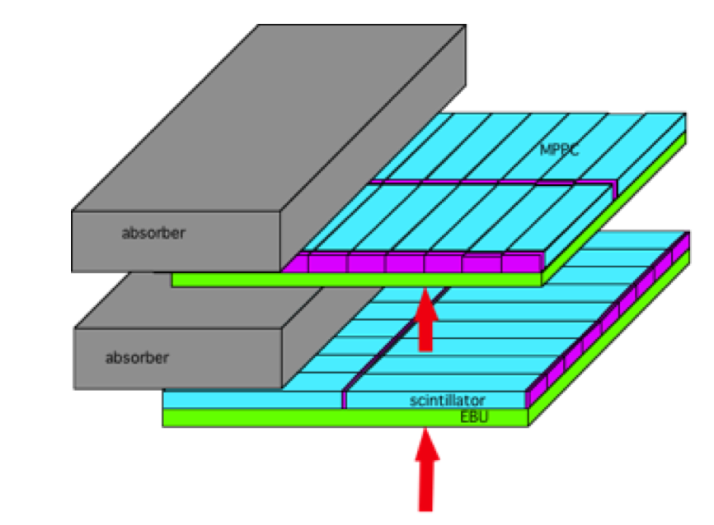
electron data (2006)
MOKKA (geant4) simulation
electron data (2006)
MOKKA (geant4) simulation
non-linearity<1%
non-linearity<1%
Ebeam
Ebeam
Technologies proposed for ILD&SiD calorimeters
ECAL for ILD
Energy resolution
12.8%/√E ⊕ 1.0%
30 layers of tungsten (24X₀) interleaved with
of 5x45 mm² scintillator strip with alternating direction
layers (X&Y) → equivalent of 5x5 mm² (SSA)
Read out by SiPM
A physics prototype with a deported electronics was built and successfully tested
A technological prototype is being developed with
Scintillator shape that optimizes light collection and reduces dead zones : rectangular, wedge, tapered..
SiPM more compact with higher linearity range
and less noise (MPPC 10000 ch in 1x1mm²)
Electronic board to host ASIC on one side
and scintillator plane on the other.
A first plane with the new technology was tested
in 2014.
Linearity <1.5%

Slide 15
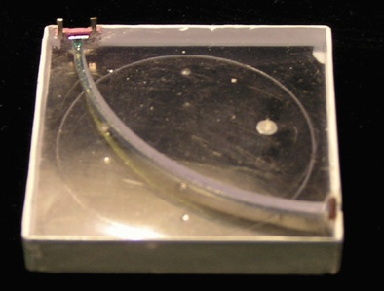
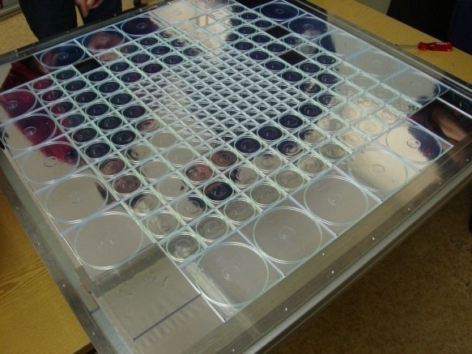
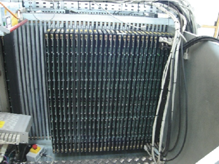
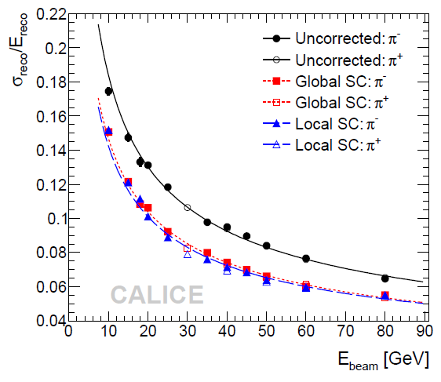
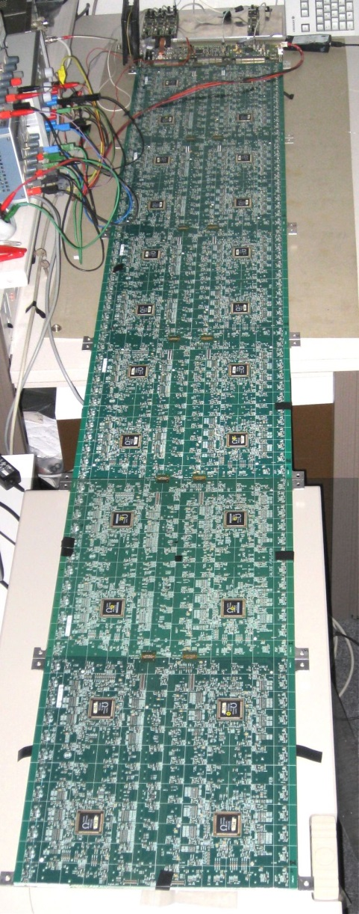
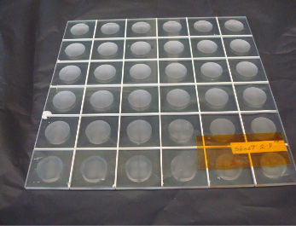
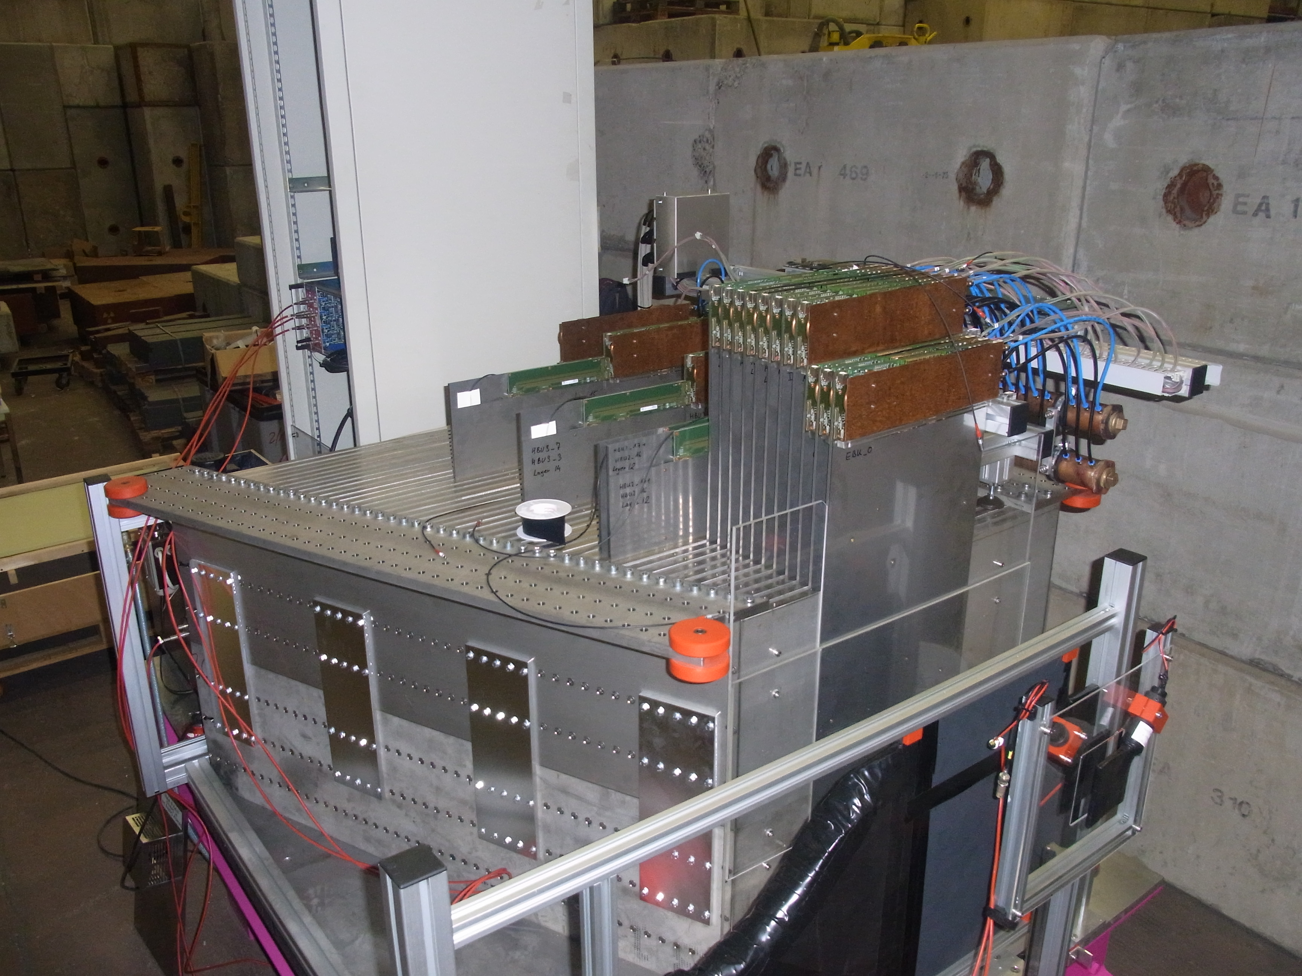
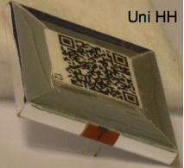
electron data (2006)
MOKKA (geant4) simulation
electron data (2006)
MOKKA (geant4) simulation
non-linearity<1%
non-linearity<1%
Ebeam
Ebeam
Technologies proposed for ILD&SiD calorimeters
HCAL for ILD
48 layers of 2 cm stainless steel interleaved with
planes made of 3x3 cm² tiles, read out directly by SiPM
and embedded electronics.
A physical prototype of 38 layers of 1 m², totalizing
(5.3 λ_{I}) accompanied by a tail catcher (6 λ_{I}) with
deported electronics was built and successfully tested
A technological prototype fulfilling the ILD requirements is being developed :
Optimized tile shape for direct readout
Embedded, power-pulsed readout electronics
Large plane with tiles assembled in a way to reduce
dead zones
Self-supporting mechanical structure
Several planes of different sizes were made and successfully tested in 2014

Slide 16
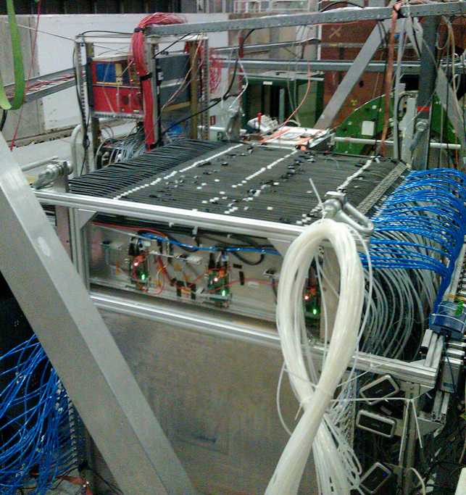
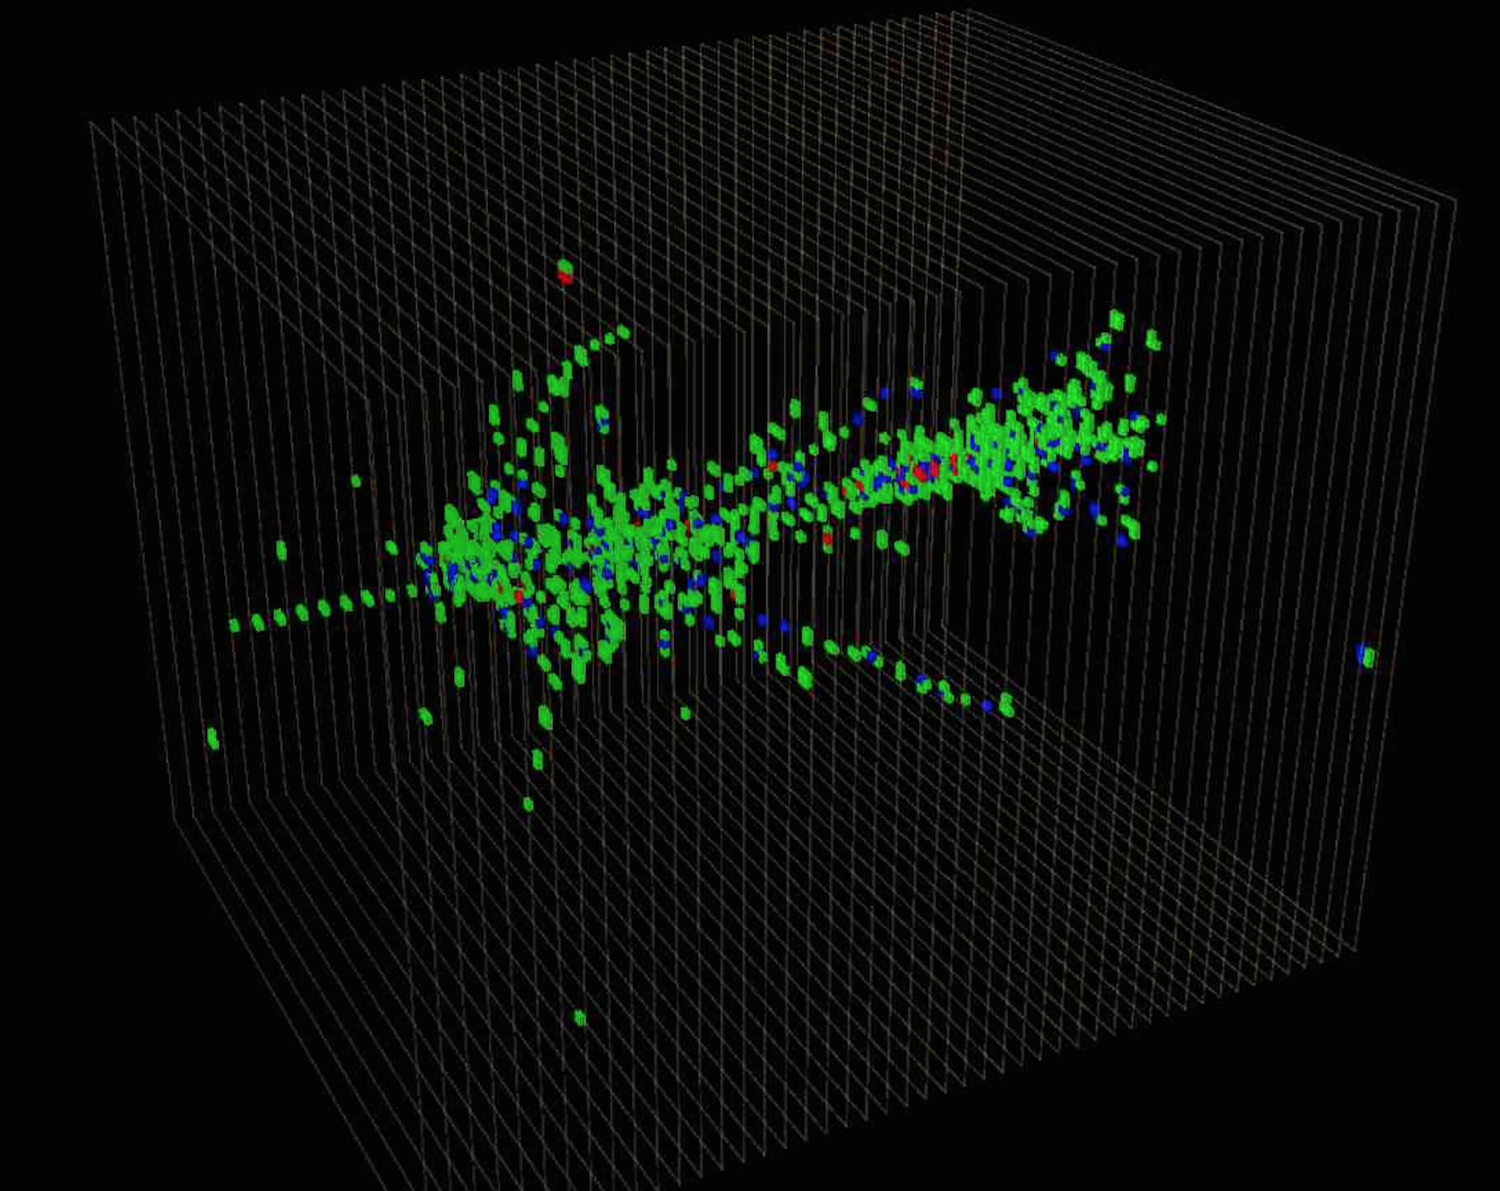
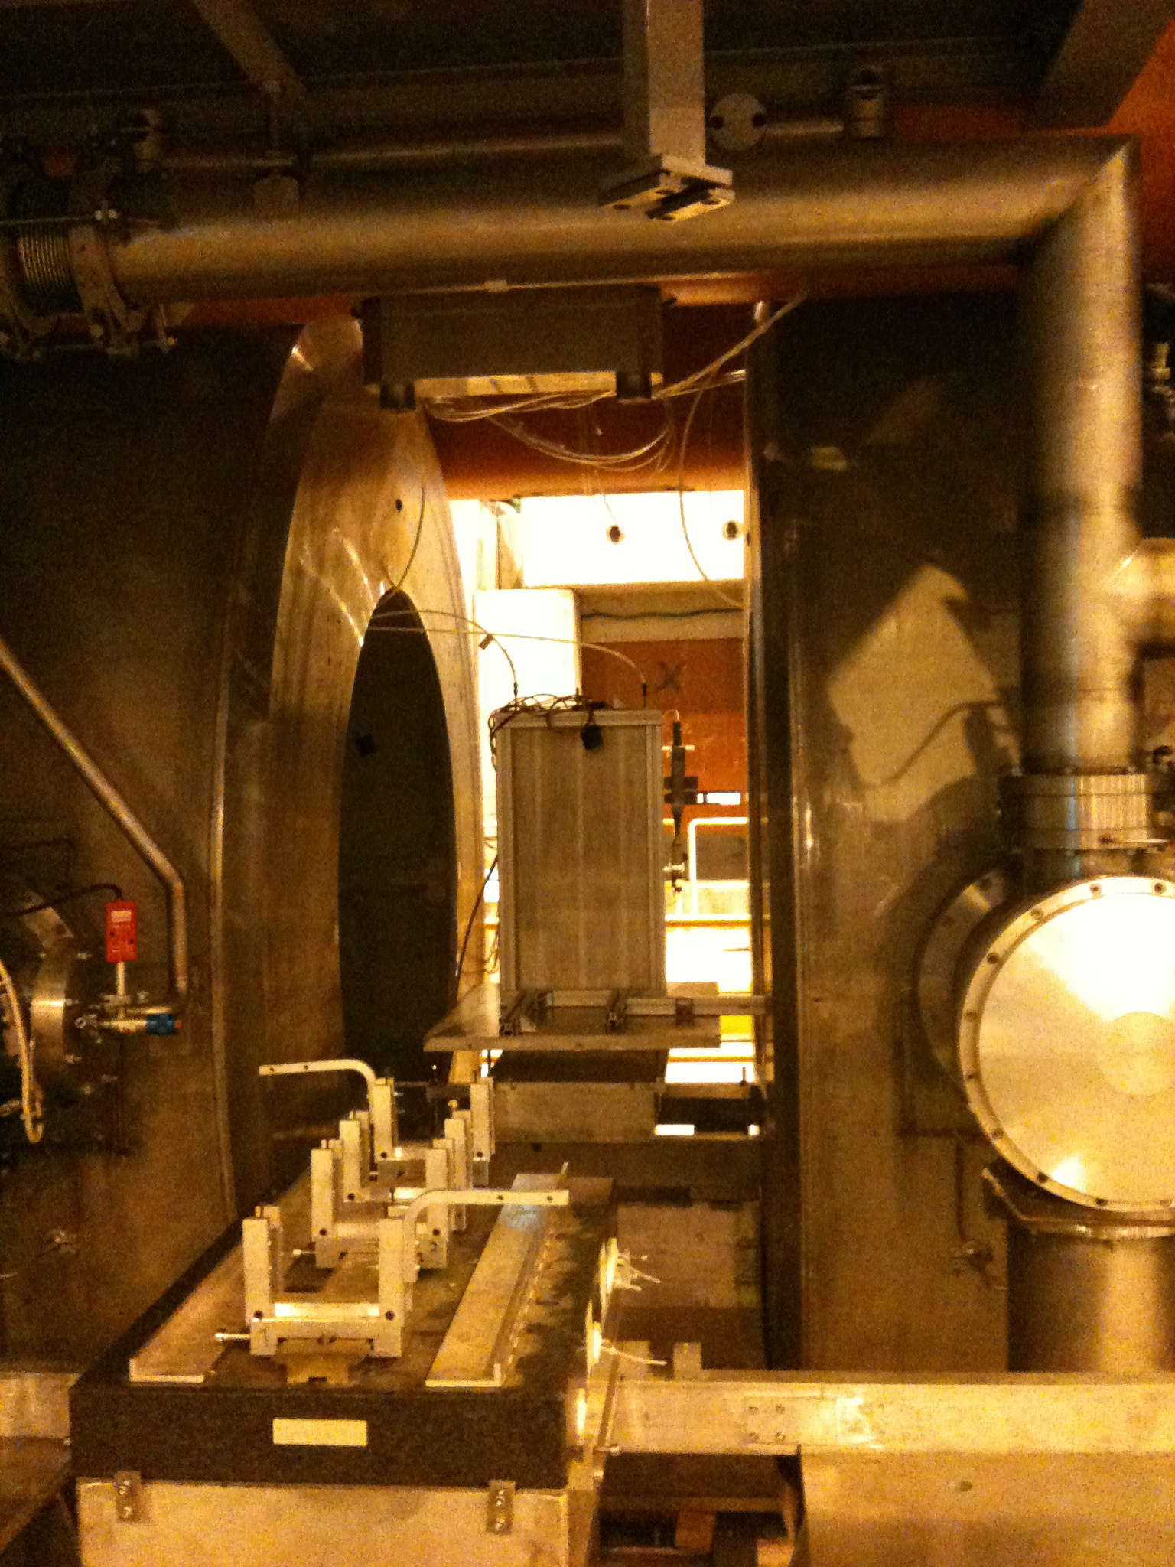
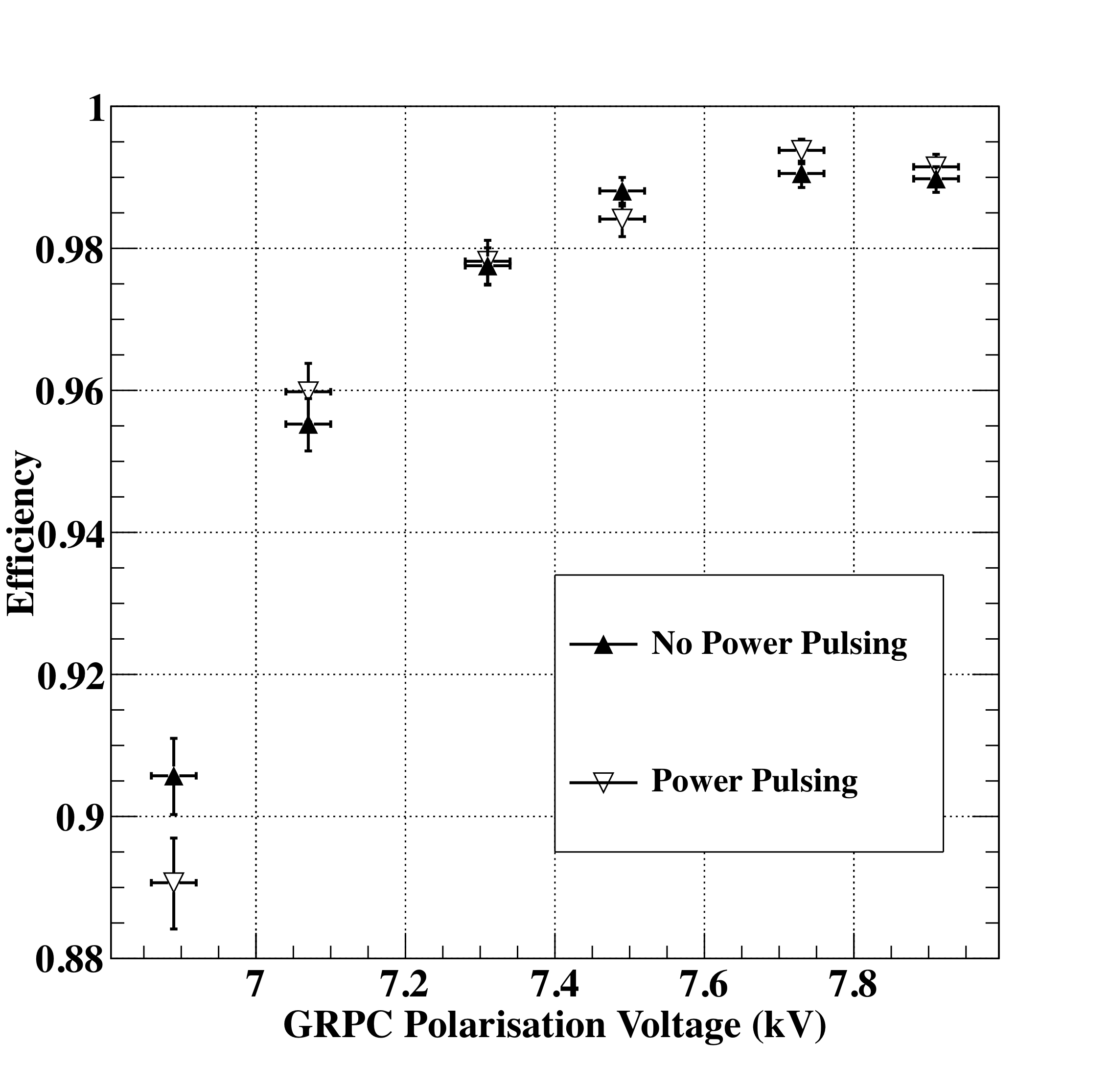
electron data (2006)
MOKKA (geant4) simulation
electron data (2006)
MOKKA (geant4) simulation
non-linearity<1%
non-linearity<1%
Ebeam
Ebeam
Technologies proposed for ILD&SiD calorimeters
HCAL for ILD
48 layers of 2 cm stainless steel interleaved with
planes made of Glass RPC and their embedded readout 2-bit electronics allowing a lateral segmentation of 1 cm²
A technological prototype of 48 fulfilling almost all the ILD requirements of compactness and power consumption was built with a self-supporting mechanical structure. It ws successfully tested with
Triggerless mode
Power-pulsing mode
Last step is to build very large GRPC and equip them with the last generation of the readout electronics
The GRPC was also successfully tested in a magnetic field of 3 T using the power-pulsing mode

Slide 17
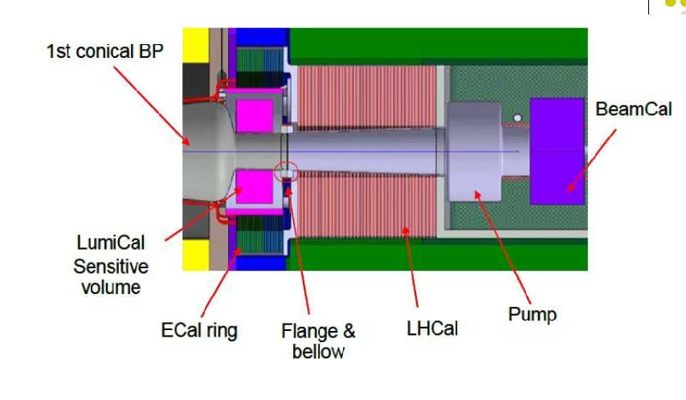
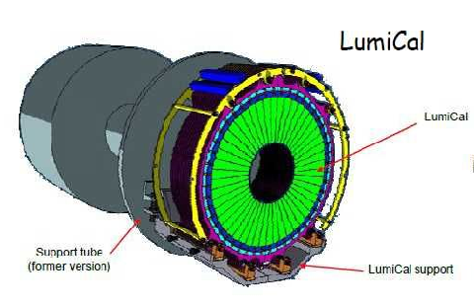
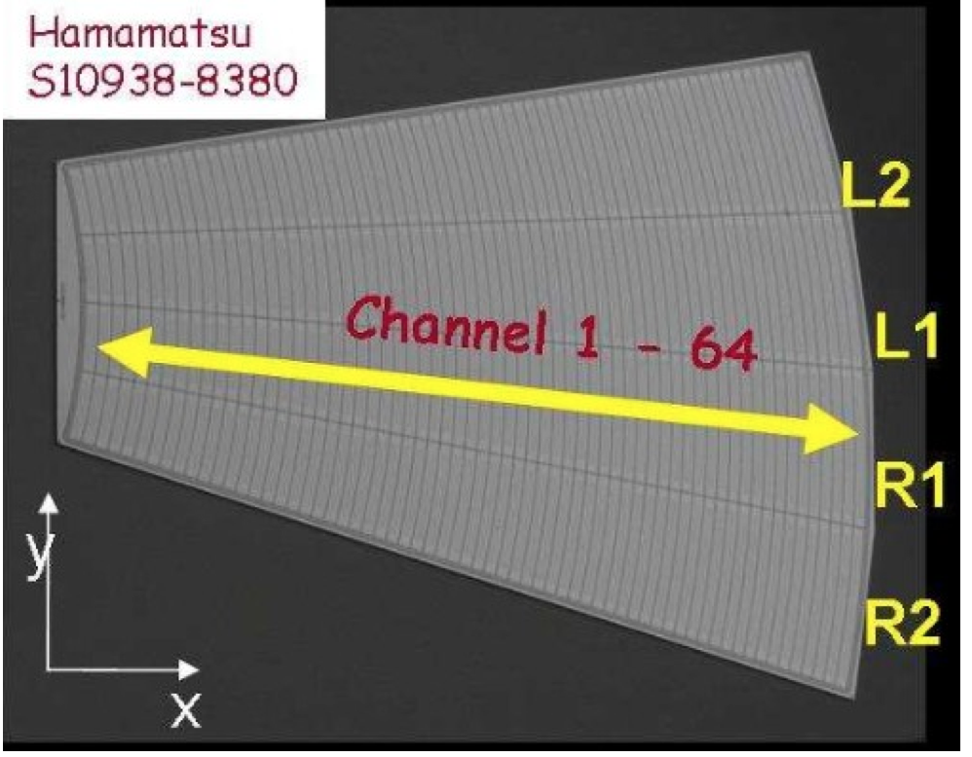
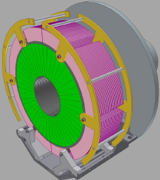


electron data (2006)
MOKKA (geant4) simulation
electron data (2006)
MOKKA (geant4) simulation
non-linearity<1%
non-linearity<1%
Ebeam
Ebeam
Technologies proposed for ILD&SiD forward calorimeters
LumiCal: Precise luminosity measurement (10⁻³) at 500 GeV.
BeamCal : Instantaneous luminosity measurement, beam diagnostics
but very high radiation load (up to 1MGy/ year)
LHCaL: Extends the calorimeter measurements to small polar angles
LumiCal (31 -77 mrad)
Two Si-W sandwich EM calo at ~ 2.5 m from the IP (both sides).
30 tungsten disks of 3.5 mm thickness. Si sensor pitch of 1.8 mm
Two tracking layers in front are envisaged to improve angle
measurement and separate e/γ.
BeamCal (5 – 40 mrad)
similar W-absorber as for the LumiCal but radiation hard sensors
(GaAs, CV Diamond, Sapphire, Si).
Segmentation is being worked out,
new ideas on the sensor orientation

Slide 18






electron data (2006)
MOKKA (geant4) simulation
electron data (2006)
MOKKA (geant4) simulation
non-linearity<1%
non-linearity<1%
Ebeam
Ebeam
Technologies proposed for ILD&SiD forward calorimeters
LumiCal chip in 130 nm.
● 8 channel (preamp, shaper Tpeak ~ 60 ns,~9 mW channel);
● 8 channel pipeline ADC, ~1.2 mW/MHz;
● FPGA based data concentrator and further readout.
4 layers are realized and tested in TB
Mechanical structure studied and prototyped
BeamCal
Choice of the sensor will depend on the T-506 studies at SLAC
BeamCal is sensitive above 50 GeV. At 50 GeV the fake rate due to beamshtrahlung is 0.5% for R>7 cm,
energy resolution = 10%, at 200, 4% at 500
GeV 4%

Slide 19
From ILC to FCCee
For ILC the high-granularity calorimeters concept is possible thanks to the power-pulsing mode. This mode allows a reduction of power consumption of a factor of 100-200. Cooling is still needed but is limited to the outer surface.
For FCCee and similar accelerators (CEPC) the power-pulsing is not possible
and one should extract the heat produced by the embedded electronics in
efficient way.
Some studies have been initiated in the case of SDHCAL and SiW ECAL.

Slide 20

Example1: ILD SDHCAL
1 m
Max ~3.0m
Chambers are 91.6 cm in width, maximum length 290 cm
Embedded front-end Hardroc electronics cover the whole area
Active cooling essential if no power-pulsing : 70 10⁶ channels
Power of each channel : 1 mW

Slide 21




SDHCAL technological prototype
144 ASICs= 9216 channels/1m²
6mm(active ara) + 5mm(steel) =
11 mm thickness
12 x 12 matrix for SDHCAL prototype → 144 Hardroc / m2
For longest chambers in ILD design: 1m x 3m → 432 hardroc
Power (no power-pulsing): ~10 W / m2 (1 mW/chan, 64 chans / Hardroc)
ILD-SDHCAL : 70 kW

Slide 22
Active cooling scenarios
→ ‘In-chamber’ routing
  -Attempt to make thermal contact between cooling pipes and all Hardrocs (not easy)
  -Embed pipes in cassette cover (cover thickness 2mm: very small pipe diameters)
→ ‘In-absorber’ routing
  -Embed pipes in absorber
  -Convective heat transfer in air gaps between Hardrocs and cassette, and cassette and
  absorbers
  -Larger pipe diameters possible
  -Caveat: degradation of physics performance as diameters increase!
→ Outside edge of absorber (between HCAL and cryostat) or full circumference of absorber
  -As for ‘in-absorber’ routing, but much longer heat transfer paths through absorber to cooling
  pipe.

Slide 23
In-chamber’ cooling: possible pipe configurations
In
Out
In
Out
3m
x12
x12
1m
Longest pipe ~3m
Disadvantage: many joints/welds
Length ~36m
Disadvantage: high Δp

Slide 24
Pressure drops for water and 2-phase CO2
Global assumptions:
Pipe length = 36 m (single pipe option)
Power to evacuate = 30 W
Water (single phase)
CO2 (two phase)
Heat capacity: 4.18 J/g/K
Kinematic viscosity: 1.0 * 10-6 m2/s
Assume ΔT of 2°C
Then needed mass flow = 11 kg/hr
ΔP for 1 mm pipe ~175 bar
For L = 3m, ΔP = 15 bar
Heat of evaporation: 574 J/g
Kinematic viscosity: 0.1 * 10-6 m2/s
Needed mass flow = 0.25 kg/hr
ΔP for 1 mm pipe ~0.2 bar*
*Friedel method
Conclude: single pipe OK for CO2, water needs parallel pipes

Slide 25
Two-phase CO2 cooling
‘Accumulator’
2-Phase Accumulator Controlled Loop (2PACL)
(NIKHEF)

Slide 26
CO2 cooling - Background in HEP
Attractions:
  -High latent heat (low flow) + low viscosity → Small Δp
  -Small Δp → small pipe sizes
  -Small pipe sizes → low mass
  -High heat transfer coefficient
  -Radiation hard
  -Low global warming potential
Disadvantage: High pressures (60 bar at room temp), components expensive
Running systems:
  -AMS tracker (150 W)
  -LHC-b VELO vertex detector (2x 750W)
  -CMS pixel Phase 1 upgrade (2x 15 kW, system fully tested)
Proposed for: CMS and ATLAS silicon trackers

Slide 27


1 kW Test system at IPN-Lyon
T spread from Δp along 5.5 m pipe
(Pipe diam. 1.4 mm)
Accumulator
-30
-40
~2.5 hours
HEX
Pump
Developed for CMS Phase-2 TK testing
Operation at -30°C
Could also operate at, say, 20°C
→ Test-bed for SDHCAL system?

Slide 28

Example2: ILD Si-W ECAL

Slide 29


Average surface of one active layer 1.5 m2, pixels of 0.5x0.5 cm²
SKYROC ASIC is used (64 channels)
Power : 10 mW/ch if no power-pulsing
For one layer 60000 x 10 mW = 600 W
ILD-SiW ECAL 1400 kW

Slide 30
Géométrie
Two-Phase CO₂ cooling for Si-W ECAL active layer
Chip
100µm Epoxy
Cooling Tube
H composite
PCB
Silicon
Tungsten

Slide 31

Ideal case:
By requiring a temperature of 20°c at in the heat exchanger tube, the temperature map of one active layer shows that variation is 2°c
A demonstrator for the HGCAL is being built to confirm the simulation results.

Slide 32
Rate &Timing
Time information could be a big asset for FCCee calorimeters when contamination by delayed neutron and pile-up become an issue.
Some ILC calorimeters like SDHCAL could achieve excellent time resolution by replacing single gap RPC by multigap RPC to reach resolution better than 100 ps. Their rate capability could also be enhanced using new low-resistivity material (rate capability of 100 kHz/cm2). Calorimeters become not only trackers but also TOF.
FCCee groups interested to work on these topics are welcome to join the efforts initiated by IPN-Lyon and recently joined by GWNU.

Slide 33
Conclusion
ILC Calorimeters are PFA-based detectors that could be used in other projects (CLIC, FCCee, CEPC,…).
Technical issues related to power consumption and consequently heating and cooling problems are being addressed. Demonstrators are to be built soon.
Timing in FCCee calorimeters could be an asset that needs to be carefully investigated.
Collaboration on e⁺ e⁻ is always welcome.

Slide 34



ILD PFA performance

